Slide 1
Flux Profiles at Intermittent Eddy Development; What The Flux?
A Saga in Two Parts
David Reed
Yohannes G/Eyesus Getahun
Steve Oncley
Tom Horst

Slide 2
Site Description
Marshall site is located at (39°56' 56.93'' N , 105°11’47.52'' W), elevation 1744 m asl (5722 ft asl).

Slide 3
Instrumentation
A 10 m high flux tower
Five CSAT3 sonic annemometers installed at five levles (2, 4, 6, 8 and 10 m),
Two LI7500 infrared gas analyzers (IRGA) (4 and 10 m) .
Four component radiation.

Slide 4
Weather and Atmospheric Stability Conditions
Wave clouds were observed over the Boulder area in the morning, with increasing mid-level clouds during the day.
Haze dominated the area around Boulder and the Marshall site until late afternoon when a thunderstorm with lots of lightning and occasionally heavy rain passed over (Brown and Gary, NCAR Wiki, June 6, 2009)

Slide 5
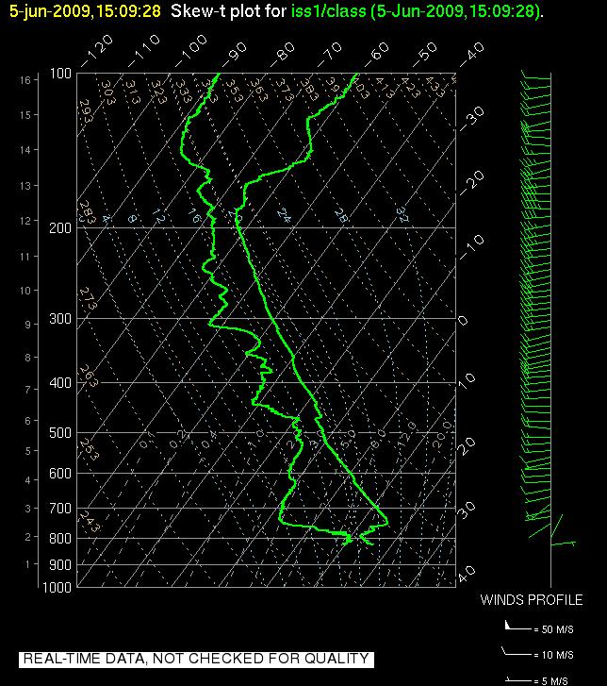
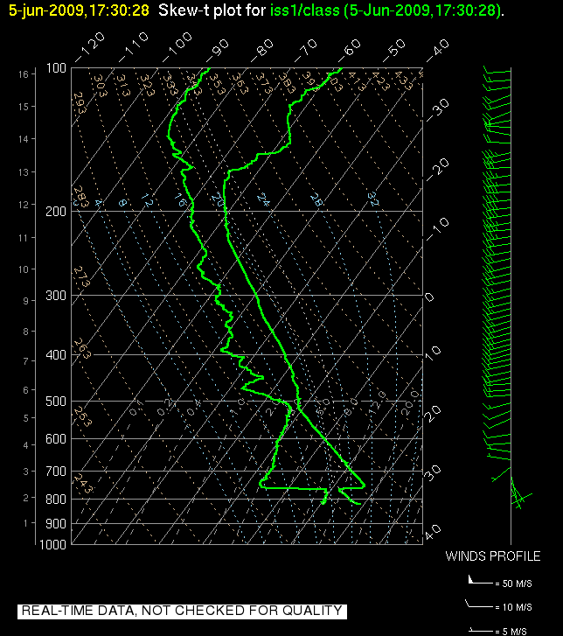
Weather and Atmospheric (…)
Vertical profiles produced from the radiosonde ascents indicate nearly neutral or close to adiabatic conditions prevailed in the lowest 1 km (760 mb) capped by inversion or isothermal layers aloft up to 2.5 km (740 mb)

Slide 6
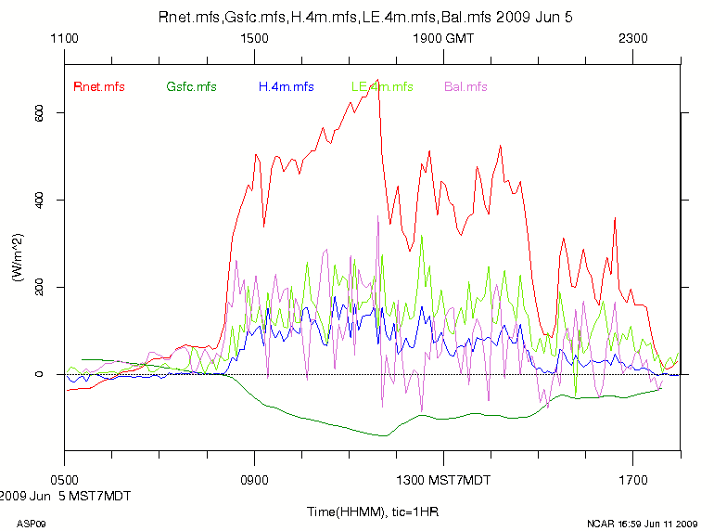
A Motivating Question Part One
Compare how the heat fluxes affect the energy budget
Changing the averaging times to help close the energy budget
↓sw + ↓lw + ↑sw + ↑lw = Net Rad
Net Rad + Soil Heat Flux = Sensible + Latent Heat Flux
Hopefully?

Slide 7
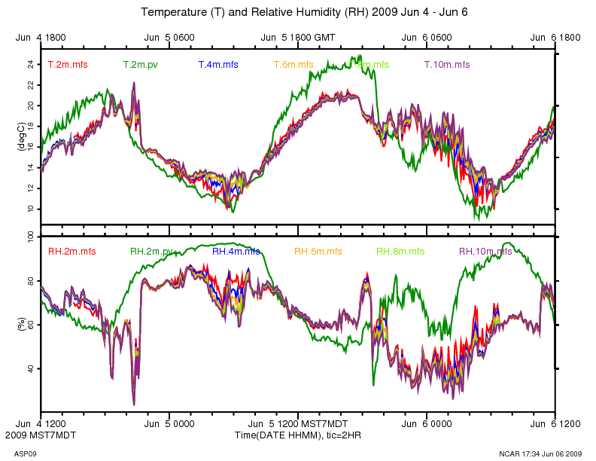
Time Series Analysis
Measurements at a fixed point over a period of time
Time series data is widely used
Easy to visualize what is happening
(But yet my advisor says I can’t publish with just time series)

Slide 8
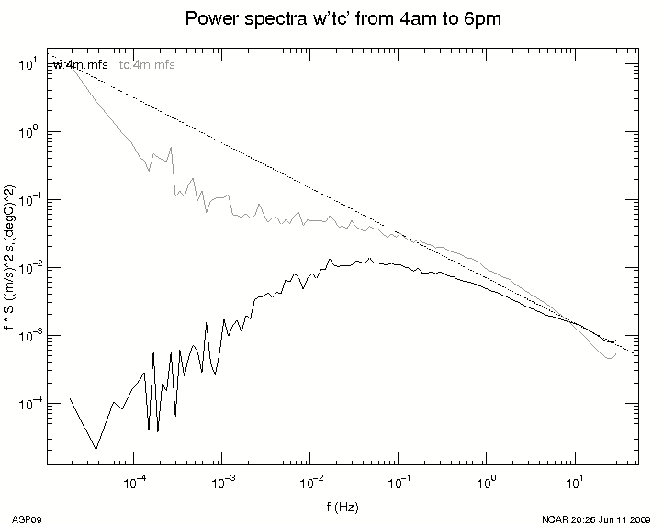
Frequency Analysis
Fourier Transform to frequency domain
Power of signal at each frequency
-5/3 line is empirical formula of turbulence (Kolmogorov’s Spectrum)

Slide 9
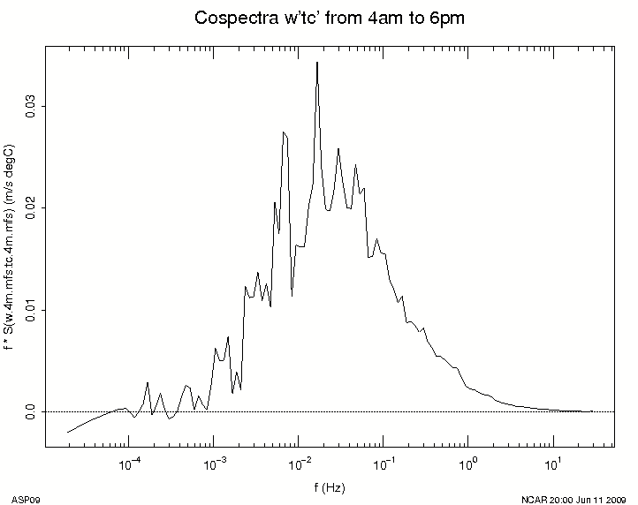
Frequency Analysis
Cospectra
In phase components of the covariance
Visualize what frequencies are contributing to the flux

Slide 10
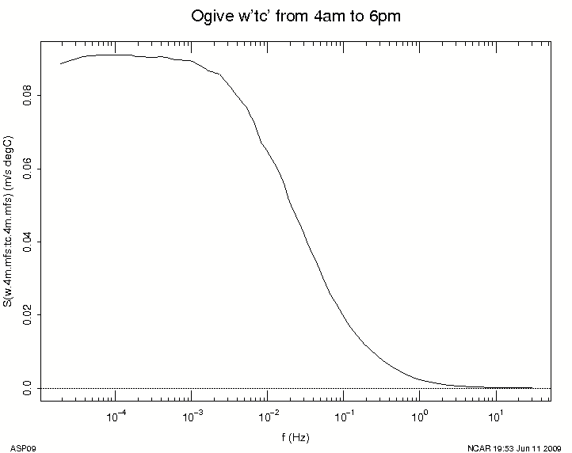
Frequency Axis
Ogive Plot
Cumulative Summation of Cospectra from high frequency to low
Can be used to find frequency at which you can efficiently average and not lose data

Slide 11
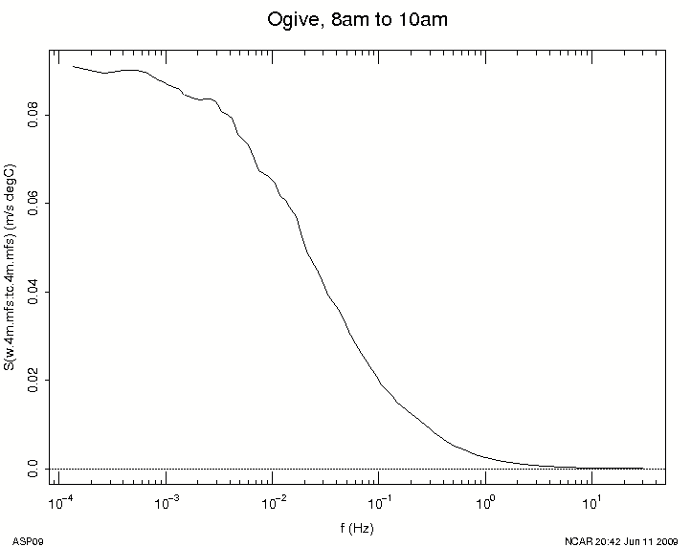
Calculating Averaging Times
Mid day
Developed BL
Very similar to full day Ogive
Averaging time of an hour is plenty fine

Slide 12
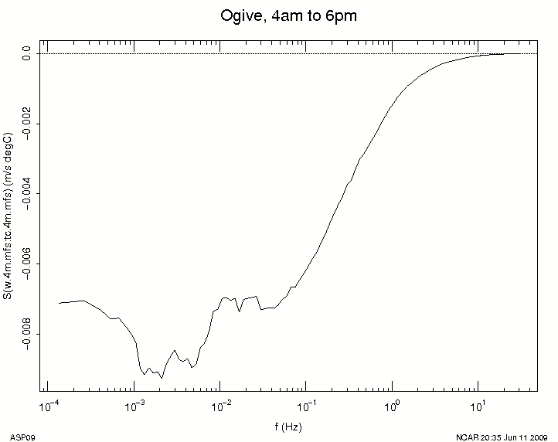
Calculating Averaging Times
Night Time
Stable Atmosphere
Averaging time of less then a minute, or 20, or maybe even 2 hours (In this case study)
2 minute averaging time in general
4am to 6am

Slide 13
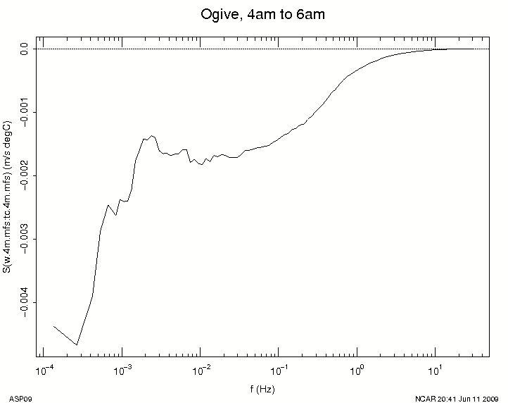
Calculating Averaging Times
Sunrise, BL birth
Increasing fluxes and increasing energy budget imbalance
Averaging time of less then a minute in this case
6am to 8am

Slide 14
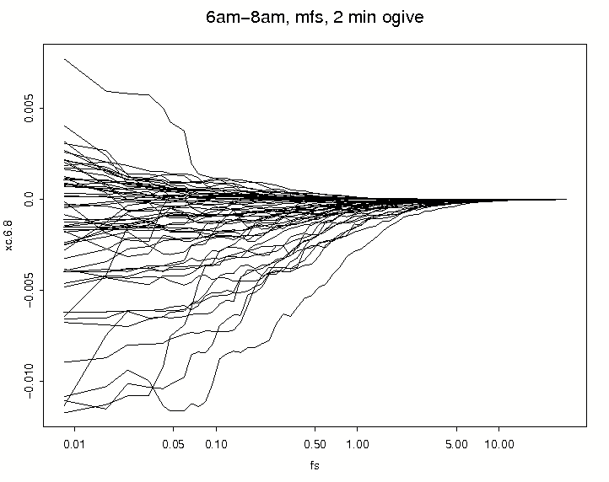
A Closer Look at Boundary Layer Birth
If two minute average times is needed in the early morning, we can look at two minute sections and they should show a leveling off
Or, it’s just a mess

Slide 15
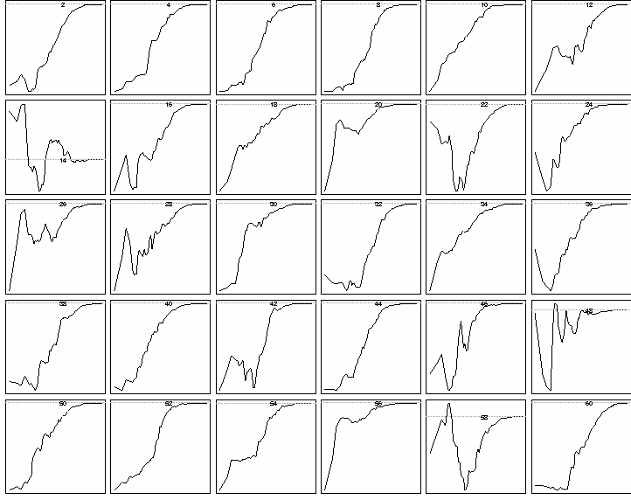
A Closer Look at Boundary Layer Birth
First 60 minutes
Periods of ‘normal’ two minute sections broken up by smaller scale turbulence

Slide 16
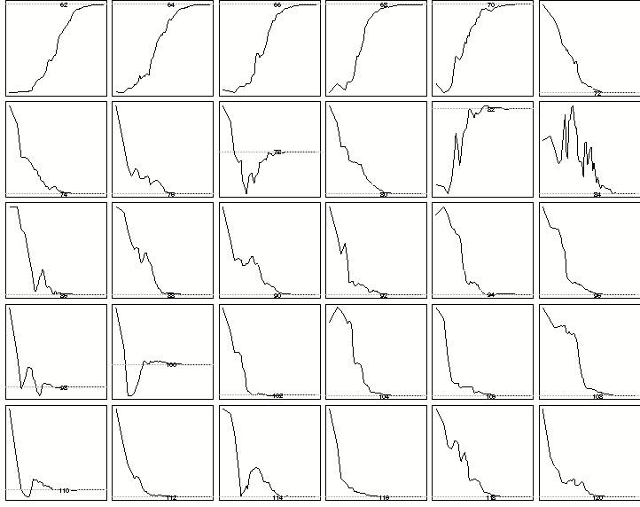
A Closer Look at Boundary Layer Birth

Slide 17
Energy Budget on Differential Averaging Time Scales
Five Minute Scale
Captures most flux carrying frequencies, but oversamples during the day time while slightly under-sampling at night/evening/dawn

Slide 18
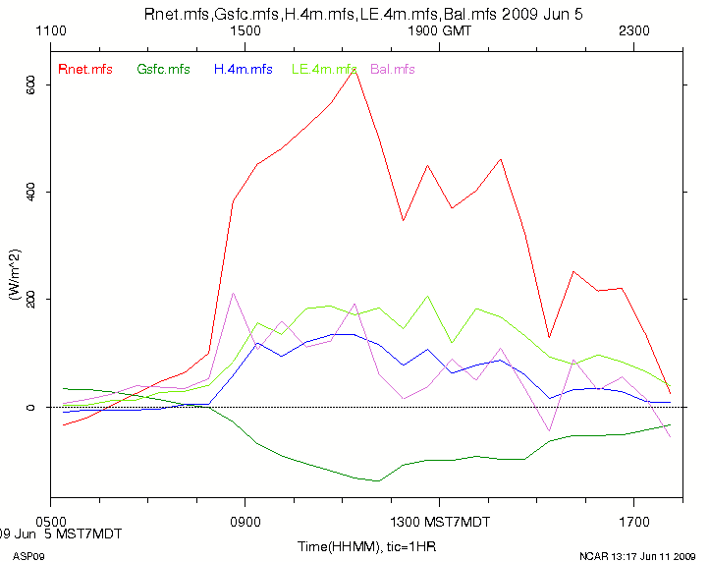
Energy Budget on Differential Averaging Time Scales
Thirty Minute Scale
Captures almost all flux carrying frequencies during the day, missing flux at night
Ameriflux standard

Slide 19
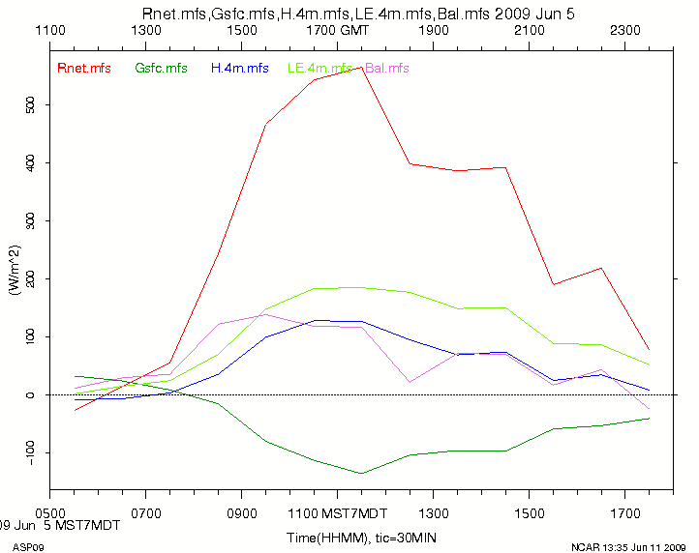
Energy Budget on Differential Averaging Time Scales
Sixty Minute Scale
Captures enough flux carrying frequencies during the day, hopeless at night

Slide 20
Energy Budget on Differential Averaging Time Scales Results
Five Minute Scale
Mean Energy Budget Imbalance was 72 W/m²
Thirty Minute Scale
Mean Energy Budget Imbalance was 62 W/m²
Sixty Minute Scale
Mean Energy Budget Imbalance was 60 W/m²
There was a difference!

Slide 21
Energy Budget on Differential Averaging Time Scales Results
What does this mean? I got lucky.
Longer time average was better during the mid-day, but missing flux carrying frequencies at night and during periods of intermittent flux
But most of the flux signal is during the mid-day
Proper use of this could allow dynamic averaging time to match dynamic flux periods

Slide 22
Research Question
How best to quantify the total flux contributions from eddies that popup and die during intermittent turbulent activities.

Slide 23
Justification
Energy closure will not be observed, because intermittent fluxes do not satisfy the stationarity condition, and also advection could play a role (Aubinet, 2008; Finnigan et al, 2003).
Measurement of advection requires site-specific experimental setup (Aubinet, 2008).
Decreasing the sampling rate of fluxes increases the uncertainty in the flux estimates, but not the total value of flux estimates (Bosveld and Beljaars, 2001).

Slide 24
Data
Raw wind and sonic temperature data for June 5, 2009 were used for this case study.

Slide 25
Methods
Coordinate rotation to streamline coordinates
The x-axis is aligned with the average direction of the horizontal wind in streamline coordinates(u_{ave}),
Perturbations in the y-direction (v_{s}’) are minimum,
Average vertical wind sums up to zero (w_{ave} =0).
u_{s}’= u’cos(θ_{ave}) + v’sin(θ_{ave}) (1)
cos(θ_{ave}) = u_{ave}/((u_{ave)}² +(v_{ave})²)^{½} (2)
sin(θ_{ave}) = v_{ave}/((u_{ave)}² +(v_{ave})²)^{½} (3)

Slide 26
Methods (…)
Vertical Momentum Flux (<w’u_{s}’> )
<w’u_{s}’> = <u_{s}w><u_{s}><w> (4)
u_{s} Horizontal wind in streamline coordinates.
Heat Flux (<w’ts’>)
<w’t_{s}’> = <wt_{s}> (5)
Plots
Time series and ogive plots were produced.

Slide 27
Wind and Friction Velocity

Slide 28
Momentum Flux (w’u’) at Marshall (June 5, 2009)

Slide 29
Cospectra: Momentum Flux at Marshall (June 5, 2009; 00 – 08 MDT)

Slide 30
Ogive Plot: Momentum Flux at Marshall (June 5, 2009; 00 – 08 MDT)

Slide 31
Cospectra: Heat Flux at Marshall (June 5, 2009; 00 – 08 MDT)

Slide 32
Ogive plot: Heat Flux at Marshall (June 5, 2009; 00 – 08 MDT)

Slide 33
Conclusions (Yohannes)
Intermittent turbulent fluxes are short lived (~ 1 min), but averaging at longer time periods will eliminate their contribution.
Coordinate transformation alone does not solve the problem of under-representation of the momentum flux from intermittent turbulent fluxes .

Slide 34
Questions?
Thank you ASP/NCAR
Go Red Wings

