Slide 1
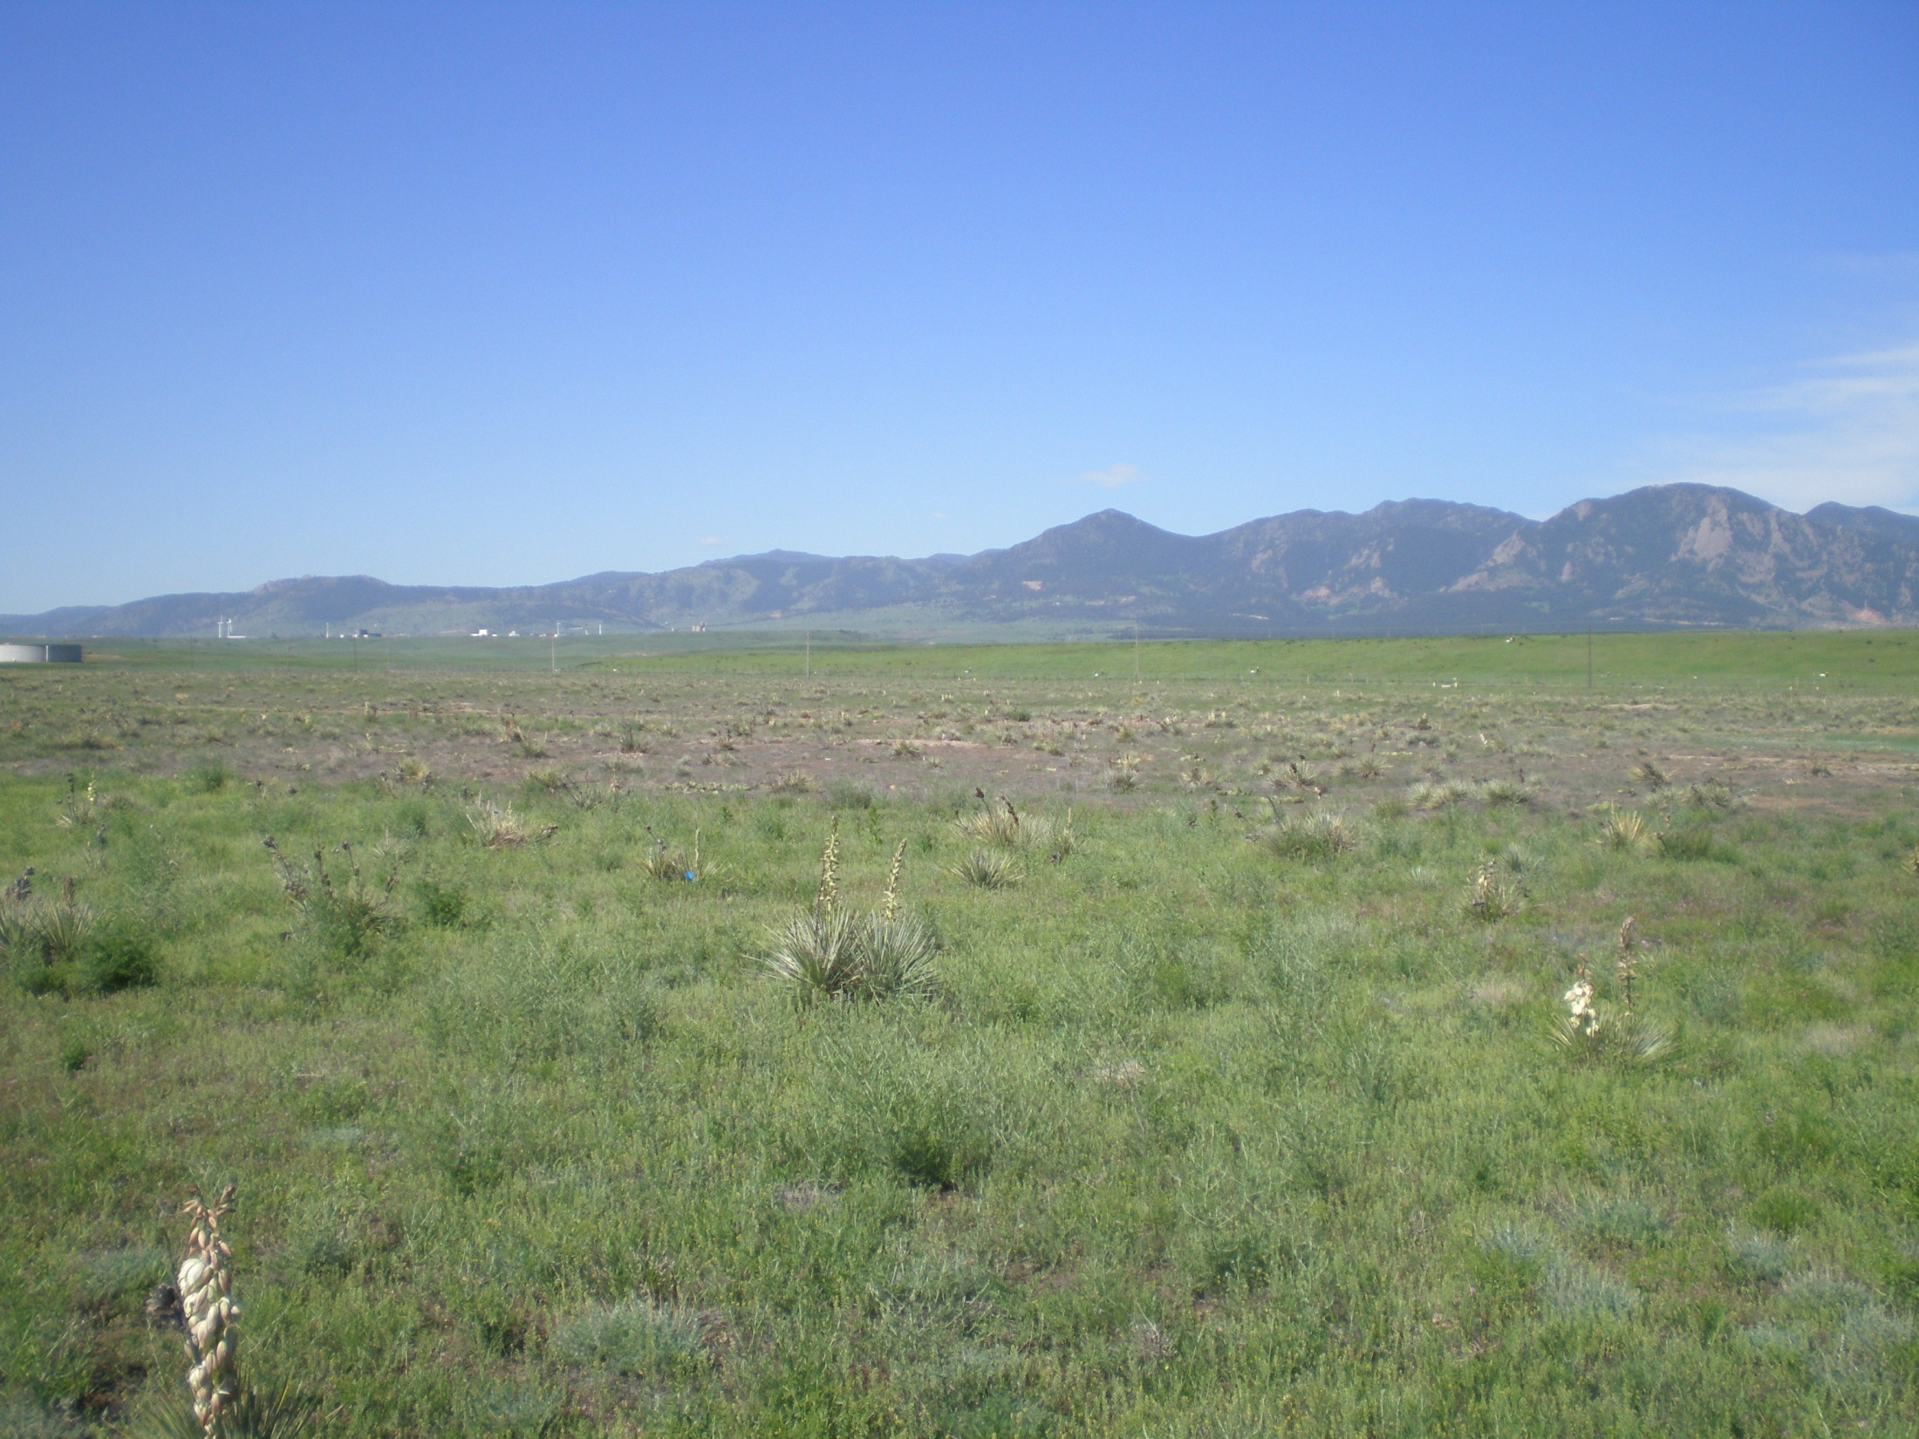
A Case Study in Boundary Layer Evolution
Neil Lareau
Temple Lee
Joel Lisonbee
NCAR ASP Colloquium
12 June 2009

Slide 2
Atmospheric Boundary Layer
Diurnal Variation
2000
1500
1000
500
0
Inversion
Height (meters)
Convective Mixed Layer
Residual Layer
Residual Layer
Stable (nocturnal) Layer
Stable (nocturnal) Layer
Sunrise
Noon
Sunset
Sunrise
Adapted from Stull (1988) and Angevine (2009)

Slide 3
Research Questions
What is the spatial and temporal evolution of the planetary boundary layer over eastern Colorado during a 2-day period in early June? How does this differ from an idealized model?
What is the impact of the coupling of the local boundary layer with the residual layer(s) on atmospheric stability?
What is the role of advection and entrainment in the observed boundary layer development?

Slide 4
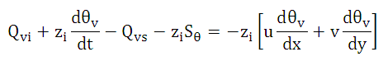
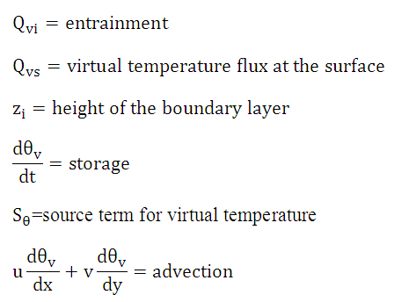
Entrainment flux + heat storage - surface flux - radiative heating = advection

Slide 5
Entrainment Processes
Penetrating Updrafts:
Thermals intrude into the stable air above the CBL
Strength of capping inversion matters in this process
Shear:
Mechanical production of turbulence by wind shear across the inversion
Source of uncertainty in boundary layer models
Courtesy of Angevine (2005)

Slide 6

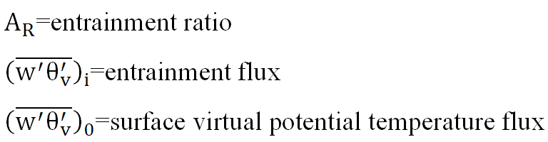
Parameterizing Entrainment Flux
Entrainment ratio = – entrainment flux / surface flux

Slide 7
Methods
Estimate height of the CBL from soundings and wind profiler data
Calculate virtual potential temperature budget for the CBL
  Surface flux data
  Parameterized entrainment
  Storage derived from radiosondes
  Solving for residual advection term
Qualitative analysis of CBL and elevated layer evolution

Slide 8
June 6
Coupling of Local Boundary Layer with Elevated Mixed Layer

Slide 9
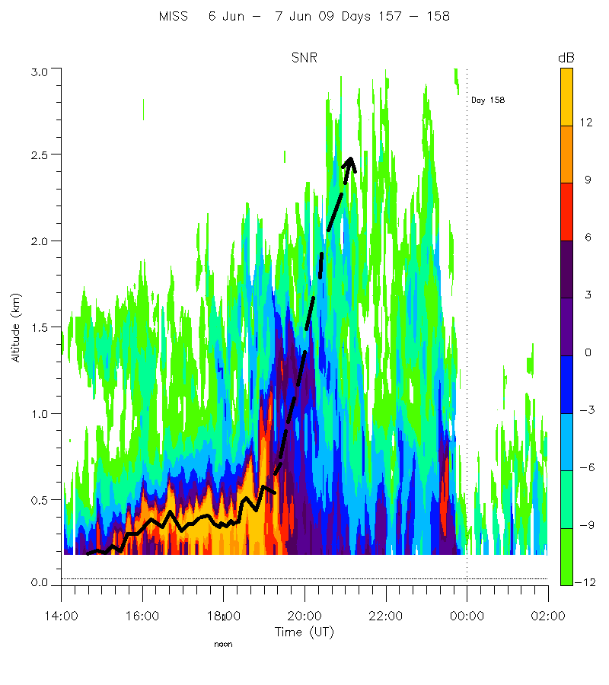

Slide 10
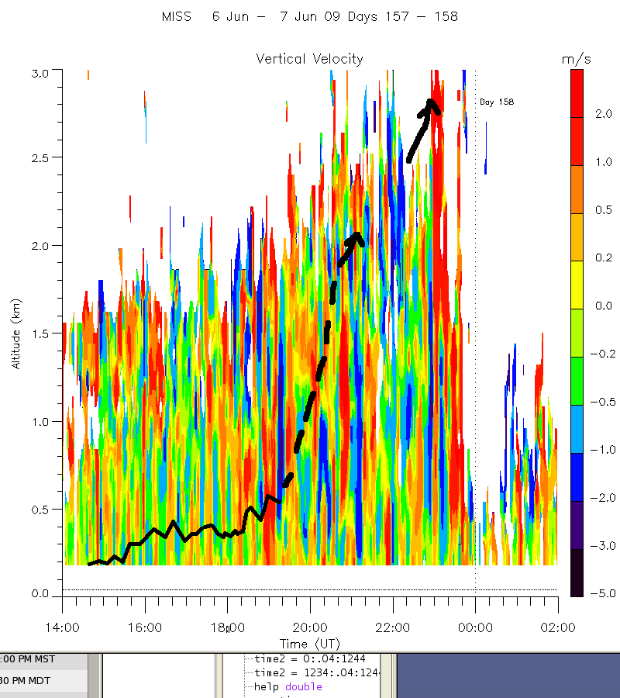

Slide 11
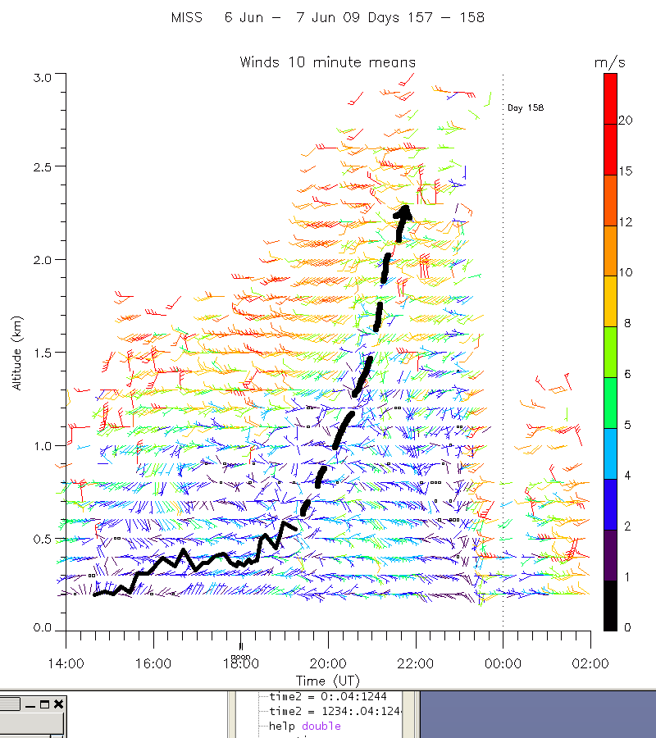

Slide 19
June 5
Atypical Boundary Evolution

Slide 20
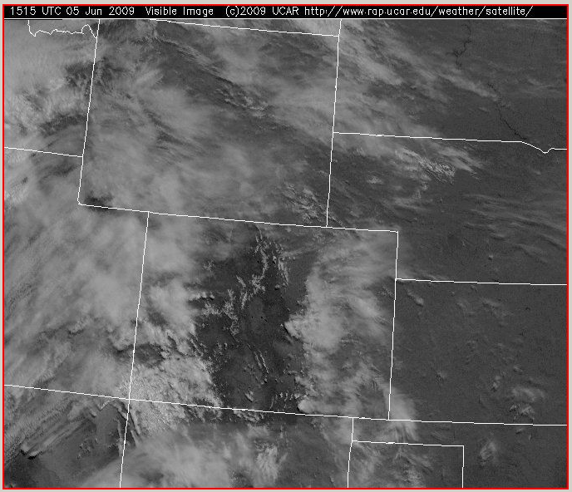

Slide 21
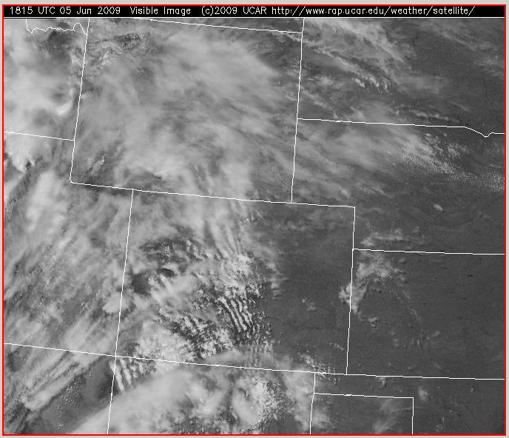

Slide 22
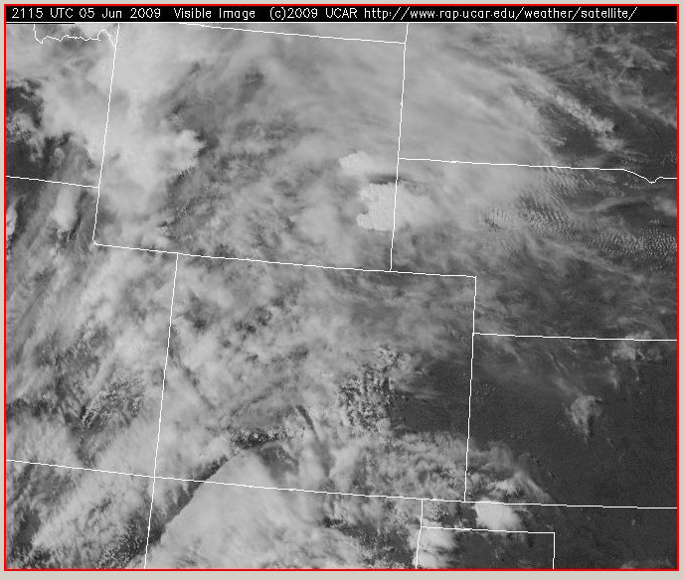

Slide 23
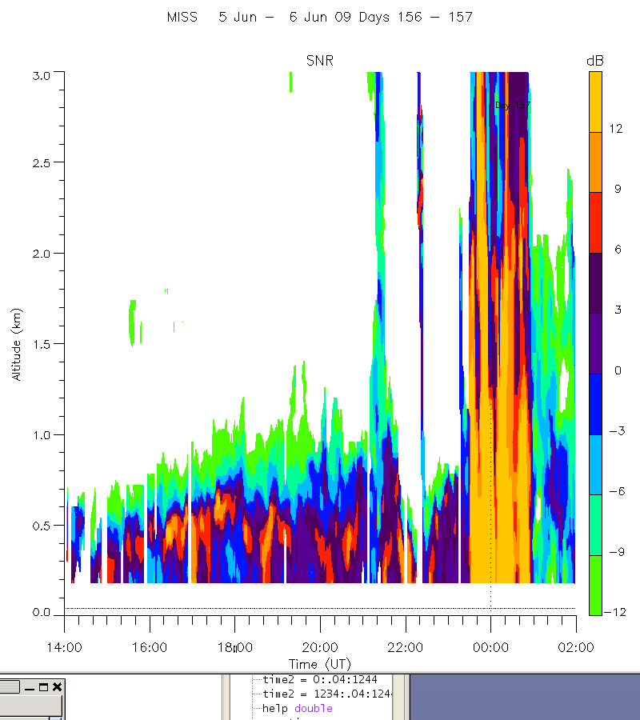

Slide 24
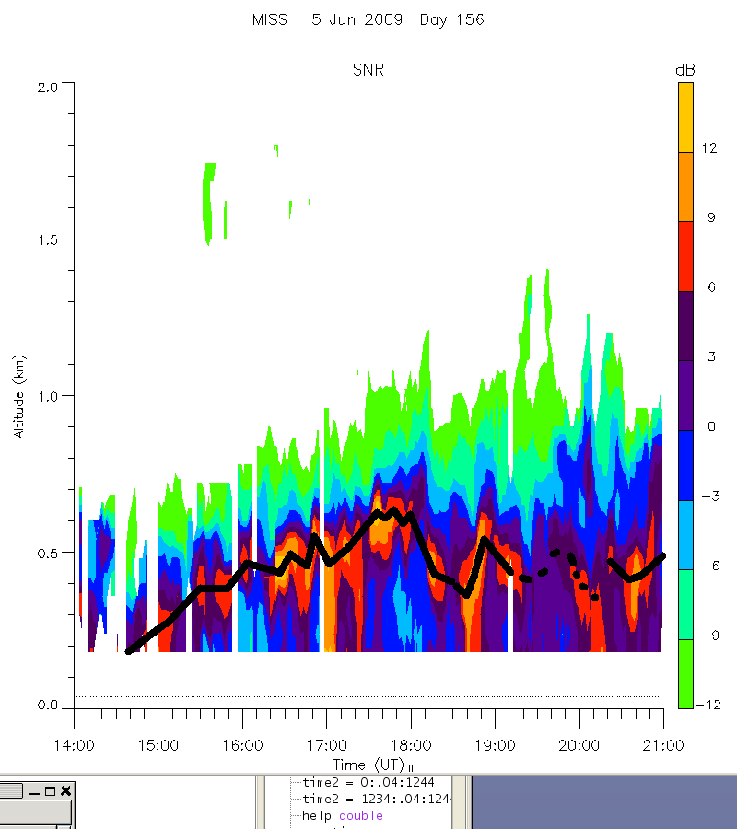

Slide 25
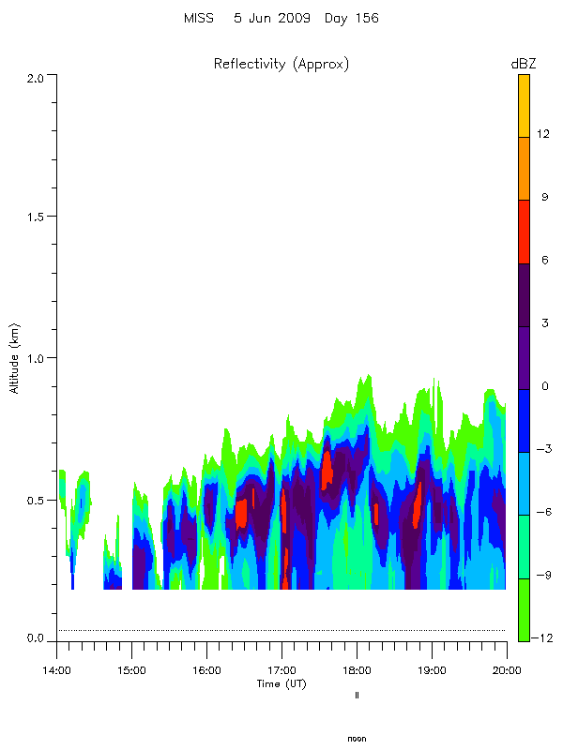

Slide 26
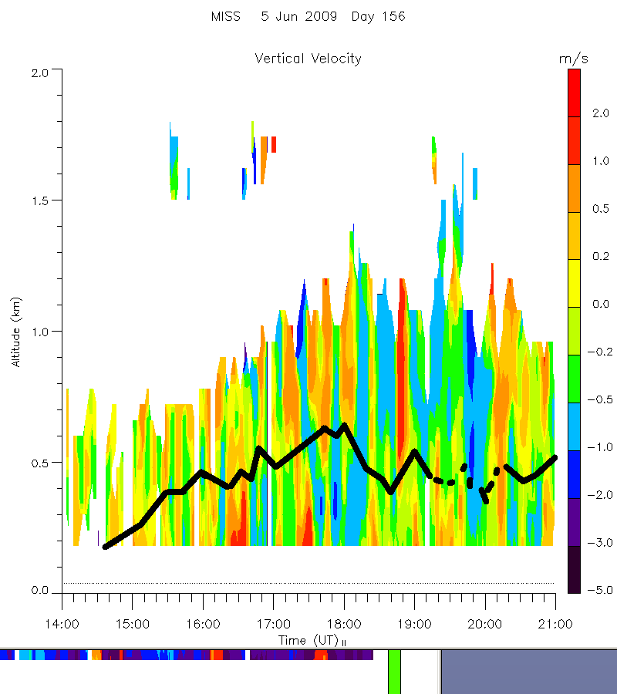

Slide 27
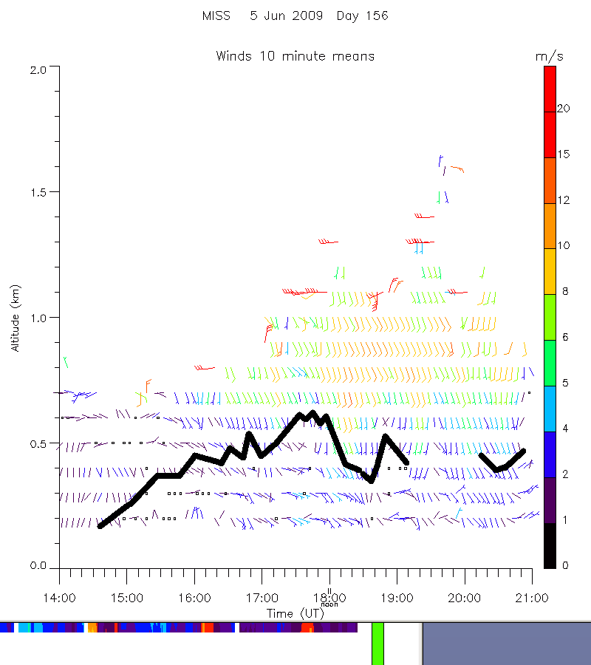

Slide 36
Thermodynamic Variables on 5 June 2009
Time | LCL (mb) | LFC (mb) | CI (J/kg)
15:09 UTC | 750 | 550 | 329.8
17:30 UTC | 720 | 620 | 180.5
20:39 UTC | 720 | 650 | 102.7
23:32 UTC | 715 | 650 | 119.8

Slide 37
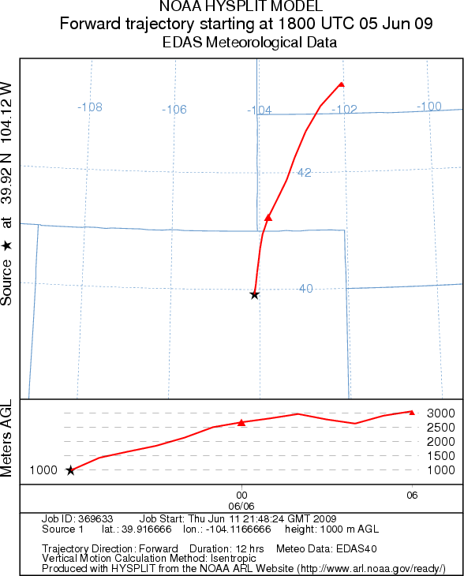

Slide 38
Aircraft data
Could be used to estimate budget of layers between stacked paths
In-situ data used for flux divergence across the layer.
Describe spatial characteristics

Slide 39
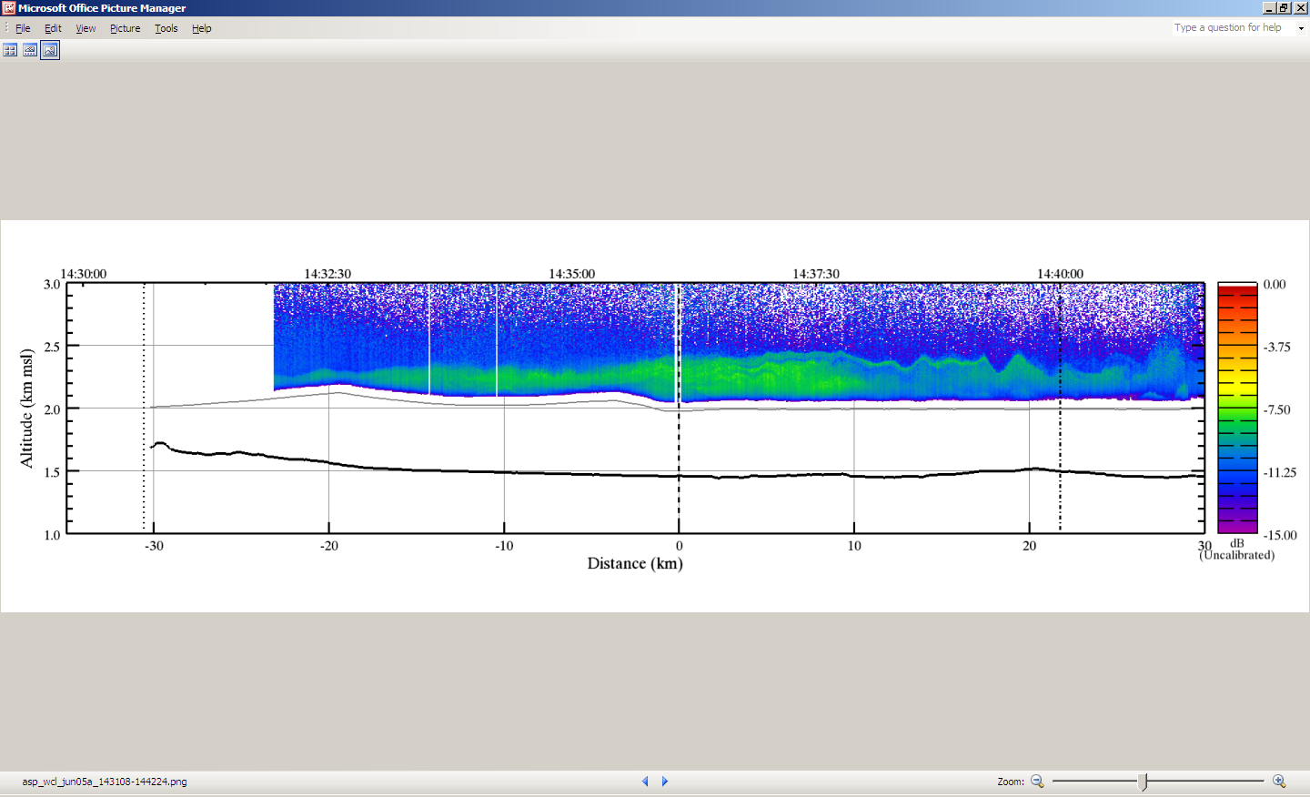

Slide 41
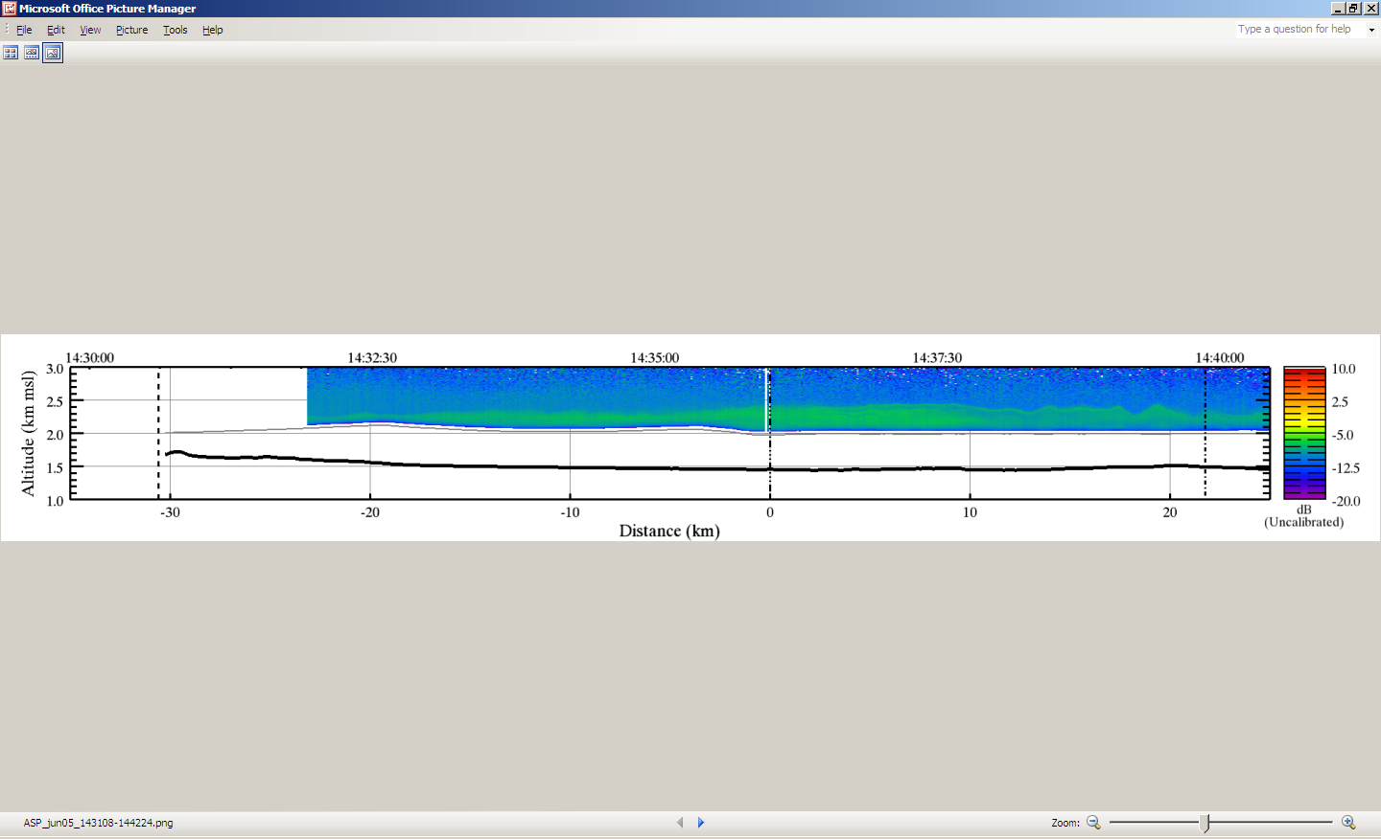
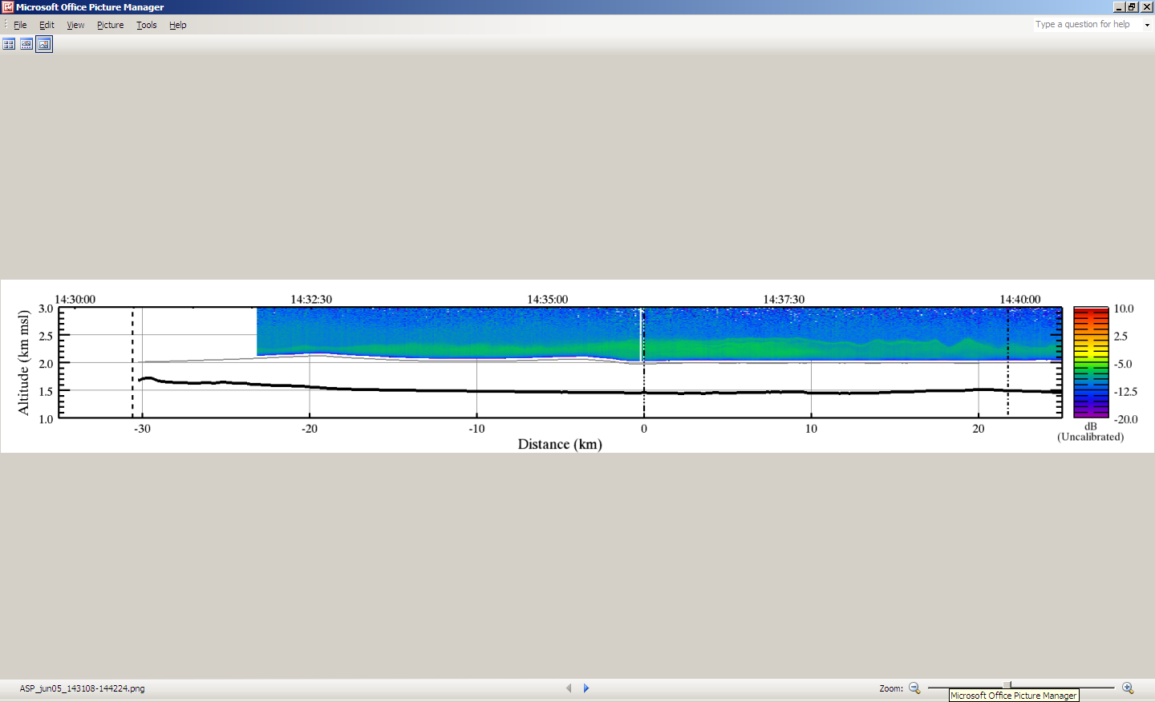
LIDAR Backscatter Concentrated Aerosol

Slide 42
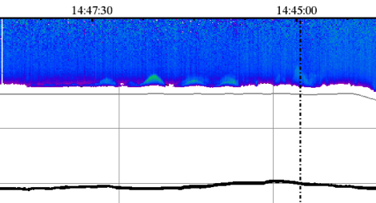

Slide 43
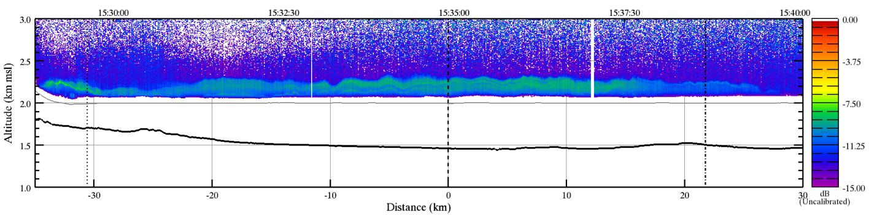

Slide 44
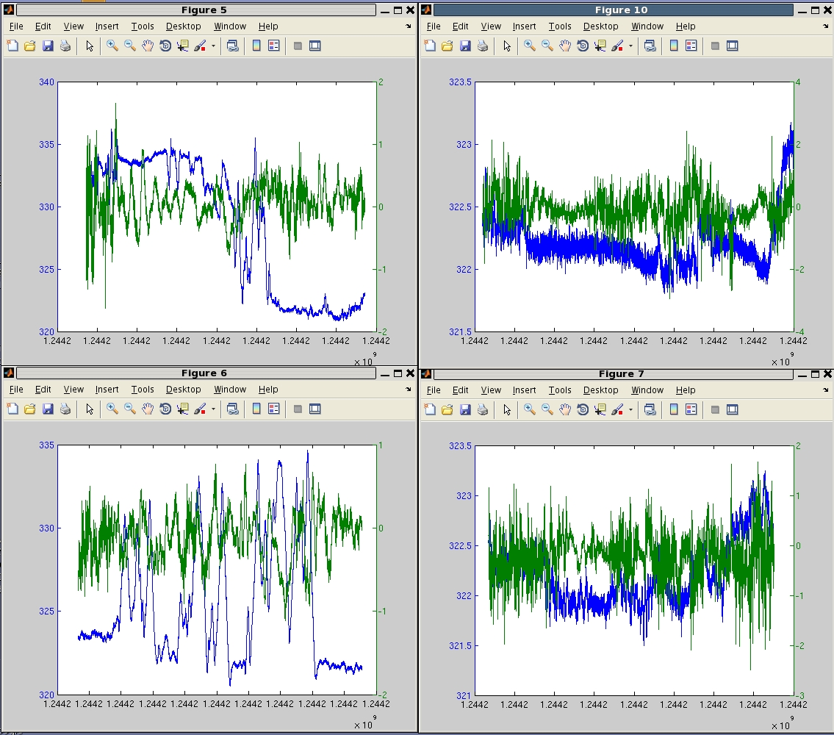

Slide 45
Conclusions
Evolution of CBL on Saturday June 6th is fairly consistent with conventional CBL growth.
  Coupling between the local CBL and an elevated mixed layer occurred.
Evolution of CBL on Friday June 5th is atypical with advective and entrainment processes playing an important role.

Slide 46
Future Work
Though much still needs to be understood about boundary layer evolution, the evolution of layer(s) above the boundary layer are equally important yet less understood.
  Experiments are needed to quantify entrainment and advection budget terms.

