Slide 1
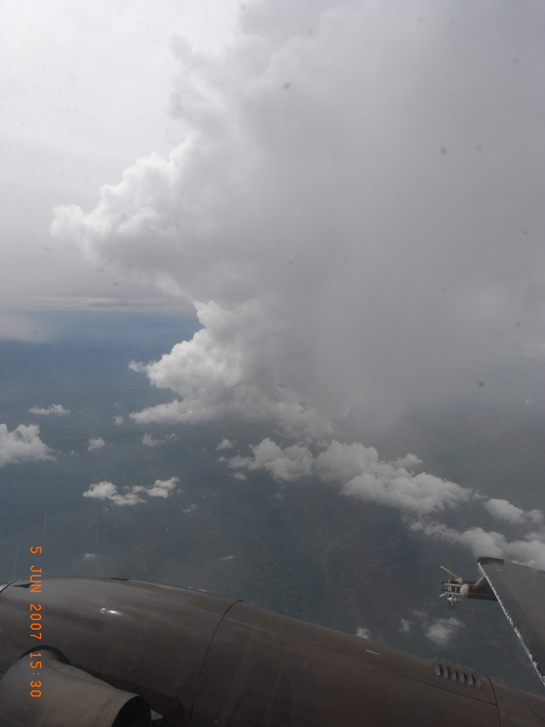
Visualizing Colorado entrainment 30 years after Paluch
Cloud Scientists
“En-training”?
Yonggang Wang
Jon Zawislak
Sam Dorsi
Marcia DeLonge
Mentors
Jorgen Jensen
Al Cooper
Advanced Studies Program
Final Presentation
11 June 2009

Slide 2
Background
Motivation: Entrainment controls growth/decay of cumuli
Objective: determine the sources and amount of entrainment
Plumes/Thermals/Blobs
Penetrative downdraft
LATERAL ENTRAINMENT
CLOUD TOP ENTRAINMENT
Air parcel at any level includes air from the levels near it
Evaporative cooling due to entrainment at cloud top can cause mixed air to dilute air below (mixed air mostly in downdraft)
Stommel 1947, Morton 1957, Scorer & Ludlam 1953
Squires 1958, Paluch 1979

Slide 3
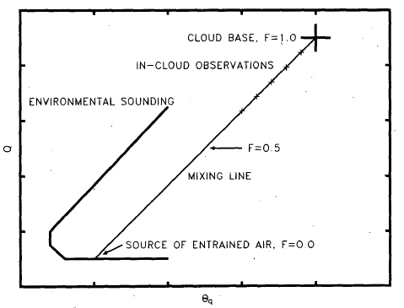
Methods: Paluch Analysis
Paluch Diagram
Based on Paluch 1979
+
Cloud Base
In-cloud obs.
Sounding
Total Water Content
Aircraft Sounding
In-cloud observations
Wet equivalent
potential temp
Cloud Base
Jensen et al. 1985

Slide 4
Methods: Paluch Analysis
+
Cloud Base
In-cloud obs.
Sounding
Total Water Content
[water vapor + liquid water + ice]
* FRACTION OF ENTRAINED AIR
* SOURCE OF ENTRAINED AIR
Wet equivalent potential temperature

Slide 5
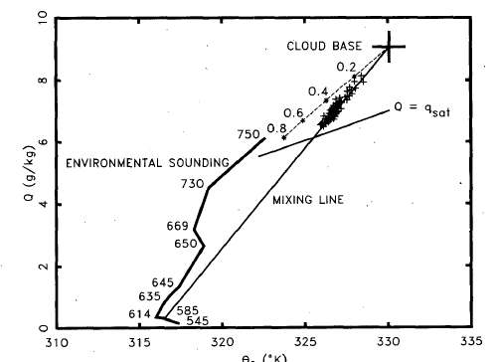
Methods: Paluch Example
+
LWC(2 g/m3)
Cloud Base
P
(20 mb)
T
(2°C)
In-cloud obs.
Sounding
Total Water Content
[water vapor + liquid water + ice]
* FRACTION OF ENTRAINED AIR
* SOURCE OF ENTRAINED AIR
Wet equivalent potential temperature

Slide 6
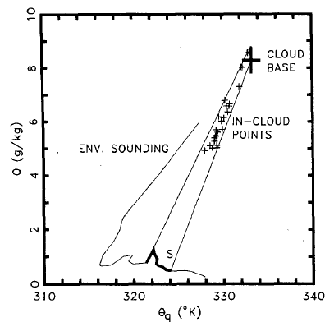
Methods: Paluch Example
+
Cloud
Base
In-cloud obs.
Sounding
Total Water Content
[water vapor + liquid water + ice]
* SOURCE OF ENTRAINED AIR
Wet equivalent potential temperature
Blythe et al. 1988

Slide 7
Methods: Paluch Analysis
Assumptions/ Challenges:
Young cloud
No precipitation (during all legs)
No ice
Mixing is linear
Cloud air is saturated
Aircraft sounding represents environmental air
Cloud base q, θ_{q} accurately determined
+
Cloud Base
In-cloud obs.
Sounding
Total Water Content
Wet equivalent
potential temp

Slide 8
Methods: Paluch Analysis
Steps:
Identify transects
Apply filters using 25 hz data (remove “pockets”)
LWC (> 0.03 g/cm³)
Droplet Concentration (> 50 #/cm³)
Determine best sounding
Locate cloud base (WCL)
Sensitivity tests
+
Cloud Base
In-cloud obs.
Sounding
Total Water Content
Wet equivalent
potential temp

Slide 9
Instrumentation: King Air
Pressure: static pressure form Rosemount
Height: ‘ztrue’ from hypsometric
Droplet Concentration: FSSP 1/10 Hz considered
Ice Water Content (IWC): from 2D-C and 2D-P
Temperature: Reverse flow thermometer (RFT); Rosemount Thermometer
Instrument/sampling rate important – will see later

Slide 10
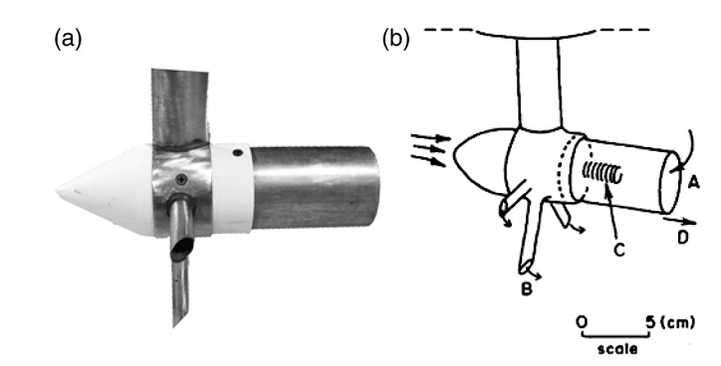
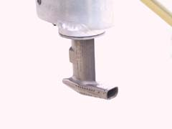
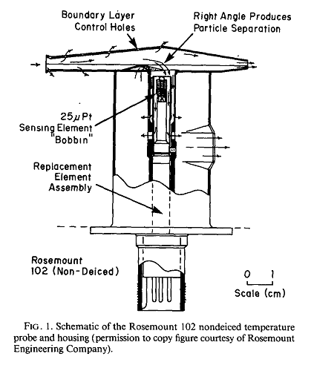
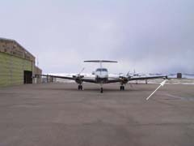
Rosemount 102 E4AL:
Instrumentation: Temperature (UWKA)
Reverse flow thermometer(TRF):
Range | Accuracy | Resolution
-50 to 50 ºC | 0.5 ºC | 0.006 ºC
Range | Accuracy | Resolution
-50 to 50 ºC | 0.5 ºC | 0.006 ºC
An immersion thermometer.
Exposure of sensing element to stream of water droplets yields an anomalously low temperature.
Sensor is shielded in a housing through which air flows in the direction opposite to airstream.
Wand and Geerts 2009 & Lawson and Cooper 1990
Payne, et al. 1994
http://flights.uwyo.edu/ka_doc/

Slide 11
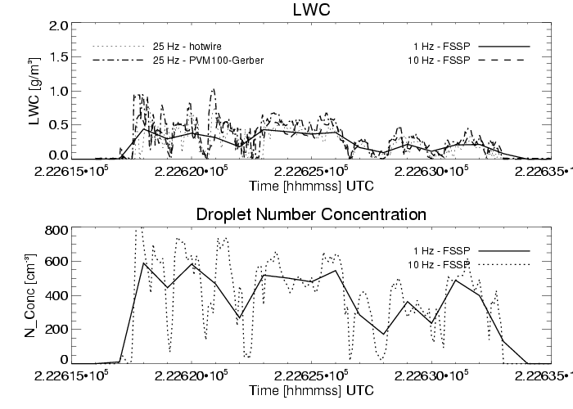
June 5 – RF 2: 3281 m (10827 ft MSL)
Basis for defining “cloudy” air v. “clear” (subsaturated) air
1 Hz v. 10/25 Hz – indicates “cloud”

Slide 12
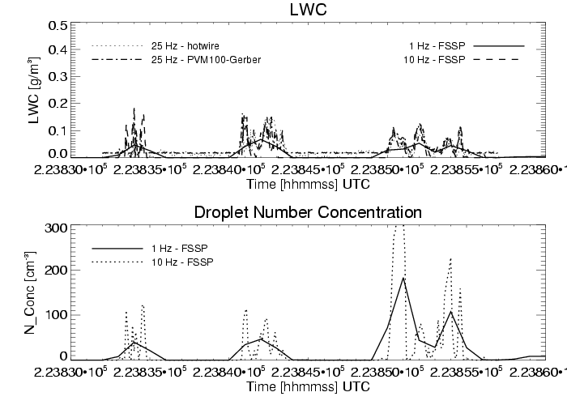
June 5 – RF 2: 4700 m (15510 ft MSL)
Hotwire and Gerber PVM100 - undergoes post-processing, but still artifact still remains

Slide 13
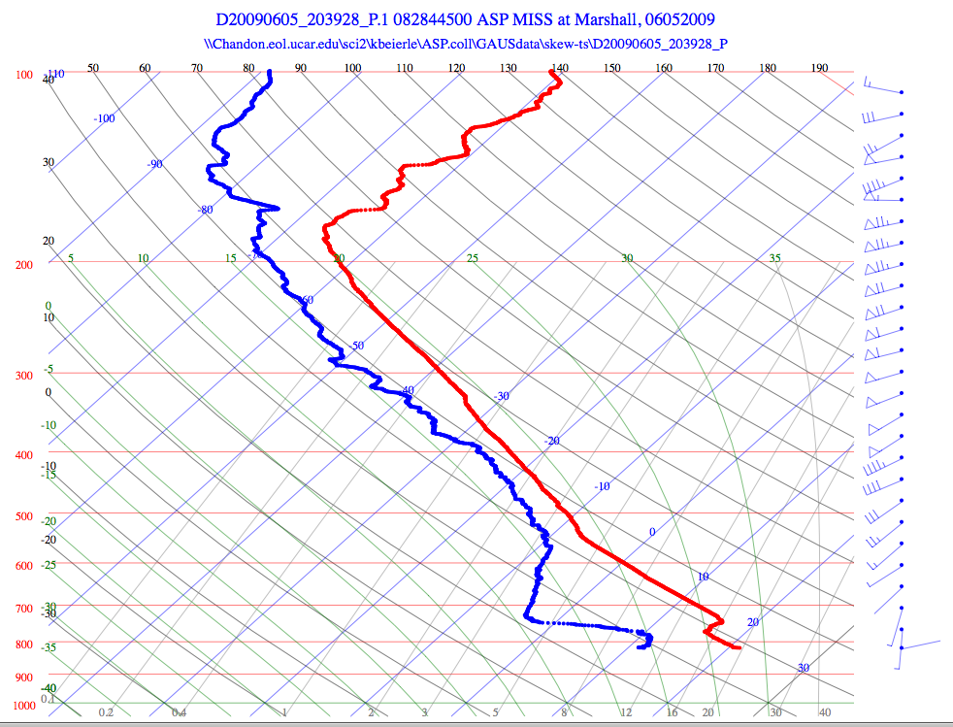
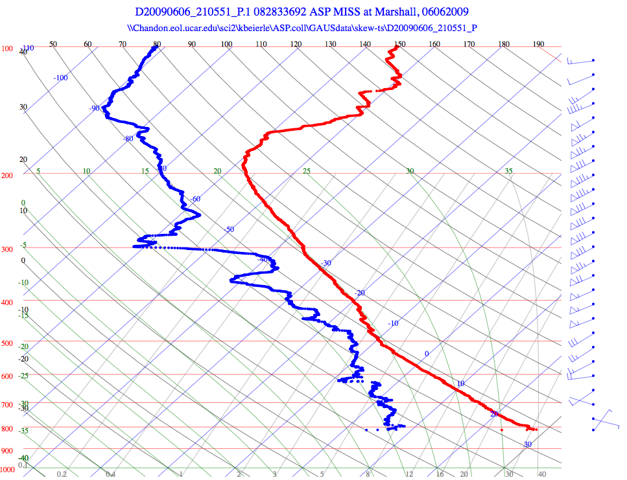
Hoping for (good) clouds!
Friday 2039 UTC
Saturday 2105 UTC

Slide 14
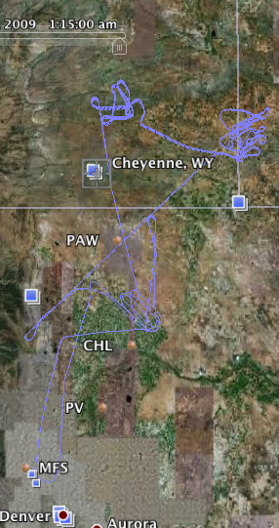
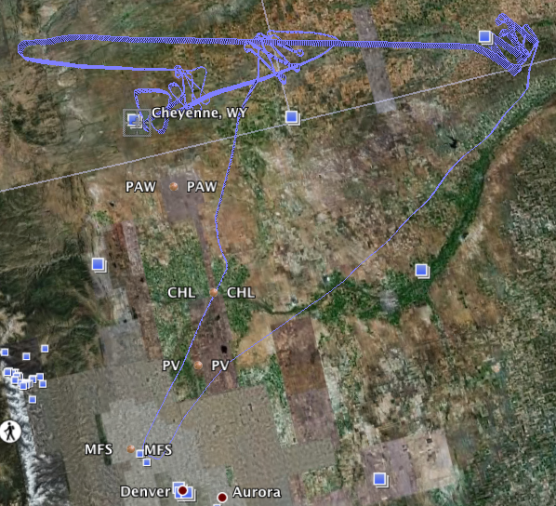
4 Case Study Clouds
3
2
1
0
Friday 2:00 PM F2
Saturday 3:30 PM F4

Slide 15
Case Study Cloud Features
0. Quickly dissipating cloud; incomplete sounding
1. Rain/Graupel in 2nd pass, clear sounding
2. No precip during passes, virga at dissipating base, unclear sounding
3. Rain/ Graupel at upper level, no cloud base, incomplete sounding
Friday 2:30 PM F2
Saturday 3:30 PM F4

Slide 16
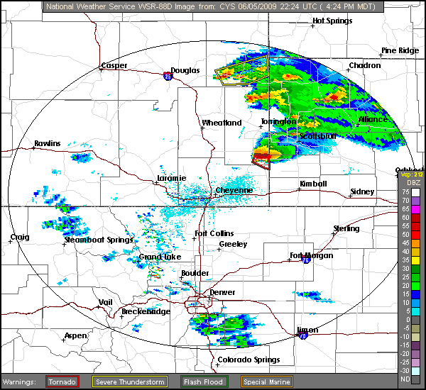
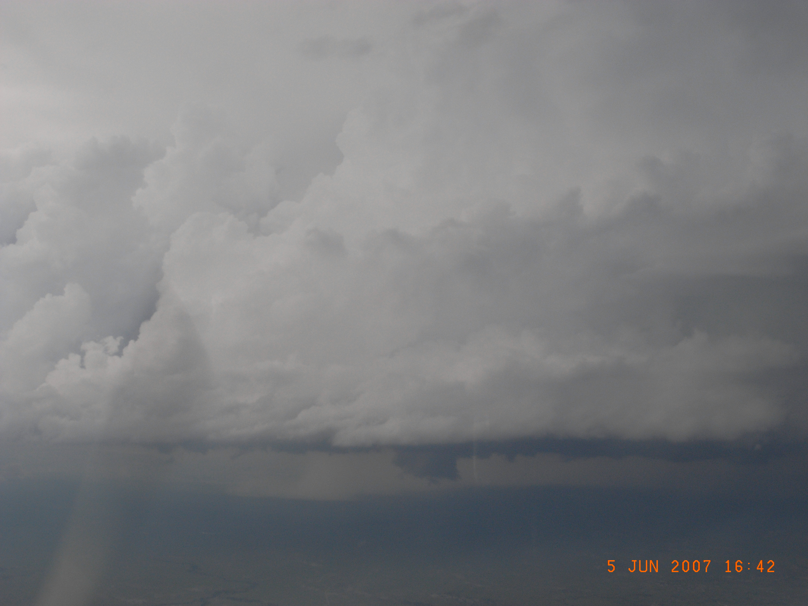
Cloud fields – Flight 2
Case 0
Friday 2226 - 2340 UTC

Slide 17
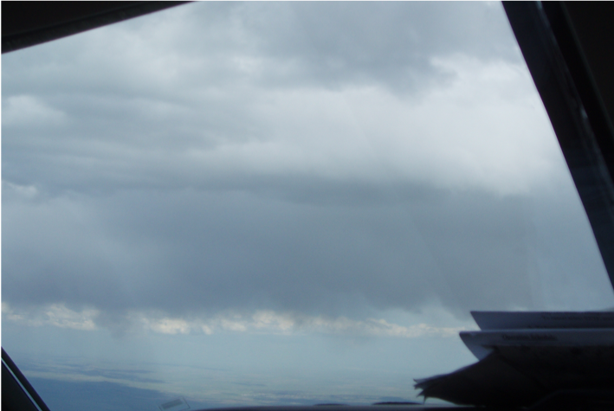
Cloud fields – Flight 4
Case 1
Saturday 2156 – 2221 UTC
Case 3
Saturday 000400 - 002700 UTC
Case 2: Saturday 2256 - 2319 UTC

Slide 18
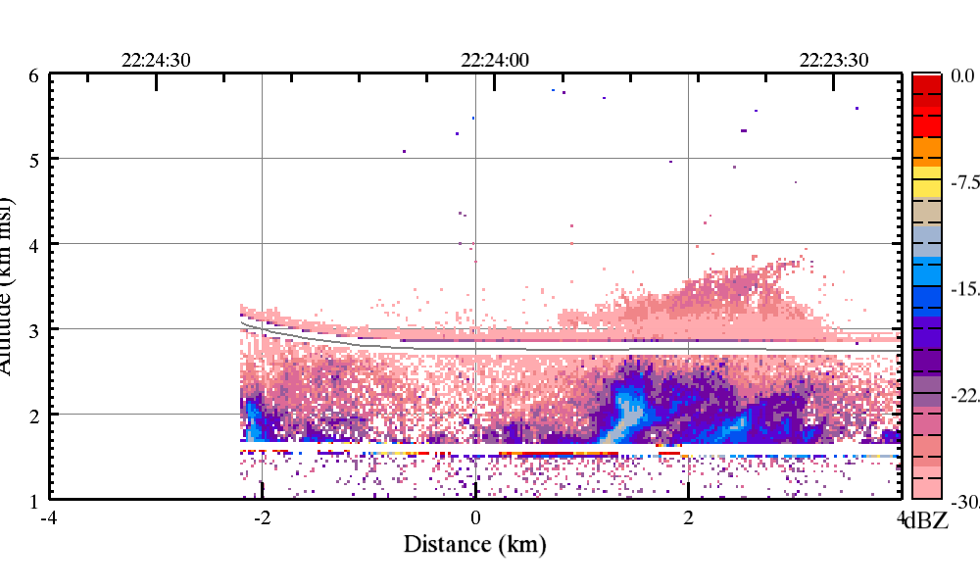
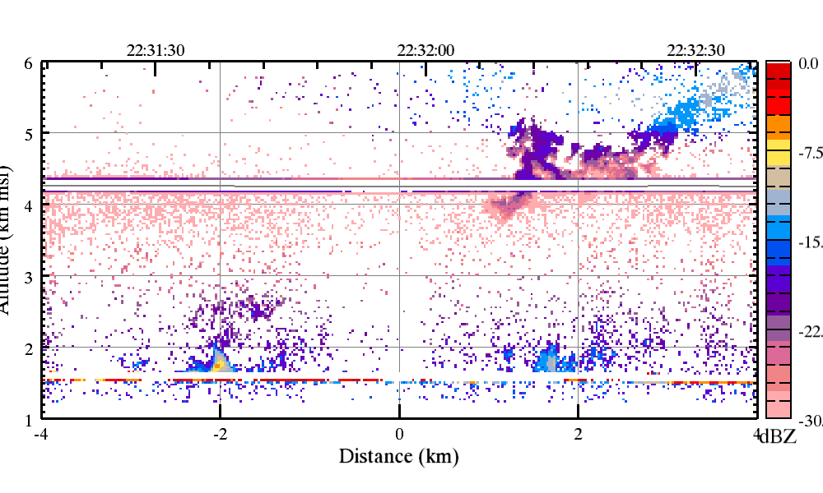
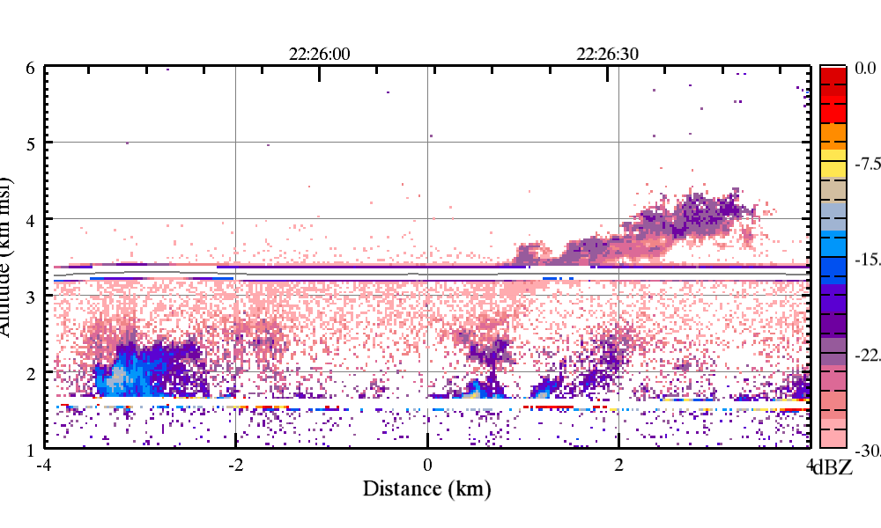
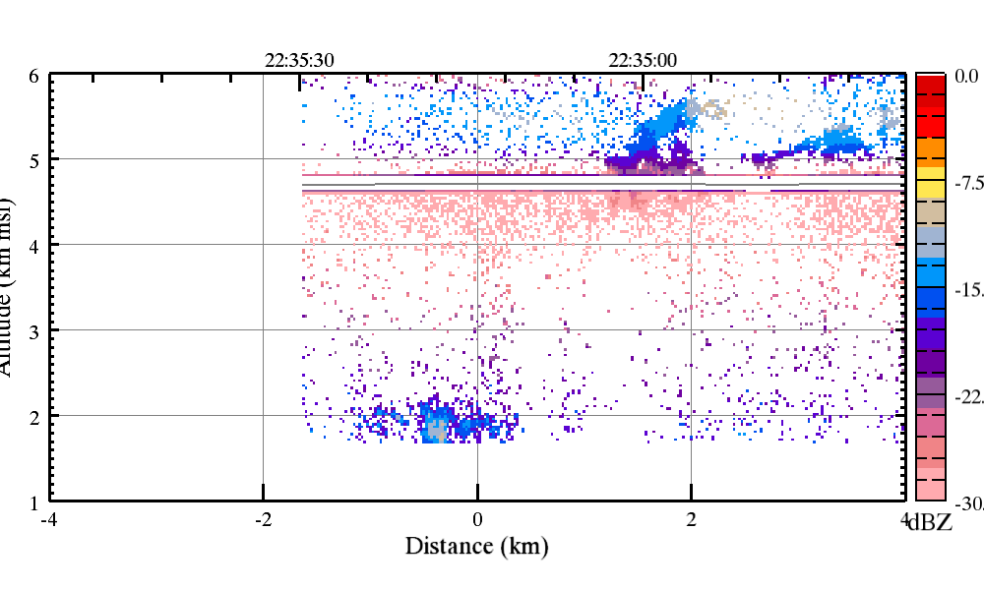
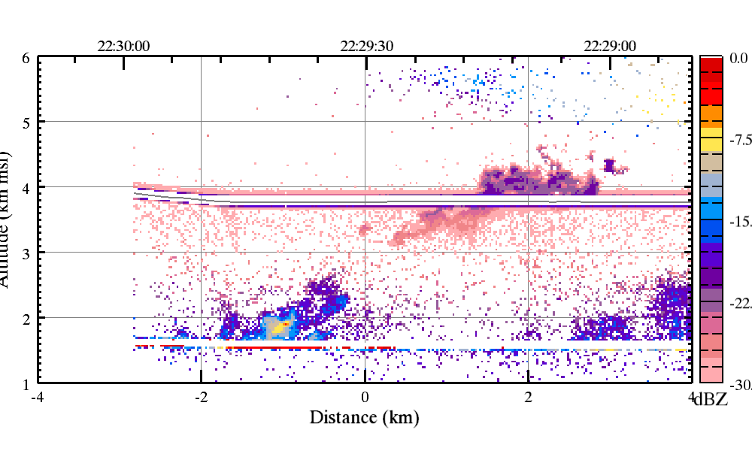
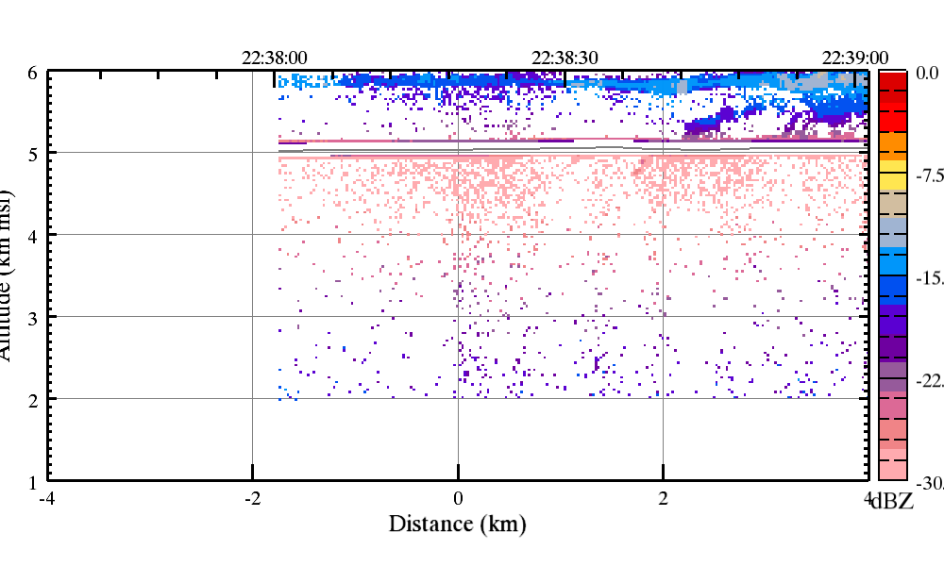
WCR: June 5, Cloud #2

Slide 19
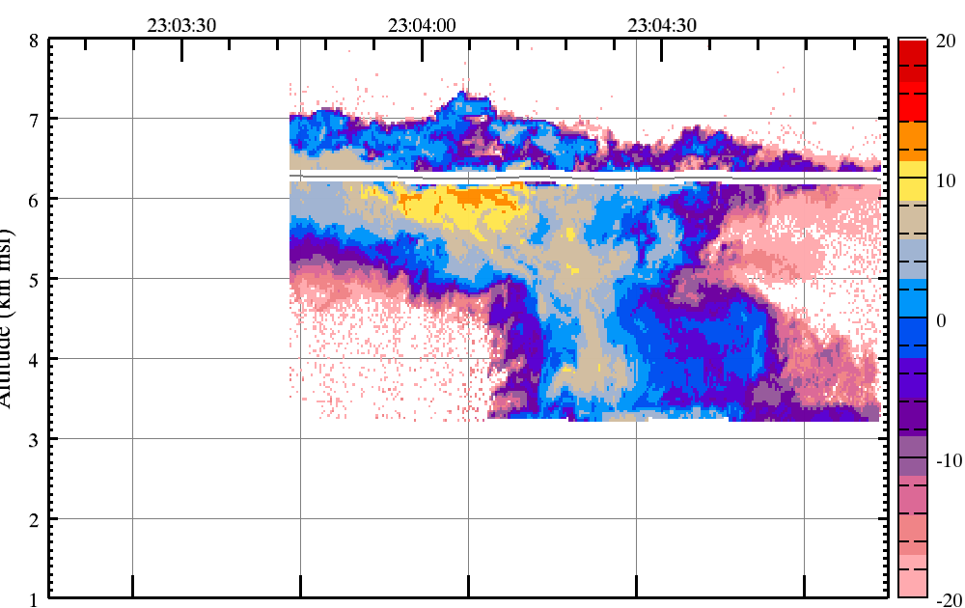
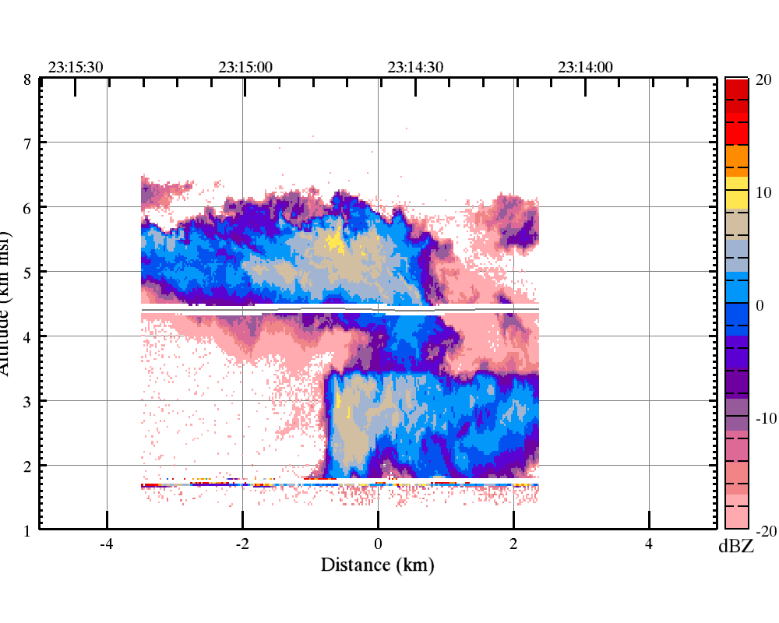
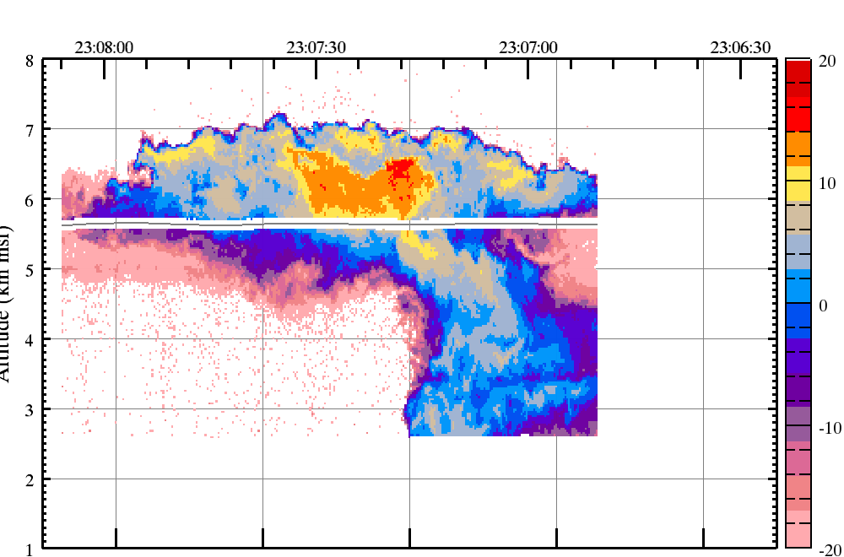
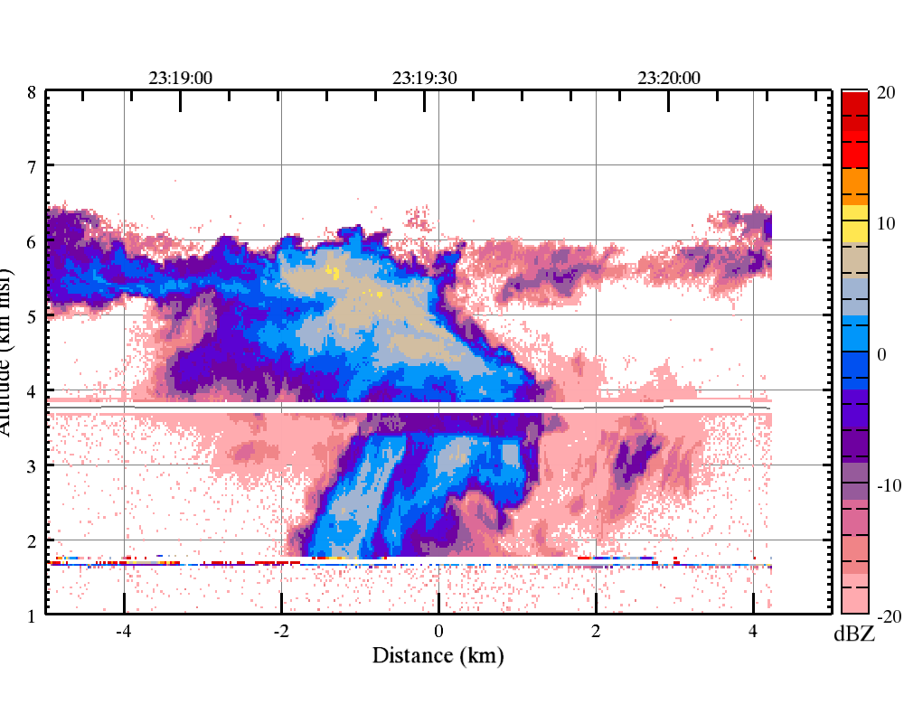
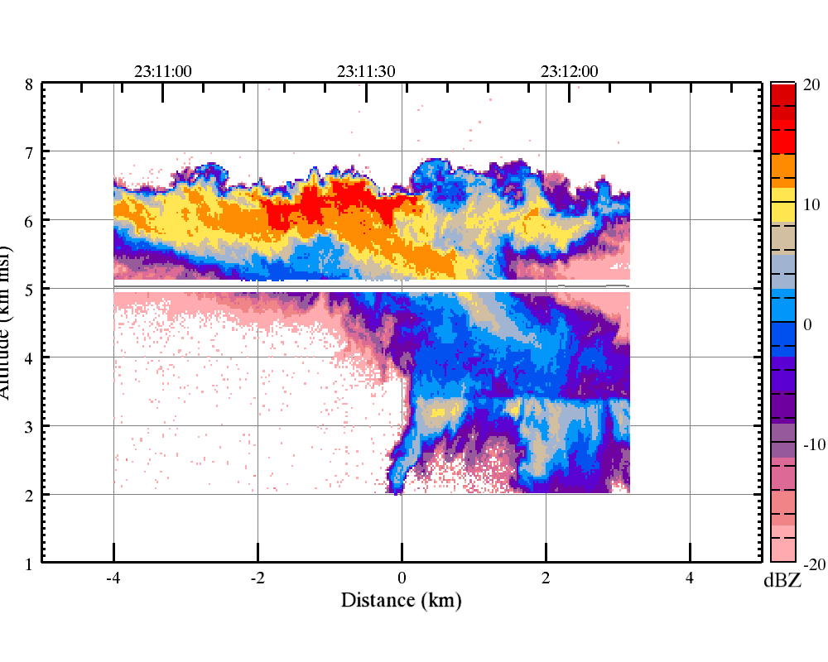
WCR: June 6, Cloud #2

Slide 20
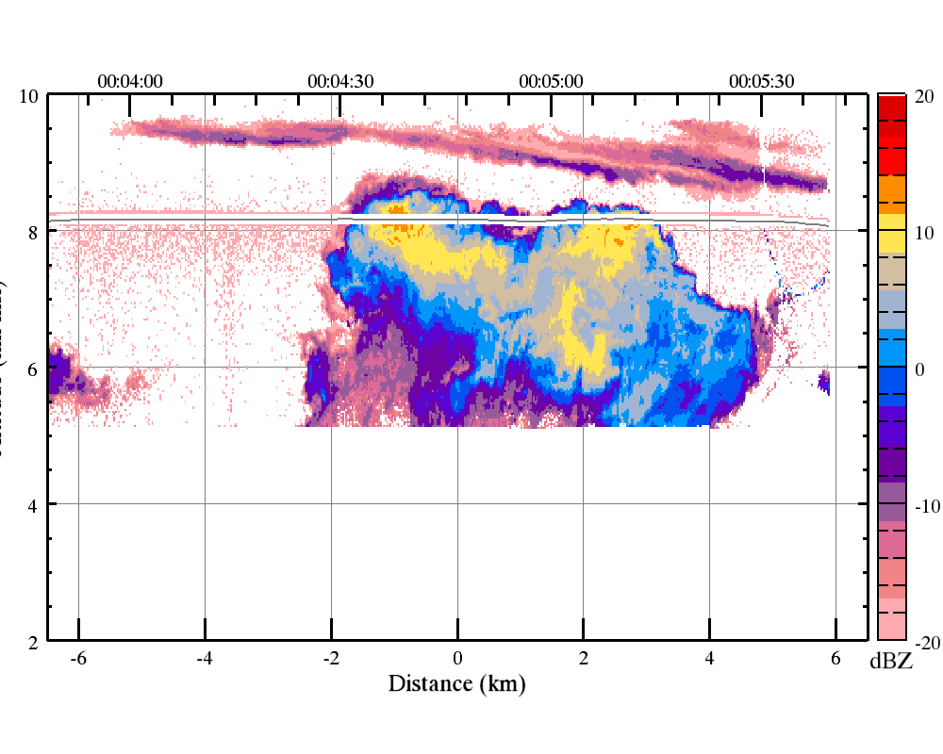
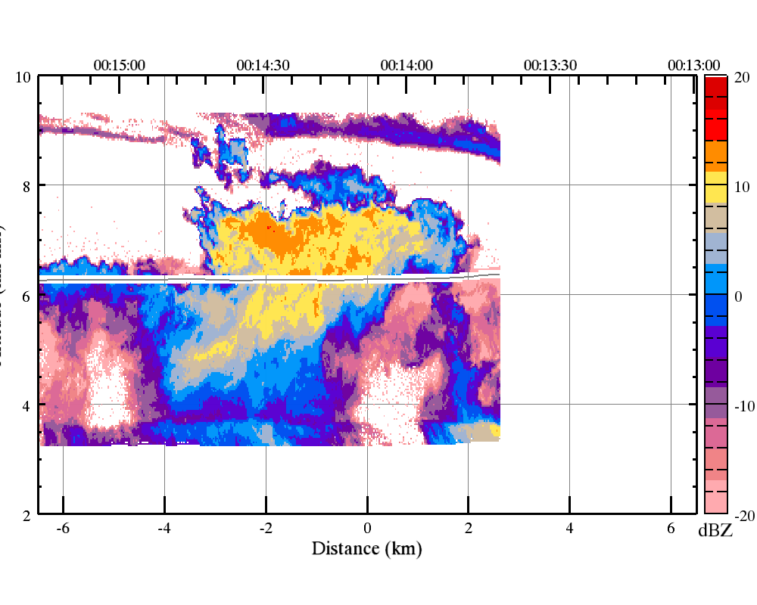
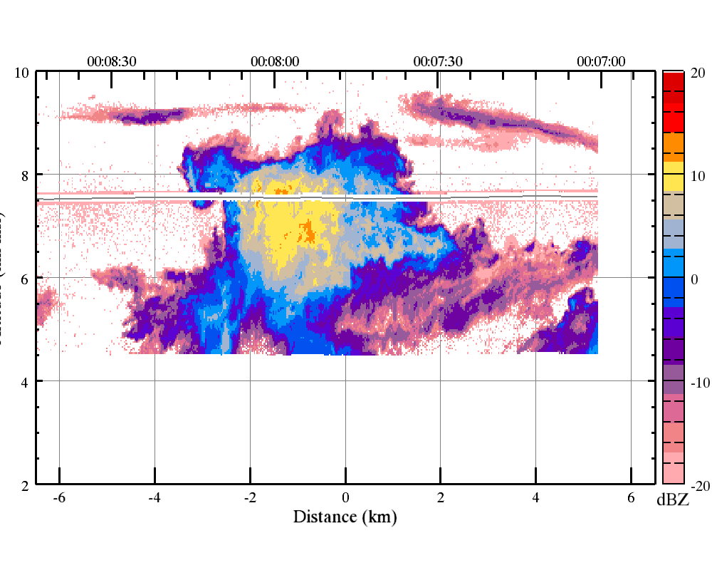
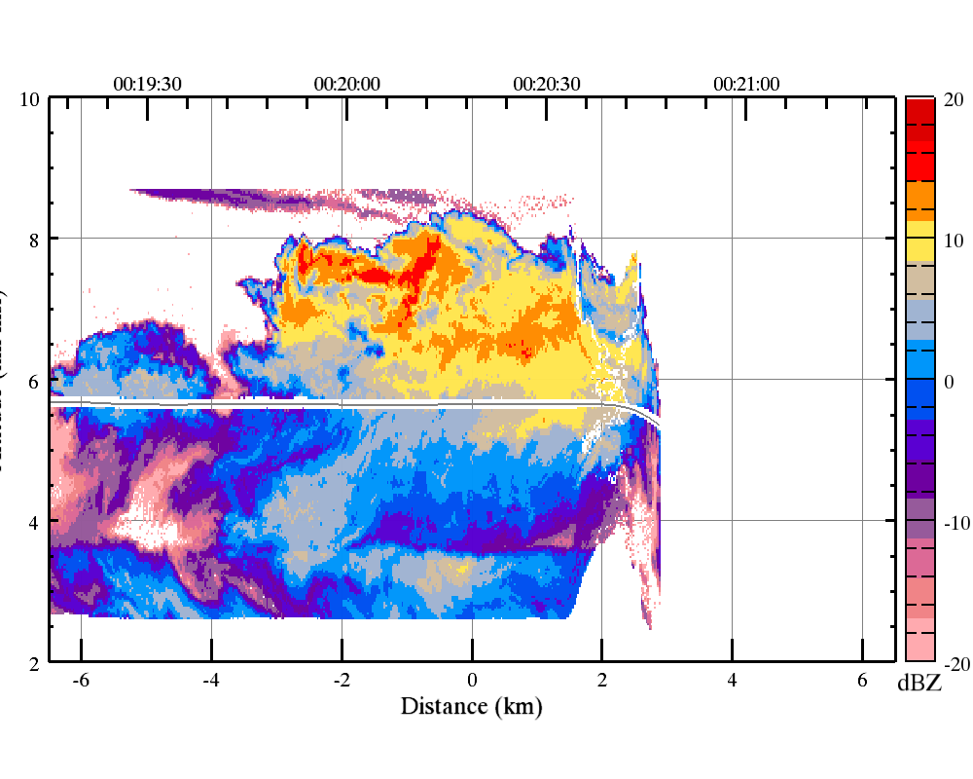
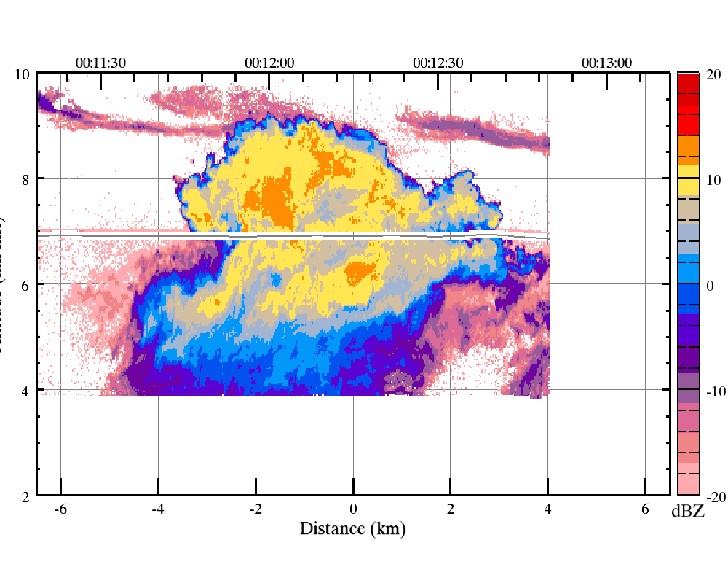
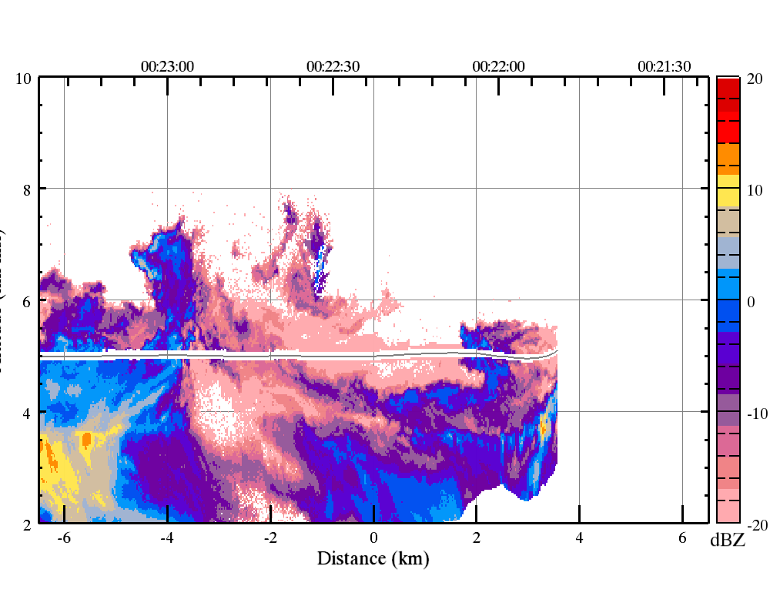
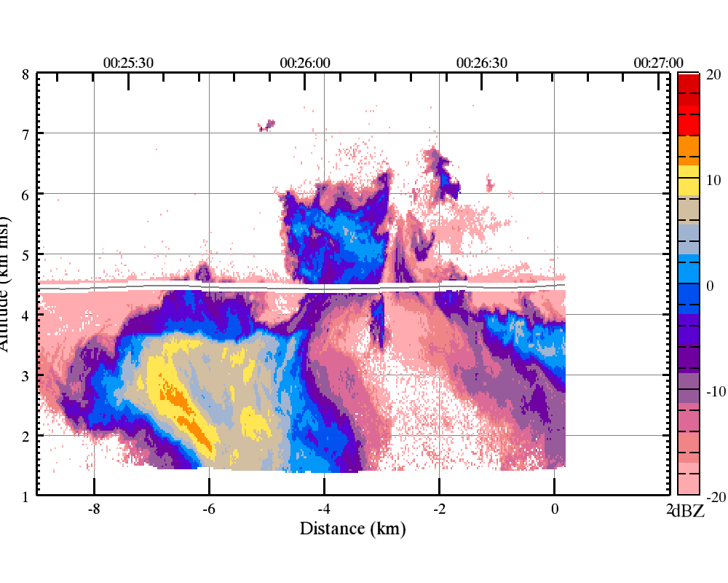
WCR: June 6, Cloud #3

Slide 21
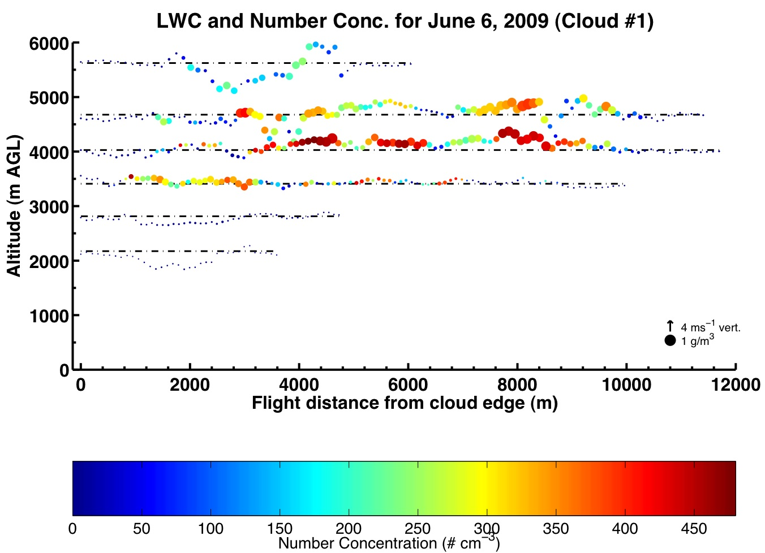

Slide 22
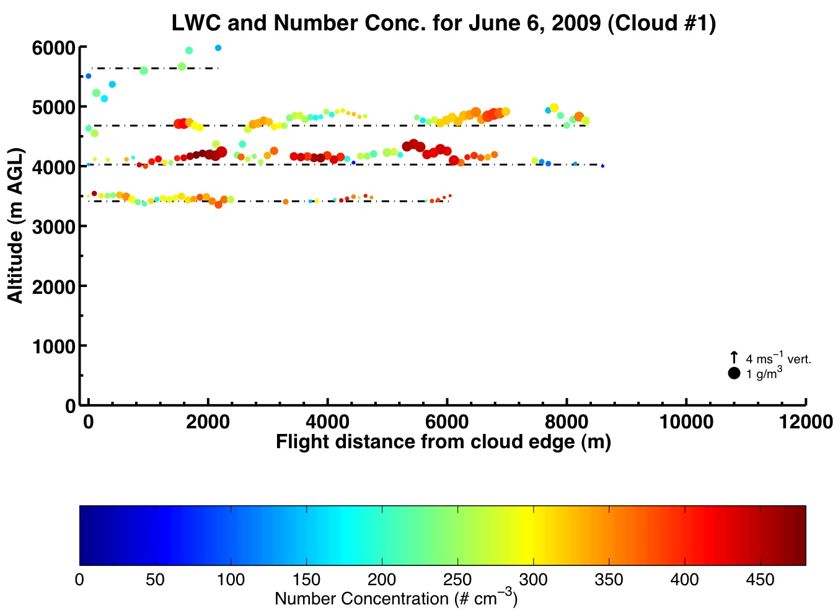

Slide 23
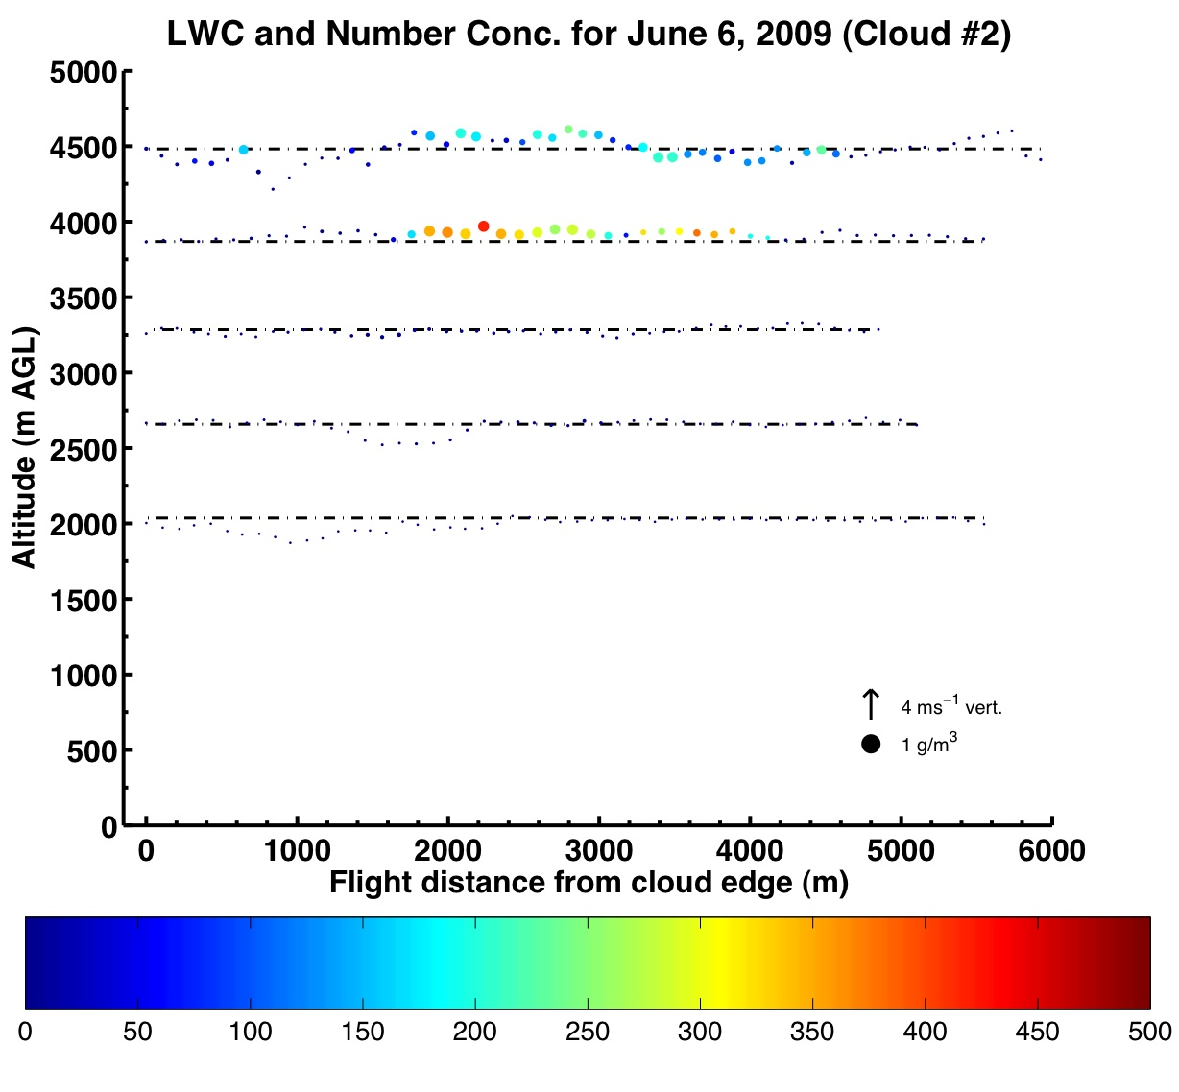

Slide 24
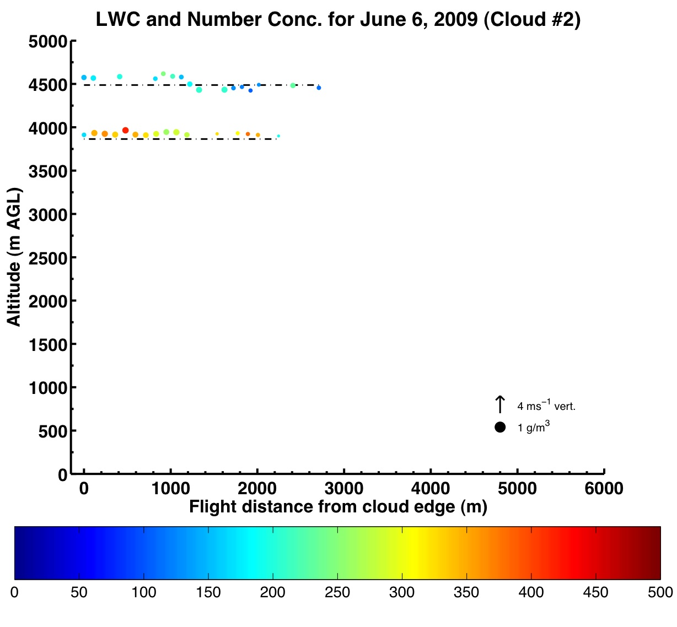

Slide 25
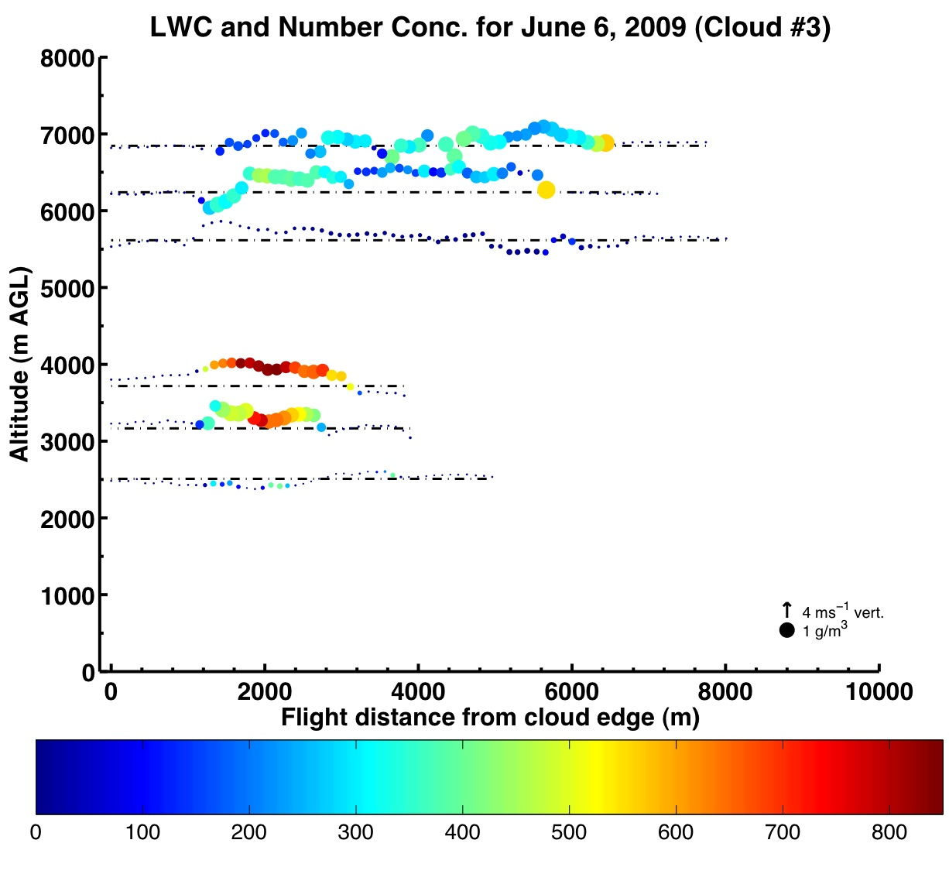

Slide 26
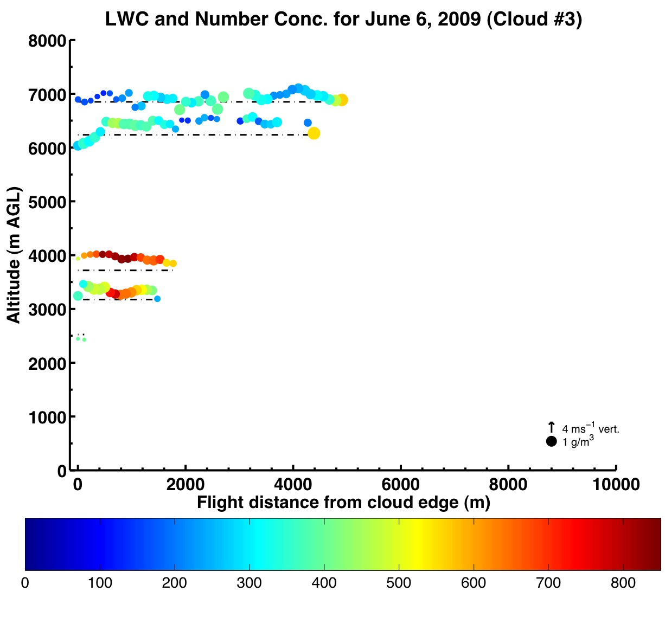

Slide 27
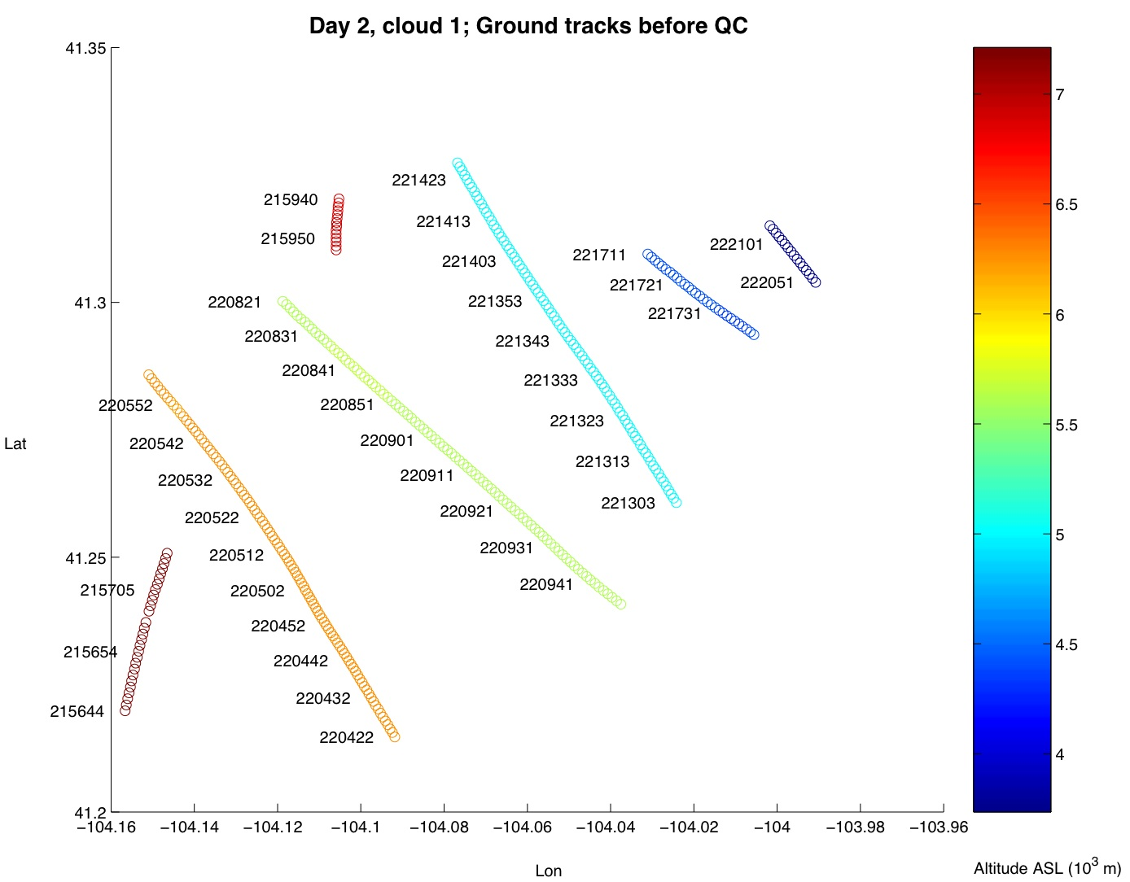
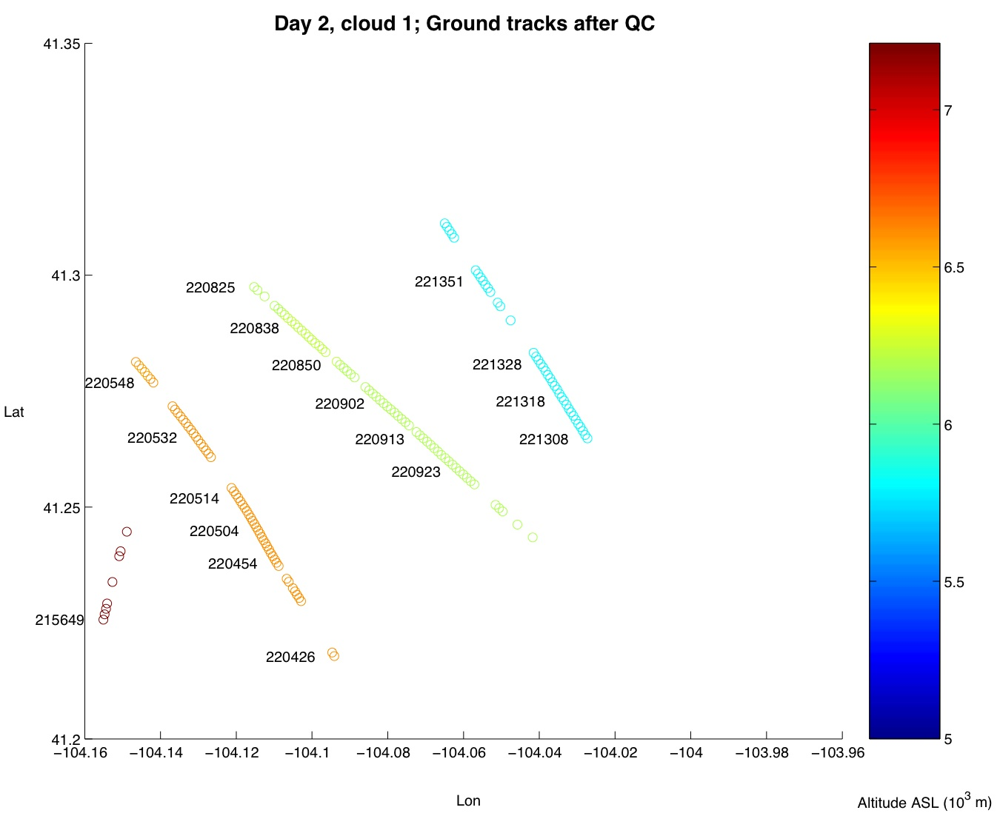
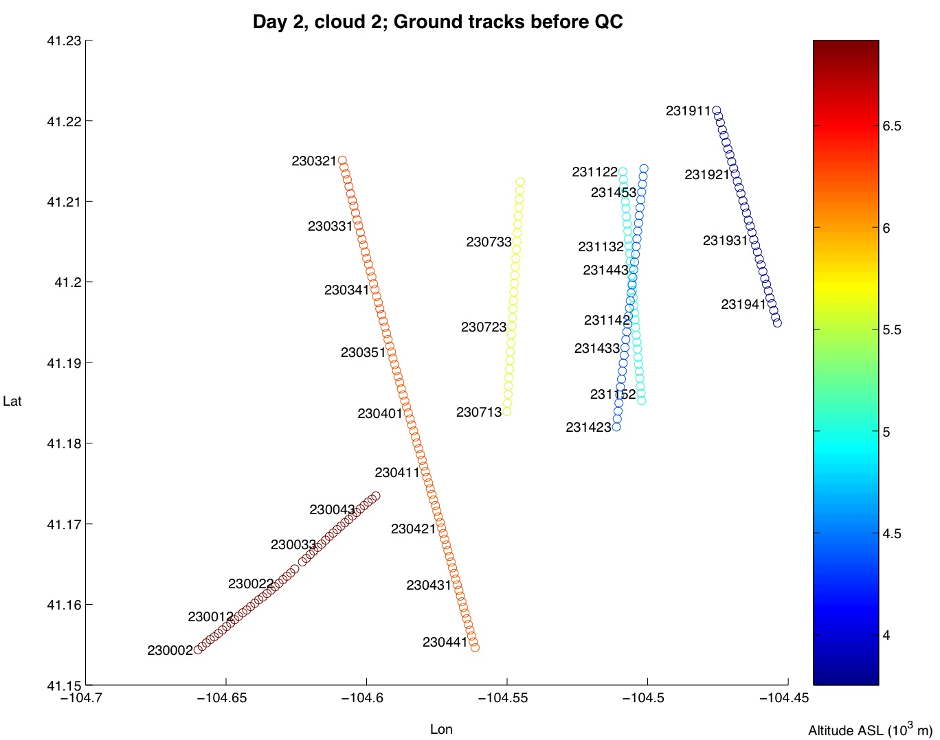
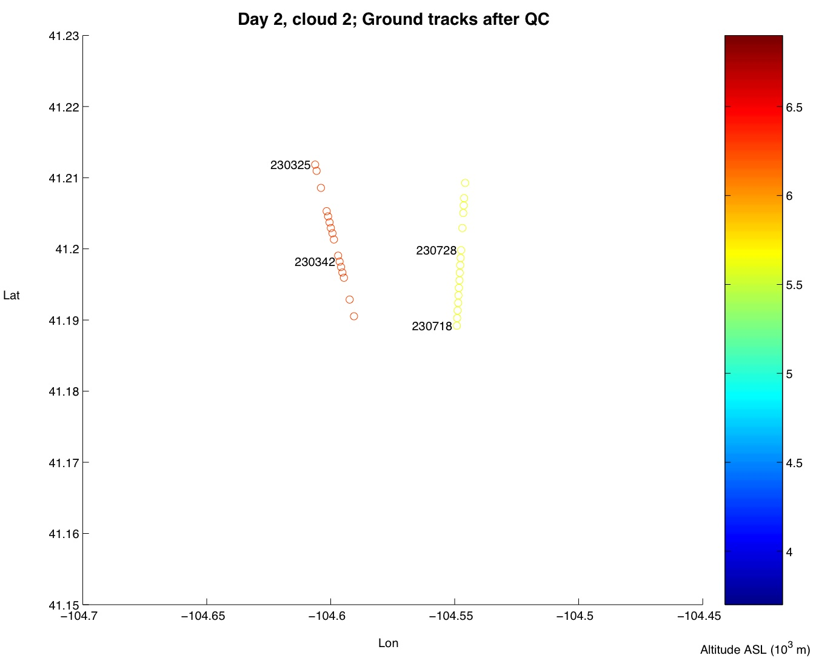

Slide 28
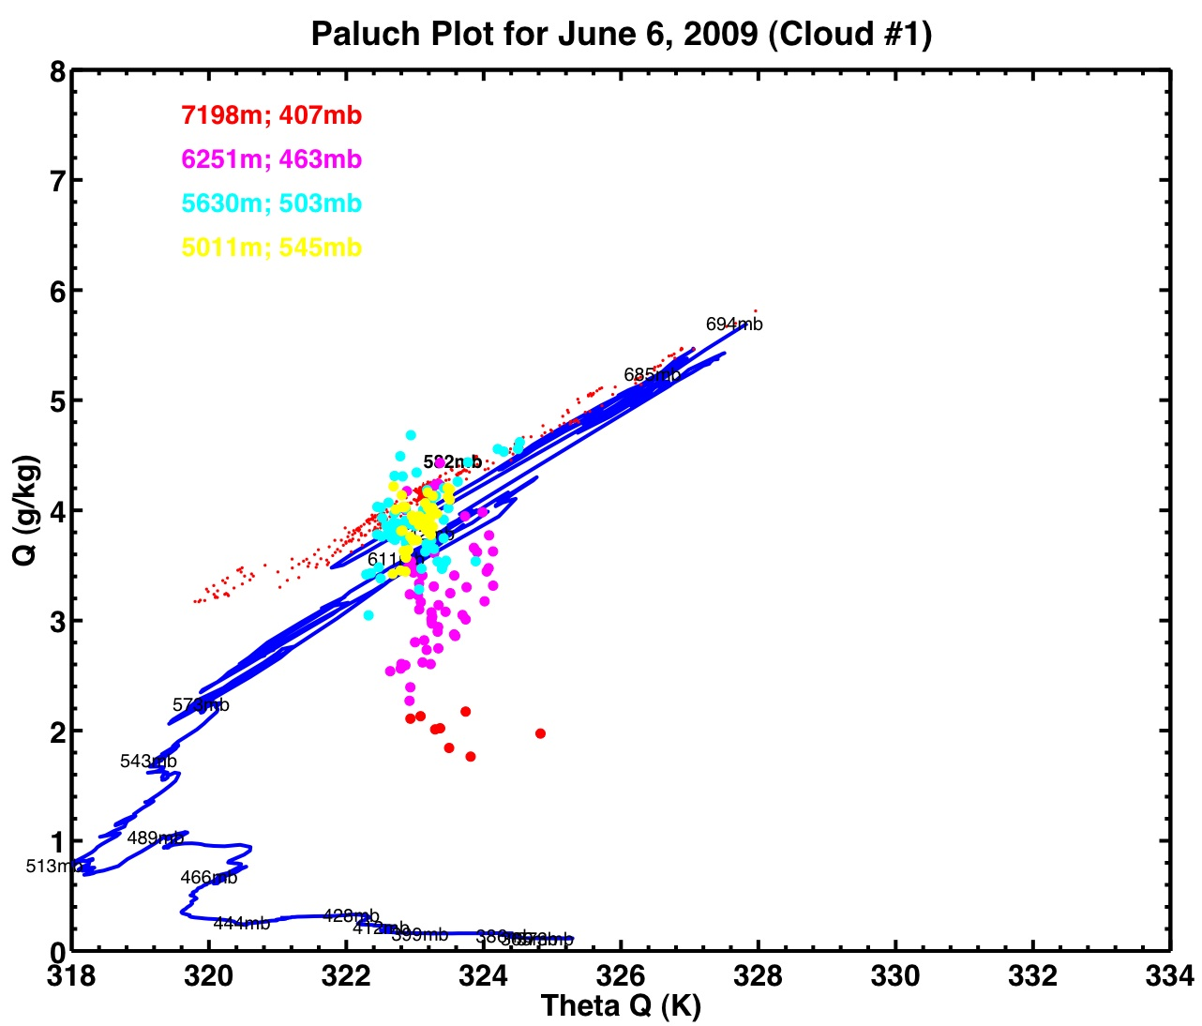

Slide 29
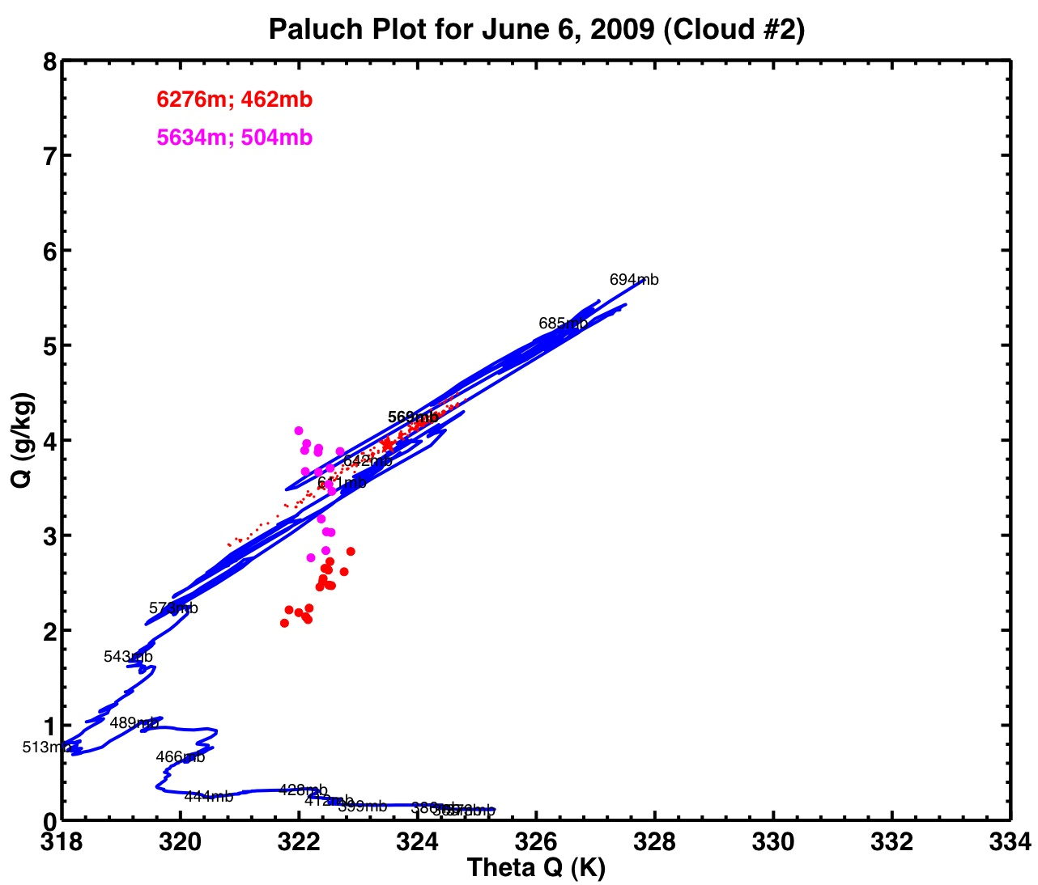

Slide 30
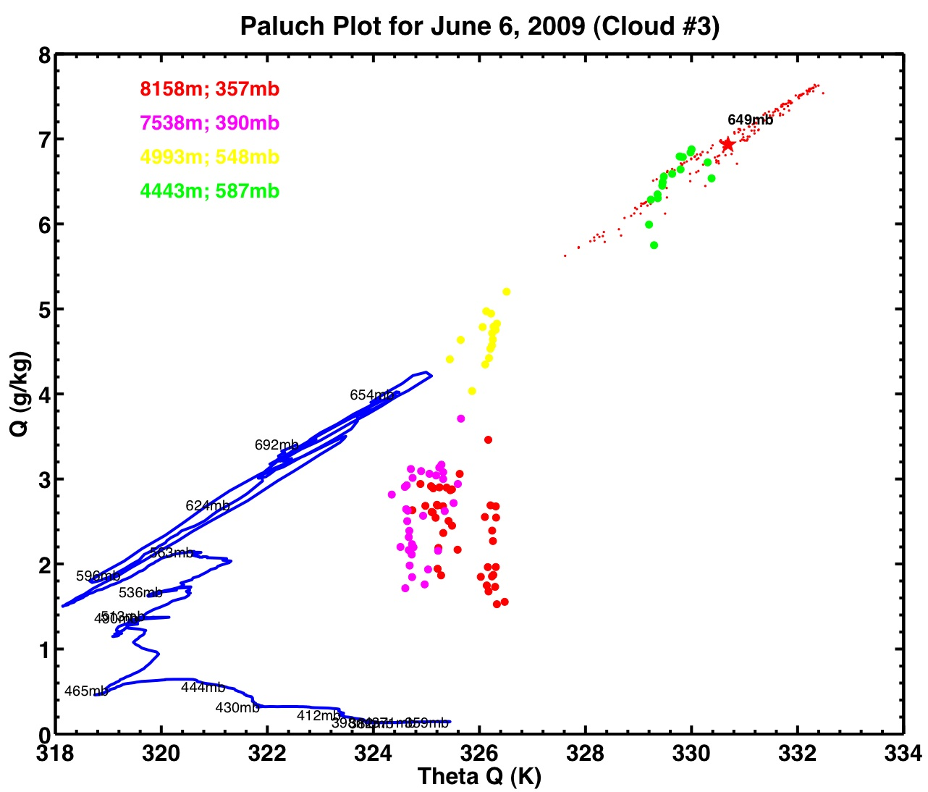
0019 UTC, 6 km msl
0025 UTC, 4.5 km msl

Slide 31
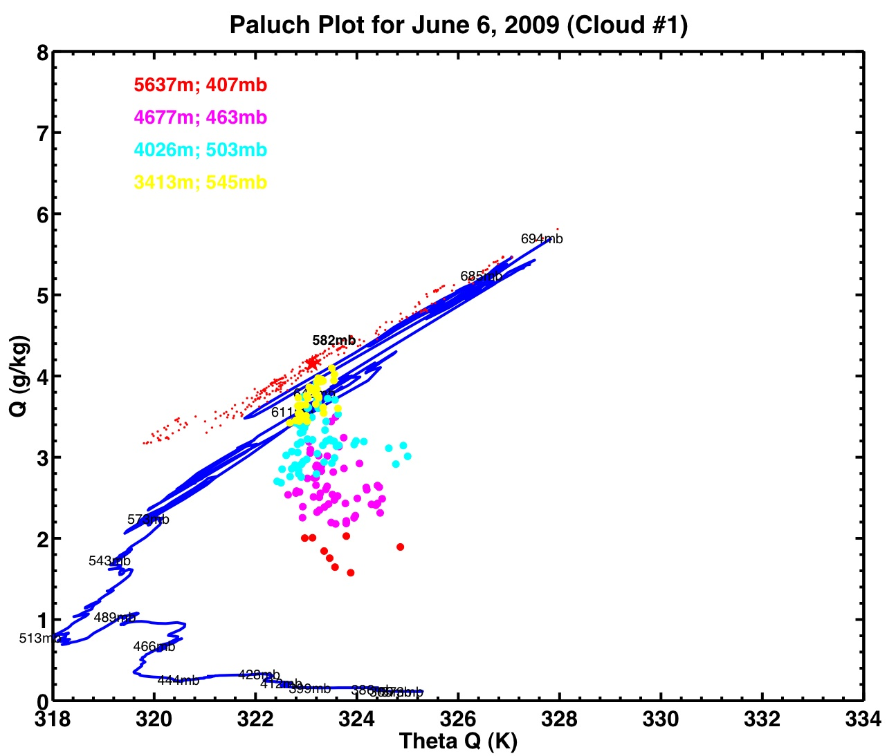
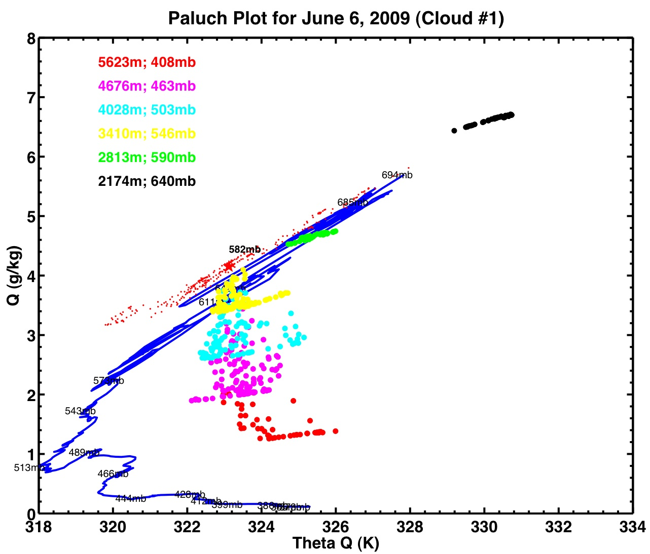
Inappropriate assumption of water vapor saturation creates linear Θ_{q} variations, which appear as horizontal lines in Θ_{q} vs. Q plots. We used these features to diagnose problems with cloud filtering.
Filtered
Unfiltered

Slide 32
Paluch analysis is usually performed under the assumption of non-glaciated clouds. We sampled glaciated clouds. We include ice in our total water estimates, but do not account for the release of latent heat of melting.
Q = q_{vapor} + q_{liquid}
Q = q_{vapor} + q_{liquid} + q_{ice}

Slide 35
Sensitivity: Temperature
T θ_{q} Q
(Paluch 1979)

Slide 36
Sensitivity: Liquid water content
LWC θ_{q} Q

Slide 37
Sensitivity: LWC

Slide 38
Sensitivity: Water Vapor

Slide 39
Instrumentation: Humidity measurement
CLEAR
CLOUD
LI-COR 6060
- Wetting symptoms in some cumulus penetrations
- At T< 0°C rime accumulation on sensor renders water vapor trace post-cloud unreliable.
-Even in RICO-04 (At T> 0°C ), mixing ratio traces show significant differences between cloud exit/entrances (due to occasional instrument wetting & inadequate sensor response time).
Chilled mirror:
much slower response time.
NO GOOD MEASUREMENT in CLOUD!!
(Wang and Geerts, 2009)

Slide 40
Adiabatic LWC: #1
(Albrecht, et al. 1990)

Slide 41
Adiabatic LWC: #2

Slide 42
Adiabatic LWC: #3

Slide 43
6500 m
21450 ft
PCASP
FSSP

Slide 44
6500 m
21450 ft
PCASP
FSSP

Slide 45
6500 m
21450 ft
PCASP
FSSP

Slide 46
6500 m
21450 ft
PCASP
FSSP

Slide 47
6500 m
21450 ft
PCASP
FSSP

Slide 48
5000 m
16500 ft
PCASP
FSSP

Slide 49
5000 m
16500 ft
PCASP
FSSP

Slide 50
5000 m
16500 ft
PCASP
FSSP
PCASP

Slide 51
Conclusions
Check your assumptions
Instrument variability can be a big problem
The importance of environmental soundings (we should have requested a sonde in Cheyenne!)
Entrainment mechanism remains unclear
Paluch diagrams can be a useful tool in many cases

Slide 52
Questions?
References
Paluch 1979, The entrainment mechanism in Colorado Cumuli
Peter et al. 2006, Prediction and observation of cloud processing of the aerosol size distribution by a band of cumulus
Jensen et al. 1985, Turbulent mixing, spectral evolution and dynamics in a warm cumulus cloud
Blythe, Cooler, Jensen. 1988, The source of entrained air in Montana Cumuli
Heus et al. 2008, Mixing in shallow cumulus clouds studied by Lagrangian particle tracking

Slide 53
MAJOR RESARCH
Paluch 1979, The entrainment mechanism in Colorado Cumuli
Use cloudy & cear air properties to determine altitude and amount of entrained air
Most air originates several km above observation level
Mixed regions in downdrafts & weak updrafts
Inconsistent with laterally entraining plume model
Mixing of envt air with cloud air produces evaporative cooling to create downdrafts that penetrate several km
Updraft air diluted with nearby downdraft air
Jensen et al. 1985, Turbulent mixing, spectral evolution and dynamics in a warm cumulus cloud
Used peulch to show that some cumuli contain cloudy air from only clou dtop and base
Inestigated droplet spectral evolution in clouds composed of air from these 2 sources
Mixing between cloud and entrained air often appears wthout total removal of dropplet
Observed droplet spectra compared with adiabatic parcel method calculations
Supports hypothesis that cloudy and envt air interact on large scales with homogenization of large scale regions
Blythe, Cooler, Jensen. 1988, The source of entrained air in Montana Cumuli
measured small cumuli to large supercell
Showed that the source of entrained air is close to or slightly above the observation level, even when aircraft decends through different levels
Consistent with the idea that cumulus clouds consist of athermal-like elements from which the least buoyant mixed parcels are shed off and the most buoyant mixed parcels may continue
Peter et al. 2006, Prediction and observation of cloud processing of the aerosol size distribution by a band of cumulus
Determined origins of detrained air, using observations of aerosol spectra
Heus et al. 2008, Mixing in shallow cumulus clouds studied by Lagrangian particle tracking
Mixing studied using large eddy simulations
Study source of in-cloud air using paluch and by tracing back cloud air parcels
CLASSIC PALUCH PROVIDE EVIDENCE FOR CLOUD TOP MIXING, PARTICLE TRACKING SHOWS THAT VIRTUALLY ALL MIXING OCURS LATERALLY!!!!
INDICATE ABSENCE OF SIGNIFICANT CLOUD-top mixing in shoallow cumuli

Slide 54
Background
Objective: determine the sources and amount of entrainment
Plumes/Thermals/Blobs

Slide 55
Soundings
Cheyenne, WY
Friday 21 UTC (1500 LST) WRF
Marshall Site
Friday 2039 UTC

Slide 56
8,500 ft (2212)
12,000 ft (2216)
9,000 ft (2223)
10,500 (2225)
12,000 (2228)
14,000 (2230)
15,000 (2233)
16,000 (2236)

Slide 57
Cloud fields – Flight 4
Case 2: Saturday 2256 - 2319 UTC

Slide 58
Cloud Base from WCL
Friday – Cloud #2
Base ~ 2.8 km
Saturday – Cloud #3
Base ~ 3.4 km

