Slide 1
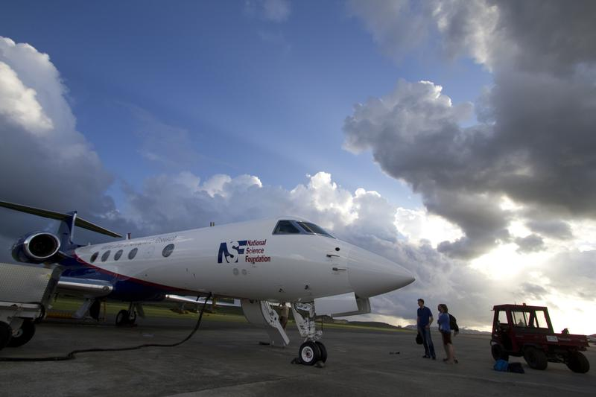

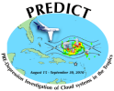
PREDICT Debrief
15 Aug – 30 Sept 2010
1 Sept - 15 Sept (double crew)
St Croix, USVI

Slide 2
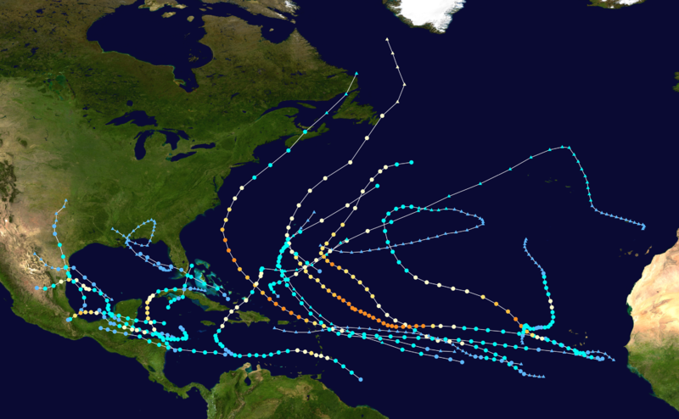
2010 North Atlantic Storms

Slide 3
Scientific Accomplishments
8 cases observed: an excellent mix
  3 genesis
  3 failed genesis
Multiple days flying the same tropical disturbance (7 cases)
Good spatial coverage of observations within and outside of pouch
Observations appear sufficient to address scientific hypotheses
Able to negotiate deep tropical convection
  Adjust routing during flight
  Flew over more deep convection than we originally thought would be possible

Slide 4
Project Management Summary
Field Project Services (FPS)
Overall Project Coordination:
  Project Coordinators (3) (Meitín (lead), Baeuerle, Salazar)
  Liaison with GRIP, IFEX, NHC, CARCAH
  ATC Coordination
  Forecast Team coordination
  Operations Center Management
  Liaison with local airport authorities & DHS (Security IDs)

Slide 5
Project Management Summary
Research Aviation Facility (RAF)
GV Project Coordination:
  Project Managers (2) (Jensen (lead), Schanot)
  Payload and integration
  Flight mission planning & execution
  Onboard mission coordinator
  Data processing & project documentation
  Local administrative support (lodging, rental cars)

Slide 6
Project Management Summary
Computing, Data and Software (CDS)
Systems Administration:
  Sys Admins (4) (Slaten (lead), Paxton, Russ, Newbery)
  Ops Center Internet Access/Communications
  General Computing Support
  Local Area Network
  Data Archival

Slide 7
Project Management Summary
Computing, Data and Software (CDS)
Field Catalog:
  On-site Catalog Specialist (2) (Stossmeister (lead), Aquino)
  Special products generation
  Mission coordinator display support
  Real-time data distribution
  Multi-agency Xchat support

Slide 8
Project Management Summary
In-situ Sensing Facility (ISF) Dropsondes:
  Dropsonde techs (3) (Tudor (lead), Golubieski, Lim)
  Student assistants (3)
  558 soundings / 26 research flights
  Multi-agency quality control training
  Real-time QC & data distribution (with CDS)

Slide 9
Research Aviation Facility
Planning and integration (fixed dates worked well)
Instrumentation
  CVI, ozone, VCSEL, TDL
  GISMOS, MTP
  3V-CPI, SID2
  PMS and CN particle probes
  Radome wind, gust pod wind
  LAMS and All-Weather-Winds pod
  Flight planning software development in the field
    Jointly developed by Pis and EOL staff on first day
    Need for future general development, esp. when including dropsonde releases

Slide 10
Research Aviation Facility
Missions and weather
  GV radar images not available in the aft cabin
  IR satellite images not available to pilots
  Day-time flights only
Mission Coordinator role
Aircraft maintenance
  Electric discharges (radome)
Evacuations and forecasts
  Aircraft
  Staffing
Diplomatic clearances
  Venezuela (DC-8 also denied access)
  Some additional acceptances
  Some denials

Slide 11
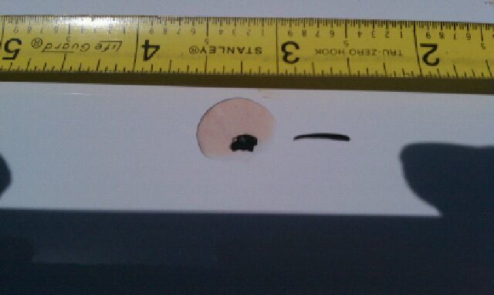
Flight through convective cores / high ice-water content at high altitude
  Sometimes impossible to predict
  Effects on temperature measurements (significant)
  Effects on pitot tubes (none)
  Effects on true air speed number (somewhat)
  Lightning discharges
  Turbulence (low to moderate)
Pilots error messages:
Engine maintenance required
Engine backup air data L-R

Slide 12
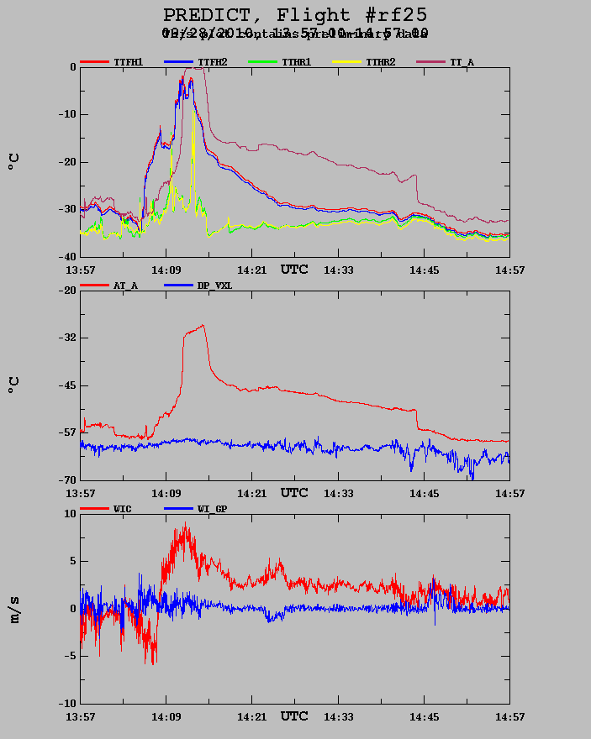
  High IWC and instrument effects:
    CVI saturated?
    Ice on optics [LAMS, forward camera]
    Radome and gust QC holes plugged with ice
    Temperature sensors plugged [meltwater]
    Static electric charge on DSM lead to clock error
    2D-probe “run-away” due to high conc.
    Only a few periods

Slide 13
Research Aviation Facility
Manpower issues
  Double crewed period (15 days)
  Only few actual days with double missions (one)
    No weather
    Storms too far away – then only single long mission
    Advantages:
      Ability to fly many days in a row (follow storms day-by-day)
      Maintenance after a long flight (second crew)
    RAF science crew strained
      Direct instrument support (CVI, ozone, etc.)
      Project management duties
      Mission Coordinator duties
      Guest flier instruction and instrument operation

Slide 14
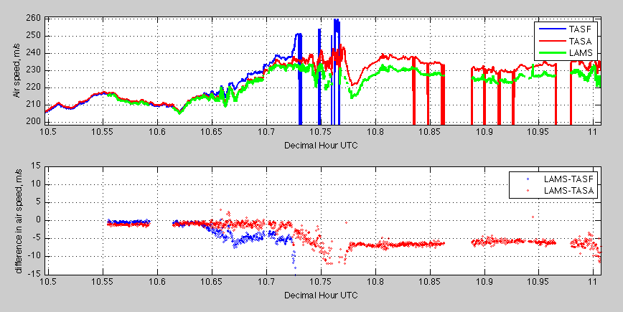
Highlights and Accomplishments (RAF)
  New instruments
    LAMS - Laser Air Motion Sensor

Slide 15
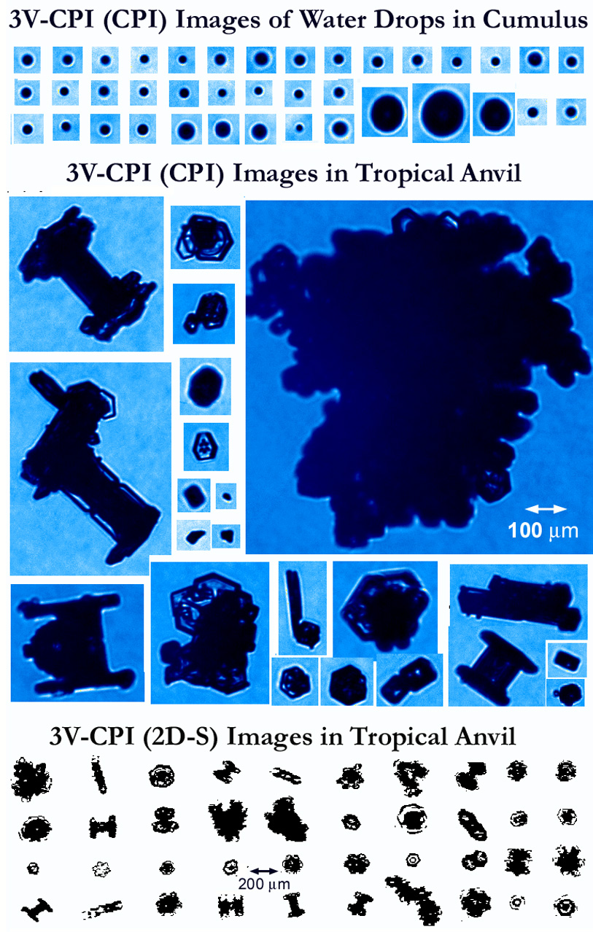
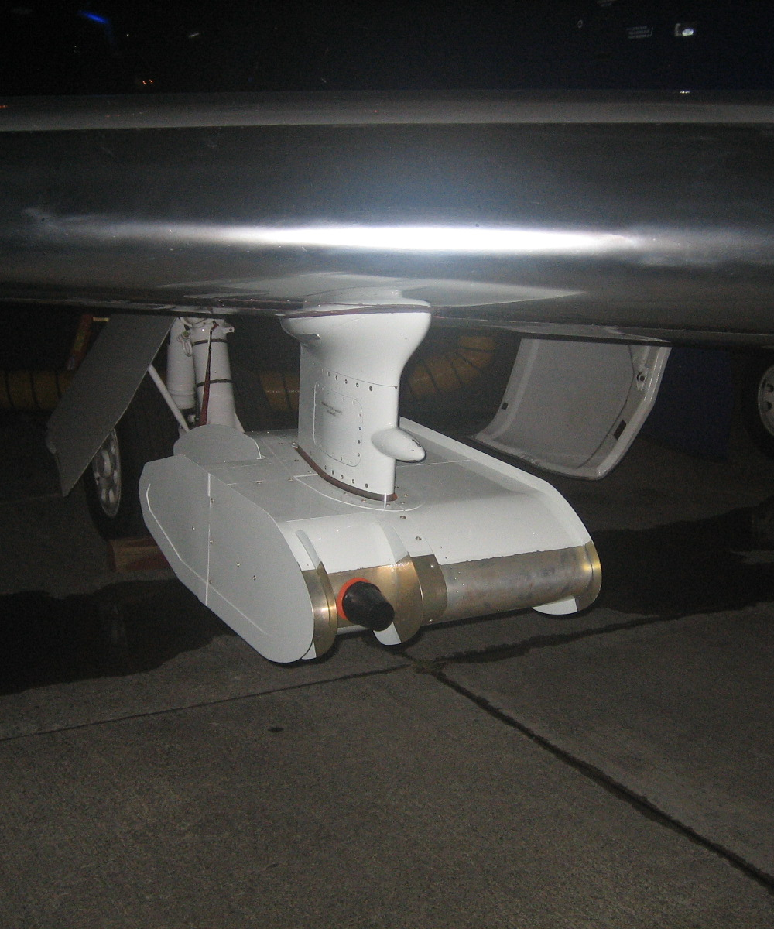
Highlights and Accomplishments (RAF/SPEC)
  New instruments
    HAIS SPEC 3V-CPI
    3V-CPI Images from NCAR GV (8-15-2010) in PREDICT
    Images provided by Paul Lawson (SPEC)

Slide 16
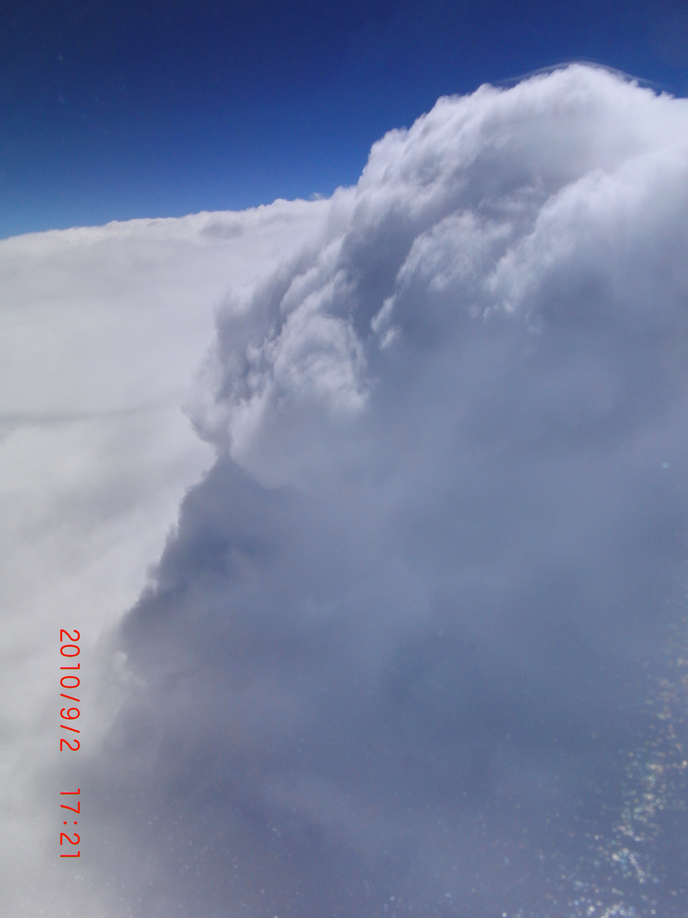
Highlights and Accomplishments (RAF)
  Successful mission coordination in a data-poor environment (no large-scale radar coverage)
  Approach to severe weather was initially cautious, later more familiar
  Deployment of new HAIS instruments (GISMOS, 3V-CPI) and LAMS
  Evacuation planning was successful – one close call with good collaboration between forecasters and operations
  Managed several research missions from a remote base
  Mission accomplished - as usual ☺

Slide 17
Highlights and Accomplishments (FPS)
  Tri-Agency planning and coordination
  Forecasters Exercise
  Weekly Teleconferences
  Dropsonde frequency allocations
  FAA coordination meetings
  Air Space coordination in the field
  Joint Daily Planning Meetings
  Hotel contracts

Slide 18
Highlights and Accomplishments (CDS)
NOAA, NCAR, and NASA aircraft and ground support teams (including CARCAH) all used the same chat messaging system for communications. Users could log in to a single system and access all of the different chat rooms.
Near real-time display of GV dropsonde winds in constant pressure levels using the Mission Coordinator Display as well as Catalog Earth.
GE KML files generated for both GV and DC8 dropsondes that included flight track, drop locations, constant pressure level winds and Skew-T profiles accessible through the field catalog Missions Table.

Slide 19
Highlights and Accomplishments (CDS)
Catalog Earth prototype demonstrated to a limited group of users allowed near real-time perusal of satellite imagery and products, e.g. NCAR, NOAA and USAF flight tracks, lightning strike information, dropsonde locations and data display using a Google Earth API. Catalog Earth also provided playback capability.
Collaboration between EOL and UW/SSEC to collect GOES-East and Meteosat data and generate imagery across the Atlantic and Africa. Also worked with SSEC to get a specialized product (overshooting tops) into the Mission Coordinator Display on the GV.
Field Catalog hosted preliminary datasets through RAMADDA database in the field. RAMADDA provided restricted access to project PIs and allowed participants to browse and download datasets.

Slide 20
Highlights and Accomplishments (CDS)
Floater satellite imagery produced for each PGI system based on NRL analyses and forecast hourly centerpoint locations. Position file was routinely uploaded to the catalog and plots were generated using the latest data file.
Quality-controlled dropsonde Skew-T plots from the GV and DC-8 as well as Howard University soundings submitted to the catalog via e-mail. Dropsonde data files submitted via e-mail, then routed to ftp site for use in analysis software as well as the field catalog.

Slide 21
Challenges and Lessons Learned (CDS)
Mission Coordinator display and Google Earth KML production makes it difficult to be flexible when the project goes outside the originally planned operations area – manual intervention is required to change all GIS display products
Last minute/in-the-field requests for new GIS products (MC display) require a lot of manual work – finding the product, setting up an automated retrieval process, re-mapping the image if needed, computing edge boundaries. Often these ad lib requests made during a flight are not archived in the field catalog so there is no record and no way to replay those displays.
It proved difficult to get NASA DC-8 flight position data. GE KML files for the DC-8 were not readily available; could not include them in the catalog or real-time tracking tools.

Slide 22
Highlights and Accomplishments (CDS)
System Administration issues

Slide 23
Highlights and Accomplishments (ISF)
  Robust multi-platform version of ASPEN (v3) software available before start of campaign (no further updates were required during the project).
  Near real-time evaluation of the dropsonde data quality during the project was conducted and proved essential in identifying problems with the dropsonde PTU sensors.
  Communication using the tri-agency email, specifically to resolve issues with transmission of data to the GTS, was very successful.
  Expected release GV dropsonde archive - January 2011

Slide 24
Challenges and Lessons Learned (ISF)
  Hands-on training of student assistants for dropsonde processing by experienced staff prior to the start of the campaign. During PREDICT, multiple webinars were conducted, however a copy of the webinar was never circulated for future reference.
  Recommend that multi-agency points-of-contact be distributed before the beginning of the campaign, including the length of that appointment for each individual, cell phone numbers, and email addresses, so that contacts can be easily identified when problems arise.
  Establishing a data policy detailing who is allowed access to the raw and/or preliminary QC data, or under what circumstances we would grant access to these data.
  Establish a secure method of data storage (i.e. password protect raw data)
  Dropsonde telemetry was poor on the GV. Relocate 400 MHz antenna on the fuselage.

Slide 25
Highlights and Accomplishments
(Education and Outreach)

Slide 26
Things that Worked (from science team)
EOL staff
  Excellent support of GV: no missions canceled because of aircraft problems
  Instruments generally functioned well
  Operating rules clear: some flexibility as appropriate
  Technical support in operations center was very good: communications, access to data, etc.

Slide 27
Things that Worked (from science team)
RAF Pilots: accommodating and dedicated
Mission planning was very efficient and accurate
Bohlke Aviation (FBO): excellent support (access, power, fuel, etc.)
St. Croix, USVI: excellent choice for base of operations
Facility (Buccaneer Hotel)
  Excellent rooms for extended stay
  Great staff
  Operations Center adequate

Slide 28
Things that Could Have Been Better (from science team)
Easier operations in Caribbean Sea: FIR limitations significant but not a “showstopper”
Some dropsonde problems, but overall not a serious issue
Operations Center issues
  Static on phone landline for teleconferences was annoying
  Flooding issues (natural and man-made)
Daily Planning Meeting usurped by earlier meetings
  Tri-agency nature of project introduced redundant meetings

Slide 29
