Slide 1

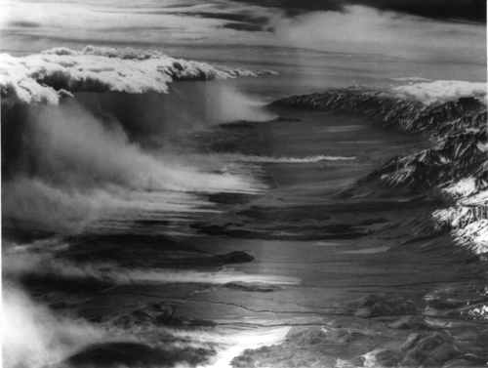
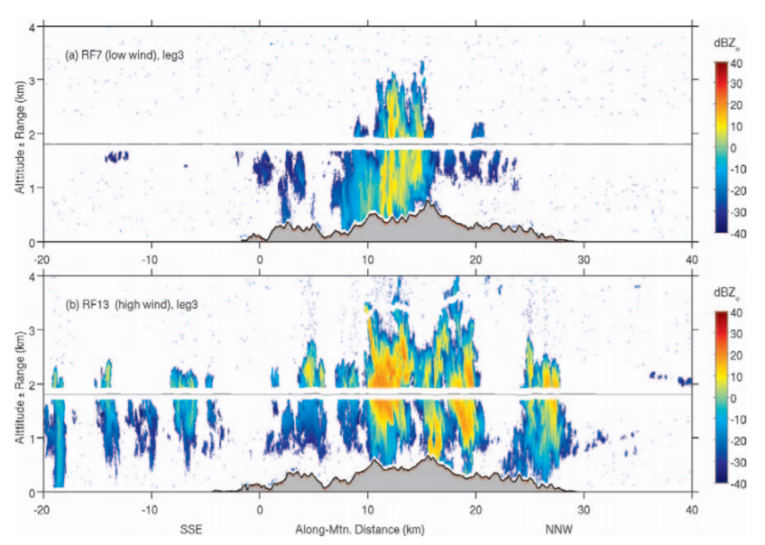
James D. Doyle U.S. Naval Research Laboratory, Monterey, CA
Acknowledgements: Vanda Grubišić (NCAR), Bart Geerts (U. Wyoming), D. Durran (UW), A. Dörnbrack (DLR), S. Eckermann (NRL-DC), D. Fritts (Gats), T. Lane (Monash), Q. Jiang (UCAR), R. Sharman (NCAR), R. Smith (Yale), M. Taylor (Utah St.), M. Weissmann (DLR)
Mountain Winds, Waves, and Turbulence
Outline
Background
Dry terrain-forced phenomena
Moist terrain-forced phenomena
Summary
Robert Symons
5 March 1950
Smith et al. (2012)

Slide 2
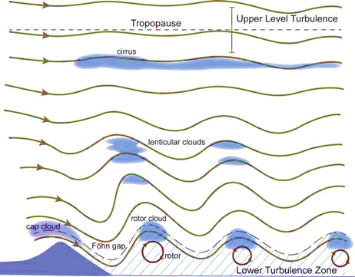
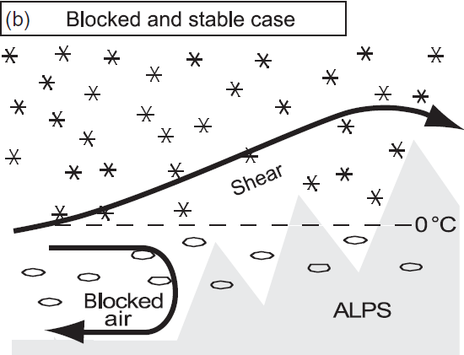
Background
The nature of mountain flows (dry and moist) are very sensitive to turbulence
Flow over/around terrain, breaking mountain waves are key generators of turbulence
Our theories (dry and moist) typically do not include realistic PBLs and turbulence
Model resolution has increased faster than we can verify with observations
Observational gaps exist related to gravity wave characteristics, turbulent breaking
Gravity wave drag parametrizations are known to be deficient and highly tuned. Crude GWD parameterizations lead to large systematic biases in weather/climate models.
Dynamically-Driven Waves
and Turbulence
Effects of Terrain
on Clouds and Precipitation

Slide 3
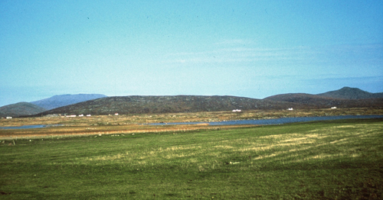
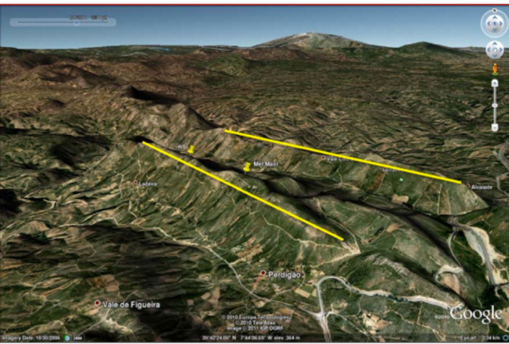
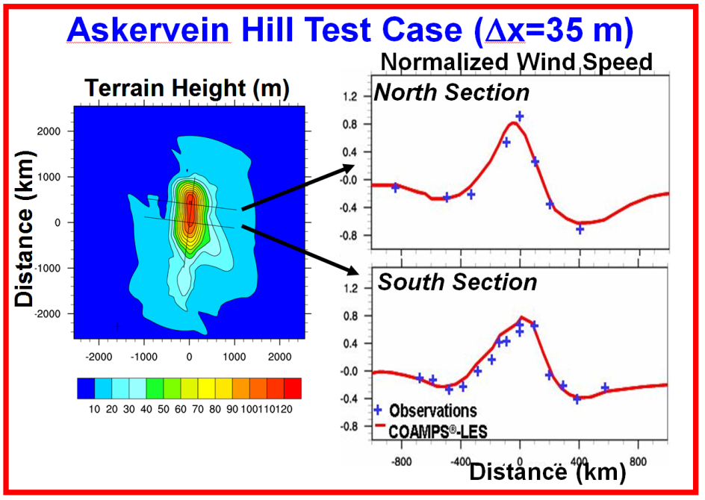
Turbulent Flow over Terrain
Askervein Hill (early 1980’s)
Perdigão Experiment (2016-17)
6-week IOP using 47 instrumented towers, lidars, radiosondes
Frontiers
  Complex terrain
  Varying land surface characteristics
  Flow dependence
Key Science Questions
  How much momentum is extracted?
  How much heat and CO₂ are transferred between wind & landscape?
  What degree of model sophistication is needed to simulate this with LES?
Golaz et al. 2009 (JAMES)

Slide 4
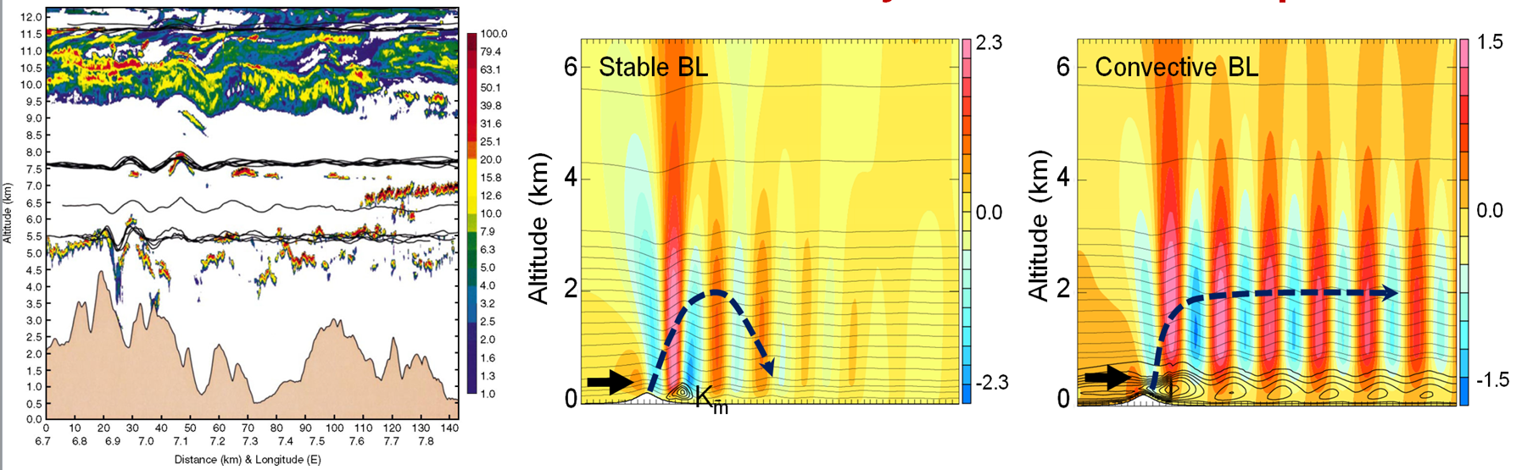
Lee Waves and Turbulence
DIAL Lidar (Mt. Blanc)
Vertical Velocity and Potential Temperature
Mountain lee waves are sensitive to nature of turbulence (theory/limited obs)
Frontiers
  Role of turbulence and PBL on: i) wave launching, ii) lee waves
  Influence of varying land surface characteristics, diurnal cycle
Key Questions
  How does the PBL/turbulence influence lee waves and wave breaking?
  How does upstream the mountain PBL influence waves and turbulence?
Jiang, Doyle, Smith (JAS 2006); Smith, Jiang, and Doyle (JAS 2006); Jiang, Doyle, Wang, and Smith (JAS 2007), Jiang and Doyle (JAS 2008); Jiang, Smith, Doyle (JAS 2008)

Slide 5
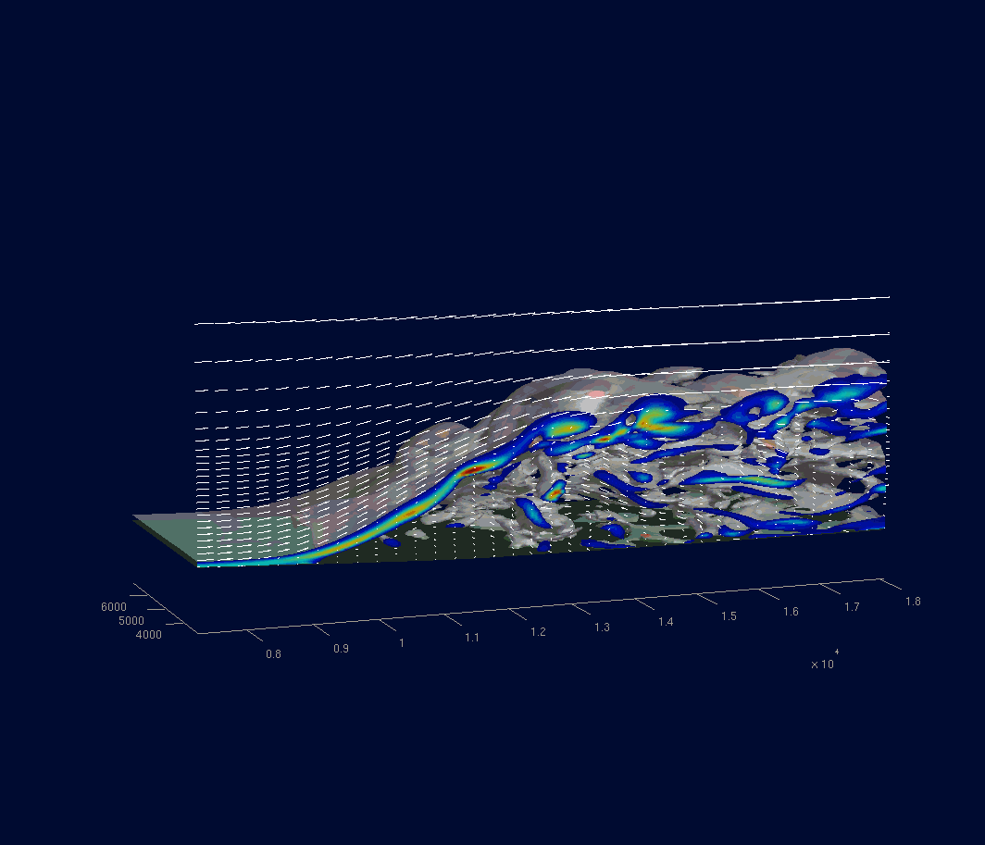
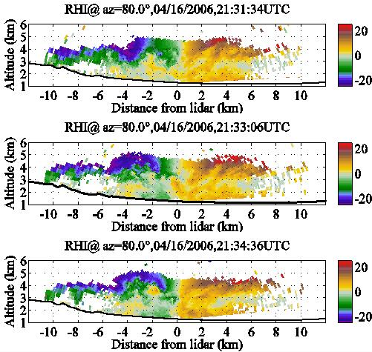
Rotors
Subrotor Vortices During the Terrain-Induced Rotor Experiment
Doppler Lidar Velocities
LES Simulation
2100 UTC 16 April 2007
[30 min. period, Δx=60 m]
η Vorticity (color)
η = 0.15 s-1 (red)
η = 0.02 s-1 (gray)
Doyle, Grubišić, Brown, De Wekker, Dörnbrack, Jiang, Mayor, Weissmann, 2009, JAS
Frontiers
  Characterization of low-level turbulence in rotors and wave breaking
Key Questions
  Under what conditions do subrotors form? Is this a KH instability?
  What is the role of the PBL and heating/turbulence? Role of clouds?

Slide 6
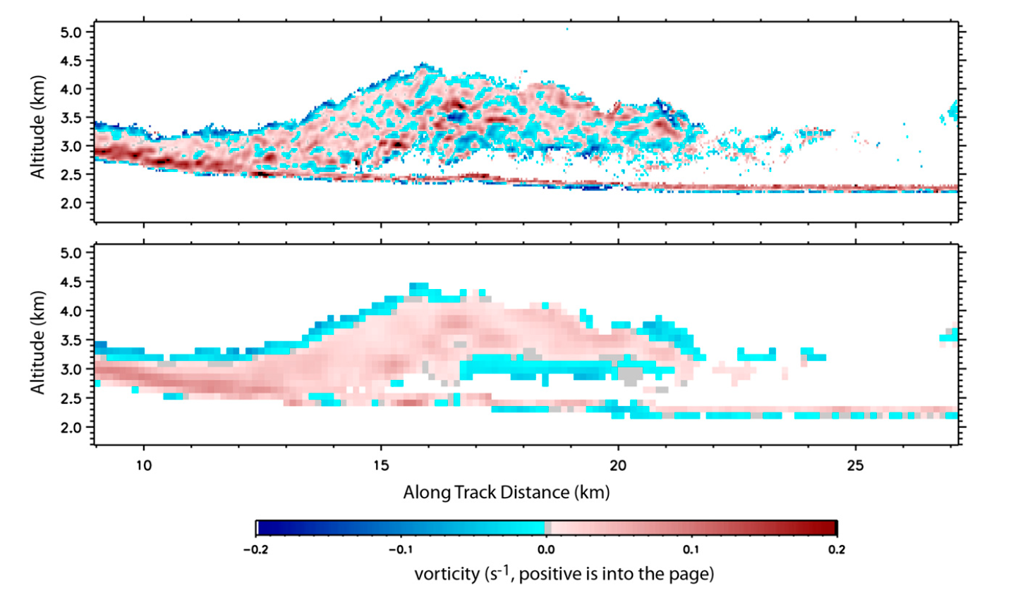
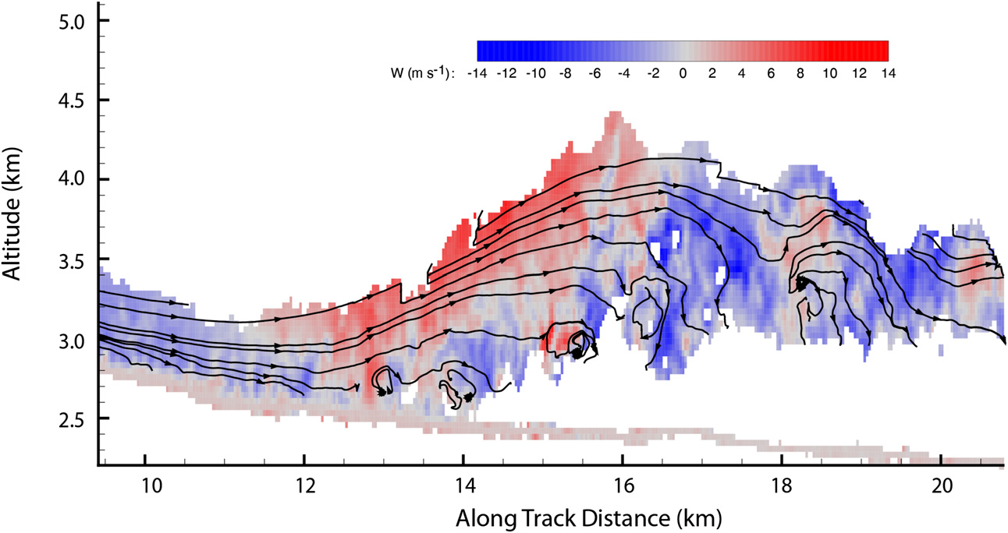
Rotors
Subrotor Vortices over the Medicine Bow Mountains
Vertical Velocity
Horizontal Vorticity
Horizontal Vorticity
(Filtered)
French et al. (2015)
Frontiers
  Characterization of low-level turbulence in rotors and wave breaking
Key Questions
  Under what conditions do subrotors form? Is this a KH instability?
  What is the role of the PBL and heating/turbulence? Role of clouds?

Slide 7
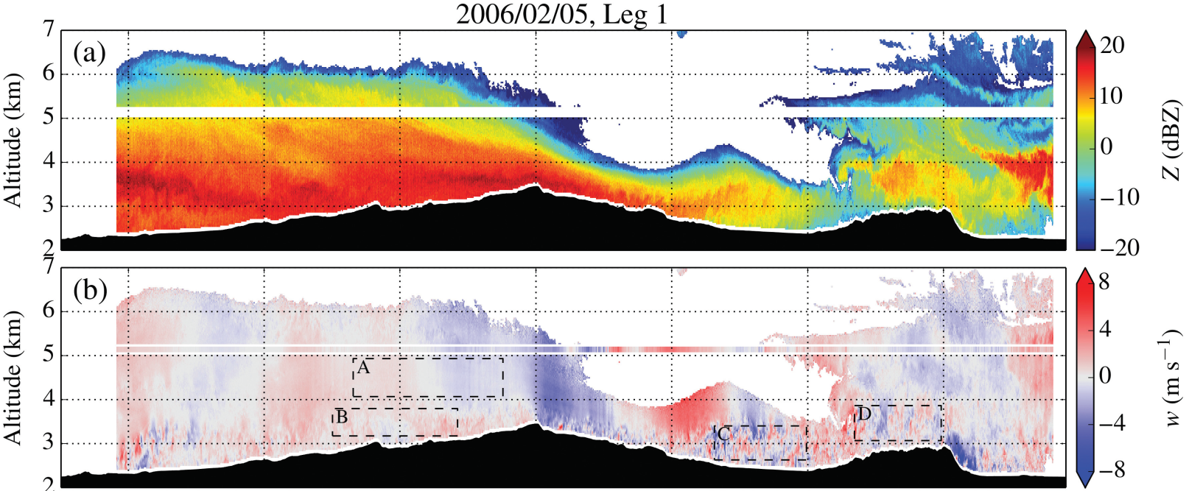

Rotors
Medicine Bow Mountains during the NASA Orographic Clouds Experiment
Hydraulic jump type of rotor
Severe turbulence is encountered in the downdraft, with maximum σ²w and EDR_{w} of 16.4m²s⁻² and 0.77m^{2/3}s⁻¹
Strauss et al. (2015)
Frontiers
  Characterization of low-level turbulence in rotors and wave breaking
Key Questions
  How does the turbulence differ between hydraulic-like jump rotors and lee wave rotors?

Slide 8
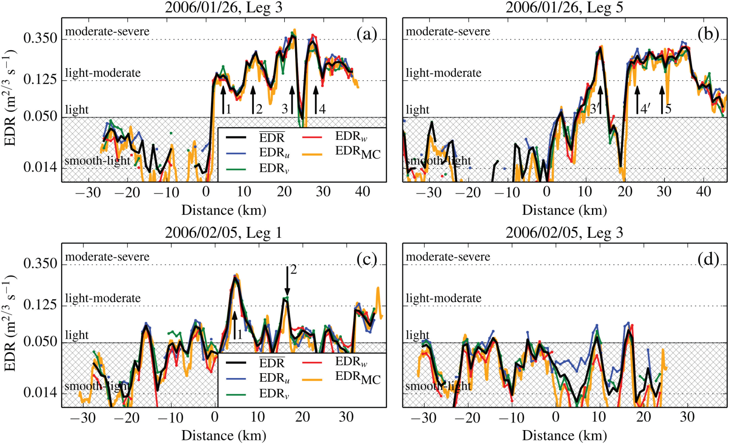
Low-Level Wave Breaking
Strauss et al. (2015)
Frontiers
  Measurements of low-level turbulence in rotors and wave breaking are rare
Key Questions
  What are the characteristics of wave breaking and associated turbulence?

Slide 9
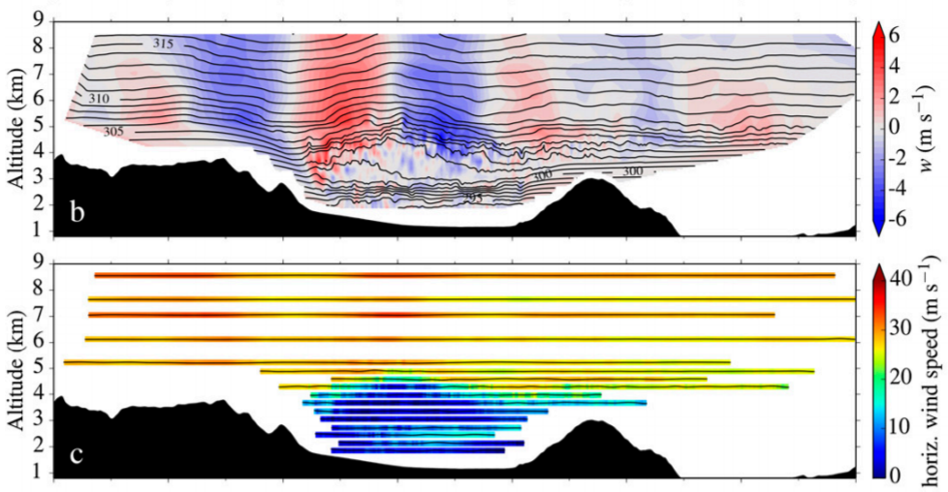
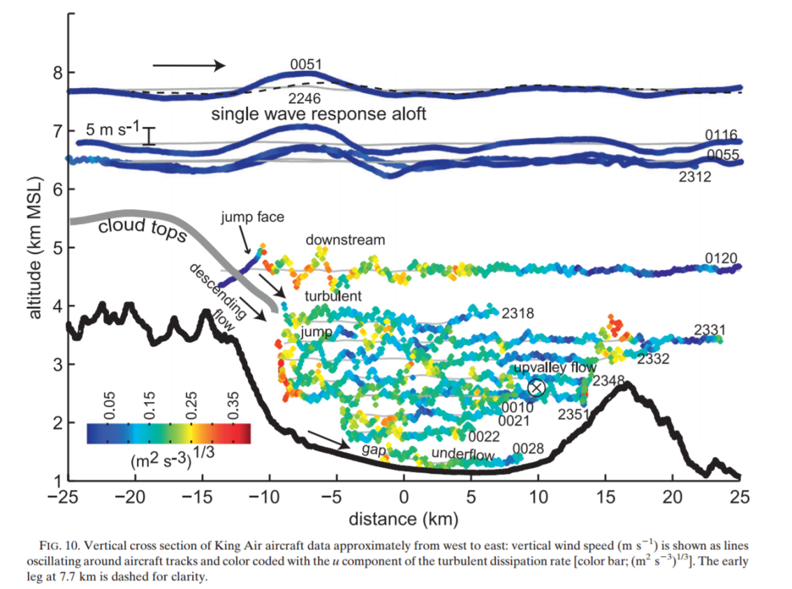
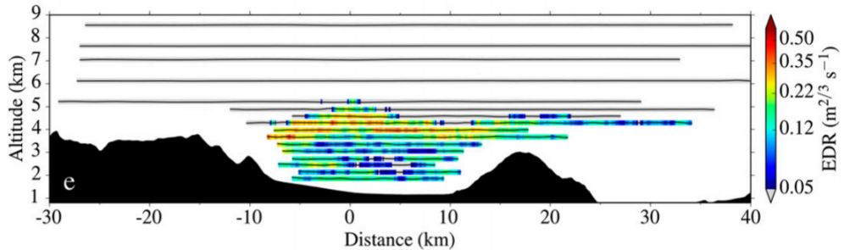
Low-Level Wave Breaking
Wave Breaking / Rotor Regime
Hydraulic Analogue
Strauss et al. (2016)
Armi and Meyer (2011)
Frontiers
  Internal hydraulic jump vs. low-level wave breaking paradigms
  Characteristics of turbulence and relationship to vortex breakdown
Key Questions
  What are the key dynamics and sources of turbulence?
  What is the role of flow through high-level gaps, which are too turbulent to observe?

Slide 10
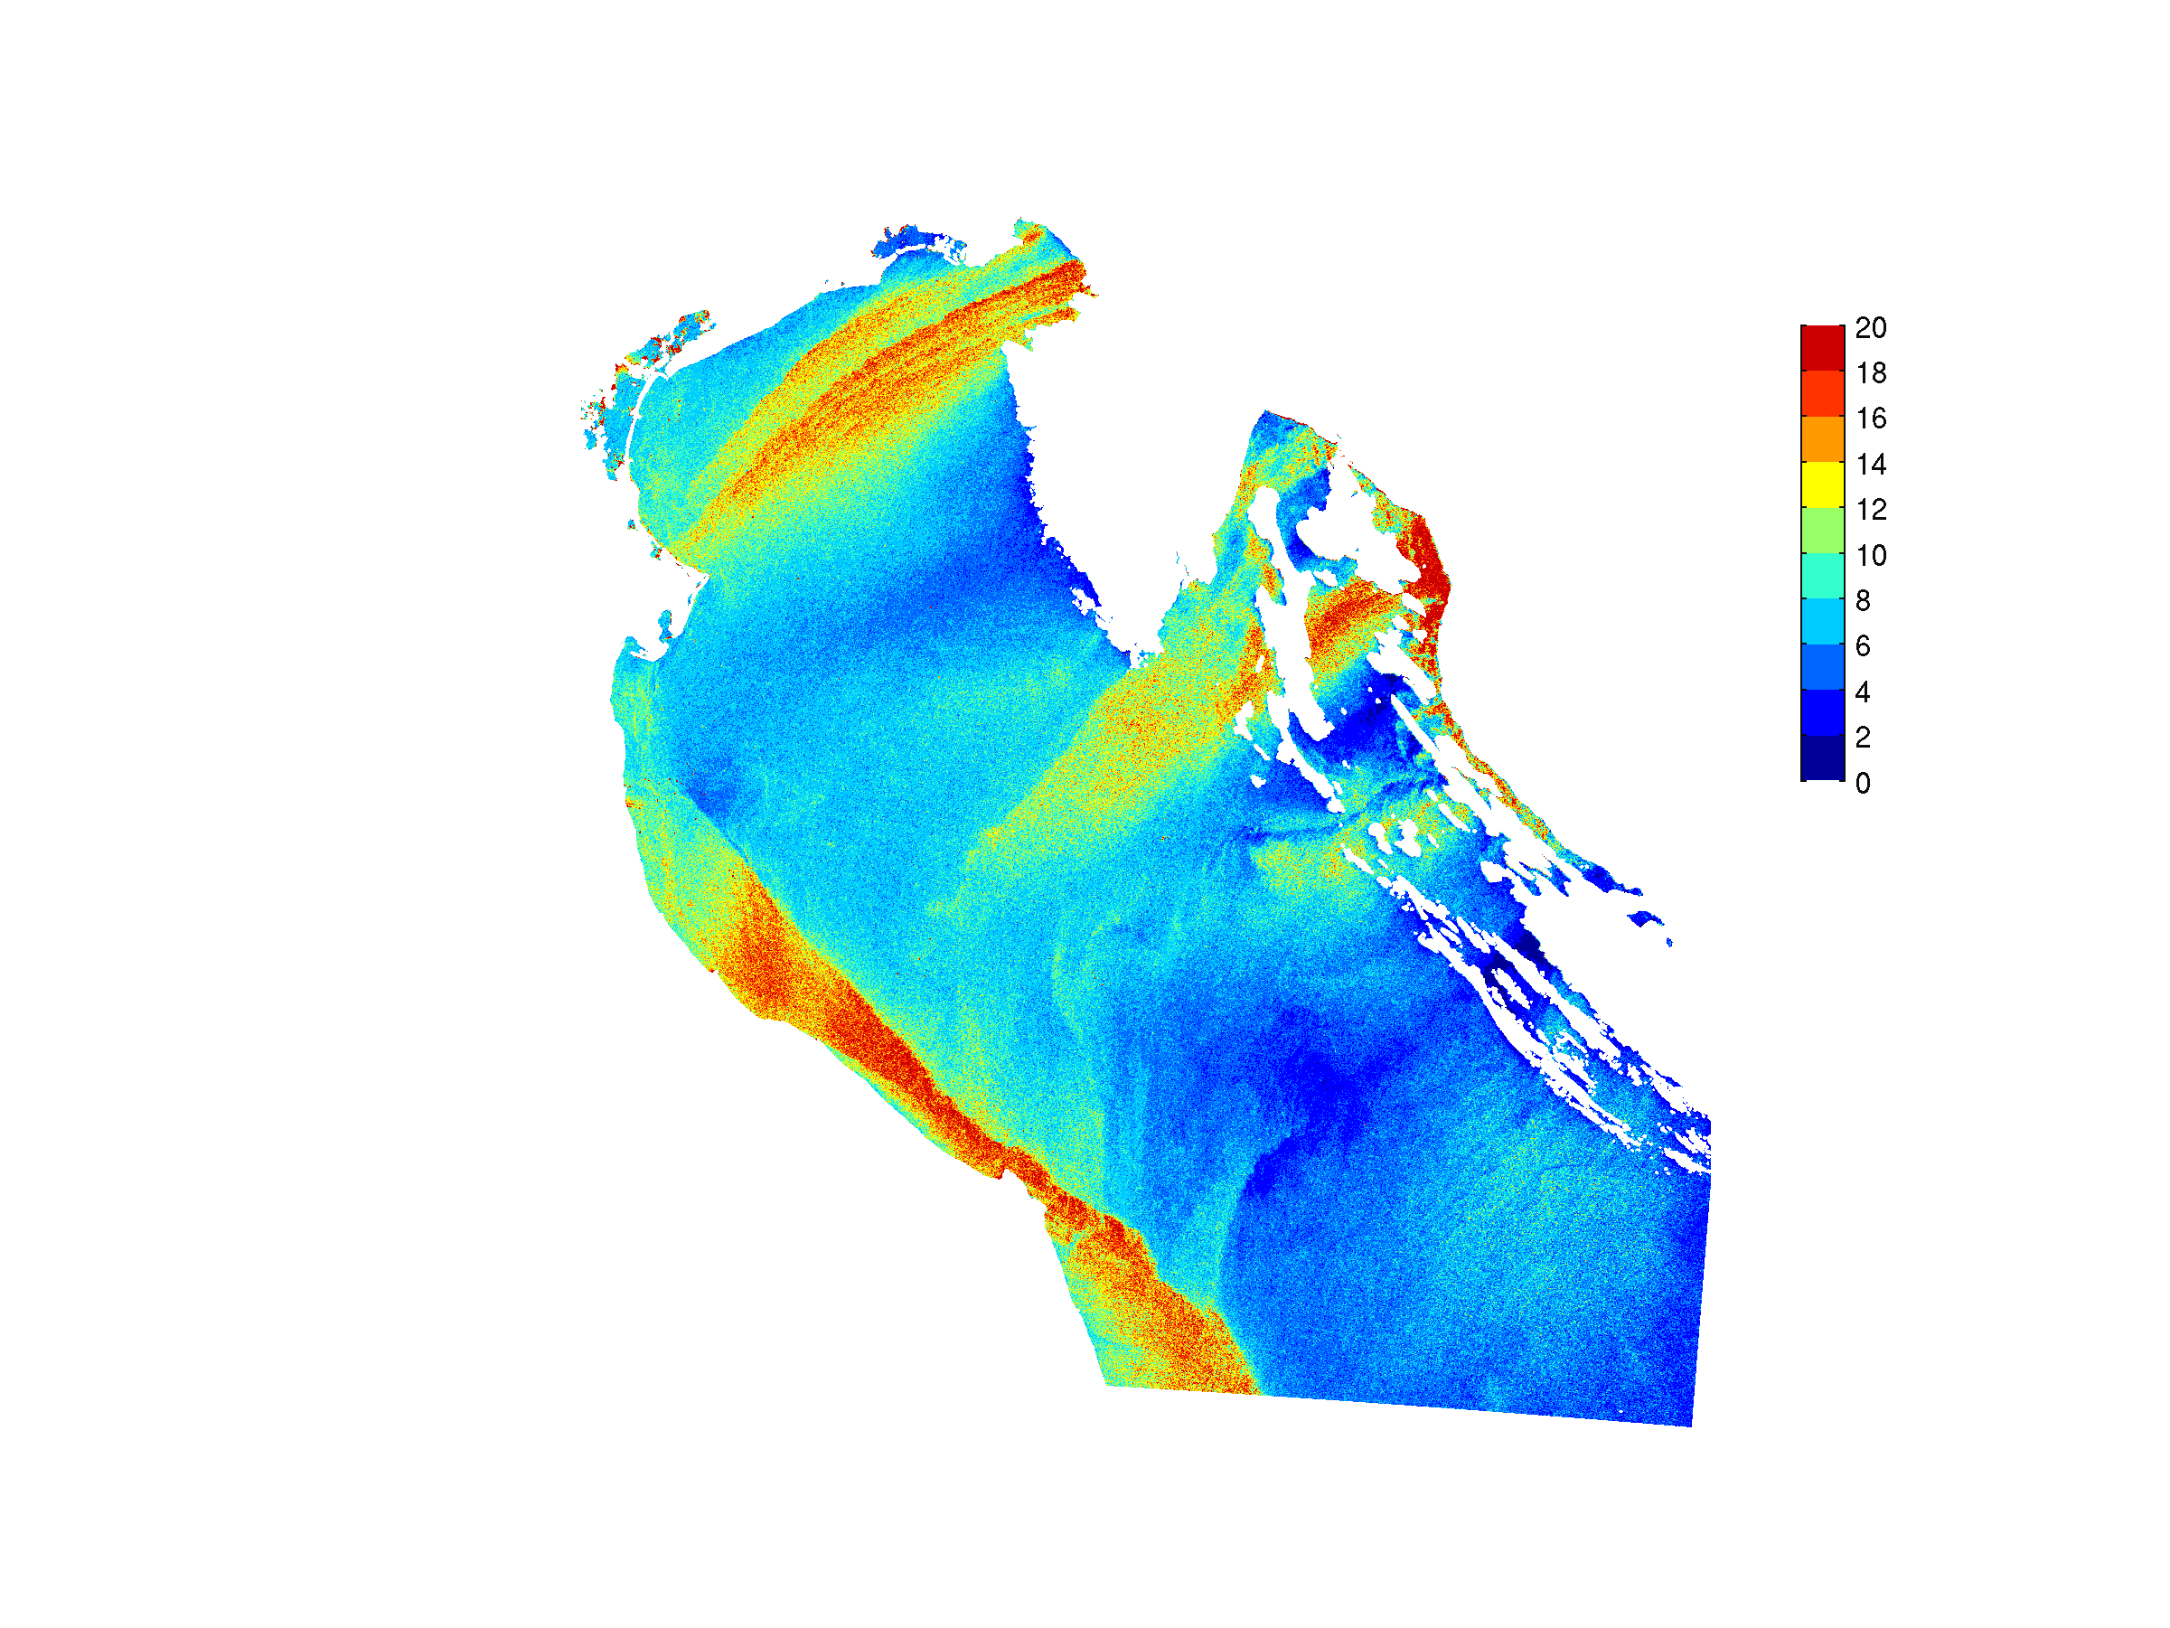
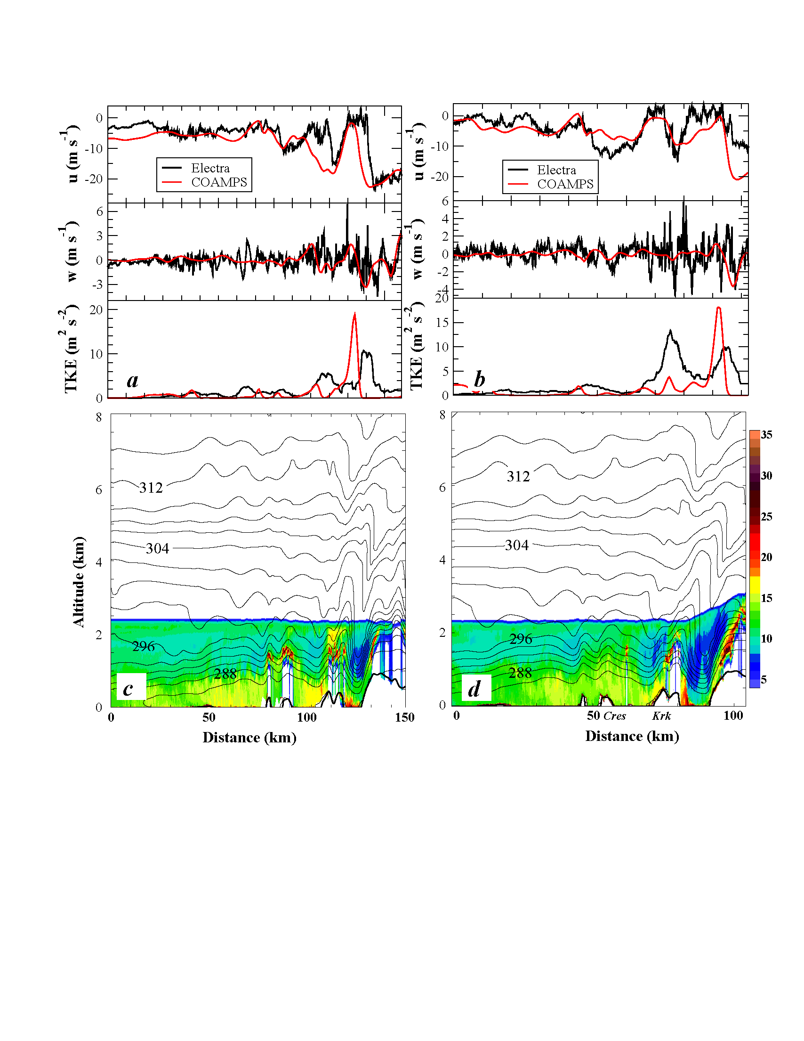
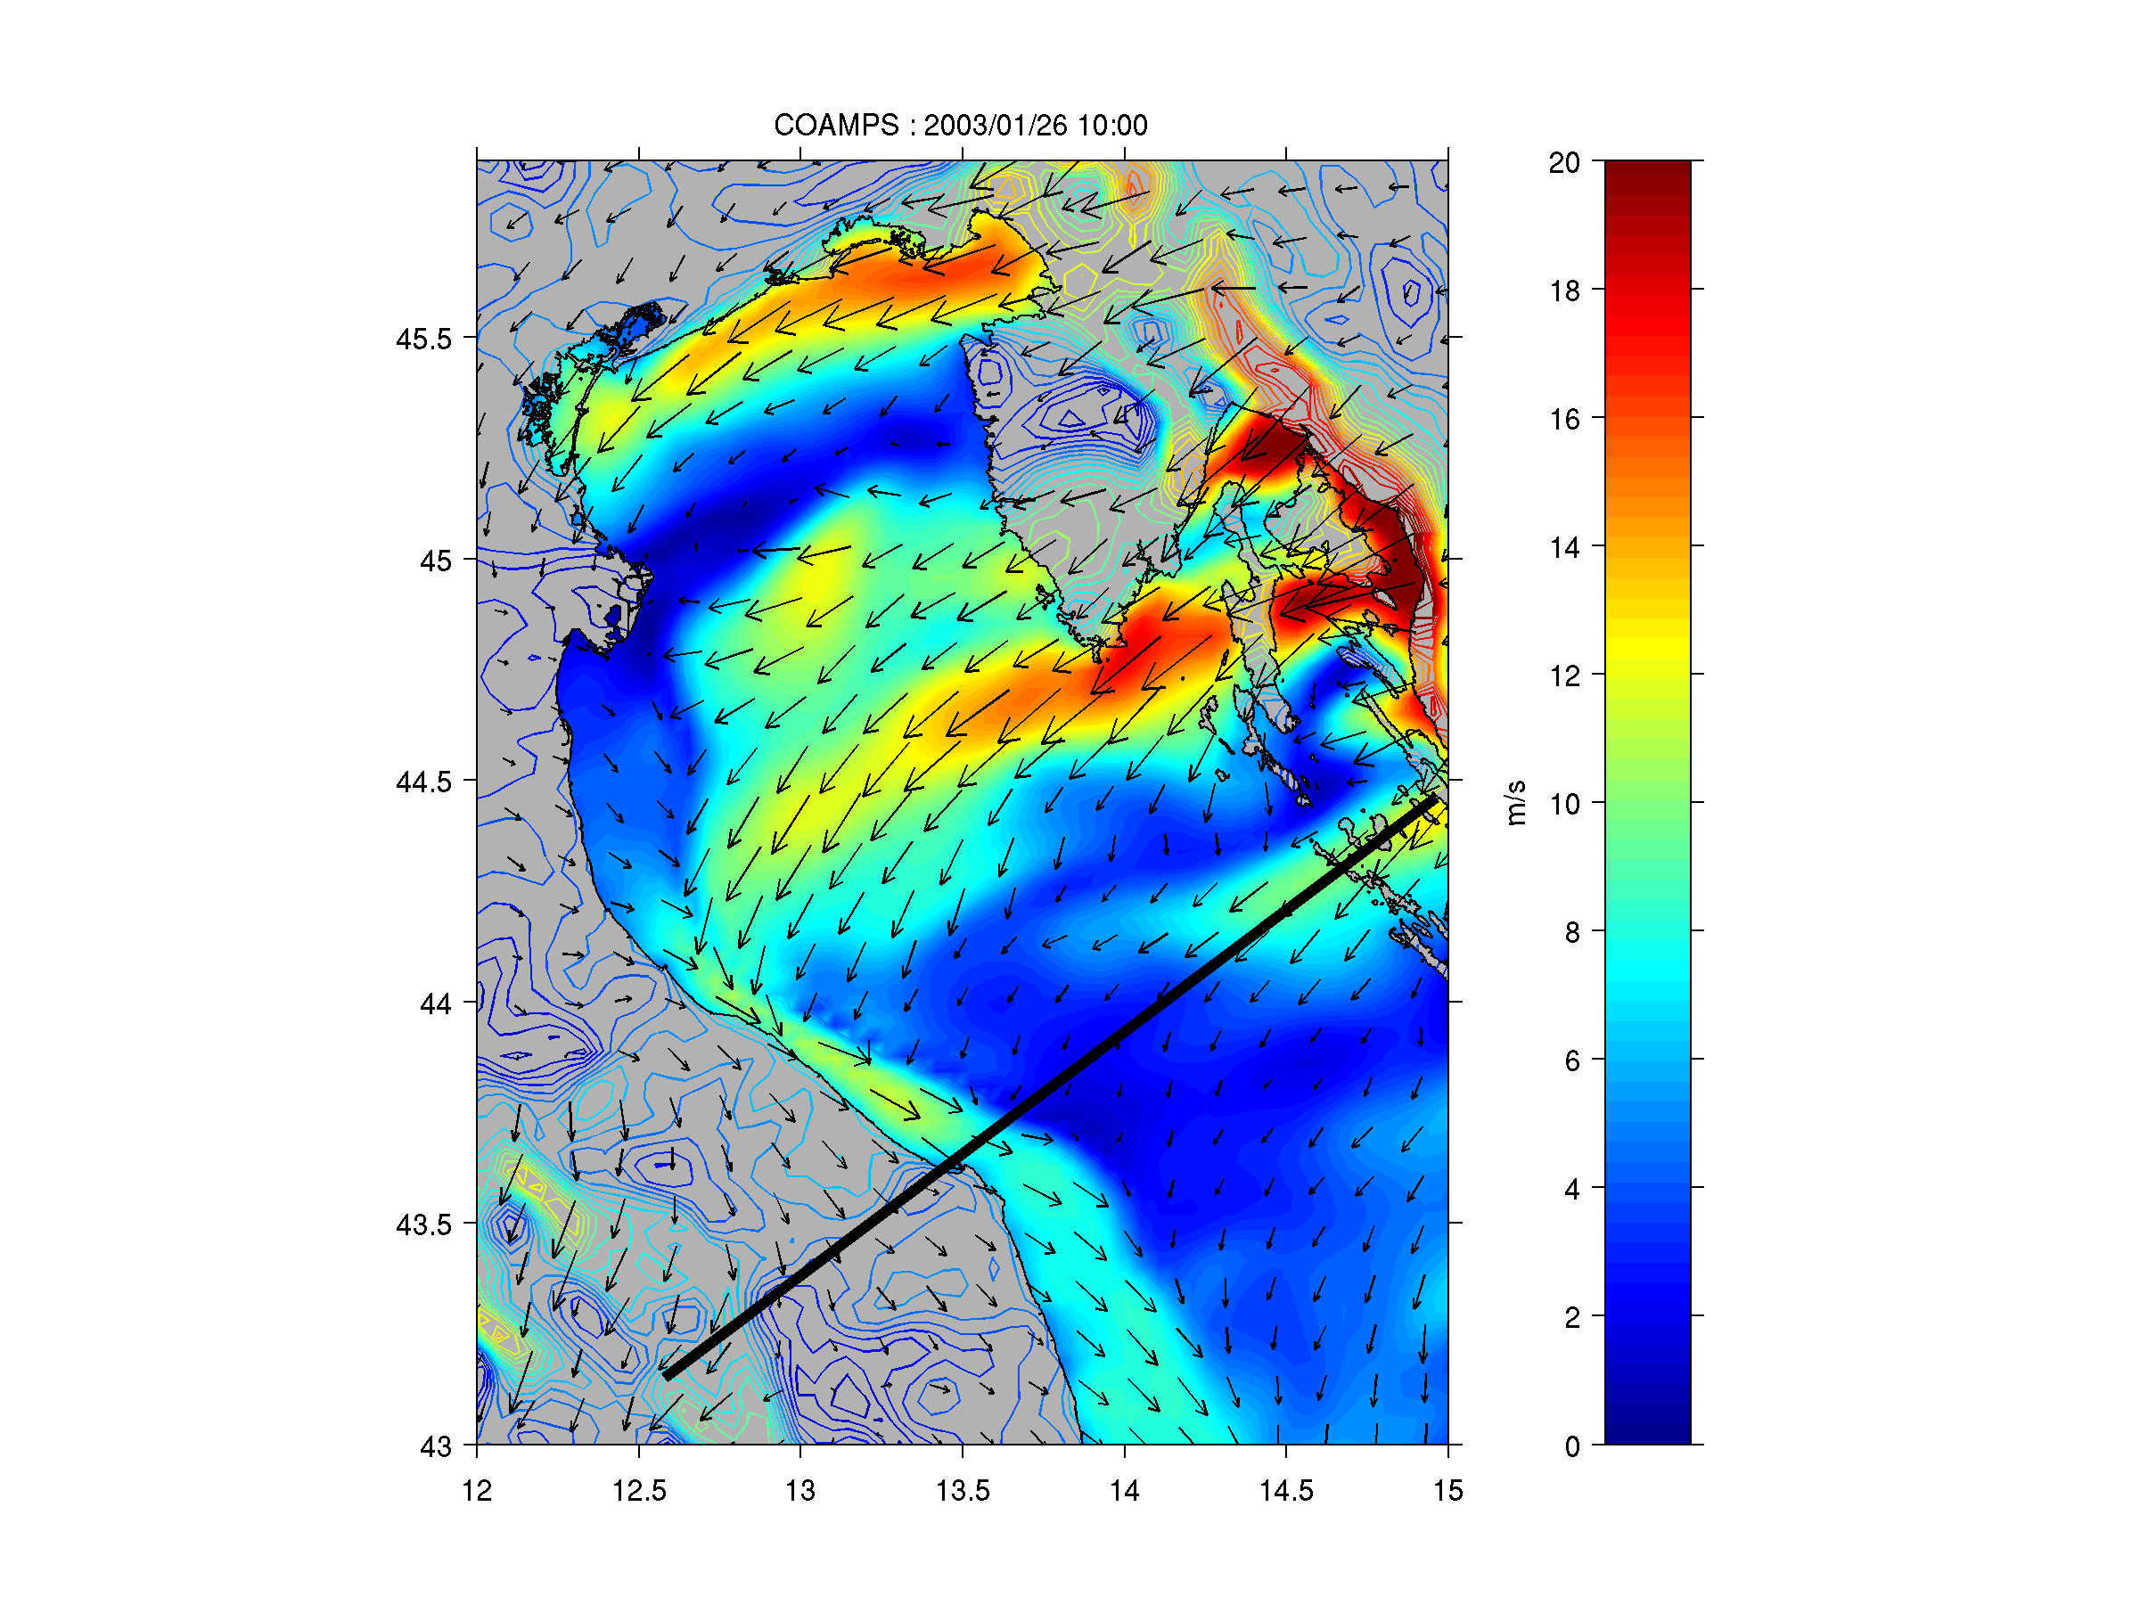
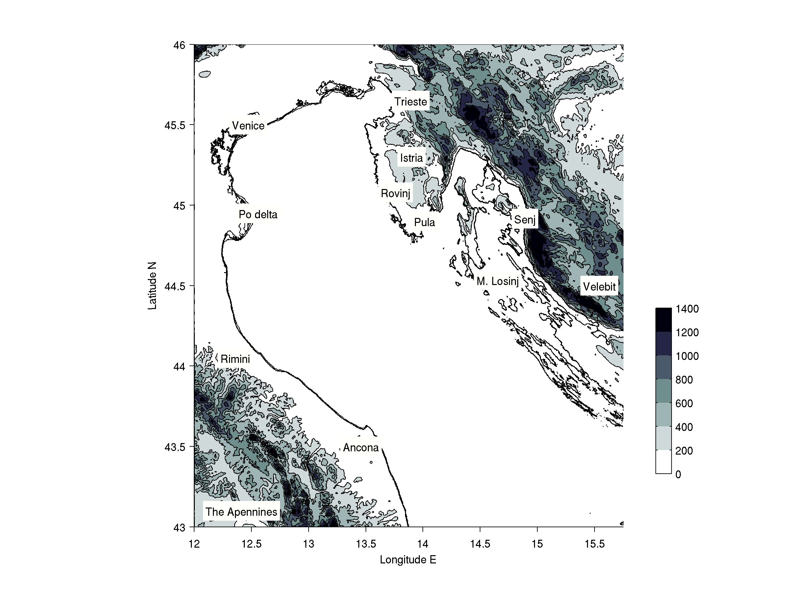
Downslope Windstorms
COAMPS Winds
SAR-Derived Winds
Askari et al. (2006), JGR
Jiang and Doyle (2005), GRL
Frontiers
  Turbulent “shooting flow” in downslope windstorms
  Air-sea interaction and reconnection with marine PBL (models are poor)
Key Questions
  What are the key dynamics and sources of turbulence?
  What is the role of flow through gaps (too turbulent to observe)?
Notes:
1

Slide 11
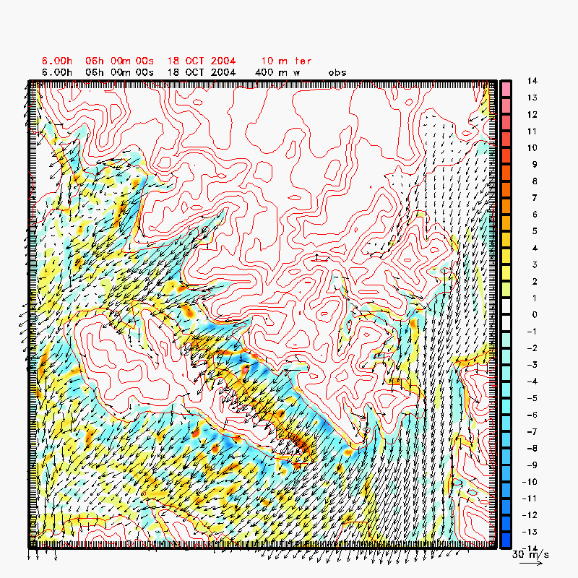
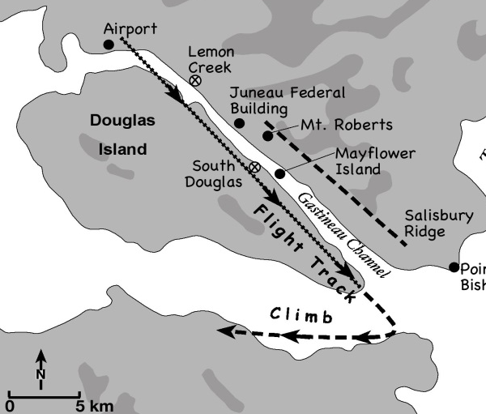
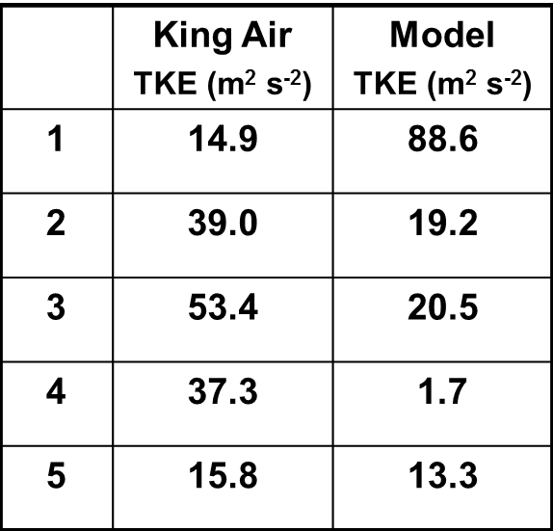
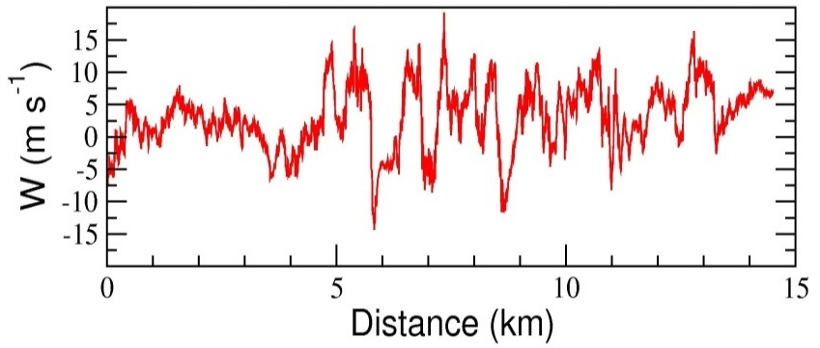
Downslope Windstorms
SARJET (Alaska)
UW KingAir Flight Path
LES Wind and Vertical Velocity at 400 m
(Terrain in Red Contours) Δx=150 m
Bond et al. (2006)
Aircraft Observations of w
Frontiers
  Explicit and LES modeling of wave breaking and secondary wave generation
Key Questions
  What observations are needed of turbulent downslope winds to constrain models?
Notes:
1
When stably stratified air is forced to rise over a topographic barrier, mountain waves are generated and radiate away from the barrier. Mountain waves may be accompanied by severe downslope winds near the surface, occasionally in excess of 50 m s⁻¹, that rapidly decelerate in the lee and flow back toward the mountain as part of an intense circulation. These vortices, known as rotors, can be severe aeronautical hazards due to intense wind shear and have been cited as contributing to numerous aircraft accidents, including occurrences involving modern commercial and military aircraft. The characteristics of mountain waves and rotors forced by three-dimensional topography are investigated through a series of high-resolution real data simulations (150 m horizontal grid increment) with the non-hydrostatic COAMPS© model. The focus of this presentation is on a windstorm that occurred in the mountainous coastal region of Alaska near Juneau. Research aircraft observations show that strong downslope flow was characterized by substantial vertical wind shear and strong up and down vertical motion (in excess of 15 m/s). High data-rate measurements by a research aircraft in the region of vertical shear revealed extreme magnitudes of turbulence, most notably turbulent kinetic energy exceeding 50 m²/s⁻². The high-resolution simulations underscore the importance of the proper representation of topography and the necessity of high-horizontal resolution (150 m in this case). The simulations indicate that the strong region of vertical wind shear appears to be associated with a rotor-like circulation. Eddy resolving simulations using COAMPS, such as the vertical velocity at 400m shown on the right, underscore the aviation hazard potential of these wind shear zones for commercial and military aviation operations particularly helicopter operations. A series of strong eddies are shed off the terrain and trail downstream across the Gastineau Channel.

Slide 12
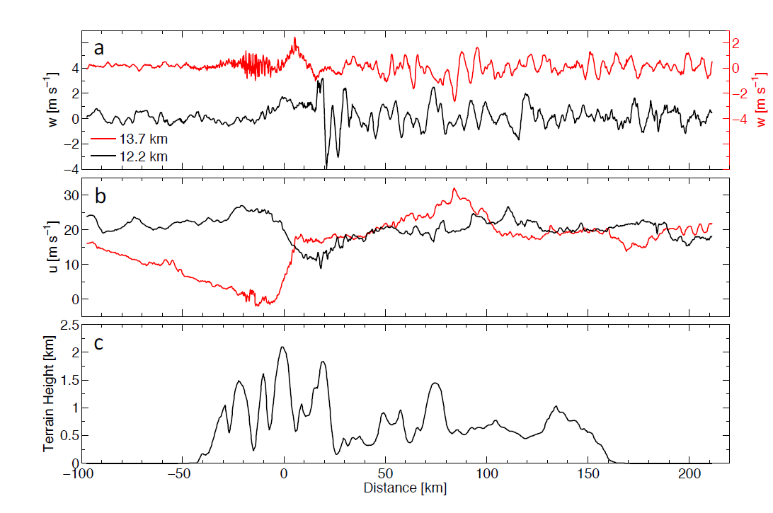
Upper-Level Wave Breaking
DEEPWAVE Wave Breaking (29 June)
FASTEX Wave Breaking
Smith et al. (2016)
Doyle et al. (2005)
Frontiers
  Observe turbulent upper-level wave breaking (and mixing in UTLS)
  Momentum flux diagnostics (including stratosphere - middle atmos.)
  Real world complex flows (cyclones with time-dependent forcing)
Key Questions
  What are fine-scale (spectral) characteristics of wave breaking?
  How does the momentum flux depend on the turbulence evolution?

Slide 13
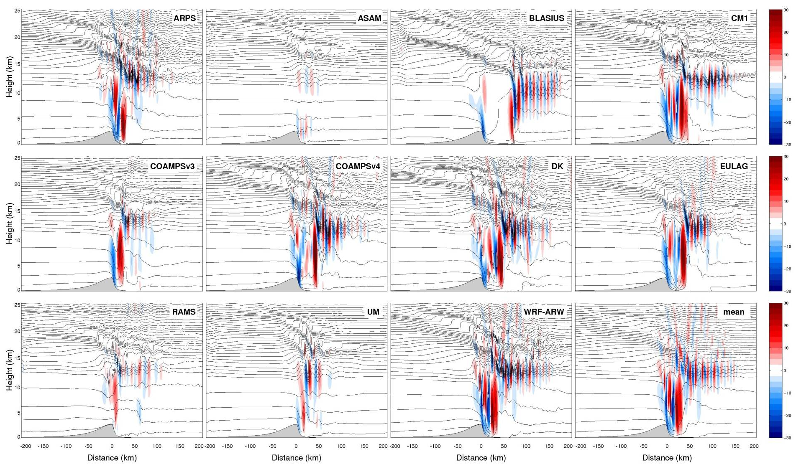
Upper-Level Wave Breaking
Model Intercomparison of Wave Breaking [w (m s⁻¹)]
Doyle et al. (2011)
Frontiers
  Explicit and LES modeling of wave breaking and secondary wave generation
  Models still disagree radically for relatively simple problems
Key Questions
  What obs. of wave breaking are needed to constrain models/parameterizations?

Slide 14
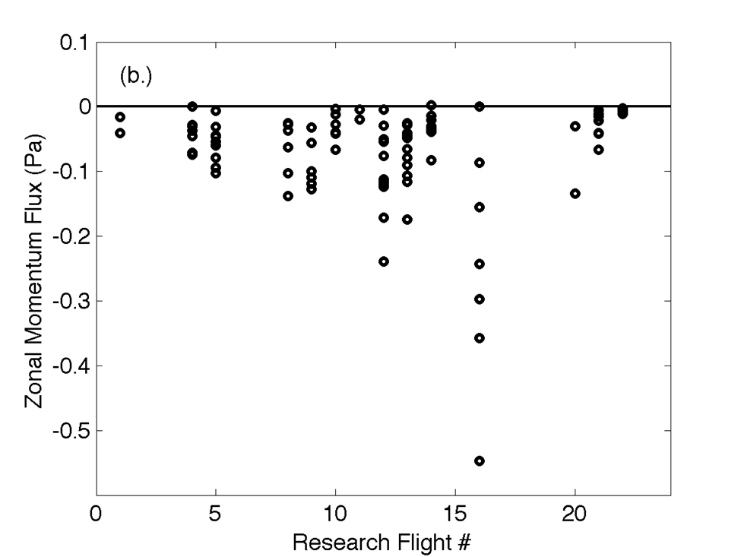
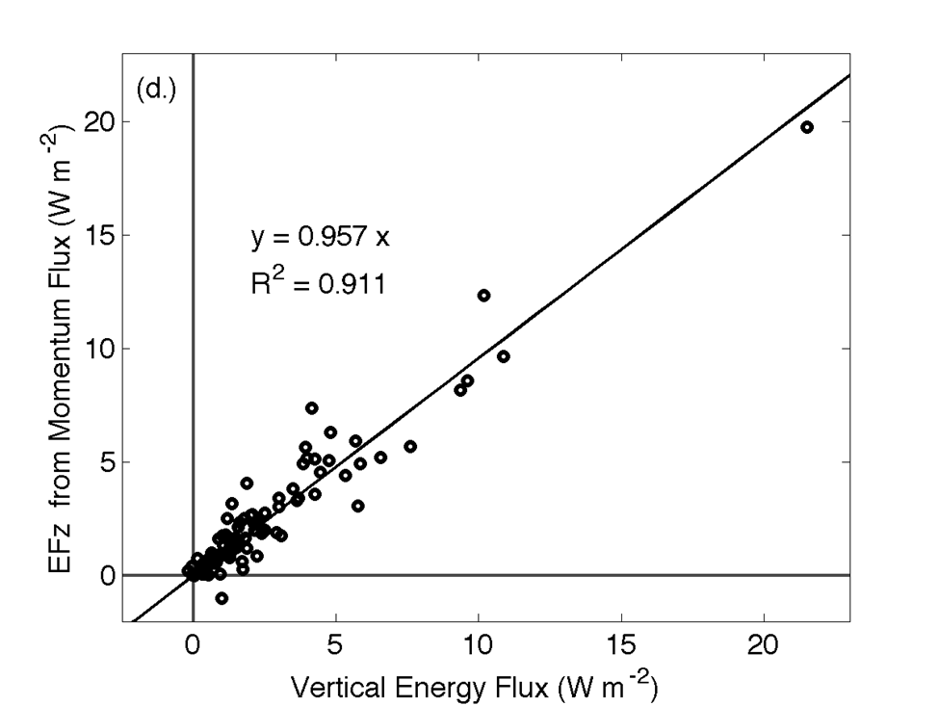
Mountain Waves and Fluxes
DEEPWAVE G-V Zonal Momentum Fluxes
<ρp’u’> (<0 for upward prop. waves)
Eliassen-Palm Relationship
EFz = -U·MF =EFzM
(Eliassen-Palm 1960)
Smith et al. 2016 (JAS)
Frontiers
  Observing needs: Differential GPS needed for accurate fluxes; long aircraft legs needed
  Momentum fluxes under varying conditions (terrain, large-scale flow)
  Gravity wave drag parameterizations are still poor (models extremely sensitive)
Key Questions
  What causes the variability in momentum fluxes?
  How can we obtain obs. of wave breaking to constrain models/parameterizations?

Slide 15
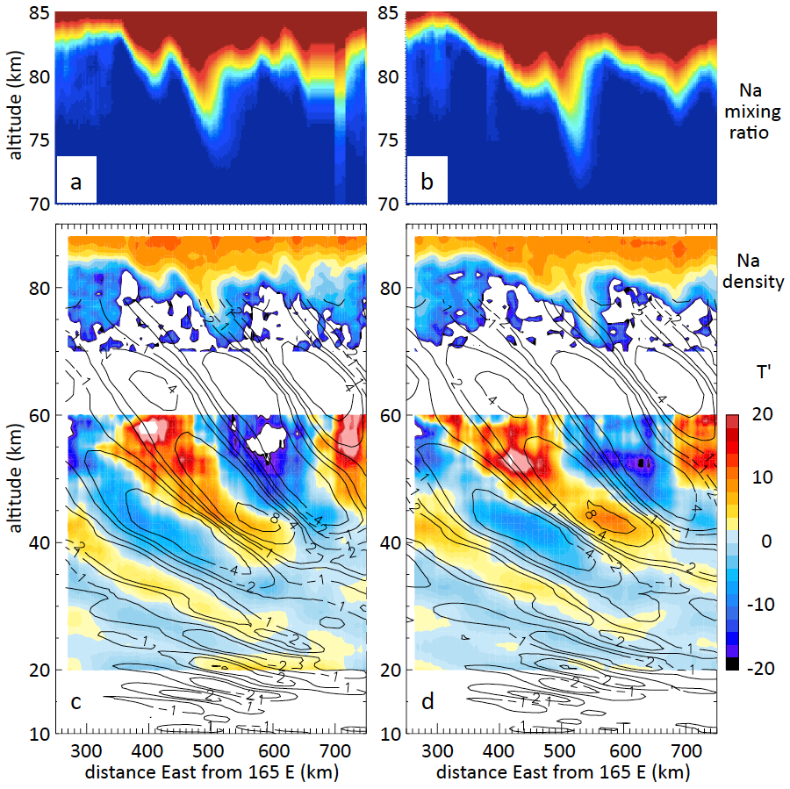
Upper-Level Wave Breaking
Rayleigh Lidar Na Density
Rayleigh Lidar T’ (color)
ECMWF T’ (contours)
Fritts et al. 2016
(BAMS)
Frontiers
  Observations of upper-level (mesosphere-lower thermosphere) of wave breaking
Key Questions
  What are the wave characteristics that propagate to deep altitudes?
  What are the momentum flux characteristics?

Slide 16
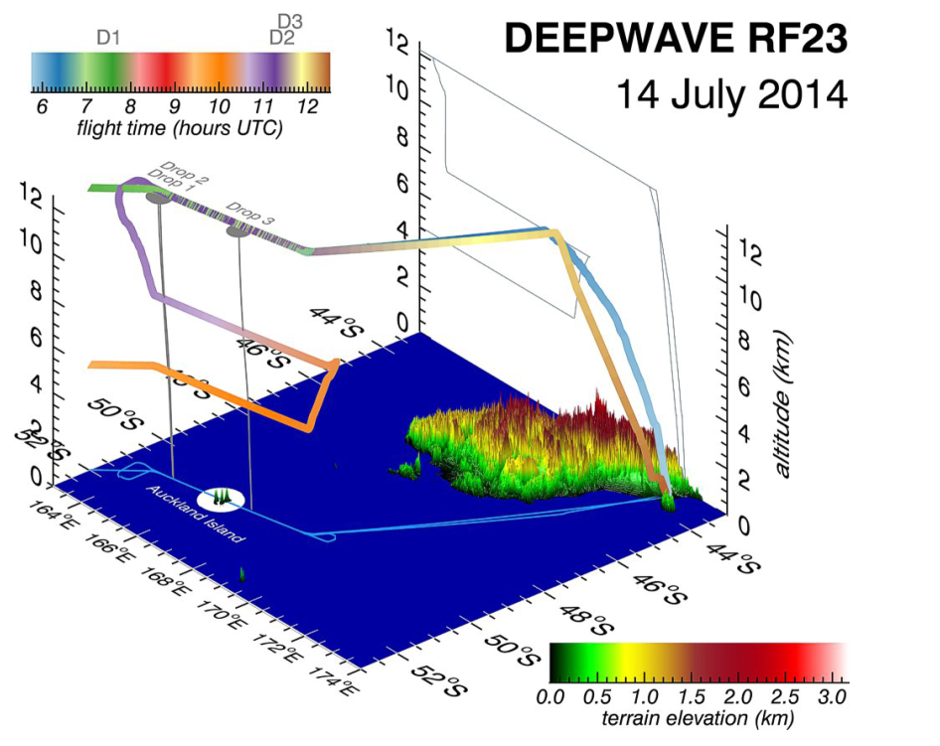
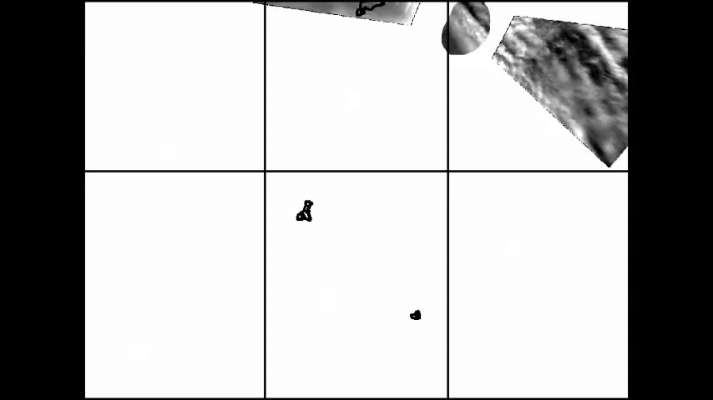
Upper-Level Wave Breaking
DEEPWAVE G-V Flight Over
Auckland Island
G-V AMTM Observations (~87 km)
Eckermann et al. (2016)
Pautet et al. 2015 (JGR)
Frontiers
  Growing evidence that gravity waves generated by small islands are important contributors to momentum fluxes and missing from GCMs (Alexander et al. 2009)
Key Questions
  What are the wave characteristics that propagate to deep altitudes?
  What are the momentum flux characteristics?

Slide 17
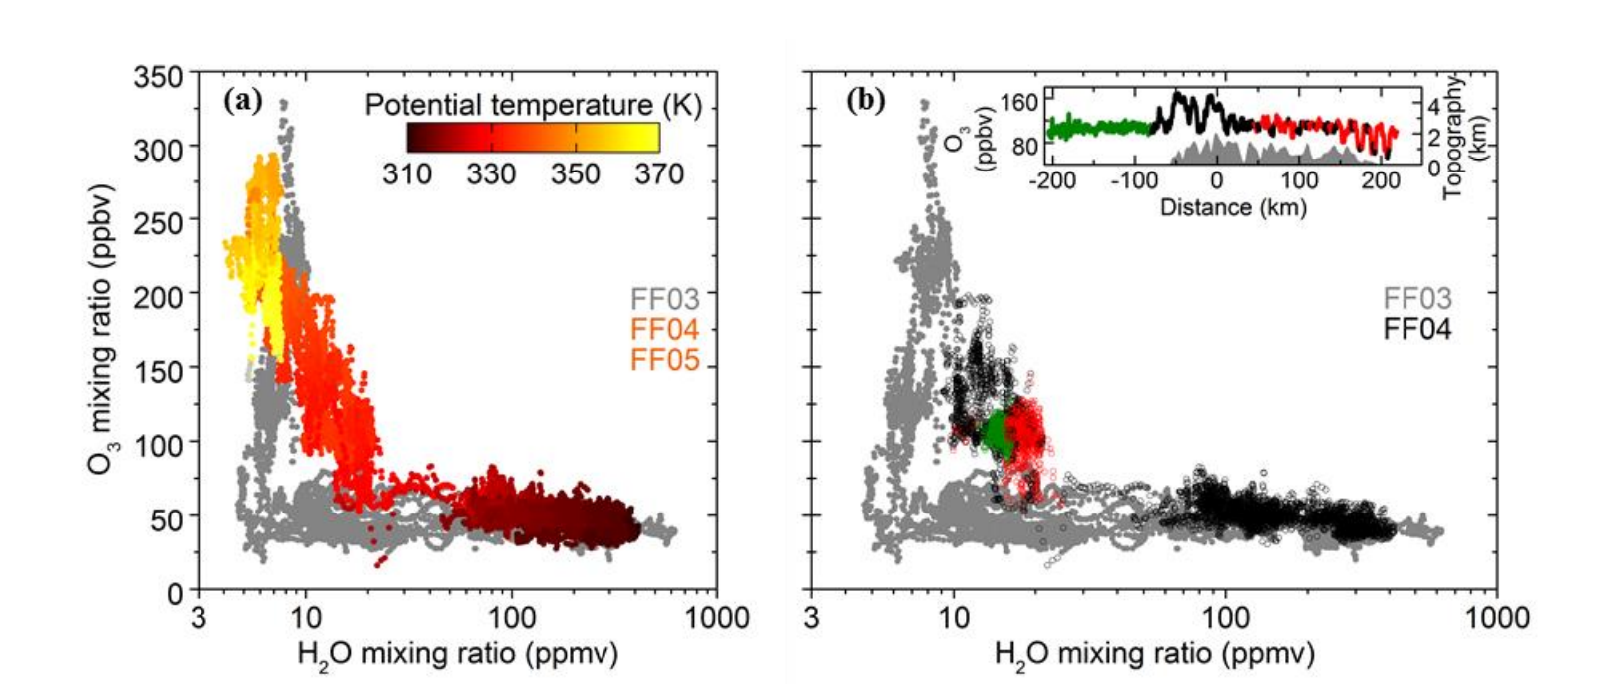
Upper-Level Wave Breaking
DEEPWAVE DLR Falcon Flights
O₃ vs. H₂O Mixing Ratio in Upper Troposphere/Lower Stratosphere
Heller et al. 2017
Frontiers
  UTLS mixing due to gravity waves and wave breaking
Key Questions
  What are the turbulence characteristics important for mixing in the UTLS region?

Slide 18
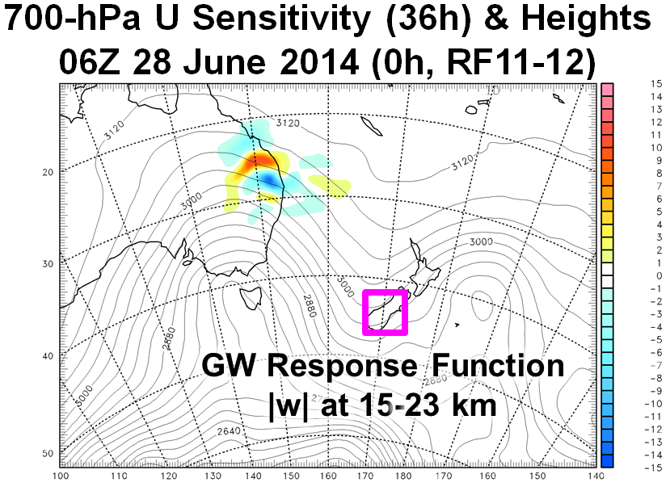
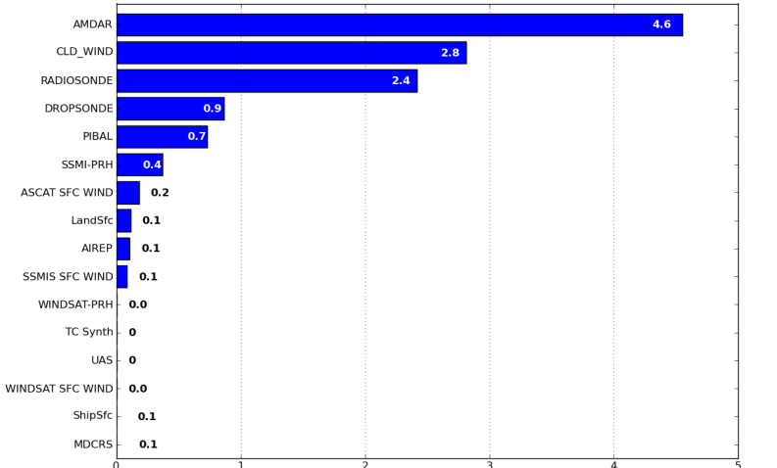
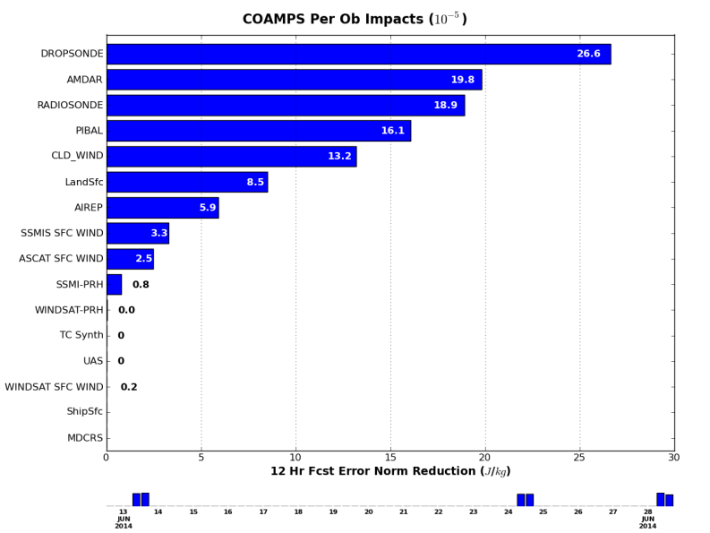
Observations Impact on Mountain Wave Launching
Total Impact
AMDAR
Sat. Winds
Radiosonde
Dropsonde
12 h Forecast Error Norm Reduction (J/kg)
Impact (Per Observation)
Dropsonde
AMDAR
Radiosonde
PIBAL
Sat. Winds
Adjoint (model+DA) observation impact on 12-h forecasts during DEEPWAVE.
Targeted dropsondes have the largest impact on a per observation basis.
Adjoint shows large impact of remote upstream regions of q (especially) and t, u
12 h Forecast Error Norm Reduction (J/kg)
C. Amerault

Slide 19
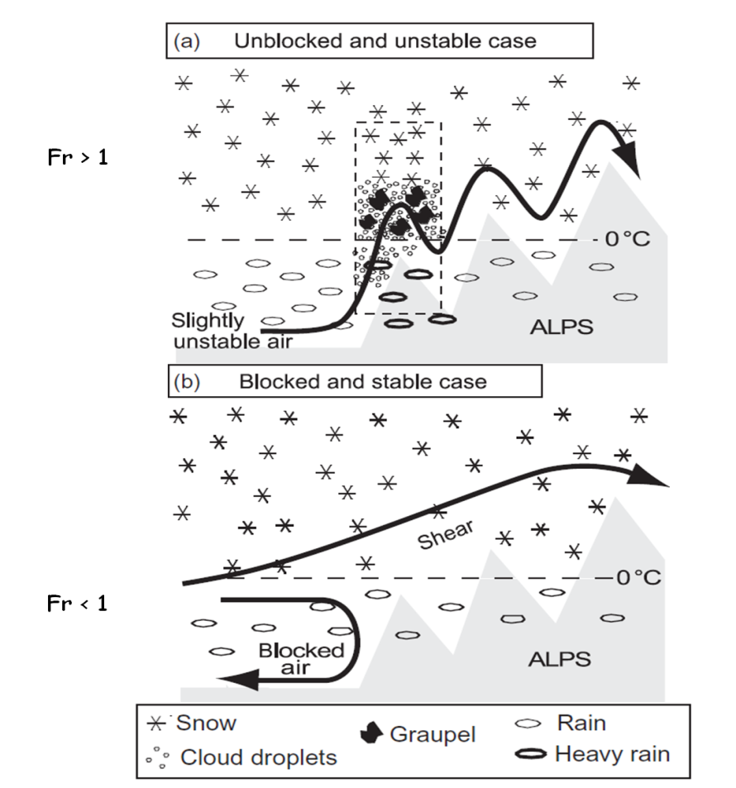
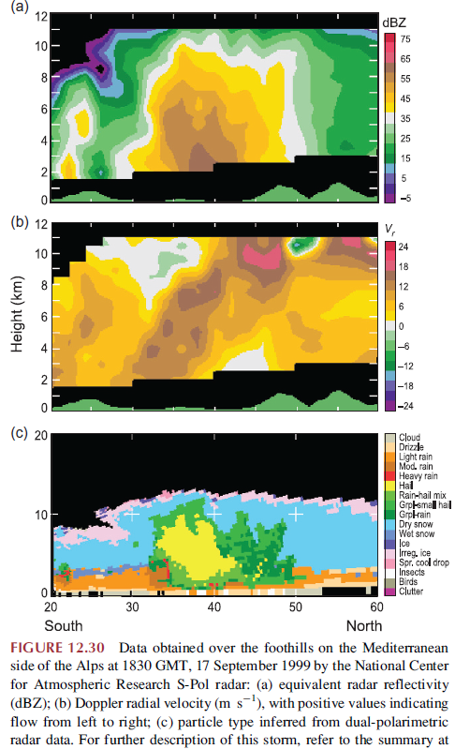
Blocked Moist Flow
Rotunno and Houze (2007)
Seity et al. (2003)
Frontiers
  Turbulence generated by terrain-induced blocking and microphysical processes
Key Questions
  How does blocking and shear modulate the orographic precipitation?

Slide 20
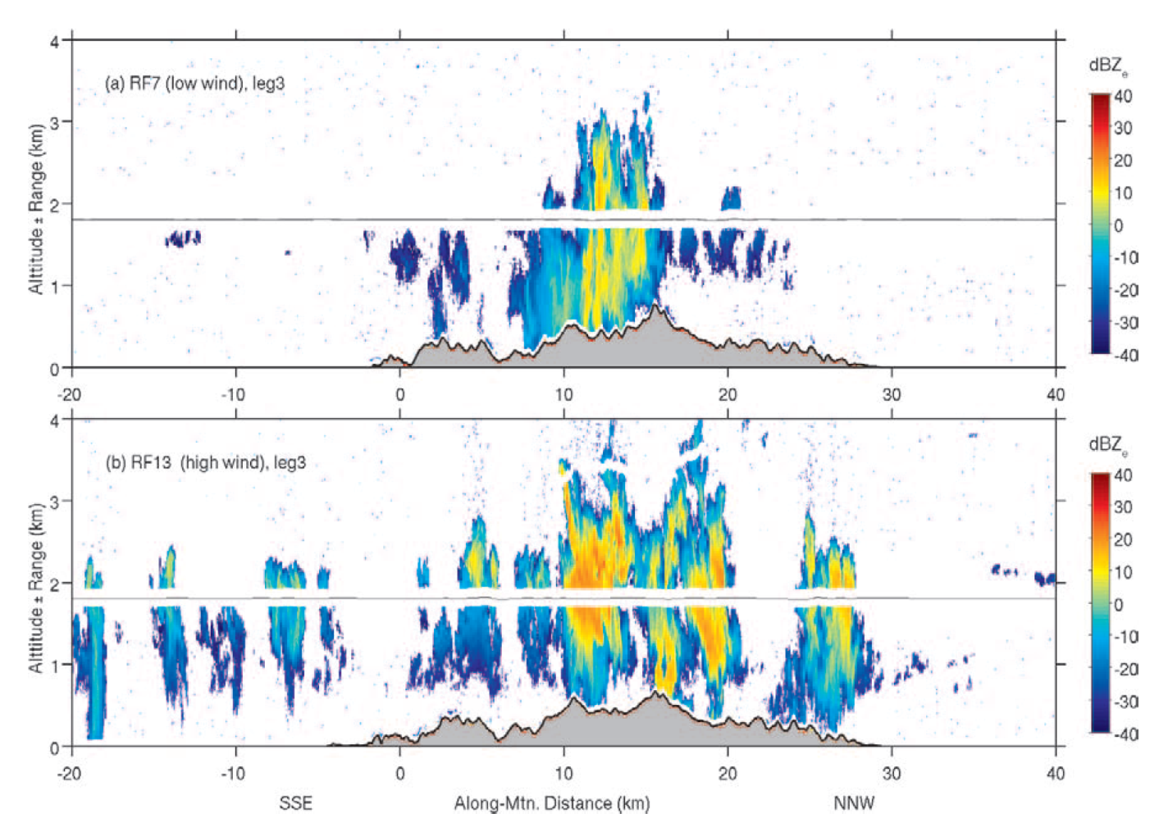
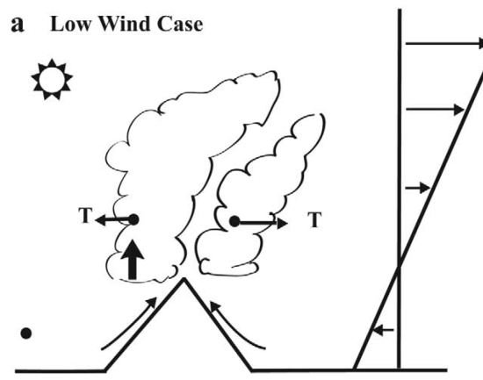
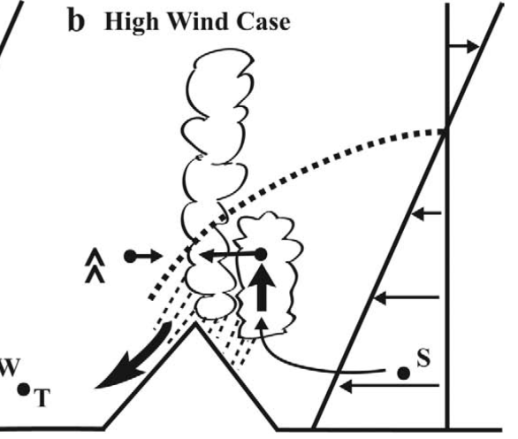
Terrain-Induced Convection
Diurnally-Forced Thermal Convection
(low wind)
Mechanically-Forced Convection
(High wind)
Smith et al. (2012)
Frontiers
  Mechanical convection over small scale terrain, and generation of clear air turbulence
Key Questions
  What are the key processes governing mechanically-driven convection and associated turbulence?

Slide 21
Mountain Winds, Waves,
and Turbulence Summary
Improved understanding and modeling of mountain waves, winds, breaking are needed, particularly bridging the gap between theory and the real world
Theory builds on simple flows and terrain with no or simple PBLs & turbulence
Model parameterizations for gravity wave drag are known to be deficient and highly tuned. Significant source of model biases in weather/climate models.
Observational Gaps (e.g., characteristics, spectra, time dependence, mixing)
  Mountain PBL: strongly modulates gravity wave launching
  Multi-scale (dynamics and predictability studies): Atmospheric profiles upstream, over, downstream of terrain (time continuity)
    Wave breaking and turbulence (low-levels to UTLS to MLT)
    Rotors, subrotors, shear instabilities, rotor clouds
    Downslope windstorms / “shooting flow”, vortex sheet, separation pts
    Wide/narrow gap flows and airflow through passes
    Accurate u’, v’, w’, p’ for flux calculations (need long aircraft legs)
    Turbulence in moist flows: i) important for precipitation, ii) caused by terrain-forced convection

