Slide 1
AMS Performance at DC3-Test
Some preliminary results
Pedro Campuzano Jost, Douglas Day, Michael Lechner, Jose Luis Jimenez

Slide 2
Overview
Instrument was in working order for all six flights. Data was acquired for >95% of flight time (the rest being filters and software mode switches).
Real time data was exported for all six flights to the G-V data system. After some minor software fixes, starting with RF03 the stream was fully functional
Topics
Inlet characterization: Still loose ends, but basic performance seems acceptable
UHSAS comparison
Stratospheric/UT aerosol measurements in clean air and after deep convection: AMS detection limit
Sampling of polluted air thru clouds: AMS time resolution
Size and chemical characterization of organics: brief case study

Slide 3
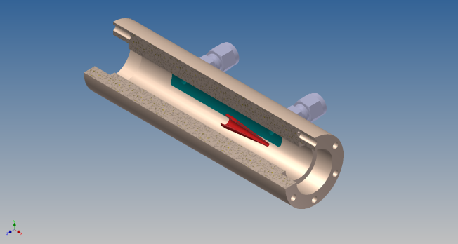
Inlet
A new secondary diffuser was build for improved sampling of larger particles. At the same time, small modifications were performed on the pressure controlled inlet (PCI) system to make it work all the way to 50.000 ft
The transmission of the PCI showed little changes in transmission over a wide range of inlet flows, being close to 100% for submicron aerosol
To characterize the transmission of the inlet system up to the AMS, the following was investigated:
Flow into the system under “free flow” conditions. Is the diffuser working? Is the pressure drop sufficient despite the filters to run the inlet?
Comparison of concentrations and size distributions for free flow and “choked” flow thru rapid switches
Comparison with calculated inlet transmissions
Comparison with the UHSAS (RF02 and 03)

Slide 4
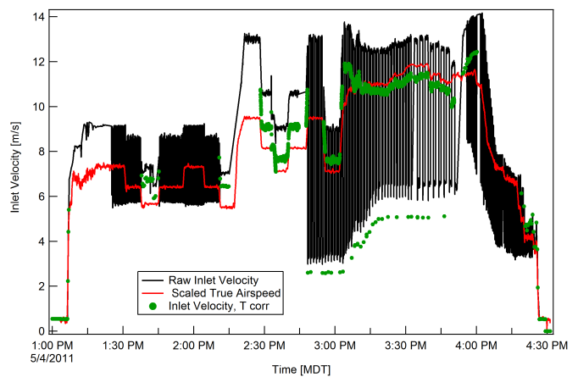
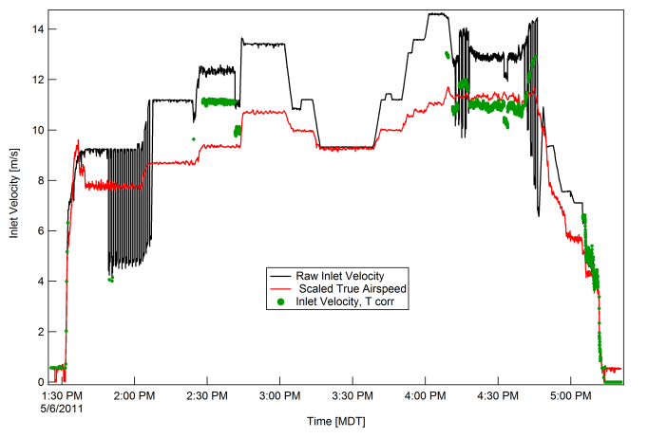
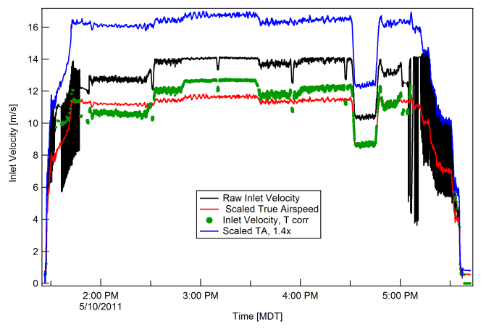
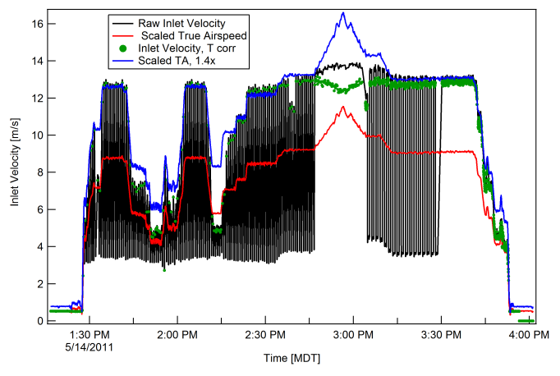
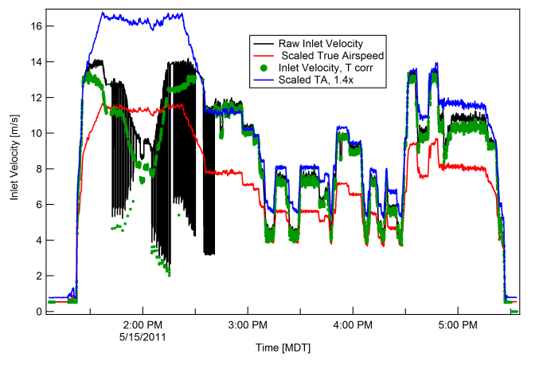
Aircraft Speed vs Inlet Velocity, “free flow” conditions
Red: Scaled Airspeed
Black: Cabin flow speed
Green: Corrected inlet speed, free flow
Blue: Scaled airspeed x 1.4
RF01
RF02
RF03
RF04
RF05
RF06

Slide 5
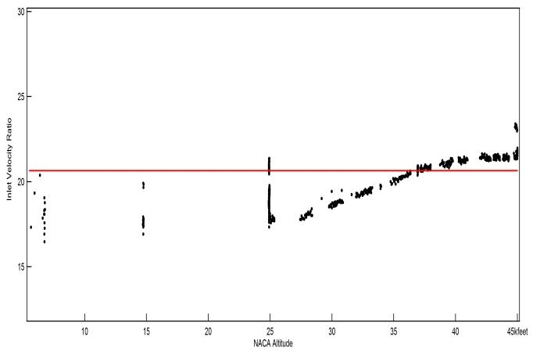
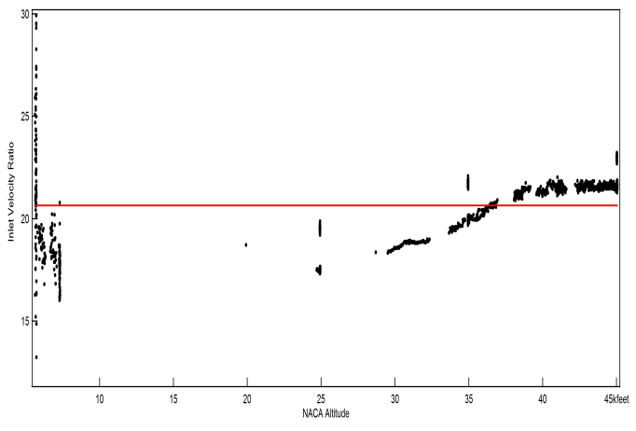
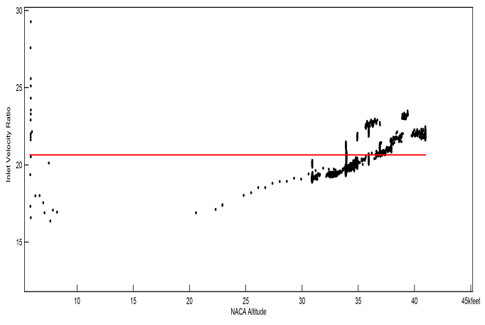
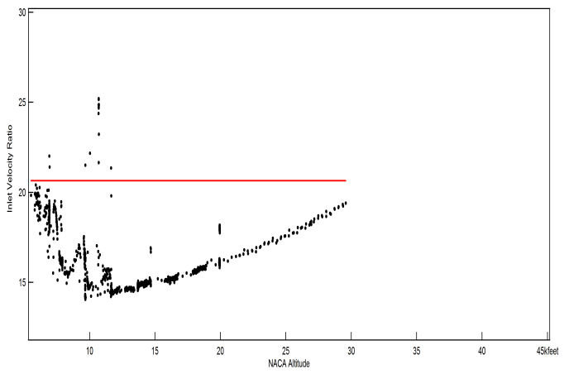
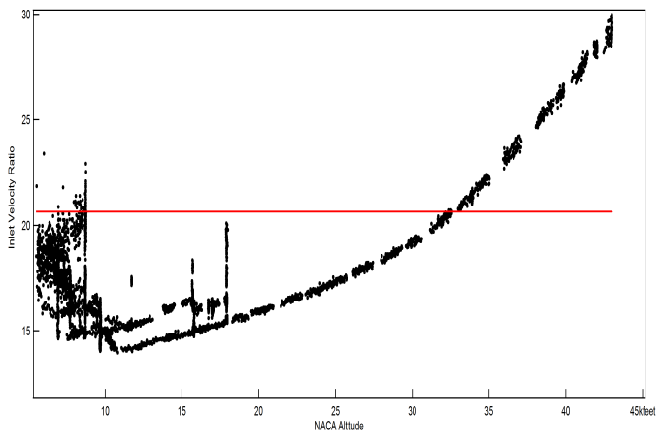
Aircraft Speed/Inlet Velocity vs Height, “free flow” conditions (actual ratios)
Red Line: “Ideal ratio”. Bottom range: 5 -45 kft
RF01
RF02
RF03
RF04
RF05
RF06

Slide 6
Varying Inlet speeds (free, /2, /4) during RF05: Nitrate

Slide 7
Varying Inlet speeds (free, /2, /4) during RF05: Sulfate
Only for low to midheights! Testing during RF06 for >40 kft showed the same (s.b.)

Slide 8
Chemically Resolved Size Distributions during the switching

Slide 9
Size Distributions during the switch (averages)

Slide 10
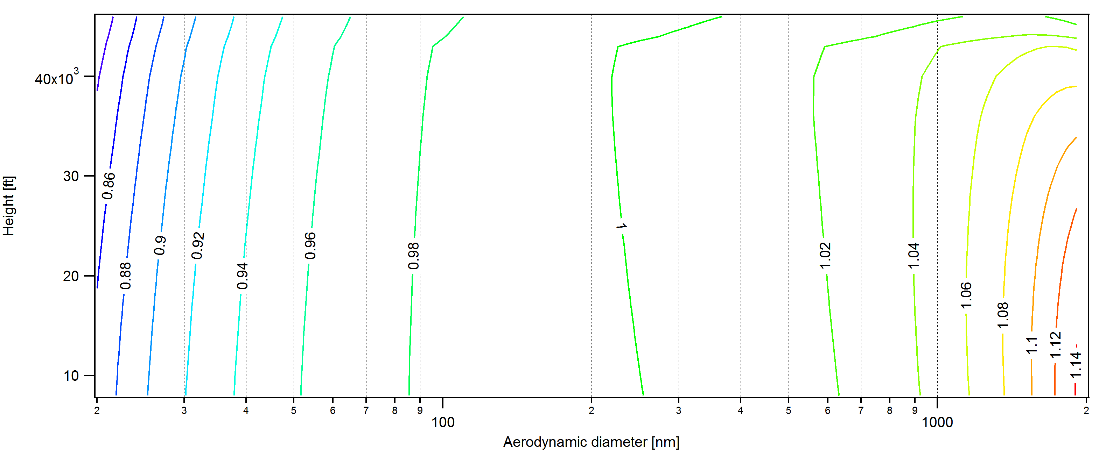
Calculated trasmission(line only)
“Free flow”
“Free Flow”/2

Slide 11
UHSAS comparison, RF02
Filter

Slide 12
UHSAS Comparison, RF03

Slide 13
Altitude Profiles (RF01, RF03)

Slide 14
Altitude Profiles (RF05, RF06)

Slide 15
Stratosphere/UT aerosol loadings
This is a switched dataset!

Slide 16
Typical AMS Detection Limits

Slide 17
AMS Response to fast changing conditions Missed Approaches I: COS

Slide 18
Missed Approaches I: COS (detail)

Slide 19
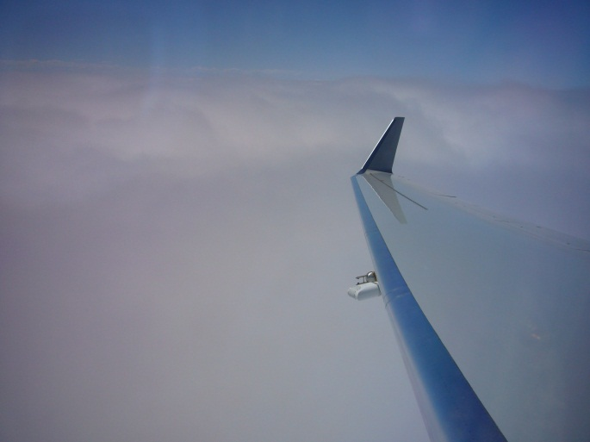
Speeding thru clouds on the way to COS (10 kft)…

Slide 20
Missed Approaches II: BJC
Cloud base higher than COS, hence no sharp transitions as seen there.
The “sulfate mystery spike” still shows up here, though

Slide 21
Speciated Mass Size Distributions

Slide 22
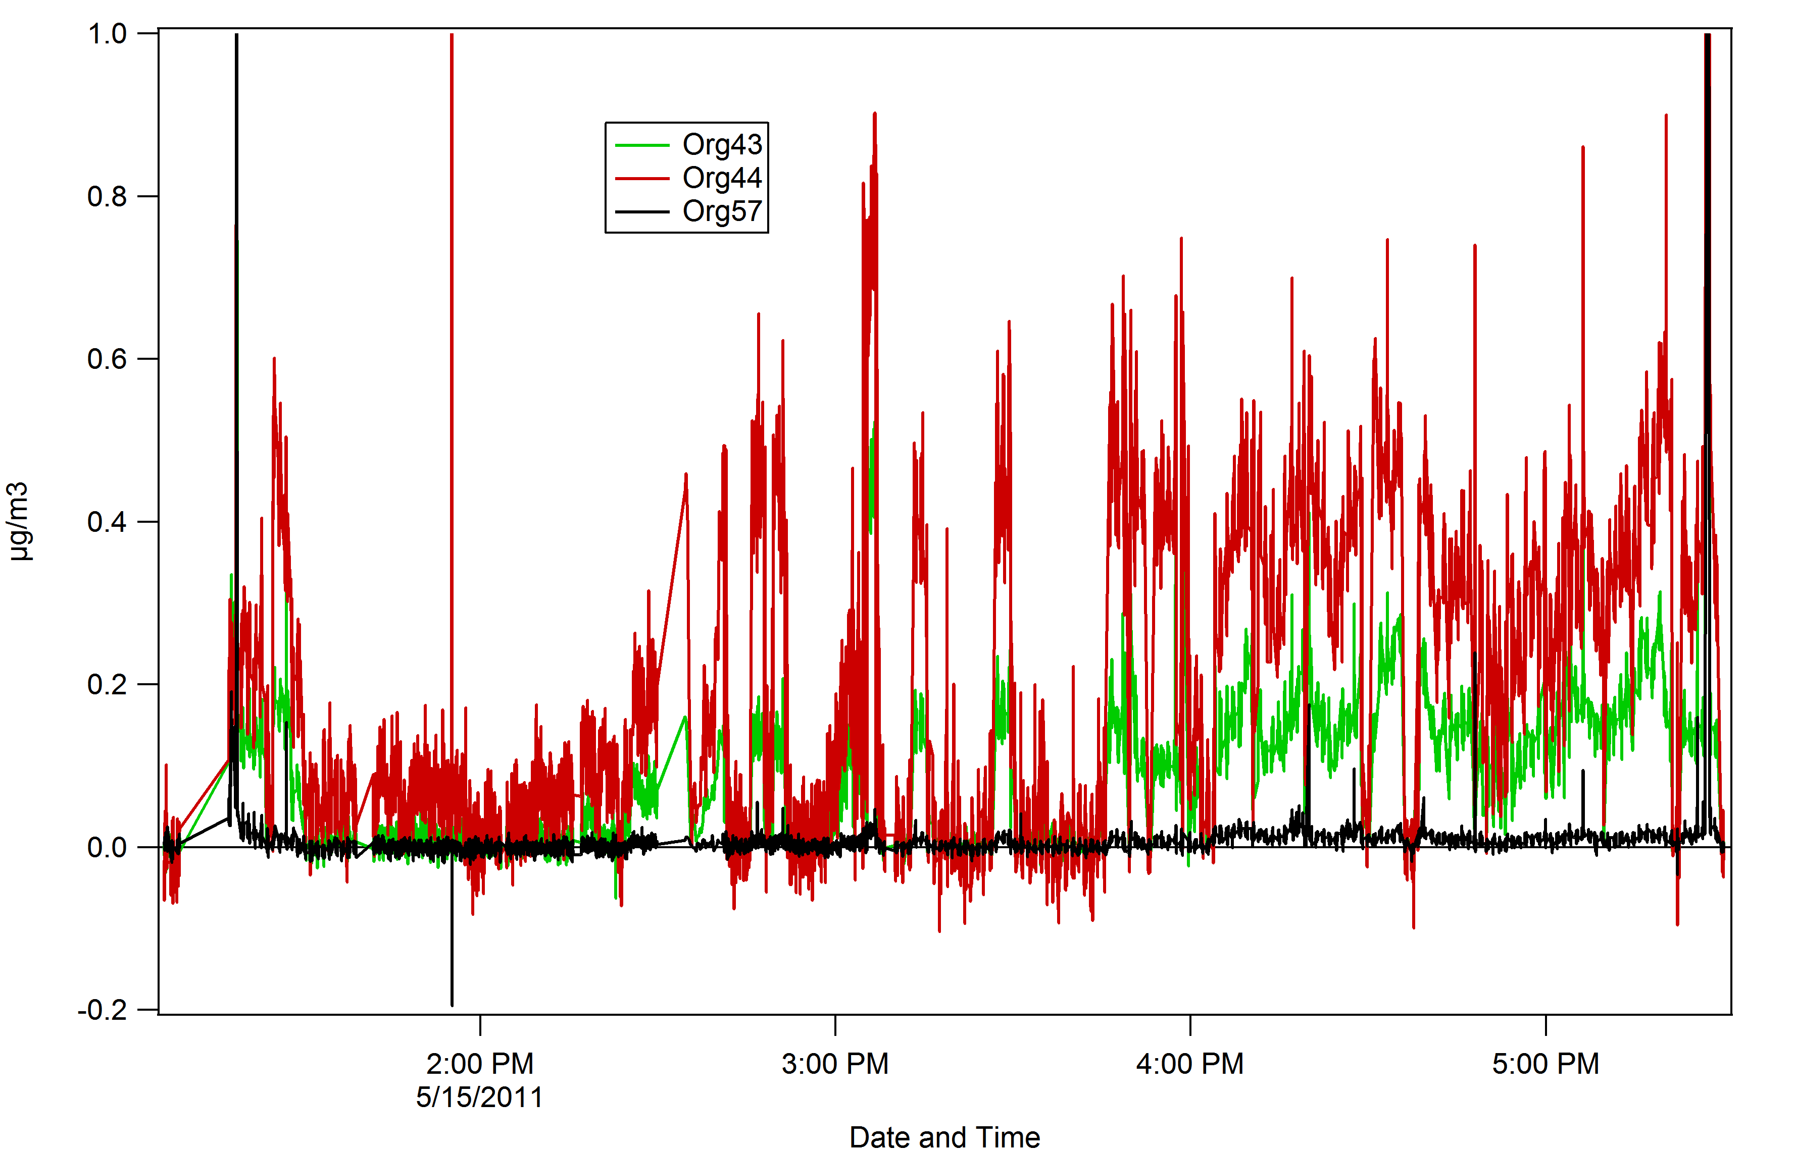
Bloomfield metro vs RM Nat Park

Slide 23
Things to do for DC3-test…
CFD modeling of the inlet in collaboration with RAF (Dave Rogers) would be very helpful to understand the exact behavior at high altitude and under high pitch and roll angles (would be extremely useful for all aerosol instruments in the HIAPER cabin).
Explore HR analysis and repeat UHSAS comparison according to Middlebrook et al, 2011
Take a closer look at the mass spectral signature of the organic aerosol measured in the stratosphere during RF06
Once available, explore correlations between AMS loadings with the other chemical data acquired during DC-3
Try to increase the data quality of the size distributions by developing an HR analysis procedure for them

Slide 24
Things to do before the next campaign (RHINO 2014?)
Depending on funding integrate cryopump to reduce pre-flight pumping requirements and increase sensitivity.
Automate filter sampling.
Redesign inlet assembly for easier service
Add flow meter to PCI bypass flow line
Explore software options for remote control of the AMS
Fly with a heated HIMIL and temperature monitor next time.

