Slide 1




CAESAR: Cloud-aerosol-dynamic interactions in Cold Air Outbreaks over the Arctic Ocean
Greg McFarquhar
Cooperative Institute for Severe and High Impact Weather Research and Operations
^{School of Meteorology}
University of Oklahoma, Norman, OK
CAESAR Planning Meeting
Boulder, CO 9 May 2023
Notes:
Hello my name is Rose Miller and today I will be discussing the discovery of supermicron sized aerosol particles over the south east atlantic ocean during the ORACLES 2017 campaign

Slide 2
Team Members
Greg McFarquhar, Lead PI
Can be present for full campaign or partial campaign as needed
Andrew Dzambo, Research Scientist
Available to help with forecasting if needed, or data analysis
Can be present for full campaign or partial campaign as needed
Nick Amundsen (FSU), Graduate Student
Will conduct M.S. on CAESAR; can be present for half campaign
Other OU Graduate Students will come to CAESAR for field experience
Mastooreh Ameri (Tehran), Amanda Richter (UAH), Hazel Xia, Qing Niu, Yayun Qiao all available for half campaign (need tasks for them)
Emma Järvinen (KIT), scientist for PHIPS HALO (or group member)
Lulin Xue (NCAR) and group, modelers will participate in part campaign

Slide 3
Theme/Task
Study cloud-aerosol interactions & processes responsible for production, maintenance & decay of supercooled water
Determine how vertical profiles of cloud microphysics (size, shape & phase of cloud particles, bulk properties of r_{ew}, r_{ei}, N_{w}, N_{i}, β_{ei}, β_{ew}, LWC, IWC) correlated with aerosol, CCN, giant CCN, and INP concentration/composition above and below cloud, and with vertical velocities over range of surface (open ocean, ice-covered, land) & environmental conditions (lower atmospheric stability, inversion strength and height, humidity, wind speed, temperature, overlying free tropospheric aerosol concentrations, air-sea temperature difference, shear, distance and location from cyclone center, etc.)

Slide 4
Data & Products
Science team lead for
Bulk condensed water content (Nevzorov, King, Rosemount icing)
Droplet size distributions (CDP)
Cloud & precipitation size distributions (2DS, 2DC, HVPS3)
Shape distributions (2DS, 2DC, HVPS3)
PHIPS-HALO size and shape distributions (collaboration with E. Järvinen)
Other core datasets
CVI
HOLODEC-II

Slide 5
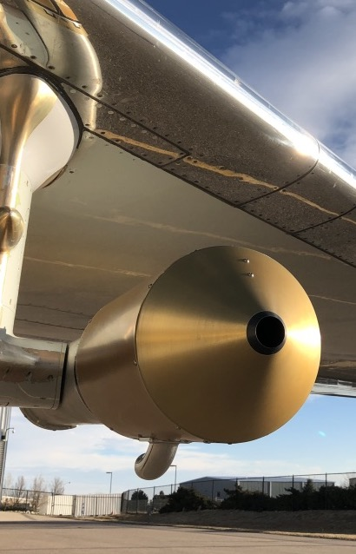
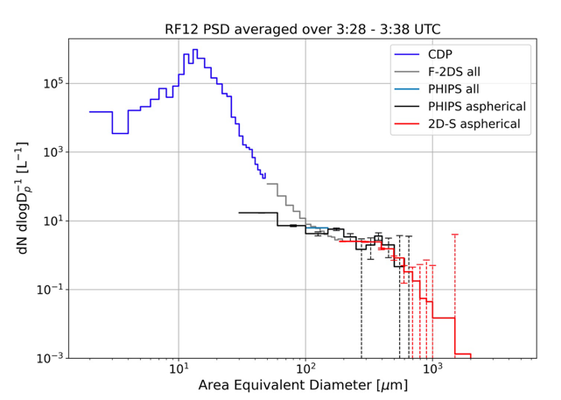
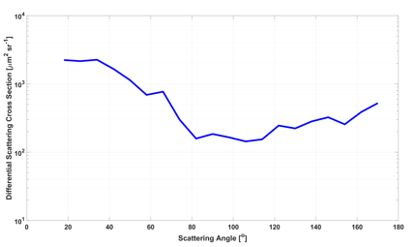
The Particle Habit Imaging and Polar Scattering (PHIPS) probe
PHIPS is an airborne probe combining a polar nephelometer and a stereo-microscopic imager. It can be used to investigate (i) ice particle optical properties, (ii) detailed ice crystal morphology and (iii) to retrieve ice particle PSDs in the size range from 30 to 700 µm (without interference of cloud droplets).
With PHIPS research questions related to cloud radiative properties and ice formation, e.g., via secondary ice processes can be addressed.
Example from SOCRATES
Example from IMPACTS
Stereo-image of a plate crystal
PHIPS has an imaging rate of 10 Hz
CDP
PHIPS
F2DS
Corresponding angular scattering function from 18 to 170°
Nephelometer has a data acquisition rate of 13 kHz
PHIPS: particles smaller than 200 µm
-> lower 10-s detection limit ~3 L⁻¹
(In manouvers angle of attack should be ideally <4°)

Slide 6
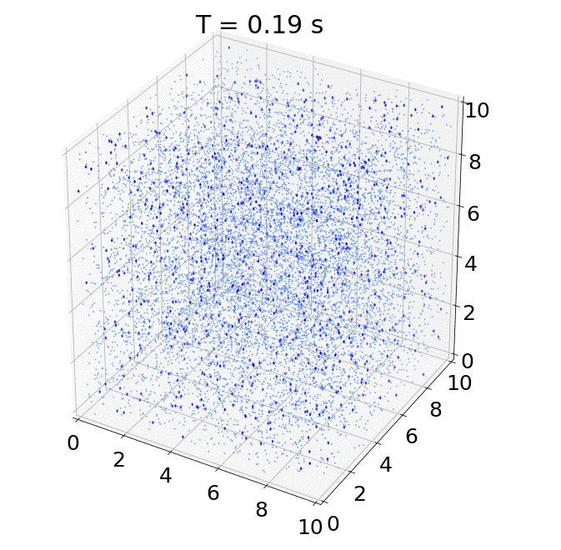
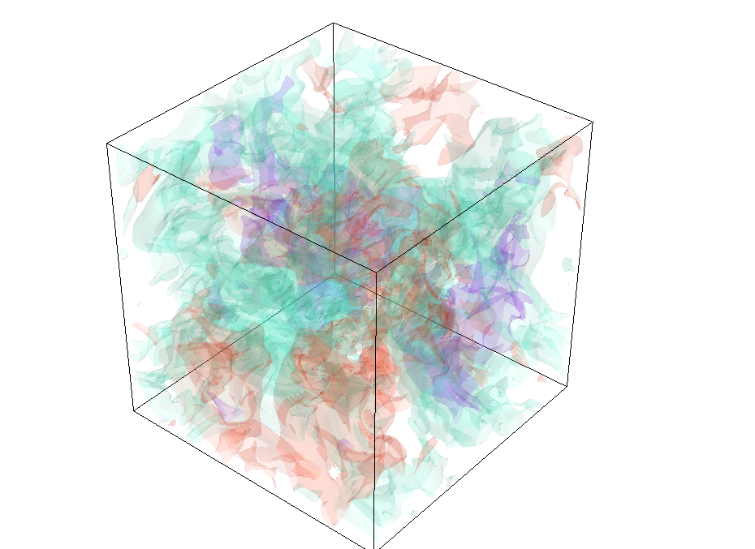
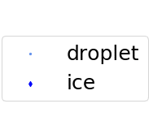
Mixed-phase DNS particle-by-particle model
z (cm)
Interactions of
microphysics, thermodynamics, and dynamics
y (cm)
x (cm)
Turbulence
Temperature
Water vapor mixing ratio
Droplet & ice particles
Diffusional growth of ice crystals and droplets
Notes:
One of the key advantages of using DNS is that it allows us to track the Lagrangian history of individual particles, which is crucial in studying particle growth.
The model tracks the droplet condensation and ice deposition
The turbulent fluctuations of temperature and water vapor are resolved, therefore the growth responding to turbulence can be tracked.

Slide 7
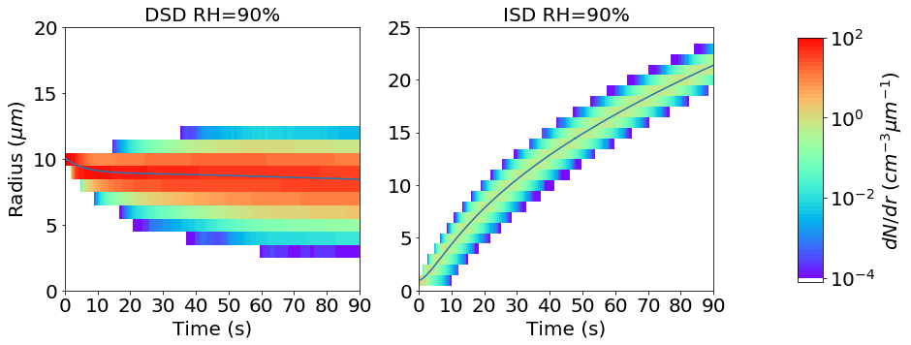
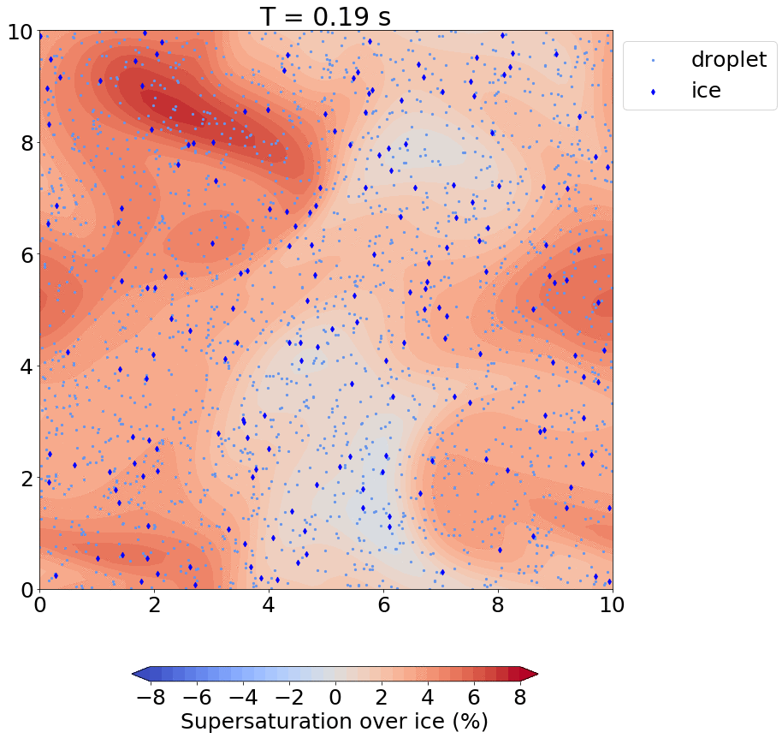
Turbulence broadening of particle size distributions
Droplet size distribution
Ice size distribution
Ice and droplets begin with single size.
The effective size spectral broadening is solely due to the
turbulent fluctuations of the thermodynamics.
Notes:
One important aspect of turbulence impact is on the droplet size distributions. Because this will affect the terminal velocities and aggregation, which further modulate the collisions.
So how does it impact ice?
Here shows the evolution of particle size distribution from one of our cases. the left is for the droplets and the right the ice.
we found a significant broadening in the spectral width with time, especially on droplets. This means that droplet sizes become more and more diverse with time, though the mean size does not change much.
Haven’t looked at whether this broadening is enhanced by the presence of ice. But this will be an interesting topic
In our experiment, ice and droplets are initially monodisperse.
Therefore this broadening is solely due to the turbulent fluctuations in temperature and moisture
This animation shows the evolution of the moisture field, and we see that even though the parcel is saturated on average,
there are pockets of high and low values that make the growth of particles spatially dependent, even at the mm-scale.
Therefore, turbulence has an immediate impact on broadening the droplet size spectra.
Turbulence → similar size collisions
Turbulence → enhance broadening → enhance gravitational collection.

