Slide 1
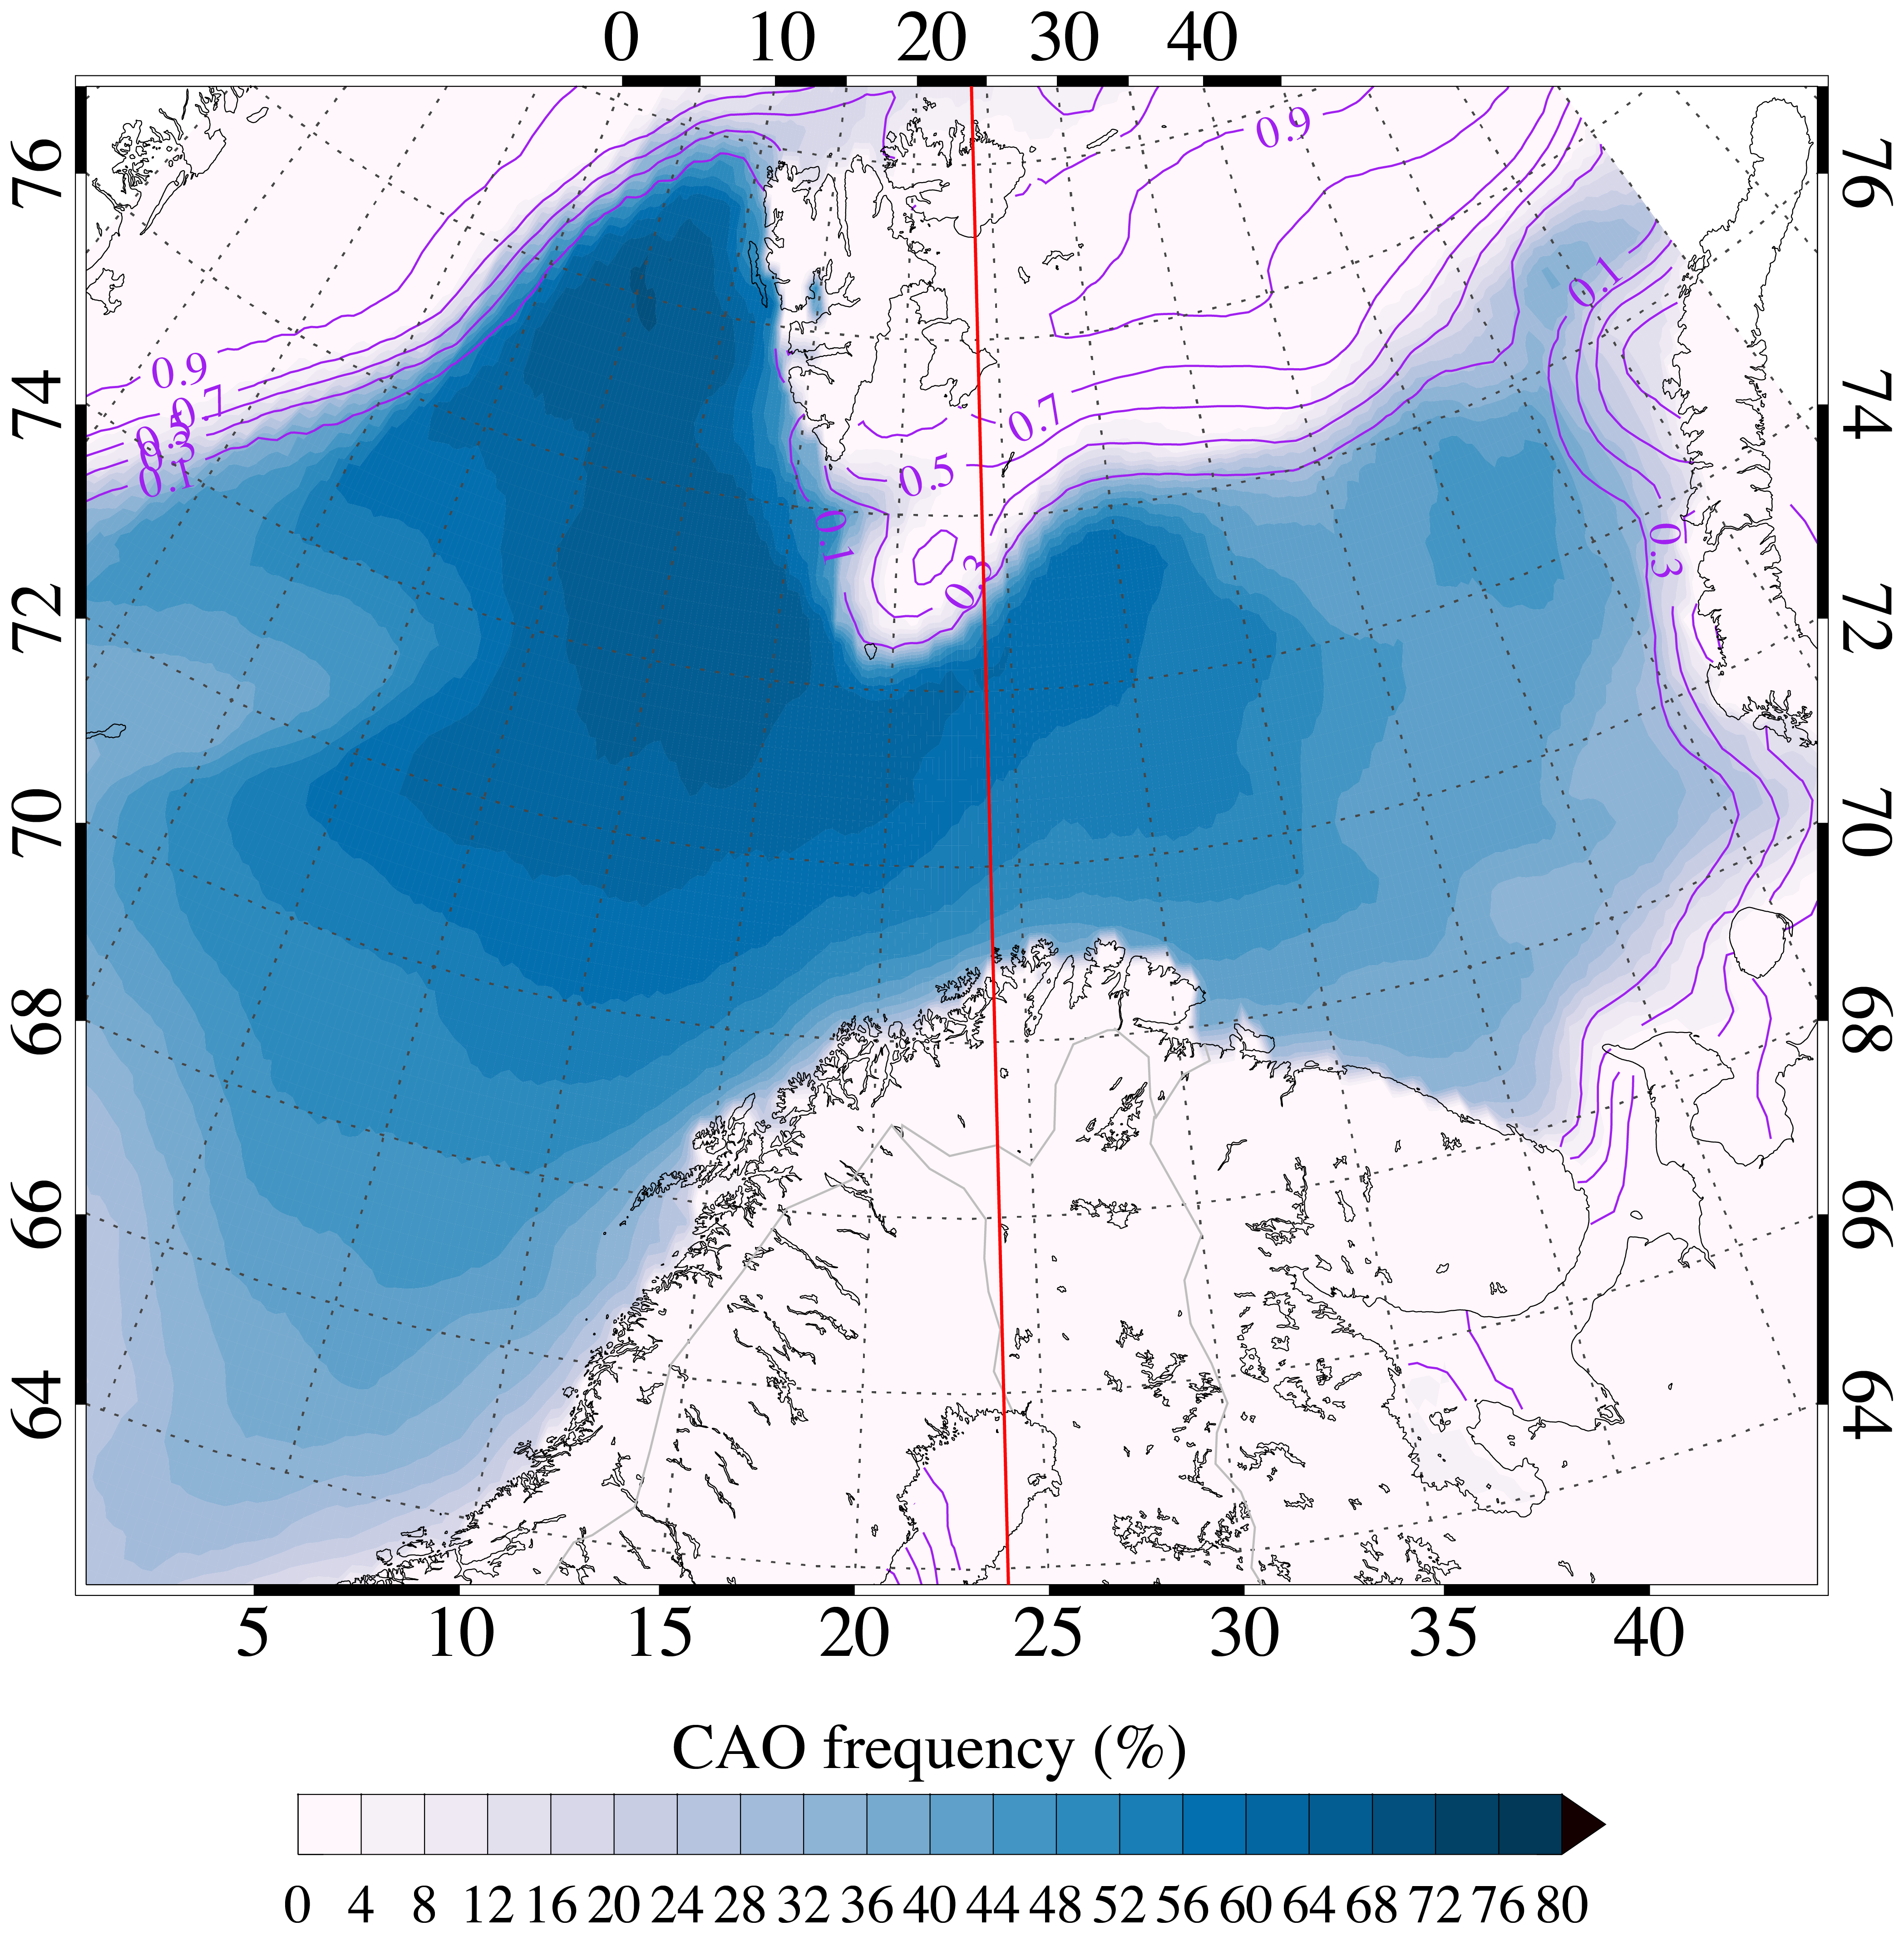
Daily schedule strawman plan
Kiruna time: CET
UTC + 1 till 3/30/’24
UTC + 2 from 3/31
Bear
Island
Factors:
For F1/F2 flights, prefer to be at the Arctic ice edge during daylight hours
Jan
Mayen
24°E
.
Kiruna
2 hourly radiosondes from Bear Island & Jan Mayen

Slide 2
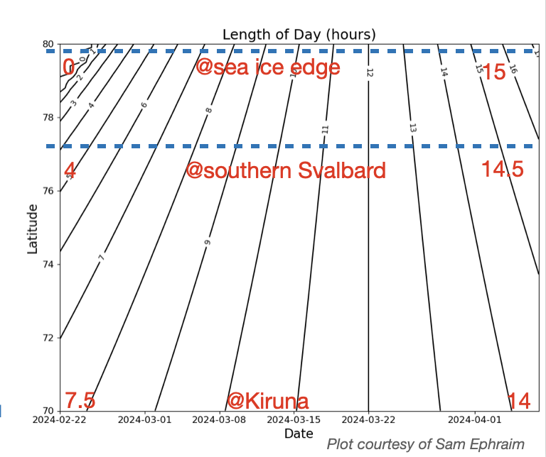
CAESAR
starts
CAESAR
ends
time of local solar noon
LON | UTC | CET
10°W | 12:40 | 13:40
0 | 12:00 | 13:00
10°E | 11:20 | 12:20
20°E | 10:40 | 11:40
24°E | 10:24 | 11:24
Maybe the earliest flights in the campaign (Feb) should not target the Arctic ice edge

Slide 3
Daily schedule – strawman plan
Kiruna time: CET
UTC + 1 till 3/30/’24
UTC + 2 from 3/31
Factors:
For F1/F2 flights, prefer to be at the Arctic ice edge during daylight hours
C130 crew duty limitations
max # consecutive work days before hard down day: 6
max “work” hrs/day: 14
min crew rest period (“non-work”): 12
max # flights in row: 2, for full flights (9 hrs) Day 2 to start 2 hrs later than Day 1 (Day 3 would be a short flight)
back to back flights require 2 flight plans, Day 1 and Day 2
Met Norway’s preferred forecast time: 5 pm. They can do 2-3 pm as well (crew rotation 4 pm)

Slide 4
Daily schedule – strawman plan
Kiruna time: CET
UTC + 1 till 3/30/’24
UTC + 2 from 3/31
Typical daily ops:
Take-off (TO) – 4 hrs: weather update
TO – 3.5 hrs: relay any flight plan mods to pilots
TO – 2 hrs? final go/no-go decision
TO: between 6-8 am CET (5-7 UTC)
return to ESNQ: 3-5 pm CET (14-16 UTC)
Land + 0.5 hrs: debrief
Daily weather briefing: starts 1 pm (12 UTC)
available products:
ECMWF 00 Z forecasts, AA 09 Z forecasts, radar and satellite imagery up to 12 Z
next-day forecast, consider Kiruna terminal wx conditions as well
back-to-back and longer-term mission planning
decision for next day ops by 3 pm (14 UTC) so pilot can file flight plan no later than 4 pm
First possible flight date is 3/9. Start of Dry run: 3/8 at 12 UTC.
Flight times typically are in the window 5-16 UTC. LSN up north ranges from 10:30 Z (east end) to 12:30 UTC (western Fram Strait)

Slide 5
Climatological airport weather conditions during CAOs over the Norwegian Sea between 22 Feb – 7 April. Bad conditions for T/O are in red. Bad conditions for T/O and landing in purple
 | Kiruna (ESNQ)
 | 1991-2016 | 2017-2022
mean min temperature (°C) | -13.4 | -12.5
mean max temperature (°C) | -4.3 | -3.9
dry (% of time) | 87.5 | 85.5
rain and drizzle (% of time) | 0.4 | 0.1
snow and mixed precip (% of time) | 12.1 | 14.4
prevailing wind direction (degree) | 200-240 | 200-240
wind speed >20 kts (% of time) | 1.9 | 4.0
cross-track wind speed > 25 kts ¹ (% of time) | N/A | 0.4
visibility > 3 miles (% of time) | 92.5 | 86.8
ceiling > 1500 ft (% of time) | 86.2 | 74.2
visibility and/or ceiling too low for VMC ¹ | 17.5 | 36.7
VIS/Ceiling too low for VMC and/or snowfall ² | 28.2 | 45.5
1: IMC ops possible otherwise. Kiruna (ESNQ) has climb gradients in place during IMC conditions, which will reduce the C-130 flight time by 2 hours (maximum weight reduced by 10,000 lbs during IMC). VMC conditions are: ceiling at least 1500 ft and visibility at least 3 statute miles.
2: conditions needed for T/O, since the aircraft with instruments cannot be de-iced

Slide 6
questions to consider for the Dry Run
Single-day vs back-to-back flights
How do we decide a polar low can be targeted?
Scorecard for hypothesis checking
What flight planning info to provide the Mission Coordinator
Gunnar Noer’s forecast package?

Slide 7
How to fly F1-F2 long legs with cloud penetrations
Sawtooth legs:
climb and descend to PI specifications (~500 ft MSL to ~1500 ft above cloud top) and use the clock to ascertain climb and descent points
Descend/climb at 1,000 FPM
Note: aircraft can’t go from level to 1,000 climb/descent instantaneously
Flux legs at 500 ft:
Descent to 500ft requires momentary level off at 1,000ft to calibrate altimeters
maintain 500 ft for 10 min
in-cloud legs
maintain for 10 min if icing conditions allow
1000 ft above cloud top legs
maintain for 10 min

Slide 8
Pre-flight info the Mission Coordinator (pilots) need from us: Flight plan
F1-F2:
Terminal target Coordinates – Degrees and Minutes, e.g., N8015 E01015
preferred initial point waypoint for “research”, i.e. southernmost location with CAO conditions
L, P, S, C:
starting point and tentative pattern
refinement possible during outbound ferry
PL
initial waypoint to ferry to
refinement of rosette pattern during outbound ferry

Slide 9
real-time info critical for mission coordination
Real-time satellite/model data to be uploaded to the plane
MODIS/VIIRS imagery
AA model output at SL, 900, 800, 700 mb
Real-time CT height (WCR), cloud LWC near cloud top below (WCL/Marli), and cloud base height (dropsondes). This info will be collected on the outbound leg and will inform the inbound leg of F1 flights

Slide 10
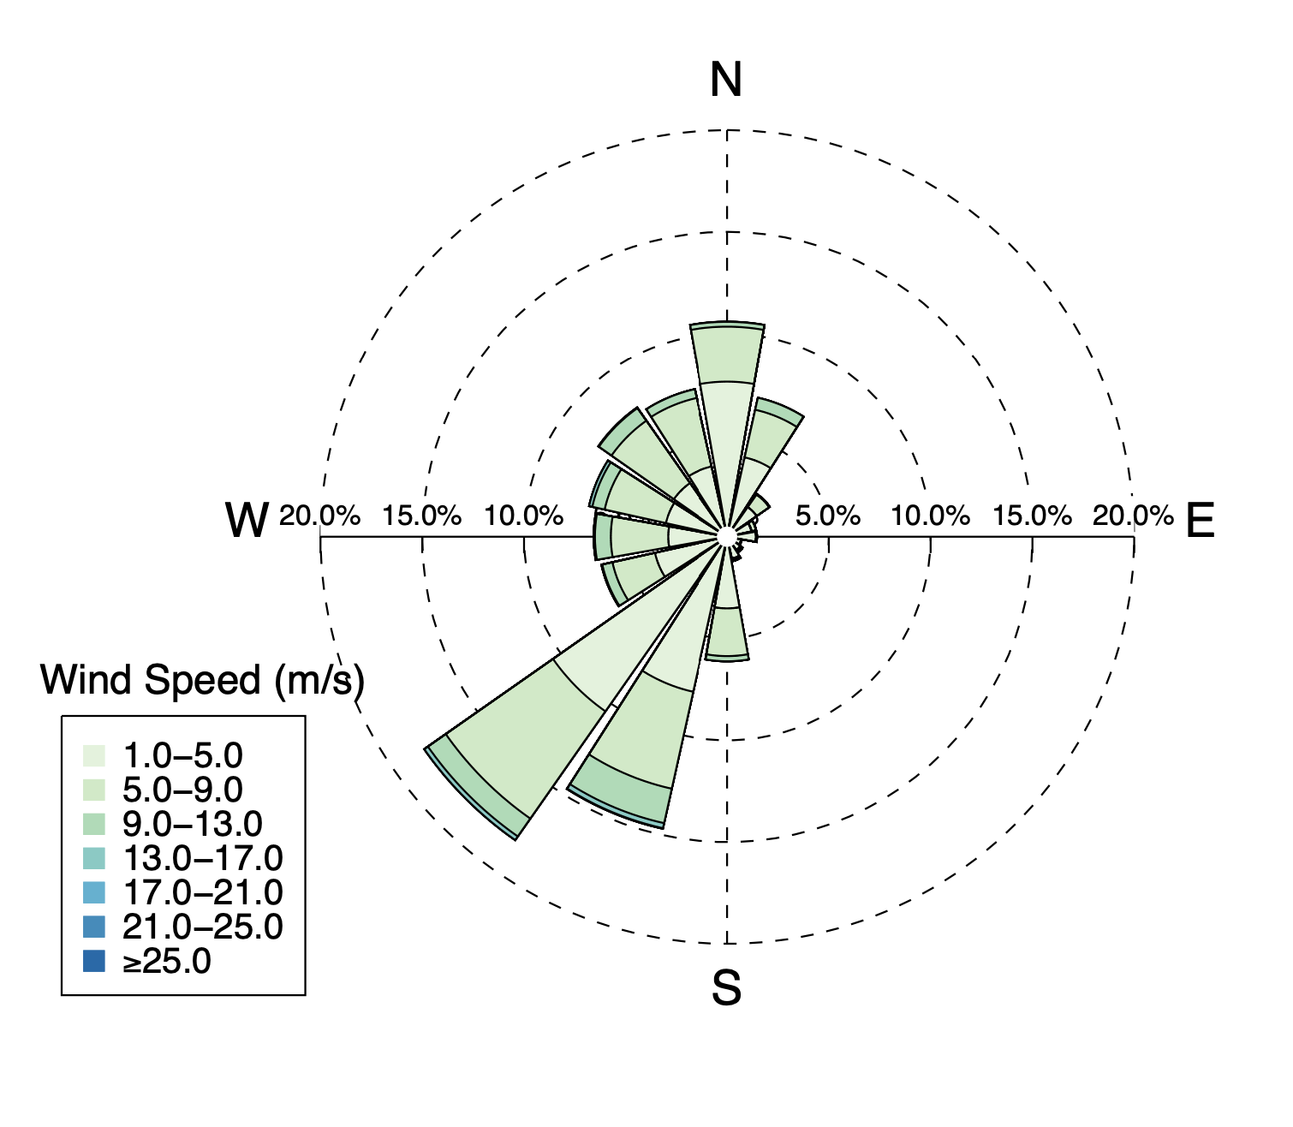
Climatological airport weather conditions during CAESAR:
wind
ESNQ
Kiruna

