Slide 1
C-130 Information and CAESAR Site Survey
CAESAR Science and Planning Meeting
Cory Wolff
Research Aviation Facility
9 May 2023

Slide 2
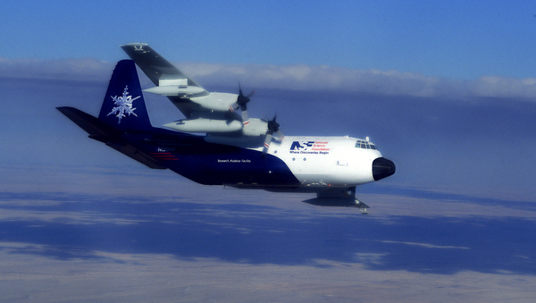
Introduction
Overview
Payload
C-130 Information
Site Survey Report
RAF Personnel
Project Managers: Cory Wolff and Pei-Sang Tsai
Science Group: Adriana Raudzens Bailey and Patrick Veres
Flight Operations: Bo LeMay
Administrator: Chrissy Fladung
Engineering: Kurt Zrubek, Rani Bartlett, and Ben Froelich
Field Catalog: Carol Ruchti (DMS)
CAESAR Science & Planning Meeting

Slide 3
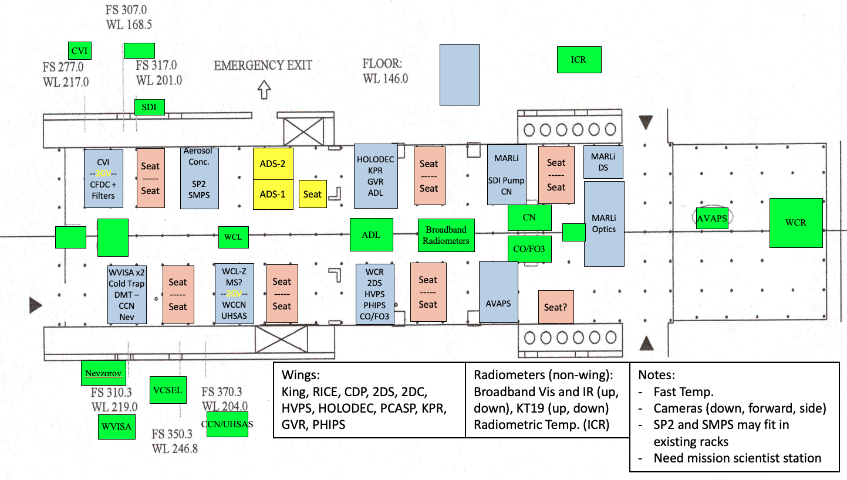
Draft Payload
CAESAR Science & Planning Meeting

Slide 4
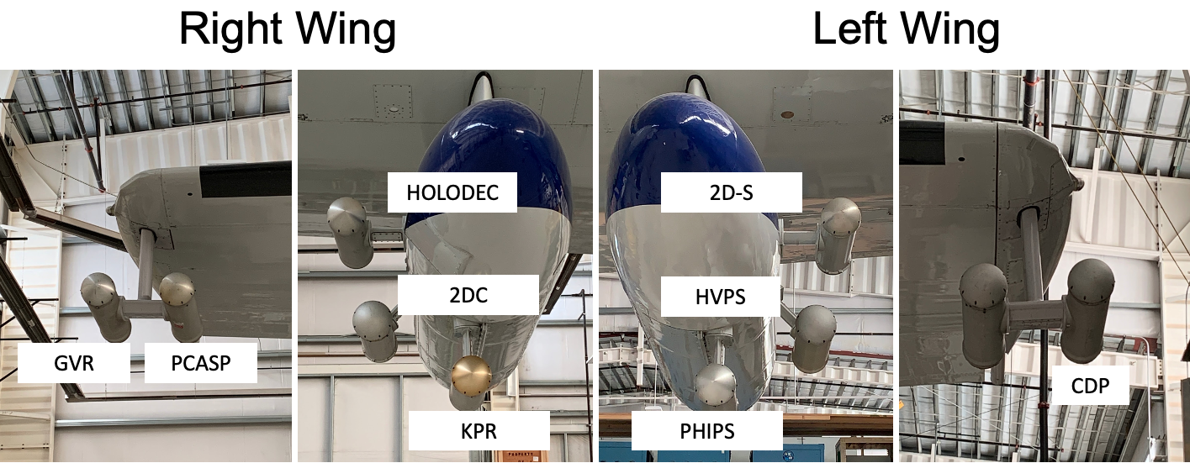
Wings
CAESAR Science & Planning Meeting

Slide 5
Payload Discussion
Airborne Doppler Lidar
Large effort for mounting design, engineering approvals, and fabrication
New aperture plate with glass ports
Other engineering tasks
Nevzorov install
IR camera
Other work likely for installs
Wings
Tradeoffs required
KPR will be down only
Outer can limitations
No obvious place for In-Cloud Radiometer
Understanding inlet needs and space requirements
Will be working with users
CAESAR Science & Planning Meeting

Slide 6
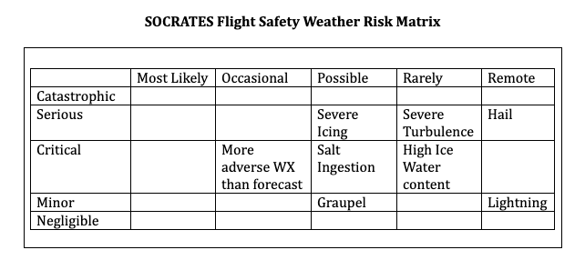
Mission Coordinator
Qualified RAF staff member
3-4 people currently
Focus on mission safety from hazardous weather events
Determine when to leave an area or altitude
Provide escape routes
Icing, sea spray will be main concerns during CAESAR
Similar to SOCRATES
Also severe turbulence, convection, low level winds
Will be monitoring cloud/icing probes, winds, visual cues
Sits in cockpit to have direct comms with pilots and ability to see windscreen, wings, and propeller hubs
CAESAR Science & Planning Meeting

Slide 7
C-130 Update
Returned late from propeller install
Training required
Pilots and Flight Engineers
Grounded by maintenance issues (supply chain)
Pilot Staffing
Short on C-130 qualified pilots
Two casual C-130 pilots with varying availability
GOTHAAM cancelled for 2023
Training and availability
Impact on CAESAR-Test is unknown
Efforting to get back to full complement of pilots this summer/fall
Hiring and training are highest priorities
CAESAR Science & Planning Meeting

Slide 8
2024 Project Schedule (Nominal)
17 Feb: Ferry to Kiruna
Stops in St. Johns and either Keflavik or Shannon
19 Feb: Arrival in Kiruna
2 days for recovery and unpacking/set up
22 Feb: Project Begins
145 research hours
15 – 18 flights (3 flights per week)
7 Apr: Last Flight Day
1 day to pack and prepare
9 Apr: Ferry to Broomfield
Stops in Keflavik or Shannon and St. Johns
11 Apr: Arrive in Broomfield
CAESAR Science & Planning Meeting

Slide 9
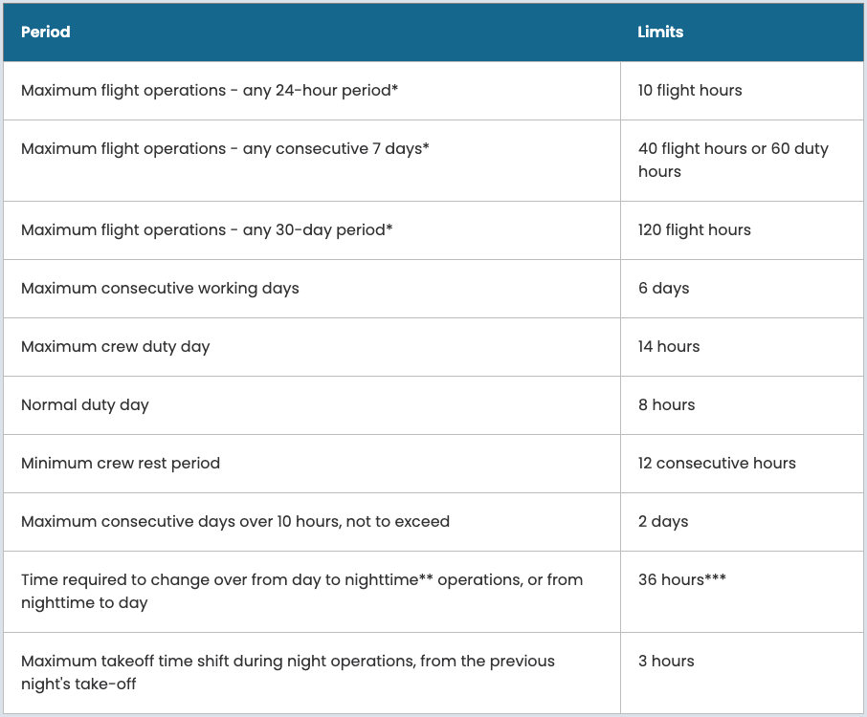
Crew Duty
https://www.eol.ucar.edu/research-facilities/request-laof/guidance-pis-requesting-laof/aircraft-crew-duty-policy
CAESAR Science & Planning Meeting

Slide 10
Crew Duty in Practice
Flying Every Other Day
Day 1: Maintenance/Flight Planning Day (8 hrs)
Day 2: Flight Day (12 hrs)
Day 3: Maintenance/Flight Planning Day (8 hrs)
Day 4: Flight Day (12 hrs)
Day 5: Maintenance/Flight Planning Day (8 hrs)
Day 6: Flight Day (12 hrs)
Day 7: Hard Down Day
CAESAR Science & Planning Meeting

Slide 11
Crew Duty in Practice
Back to Back Flights
Day 1: Maintenance/Flight Planning Day (8 hrs)
Need to plan flights for next 2 days
Day 2: Flight Day
0700: Crew showtime and flight prep (start of duty day)
0900: Takeoff
1800: Landing (duty day at 11 hrs)
1900: End of postflight
1900 – 2100: Flight planning (14 hr day)
Day 3: Flight Day
0900: Crew showtime and flight prep (need 12 hr break)
1100: Takeoff
2000: Landing (duty day at 11 hrs)
2100: End of postflight (12 hr day)
Day 4: Maintenance/Flight Planning Day (8 hrs)
Starts at 0900 (need 12 hr break)
CAESAR Science & Planning Meeting

Slide 12
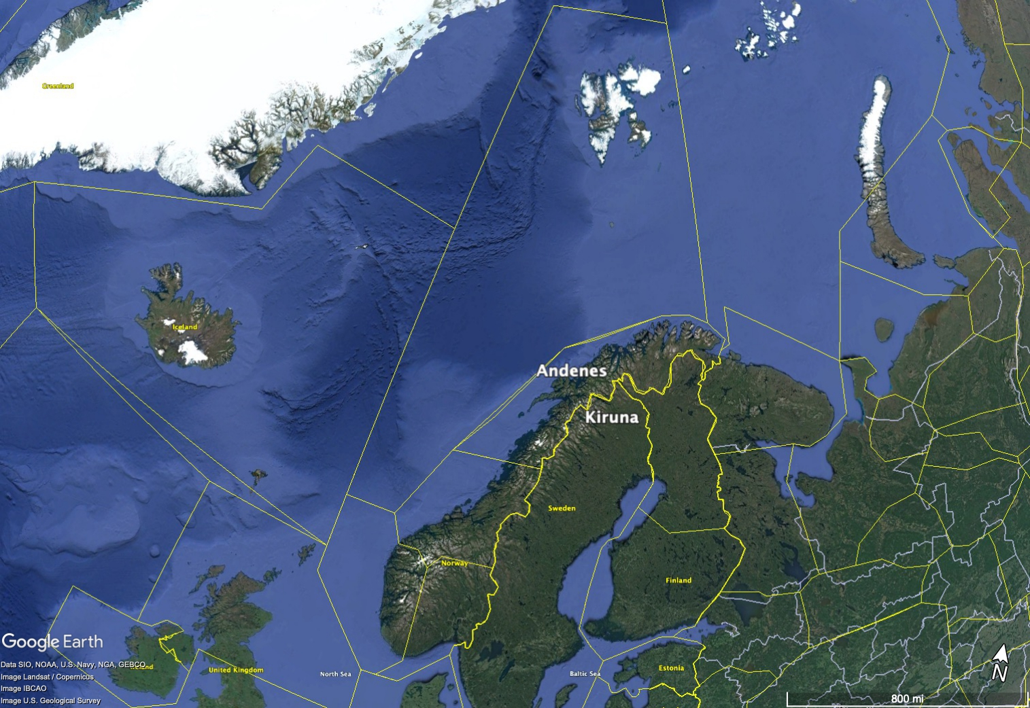
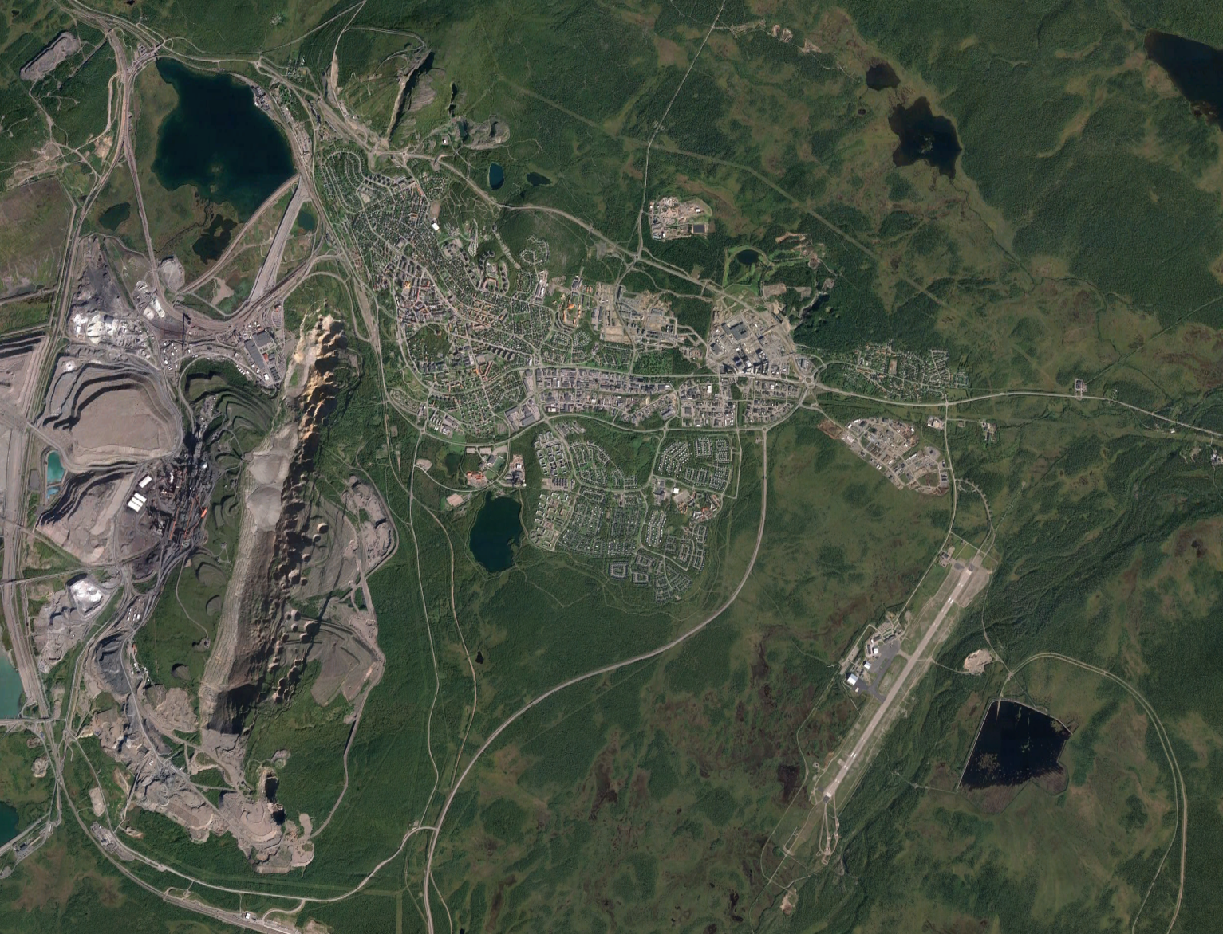
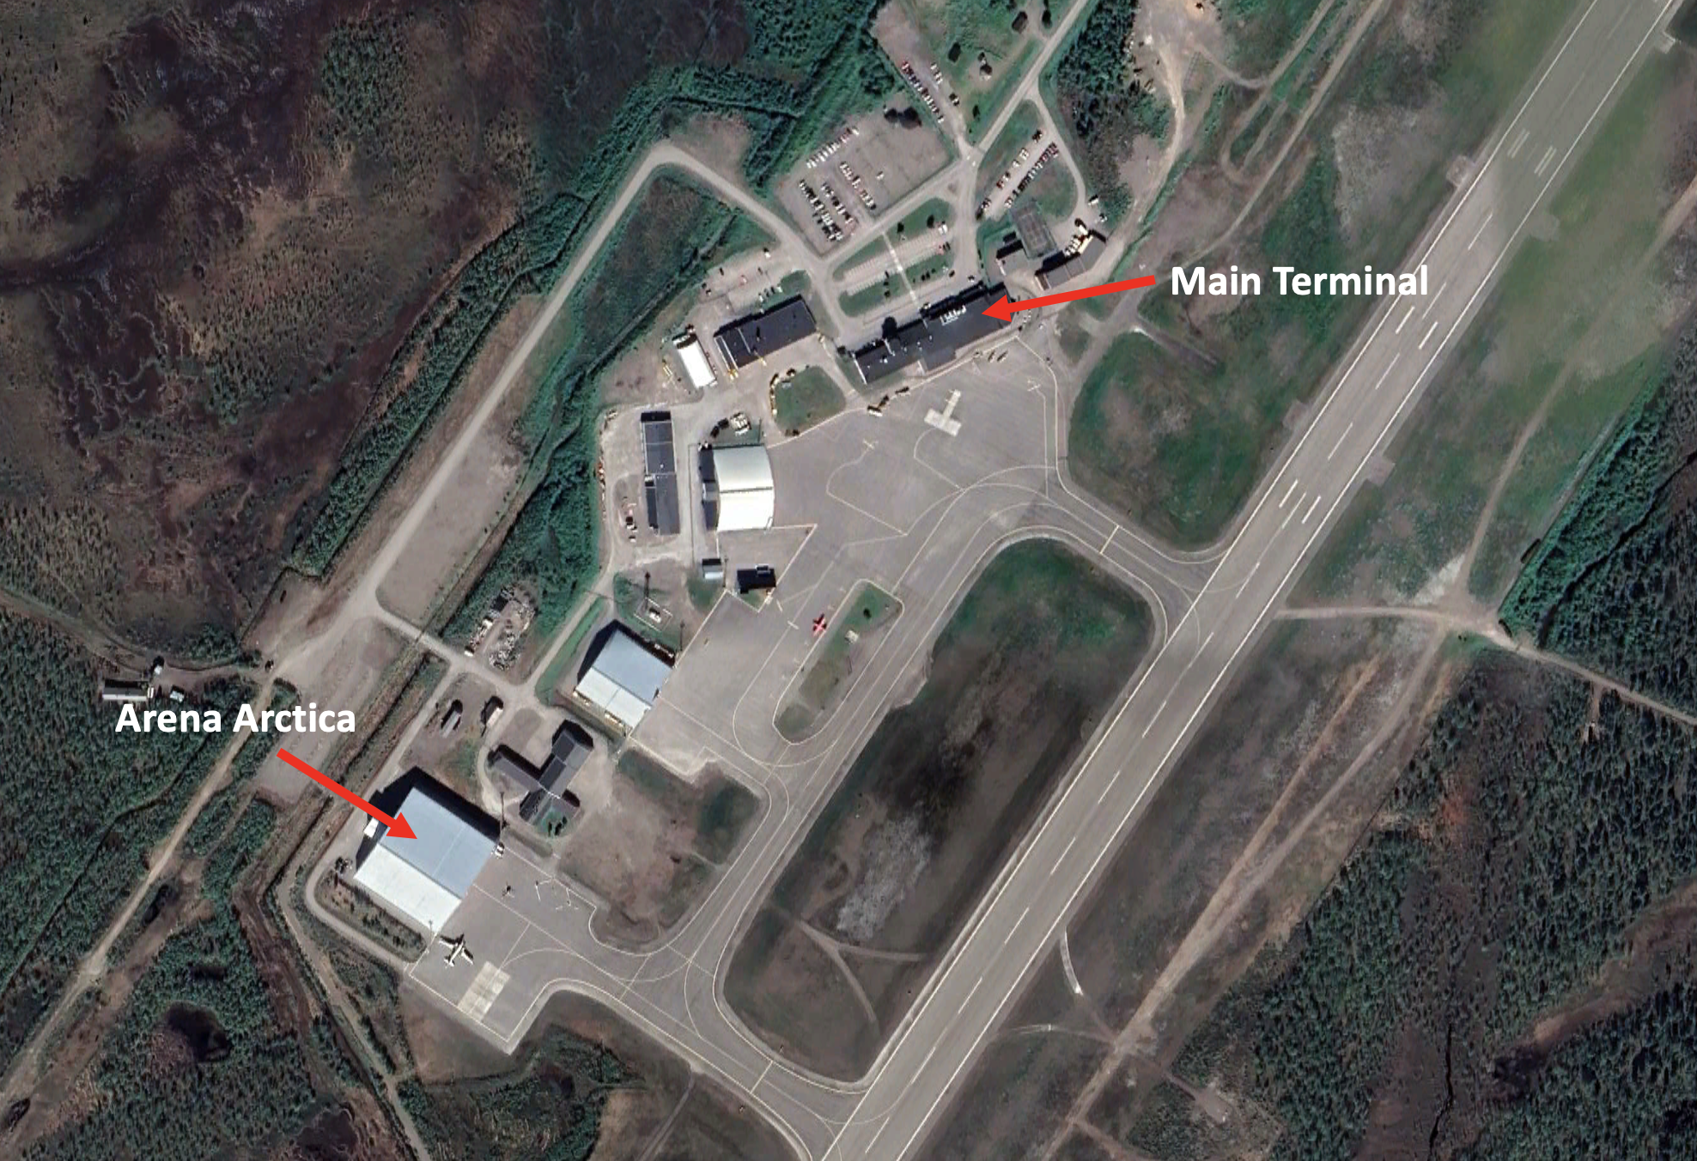
Kiruna, Sweden (ESNQ)
24 E
CAESAR Science & Planning Meeting

Slide 13
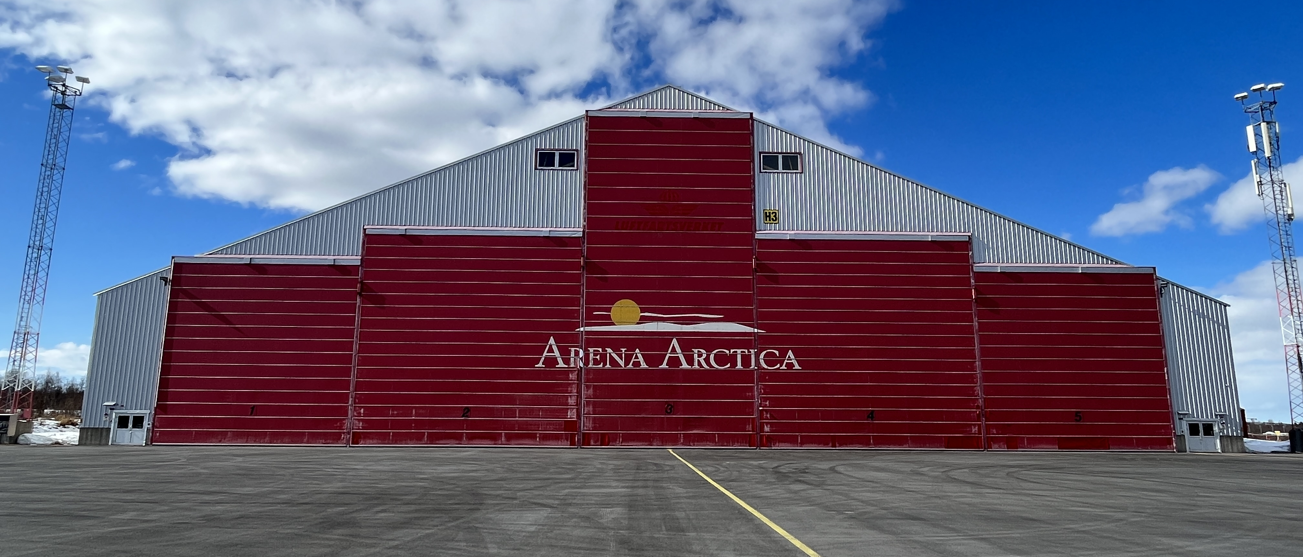
Arena Arctica
Total Width: 221 ft
Door Heights: 33 ft, 39 ft, 69 ft, 39 ft, 33 ft
Sharing with Swedish military for first few weeks of project
Training required for all participants to get access
CAESAR Science & Planning Meeting

Slide 14
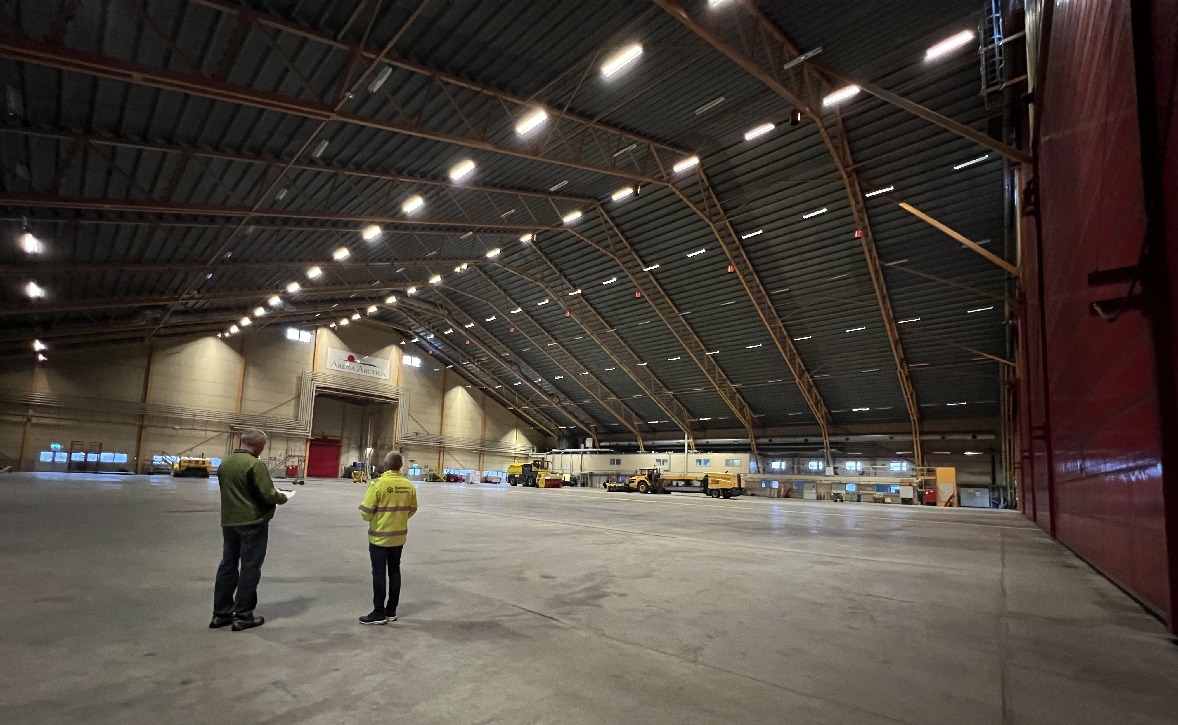
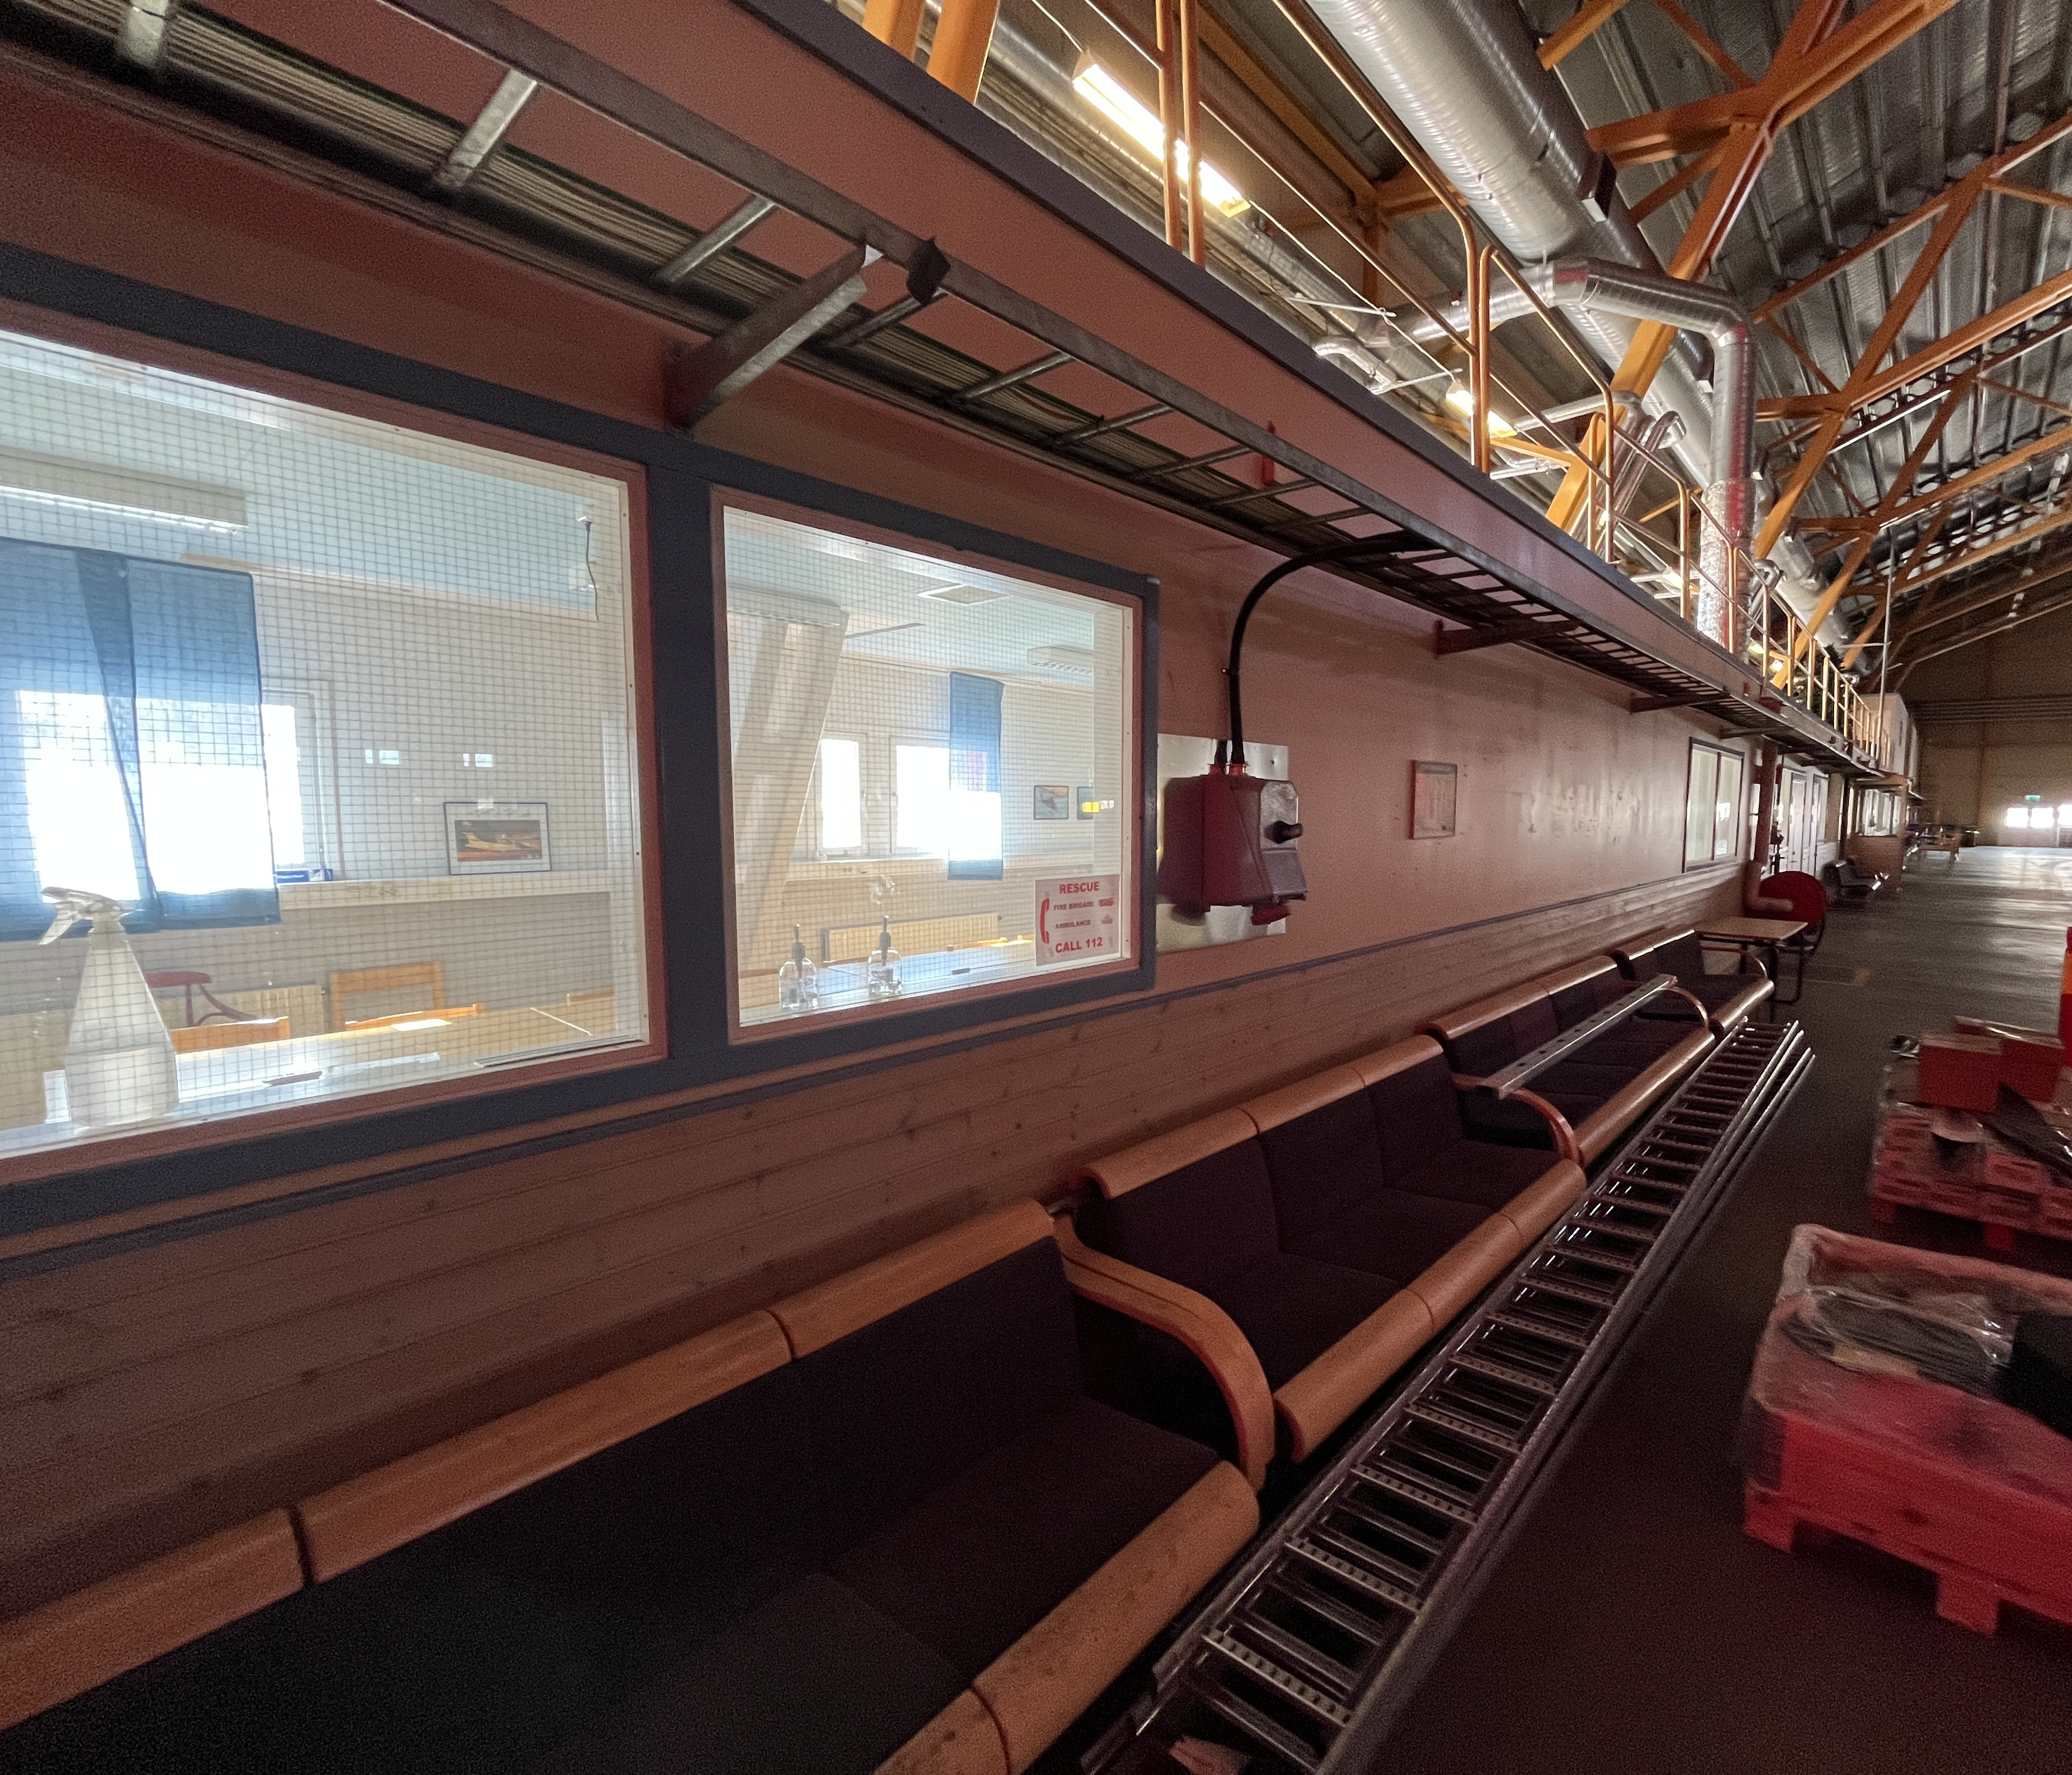
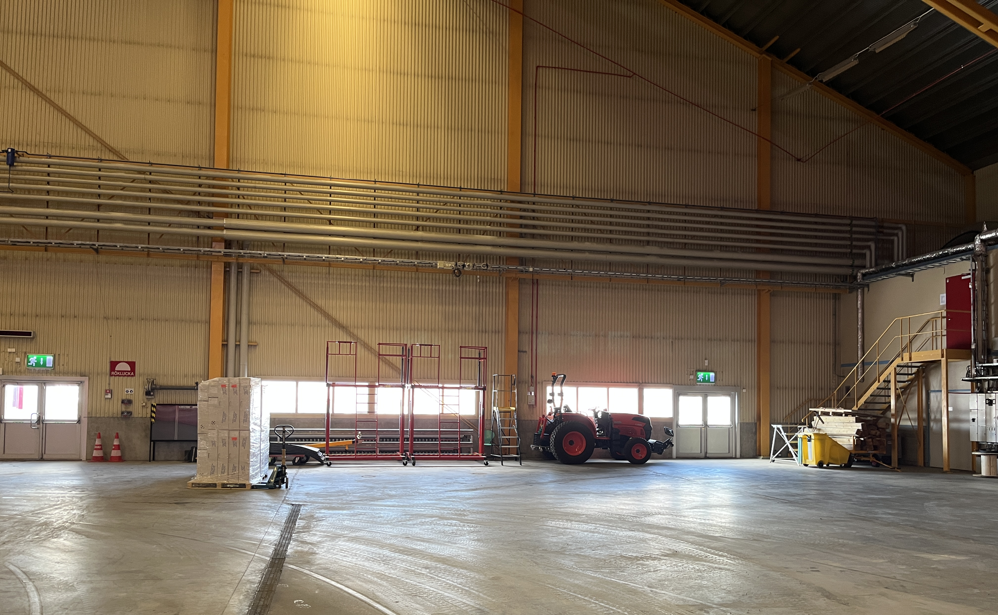
Arena Arctica (Interior)
CAESAR Science & Planning Meeting

Slide 15
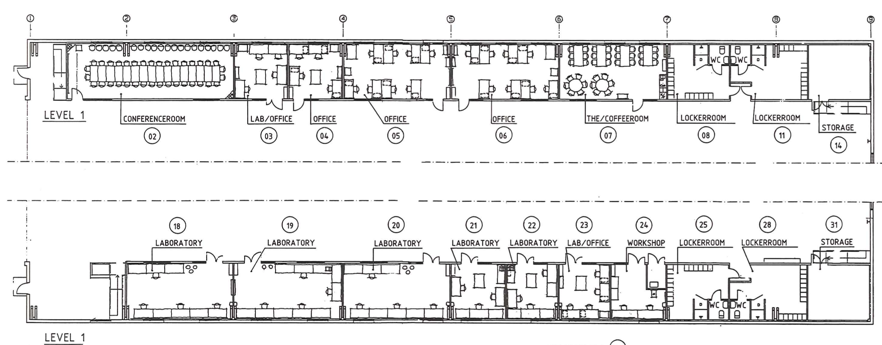
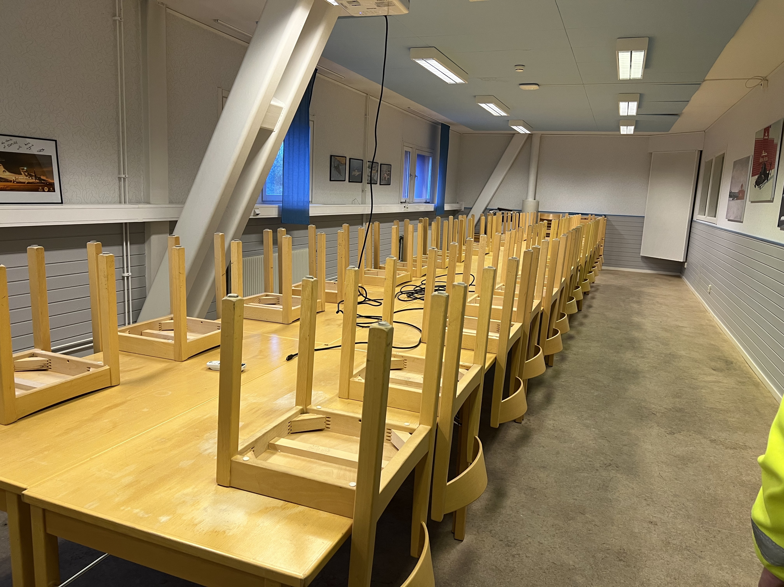
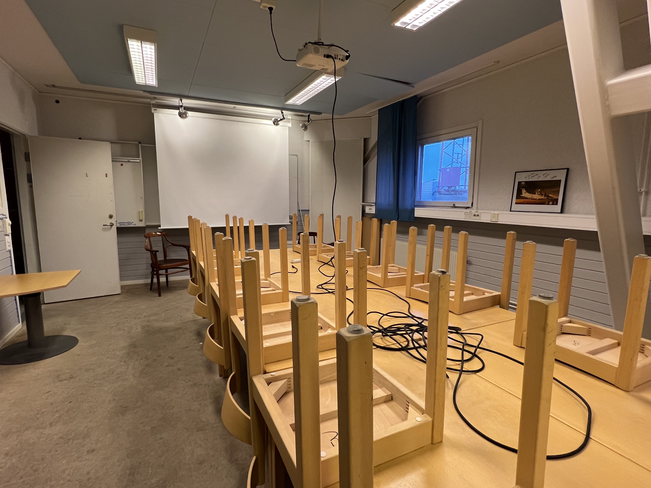
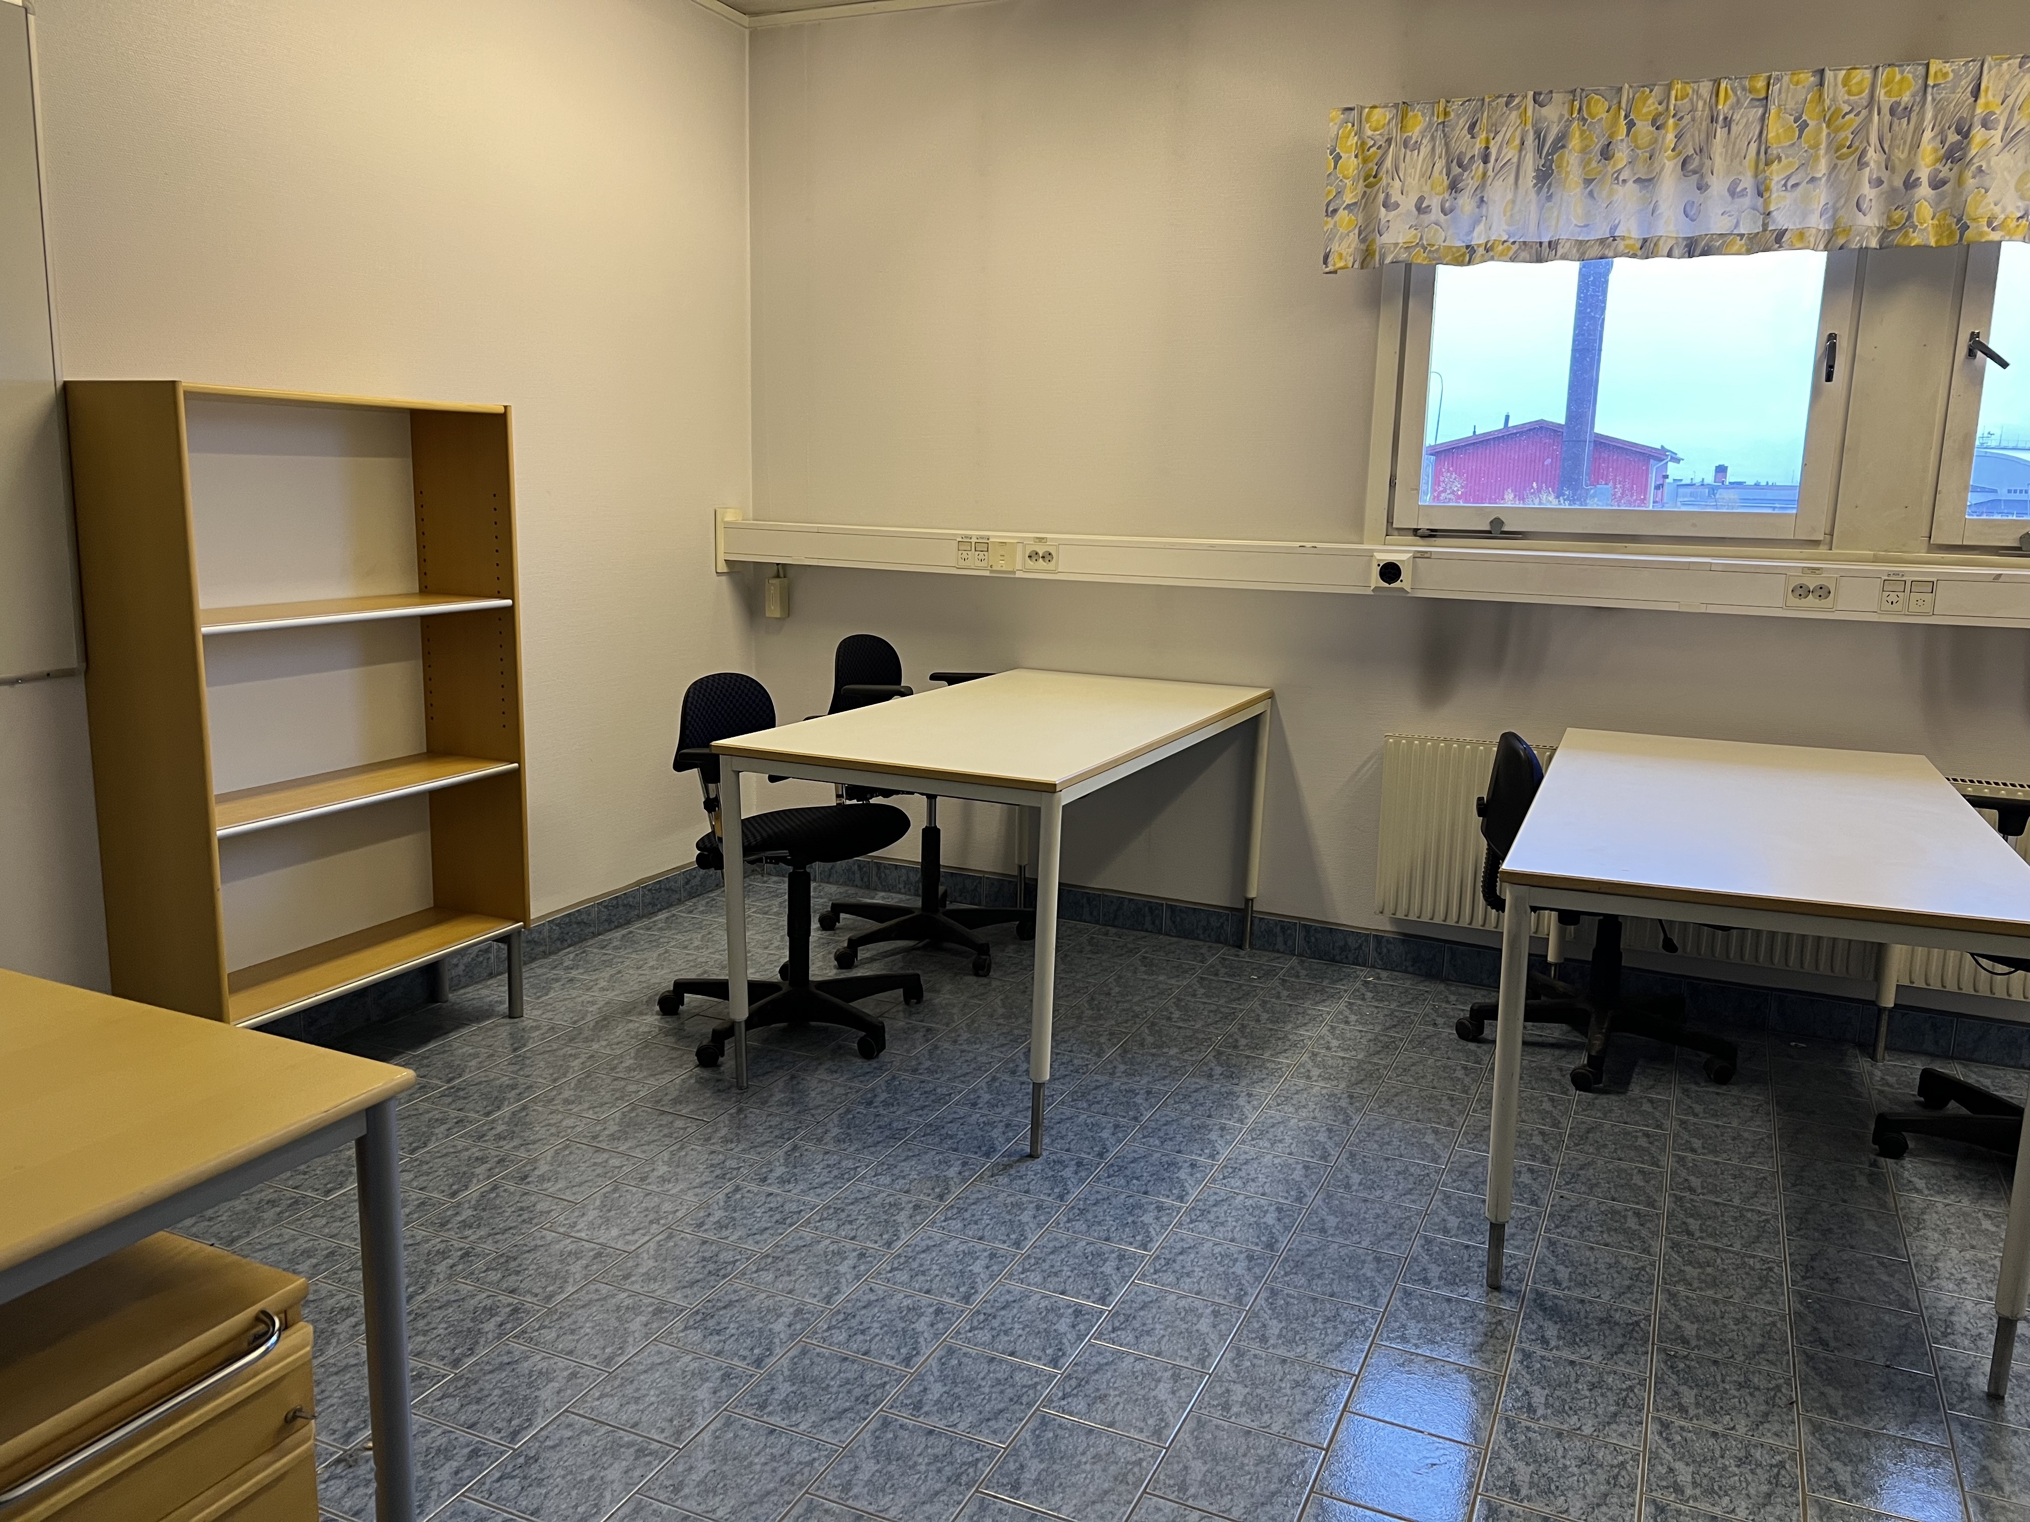
Arena Arctica (Ops Center)
CAESAR Science & Planning Meeting

Slide 16
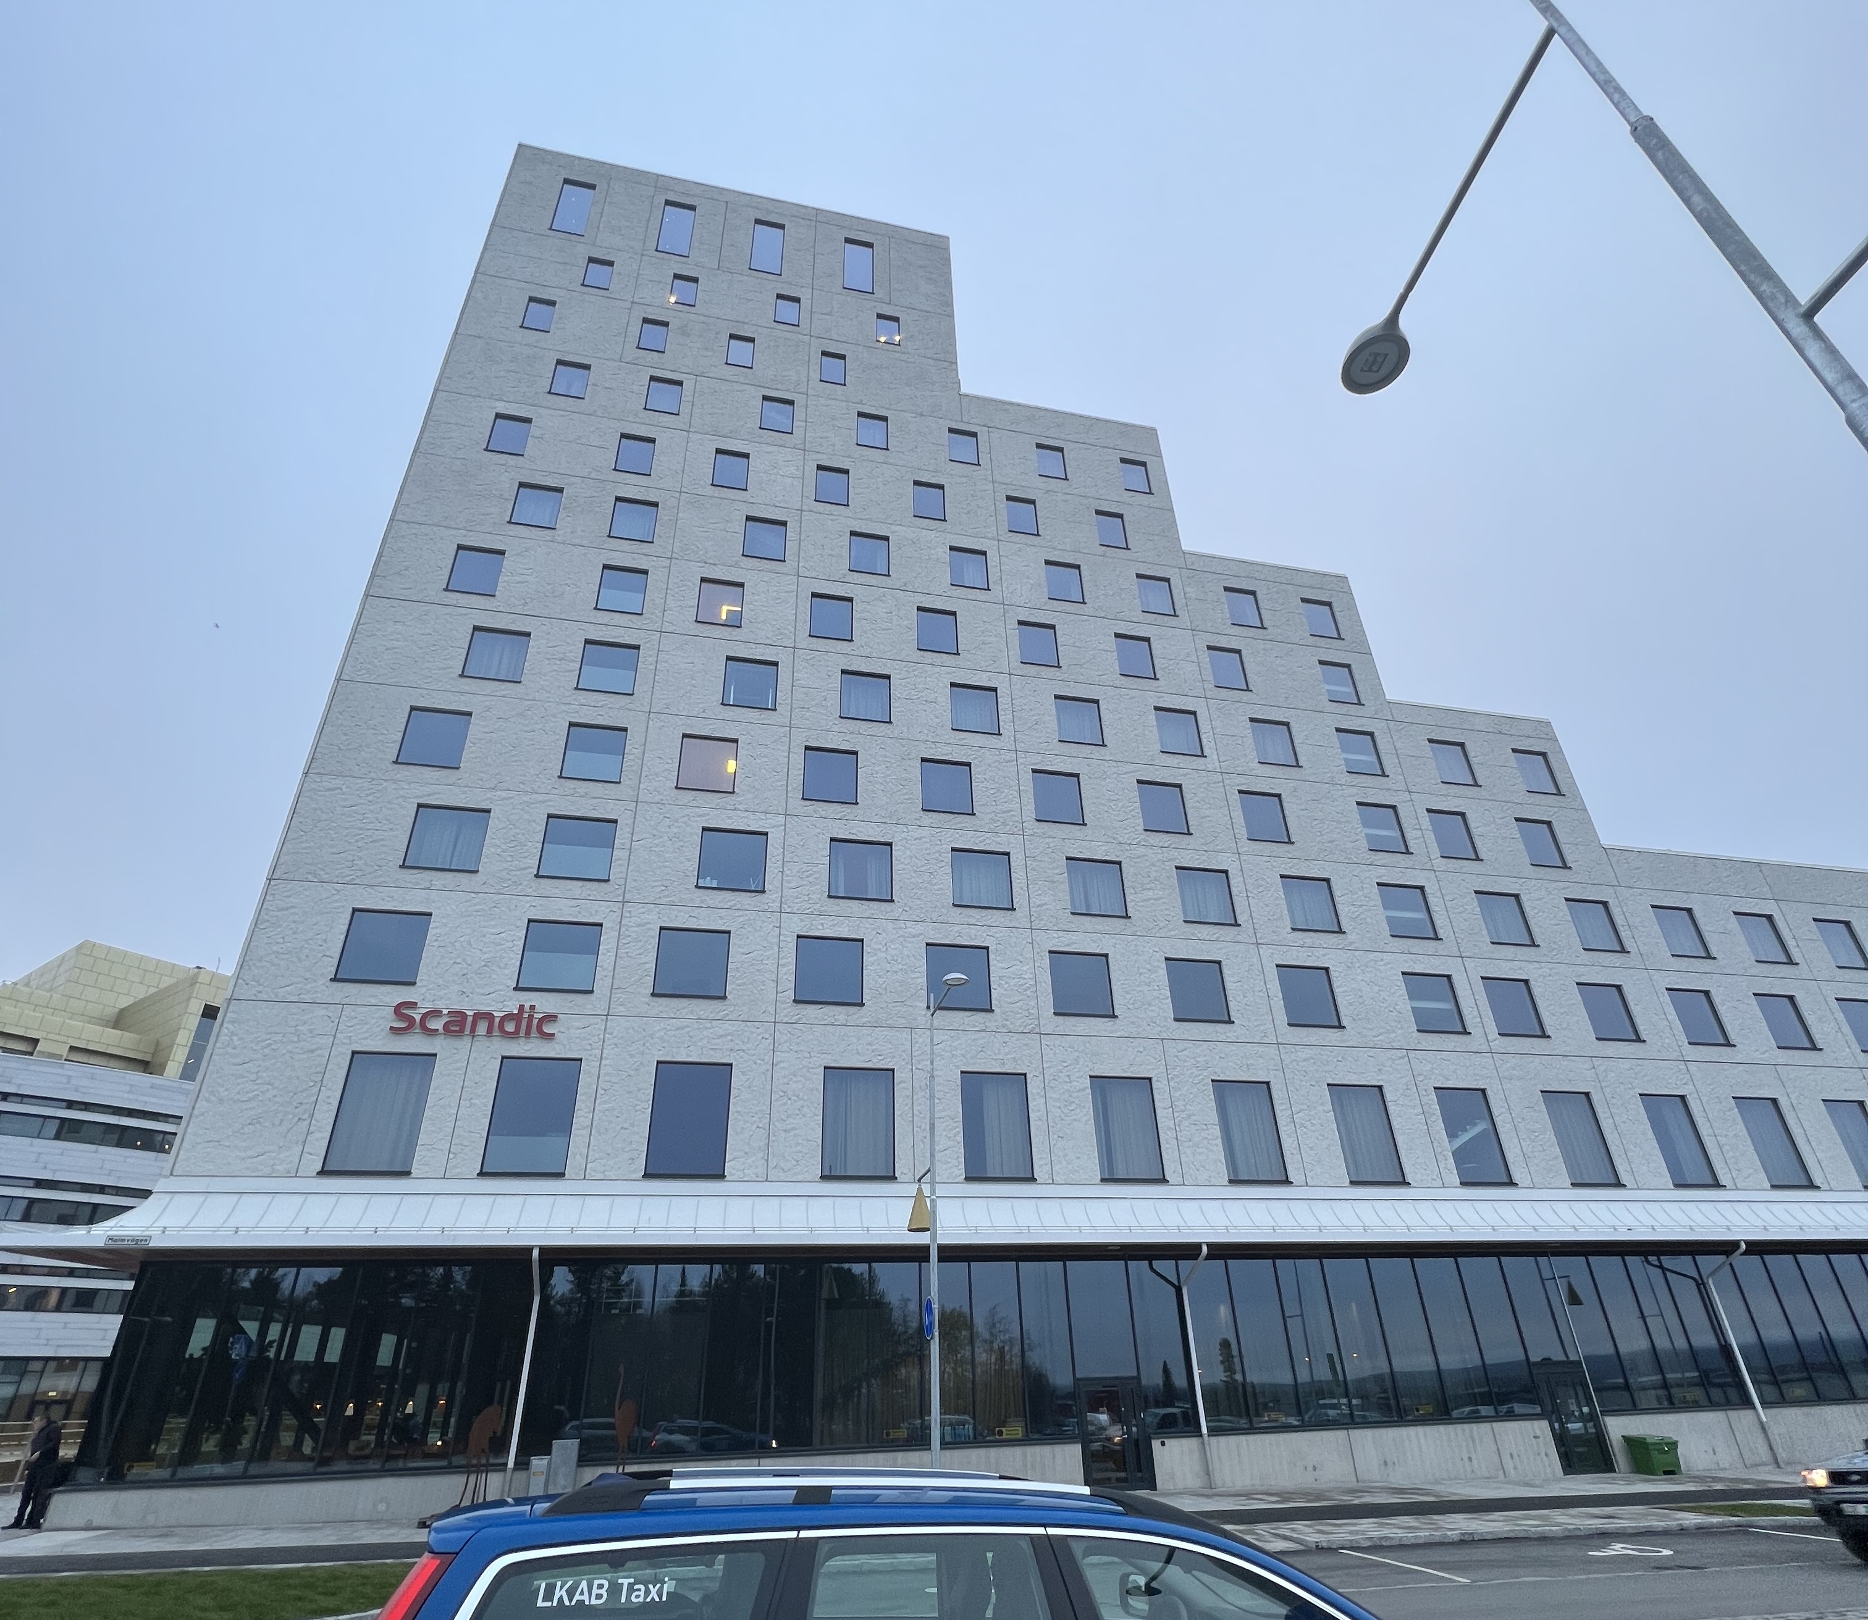
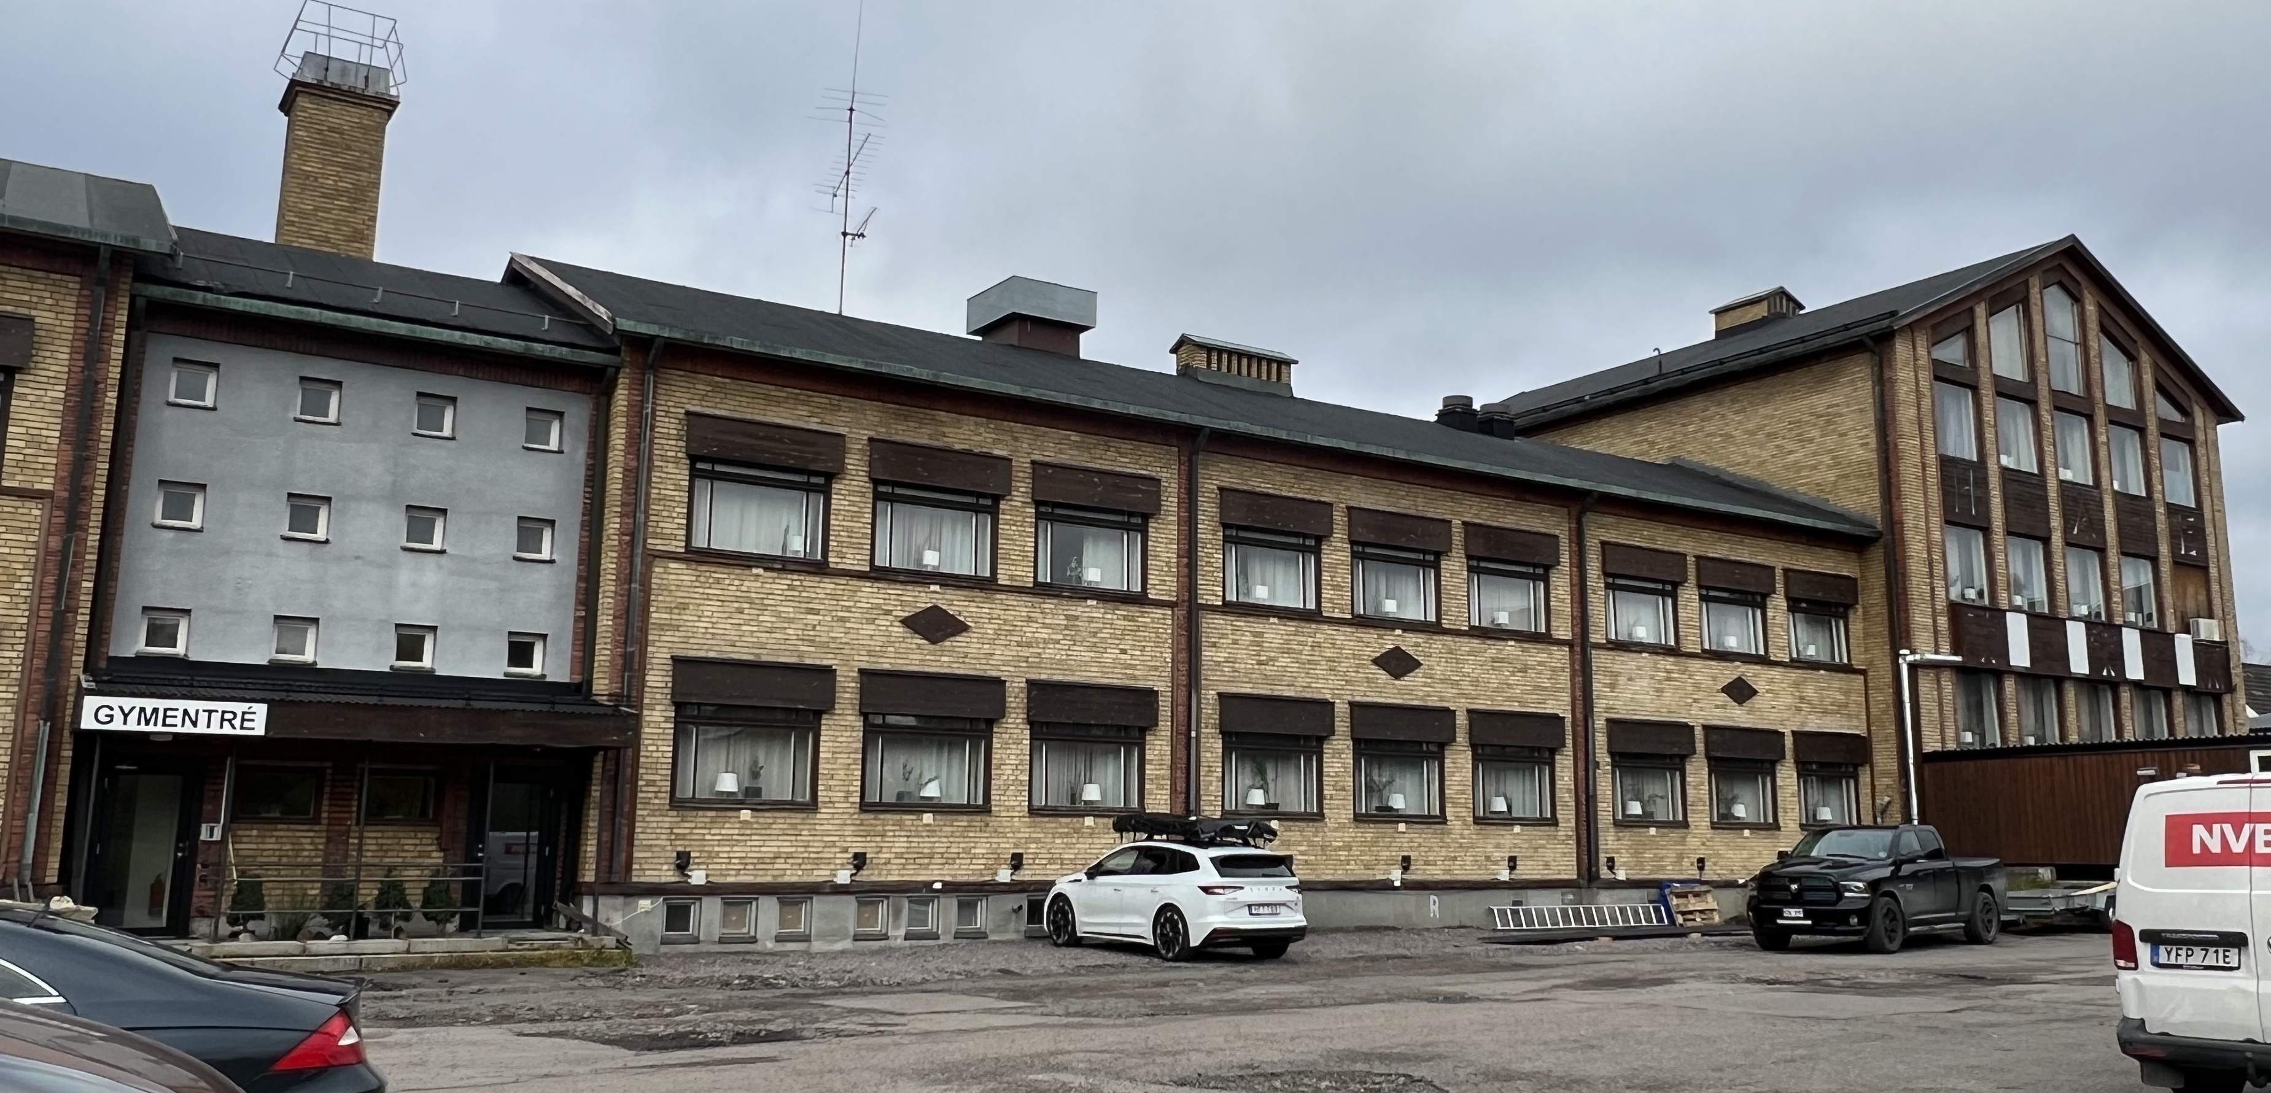
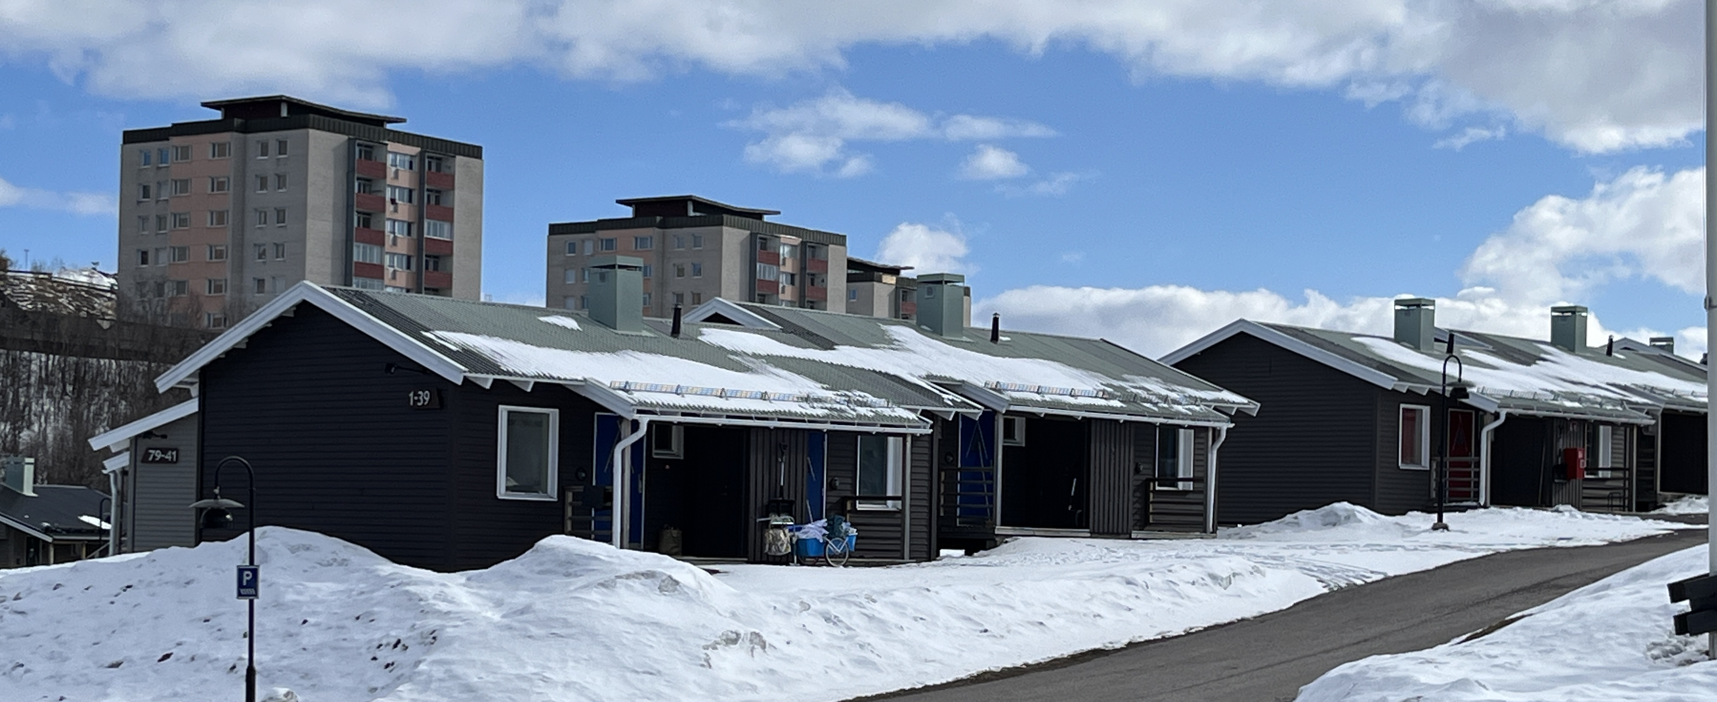
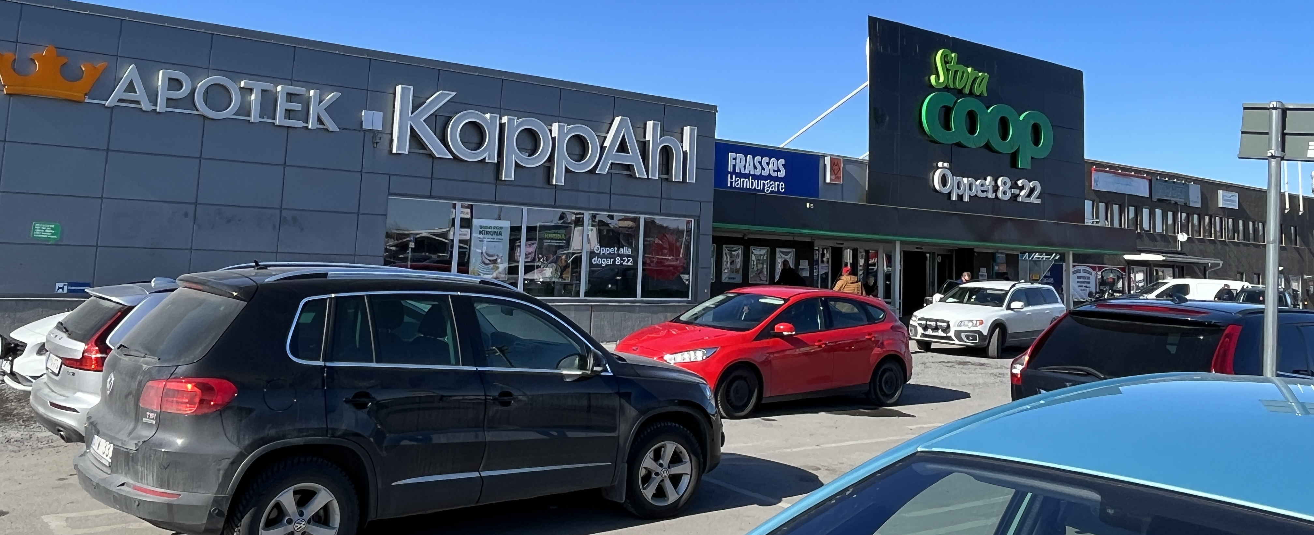
Kiruna Living
Population: ~26,000
High season is Feb – Mar
Skiing, snowmobiling, northern lights, Ice Hotel, etc.
Hotels
Scandic Kiruna (largest)
Best Western
Camp Ripan (very limited)
Support
Grocery stores
Number of restaurants
Sporting goods (cold weather gear)
Laundry?
CAESAR Science & Planning Meeting

Slide 17
Other Items of Interest
Weather
Daylight: 8.5 hrs (2/20) increasing to 15 hrs (4/10), gaining ~8 min/day
Cold: Mostly below freezing, sometimes below 0 F
Snow: 5 – 6” per month in Feb, Mar, Apr (Winter 22-23 was above ave.)
Visa requirements
US citizens – only passport needed for up to 90 day stay
EU may be going to an ESTA structure; will need to track
Foreign participants – may need Schengen Visa, check list
https://www.schengenvisainfo.com/who-needs-schengen-visa/
Shipping
Containers
Likely going in the fall
Ship as many consumables as possible
Air shipments
Unclear how long they will take
Will work with freight forwarder to make as painless as possible
CAESAR Science & Planning Meeting

