Slide 1
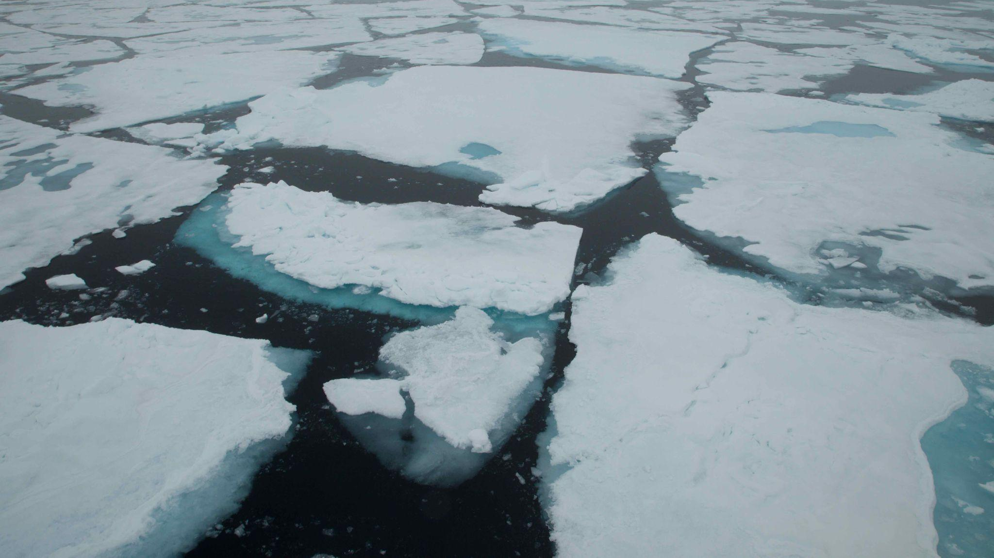
NCAR CESM2 Modeling for CAESAR
Xiaohong Liu and Tyler Barone (Texas A&M University)
Objectives
Evaluate the NCAR CESM2 model performance using single column model (SCM) and nudged global model simulations. CAESAR aircraft sampled clouds/aerosols along the trajectory of CAOs will be compared with CESM2 model simulations.
Examine whether CESM2 can reproduce cloud and aerosol states and transitions between stratiform and shallow cumulus states during CAOs.
Research Questions
1) Based on CAESAR observations, how well does the CESM2 model simulate cloud properties and cloud-aerosol interaction processes during CAOs (e.g. fetch-dependent cloud phase, mesoscale organization, convection)?
2) Are CESM2 biases of cloud properties correlated with the distance from the sea ice or CAO intensity?
CESM2 sets-up
1) Single Column Model (SCM) Simulation
- SCM moves in Lagrange mode following the winds along the CAO trajectory
2) Nudged Global Model Simulation
- Nudged 2-D wind and temperature field toward MERRA-2 reanalysis data
- High-frequency output of modeled clouds, aerosol, and radiation.
Texas A&M University Image (https://missionblue.org/wp-content/uploads/2018/06/KM-2920.jpg)

