Slide 1
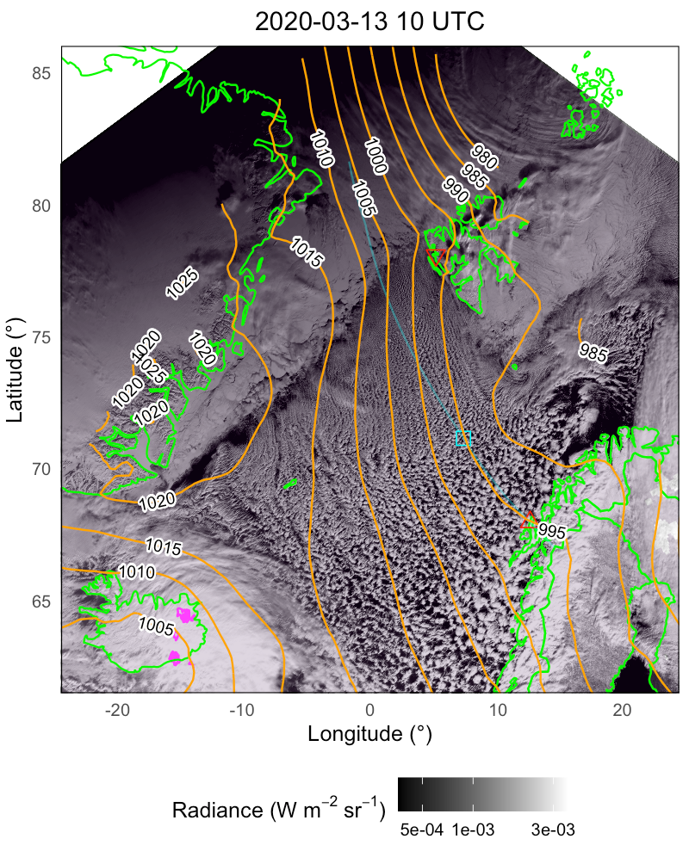
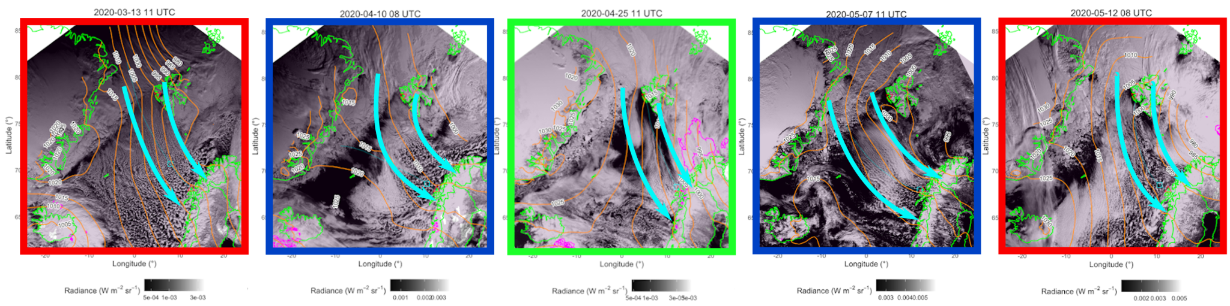
CAO cases for COMBLE-Model Intercomparison Project (MIP)
Please check out our poster for case specifics!
Closed-to-open transitions
Moderate large-scale subsidence
Relatively little PBL deepening
Relatively swift cloud fraction decrease
Roll-to-cell transitions
Little-to-no large-scale subsidence
Substantial PBL deepening (reaching 4-5 km)
Gradual cloud fraction change, dominated by cells that grow in size with fetch
VIIRS (NOAA20 & SNPP) day-night-band imagery paired with ERA5 surface pressure

Slide 2
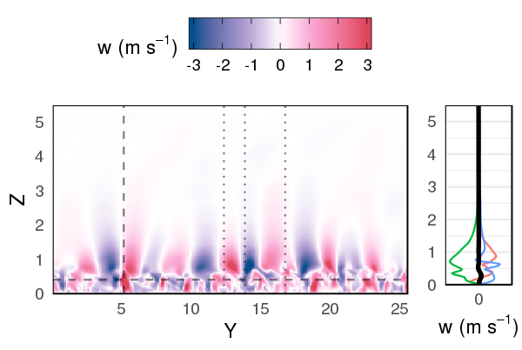
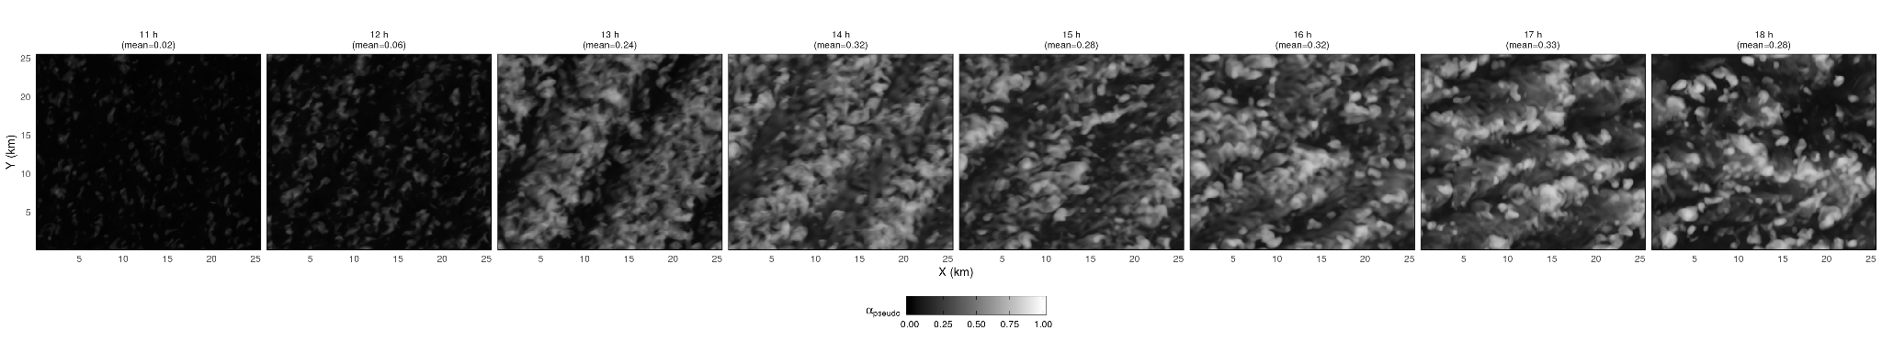
Upwind and fetch measurements that we think may help better constrain models during CAOs: kinematics/dynamics and thermodynamics
Dropsondes
  Large-scale thermodynamic structure, esp. inversion strength and stability profile evolution from upwind of ice edge to downwind BL
  Wind shear profile, including along-ice edge jet strength/location
In-situ probes
  Pressure gradient force to determine ageostrophic wind component
  3D winds, temp, and moisture (can compute turbulence statistics)
Radars/lidars
  Cloud top height (rate of BL deepening under convective conditions)
  Temp/moisture structure above cloud top
LW radiometric
  Skin temperature of underlying sea surface (Lagrangian data points)
  Downwelling LW above cloud top
  Lagrangian evolution of cloud top temperature
Lidars/in-situ probes
  Gravity wave structure structure above cloud top
Iteration on March 13 using DHARMA LES (first 4 hours)

Slide 3
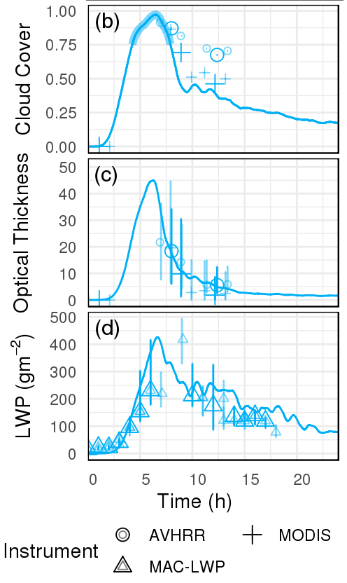
Upwind and fetch measurements that we think may help better constrain models during CAOs: aerosols, macro- and microphysics
rain onset
LWP and IWP (note: LWP provides strongest constraint on IWP in current case studies)
Aerosol size distribution profiles, including INP measurements
Droplet and ice particle size distributions
Ice hydrometeor single-particle characteristics
(e.g., degree of riming, presence of drizzle-size drops and SIP)
Cloud and precipitation structure (optical depth, reflectivity, organization state)
Cloud top and cloud base liquid boundaries
IWC/LWC/TWC from profiling flight legs in different cloud regimes (e.g., cloud streets, transition, and cellular)
Example from ACTIVATE pre-campaign case using various satellite products, including MAC-LWP (Elsaesser et al., 2017)

