Slide 1
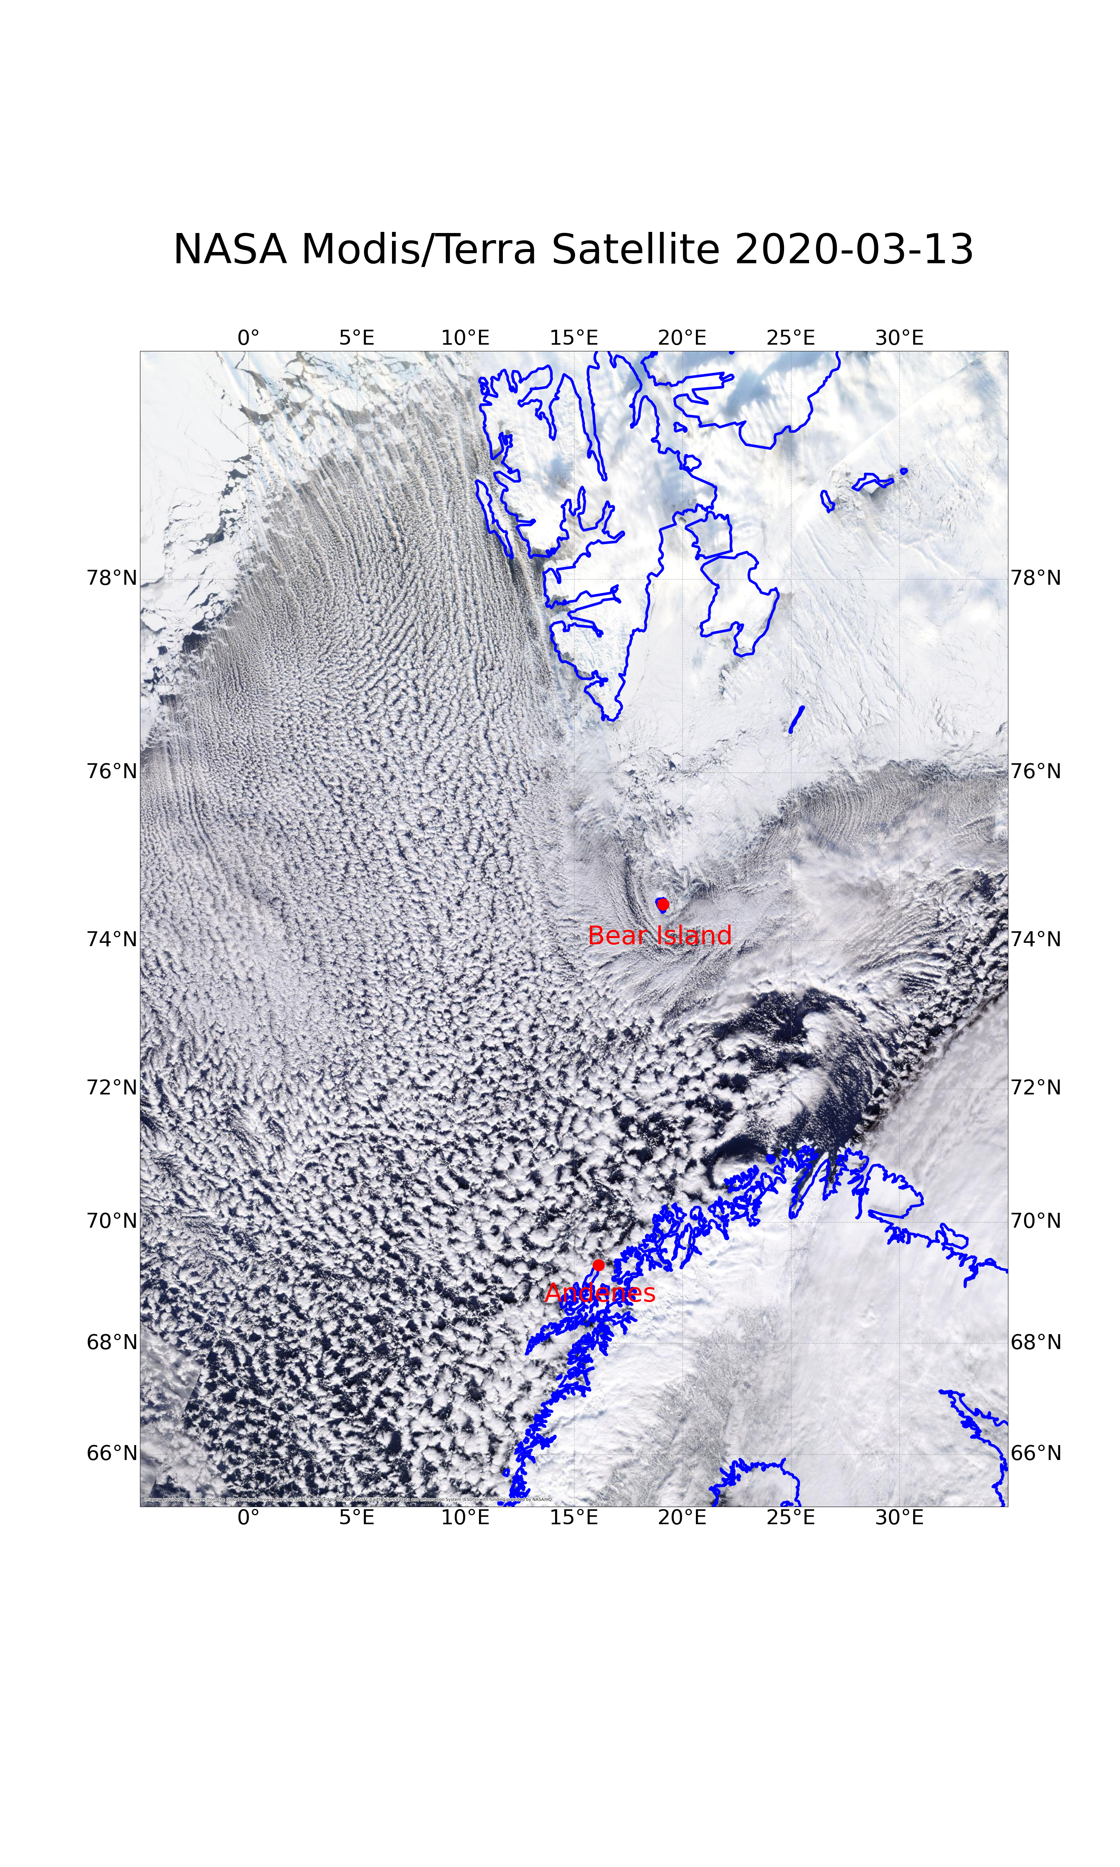
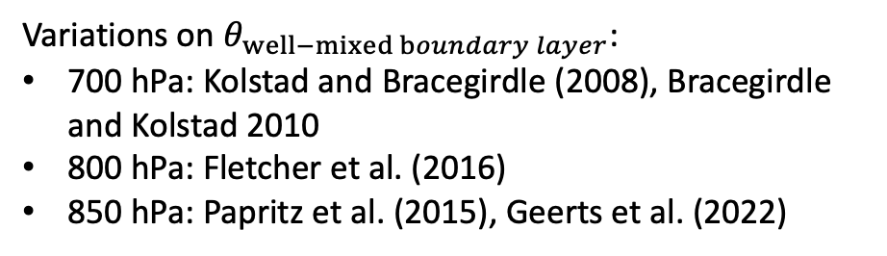
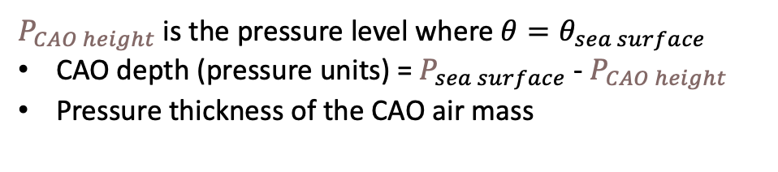

1. Cloud morphology (e.g., from satellite imagery or convection-permitting model output, like Arome Arctic)
Identification of CAO events
cloud streets, roughly aligned with the wind
mostly open cells
closed cells / StratoCu
2. Low-level thermal instability:
(a) Positive M index (most common)
$$M ≡ θ_{SST} − θ_{well−mixed boundary layer}$$
Variations on $θ_{well−mixed boundary layer}$:
700 hPa: Kolstad and Bracegirdle (2008), Bracegirdle and Kolstad 2010
800 hPa: Fletcher et al. (2016)
850 hPa: Papritz et al. (2015), Geerts et al. (2022)
(b) CAO height < 800 hPa (Terpstra et al. (2021))
$P_{CAO height}$is the pressure level where $θ=θ_{sea surface}$
CAO depth (pressure units) = $P_{sea surface}$- $P_{CAO height}$
Pressure thickness of the CAO air mass

Slide 2
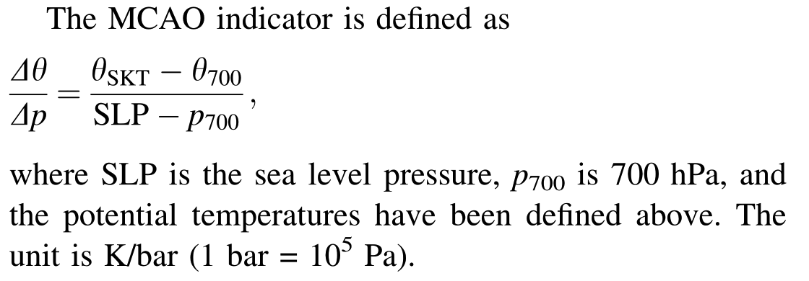
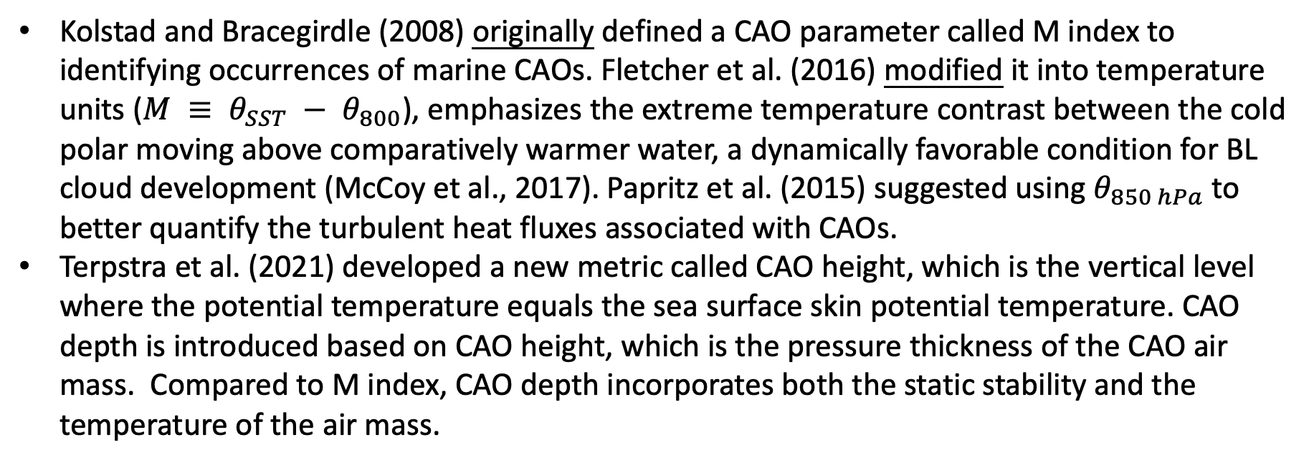
From Kolstad and Bracegirdle (2008), the M index is defined as :
Kolstad and Bracegirdle (2008) originally defined a CAO parameter called M index to identifying occurrences of marine CAOs. Fletcher et al. (2016) modified it into temperature units ($M ≡ θ_{SST} − θ_{800}$), emphasizes the extreme temperature contrast between the cold polar moving above comparatively warmer water, a dynamically favorable condition for BL cloud development (McCoy et al., 2017). Papritz et al. (2015) suggested using $θ_{850 hPa}$ to better quantify the turbulent heat fluxes associated with CAOs.
Terpstra et al. (2021) developed a new metric called CAO height, which is the vertical level where the potential temperature equals the sea surface skin potential temperature. CAO depth is introduced based on CAO height, which is the pressure thickness of the CAO air mass. Compared to M index, CAO depth incorporates both the static stability and the temperature of the air mass.

Slide 3
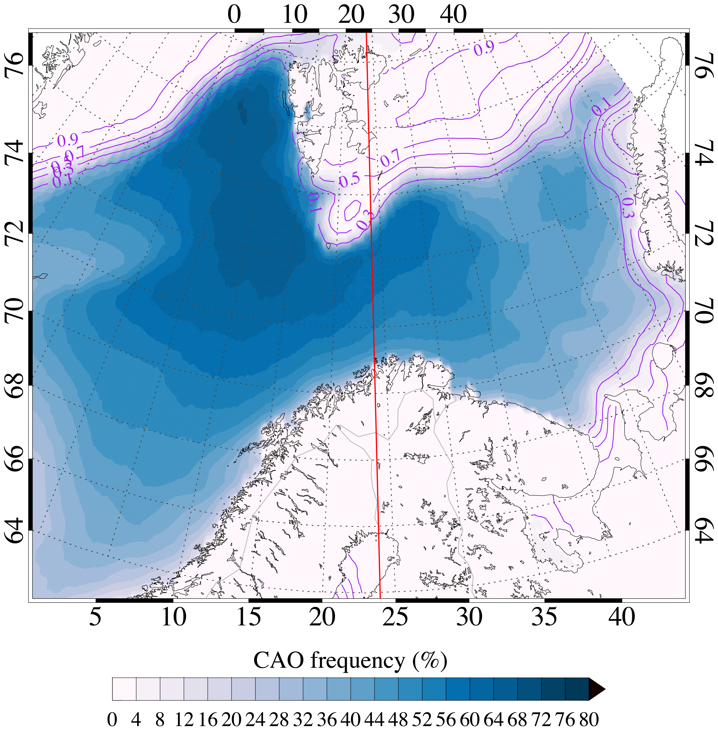
MCAO climatology
A: Andenes
K: Kiruna
Data: ERA5 reanalysis
Time: 2017 – 2022, between 22 Feb – 7 April only
CAO criteria
  M > 0 (M=θ_{skin} – θ_{850 mb} (K) )
  v < 0 (v - meridional wind)
  Sea ice < 10%
Fram
Strait
max:
62%
Barents Sea
24°E
Norwegian Sea
.
Andenes
.
Kiruna

Slide 4
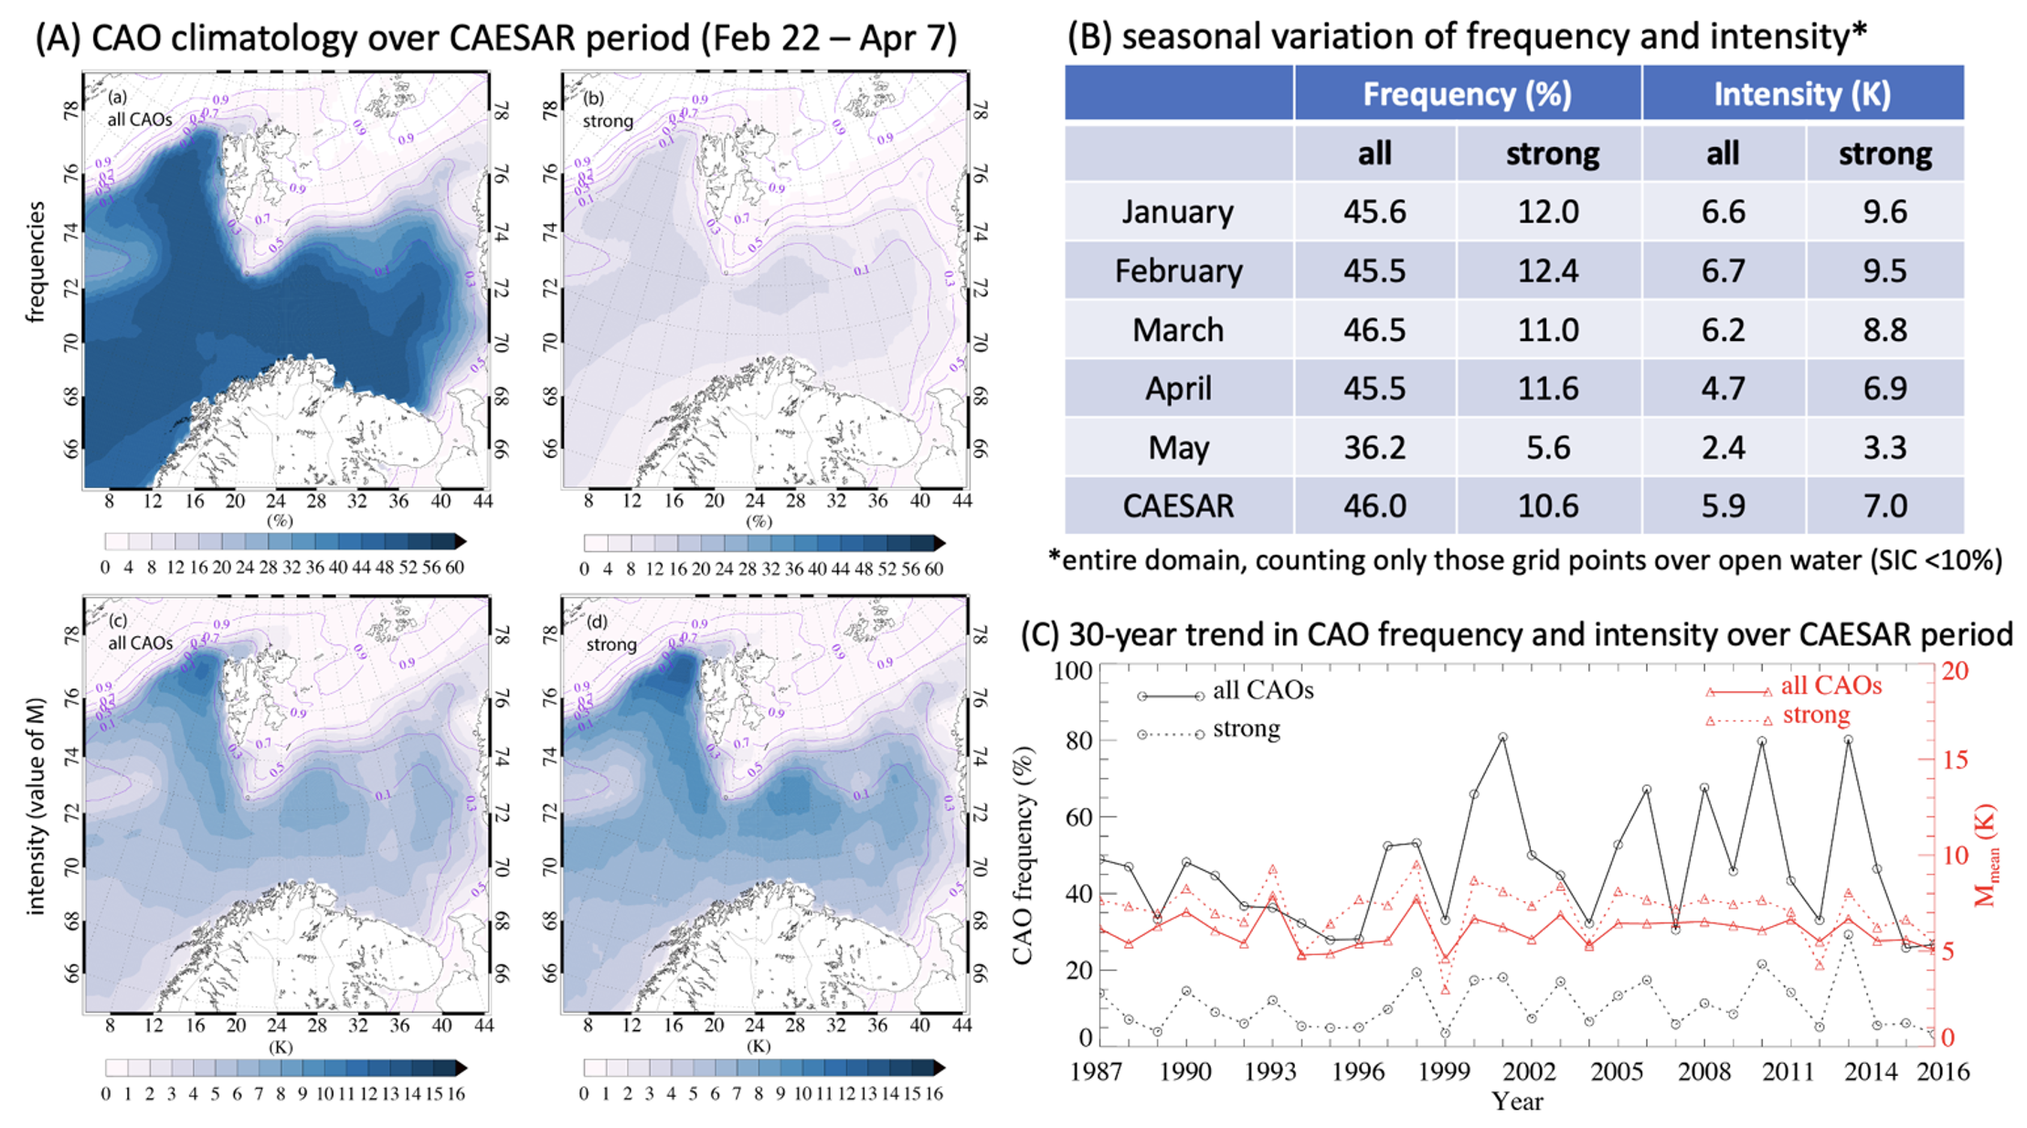

Slide 5
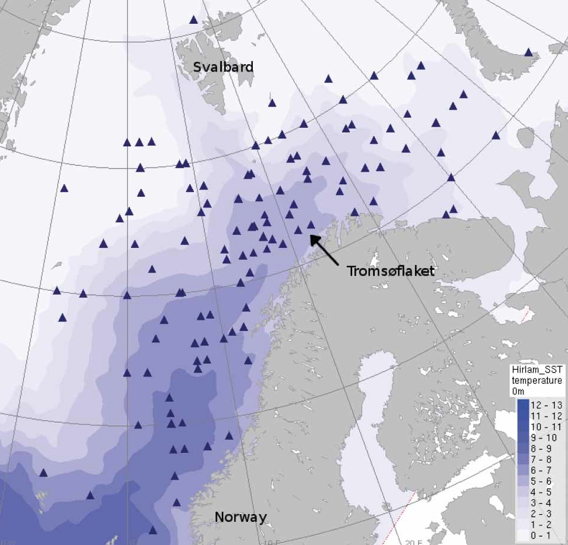
polar low
climatology
24°E
. Kiruna
Noer et al. 2011

