Slide 1
Mesoscale dynamics and mixed-phase microphysics of the marine CAO cloud regime
Bart Geerts and Jeff French
U. Wyoming

Slide 2
Relevant CAESAR hypotheses: mesoscale dynamics
H2a. Measurable helical convective roll (HCR) circulations with up/down-drafts approaching O(1 m/s) exist in the sheared BL heated from below, resulting in the alignment of convective cells in cloud streets, but the convective updraft strength typically exceeds that of the HCRs.
H2b. The spacing of cloud streets is controlled by BL winds and cloud processes, not by convectively-induced gravity waves above the MBL.
H2c. Transitions in mesoscale organization (linear to cellular convection, and open to closed cells), is more correlated with convective processes such as cold-pool formation and precipitation-induced stratification, than with wind shear.
H5a. Polar low clouds are mostly convective and result from rapid local ascent (potential instability release) rather than slow, broad ascent.

Slide 3
Relevant CAESAR hypotheses: cloud microphysics
H3b. Primary nucleation becomes increasingly important with fetch. Ice-nucleating particles (INPs) are present in insufficient numbers to fully consume liquid mass. When present, cloud-top generating cells are the primary loci for increased primary nucleation and result in local regions of increased ice mass and depleted super-cooled liquid water (SLW).
H3c. High ice concentrations develop in deepening clouds, principally driven by secondary ice production. Where this occurs is strongly correlated with the thermodynamic and microphysical structure of the clouds. Secondary production of ice requires clouds of sufficient depth to support growth of cloud droplets to a sufficient size, varying with the specific secondary process.
H3d. Turbulence modulates the precipitation-LWP relationship, through ice initiation and riming.

Slide 4
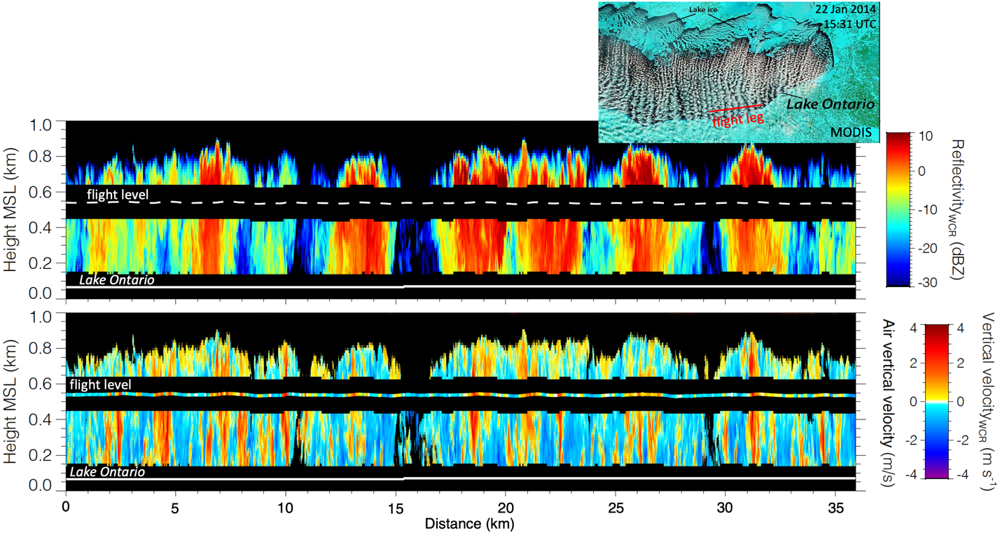
WCR data in the cloud street regime

Slide 5
CAESAR products
WCR best-estimate hydrometeor vertical velocity w-V_{t} (all level flight legs, up and down)
dual-Doppler synthesis of the along-track (u) and vertical (w-V_{t}) hydrometeor flow below the aircraft (select legs)
ice water content (IWC)
  in situ (Nevzorov)
  retrieved from KPR (down) & WCR (up and down)
Ka-W band dual wavelength ratio (DWR)
  estimation of ice particle median volume diameter D_{o} and particle concentration N_{i},

