Slide 1
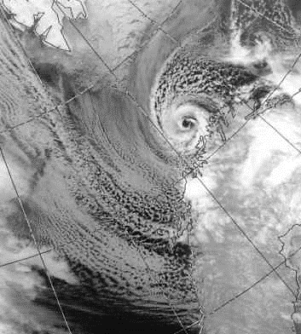
Cold-Air Outbreaks and Polar Lows Overview of NRL’s Program
Svalbard
James Doyle
Marine Meteorology Division
U.S. Naval Research Laboratory
Monterey, CA
james.doyle@nrlmry.navy.mil
Ice
Polar Low
Qingfang Jiang
NRL-MRY, LES / PBL Modeling,
Rolls, Cold-Air Outbreaks
Alex Reinecke
Numerical methods, high-resolution modeling, grid refinement for polar lows
Cold-Air
Outbreak
200 km
Norway
Reuben Demirdjian
NRL-MRY, Mesoscale Modeling, Polar Low Dynamics & Processes
Kevin Biernat
NRC Post Doc, Mesoscale Modeling, TPVs, Polar Low Dynamics & Processes
Travis Smith (co-PI)
NRL-SSC, oceanography,
Coupled COAMPS, Polar Lows
Tommy Jensen
NRL-SSC, oceanography, air-sea processes, coupled COAMPS
David Hebert
NRL-SSC, sea ice (CICE modeling) ocean dynamics, coupled ESPC
https://www.dundeesat.co.uk/
NRL is providing additional support for flight hours to offset some costs for NSF
NRL is coordinating with ONR to possibly support several Saildrones
Likely participate in the field (1 – 2? people). Could serve in forecasting, flight planning/execution, science roles.
Distribution Statement A: Approved for public release. Distribution is unlimited.

Slide 2
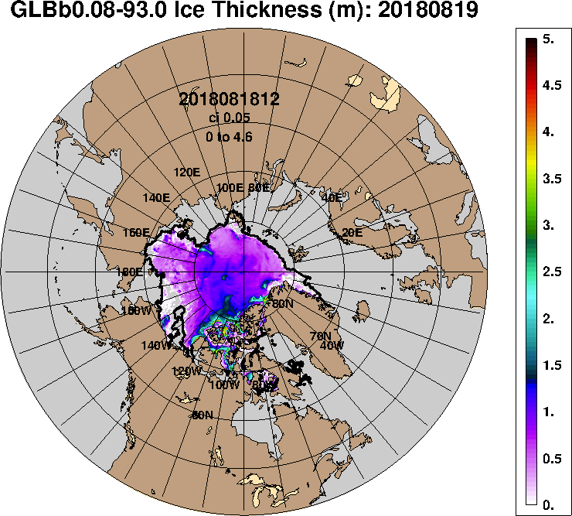
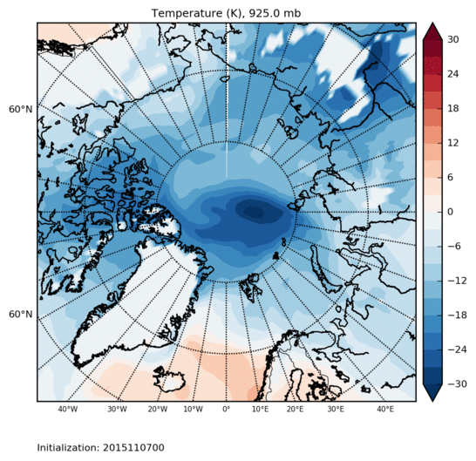
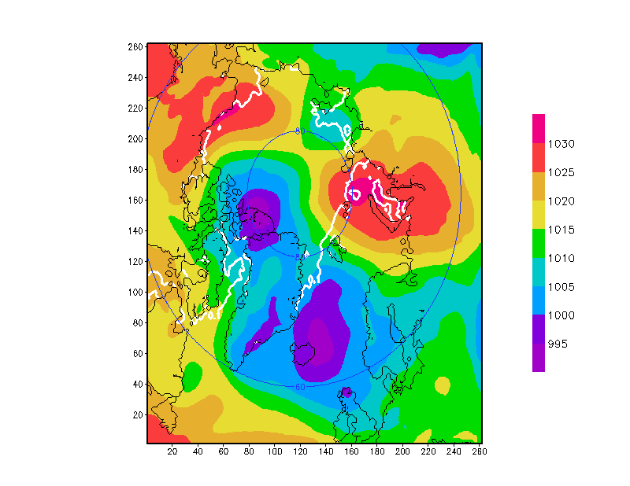
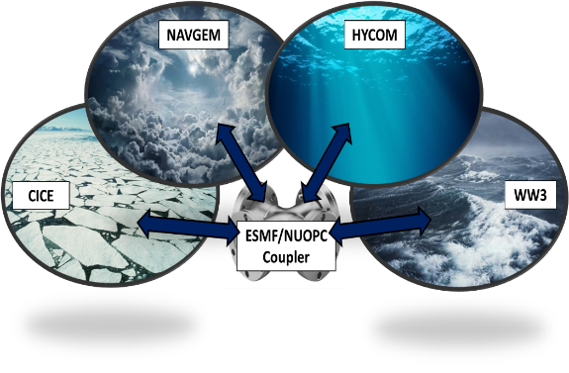
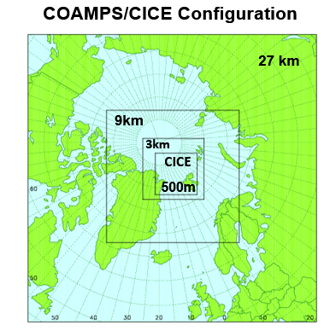
Models
Navy ESPC: Fully coupled S2S
45 day; 16 members; once weekly
Ensemble: NAVGEM (37km); HYCOM-CICE (1/12°)
Deterministic: NAVGEM (19km); HYCOM-CICE (1/25°) (2024 in ops)
NEPTUNE: Spectral element core; highly scalable and accurate
Common Community Physics Pkg.
Next-generation, unified regional, global, high-altitude option
Static mesh refinement (2024/25)
COAMPS: Coupled air, ocean (NCOM), wave (WWIII), ice (CICE)
Nested grids
Full suite of physics
LES option
Adjoint sensitivity
Global Ice Thickness (m)
925 hPa Temperature (°C)
24-h Fcst 00Z 21 July 2018
Sea Ice
27km

Slide 3
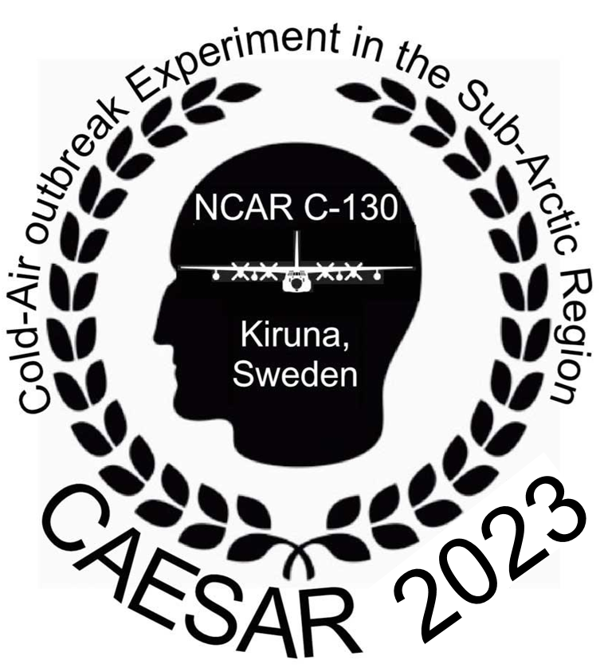
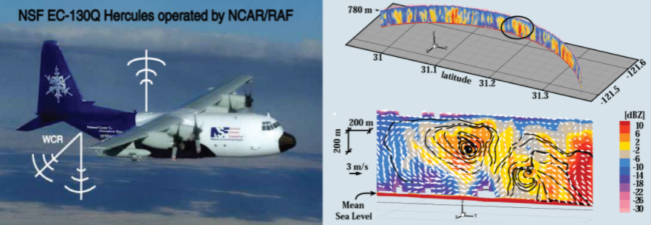
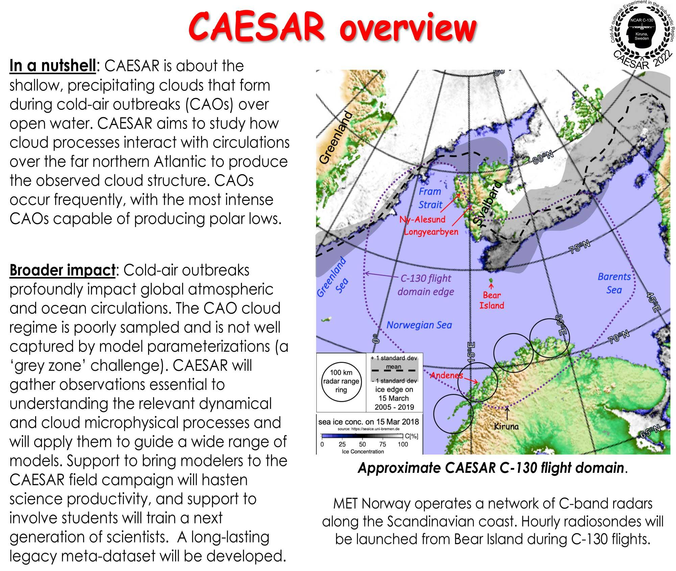
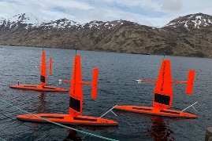
Research Approach
New Observations
Models
Diagnostics & Verification
CAESAR
Cold-Air Outbreak Exp. In the Sub-Arctic Region
(Feb – Apr 2023)
National Science Foundation
Large Eddy Simulation (LES)
Turbulence resolving resolutions (~50 m) with cloud processes
COAMPS LES, CM1
COAMPS Coupled Air-Sea-Ice
Fully coupled atmosphere, ocean (NCOM), sea ice (CICE) capability
COAMPS Adjoint
Mathematically rigorous method to compute forecast sensitivity
6 class microphysics and ocean mixed layer model
NEPTUNE Limited Area
Next-generation model for multi-scale cloud-resolving simulations
Cold-Air Outbreaks
Boundary layer processes (LES, COAMPS, CAESAR flux legs)
Cloud processes & dynamics (COAMPS, cloud radar and cloud lidar)
Air-sea-ice interactions (coupled COAMPS, fluxes, Saildrones?)
Polar Lows
Polar low genesis-intensification (COAMPS, LES?, cloud radar, dropsnd)
Quantify air-sea-ice interactions (COAMPS, flux legs, Saildrones?)
Predictability barriers-verification (COAMPS & adjoint, dropsondes, SAR, cloud-scale processes, water vapor)
Cloud Radar and Lidar
Saildrones & Drifters?
Other Datasets
MOSAiC
International Arctic Drift Expedition (2019-20)
COMBLE
Cold-Air Outbreaks in the Marine Boundary Layer Exp.
(2019-20)
Satellite Winds
SAR
Synthetic Aperture Radar data Sentinel-1
Scatterometer
Advanced Scatterometer (ASCAT)

Slide 4
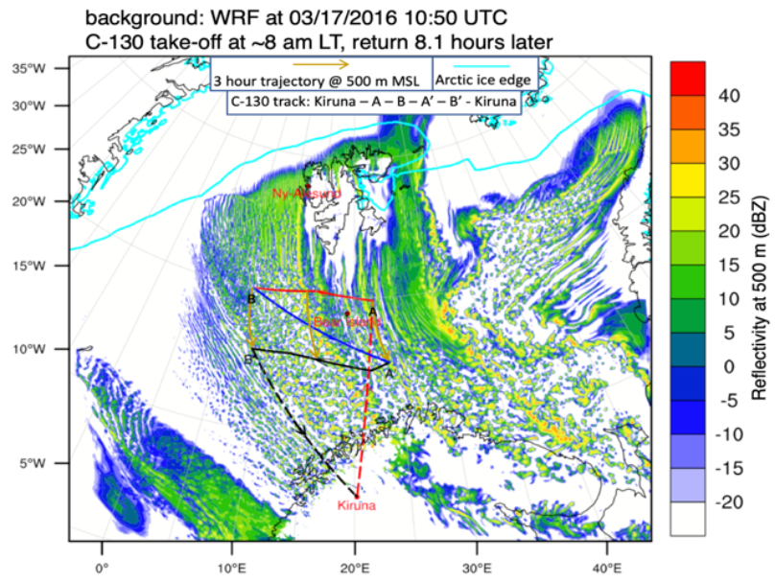
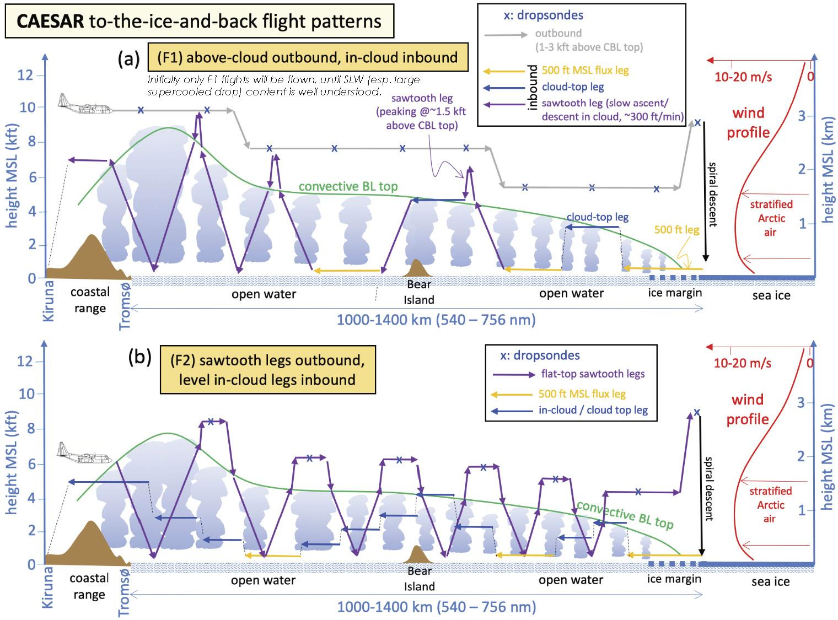
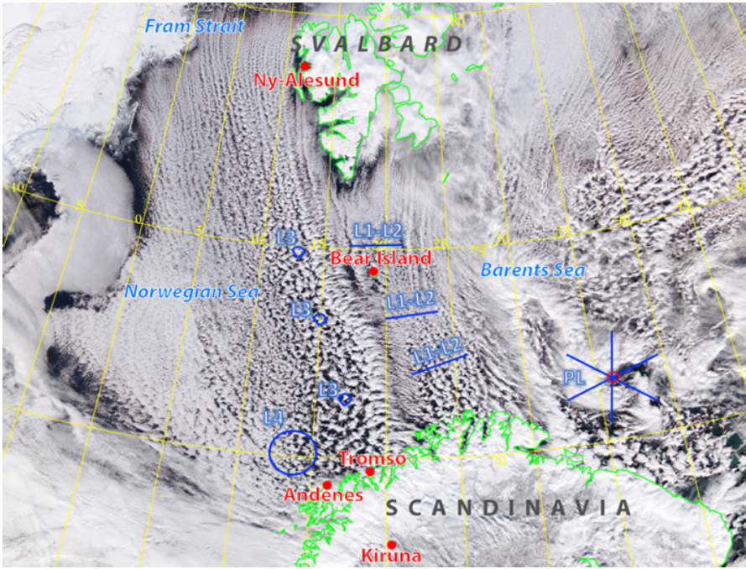
Observing Plans
CAESAR EDO
CAESAR EDO
CAESAR EDO
CAESAR schematic flight plans are generally complementary with the NRL objectives
May want to consider C130 overflights of Saildrones when feasible
Sampling to/from the ice edge is desirable when feasible; Lagrangian type of flights also desirable

