Slide 1
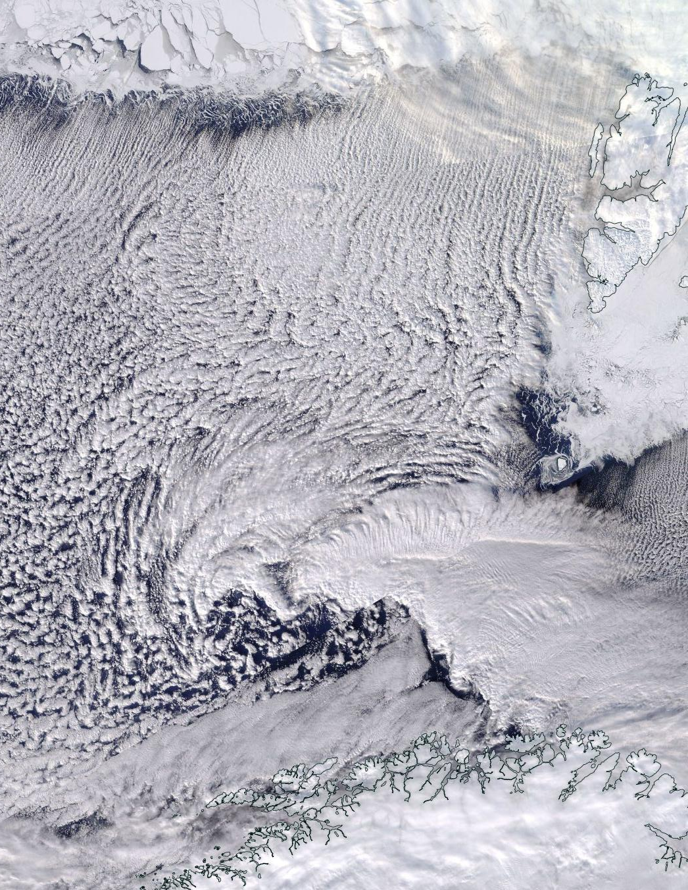
CAESAR proposed flight patterns
Full-fetch flights:
objective: remote sensing and in situ observations along-fetch, from the Arctic ice edge
Quasi-Lagrangian
objective: fetch-dependent changes in cloud properties
Local CAO conditions
Objective: statistical sampling of a given cloud regime
23°E
sample F1 flight tracks
inbound may differ some from outbound, and should be straight to Kiruna
. Kiruna
2020-03-12

Slide 2
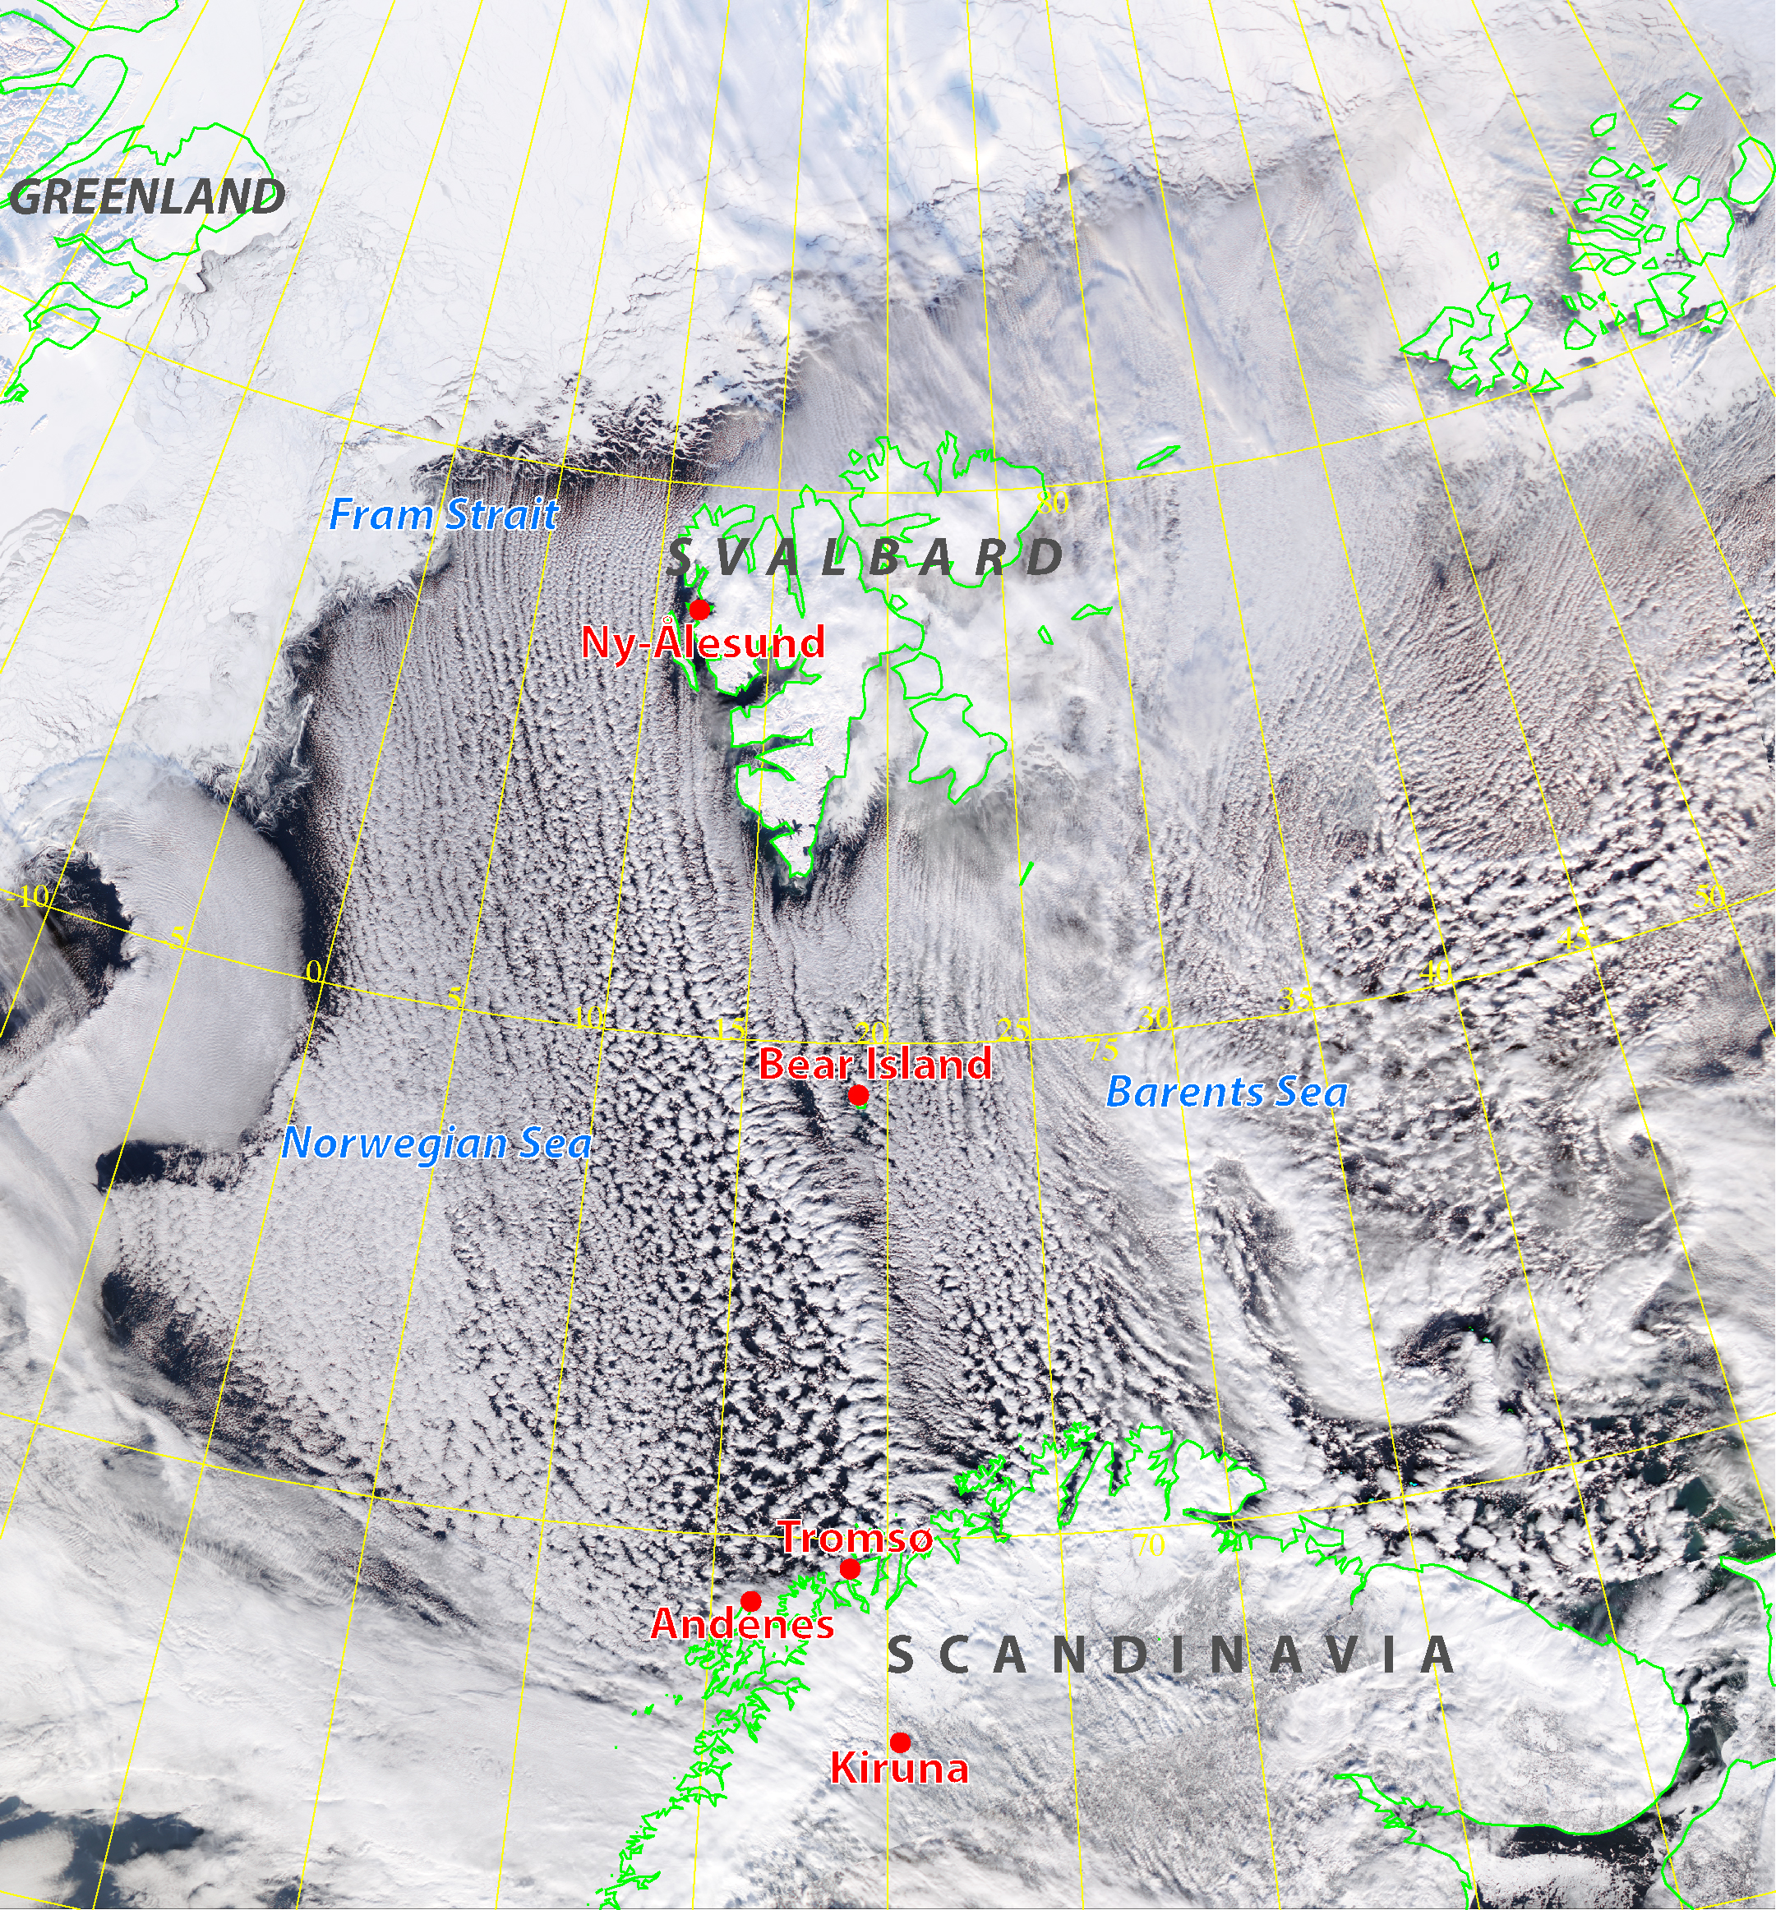
~1250 km
~830 km

Slide 3
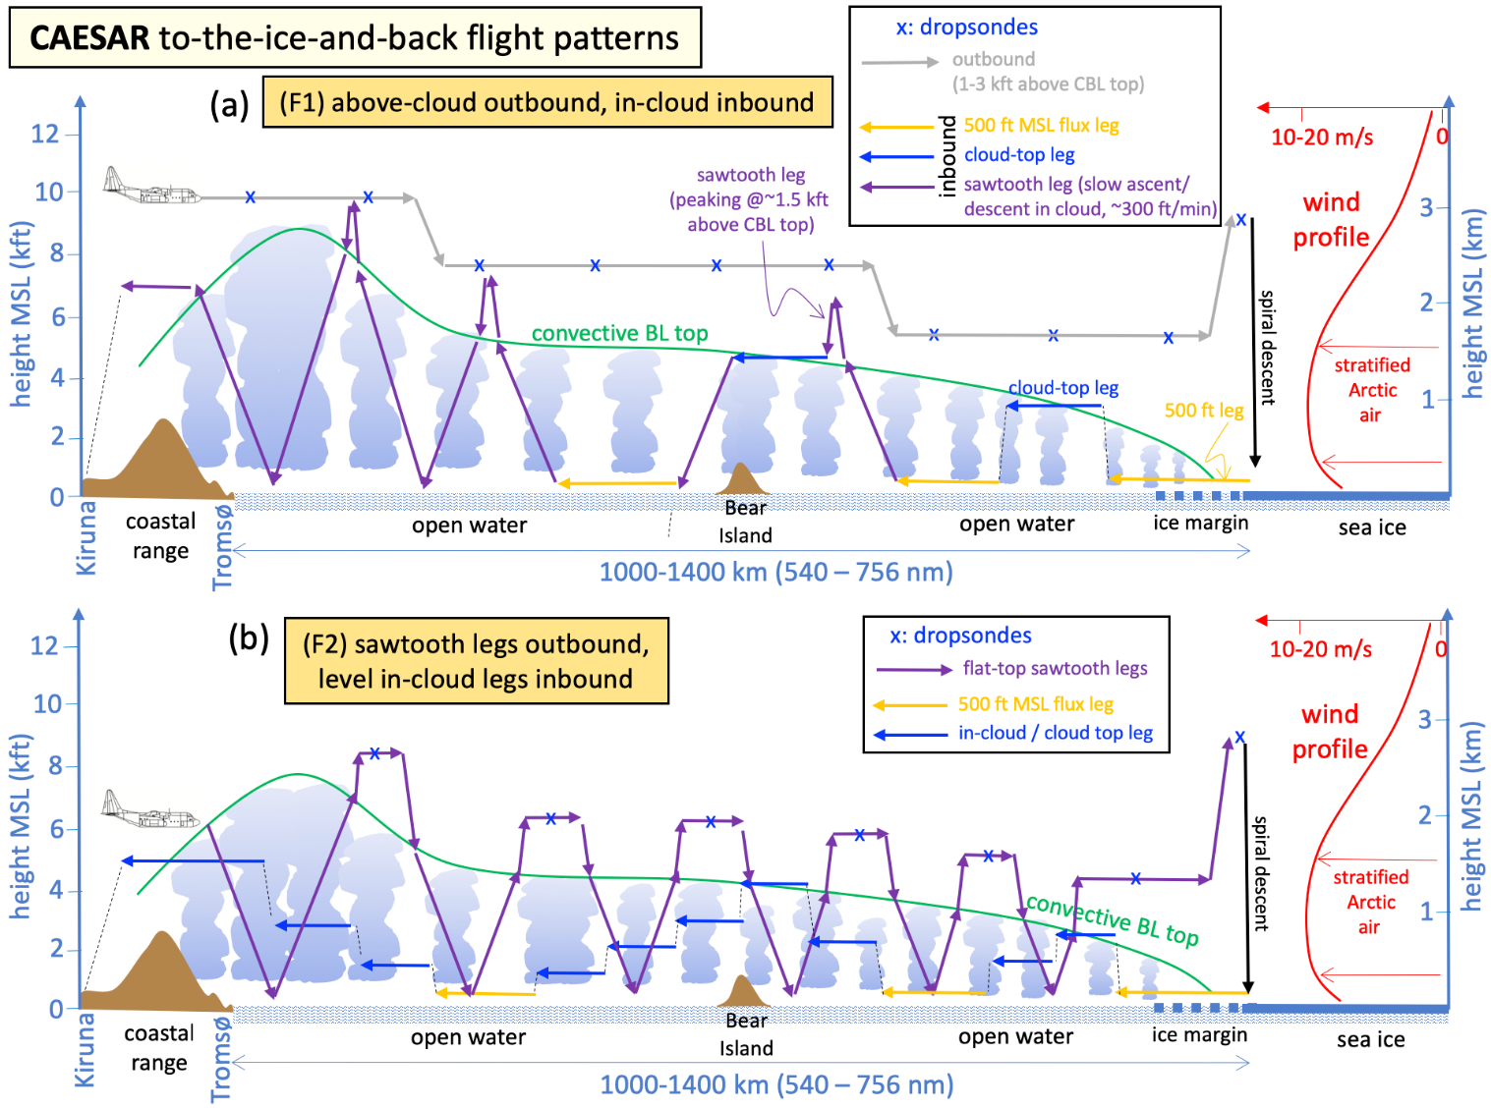
Full fetch flights: F1 and F2
Initial flight F1?
~300 m above cloud top
AVAPS dropsondes roughly every 100 km
Inbound Leg types:
~300 m above CT – 10 min
cloud-top legs – 10 min
flux legs (150 m MSL) – 10 min
sawtooth legs (150 m MSL – 500 m above CT), ~200 m vertical per min
Note: flux legs will not be possible if the cloud base is lower than 150 m, the visibility in snow showers is poor, and/or there is not enough daylight

Slide 4
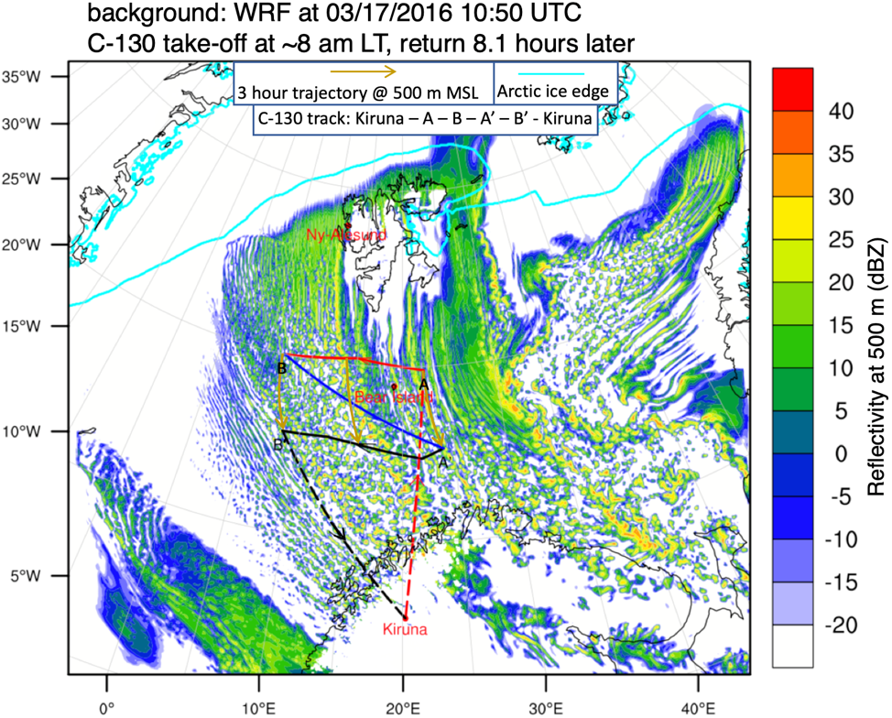
B1. Quasi-Lagrangian (QL): strong winds: parcel resampling on same flight
objective:
sample Lagrangian changes in PBL vertical structure, mesoscale circulation, cloud / precip / aerosol over a time period of a few hrs
details:
single pass only, at least 300 km long
flight level: in–cloud (mid PBL)
the outbound leg is above cloud level, and the inbound leg is similar to the F1-inbound leg.

Slide 5
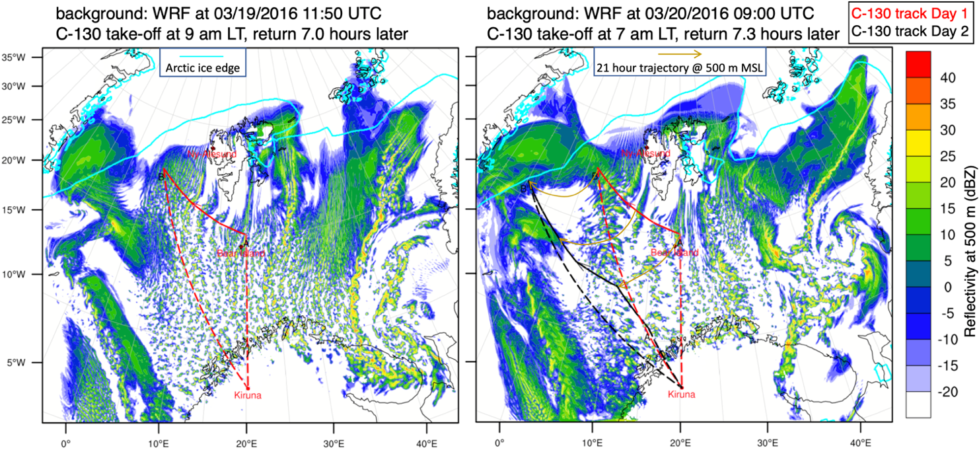
B2 Quasi-Lagrangian: weak winds: parcel resampling on next-day flight
Objective: sample Lagrangian PBL changes over a time period of nearly a day.
A2
B2
A1
B1

Slide 6
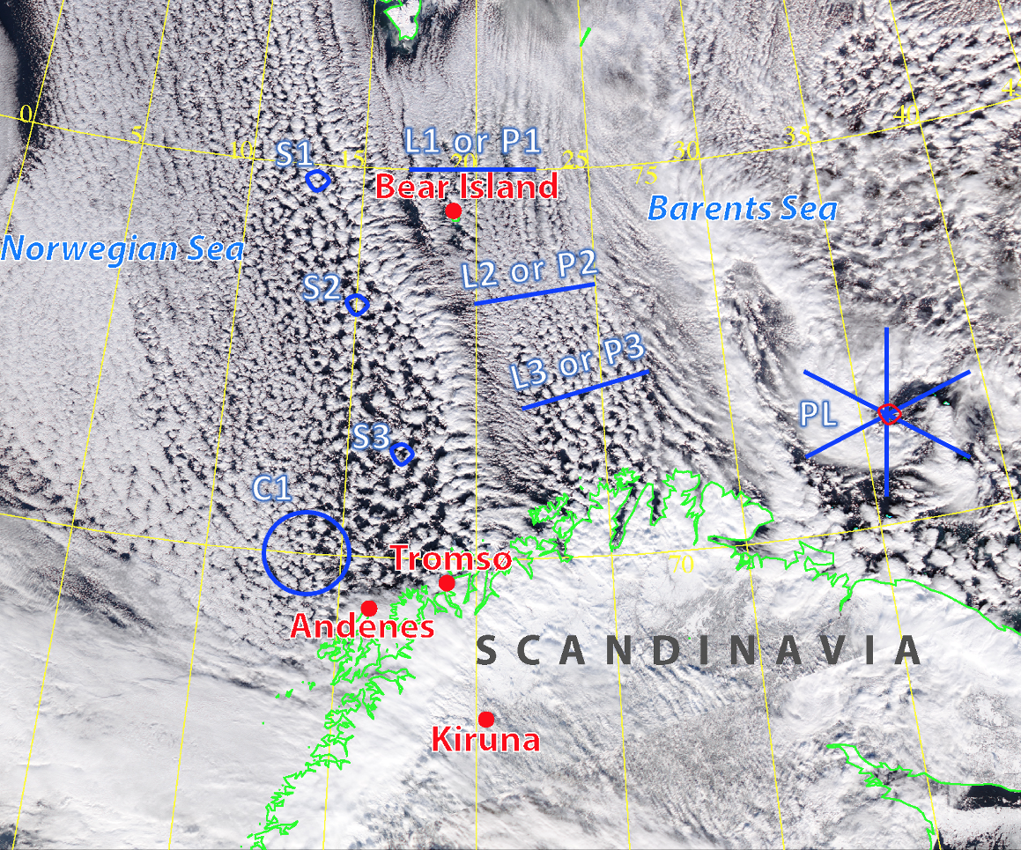
local CAO conditions L (local): Level legs across the prevailing wind and cloud streets, ~150 km long, at (a) 300 m above cloud top (b) cloud top legs (c) mid-BL (d) flux leg (150 m MSL) P: as L, but porpoising (sawtooth legs) S: spirals ~200 m /min, in & out of cloud C (circle): ~125 km diameter circles, drifting with wind, above cloud top and mid-BL PL: polar low traverses in at least 2 directions (rosette preferred if the PL is rather symmetric), 200-250 km long, starting just above cloud top, then mid-BL In all cases, the outbound leg is above cloud level, and the inbound leg is similar to the F1-inbound leg.

Slide 7
Flight pattern prioritization
F1 (or F2 if deemed feasible) if
CAO conditions extend from the ice edge across much of the Nordic Seas
the upstream ice edge is within reach
the maximum flight duration is NOT restricted (i.e., 9 hrs)
Polar Low (PL) if
the PL is sufficiently persistent, large, close to base
has not been successfully sampled yet
Quasi-Lagrangian (QL) if
the CAO conditions are widespread, at least 300 km wide in the cross-wind direction
CAO conditions are anticipated to persist during Leg 2 (same flight or next day)
Local CAO conditions (L, P, S, or C)
under all other conditions, or
if they have not been sampled enough
A scorecard will be maintained during the campaign to ensure that all objectives are pursued

Slide 8
action items:
develop Lagrangian trajectory tool using real-time ECMWF and AA NWP model output
develop RT tool to estimate CT height (radar), cloud LWC near cloud top below (lidar), and cloud base height (dropsondes). This info will be collected on the outbound leg and will inform the inbound leg of F1 flights
series of points [x₁,y₁,z₁,t]
travel time ~ δt
series of points [x₂,y₂,z₂,t+δt] Note z₂ $≈$ z₁
Notes:
Where will air sampled between [t1, t2] at a certain level z end up after δt hours? The second flight track should be flown such that the delta-t for all parcels along the track is fairly constant, about δt hours. Your student’s code should take in a line of [x1,y1,z1,t] points, and spit out a new line of [x2,y2,z1,t+ δt] points. We choose xx and the flight level z1 (roughly constant), and of course the initial flight leg. The delta-t δt can be short (part of the same flight) or long (to be flown the next day), depending on background winds.

