Slide 1
Software
Catherine Dewerd,
RAF Software Engineer
May 9, 2023
Notes:
NOTE: Background image can be used as is or changed for a particular presentation. Click: Slide > Edit master.

Slide 2
Contact information
RAF Software Engineering Team:
rafsehelp@ucar.edu
Janine Aquino - janine@ucar.edu
Catherine Dewerd - cdewerd@ucar.edu
Chris Webster - cjw@ucar.edu
RAF Data Manager:
Taylor Thomas - taylort@ucar.edu
RAF IT:
Mike Paxton - mpaxton@ucar.edu
CAESAR Science Meeting

Slide 3
Collection of Links
Due to current website migration these may change:
https://www.eol.ucar.edu/software/ric
https://www.eol.ucar.edu/software/aeros
General Overview:
https://archive.eol.ucar.edu/raf/Software/
Contains links to user manuals
Download areas for Aeros, RIC
Other netcdf viewing utilities: xpms2d, NCplot, NCPP
CAESAR Science Meeting
Notes:
NCplot:
view time-series data stored in netCDF files
NCPP:
allows the user to view histograms of PMS-1D and other size-distribution probe data in netCDF files
XPMS2d:
allows the user to view PMS-2D, 64 bit Fast2DC, 2DS, HVPS1, and CIP/PIP
RIC <-> user instrument interface sample
https://www.eol.ucar.edu/content/sample-instrument-emulator-python-0

Slide 4
Recommended for computers on the plane:
Internet Relay Chat Client (IRC)
Virtual Network Computing software (VNC)
Lroot access
Provided/Maintained By RAF:
Aeros
Remote Instrument Control (RIC)
other Netcdf utilites
Allows chat between in flight users and ground groups
Allows remote desktop access to windows computers on the plane
Real time operations sometimes require real time debugging: not having someone in the field have access to this info can lead to instrument inoperability for flights
CAESAR Science Meeting
Notes:
IWG1 Port = 7071
RIC ports are assigned per instrument, currently require encryption certificates
Semi-modern operating system: We prefer windows 10, older versions will be subject to limited network availability.
IRC recommendations:
hexchat (windows and linux)
xchat /xchat azure (linux/macos)
VNC
tightVNC/tigerVNC (windows/linux)
RealVNC

Slide 5
Aeros
Airborne Environmental Research Observation System (AEROS), is the NCAR Research Aviation Facility display program for real-time and post-processed data (netcdf format)
Primarily provides time-series, XY, and ascii plots
Optical Array Probe, Skew-T and 3D track plots are also available
Guaranteed variables are defined in the IWG1 standard, additional are subject to payload configuration
Seeing data from user instruments in real time:
UDP or Serial data feed to our data system
All variables sent are archived into our database real time
Will be available soon after the flight in netcdf format
Subsets can be sent to the ground for additional team members to view (one to many)
Notes:
In real-time mode, aeros reads from the PostgreSQL real-time data cache on the aircraft or mirrored ground database. Post flight visualization reads from netCDF files which follow the NCAR/RAF-nimbus conventions. Essentially read only access (1 to many).

Slide 6
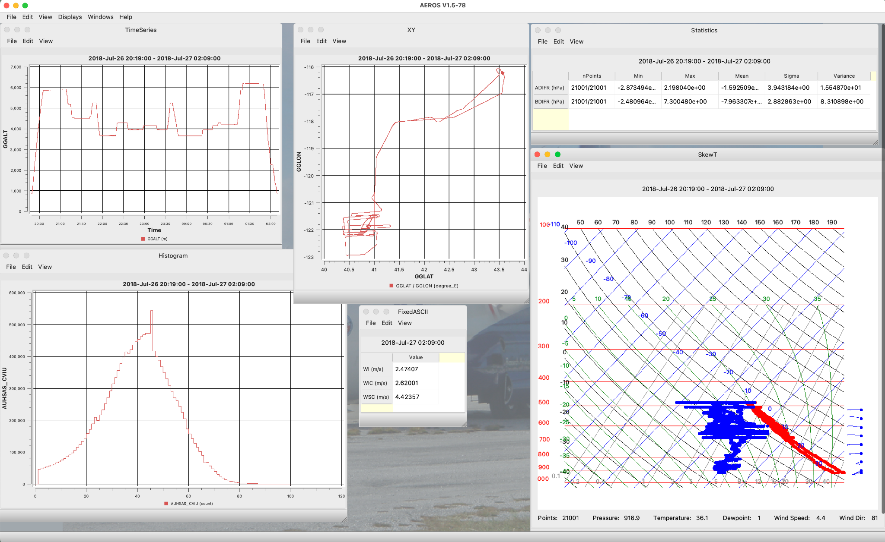
Aeros during WECAN project
Notes:
Example of AEROS during the WECAN project

Slide 7
Other Data Streams of Interest
IWG1
Ground Feed
Visible on plane
Contains date and time, plane position, speed, wind variables
Can be extended if payload instruments require real time variables from other payload instruments
https://archive.eol.ucar.edu/raf/Software/IWG1_Def.html
Subset of variables sent to our data system that is sent to the ground during flight, includes IWG1
Viewed via Aeros
Easy to modify, additional variables can be added for the very next flight
Notes:
In real-time mode, aeros reads from the PostgreSQL real-time data cache on the aircraft or mirrored ground database. Post flight visualization reads from netCDF files which follow the NCAR/RAF-nimbus conventions. Essentially read only access (1 to many).

Slide 8
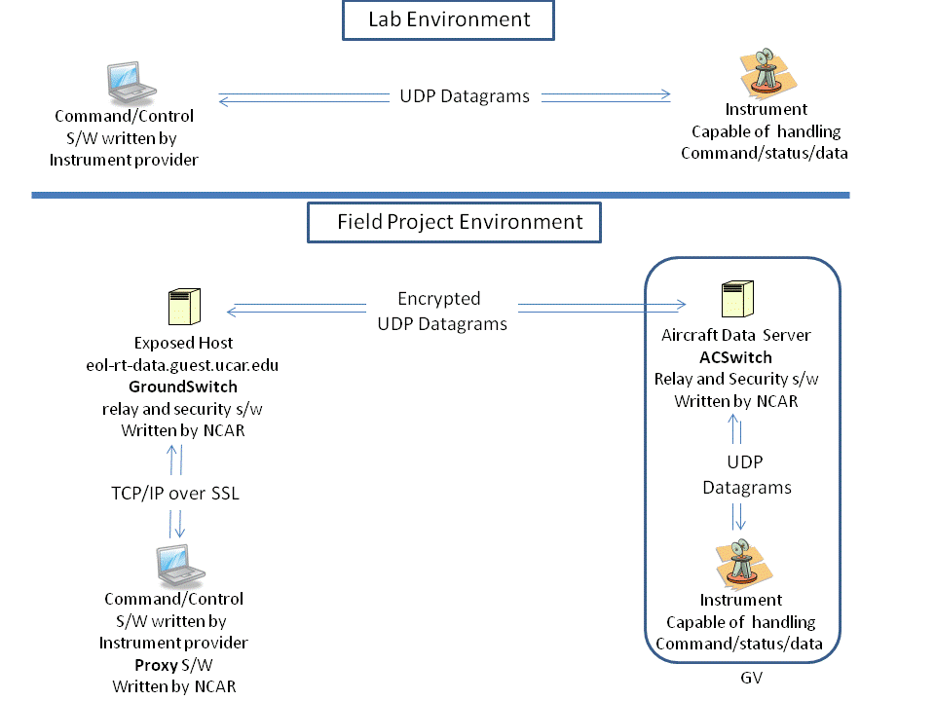
Remote Instrument Control (RIC)
Notes:
We did have examples of this on the old website, those need to be found.
Does not allow for multiple connections: one computer controlling.
Has to have security certificates on it.
Your computer on the Plane:
Requires sending and receiving additional UDP data feeds to/from our server on the aircraft
Your computer on the ground:
Requires sending and receiving UDP data feeds to/from a NCAR server that communicates with our server on the

Slide 9
NCAR Provided Laptops
Have our recommended software pre-installed
Can be Windows 10 or Alma 9 Linux
Easiest intersection between different IT policies and functionality
Require additional physical space on a rack
Most do not have USBC

Slide 10
Network Availability
Pre project:
In hangar
Mostly unrestricted access through NCAR’s guest network
Test flights
Computers on aircraft will not have internet access
Only pre-approved communication channels will be available
  (Aeros, RIC, Chat)
Field Phase:
Flight Days
Same restrictions as test flights
Maintenance Days
If needed, cell modem can be set up for full internet access
CAESAR Science Meeting

Slide 11
Data availability in field phase
During flight:
See previous slides
Post flight:
All data sent to our data system will be archived
That archive will be processed into Netcdf format, with high rate (25 samples per second) or ICARTT on request
Netcdf files will be made available shortly after a flight for field access

