Slide 1
Introduction to CAESAR Field Catalog, Forecasting Resources, Flight Planning Tools
CEASAR Field Campaign 2024
Carol Ruchti,
NCAR/EOL/DMS
May 9, 2023
Notes:
NOTE: Background image can be used as is or changed for a particular presentation. Click: Slide > Edit master.

Slide 2
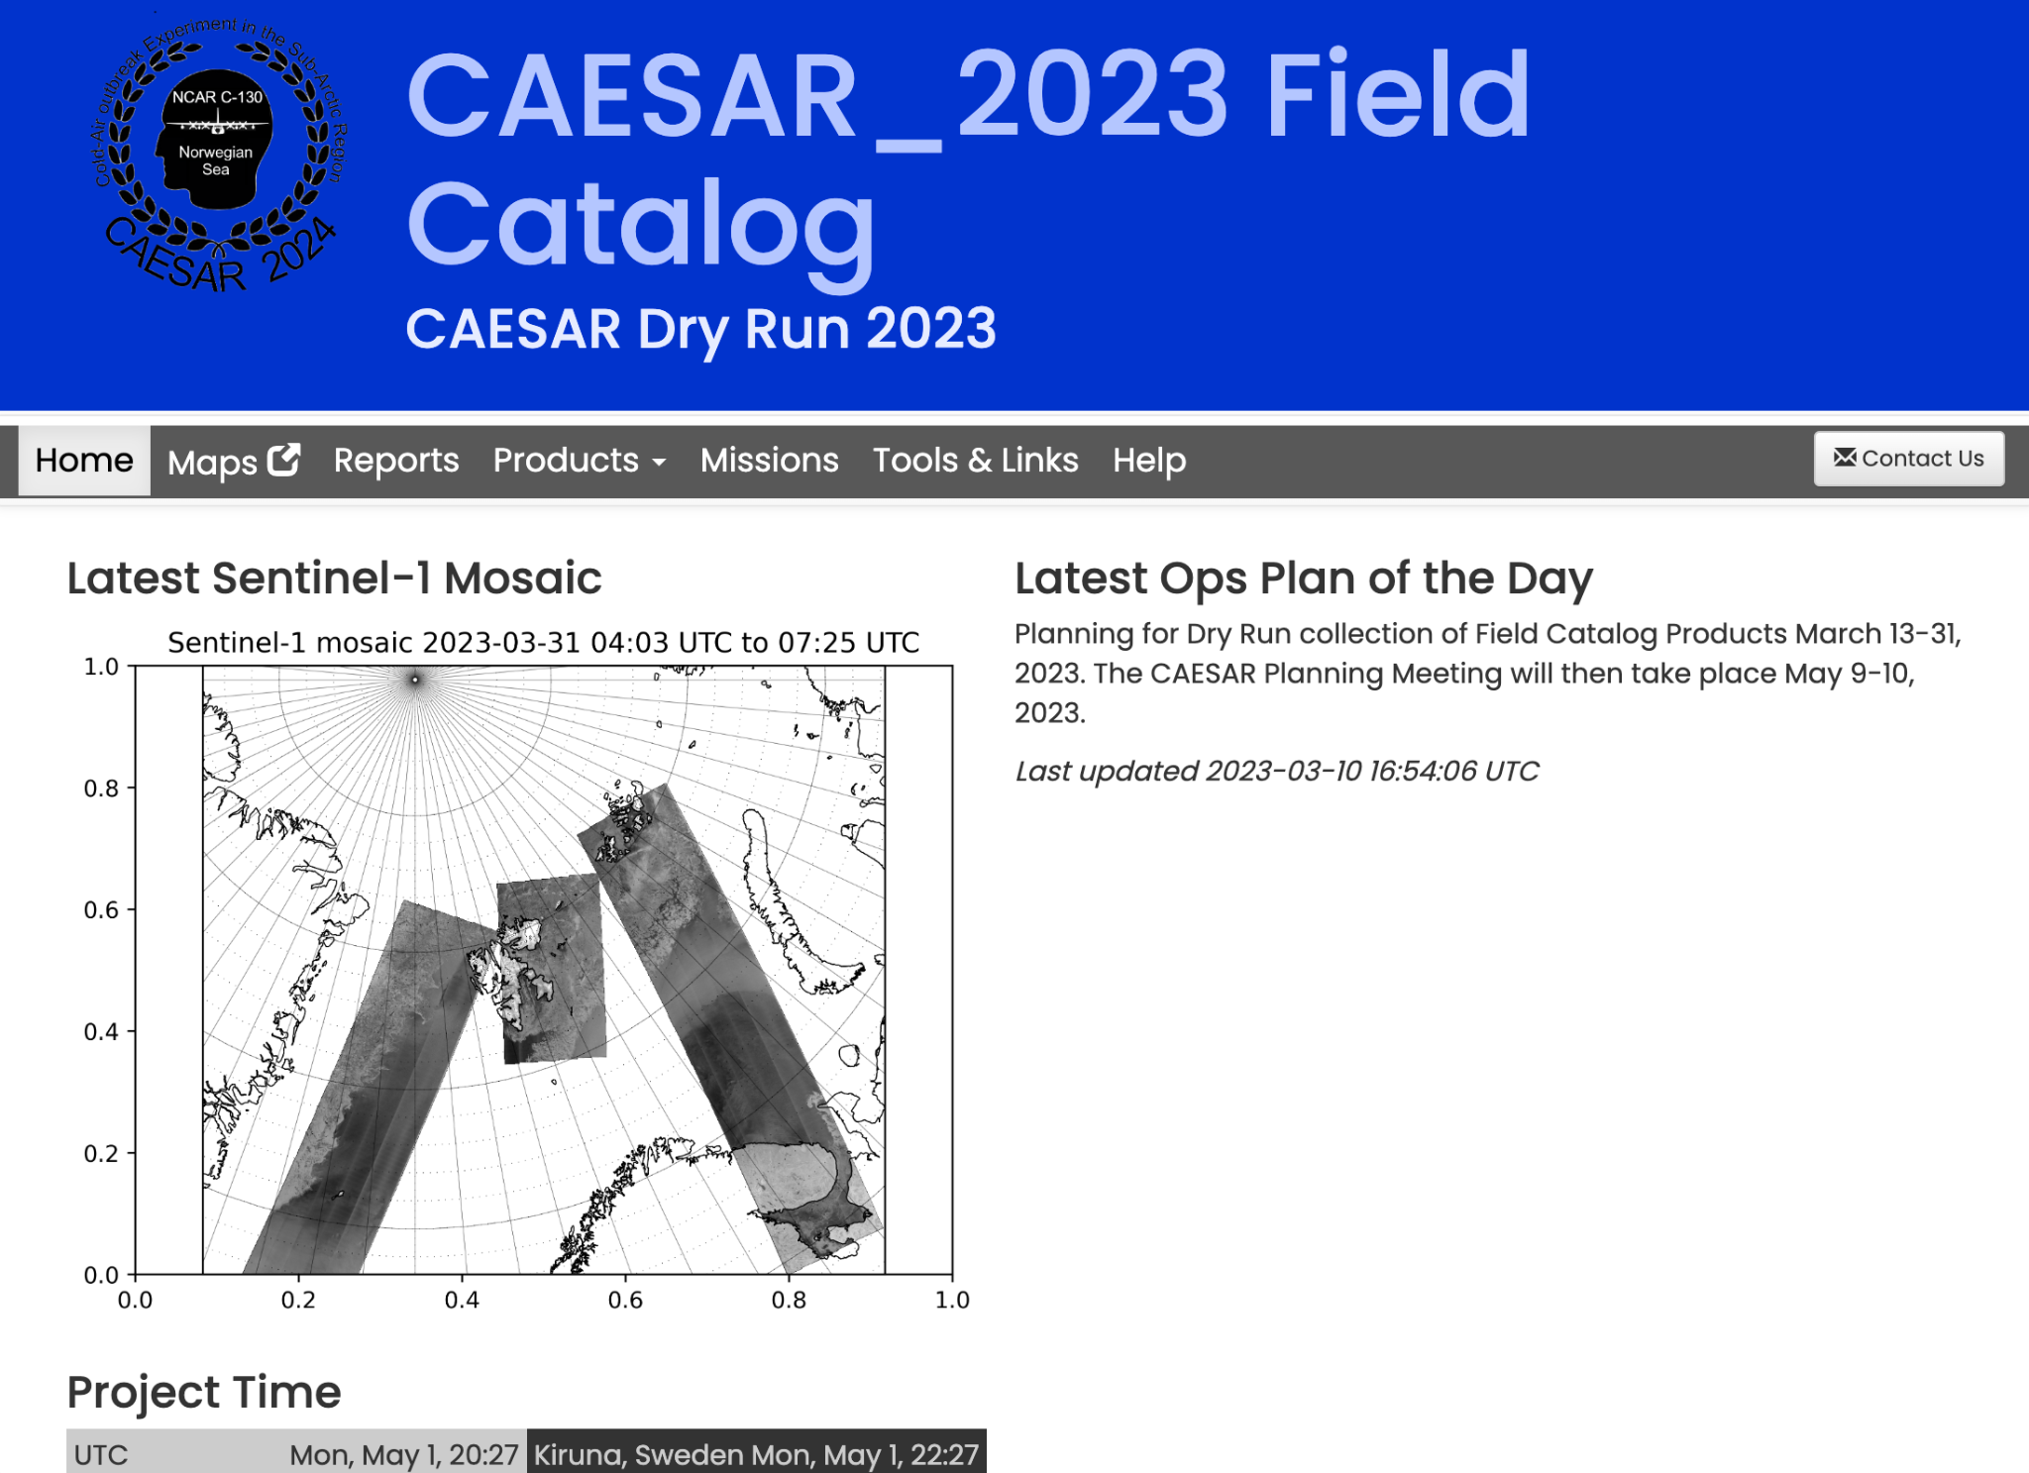
Field Catalog Introduction
Project Documentation
Mission Planning
Image Looping
Real-Time Decision Making
Nowcasting
Map Overlays
CAESAR Science Meeting May 2023

Slide 3
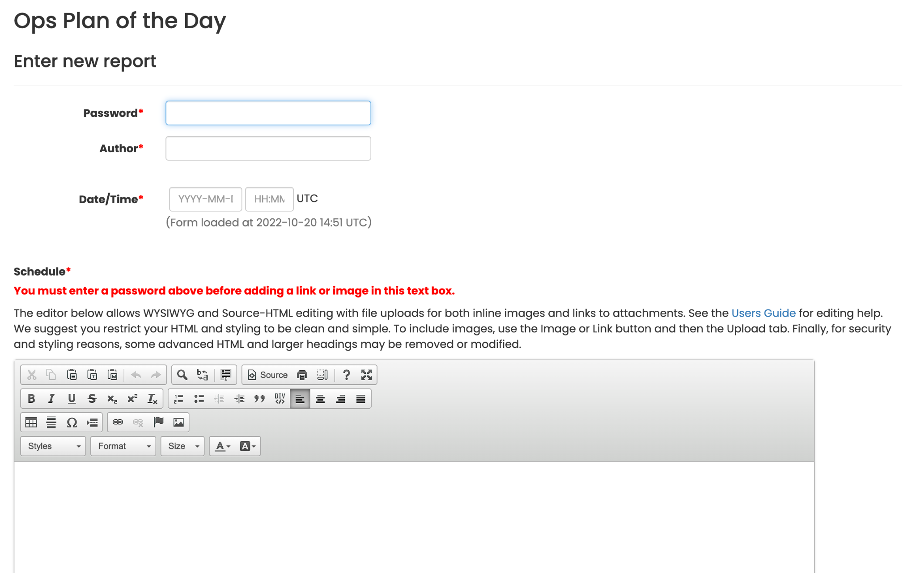
Documentation - Reports
Ops Plan of the Day
Forecast Discussion
Instrument Summaries
Mission Summaries
CAESAR Science Meeting May 2023

Slide 4
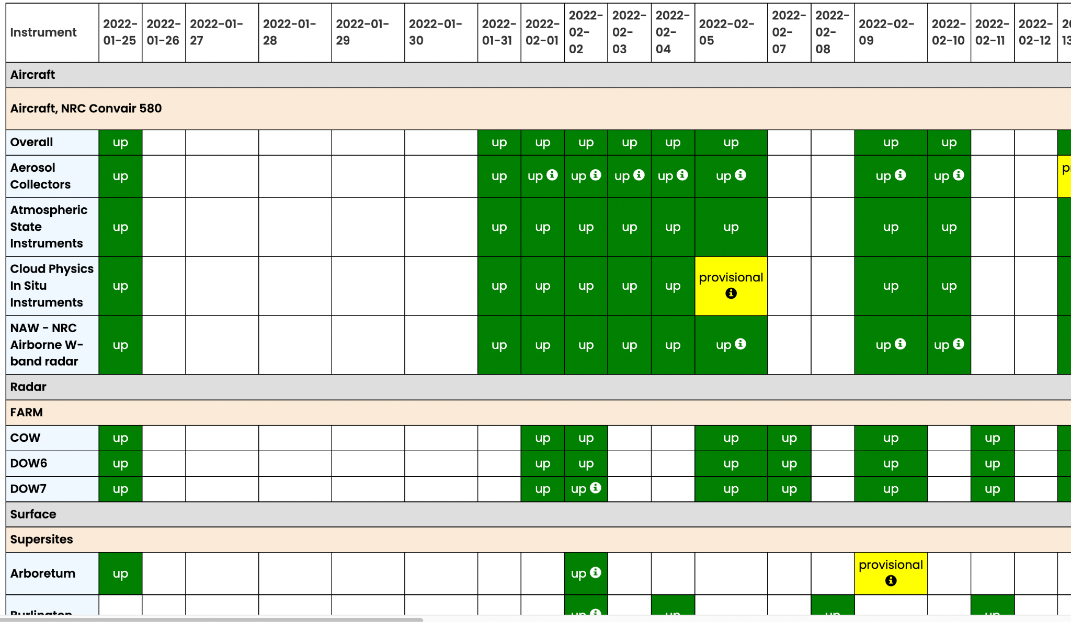
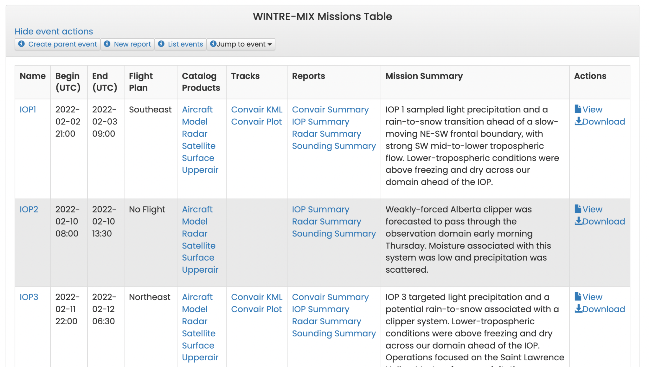
Status and Mission Table
CAESAR Science Meeting May 2023

Slide 5
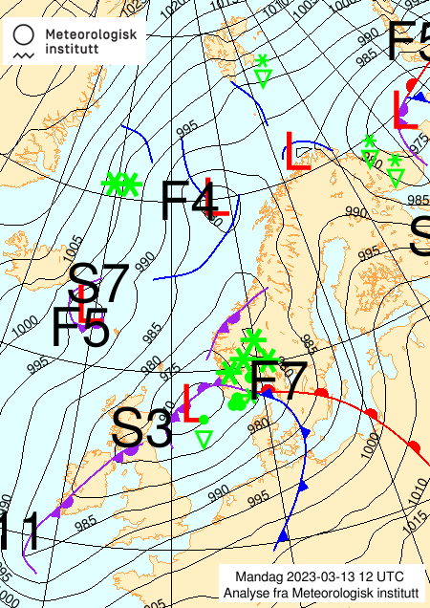
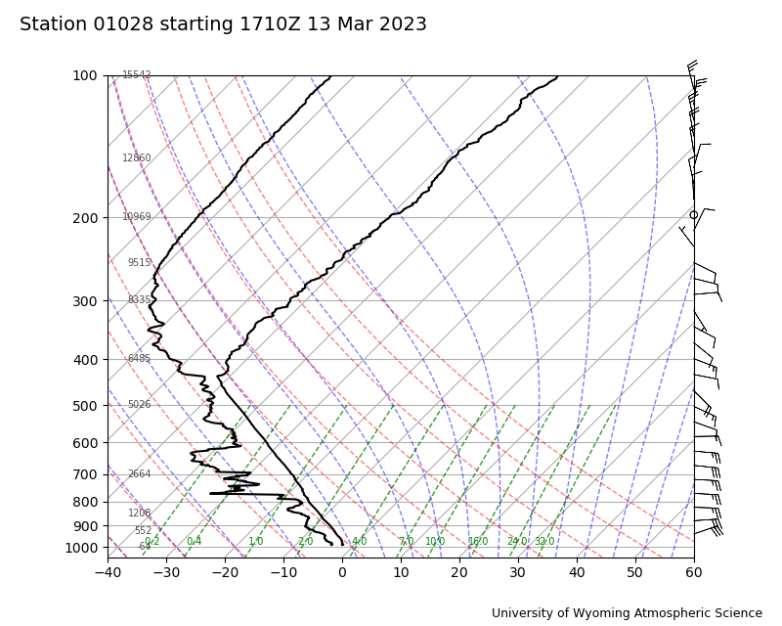
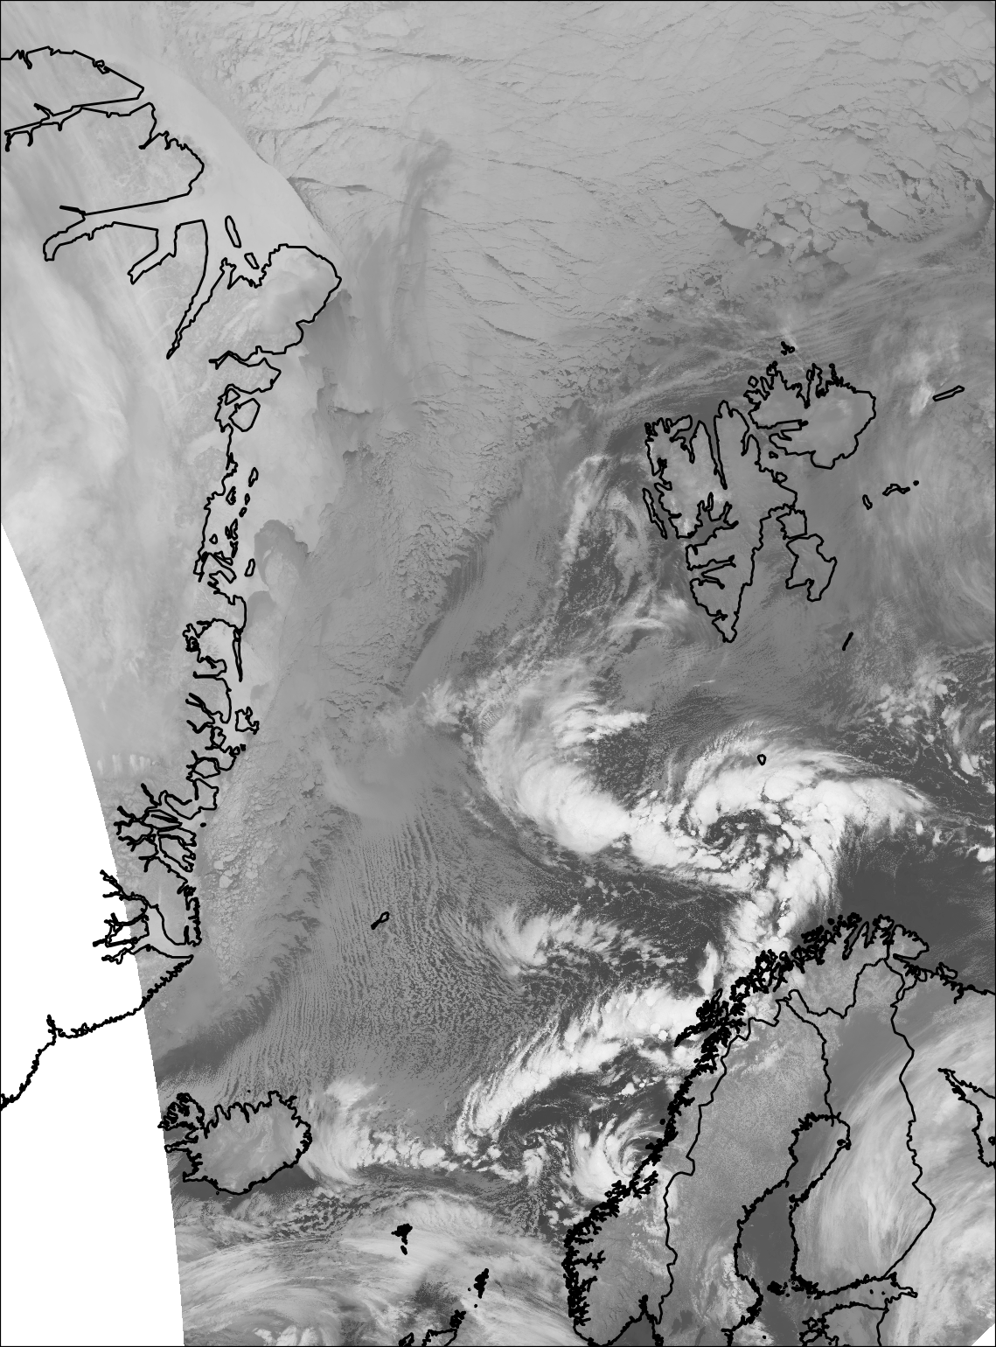
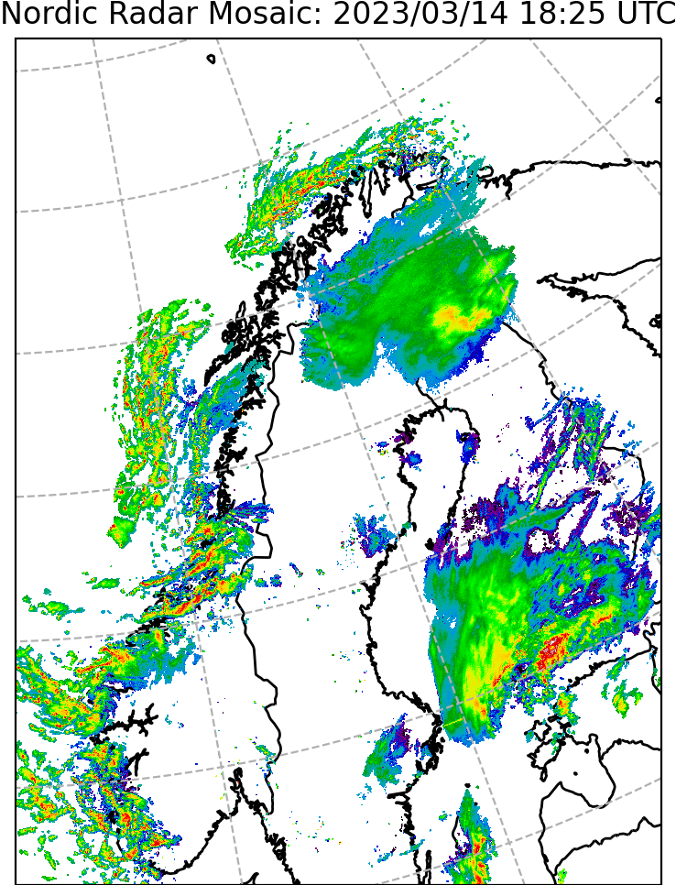
Satellite, Radar, Soundings, etc
CAESAR Science Meeting May 2023

Slide 6
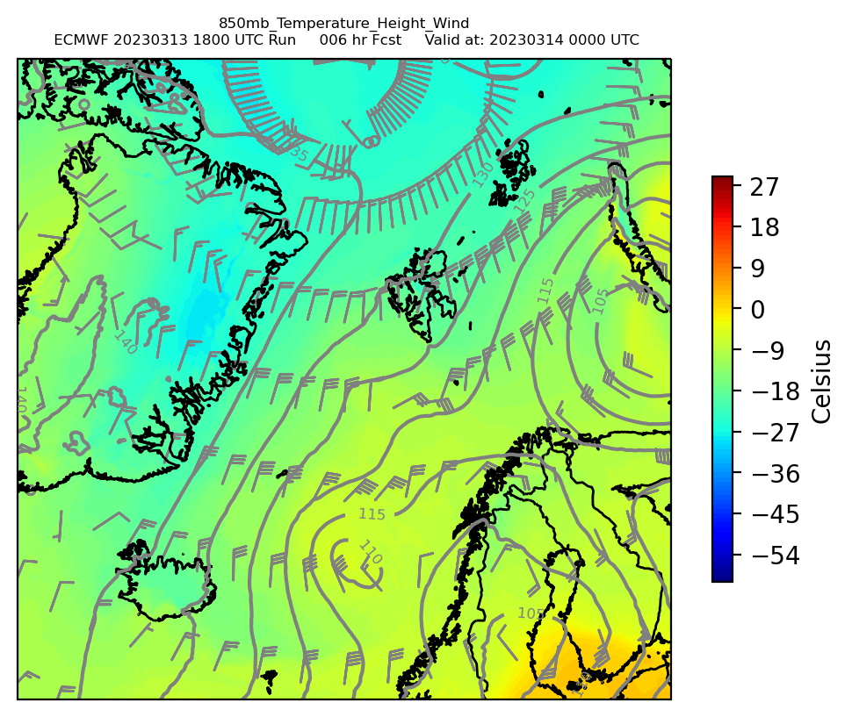
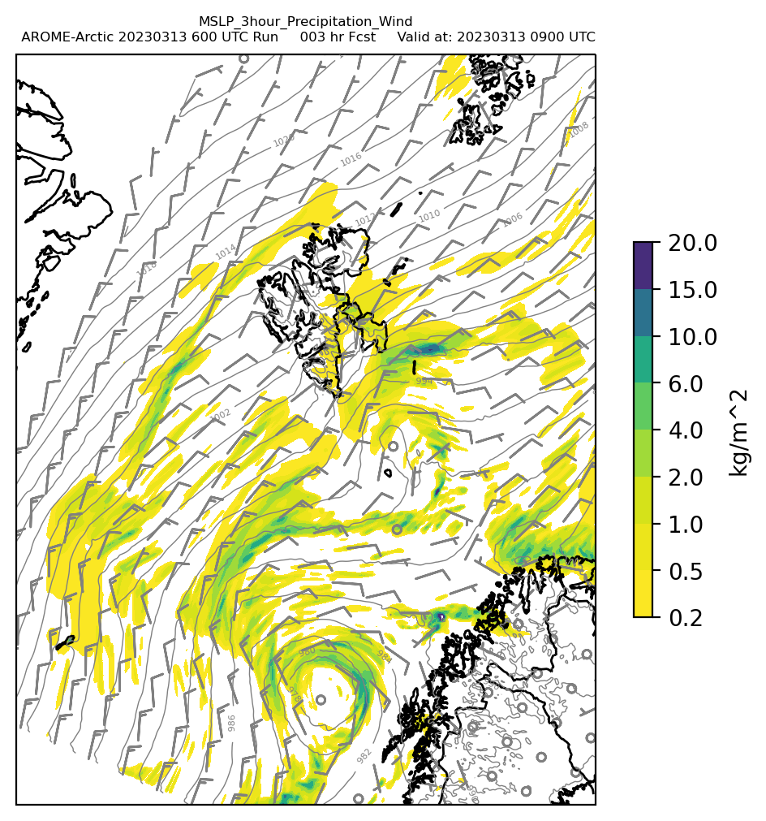
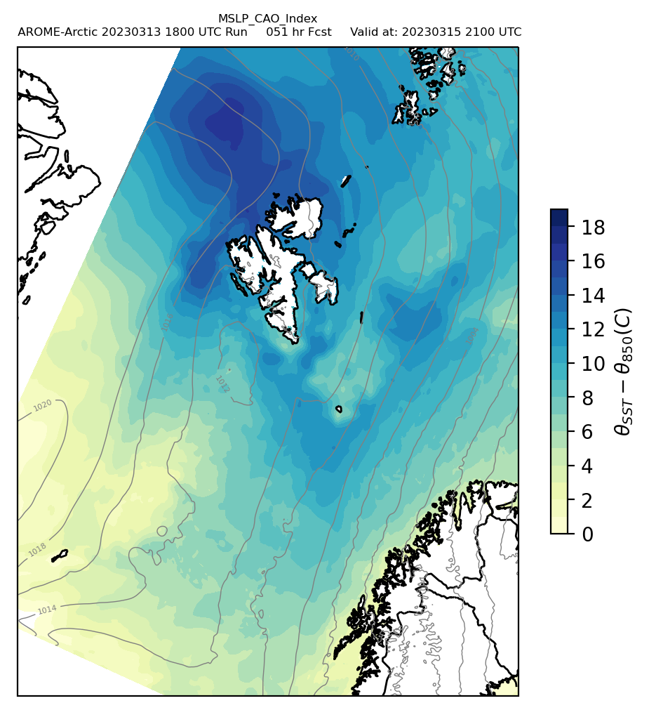
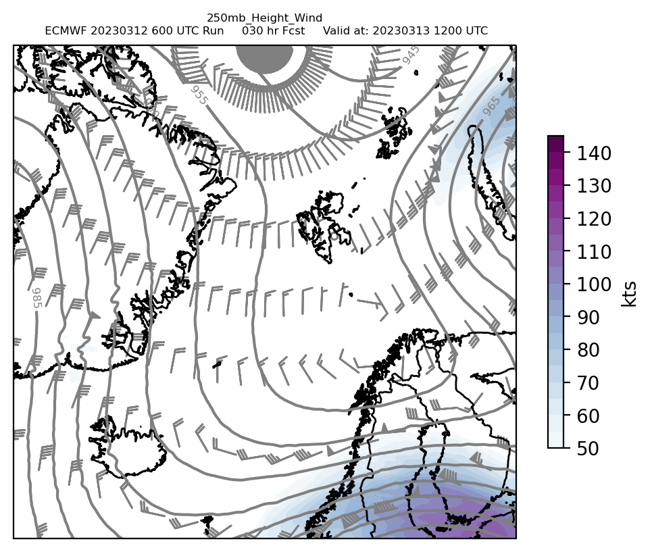
Model Products
AROME Arctic
ECMWF
CAESAR Science Meeting May 2023

Slide 7
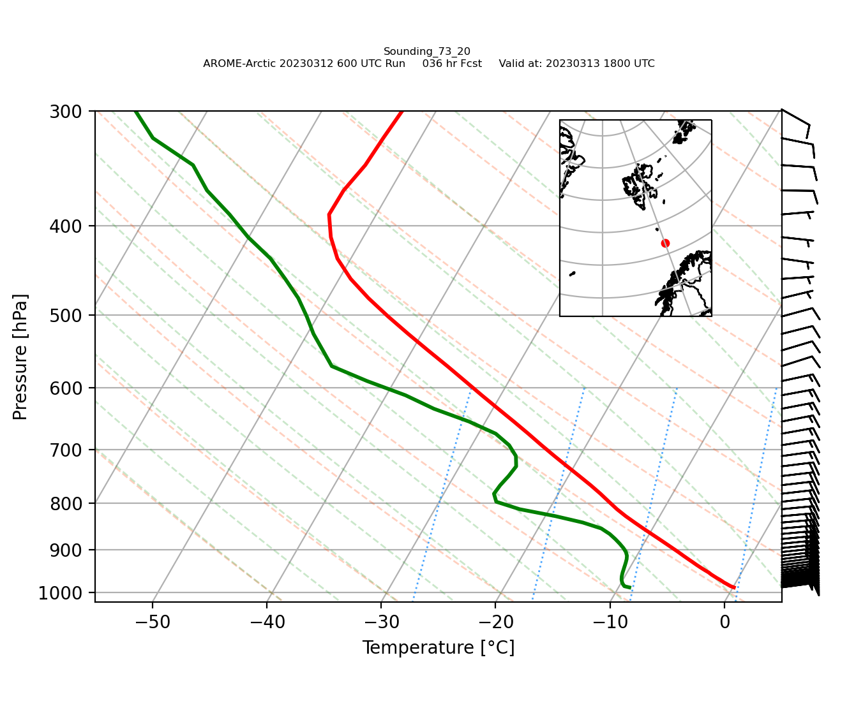
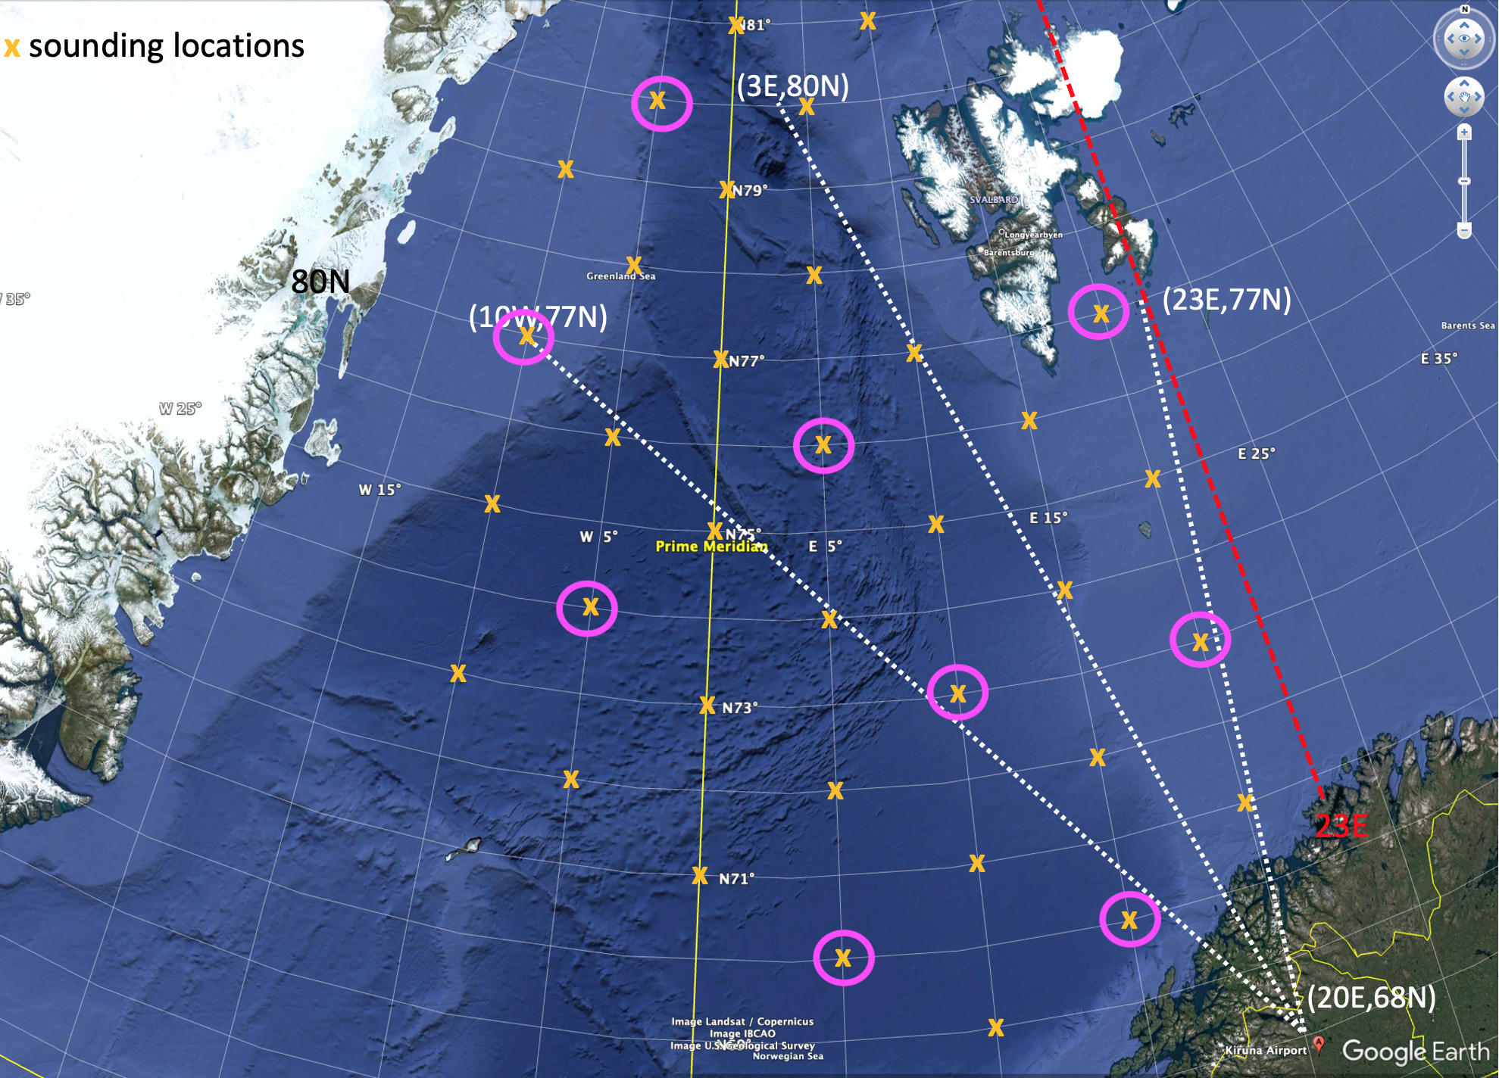
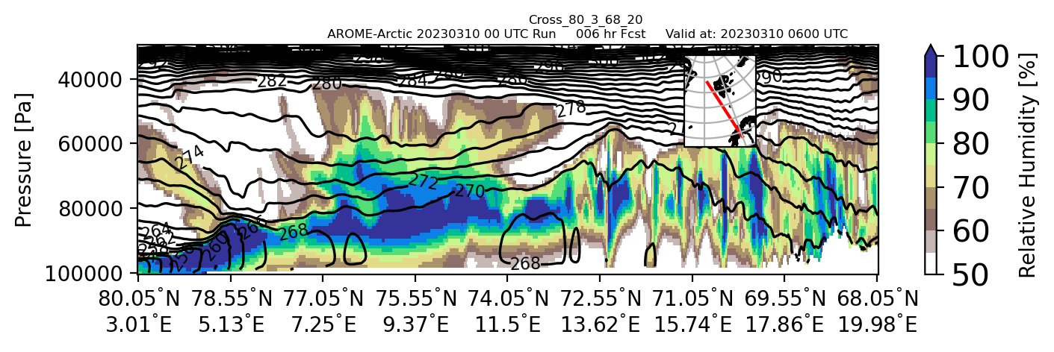
AROME Arctic Soundings and Cross Sections
CAESAR Science Meeting May 2023

Slide 8
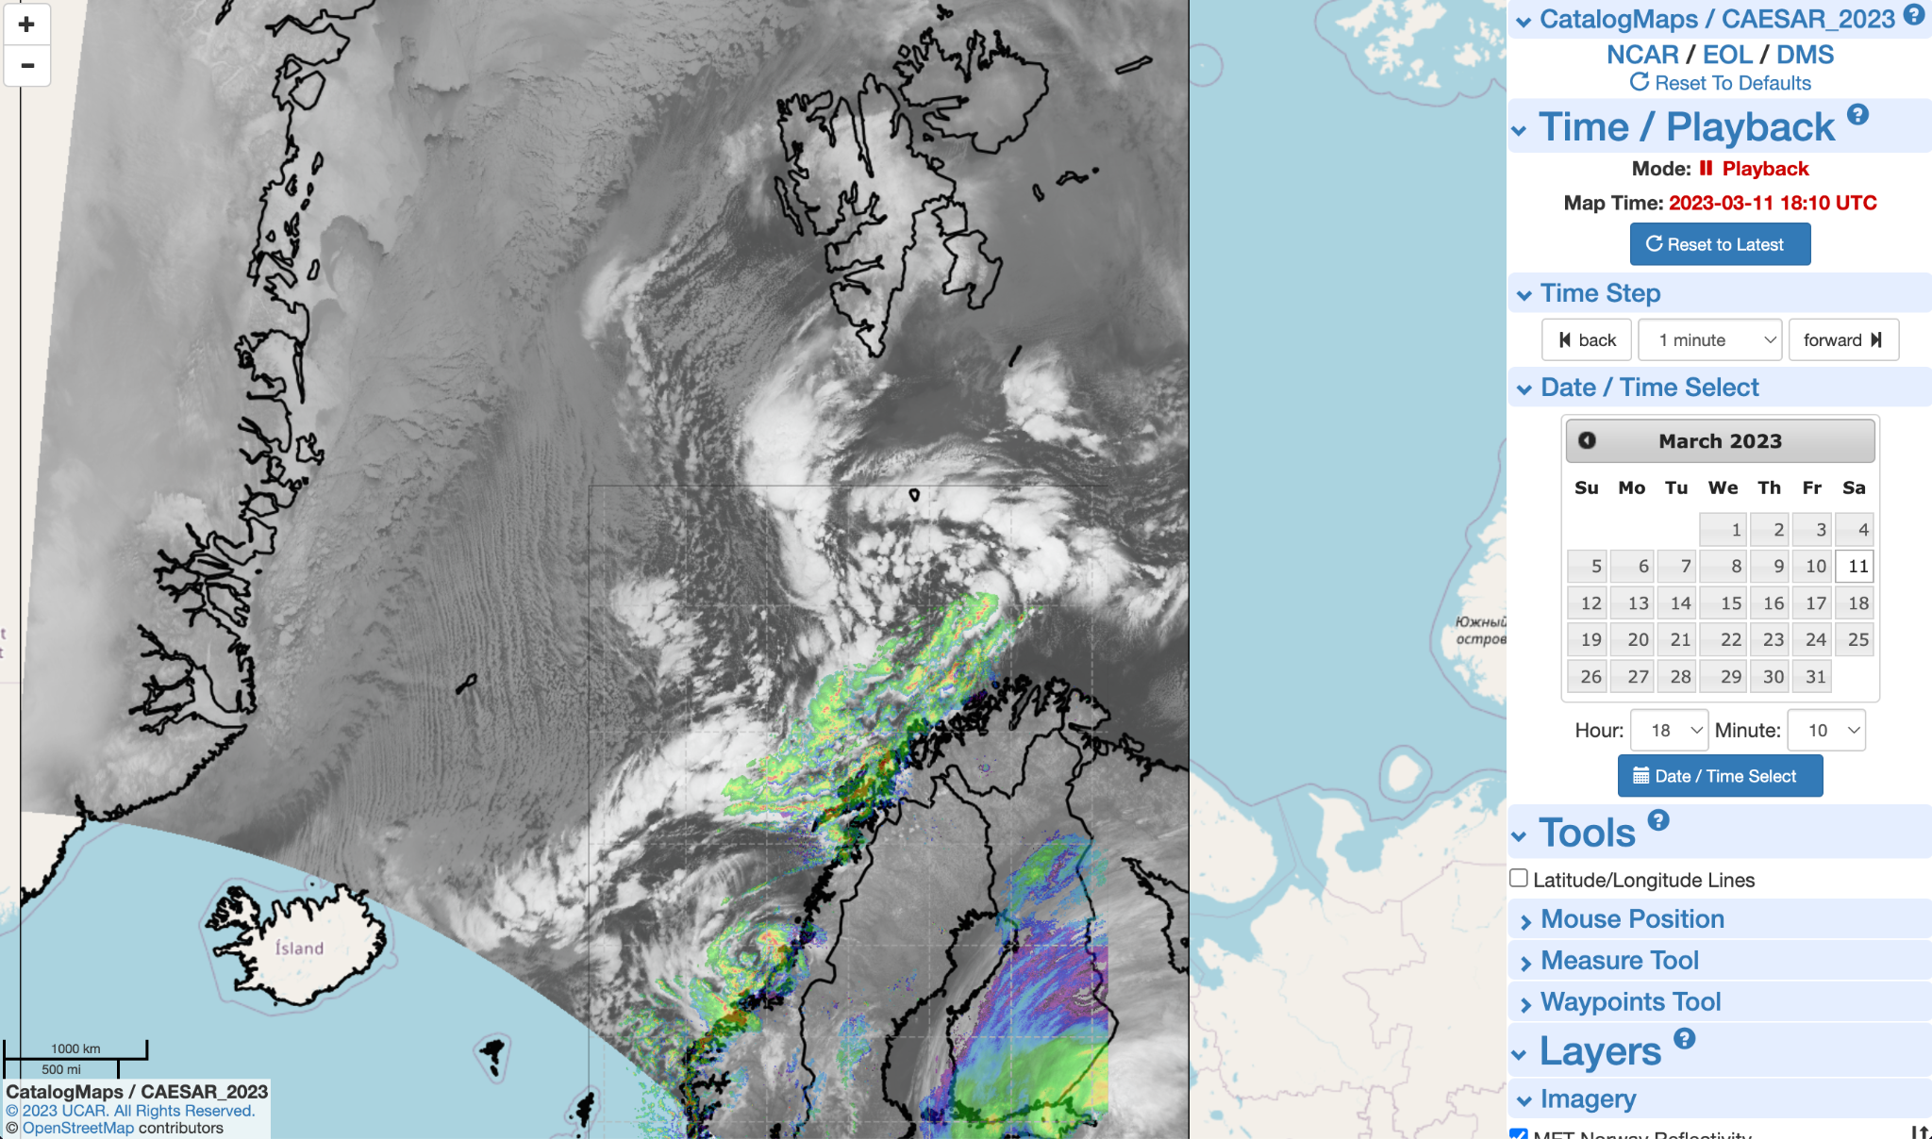
Catalog Maps
Flight Tracks and Plans
Satellite and Radar Overlays
Situational Awareness
Playback
Dropsonde SkewTs
Currently Mercator Projection
CAESAR Science Meeting May 2023

Slide 9
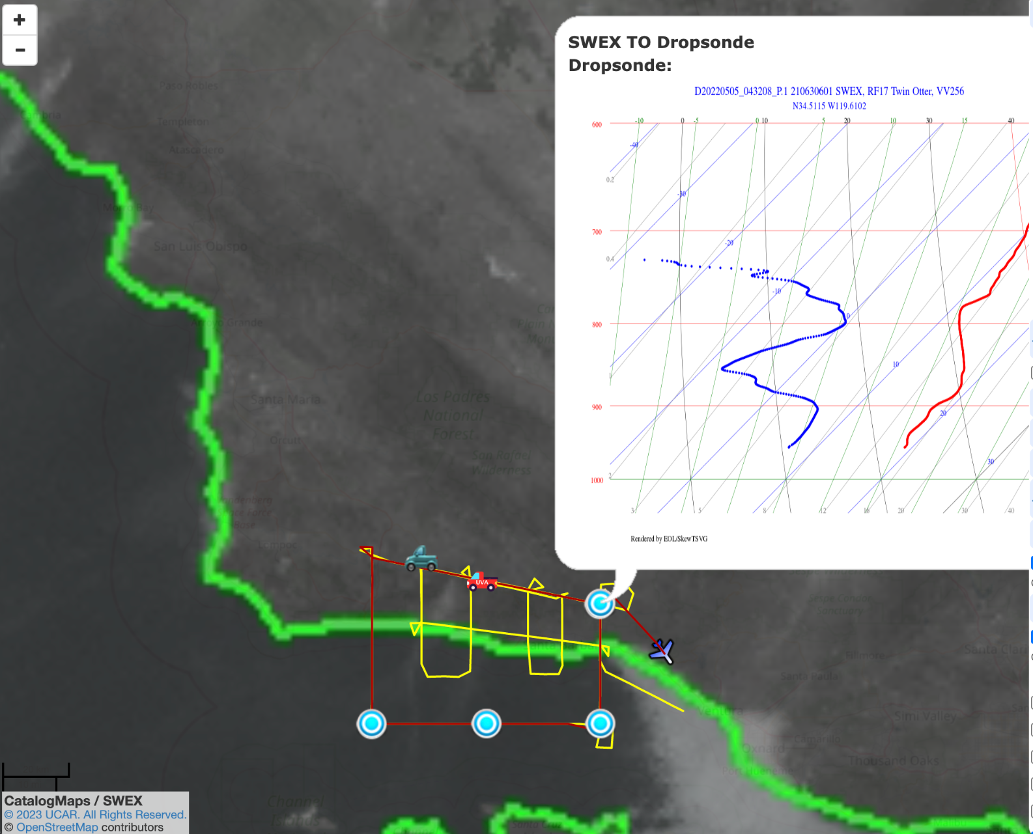
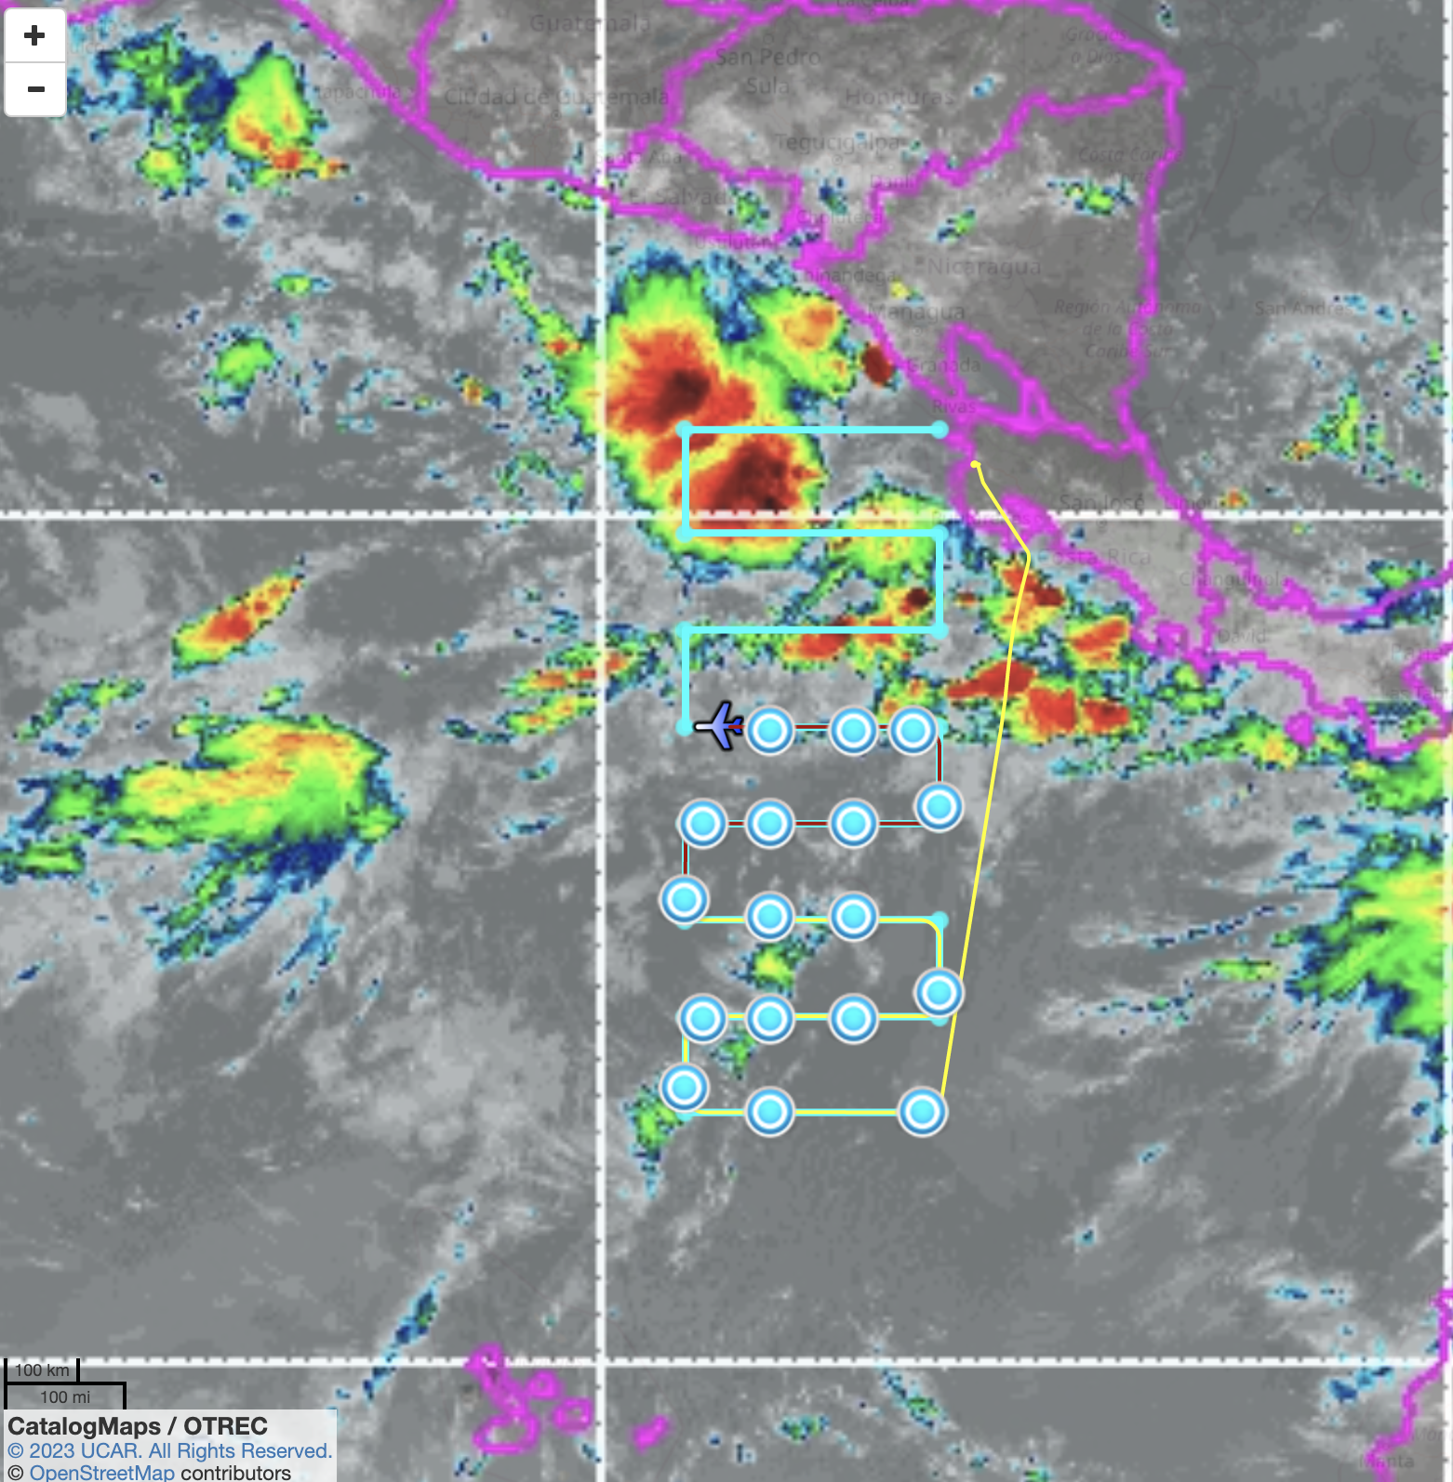
Other Catalog Maps Features
CAESAR Science Meeting May 2023

Slide 10
Data Management
for CAESAR
Greg Stossmeister and Scot Loehrer
EOL Data Management & Services Facility Manager
May 9, 2023
Notes:
NOTE: Background image can be used as is or changed for a particular presentation. Click: Slide > Edit master.

Slide 11
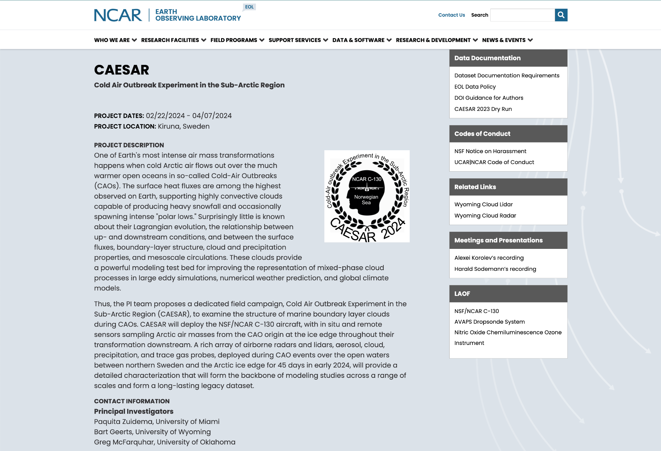
Project Web Page
Project Description
Field Catalog Access
Long-Term Data Archive Access
Data Policy
Dry Run Information
DOI Guidance for Authors
Data Provider Information
Operations Information
EOL Instrumentation Information
Meetings and Presentations
Publications
Related Web Pages
PI and Contact Information
https://www.eol.ucar.edu/field_projects/caesar
CAESAR Science Meeting

Slide 12
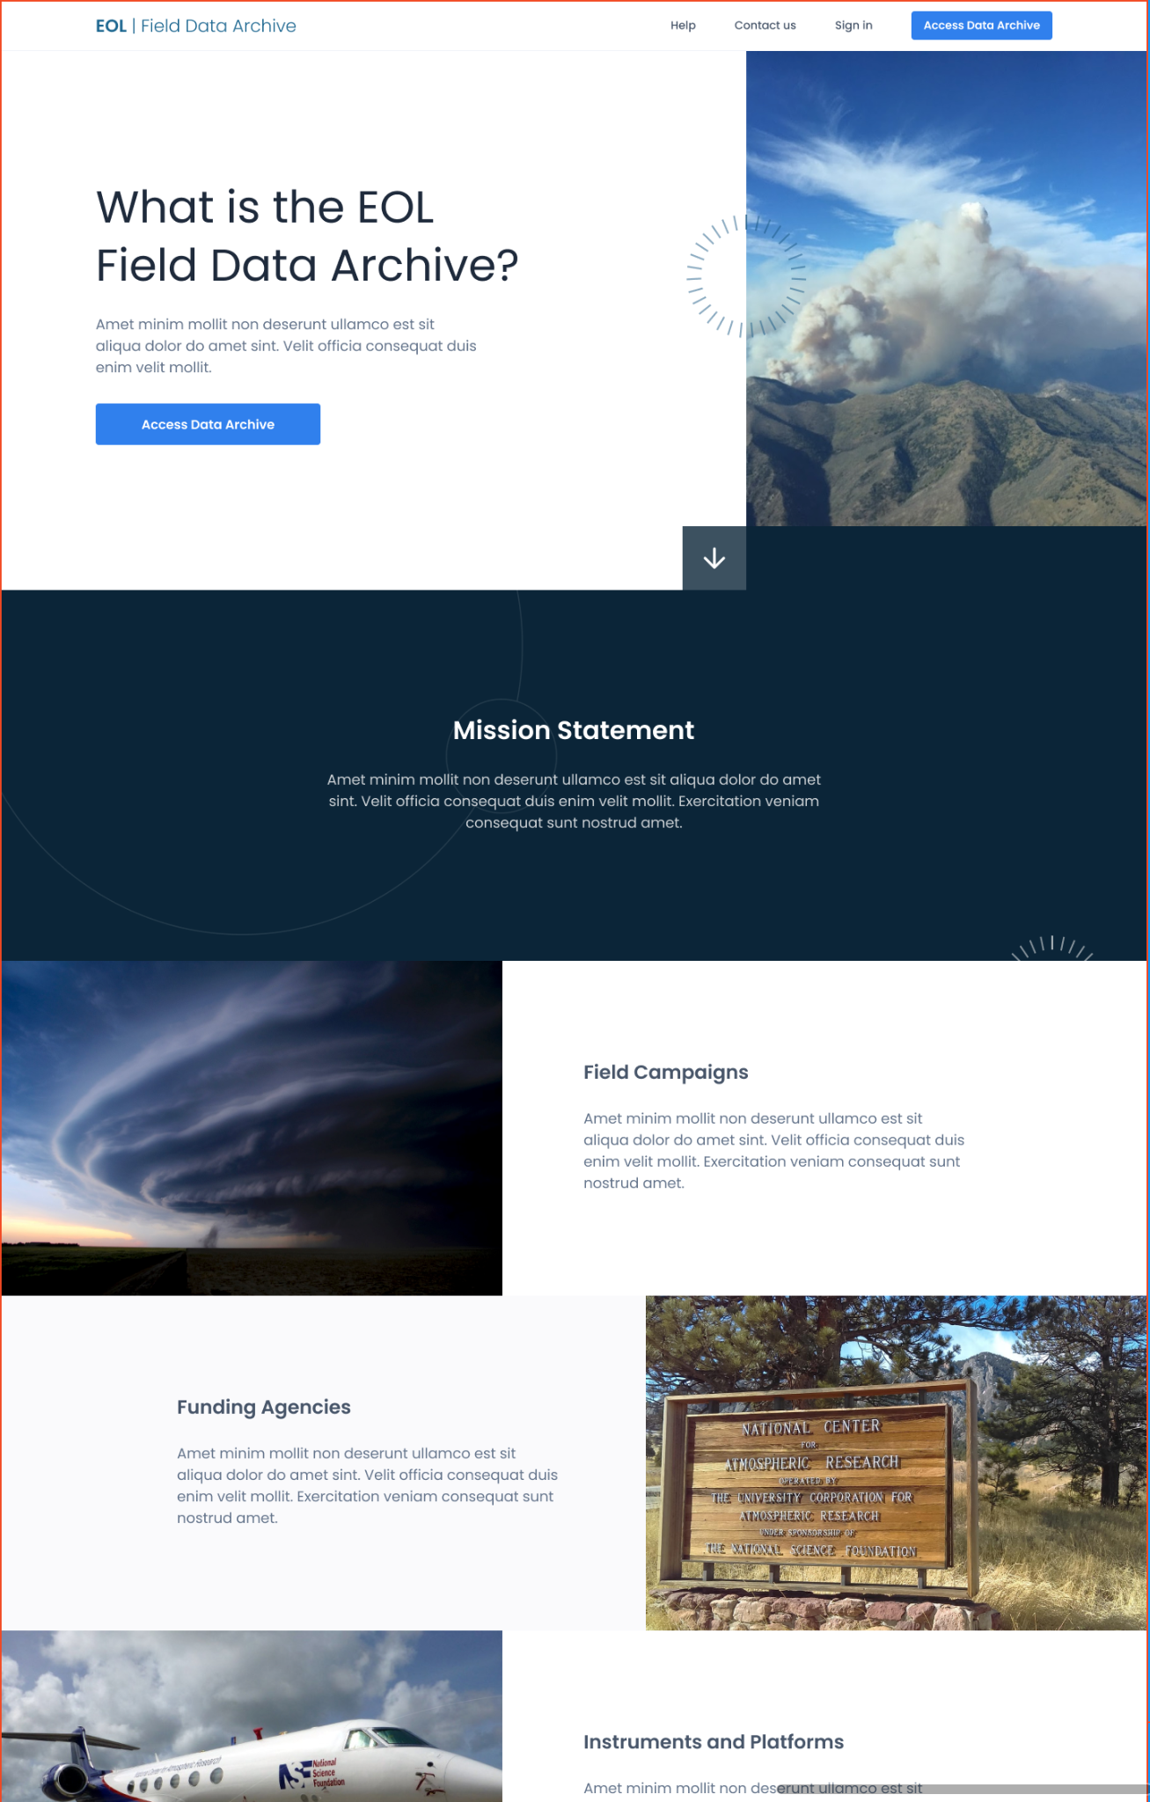
New Field Data Archive UI
Modern, friendly interface
Responsive design
Improved metadata
Advanced Search
API for automated data ordering
CAESAR Science Meeting

Slide 13
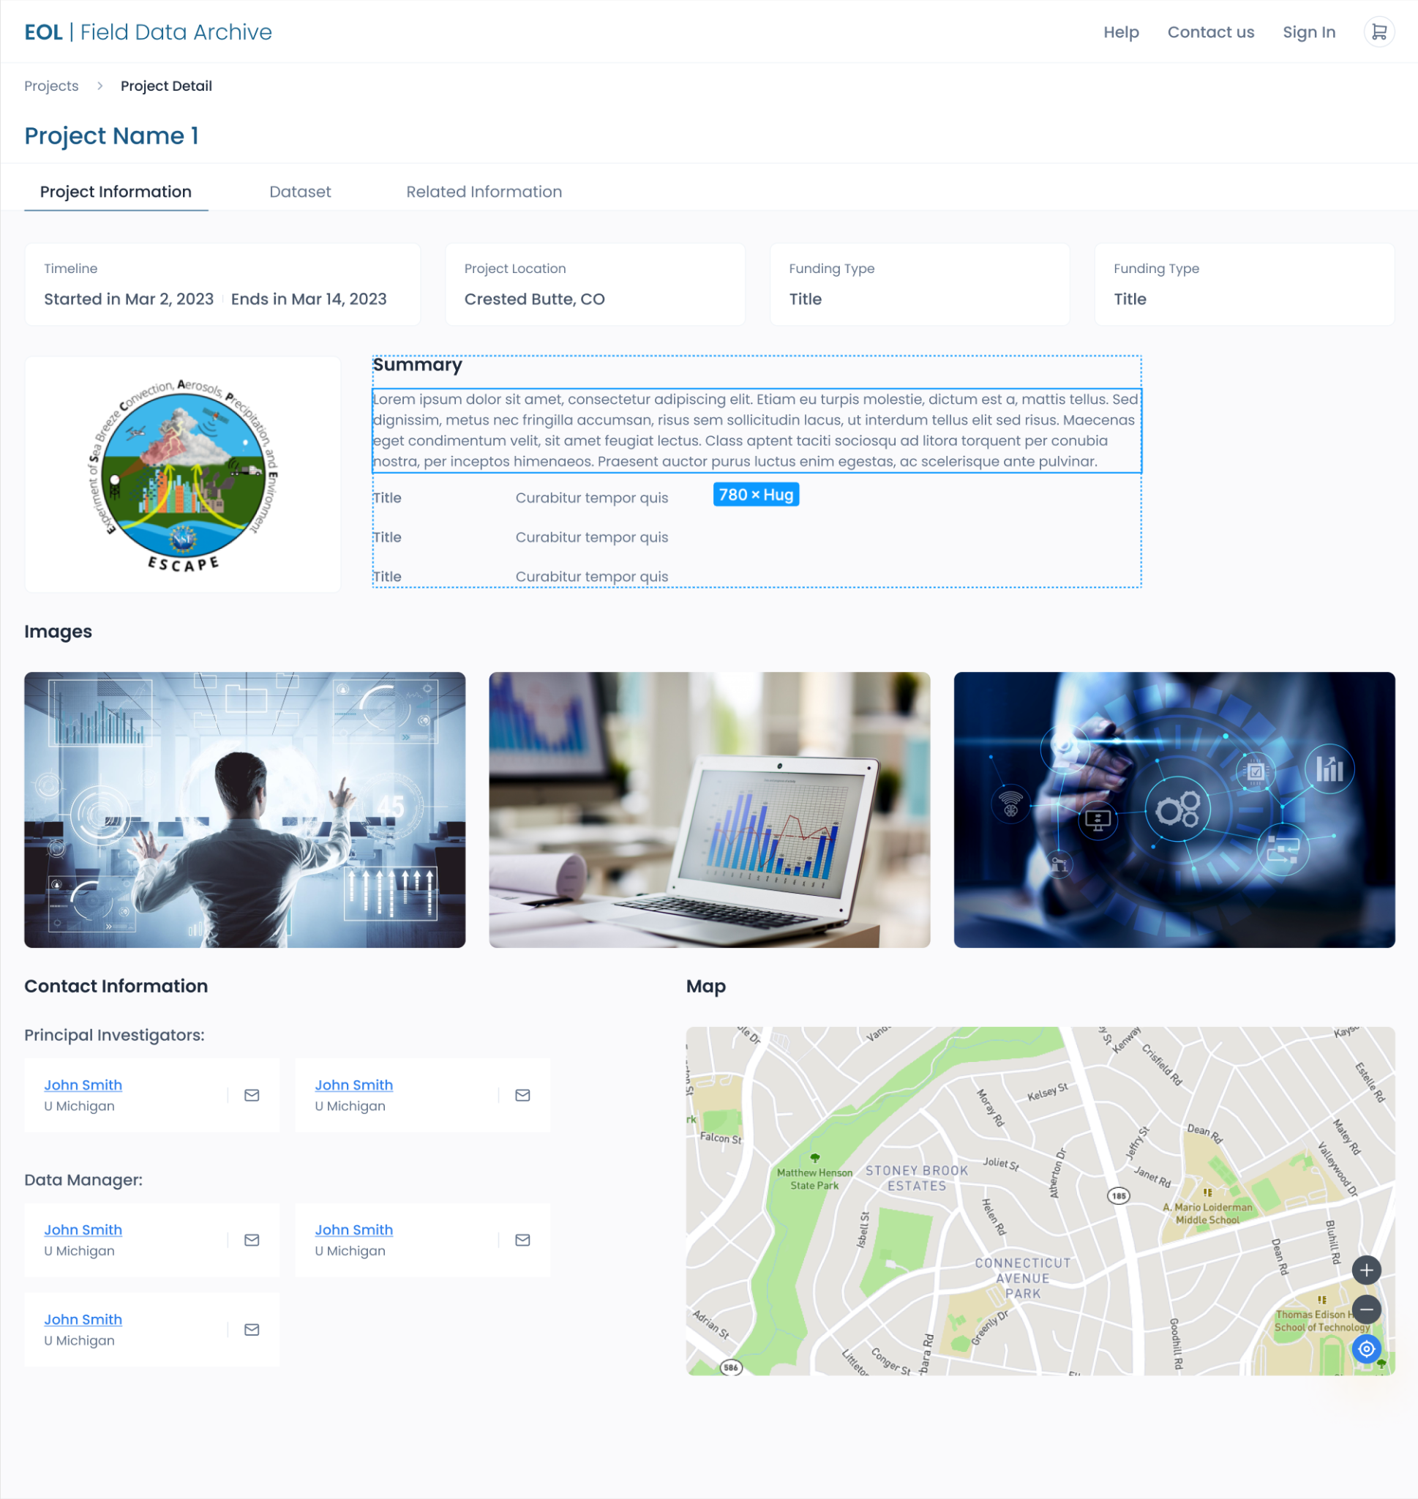
New Field Data Archive UI
Modernized project pages
More descriptive project info better integrated with data pages
PI Information
Interactive Map
Images from the project
CAESAR Science Meeting

Slide 14
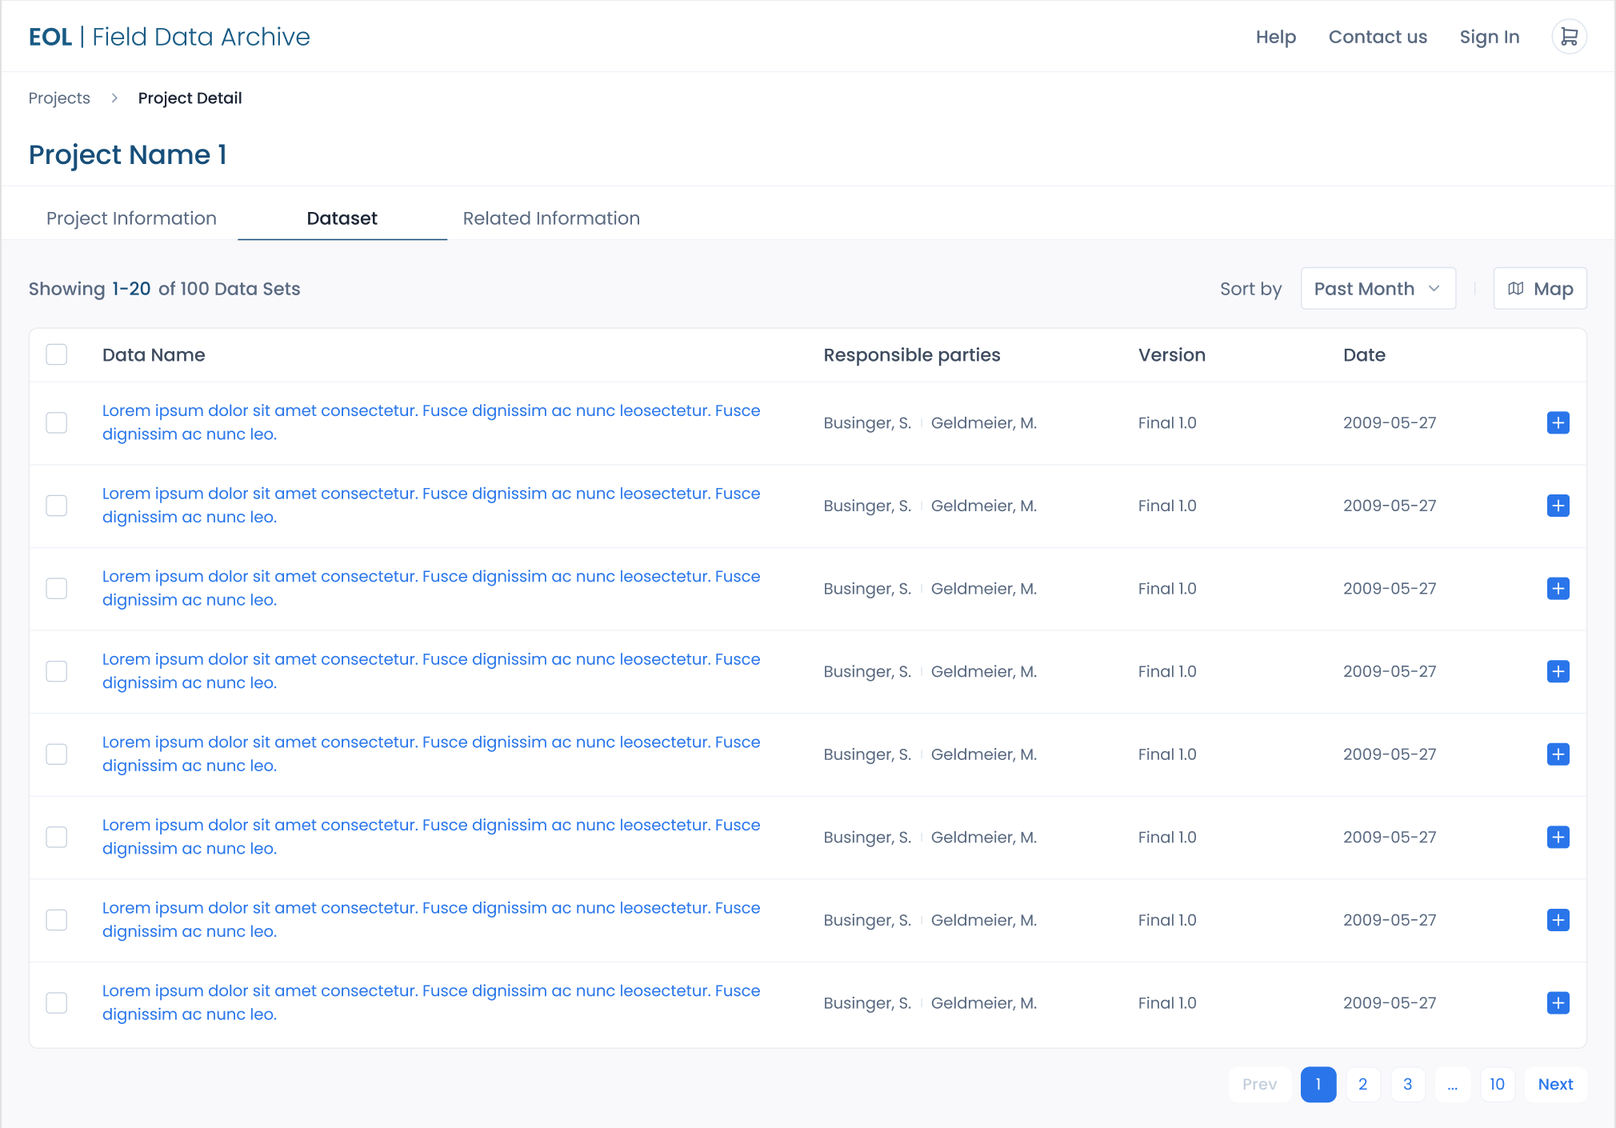
New Field Data Archive UI
Project data listing
Replaces Master Lists
Easier browsing
Allows for multiple dataset orders
Shopping Cart
Sort Capability
Map Search
CAESAR Science Meeting

Slide 15
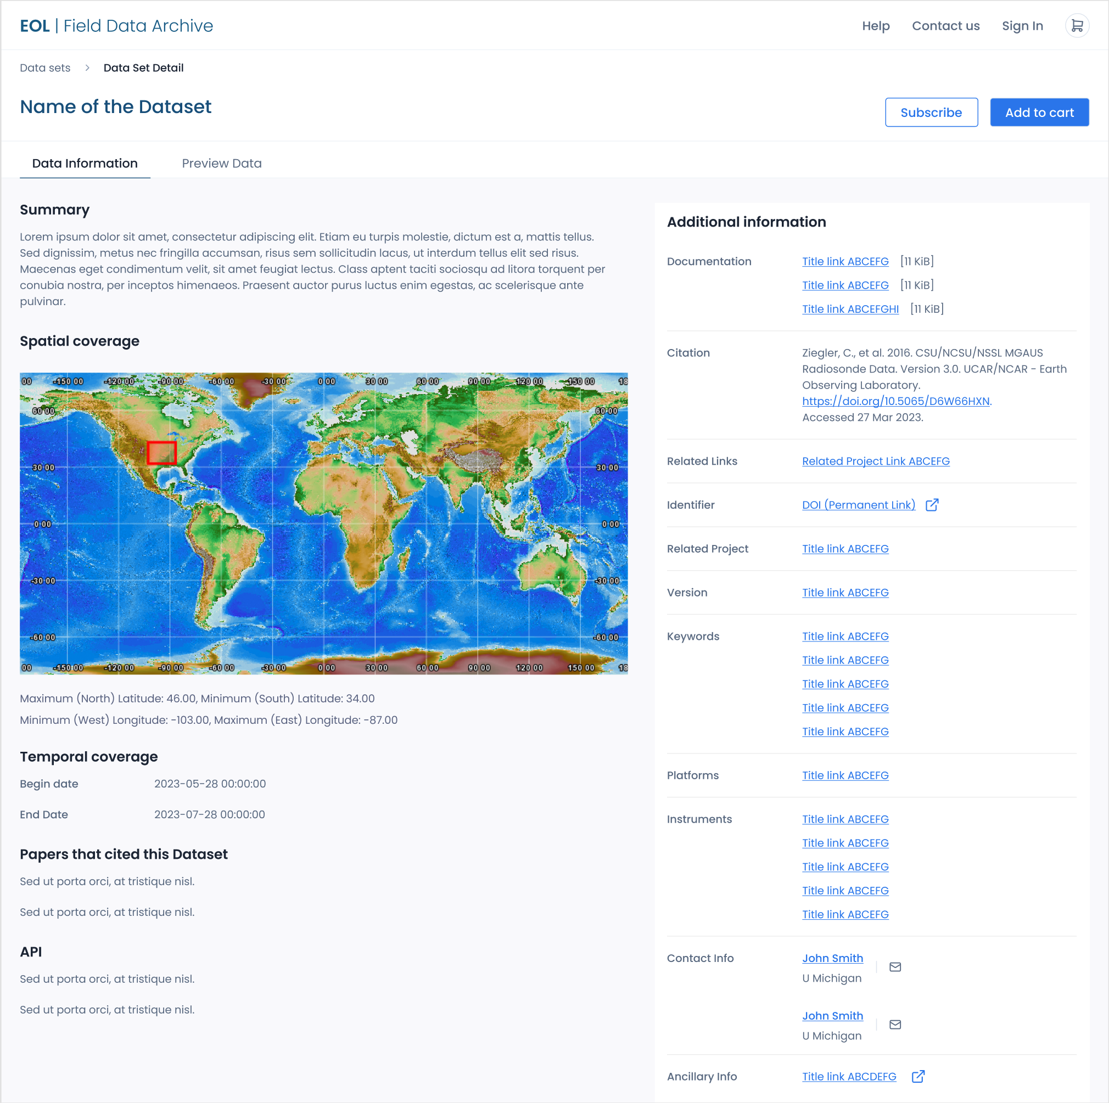
New Field Data Archive UI
Dataset page layout
Prioritized order
Subscribe for change notices
Papers that cite this dataset
CAESAR Science Meeting

Slide 16
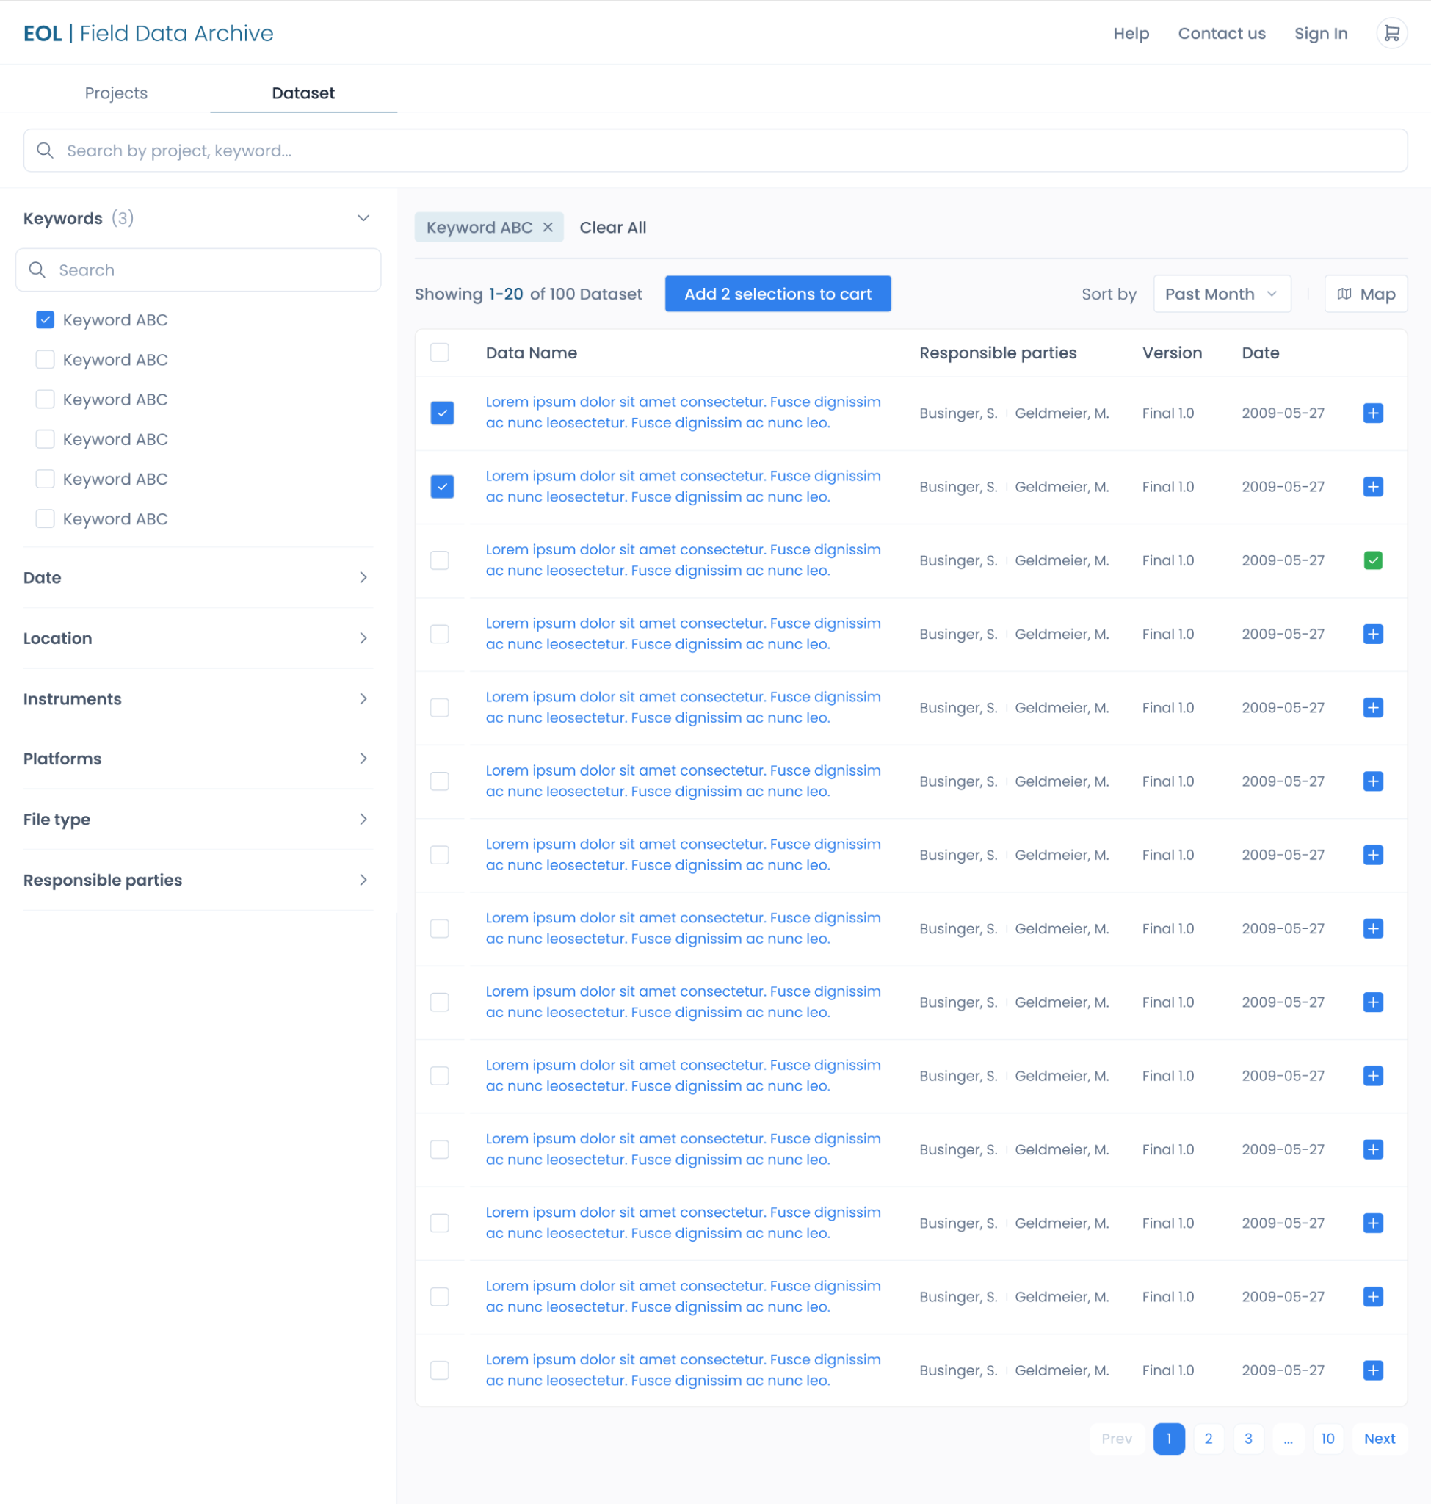
New Field Data Archive UI
Advanced search
for projects or datasets
Free text search
Refine and sort results
Search by keyword
Search by date
Search by location
Search by Instrument/platform
Search by file type
Search by responsible parties
CAESAR Science Meeting

Slide 17

Data Policy Considerations
Preliminary Data Sharing
field only or remote as well?
Submission Deadlines
Preliminary data 6 months after the end of the field campaign
Final QC’ed data due 12 months after the end of the field campaign
Need for model output archival?
Embargo period?
None requested at this time
Archival of data at other locations/centers?
None specified in facility request
Provide data in common, interoperable formats
DOIs will be provided for all datasets that have complete metadata
EOL platforms/Instruments also have DOIs, please cite these and first use papers
CAESAR Science Meeting

Slide 18
Data Archive work coming up
Scot will be the lead EOL Data Manager for the project.
He will be working with you on data collection requirements soon.
Non-project data collection
Preliminary data sharing
Adding additional documents to the website
EOL Field Data Archive survey coming this fall
Check out the new interface and let us know what you think
Feedback will inform the next phase of development in FY2024
Contact me: gstoss@ucar.edu or Scot loehrer@ucar.edu
CAESAR Science Meeting

