Slide 1

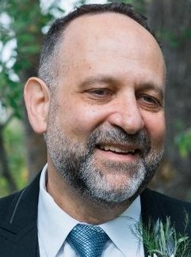
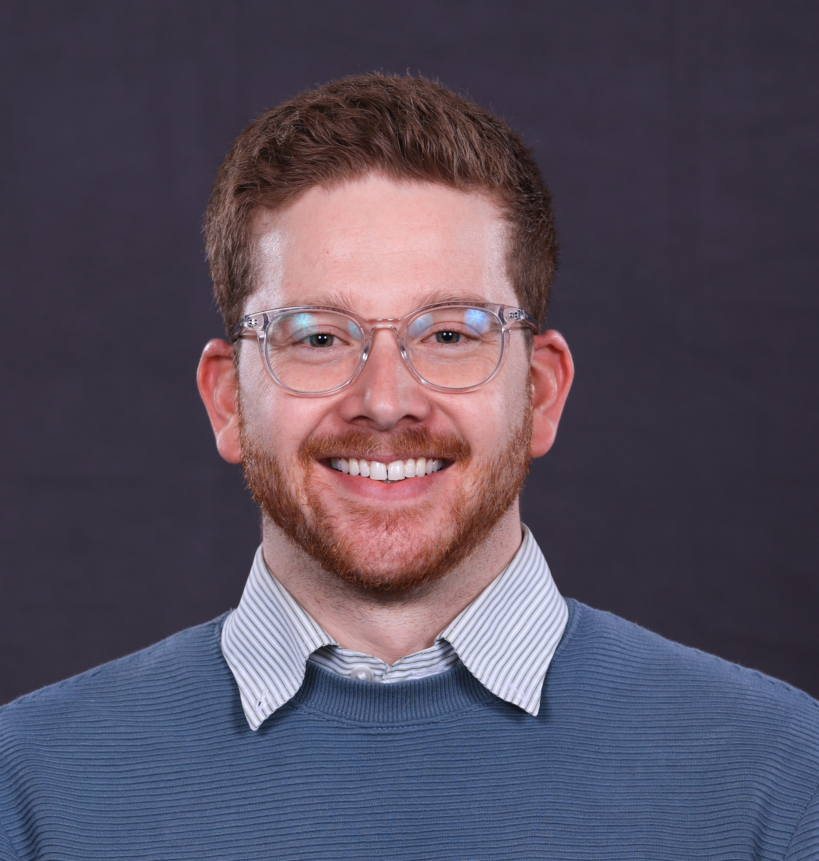

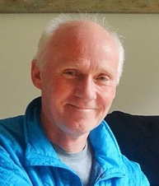
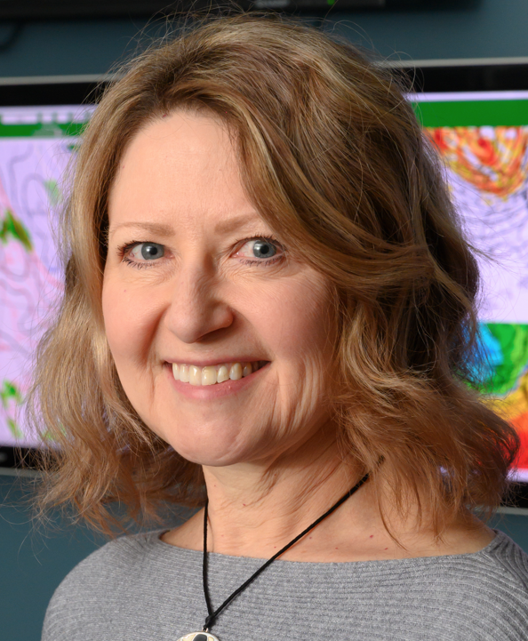

CSU CAESAR Instrumentation Team
Ryan Patnaude (Postdoc)
Camille Mavis (GRA)
Russell Perkins
Paul DeMott
Tom Hill
Sonia Kreidenweis

Slide 2
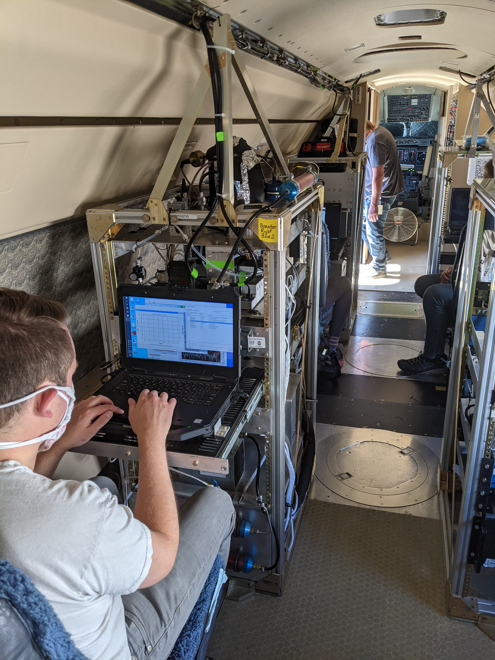
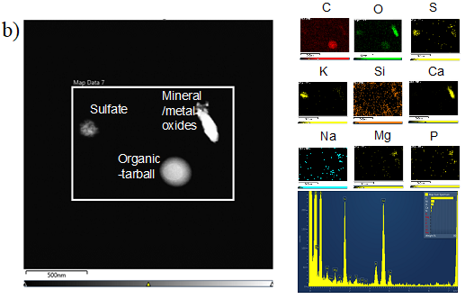
Continuous flow diffusion chamber + aerosol concentrator
Online INP concentration (typically 1-3 min resolution; 10 min “on”- 5 min “filter” - 10 min “on” cycles)
(-10) to -30°C; 105% RH_{w}
Higher temperature limit depends on INP concentration and concentrator enhancement factor (could range 10-100x)
Two inlets:
Isokinetic – for ambient “cloud-clear” conditions.
Aerosol concentrator to increase resolution/statistics
Counterflow virtual impactor (CVI) – collects cloud particle residuals for processing by CFDC
INP collection for measuring elemental
composition by Scanning TEM

Slide 3
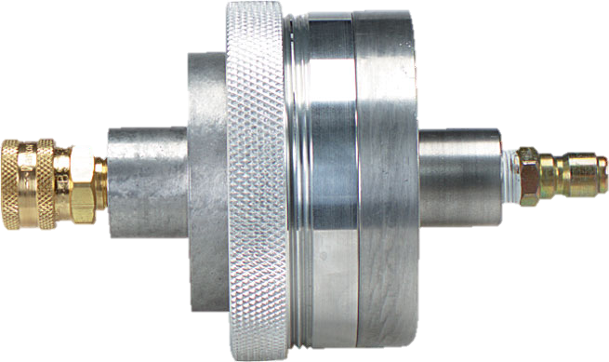
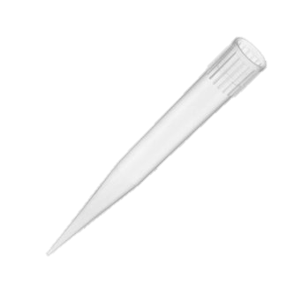
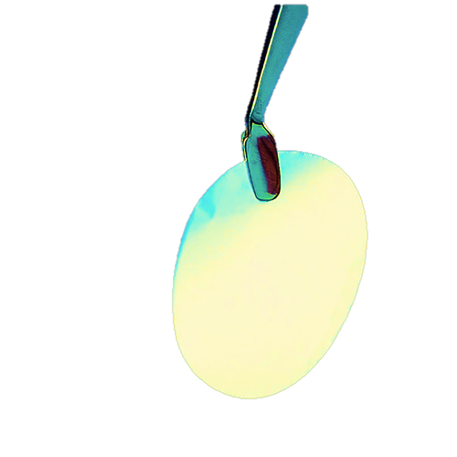
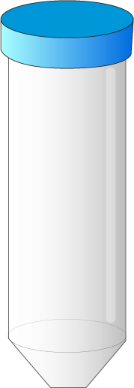
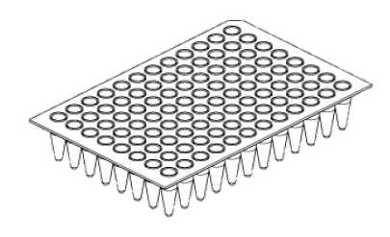
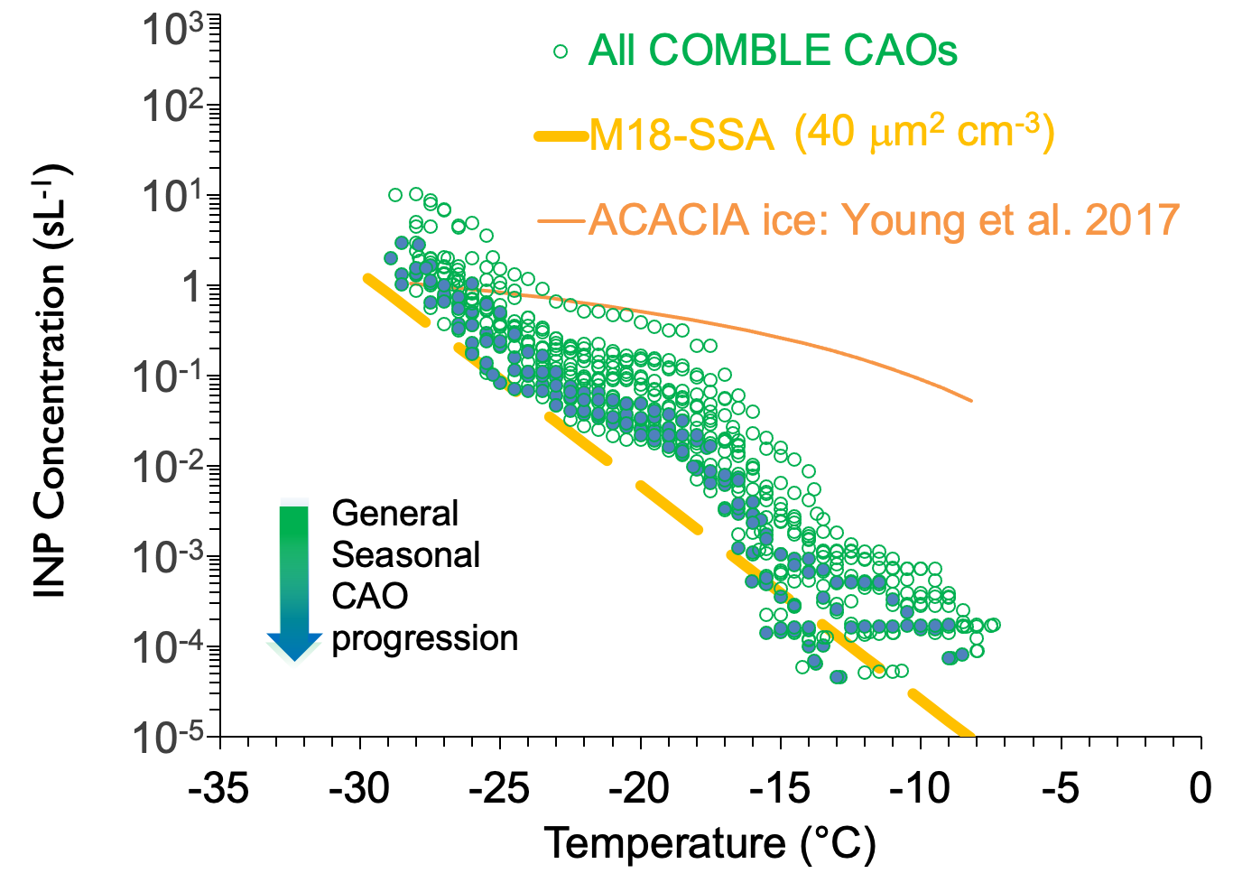
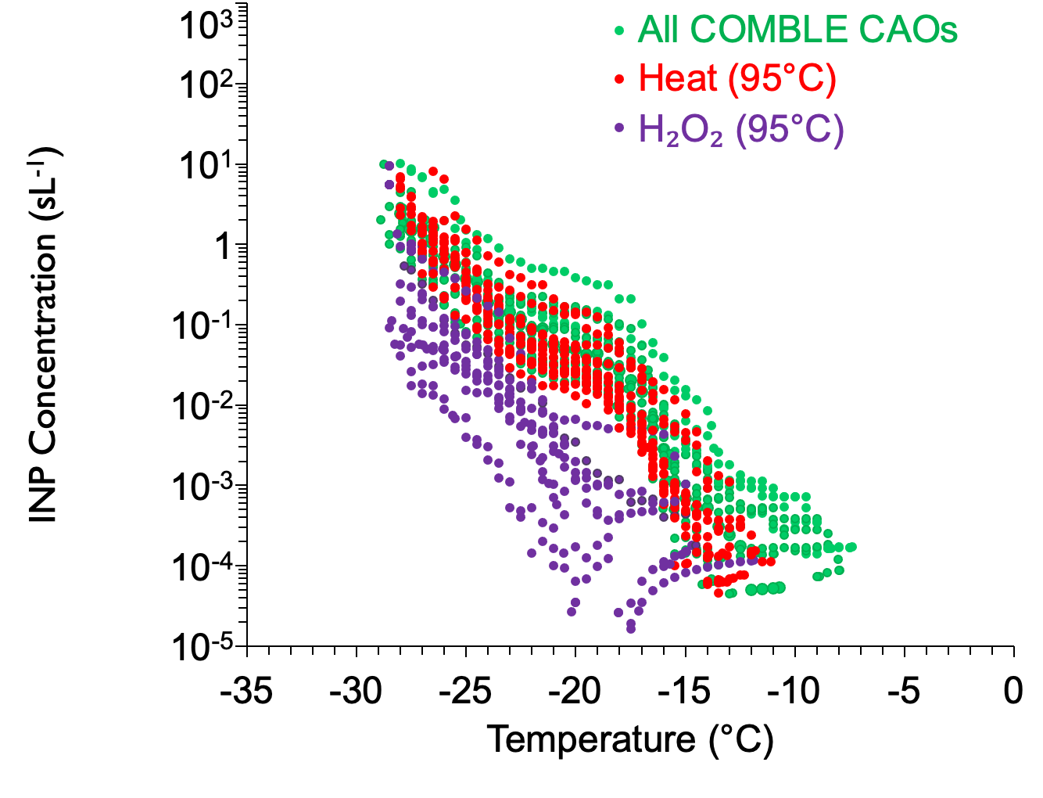
Ice Spectrometer (IS) immersion freezing analyses and treatment diagnosis of INP "types" from bulk filter collections (>200 L optimal)
50 μL aliquots
coolant
Samp A
Samp B
Samp C
Frozen well
Unfrozen well
COMBLE CAOs

Slide 4
CAESAR concept for sampling above, within and below clouds
Out of cloud:
LEVEL LEGS (ideally 10 min or greater duration)
INP reservoir aloft
INPs in MBL
--> CFDC and filters
In cloud:
Operate CFDC only, on CVI inlet
INPs present in cloud residuals

