Slide 1
Collaborative Research:
Aerosol Properties and Autoconversion during CAESAR
Markus Petters and Jefferson Sinder
CAESAR Workshop Boulder, May 9-10, 2023

Slide 2
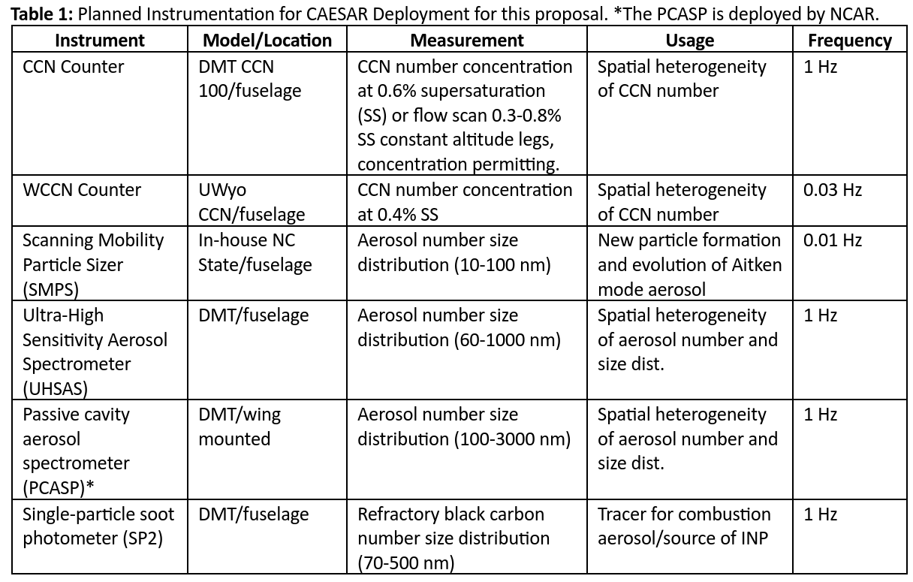
We will deploy the following instrumentation

Slide 3
We will contribute to testing of the following hypotheses
H4a. Oceanic emissions are the primary CCN source.
Test 1: Boundary layer CCN concentrations are low
Test 2: CCN roughly correlate positively with wind speed and negatively with precipitation rate
Test 3: Is there any particle formation within the CAO regime?
H4b. The springtime Arctic free troposphere is often polluted as a consequence of long-range transport.
Test 1: Contrast aerosol number, mass, CCN concentration, black carbon concentration, and coating thickness below, in-cloud, and directly above the CAO cloud regime.
Test 2: Quantify role of presence of black carbon particles that participate in droplet activation (CVI measurement).
H4c. The major source of INPs for CAO MBL clouds is from the stratified free troposphere, dominating the sea surface source, except perhaps under strong winds (> 10 m/s).
Test: Correlate black carbon and ice nucleating particle measurements in the MBL and FT to clarify the potential role of combustion aerosols from long-range transport on the CAO cloud regime.
Hx. Drizzle water content in cloud updrafts is primarily controlled by thermodynamic state at cloud base and by subcloud CCN spectra and updraft velocity distributions.
Test: Evaluate the performance of a two-moment autoconversion scheme against observations. This measurement / model comparison will help constrain the role of sub-cloud CCN spectra and updraft distributions on drizzle formation.

Slide 4
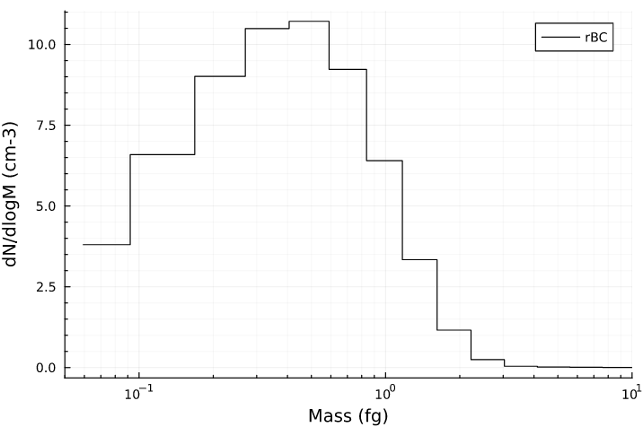
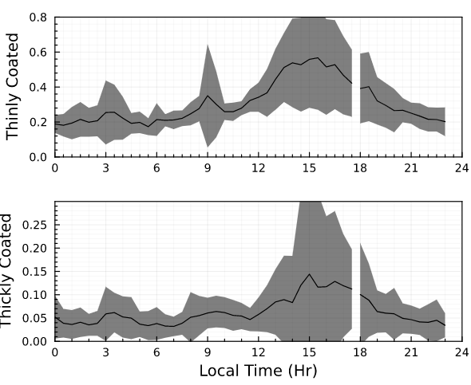
Example Black Carbon Characterization
Total number concentration
rBC Mass/Size distribution
rBC coating state
Black carbon ageing in Houston, TX

Slide 5
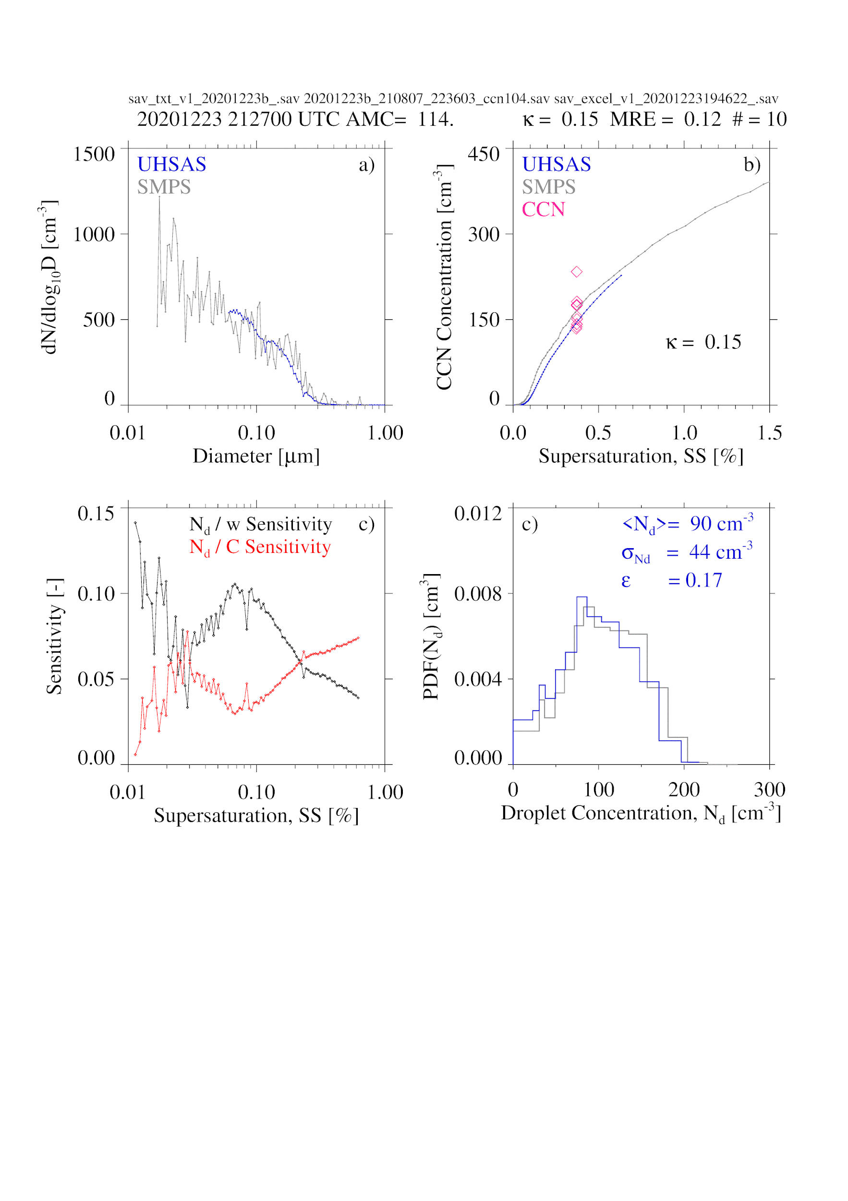
Notes:
We will use measurements (UHSAS, SMPS, CCN) and models (activation model, internal mixing model, and a prognostic two-moment drizzle model) to evaluate properties of updrafts containing mostly supercooled liquid water.
Measurement-derived products: 1) CCN activation spectrum (from CCN at single supersaturation and UHSAS- and SMPS- derived aerosol size distributions), and 2) statistical distribution of updrafts (from gust probe).
Measurements will require five to ten minutes of sampling below cloud base.
Outputs: 1) droplet number concentration (N d ) probability distribution function, and 2) droplet size dispersion (ε), and 3) abundance of drizzle (zeroth and third moments).
Cloud microphysical measurements will be compared to model output in “closure” comparison.
For in-cloud sampling, the “seesaw” pattern advocated by Steve Able (20230419) is recommended. Below cloud base, through cloud, to above cloud top, and repeat….

Slide 6
UHAS, SMPS, CCN
+
Kappa/Köhler Model
Notes:
We will use measurements (UHSAS, SMPS, CCN) and models (activation model, internal mixing model, and a prognostic two-moment drizzle model) to evaluate properties of updrafts containing mostly supercooled liquid water.
Measurement-derived products: 1) CCN activation spectrum (from CCN at single supersaturation and UHSAS- and SMPS- derived aerosol size distributions), and 2) statistical distribution of updrafts (from gust probe).
Measurements will require five to ten minutes of sampling below cloud base.
Outputs: 1) droplet number concentration (N d ) probability distribution function, and 2) droplet size dispersion (ε), and 3) abundance of drizzle (zeroth and third moments).
Cloud microphysical measurements will be compared to model output in “closure” comparison.
For in-cloud sampling, the “seesaw” pattern advocated by Steve Able (20230419) is recommended. Below cloud base, through cloud, to above cloud top, and repeat….

Slide 7
PDF(updraft)
+
Activation Model +
Cooper (1989)
UHAS, SMPS, CCN
+
Kappa/Köhler Model
Notes:
We will use measurements (UHSAS, SMPS, CCN) and models (activation model, internal mixing model, and a prognostic two-moment drizzle model) to evaluate properties of updrafts containing mostly supercooled liquid water.
Measurement-derived products: 1) CCN activation spectrum (from CCN at single supersaturation and UHSAS- and SMPS- derived aerosol size distributions), and 2) statistical distribution of updrafts (from gust probe).
Measurements will require five to ten minutes of sampling below cloud base.
Outputs: 1) droplet number concentration (N d ) probability distribution function, and 2) droplet size dispersion (ε), and 3) abundance of drizzle (zeroth and third moments).
Cloud microphysical measurements will be compared to model output in “closure” comparison.
For in-cloud sampling, the “seesaw” pattern advocated by Steve Able (20230419) is recommended. Below cloud base, through cloud, to above cloud top, and repeat….

Slide 8
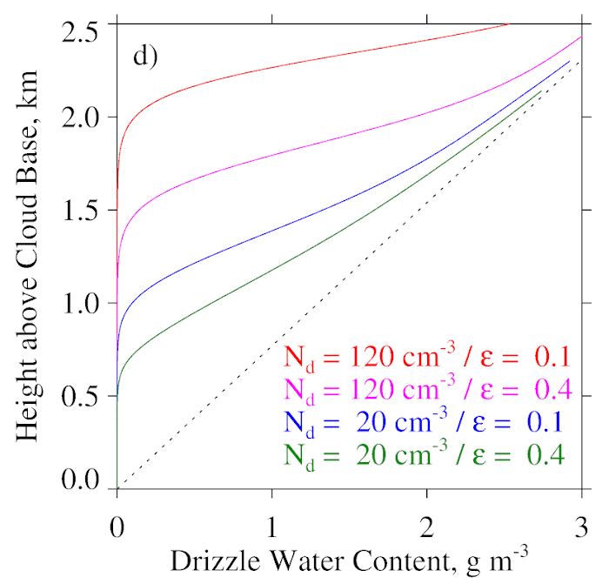
PDF(updraft)
+
Activation Model
+ Cooper (1989)
UHAS, SMPS, CCN
+
Kappa/Köhler Model
Seifert and Beheng (2001) Prognostic two moment autoconversion model
Notes:
We will use measurements (UHSAS, SMPS, CCN) and models (activation model, internal mixing model, and a prognostic two-moment drizzle model) to evaluate properties of updrafts containing mostly supercooled liquid water.
Measurement-derived products: 1) CCN activation spectrum (from CCN at single supersaturation and UHSAS- and SMPS- derived aerosol size distributions), and 2) statistical distribution of updrafts (from gust probe).
Measurements will require five to ten minutes of sampling below cloud base.
Outputs: 1) droplet number concentration (N d ) probability distribution function, and 2) droplet size dispersion (ε), and 3) abundance of drizzle (zeroth and third moments).
Cloud microphysical measurements will be compared to model output in “closure” comparison.
For in-cloud sampling, the “seesaw” pattern advocated by Steve Able (20230419) is recommended. Below cloud base, through cloud, to above cloud top, and repeat….

Slide 9
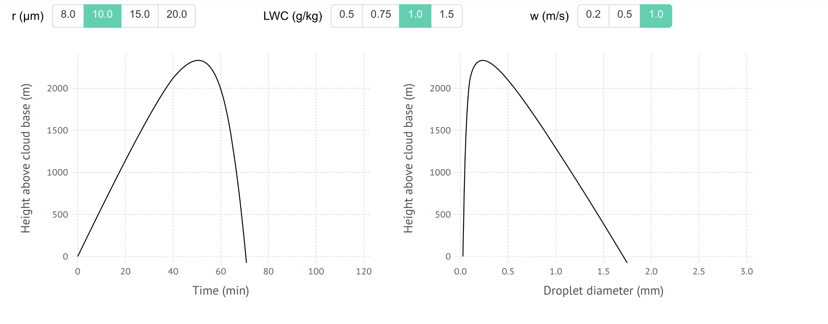
Broader impacts: interactive learning content
Petters, 2021, BAMS
We will collect video footage, weather maps, numerical weather predictions, and satellite loops collected during the campaign.
We will record a joint set of instructional videos that introduce CAOs and aerosol-cloud-drizzle effects in CAOs and weave in interactive applets for incorporation as classroom modules

