Slide 1
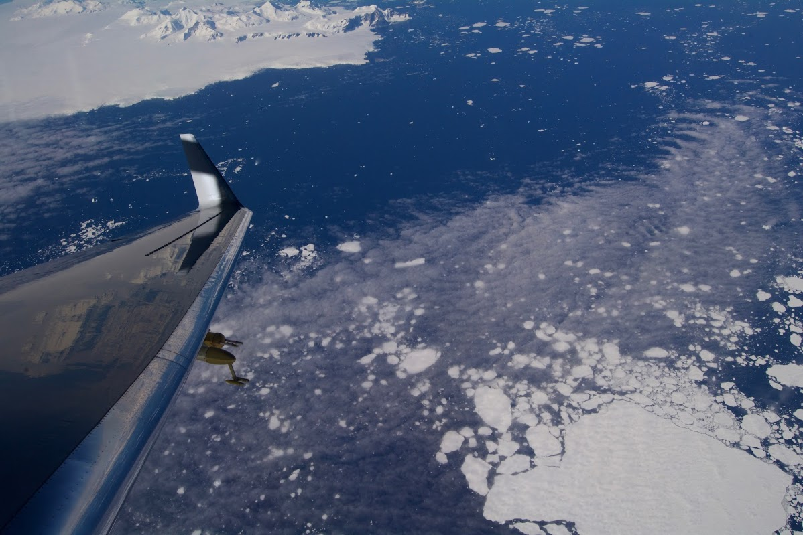
Oxygen and Carbon above the Southern Ocean
[Image: Jonathan Bent]
Britton Stephens (EOL) and the ORCAS Science Team

Slide 2
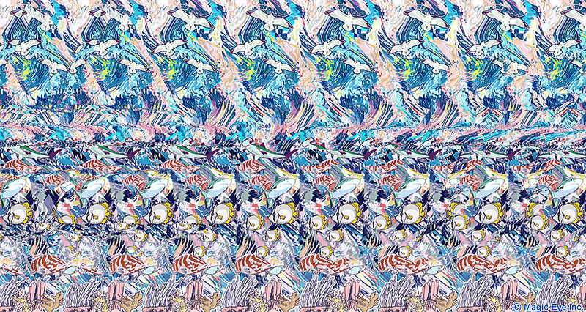
Oceanography from an airplane
Outline:
Motivation and objectives
ORCAS campaign description
Highlight results
Campaign mean CO₂ profile
Campaign mean O₂:CO₂ ratio
Implications for our understanding of Southern Ocean biogeochemistry

Slide 3
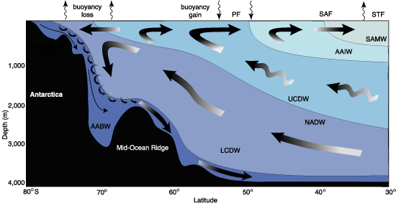
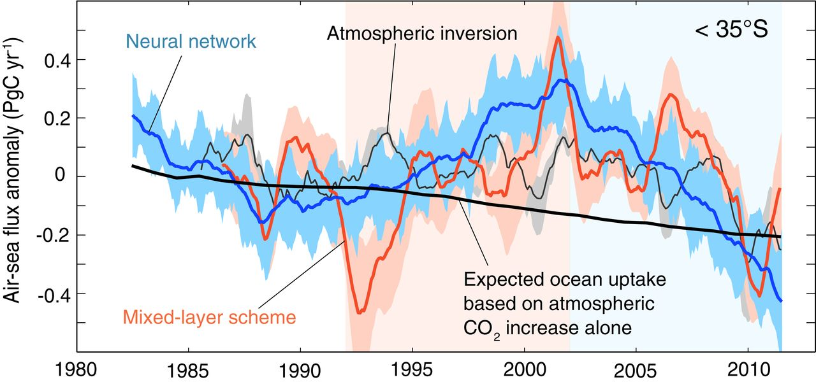
The evolving Southern Ocean carbon sink
cooling
biology
warmng
40% of human-emitted CO₂ absorbed by ocean entered S of 40 S
Recent variability
Uncertain future
Landschützer et al., Science, 2015
IPCC AR5, 2013

Slide 4
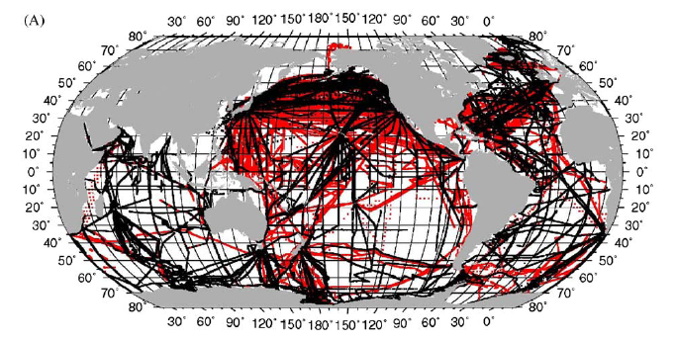
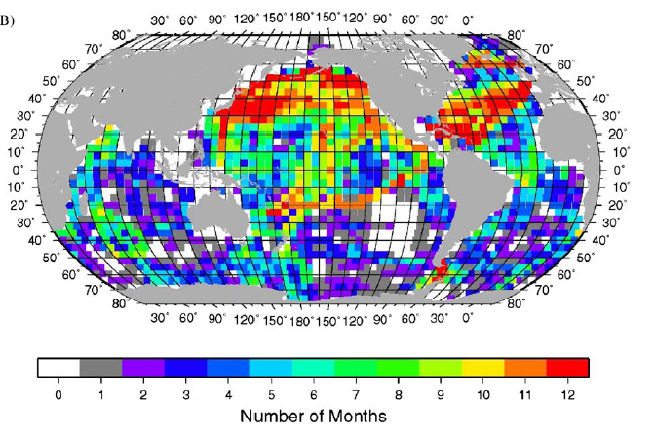
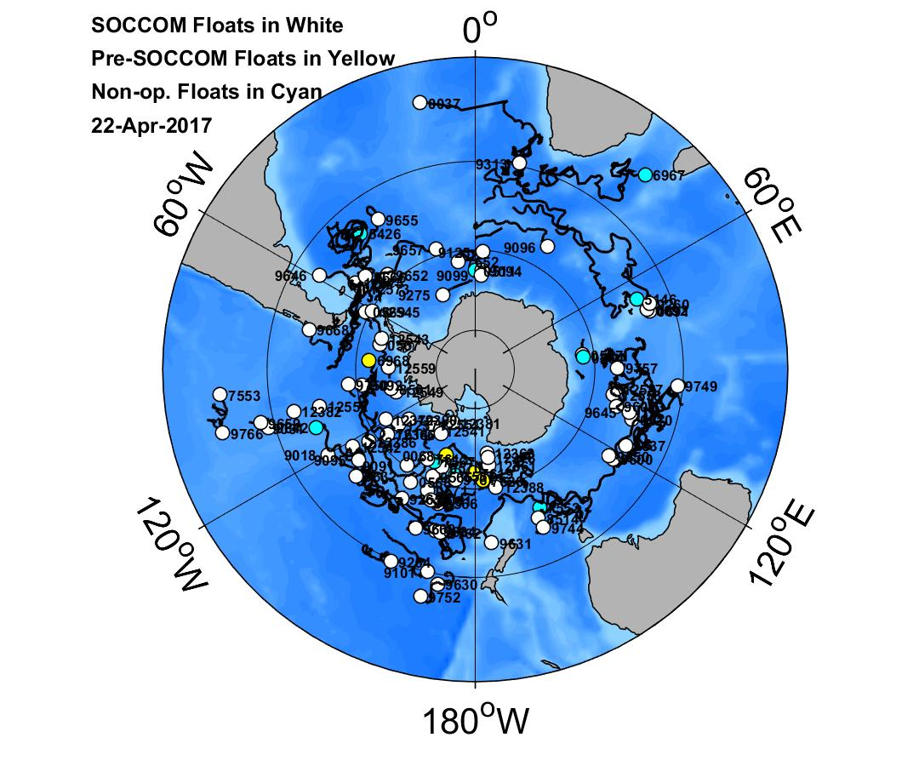
Southern Ocean surface water pCO₂ observations
Historically sparse in space and time
New technology promising but puzzling
Takahashi et al., DSR, 2009

Slide 5
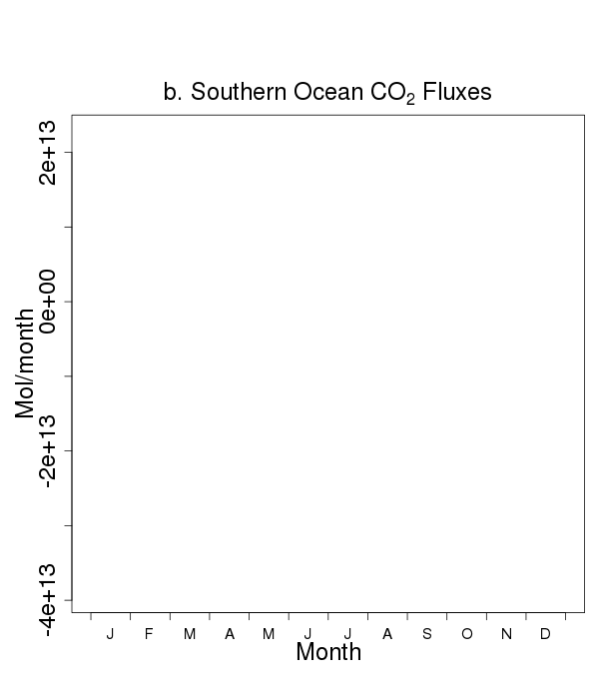
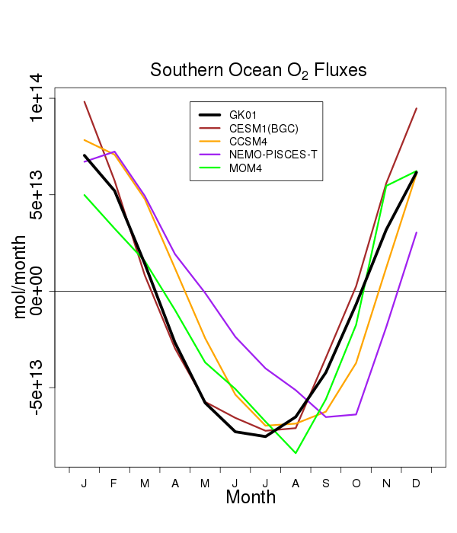
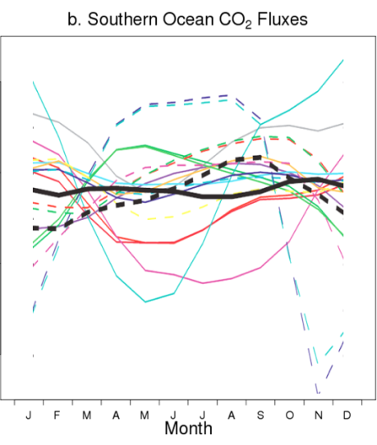
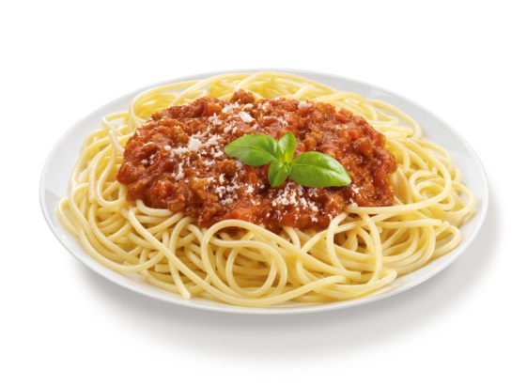
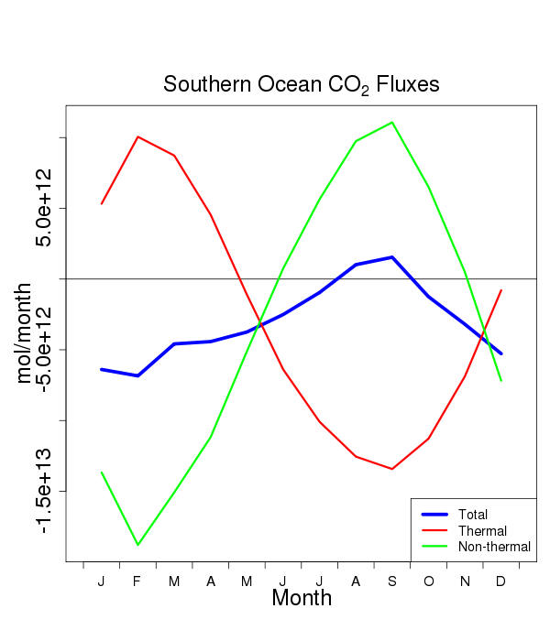
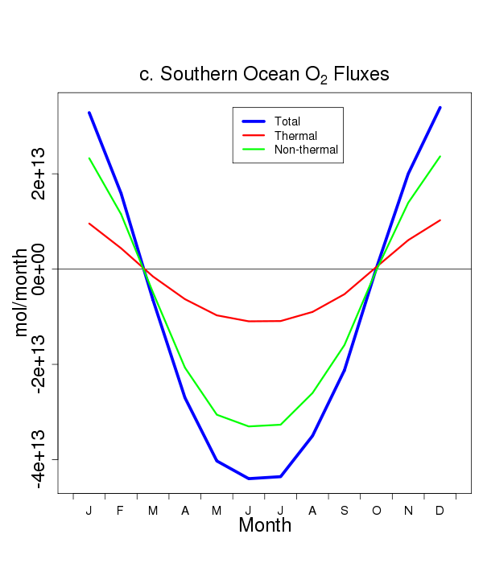
Seasonal CO₂ and O₂ fluxes
(S of 44 S)
CO₂
O₂
Models: Anav et al., J.Clim., 2013
Obs: dash = Takahashi et al. DSR, 2009
M. Long, S. Doney, C. Le Quéré, J. Dunne
black = Garcia and Keeling, JGR 2001
CO₂
O₂
Forcings:
Total (obs)
Thermal (SST, Q)
Non-thermal

Slide 6
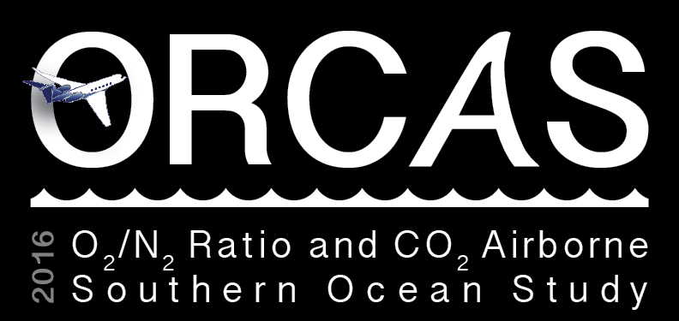
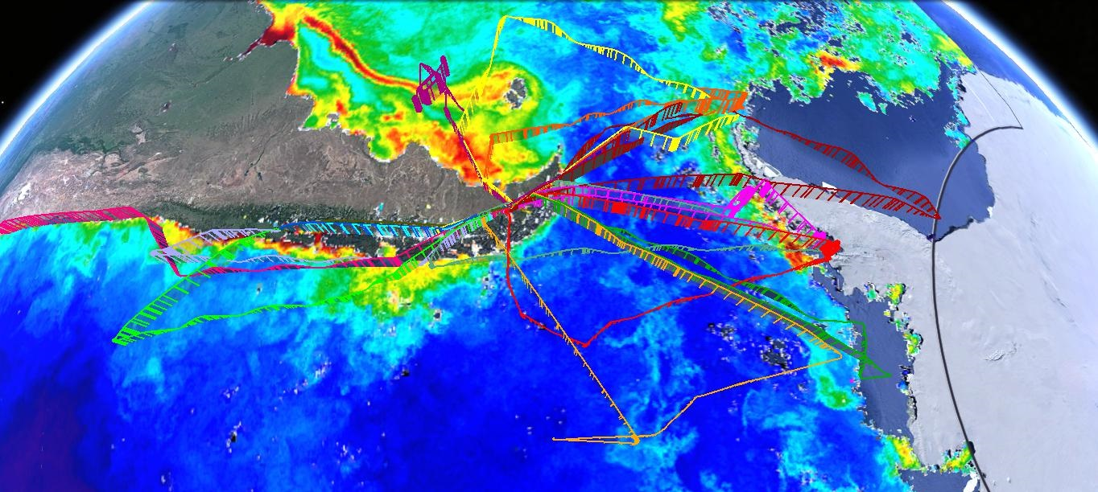
NSF/NCAR GV
Punta Arenas, Chile
15 Jan to 29 Feb 2016
http://www.eol.ucar.edu/field_projects/orcas

Slide 7
ORCAS Science Team
Principle Investigators: Britton Stephens (NCAR/EOL), Matt Long (NCAR/CGD), Ralph Keeling (Scripps), Eric Kort (U. Mich.), Colm Sweeney (CU/NOAA), Elliot Atlas (U. Miami), Michelle Gierach (JPL)
Carbon Cycle Instruments: Jonathan Bent (NCAR/EOL), Bruce Daube (Harvard), Kathryn McKain (CU), Eric Morgan (Scripps), Tim Newberger (NOAA), Mackenzie Smith (U Mich.), Andy Watt (NCAR/EOL), Steve Wofsy (Harvard)
Biogenic Reactive Gas Instruments: Eric Apel (NCAR/ACOM), Nicola Blake (UC Irvine), Valeria Donets (U. Miami), Alan Hills (NCAR/ACOM), Becky Hornbrook (NCAR/ACOM), Rich Lueb (NCAR/EOL), Sue Schauffler (NCAR/ACOM), Joanna Casey (CU)
PRISM Remote Sensing: Ernesto Diaz (JPL), Heidi Dierssen (U. Conn.), Robert Green (JPL), Justin Haag (JPL), Ian McCubbin (JPL), Pantazis Mouroulis (JPL), Scott Nolte (JPL), David Thompson (JPL), Byron Van Gorp (JPL), Kate Randolph (U. Conn.), Kat Smith (CU)
Aerosol and Cloud Microphysics Instruments: Minghui Diao (San Jose State), Andrew Gettleman (NCAR/CGD), Jorgen Jensen (NCAR/EOL), Bryan Rainwater (CU), Jeff Stith (NCAR/EOL), Darin Toohey (CU)
Forecasting support: Jim Bresch (NCAR/MMM), Shawn Honomichi (NCAR/ACOM), Jordan Powers (NCAR/MMM)
Atmosphere and Climate Modeling: Abhishek Chatterjee (GMAO), Martin Hoecker-Martinez (U. Mich.), Jean-Francois Lamarque (NCAR/CGD/ACOM), Francis Vitt (NCAR/ACOM/CGD)
Education and Outreach: Alison Rockwell (NCAR/EOL), Teri Eastburn (UCAR), Nikki Lovenduski (CU)
External Collaborators: Nicolas Cassar (Duke), Scott Doney (PALTER), Hugh Ducklow (PALTER), Oscar Schofield (PALTER), Jorge Sarmiento (SOCCOM), Lynne Talley (SOCCOM)
ORCAS was primarily supported by NSF Polar Programs and LAOF. Additional support from NSF Atmospheric Chemistry and NASA Ocean Biology and Biogeochemistry

Slide 8
Matt Long and Tim Scheitlin, NCAR
$δ({O_{2}}/{N_{2}})=\left(\frac{{({O_{2}}/{N_{2}})}_{sample}}{{({O_{2}}/{N_{2}})}_{reference}}−1\right)$ x 10⁶
https://youtu.be/VUwOAVh6CGQ
“per meg”

Slide 9
Matt Long and Tim Scheitlin, NCAR
$δ({O_{2}}/{N_{2}})=\left(\frac{{({O_{2}}/{N_{2}})}_{sample}}{{({O_{2}}/{N_{2}})}_{reference}}−1\right)$ x 10⁶
https://youtu.be/VUwOAVh6CGQ
“per meg”

Slide 10
ORCAS Research Flight 3
https://youtu.be/Df2peaFxUAM

Slide 11
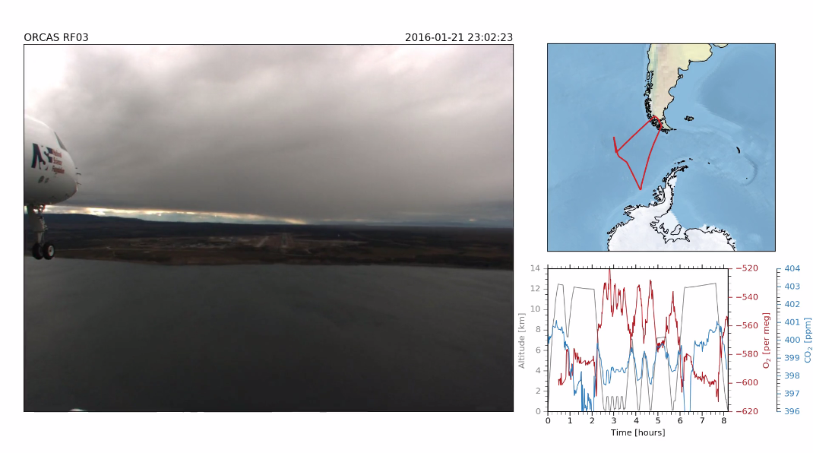
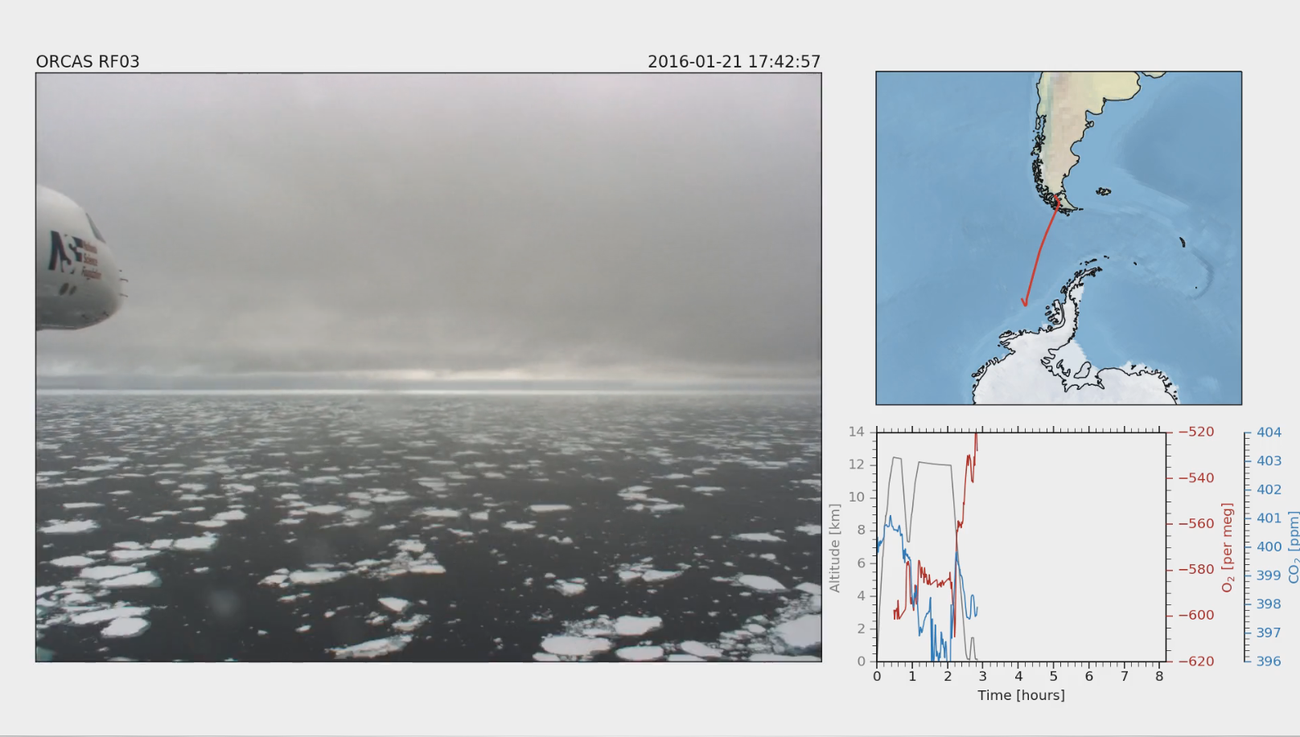
ORCAS Research Flight 3
https://youtu.be/Df2peaFxUAM

Slide 12
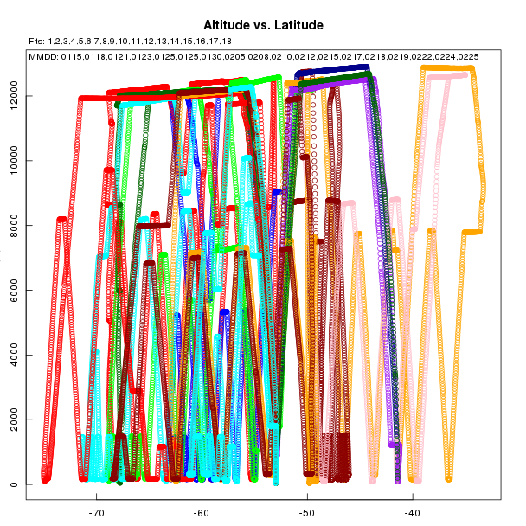
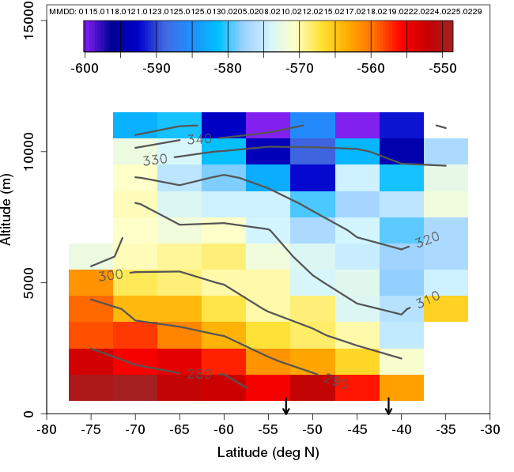
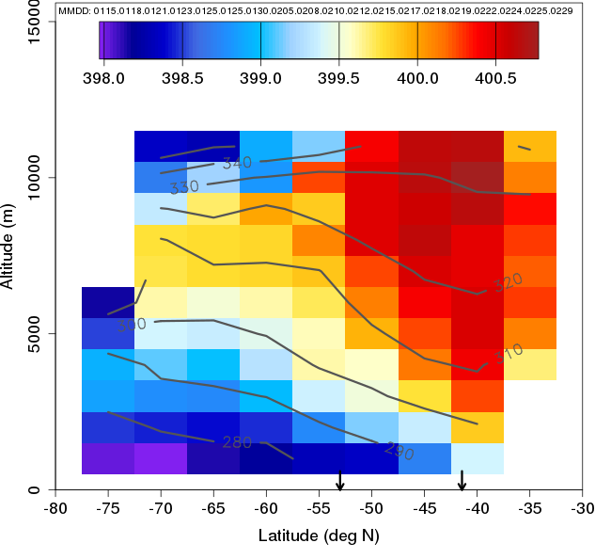
Whole campaign latitude /altittude bin averages
Alt
O₂
CO₂
Lat
per meg
ppm

Slide 13
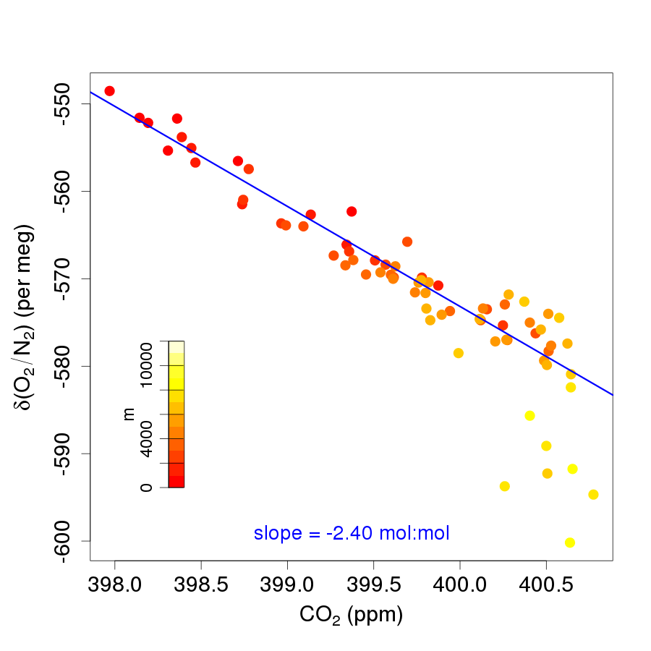
Whole campaign bin averaged O₂:CO₂ relationship

Slide 14
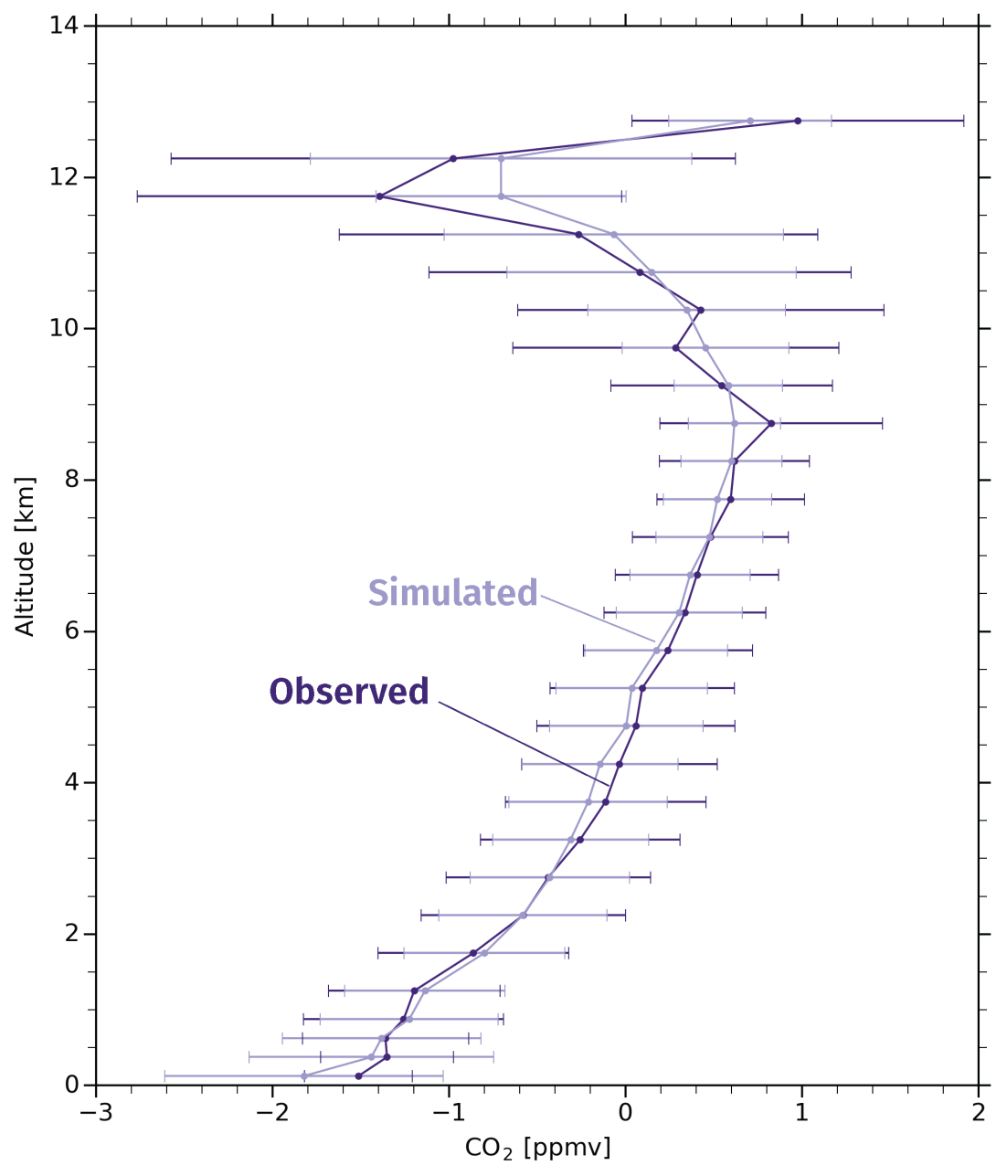
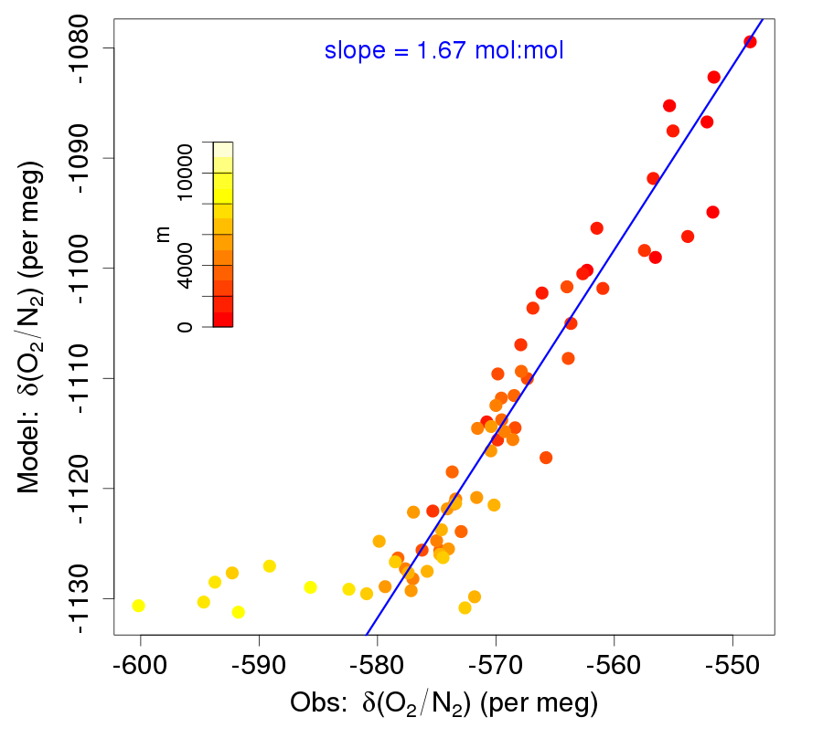
CESM(SD) Compared to Observations
CO₂
O₂
Implies CO₂ right for wrong reasons
One possibility = compensating overestimates of both biological and thermal forcing

Slide 15
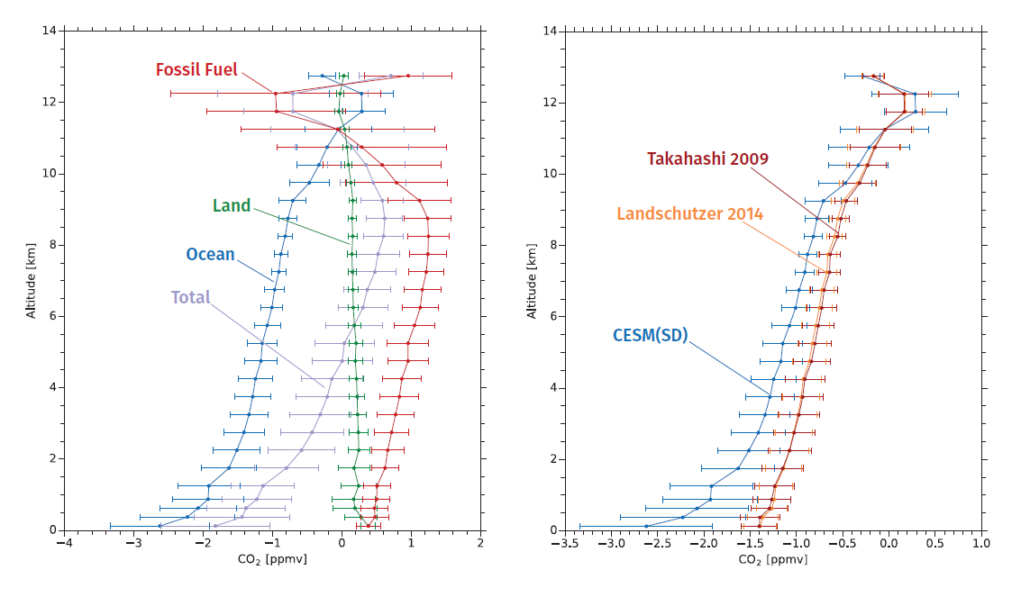
CESM(SD) CO₂ Components CAM Ocean CO₂ Comparison
Large disagreement with climatological CO₂ flux estimates, possibly related to 1) climatologies, 2) fossil/land contributions, 3) atmospheric transport, 3) spatio-temporal flux distributions, 4) interannual variability

Slide 16
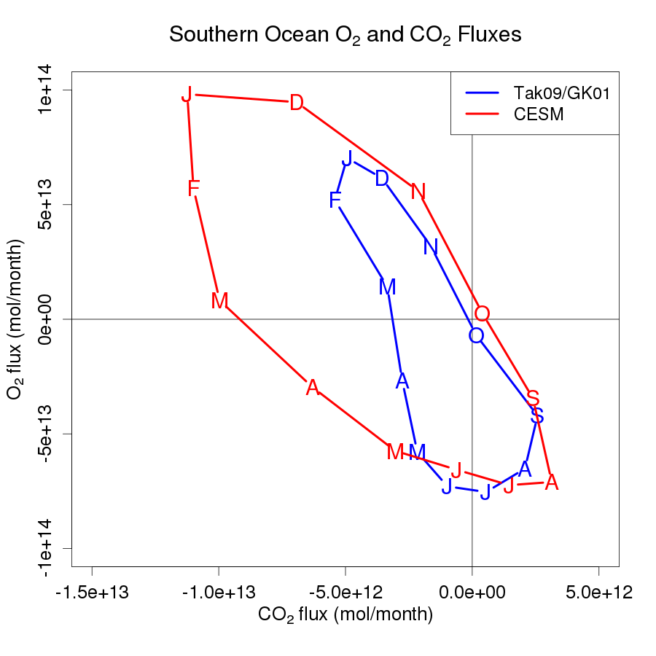
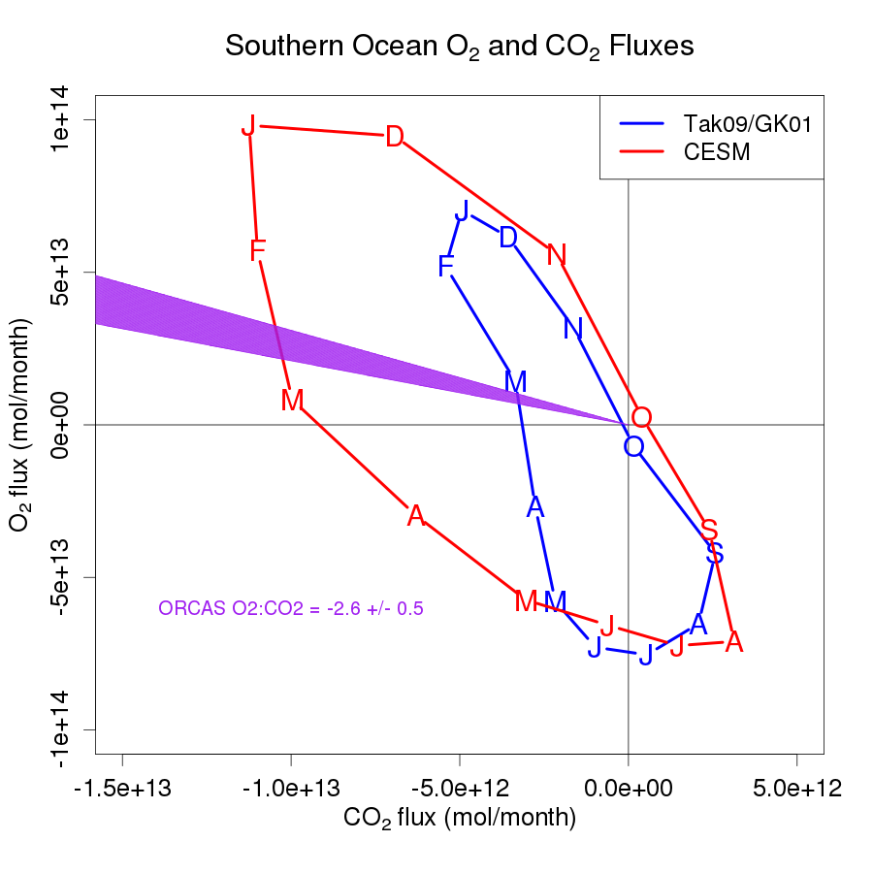
ORCAS ratio constraint
If CESM CO₂ flux correct
If GK01 O₂ flux correct
Southern Ocean (> 44 S) O₂ and CO₂ fluxes. Tak09/GK01 = Takahashi et al., 2009 CO₂ fluxes + Garcia and Keeling, 2001 seasonal O₂ fluxes + Gruber et al, 2001 annual O₂ fluxes. Observational contraint on ratios shown in magenta.

Slide 17
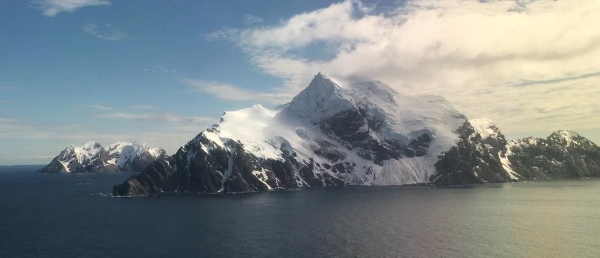
Summary
ORCAS measured predominantly negative O₂:CO₂ correlations reflecting the dominance of biological drivers on summertime CO₂ fluxes
The CESM forecast product overestimated observed O₂ signals but showed remarkable agreement with CO₂ gradients, which were themselves much stronger than climatological estimates
Both the mean CO₂ vertical gradient and O₂:CO₂ ratio suggest possible underestimation of summertime CO₂ ingassing by climatologies
Station and ship data (not shown) support this conclusion and suggest biases in the opposite direction during winter, possibly reconciling recent float data

Slide 18
Thank you!

