Slide 1
Agenda
Britt: data and BAMS paper status
Matt: CO2 flux paper
Martin: Lagrangian flux estimate paper
Eric M: BL O₂:CO₂ paper
Kathryn: ORCAS/HIPPO/ATom vertical CO₂ gradients
Britt: ORCAS/Gould/PSA O₂:CO₂ paper
Lizzy: biogenic gas paper
Minghui: RH paper
Heidi: PRISM
General discussion
  path(s) forward
  critical needs
  desirable model runs
  other collaborative opportunities
  future meetings
On Wed, Jul 19, 2017 at 9:54 AM, Neustel, Jillian <jneustel@ametsoc.org> wrote:
At this time, I am missing the signed copyright forms from 19 of your co-authors: Ralph Keeling, Colm Sweeney, Stuart Beaton, Jonathan Bent, James Bresch, Ernesto Diaz, Michelle Gierach, Robert Green, Justin Haag, Martín Hoecker-Martínez, Shawn Honomichl, Jorgen Jensen, Ian McCubbin, Scott Nolte, Mike Reeves, Mackenzie Smith, Katherine Smith, Jeff Stith, and Darin Toohey

Slide 2
Matt / Martin / Eric - pdf

Slide 3
Goal: Estimate CO₂ air-sea flux from observed vertical gradient
Quantify gradient
  Account for contribution from non-ocean fluxes
    Tagged tracers in Global CO₂ models
    Observed tracers, e.g. CH₄
Estimate residence time (20-40 days?)
  Lagrangian models with different meteorology
    GDAS
    ECMWF
    MERRA2
      - ARL converter recently completed, HYSPLIT runs forthcoming
  Short-lived tracers
    Methyl nitrate box-model
Constrain through multiple diverse, independent methods
3. Seasonality (inter-annual variability) from ORCAS + HIPPO + ATom
(4. TBD: Investigate model biases in vertical mixing, interhemispheric transport –
more obvious in this remote, well-mixed, densely sampled domain)
Kathryn McKain, Colm Sweeney, 19 July 2017

Slide 4
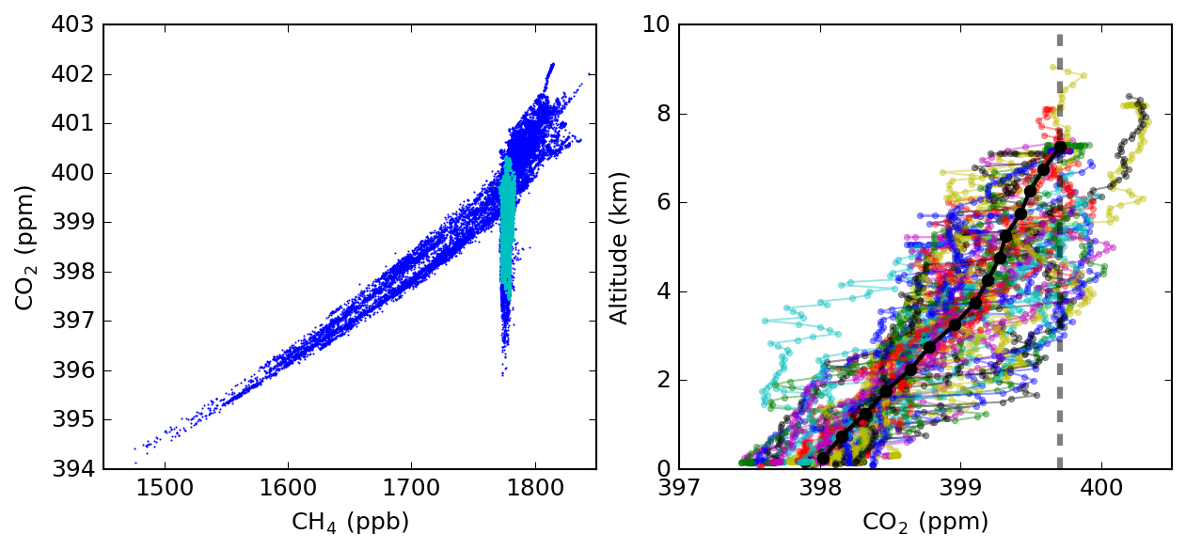
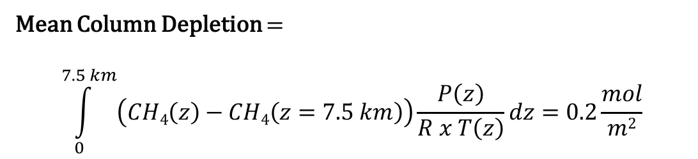
Mean Vertical Gradient in Ocean-dominated Air
  selection of Ocean-dominated Air
  Individual profiles where ΔCH₄ ≈ 0
Mean Column Depletion =
$$\int_{0}^{7.5 km}{\left(CH4\left(z\right)−CH4\left(z=7.5 km\right)\right)\frac{P\left(z\right)}{R x T\left(z\right)}dz=0.2\frac{mol}{m2}}$$
Notes:
Mean column depletion is ~1.7 ppm over 7.5 km
Selection Criteria: covering at least 279-290 K, CH4 within 8 ppb of values fit to DOY (highlighted points)
Differenced against mean(CO2) in 90th percentile alt bin
N=43 profiles, ~13% of total data pts
Why are CO2<397 are not included? Very small number of pts. Looked at one profile and it was out of PA with big depletion near the surface and also short spikes of CO2 & CH4 → infer land bio + anthro

Slide 5
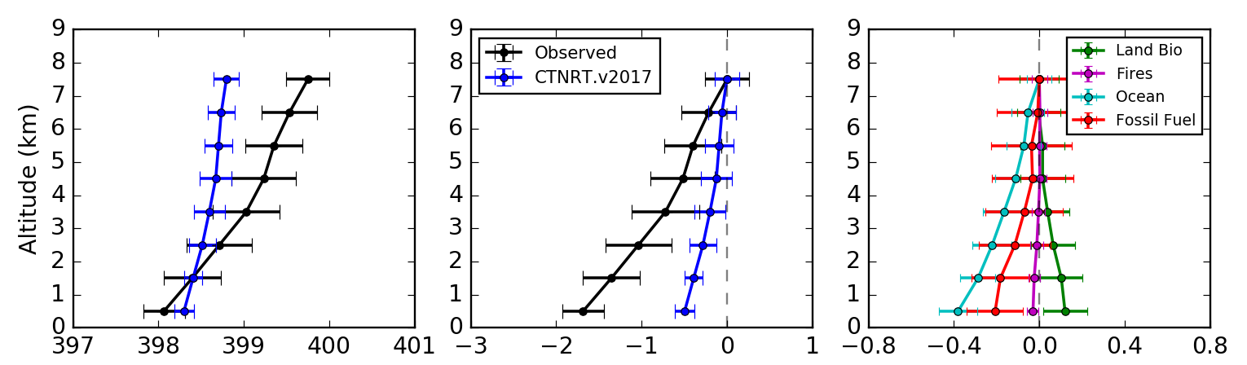
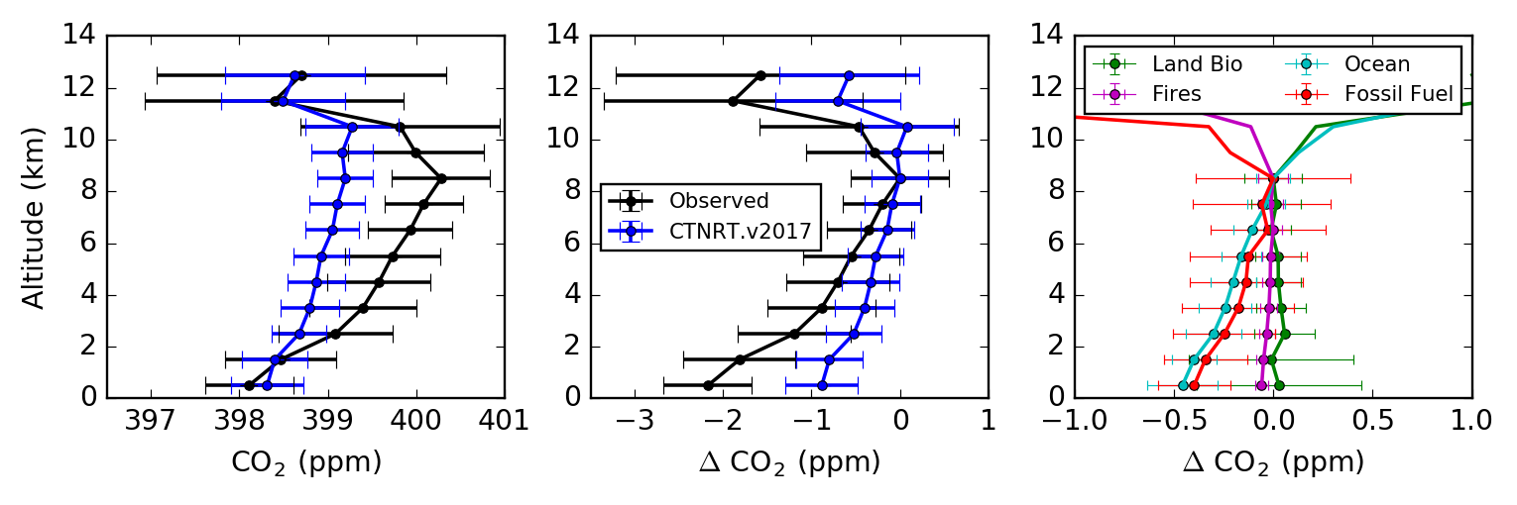
Comparison with CarbonTracker-NearRealTime
Filtered
Total concentration
Tropospheric gradient
Components
Unfiltered
Notes:
CT-NRT.v2017.1, simulation of selected ocean-influenced pts
It is inferred that CT gets the surface concentration because it is informed by surface data (e.g. DRP, PSA, SPA)
Andy realized a mistake in NRT where the ocean prior has not trend and that may be why it is underestimating the gradient.

Slide 6
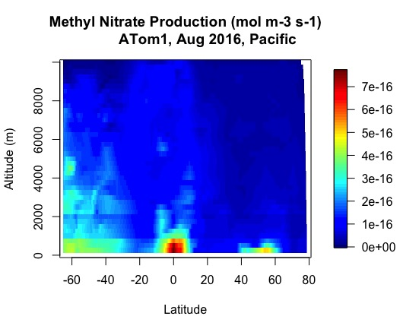
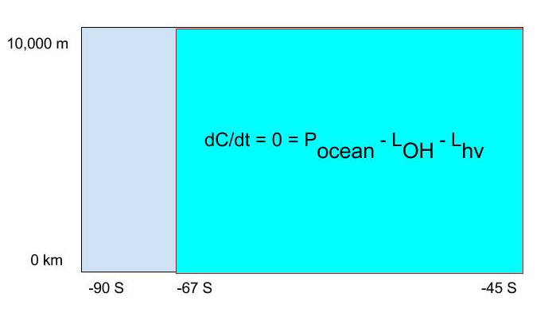
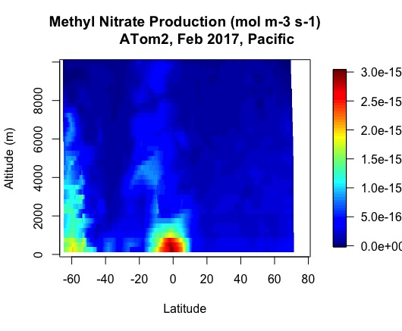
Methyl nitrate observations + box model
Source: ocean emissions Sinks: photolysis, atmospheric oxidation by OH
Box model (-45 S to -67 S)
L_{OH} = k_{OH}•[OH]•[MN]
L_{hv} = k_{hv}•[MN]
Adjusted k_{hv} and [OH]
  [OH] from Spivakovsky et al., 2000
  k_{hv} from NCAR
  k_{OH} from Talukdar et al., 1997
R. Stern, S. Wofsy using flask data from E. Atlas & D. Blake
Notes:
ATOM = atmospheric tomography mission (NASA)
ATom Aircraft observations & box model for analysis of MN emission rates
Assume no production due to biomass burning
Assume no chemical production from NO

Slide 7
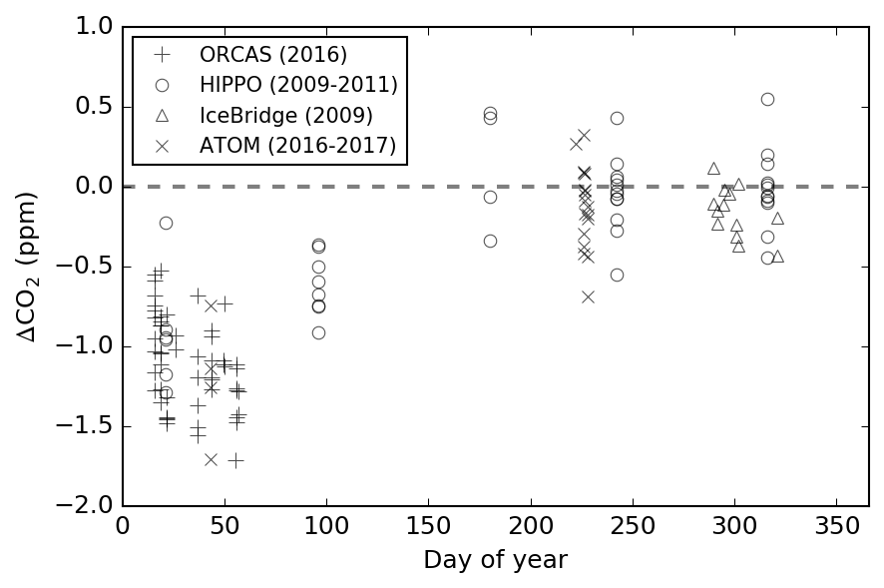
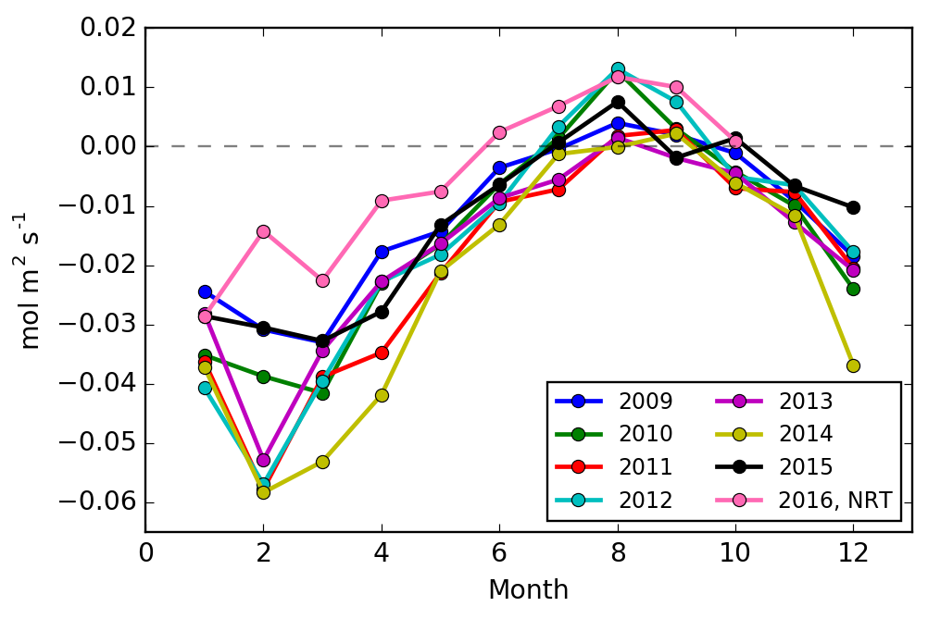
Seasonal Cycle in Atmospheric Gradient compared to Flux Models
CT-NRT fluxes for 2016 are anomalously high, consistent with the underestimated gradient compared to ORCAS obs
ATom-4 (2018)
ATom-3 (2017)
CT2016 Ocean Flux
0.05 mol m⁻² s⁻¹ ≈
0.2 mol m⁻² @ τ = 45 days
→ Basic consistency between observed gradients & CT fluxes
IceBridge data from Mellissa Yang, NASA
Notes:
In this case deltaCO2 is still calculated as the difference between bins of 270-280 and 290-300, with no filtering based on CH4, etc. Pressure-weighting does not change the answer, but aggregating the data as in slide 2 does. Will be hard to filter by CH4 for HIPPO and IceBridge because precision is not as good.
CT2016 monthly averages for 50-70 deg lat

Slide 8
Biological dominance of Southern Ocean seasonal CO₂ exchange
Stephens, B.B., Long, M.C., Keeling, R.K., Sweeney, C.S., Kort, E.A., Bent, J.D., Watt, A.S., Morgan, E., McKain, K., Hoecker-Martínez, M., Patra, P., Mikaloff-Fletcher, S., plus others
Organizing points:
Understanding of thermal / biological balance of S.O. CO₂ flux forcing is limited and tied primarily to very sparse surface water pCO₂ observations.
Flux climatologies based on pCO₂ observations and air-sea gas exchange estimates, and atmospheric inversions using pCO₂-based flux maps as prior guesses, predict small seasonal cycles in CO₂ exchange and modest interannual variability, suggesting close and persistent balance between thermal and biological forcing on annual and longer scales.
Shipboard, aircraft, and station observations of atmospheric O₂ and CO₂, as well as Earth system models, indicate large imbalances in CO₂ flux drivers that lead to much larger seasonal cycles and interannual variability in Southern Ocean CO₂ fluxes than previously thought.

Slide 9
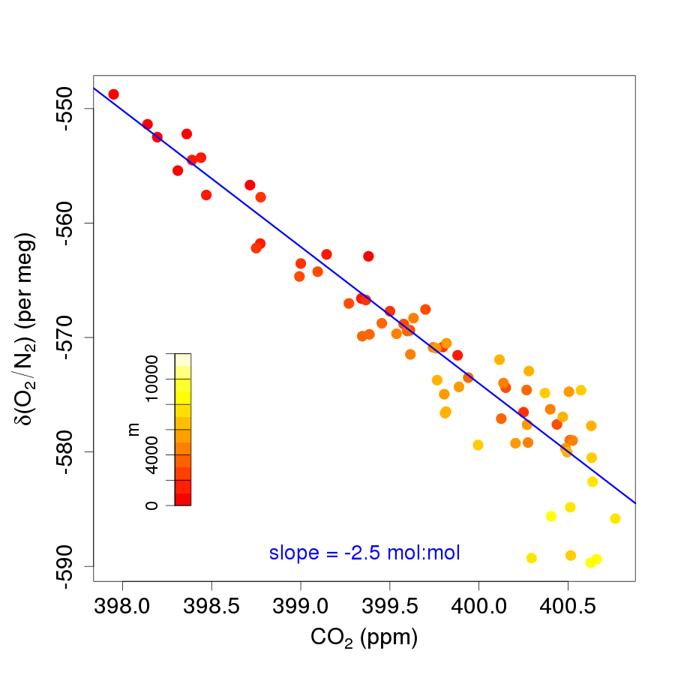
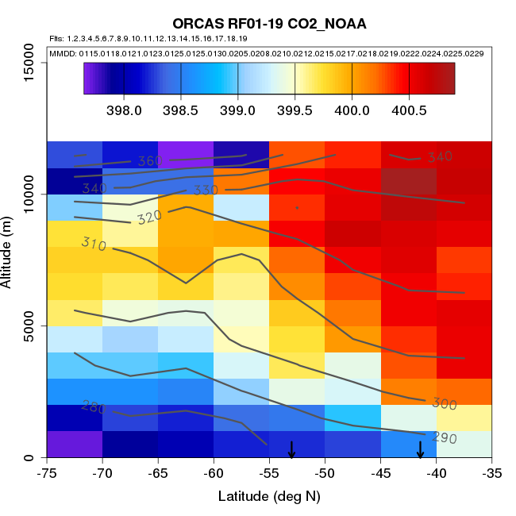
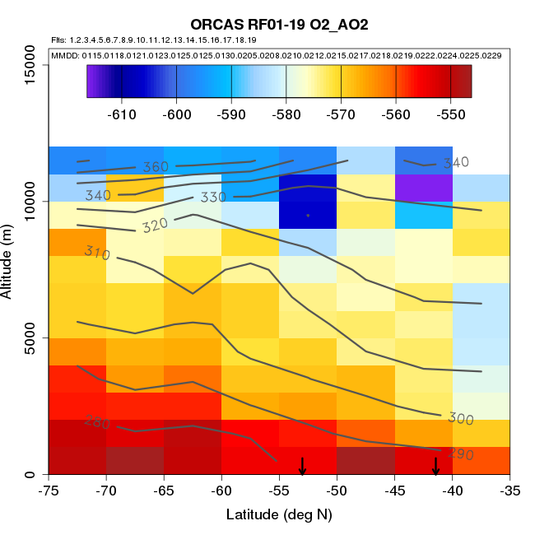
ORCAS, Jan-Feb 2016

Slide 10
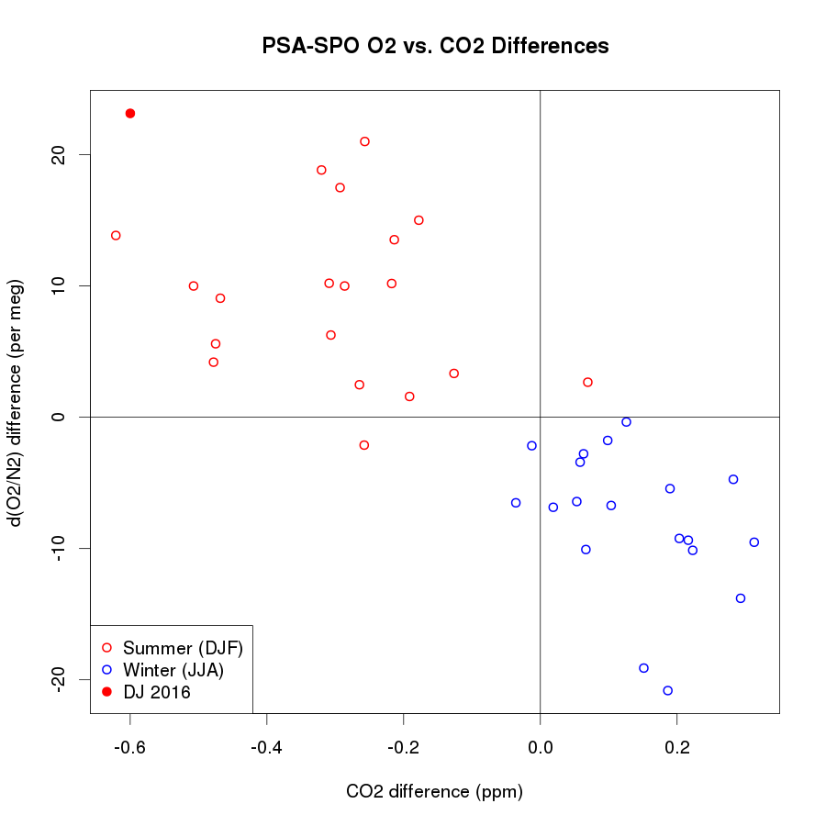
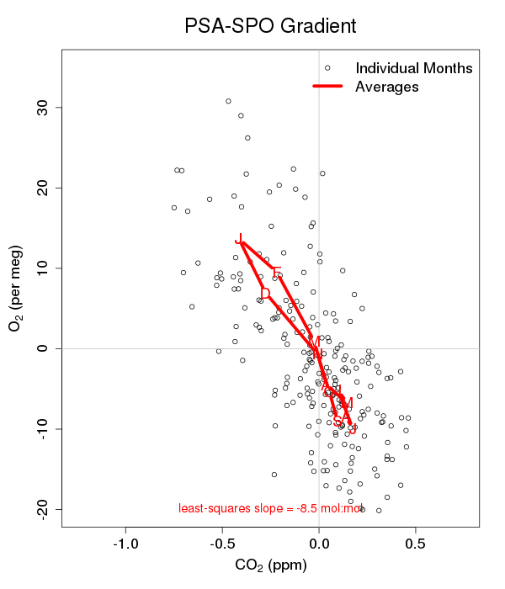
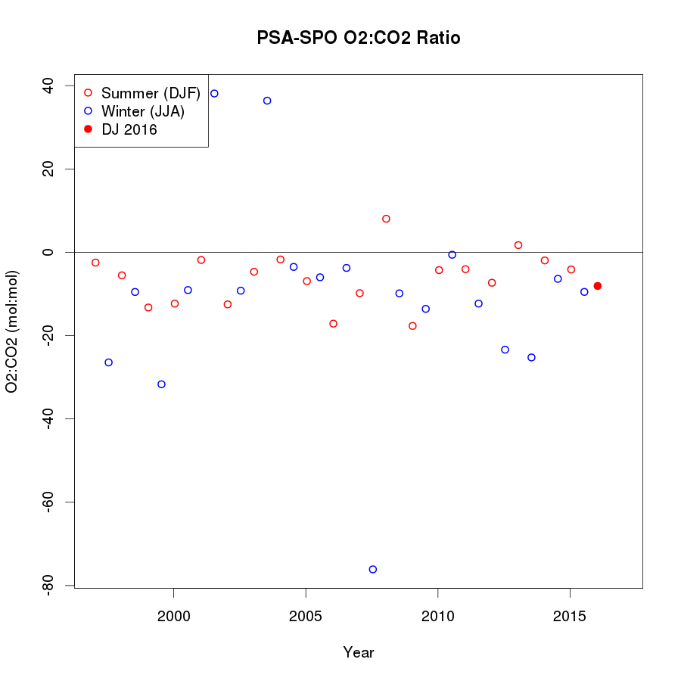
Scripps PSA-SPO,
1997-2017

Slide 11
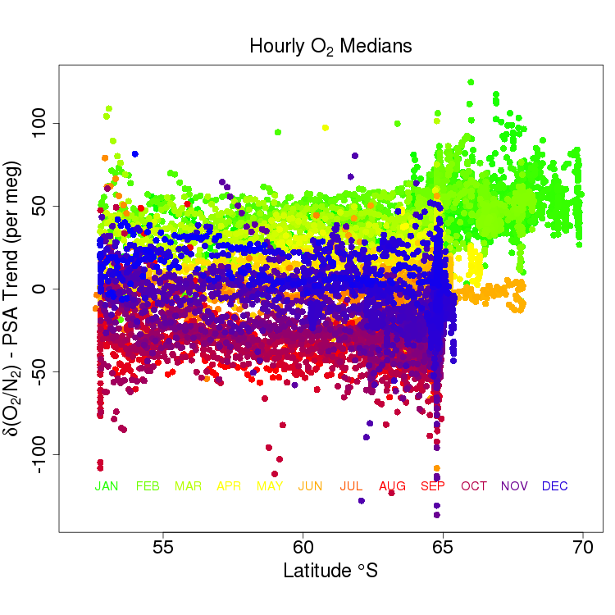
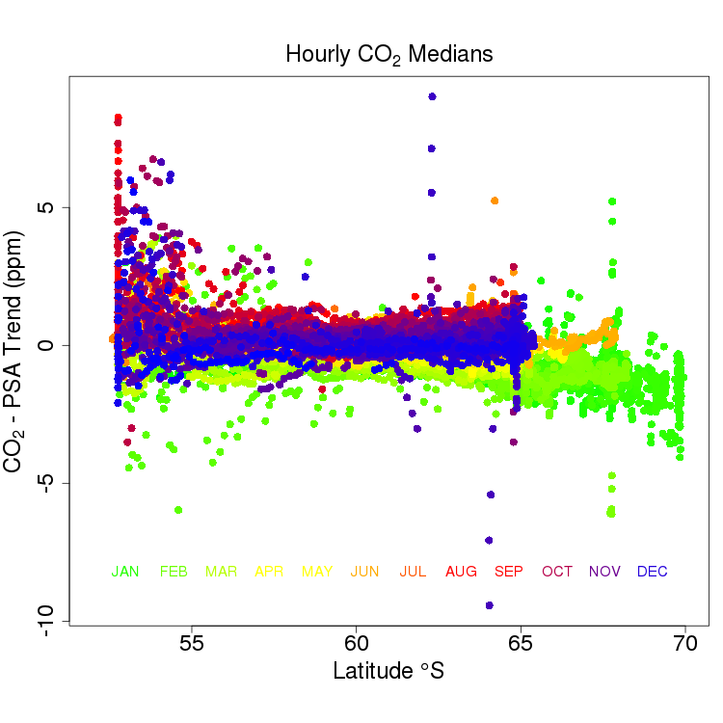
Gould, 2012-2017

Slide 12
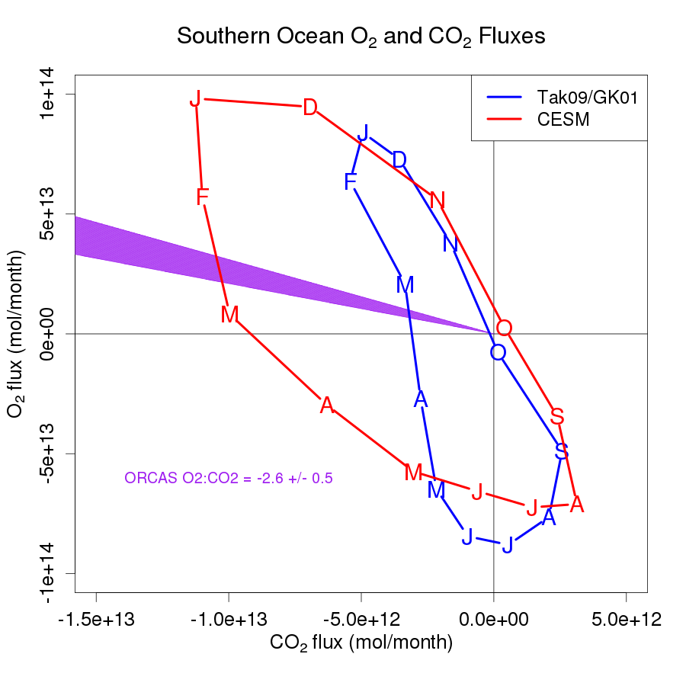
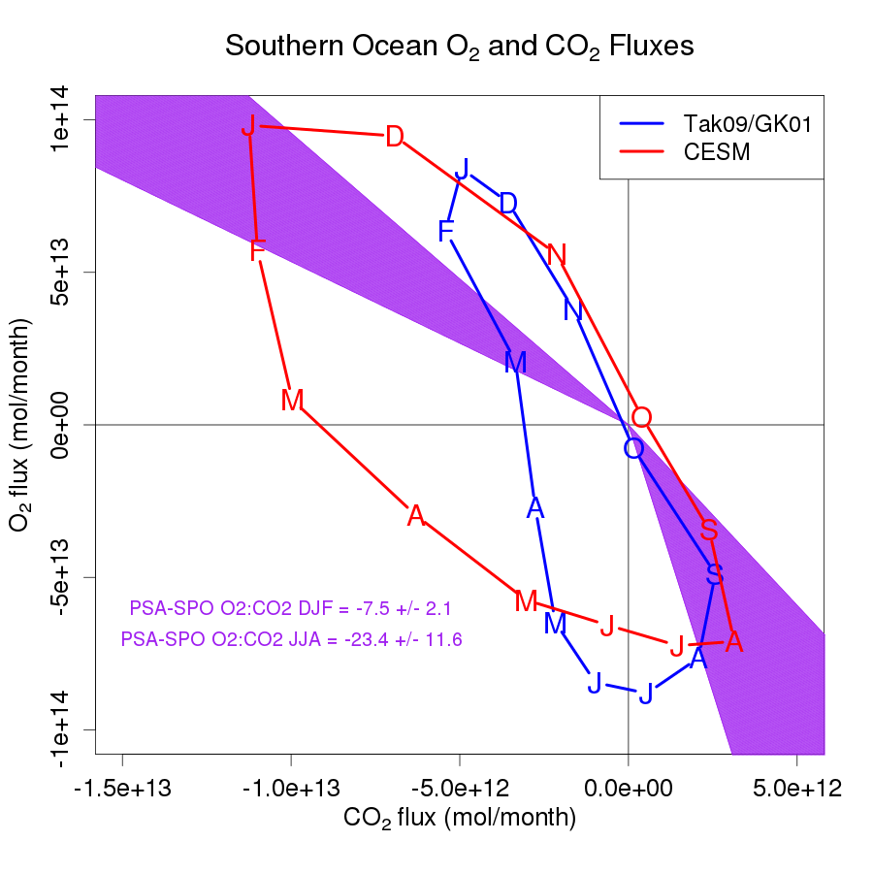
ORCAS ratio constraint PSA-SPO ratio constraint (± SE)
If CESM CO₂ flux correct
If GK01 O₂ flux correct
Southern Ocean (> 44 S) O₂ and CO₂ fluxes. Tak09/GK01 = Takahashi et al., 2009 CO₂ fluxes + Garcia and Keeling, 2001 seasonal O₂ fluxes + Gruber et al, 2001 annual O₂ fluxes. Observational contraint on ratios shown in magenta.
Notes:
fix CESM – do 2016/17 on left and long term mean on right
fundamental property of system?

Slide 13
Needs/plans:
Spatial / temporal footprints for ORCAS, Gould, and PSA-SPO
  not quantitative, but just what regions and times contribute to gradients and ratios
  analyzing multiyear CESM runs for spatial / temporal correlation between fluxes and each metric
Clean up of Gould record
Experimental plots to find best way to represent link between O₂:CO₂ ratios and Thermal vs. Biological forcing
Possible inclusion of CMIP5 model output
Journal
Highly speculative at this point but if all analyses pan out, will go for a high profile journal. Otherwise, will target GBC.
Timeline:
Early Aug prep for ICDC talk, Sept/Oct further analysis and target Journal decision, Nov/Dec writing and first draft to co-authors.

Slide 14
Reactive Gases--Lizzy
Questions:
In what ways can aircraft observations of reactive trace gasses be used to improved global climate models?
What biological or environmental parameters help explain trace gas emissions?
Lizzy Asher, Rebecca Hornbrook, Alan Hills, Eric Apel, Martin Hoecker-Martinez, Britt Stephens

Slide 15
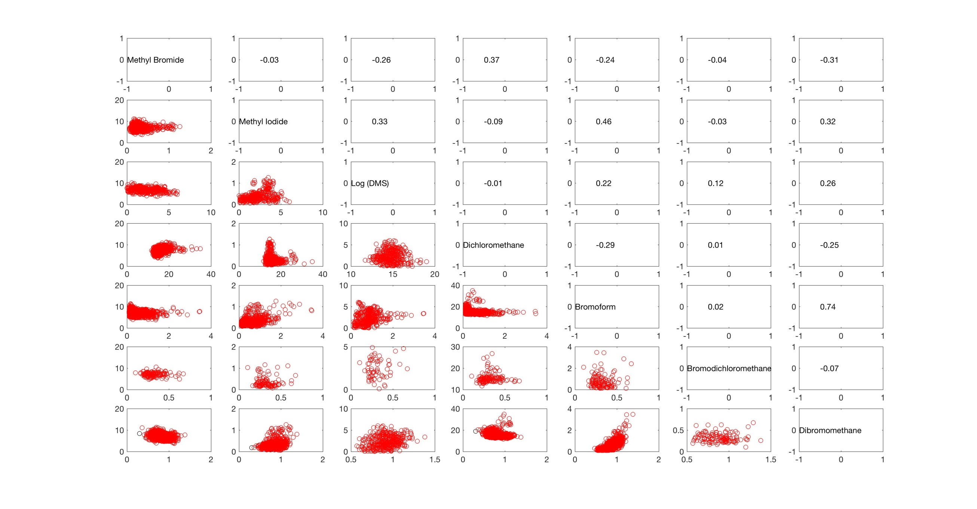
TOGA observations of reactive Gases < 10K
Correlation coefficients R
→
→

Slide 16
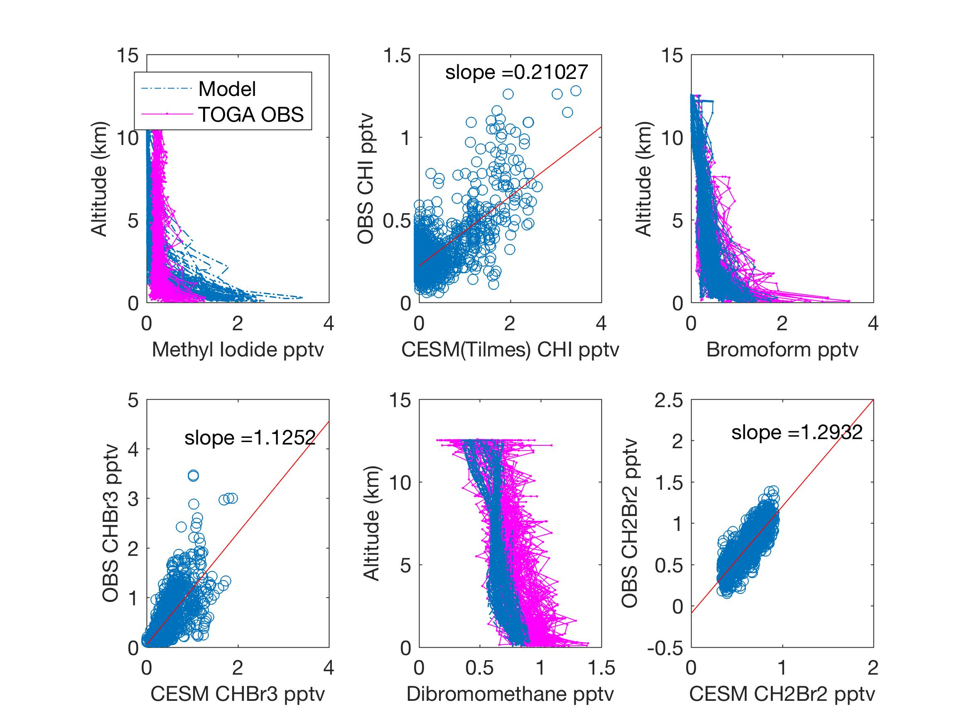
Halocarbon Model-TOGA comparison

Slide 17
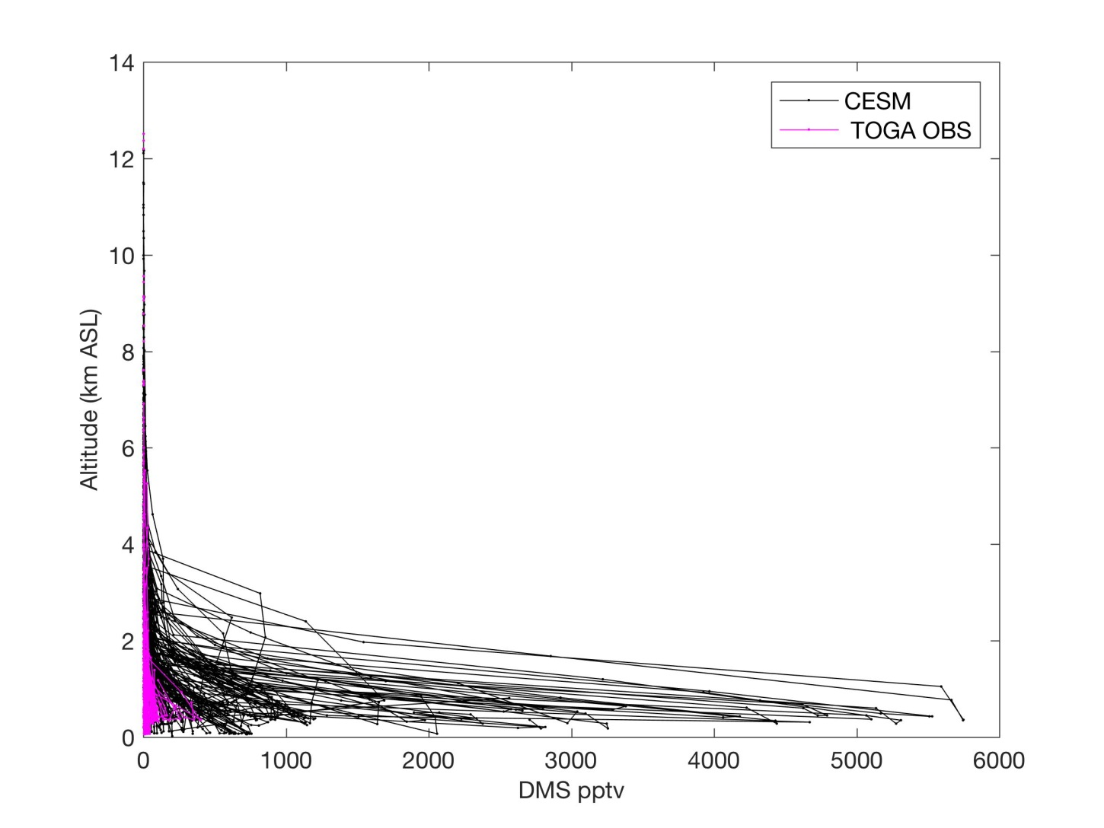
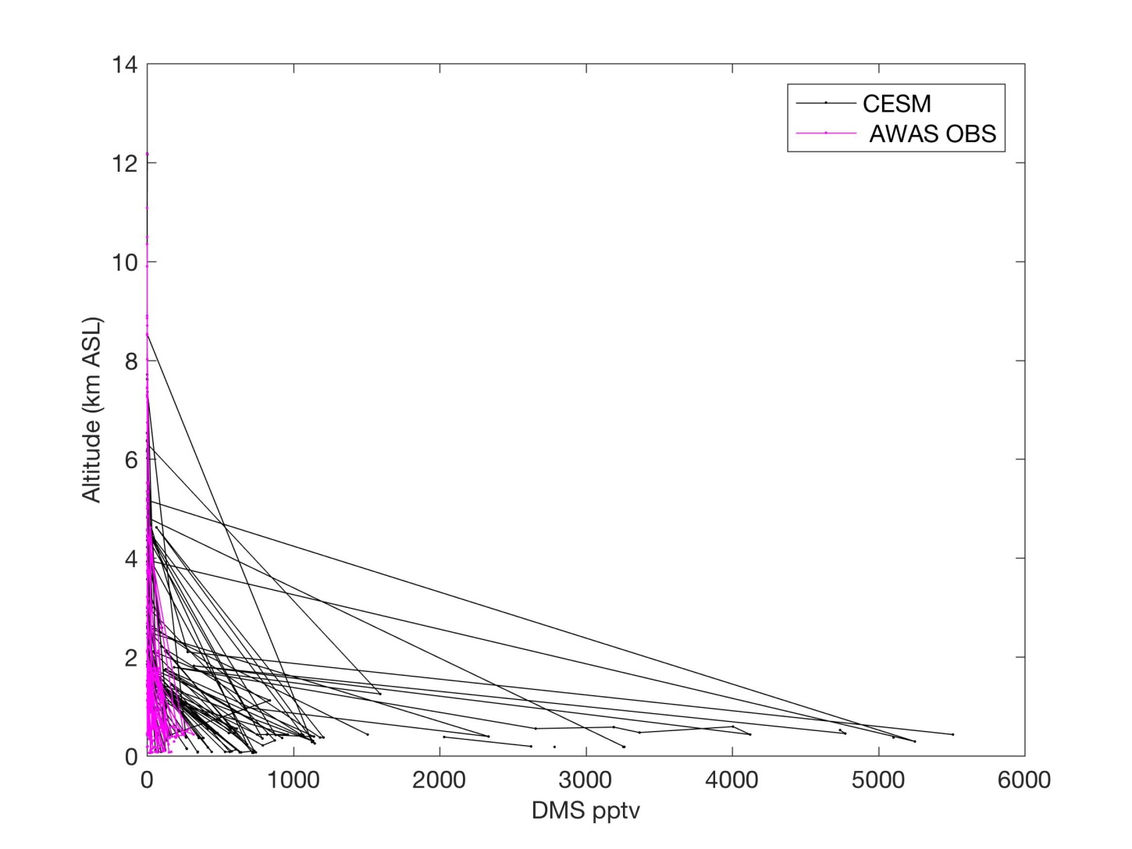
How can we improve modeled DMS?
* New/ top-down DMS emissions (Branched Runs)?

Slide 18
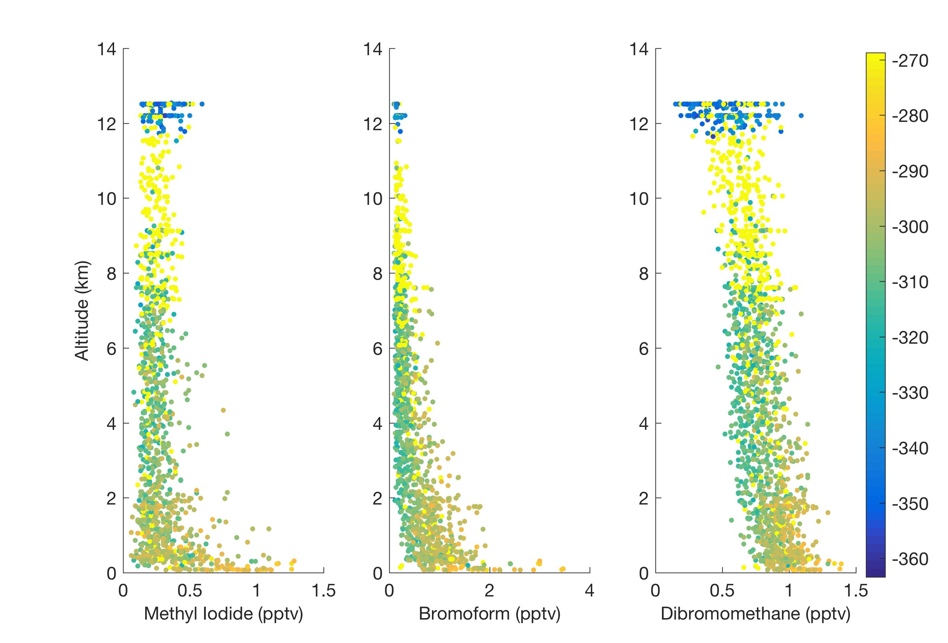
AO2-halocarbon correlation suggests biological production and outgassing
AO2 (per meg)

Slide 19
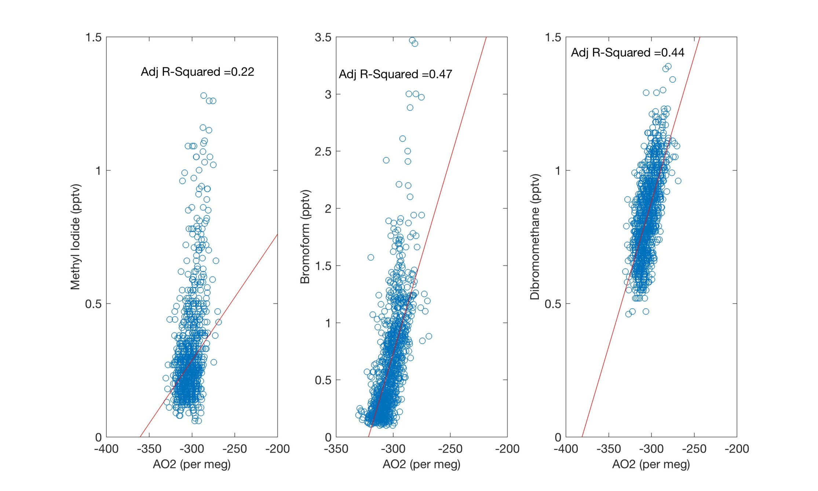
Can AO2(< 10 km) be used to further reduce model-obs bias or scatter?

Slide 20
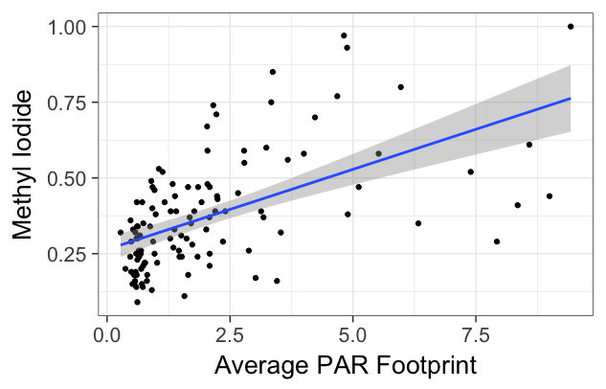
What about relationships with other environmental parameters (e.g. PAR)?
Adjusted R² = 0.34

Slide 21
Manuscript in preparation:
John D’Alessandro¹, Minghui Diao^{*1}, Chenglai Wu^{2,3}, Xiaohong Liu², Andrew Gettelman⁴, Jorgen B. Jensen⁴, Britton Stephens⁴. “Relative humidity distributions over the Southern Ocean based on in situ aircraft observations and CAM5 simulations”, in preparation for Geophysical Research Letters.
¹Department of Meteorology and Climate Science, San Jose State University, San Jose, CA, USA, 95192-0104
²Department of Atmospheric Science, University of Wyoming, Laramie, WY, USA, 82071.
³International Center for Climate and Environment Sciences, Institute of Atmospheric Physics, Chinese Academy of Sciences, Beijing, China, 1000294
⁴National Center for Atmospheric Research, Boulder, CO, USA, 80301
*Corresponding author:
Minghui Diao, San Jose State University
Minghui.Diao@sjsu.edu
Time line:
Send to co-authors in ~2 weeks; plan to submit around August.

Slide 22
Latitudinal distributions of supersaturation (SS) frequency in the NCAR CAM5 simulations
Zonal average of 50-92W
Clear-sky SS
~28% in obs
(CAM5: low bias)
In-cloud SS
~33% in obs
(CAM5: high bias)
Non-SS clouds
~39% in obs
(CAM5: high bias at lower alt, low bias at higher alt)
J. D’Alessandro, M. Diao, Wu, C., X. Liu, A. Gettelman, J.B. Jensen. Relative humidity distributions over the Southern Ocean based on in situ aircraft observations and CAM5 simulations, to be submitted to Geophysical Research Letters.
Notes:
Dot-dashed line: T = 0C
Dashed line: T = -40C
Latitude
Longitude 50-92W

Slide 23
Comparisons between CAM5 and in-situ observations
High bias
Low bias
High bias
Low bias
nudged CAM5 simulations (nudged by T, P, and 3-D wind)
CAM5 simulations can capture three conditions: clear-sky SS, in-cloud SS and non-SS clouds,
But CAM5 underestimates the clear-sky ISS occurrence frequency, and overestimate in-cloud ISS frequency (CAM5 in-cloud, either liquid or ice water content > 4.68×10⁻⁵ g m⁻³)
Notes:
Comparisons between CAM5 and in-situ observations for the three types of conditions
nudged CAM5 simulations (nudged by T, P, 3-D wind)

Slide 24
Comparisons of RHi frequency distributions over the Southern Ocean
CAM5 shows a sharper decay of ISS > 20% at temperature below -20°C
CAM5 shows a sharper decay of RHi < 80% at in-cloud conditions

Slide 25
Probability density functions (PDFs) of RHice and RHliq
Peak positions of the PDFs of RH shift with temperature
In-cloud data have two RHi between -20°C and -10°C, indicating two phases
Obs show more near-saturation conditions in clear-sky regions
Notes:
Peak positions shift with temperature
Similar peak position around 100%
More near-saturation clear-sky data in the observations
CAM5 shows a sharper decay of clear-sky ISS

