Slide 1
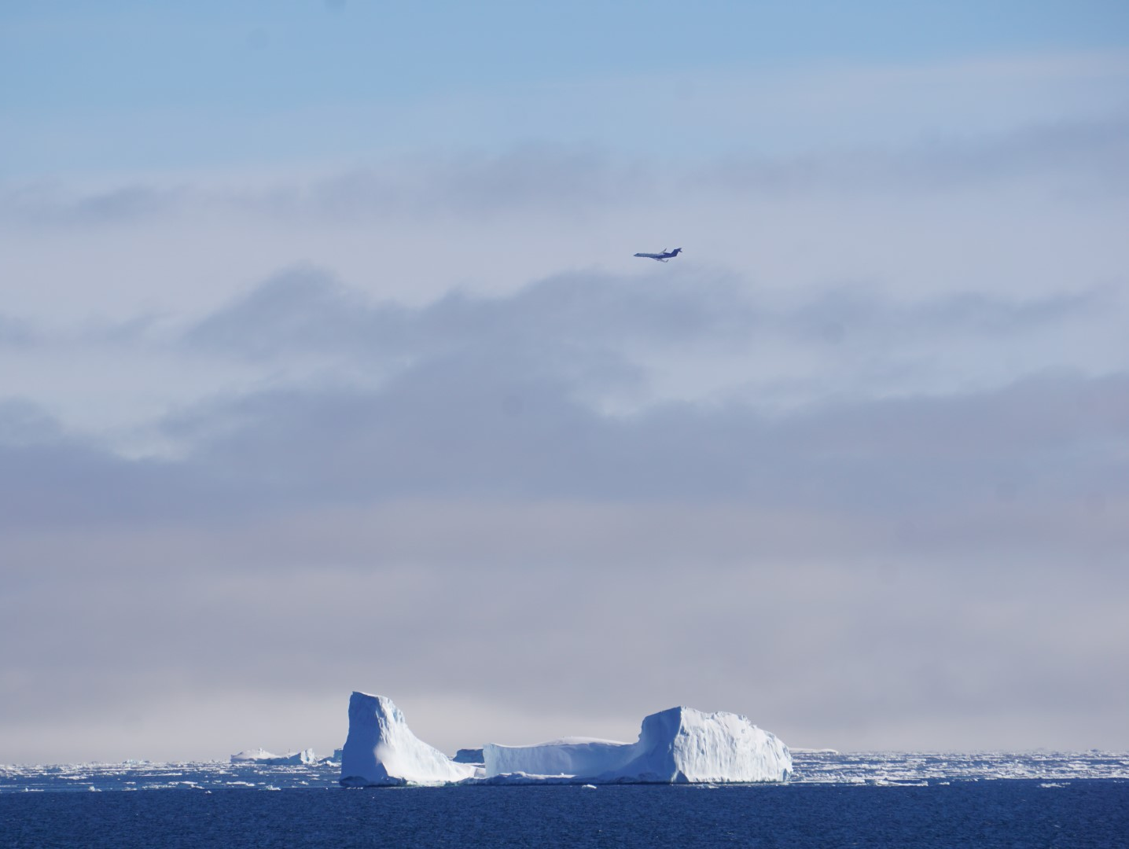


Airborne constraints on Southern Ocean carbon and oxygen fluxes: implications for magnitude of exchange and the importance of intense exchange events
Airplanes and heavy tails
Eric Kort, Martin Hoecker-Martinez, Britt Stephens, Matt Long, Colm Sweeney, Ralph Keeling, Kathryn McKain, Eric Morgan, Jonathan Bent, ORCAS science team
eakort@umich.edu

Slide 2
2 things to remember
Aircraft observations can provide unique insights into air-sea gas exchange (by probing variety of spatiotemporal scales)
  Time: 4 hours – 4 months
  Space: 10’s – 1,000’s km
“Intense” flux events may dominate Southern Ocean air-sea exchange of CO₂ (skewed, heavy-tailed distributions)
  Impactful on how to observe, represent, and simulate
  Potential impact for net exchange, controlling processes, and projected future of carbon sink.

Slide 3
4 Months: Southern Ocean uptake in spring/summer is greater than current representations?
Total Gradient
Gradient from Ocean sink only
Matt Long

Slide 4
4 Months: Southern Ocean uptake in spring/summer is greater current representations?
summer fall winter spring

Slide 5
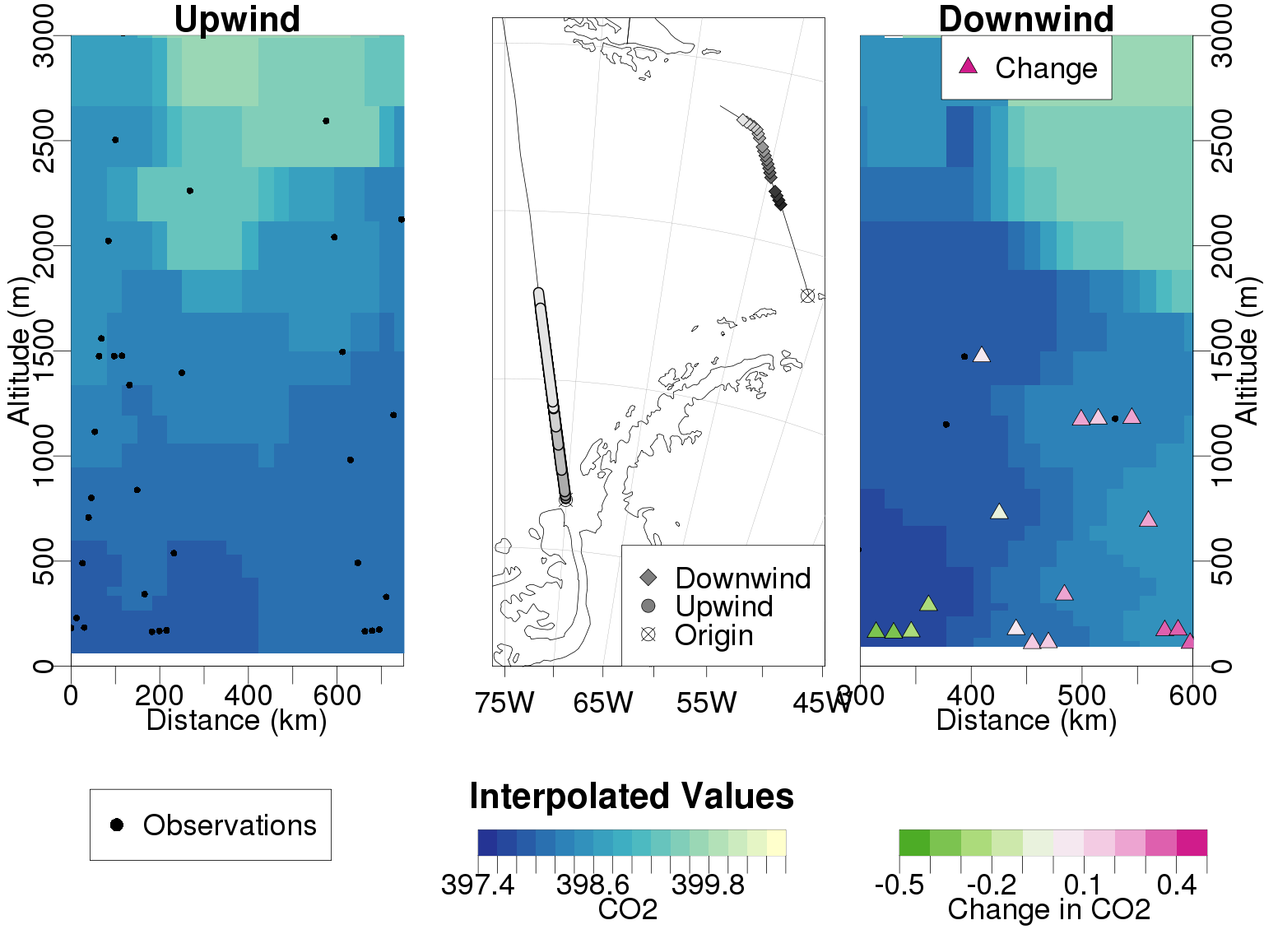
Lagrangian flights: 24-hour constraint and linking to processes
(Day 1)
(Day 2)
M Hoecker-Martinez

Slide 6
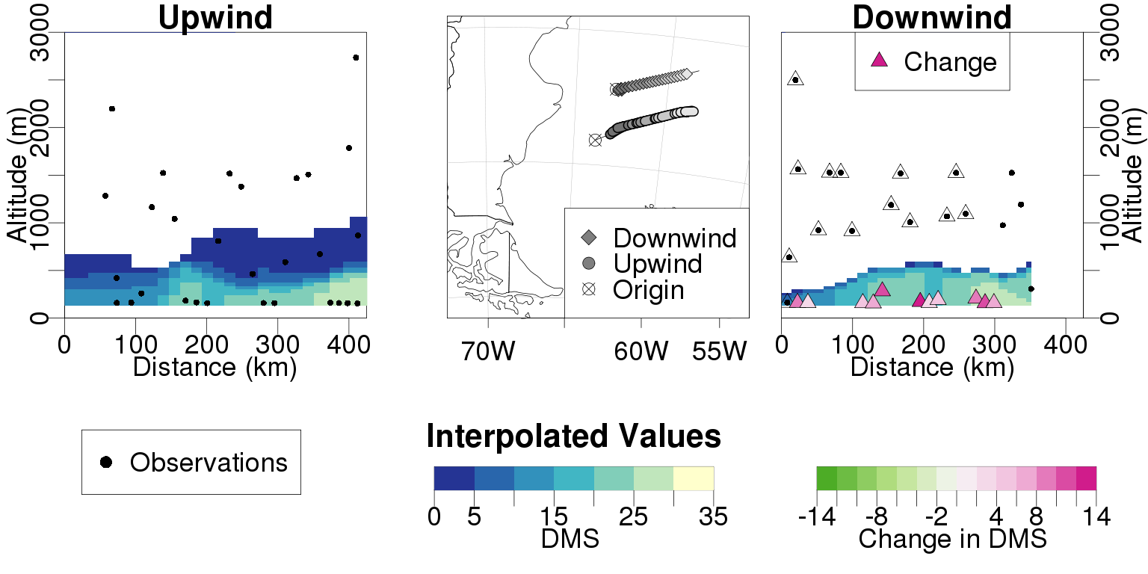
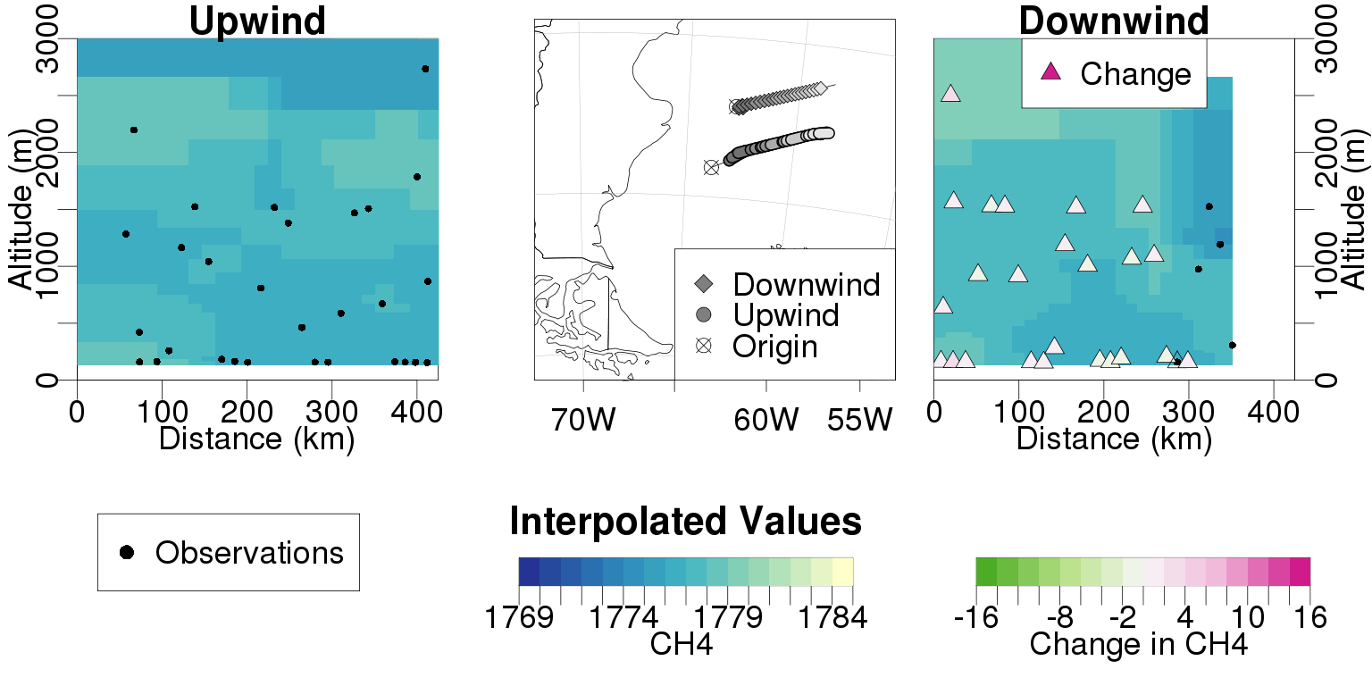
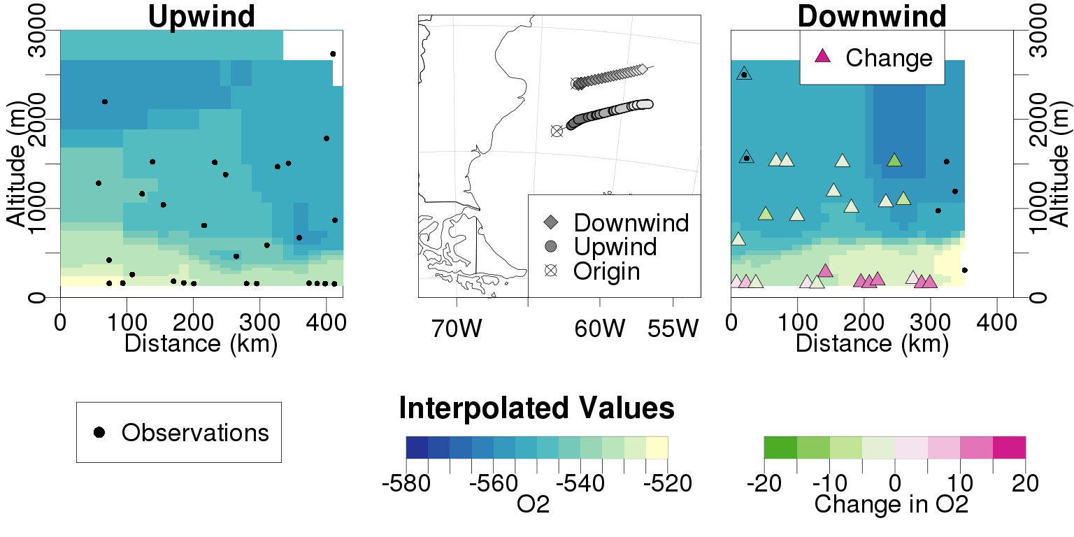
The 4-hour constraint: Argentinian Shelf
DMS – ocean source
CH₄ – no exchange
Notes:
For details see Martin’s poster. Linkaging to processes and understanding is underway.
Now let’s switch from airplane advertising to the intense flux event question.

Slide 7
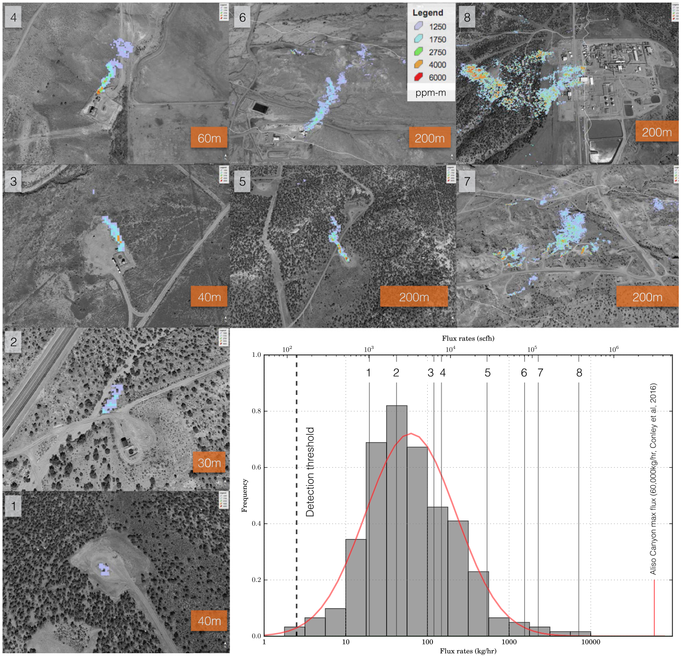
High Flux Events
Skewed distribution:
Top 10% of observed point sources explain ½ of the observed point source total and ¼ of the total field emissions.
Frankenberg et al., 2016

Slide 8
Ta
Climatological representations have smooth flux distributions
Takahashi CO₂ flux, February
Garcia Keeling O₂ flux, February

Slide 9
Models exhibit ‘intense’ flux events
Prior Flux Fields: CESM daily model
Day 1
Day 2
Day 3

Slide 10
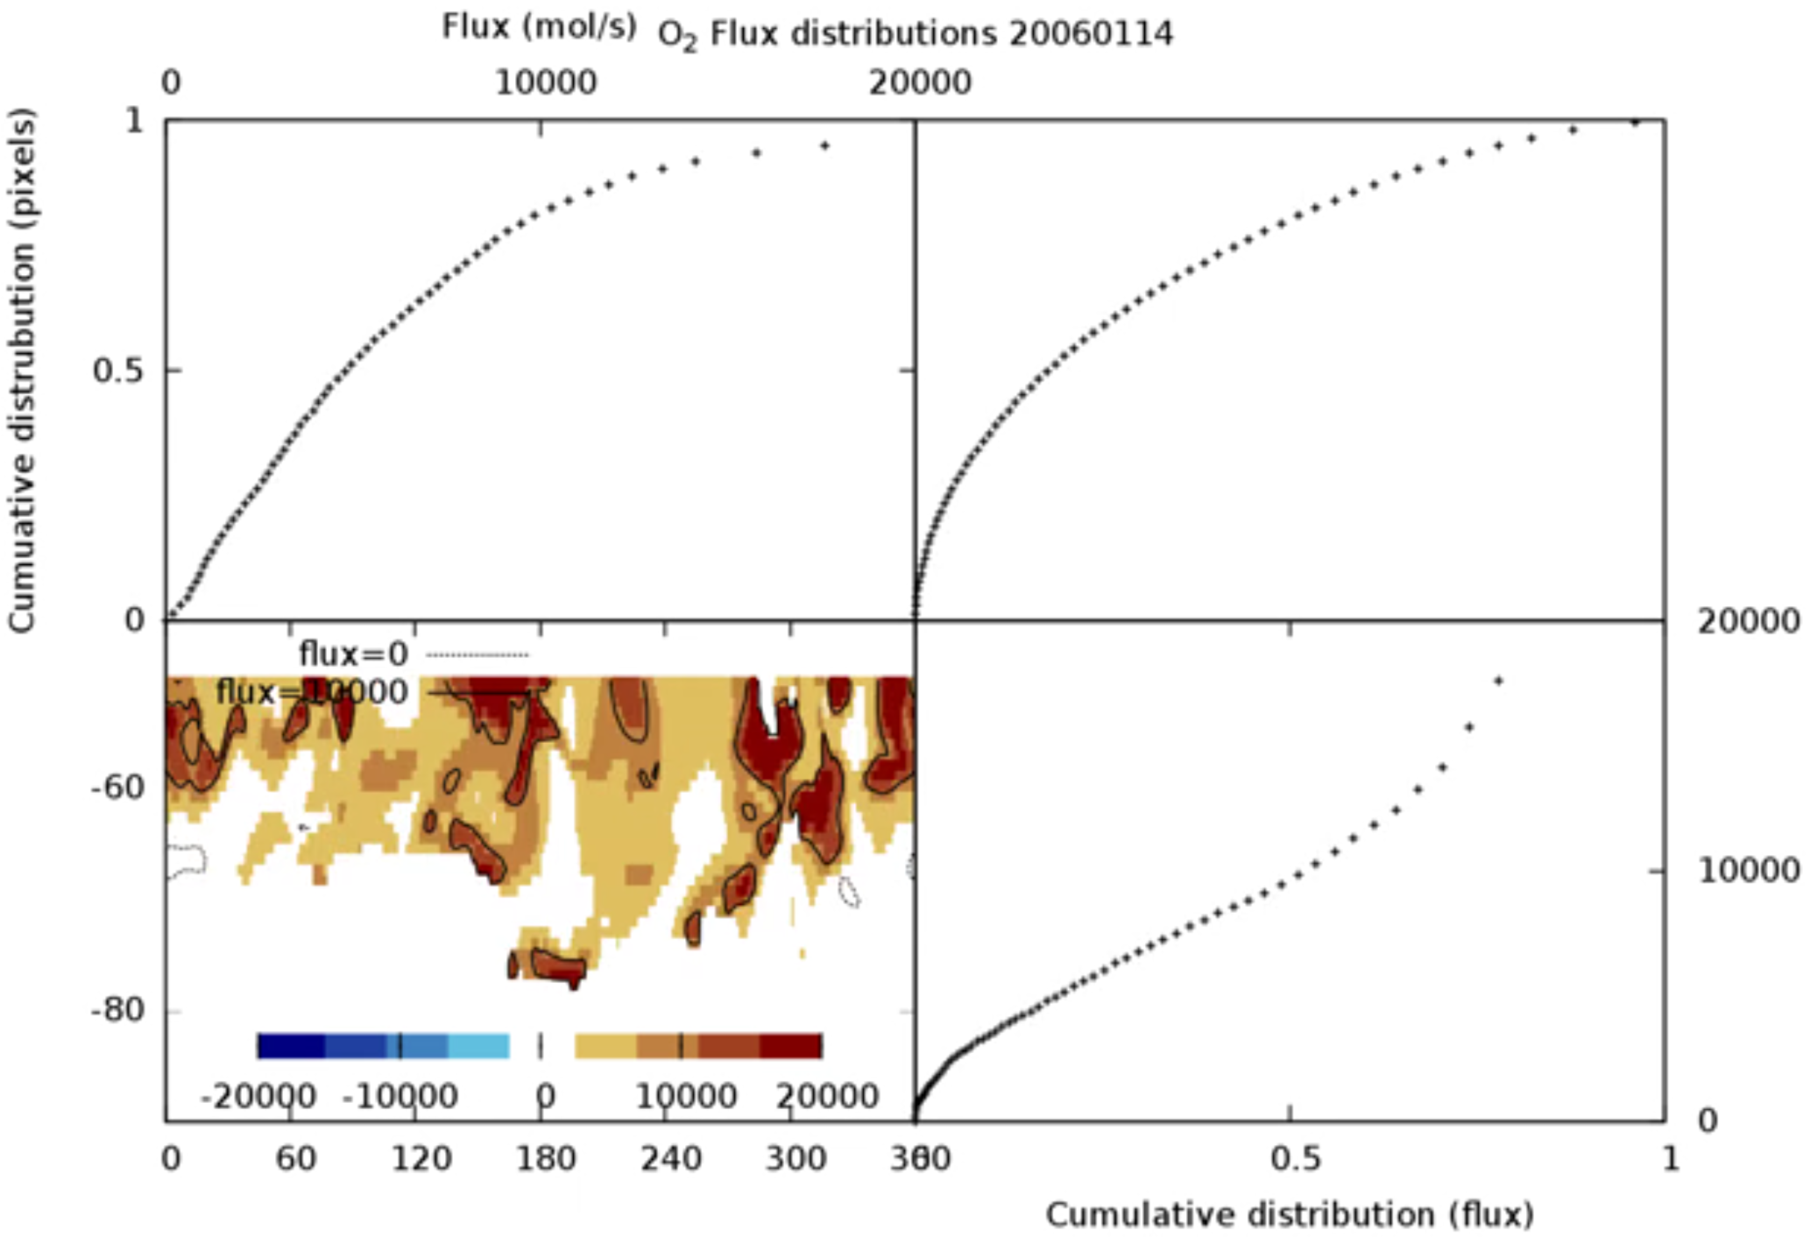
Distribution of flux statistics: importance of high-exchange events
https://www.youtube.com/watch?v=a2rQOQ0RqXw&feature=youtu.be
50% of the total flux comes from the top 20% of flux pixels

Slide 11
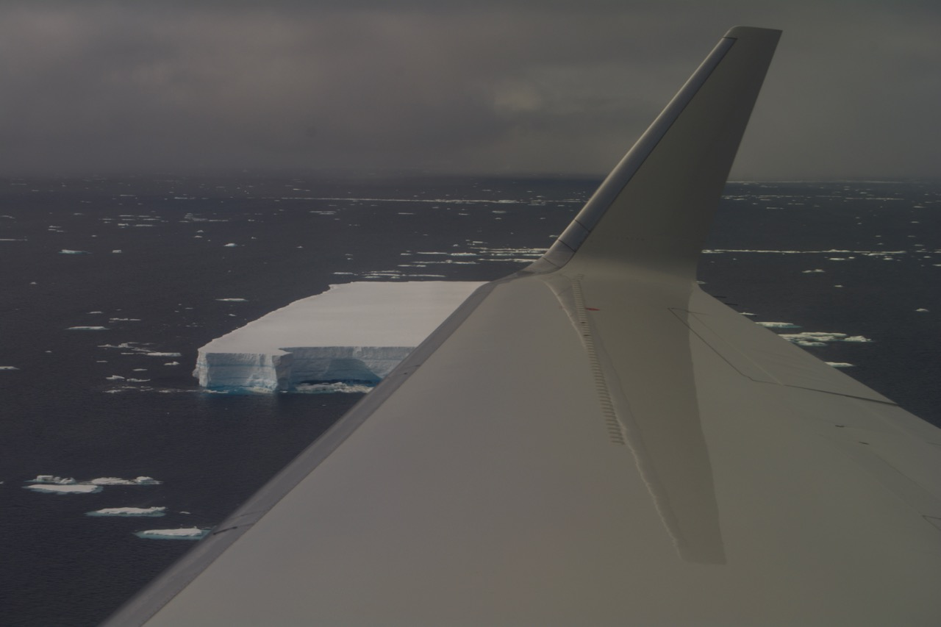
Can we look at distributions of boundary layer variability in the observations and contrast with model/climatology predictions to ‘confirm/deny’ presence of high flux events?
Related significance questions: What are most important processes controlling exchange (high flux/ or diffusive controls)? How many ocean observations are need and how should they be interpolated?

Slide 12
Use an atmospheric regional model (LPDM) to link observations with different flux realizations
Boundary Layer CO₂ depletion on RF03

Slide 13
East of the Antarctic Peninsula

Slide 14
East of Drake Passage

Slide 15
Observed PBL Depletion (ppm)
Simulated Depletion with CESM ocean model
Simulated Depletion with Climatology

Slide 16
Entire Campaign

Slide 17
2 things to remember
Aircraft observations can provide unique insights into air-sea gas exchange (by probing variety of spatiotemporal scales)
  Time: 4 hours – 4 months
  Space: 10’s – 1,000’s km
“Intense” flux events may dominate Southern Ocean air-sea exchange of CO₂ (skewed distributions)
  Impactful on how to observe, represent, and simulate
  Potential impact for net exchange, controlling processes, and projected future of carbon sink.

Slide 19
Boundary Layer O₂ enhancement on RF14

Slide 20
Boundary Layer O₂ enhancement on RF03

Slide 21
Observed PBL Variation (per meg)
Simulated Enhancement with CESM ocean model
Simulated Enhancement with Climatology

