Slide 1
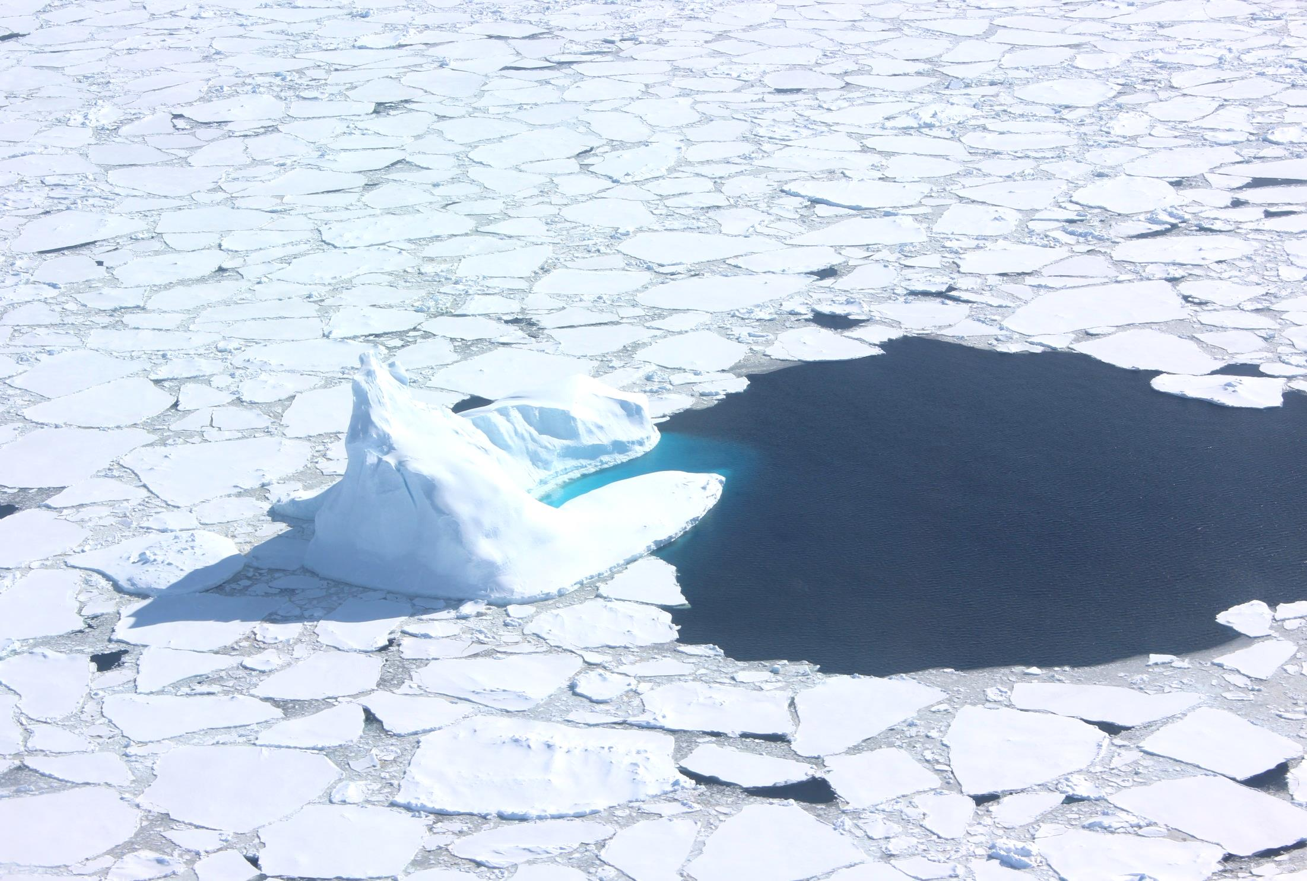
TOGA ORCAS Reactive Gases Update
TOGA team: Eric Apel, Rebecca Hornbrook, Alan Hills, Nicola Blake
ORCAS team Biweekly discussions: June 14, 2016

Slide 2
TOGA Measured Compounds - ORCAS
Anthropogenic tracers
NMHCs: 1-butene/isobutene propane isobutane n-butane isopentane n-pentane 2-methylpentane 3-methylpentane n-hexane n-heptane benzene toluene ethylbenzene/p-/m-xylene o-xylene 1,2,3-trimethylbenzene 1,2,4-trimethylbenzene Alkyl Nitrates: methyl nitrate ethyl nitrate isopropyl nitrate butyl nitrates | LOD; pptv 1 10 1 1 1 1 0.5 0.5 0.5 3 1 0.5 0.3 0.2 1 1 LOD; pptv 5 0.5 0.5 1 | OVOCs: formaldehyde (HCHO) acetaldehyde (CH₃CHO) propanal butanal acetone (CH₃COCH₃) MEK (butanone) methanol (CH₃OH) ethanol (C₂H₅OH) 2-propanol acrolein (CH₂CHCHO) MTBE (methyl tert-butyl ether) Biogenic VOCs: isoprene MBO (2-methyl-3-buten-2-ol) MVK methacrolein 3-methylfuran α-pinene β-pinene camphene limonene/3-carene | LOD; pptv 20 5 5 1 20 1 20 10 5 1 0.5 LOD; pptv 0.5 0.5 1 1 1 0.2 0.5 0.5 0.5 | Halogenated VOCs: CFC-11 (CCl₃F) CFC-113 (CCl₂FCClF₂) CH₃Cl (methyl chloride) CH₂Cl₂ (dichloromethane) CHCl₃ (chloroform) CCl₄ (tetrachloromethane) C₂Cl₄ (tetrachloroethene) C₆H₅Cl (chlorobenzene) CH₃Br (methyl bromide) CH₂Br₂ (dibromomethane) CHBr₃ (bromoform) CH₃I (methyl iodide) CH₂I₂ (diiodomethane) C₂H₅I (ethyl iodide) CH₂ICl (chloroiodomethane) CHBrCl₂ (bromodichloromethane) CHBr₂Cl (dibromochloromethane) Others: DMS (dimethyl sulfide) HCN (hydrogen cyanide) Acetonitrile (CH₃CN) | LOD; pptv 5 1 1 1 1 1 0.3 0.1 1 0.03 0.2 0.03 0.05 0.5 0.07 0.05 0.03 LOD; pptv 0.5 10 1
often bdl
often bdl
often bdl
often bdl
often bdl
often bdl
bdl
bdl
bdl
bdl
bdl
bdl
often bdl
often bdl
often bdl
often bdl
Nitrates
(ocean? Anthro?)
Biomass Burning/
Anthropogenic/
Oxidation Products
Biogenics
Ocean emissions
NCAR/ACOM TOGA group
ORCAS – June 14, 2016
Notes:
This is a list of all the compounds that we are currently able to quantify with TOGA, and the actualy targetted list for a given project can be tailored to best suit the experiment. The catch is that we need to plan the targetted list prior to the project, so if there are specific compounds that you’d like to see, please let us know well before the first deployment.

Slide 3
Benzene (e.g. directly emitted (anthropogenic) tracer)
ORCAS
Jan/Feb 2016
CONTRAST
Jan/Feb 2014

Slide 4
Benzene (e.g. directly emitted (anthropogenic) tracer)
ORCAS
Jan/Feb 2016
CONTRAST
Jan/Feb 2014
TORERO – Jan/Feb 2012

Slide 5
High CO: >50 ppbv
ORCAS – Altitude-dependent Benzene,
colored by CO (QCLS)
Mid CO: 45-50 ppbv
*Using
CO_QCLS
Low CO: <45 ppbv
Small correlation with CO

Slide 6
ORCAS – Altitude-dependent Benzene, colored by CO₂ (NOAA)

Slide 7
High O₂: >540 per meg
ORCAS – Altitude-dependent Benzene,
colored by O₂ (AO2)
Mid O₂: -560 to -540 per meg
Low O₂: < -560 per meg
No correlation with O₂.

Slide 8
Acetone (e.g. oxidation product)
ORCAS
Jan/Feb 2016
CONTRAST
Jan/Feb 2014

Slide 9
Acetone (e.g. oxidation product)
ORCAS
Jan/Feb 2016
CONTRAST
Jan/Feb 2014
TORERO – Jan/Feb 2012

Slide 10
High CO: >50 ppbv
ORCAS – Altitude-dependent Acetone,
colored by CO (QCLS)
Mid CO: 45-50 ppbv
*Using
CO_QCLS
Low CO: <45 ppbv
Clear correlation with CO

Slide 11
High O₂: >540 per meg
ORCAS – Altitude-dependent Acetone,
colored by O₂ (AO2)
Mid O₂: -560 to -540 per meg
Low O₂: < -560 per meg
Anti-correlation with O₂.

Slide 12
Acetonitrile (e.g. Biomass Burning tracer)
ORCAS
Jan/Feb 2016
CONTRAST
Jan/Feb 2014

Slide 13
Acetonitrile (e.g. Biomass Burning tracer)
ORCAS
Jan/Feb 2016
CONTRAST
Jan/Feb 2014
TORERO – Jan/Feb 2012

Slide 14
High CO: >50 ppbv
ORCAS – Altitude-dependent Acetonitrile,
colored by CO (QCLS)
Mid CO: 45-50 ppbv
*Using
CO_QCLS
Low CO: <45 ppbv
Clear correlation with CO

Slide 15
High O₂: >540 per meg
ORCAS – Altitude-dependent Acetonitrile,
colored by O₂ (AO2)
Mid O₂: -560 to -540 per meg
Low O₂: < -560 per meg
Anti-correlation with O₂

Slide 17
Even with a slight
dependence on
latitude, both nitriles are somewhat anti-correlated with O₂, both at all ORCAS latitudes, and at the high southern latitudes.

Slide 18
Bromoform (e.g. Ocean emission)
ORCAS
Jan/Feb 2016
CONTRAST
Jan/Feb 2014

Slide 19
Bromoform (e.g. Ocean emission)
ORCAS
Jan/Feb 2016
CONTRAST
Jan/Feb 2014
TORERO – Jan/Feb 2012

Slide 20
High CO: >50 ppbv
ORCAS – Altitude-dependent Bromoform,
colored by CO (QCLS)
Mid CO: 45-50 ppbv
*Using
CO_QCLS
Low CO: <45 ppbv
Weak anti-correlation
with CO?

Slide 21
High CO: >50 ppbv
ORCAS – Altitude-dependent Dibromomethane,
colored by CO (QCLS)
Mid CO: 45-50 ppbv
*Using
CO_QCLS
Low CO: <45 ppbv
Weak anti-correlation with CO?

Slide 22
High O₂: >540 per meg
ORCAS – Altitude-dependent Bromoform,
colored by O₂ (AO2)
Mid O₂: -560 to -540 per meg
Low O₂: < -560 per meg
Correlated with O₂

Slide 23
CH₂Br₂ and CHBr₃ are both correlated with O₂. CH₂Br₂ shows a similar correlation at all latitudes, while CHBr₃ has a slightly greater correlation with O₂ at higher latitudes.

Slide 24
ORCAS
Jan/Feb 2016
CONTRAST
Jan/Feb 2014
TORERO – Jan/Feb 2012

Slide 25
DMS during ORCAS, sized by the DMS mixing ratio, and colored by date.
Sized by DMS
DMS MRs were elevated during the first half of the ORCAS study.

Slide 26
ORCAS
Jan/Feb 2016
CONTRAST
Jan/Feb 2014

Slide 27
ORCAS
Jan/Feb 2016
CONTRAST
Jan/Feb 2014
TORERO – Jan/Feb 2012

Slide 28
ORCAS
Jan/Feb 2016
CONTRAST
Jan/Feb 2014
TORERO – Jan/Feb 2012

Slide 29
ORCAS
Jan/Feb 2016
CONTRAST
Jan/Feb 2014
TORERO – Jan/Feb 2012

Slide 30
ORCAS
Jan/Feb 2016
CONTRAST
Jan/Feb 2014
TORERO – Jan/Feb 2012

Slide 31
ORCAS
Jan/Feb 2016
CONTRAST
Jan/Feb 2014
TORERO – Jan/Feb 2012

Slide 32
ORCAS
Jan/Feb 2016
CONTRAST
Jan/Feb 2014
TORERO – Jan/Feb 2012

