Slide 1




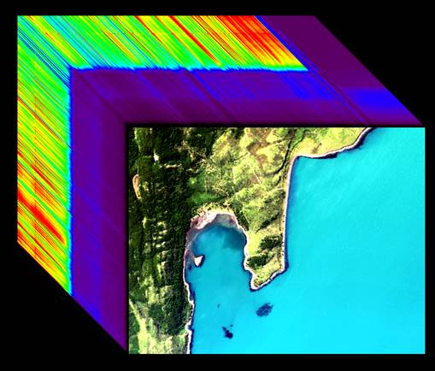
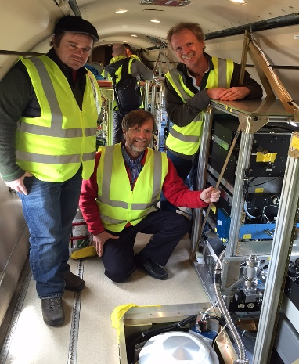
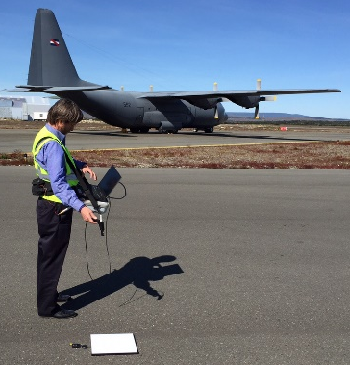

Optical Properties of the Water Column for ORCAS: Airborne (PRISM), Satellite, and Ship Measurements
Heidi Dierssen, Kate Randolph,
& Shungu Garaba
University of Connecticut
Michelle Gierach, David Thompson &
The PRISM Team*
Jet Propulsion Laboratory
*In Alphabetical Order: Ernesto Diaz, Justin Haag, Mark Helmlinger, Marco Hernandez, Byron Van Gorp, Robert Green, Didier Keymeulen, Peter Kobzeff, Linley Kroll, Frank Loya, Huy Luong, Sarah Lundeen, Ian McCubbin, Pantazis Mouroulis, Scott Nolte, Chuck Sarture, John Shaw, Peter Sullivan

Slide 2
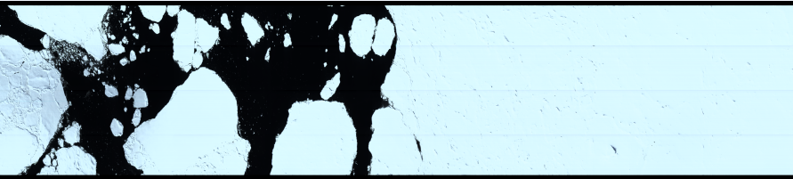
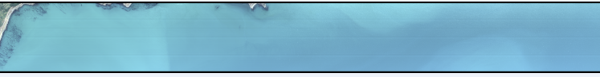
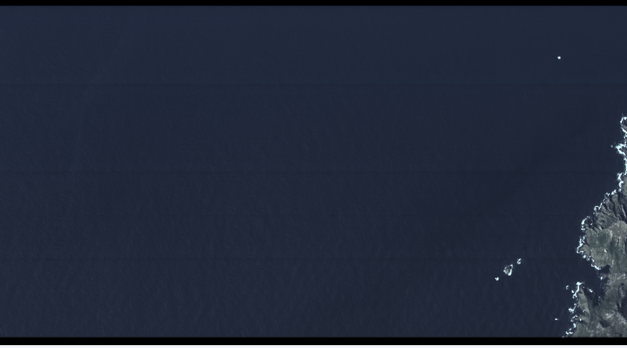
NASA Rapid Response Objectives
PRISM will complement ORCAS observations in the Southern Ocean, providing data products that are critical to:
  Improve understanding of biogeochemical processes in the Southern Ocean and their control on air-sea gas exchange (e.g., white caps, reactive trace gases and cloud droplet concentrations produced by marine biota)
  Test future ocean color satellite products and their atmospheric correction algorithms
  Provide synergy with a host of ancillary bio-optical and biogeochemical data from collaborative Southern Ocean projects
Sea Ice
Open Ocean
Coastal Waters
Notes:
SoGasEx, SOCCOM, ICESOCC, Palmer, etc

Slide 3
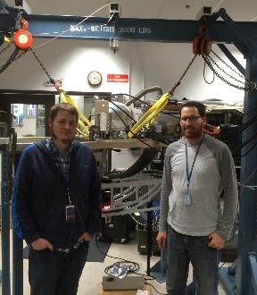


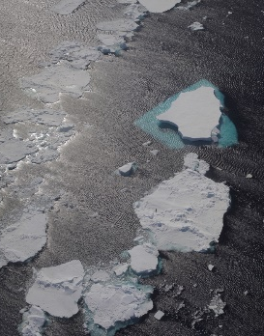
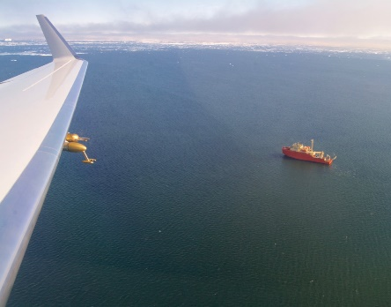
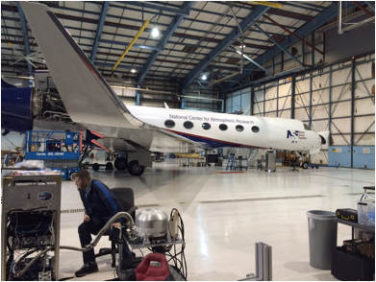
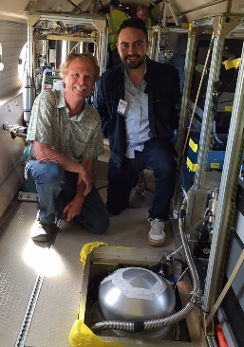
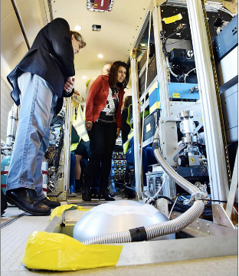
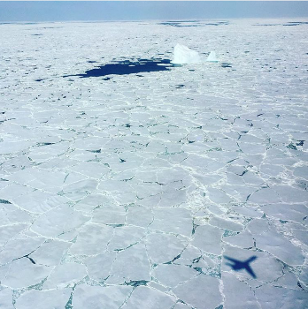
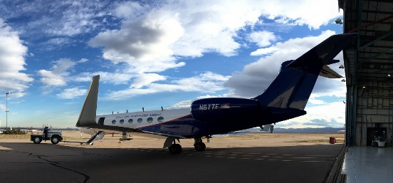
ORCAS Timeline
PRISM arrived
at NCAR
GV ferry
flight
RF02
RF04
RF06
12/4/15
12/7/15
12/18/15
1/11/16
1/15/16
1/18/16
1/21/16
1/23/16
1/25/16
1/30/16
PRISM shipped
to NCAR
All instruments
installed on GV
1st Research
Flight (RF01)
RF03
RF05
GV ferry
flight
PRISM hangar
calibration
PRISM returned
to JPL
RF07
RF09
RF11
2/5/16
2/8/16
2/12/16
2/18/16
2/24/16
2/25/16
2/29/16
3/1/16
3/2/16
3/4/16
3/7/16
RF08
RF10
RF12
GV returned
To NCAR
PRISM shipped
to JPL
The Chilean Vice Minister of the Environment, Marcelo Mena, and the Governor of the region, Paola Fernández, visited ORCAS on 2/4/16.

Slide 4
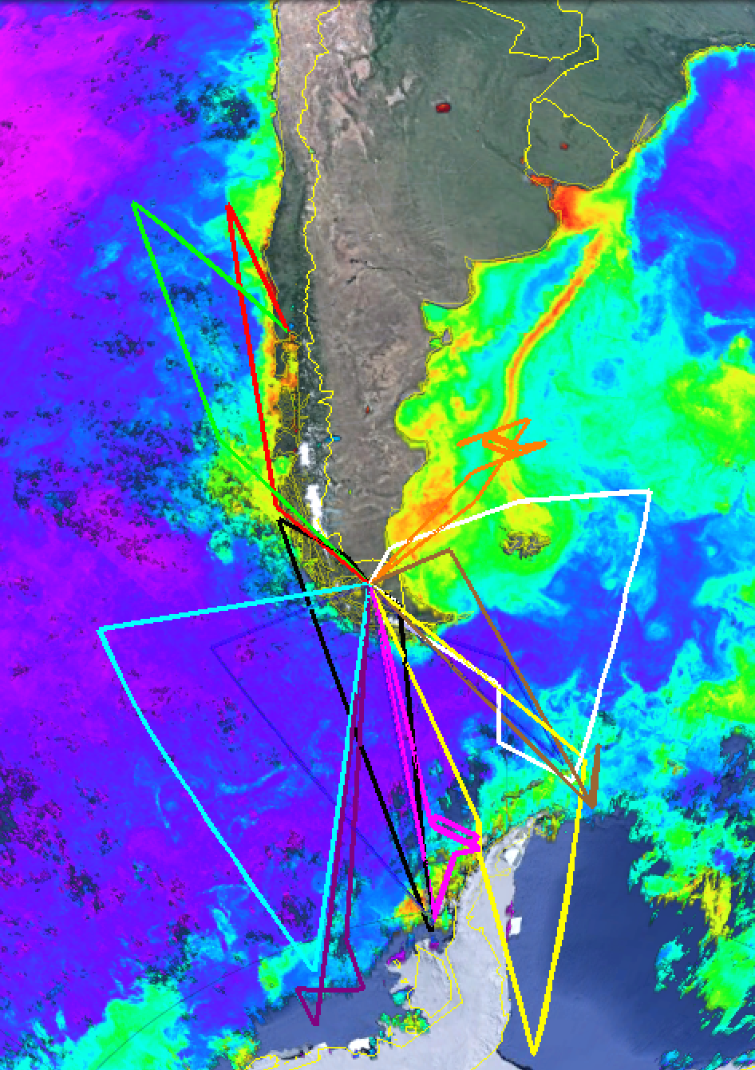
ORCAS Field Campaign
12 research flights in total (98 flight hrs)
  Western Survey:
    15, 21, 23, 25 January
    5, 8, 24 February
  Eastern Survey:
    18 January
    12, 18, 25 February
  Patagonia Shelf
    30 January
Interesting areas from a biological and integrated Earth System perspective (dashed boxes):
1. The Drake Passage
Gradients of particulate inorganic carbon and productivity
2. Patagonian Shelf
  Gradients of productivity
3. Ice edge
  Preliminary CO₂/O₂/trace gas data showed high DMS, N₂O, O₂, productivity and low CO₂

Slide 5
PRISM Image Analysis Status
PRISM processing is still underway due to:
  Significant data volume - ~5.7TB for raw PRISM data from all lab/field calibration, ferry flights, and research flights
  Code issues - Issues with orthorectification code for ascending/descending flight lines
Priority is given to flightlines that contain validation sites and that have interesting biological or integrated Earth System perspectives, including:
  February 18, 2016 – Gould Overflight & Drake Passage
  January 30, 2016 – Patagonia Shelf
  January 25, 2016 – Palmer & Gould Overflights
  January 21, February 5, & February 12, 2016 – Ice Edge(s)
  January 15, 2016 – Drake Passage
  All remaining flightlines

Slide 6
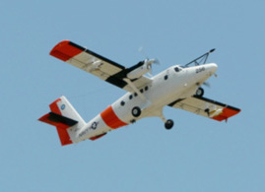
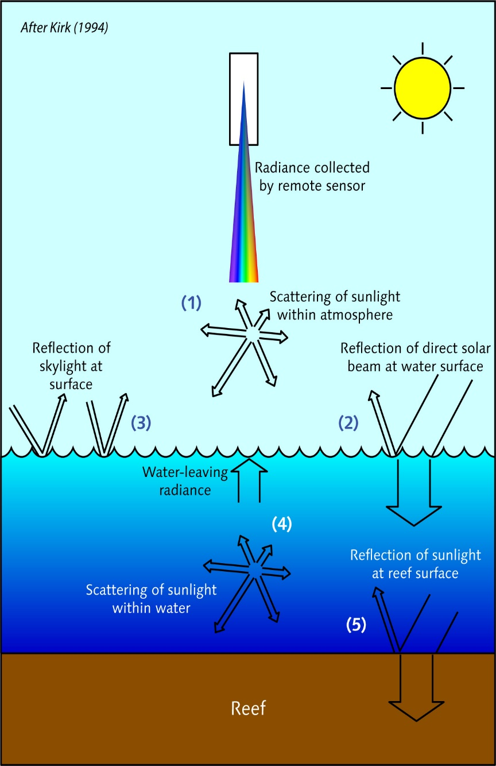
Algorithm Design and Validation
At-sensor radiance
Atmospheric properties
Water-leaving Reflectance
IOPs

Slide 7
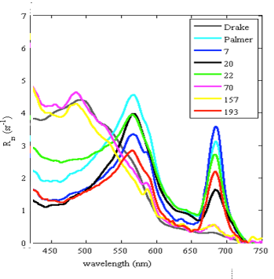
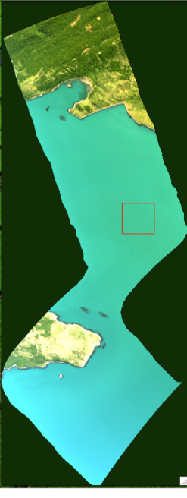
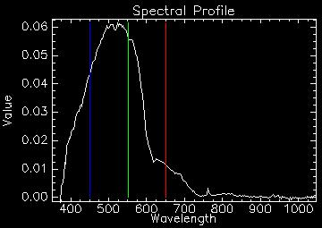
Algorithm Design and Validation
Radiometric Calibration
Open Water Validation
We derived a new calibration solution for PRISM based on hangar experiments in March 2016.
Ocean targets are generally harder to validate directly due to temporal and spatial variability; however, in situ data looks promising.
Comparison with PRISM Rrs coming soon.
The flat field used two blue sphere acquisitions at full intensity, and agree to within 0.1%.
Wavelength calibration / solar residual test was reasonable.
Level 2 Product: Reflectance
Level 3: Water Optical Properties (Chla)
Standard multi-beam & spectroscopic retrieval algorithms
PRISM R_{rs} (Visible RGB shown)
Notes:
4 mutli-band retrieval algorithms, ncl. OC4v6, OC3M, MODIS-Aqua and SeaWiFS algorithm versions for the Southern Ocean (Johnson et al., 2013)
Full spectroscopic retrieval of water properties using the deep water model of Lee et al (2004)

Slide 8
Airborne & In Situ Data Products
Data Product | Description
Airborne Data Products Generated by the PRISM Science Data System (SDS)
Level 0 | Reconstructed, unprocessed PRISM digitized numbers (DN) at full resolution with GPS
Level 1 | Calibrated spectral radiance with geolocation information, incl. illumination and observation geometry
Level 2 | Reflectance generated following atmosphere radiative transfer inversion with geolocation, support processing information and flags
Level 3 | Chlorophyll-a with geolocation, uncertainties, and flags
In Situ Data Products Generated by UCONN
Ancillary In Situ Data | Optical ship-based calibration/validation
ORCAS Data Policy
Event | Deadline
Preliminary Data Submission Deadline | 28 August 2016
Final Data Submission Deadline | 31 December 2016
Initial Data Analysis Period (ORCAS Science Team) | 1 March 2016 – 28 February 2017
Data Becomes Public Domain | 1 March 2017
Data products will follow the ORCAS Data Policy.
Notes:
The CORAL data level definitions follow the standard terminology of the NASA Earth Observing System and Data Information System (EOSDIS).

Slide 9
PRISM Data Processing Infrastructure
& Functional Architecture
Science Telemetry/Engr/Ancillary Data
User Access – Information and Science Data
Distributed
Data Products
Science Data System (SDS)
L0 PGE
Digital Numbers
L1 PGE
Radiance
L2 PGE
Reflectance
L3 PGE
Chla
Raw science data
L0
L0
L1
L1B
L2
L2
L3
Processing Control System (PCS)
Data Acquisition/
Ingestion
User Interface/Data Portal
Product Generation
Data Management
Data Discovery
Work Flow Management
Data Distribution
All products
Performance Reports
Science Product Analysis
Data System Components inherited/adapted from AVIRIS and PRISM
Product Generation Executives (PGE)
Notes:
CORAL shares a common SDS functional architecture with AVIRIS and PRISM. There are three major areas of SDS software for CORAL: processing infrastructure, product generation, and payload/science algorithm. The CORAL processing infrastructure is based on the Processing Control System (PCS). The CORAL product generation is carried out by Product Generation Executives (PGEs). The instrument and science algorithms and software are provided by the instrument and science teams respectively. The various CORAL data products are generated by their respective PGE. The PGE operations are coordinated and orchestrated by the PCS following rules, policies, and parameters that are specific to CORAL. The PCS to PGE interfaces are adopted from AVIRIS and PRISM for use by CORAL with little modification.

Slide 10
Atmospheric Correction Procedure

Slide 11
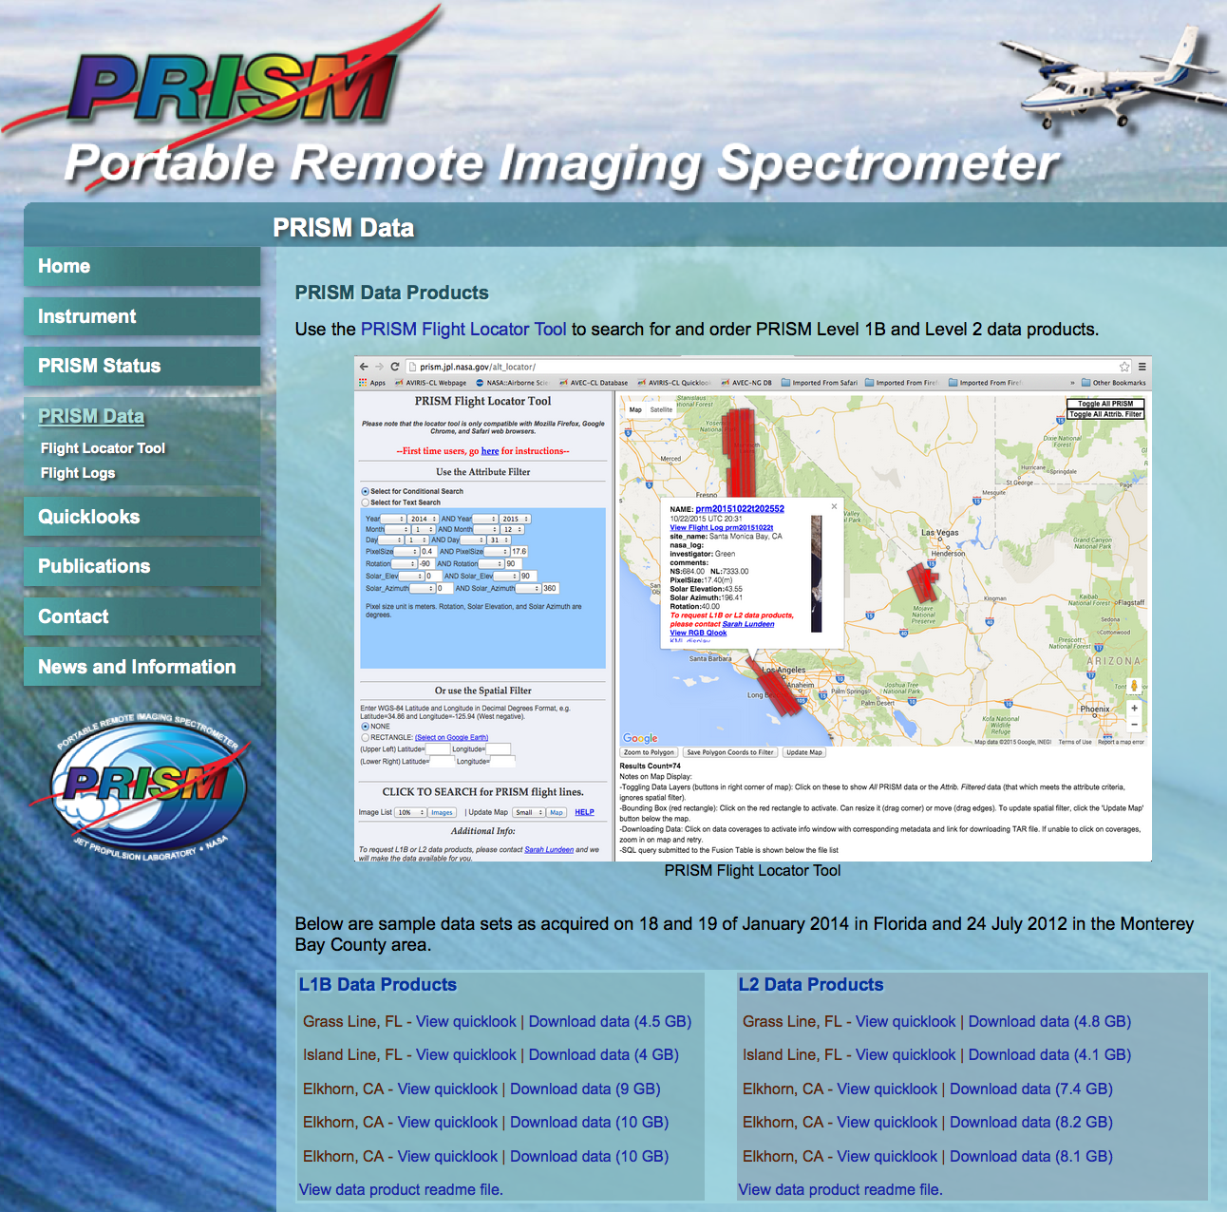
PRISM Data Dissemination
http://prism.jpl.nasa.gov/alt_locator/

Slide 12
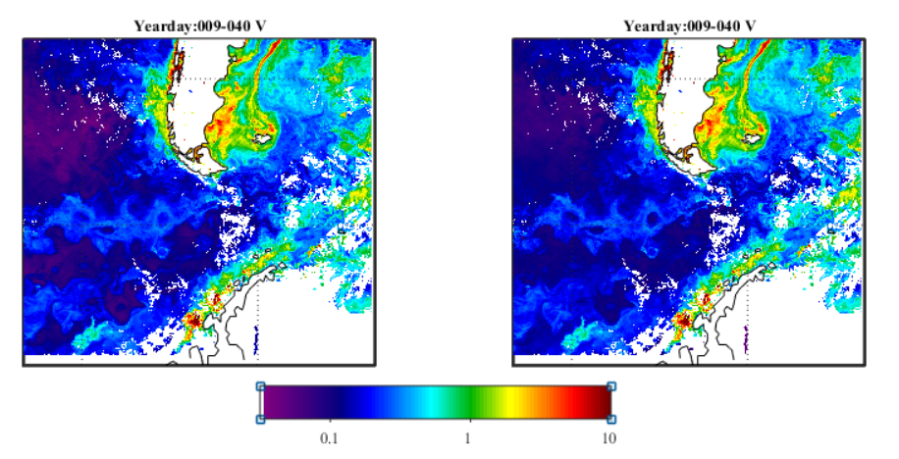
OCI algorithm OC3 algorithm

Slide 13
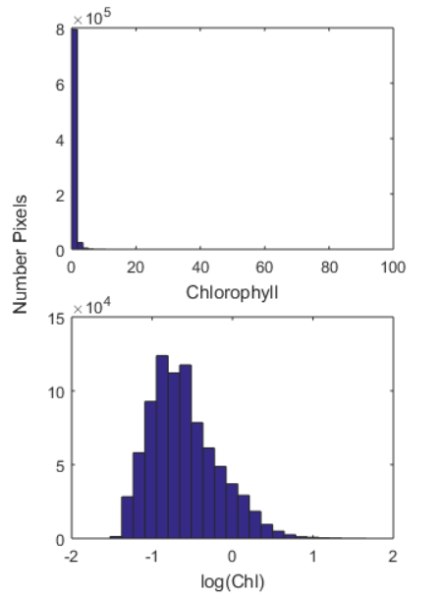
Chlorophyll and Calcite are lognormally distributed
Mean=0.45 mg m⁻³
Geomean=0.25 mg m⁻³

Slide 14
To estimate a mean from satellite mapped data
Satellite pixels are on mapped mercator grid
For a mean of a large polar area, you need to scale by pixel-area
Otherwise, overweight the southern latitudes

Slide 15
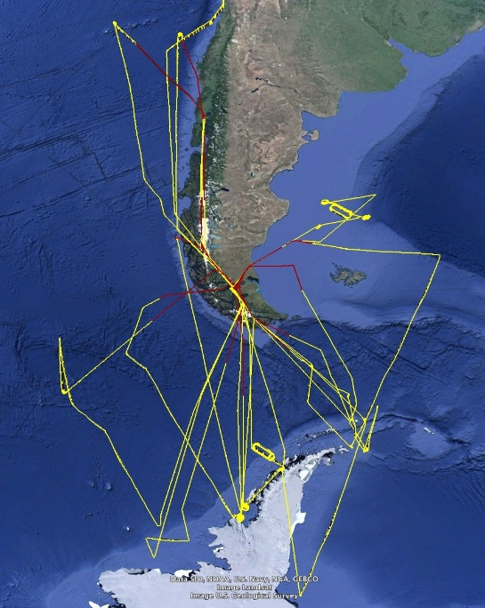
log Chlorophyll
log Calcite
Fig. 8. Overflights conducted with PRISM for ORCAS campaign.
SST

Slide 17
West = Pacific Sector
East = Atlantic Sector

Slide 19
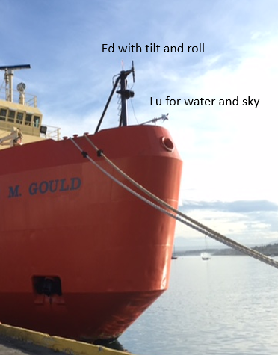
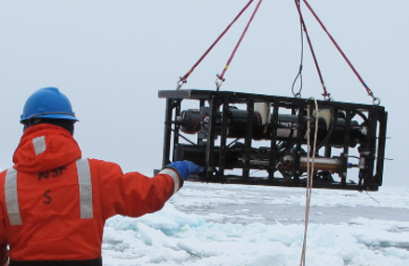
Fig. 5. Pictures of optical sensors deployed during the ORCAS/LTER field campaign. Stations with sea ice will be flagged.

Slide 20
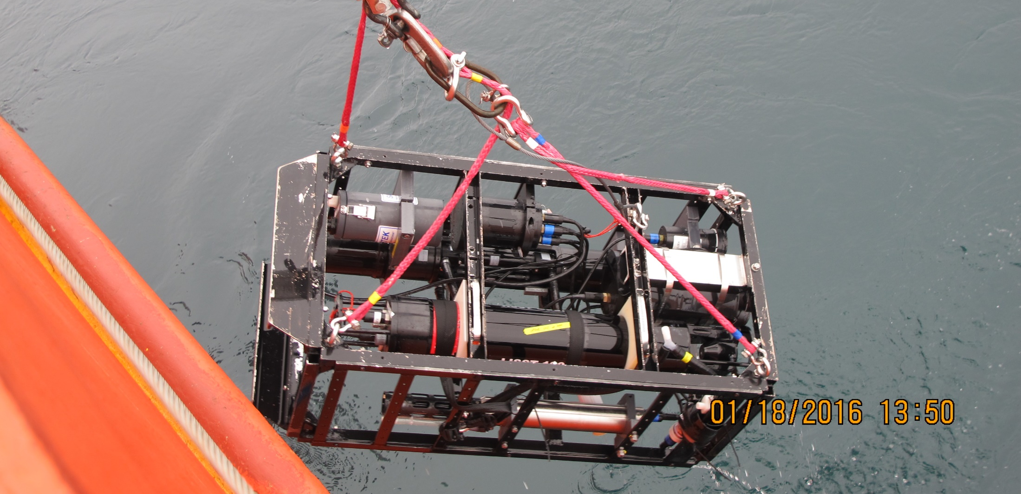
Inherent Optical Properties Collected during LTER
Spectral absorption, attenuation, scattering of particulate and dissolved material
Volume scattering function at 9 angles—an indicator of particle type, including bubbles
Particulate backscattering (single angle, single wavelength)
Chlorophyll and CDOM fluorescence

Slide 21
Level 2- Daily < 1 km resolution

Slide 22
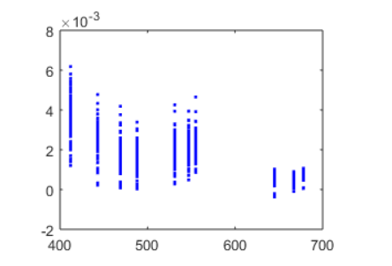
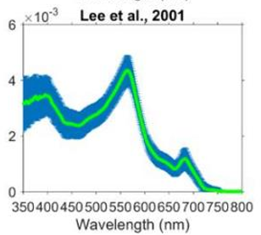
Level 2 - <1 km resolution
MODIS Aqua
Adelaide Island

Slide 24
8-day composite imagery 4 km
A= MODIS Aqua 1800
T = MODIS Terra 1300
V = NPP VIIRS 1800

Slide 27
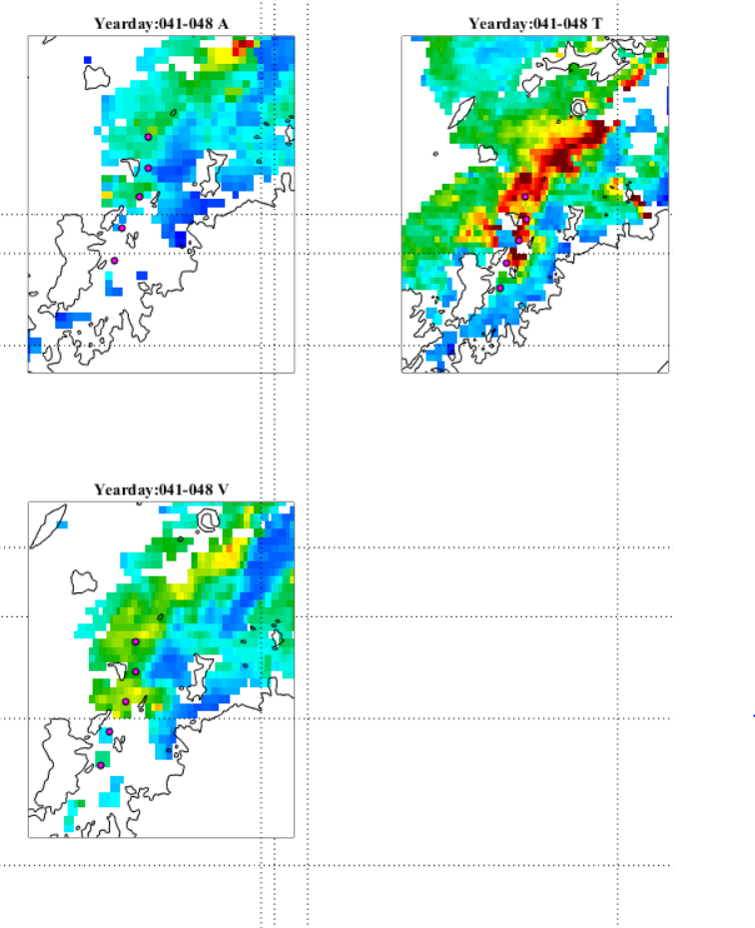

Slide 28
Chlorophyll (mg m⁻³)
log(Calcite) (mol m⁻³)

Slide 29
Causes of high backscattering waters
Coccolithophores
Phaeocystis colonies
Glacial flour from meltwater
Whitecaps and bubbles
Sea ice “bergy bits”
Influence
  Thermal flux
  Accuracy of algorithms

Slide 30
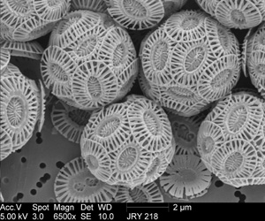
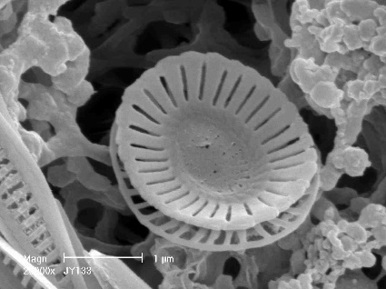
Haptophyte – Emiliania huxleyi
Coccolithophore with a calcite shell
CaCO₃ precipitation produces CO₂ that directly raises pCO_{2surf}
the calcite shells provide efficient ballast to transfer organic carbon from the surface to deep ocean potentially increasing NCP, export production and export efficiency which lowers pCO_{2surf}.
Detached Coccolith

Slide 31
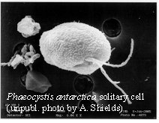
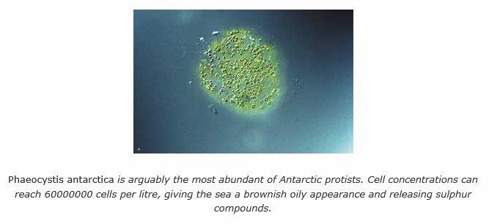

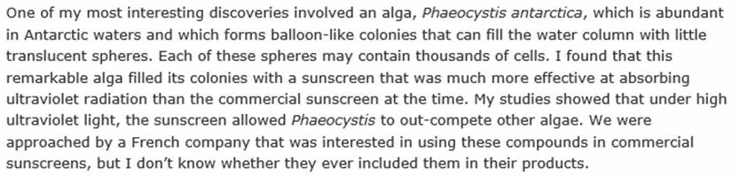
Haptophyte:
Phaeocystis antarctica
Phaeocystis antarctica, a flagellate around 6 µm diameter that forms gelatinous colonies up to 2 cm in diameter, is often the first species to bloom in ice-edge waters.
Quote from Andrew Davidson, Australian Antarctic Division

Slide 32
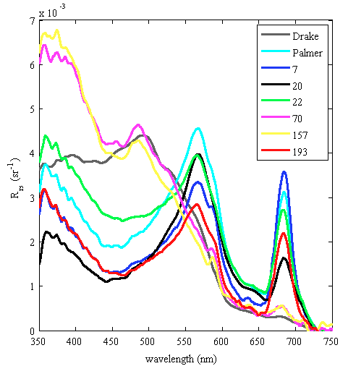
Water-leaving reflectance
Multi-Spectral Satellites Hyperspectral

Slide 33
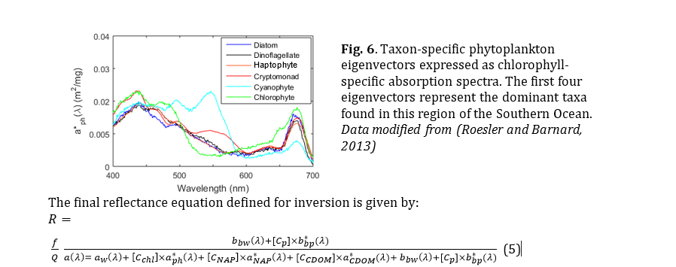
Inversion modeling to estimate phytoplankton taxa

Slide 34
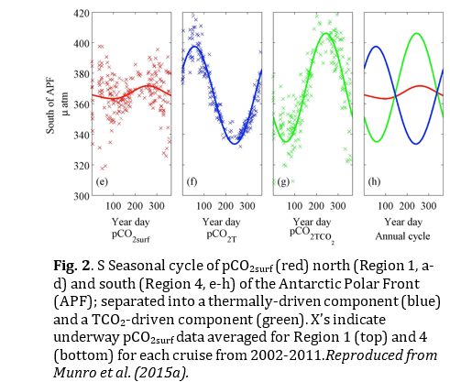
Proposal submitted to NASA Ocean Biology and Biogeochemistry Carbon Program
  Dierssen, Munro, Roesler, Gierach, Schofield
Net
Thermal
Biological
Link phytoplankton and optics to pCO2 Dynamics along Antarctic Peninsula and across Drake Passage

Slide 35
Next Steps
Finish processing PRISM flight lines
Compare Rrs from PRISM with ship and 1km MODIS/VIIRS measurements
  Validate the atmospheric correction
Compare PRISM and satellite products with ship measurements, e.g.:
  Chlorophyll
  Calcite (Particulate Inorganic Carbon)
  Absorption and Backscattering
Tune algorithms for PRISM based on field measurements

Slide 36
With additional funding
Process and evaluate in situ optical and pigment data for the region in terms of phytoplankton functional groups or taxa
Develop semi-analytical algorithms to estimate dominant phytoplankton taxa from hyperspectral water-leaving reflectance
Evaluate relationships between phytoplankton taxa and carbon fluxes
Apply phytoplankton taxa and pCO_{2surf} algorithms to the PRISM imagery collected as part of the ORCAS campaign

