Slide 1
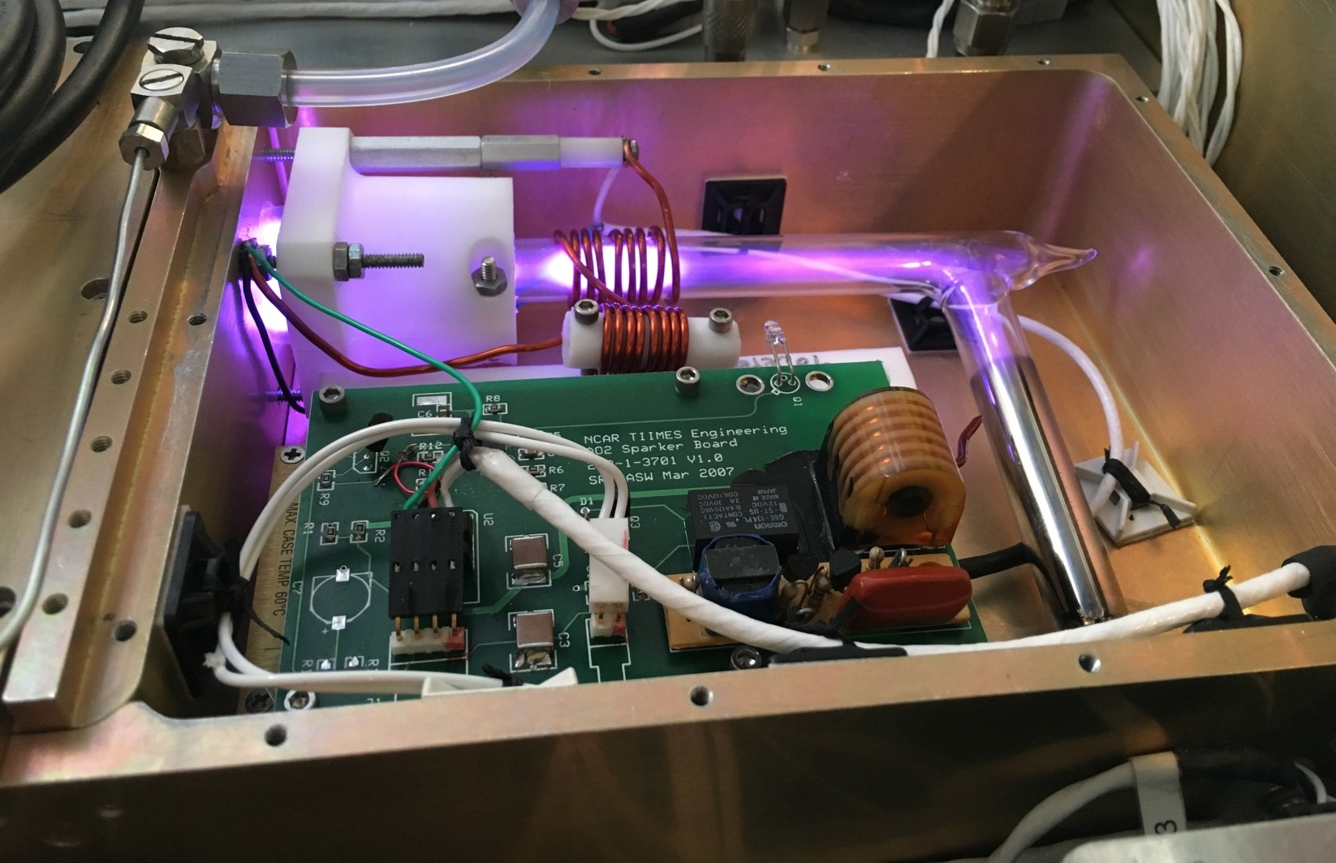
Large scale O₂ and CO₂ signals
Britt Stephens, Matt Long,
and the ORCAS Science Team

Slide 2
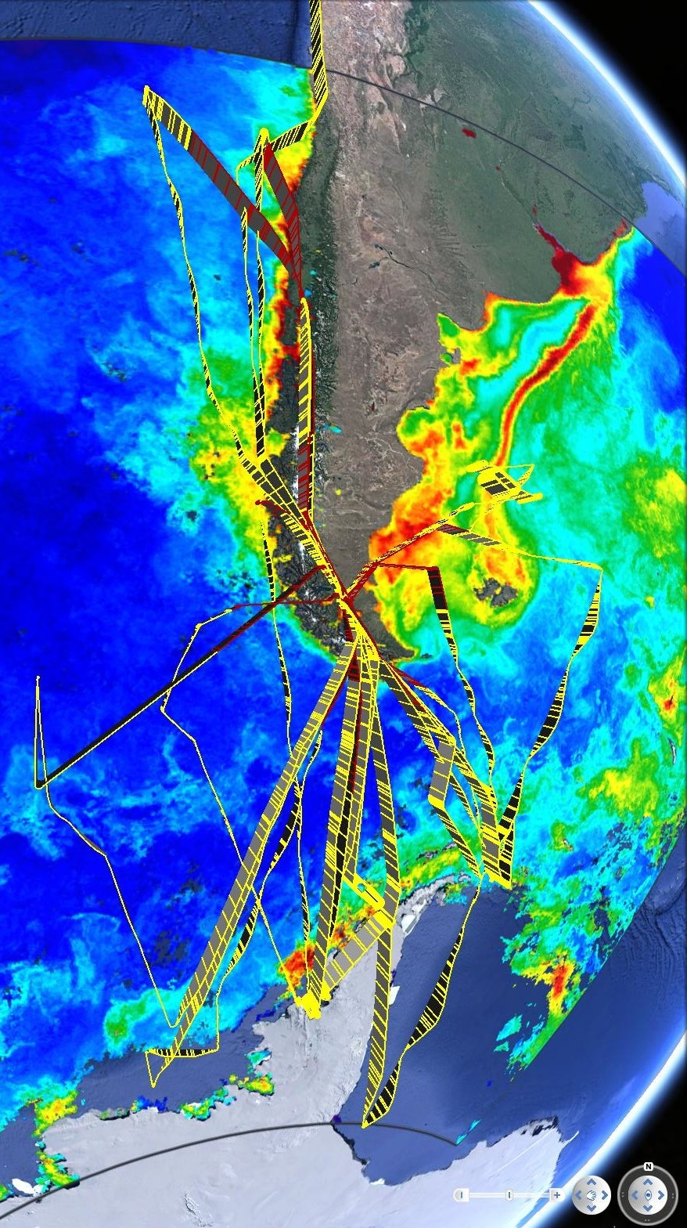
Outline:
Curtain averages for APO (and CO₂)
Individual and paired flights
Whole, half, and third campaign
Towards a quantitative estimate of Seasonal Net Outgassing
Whole campaign O₂:CO₂ ratio plots
Constraint on thermal vs. biological forcing of CO₂ fluxes
Removal of fossil and land signals with models and multiple tracers

Slide 3
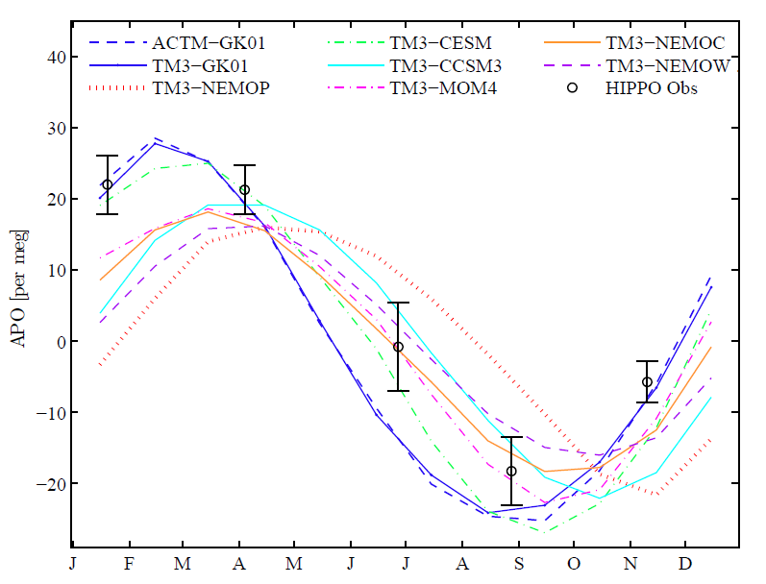
HIPPO Southern Ocean Curtain Averages
45-65 S, up to 300 mb
APO = O₂ + 1.1 CO₂
J. Bent, Dissertation, 2014

Slide 4
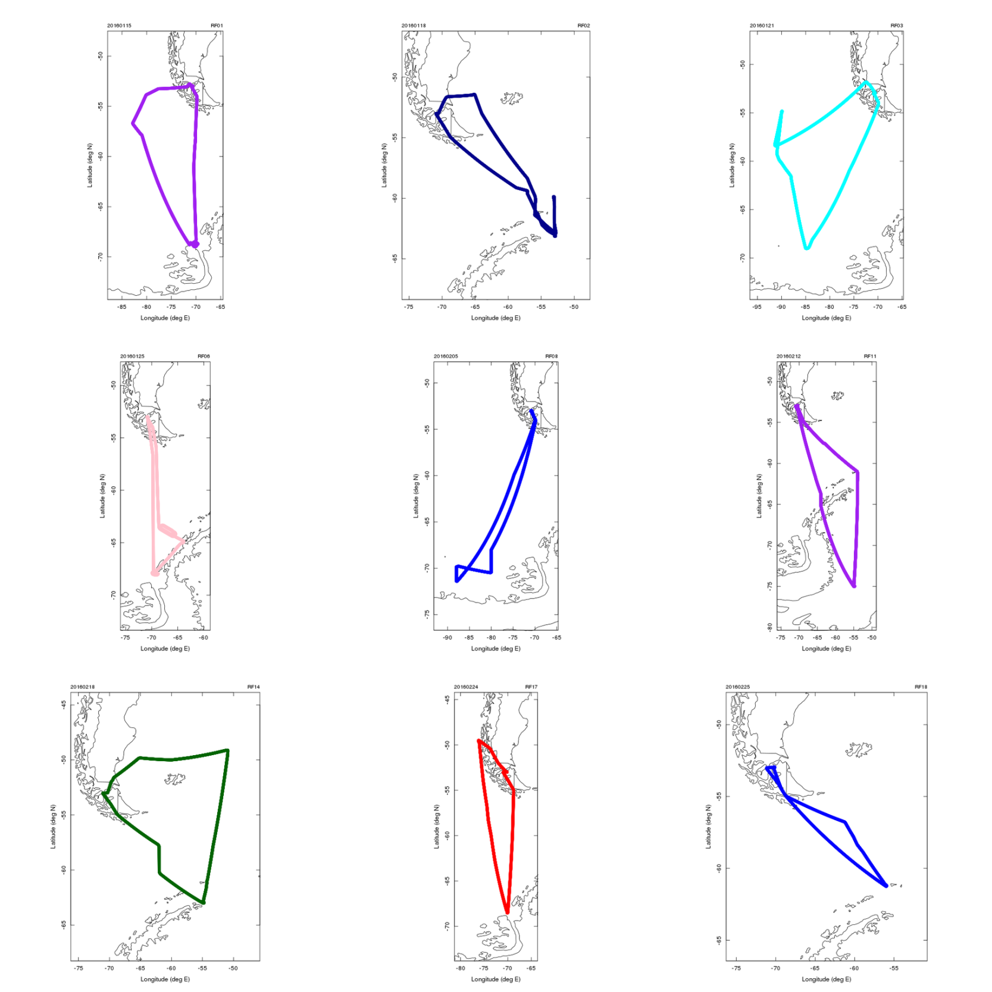
Individual Flights - tracks

Slide 5
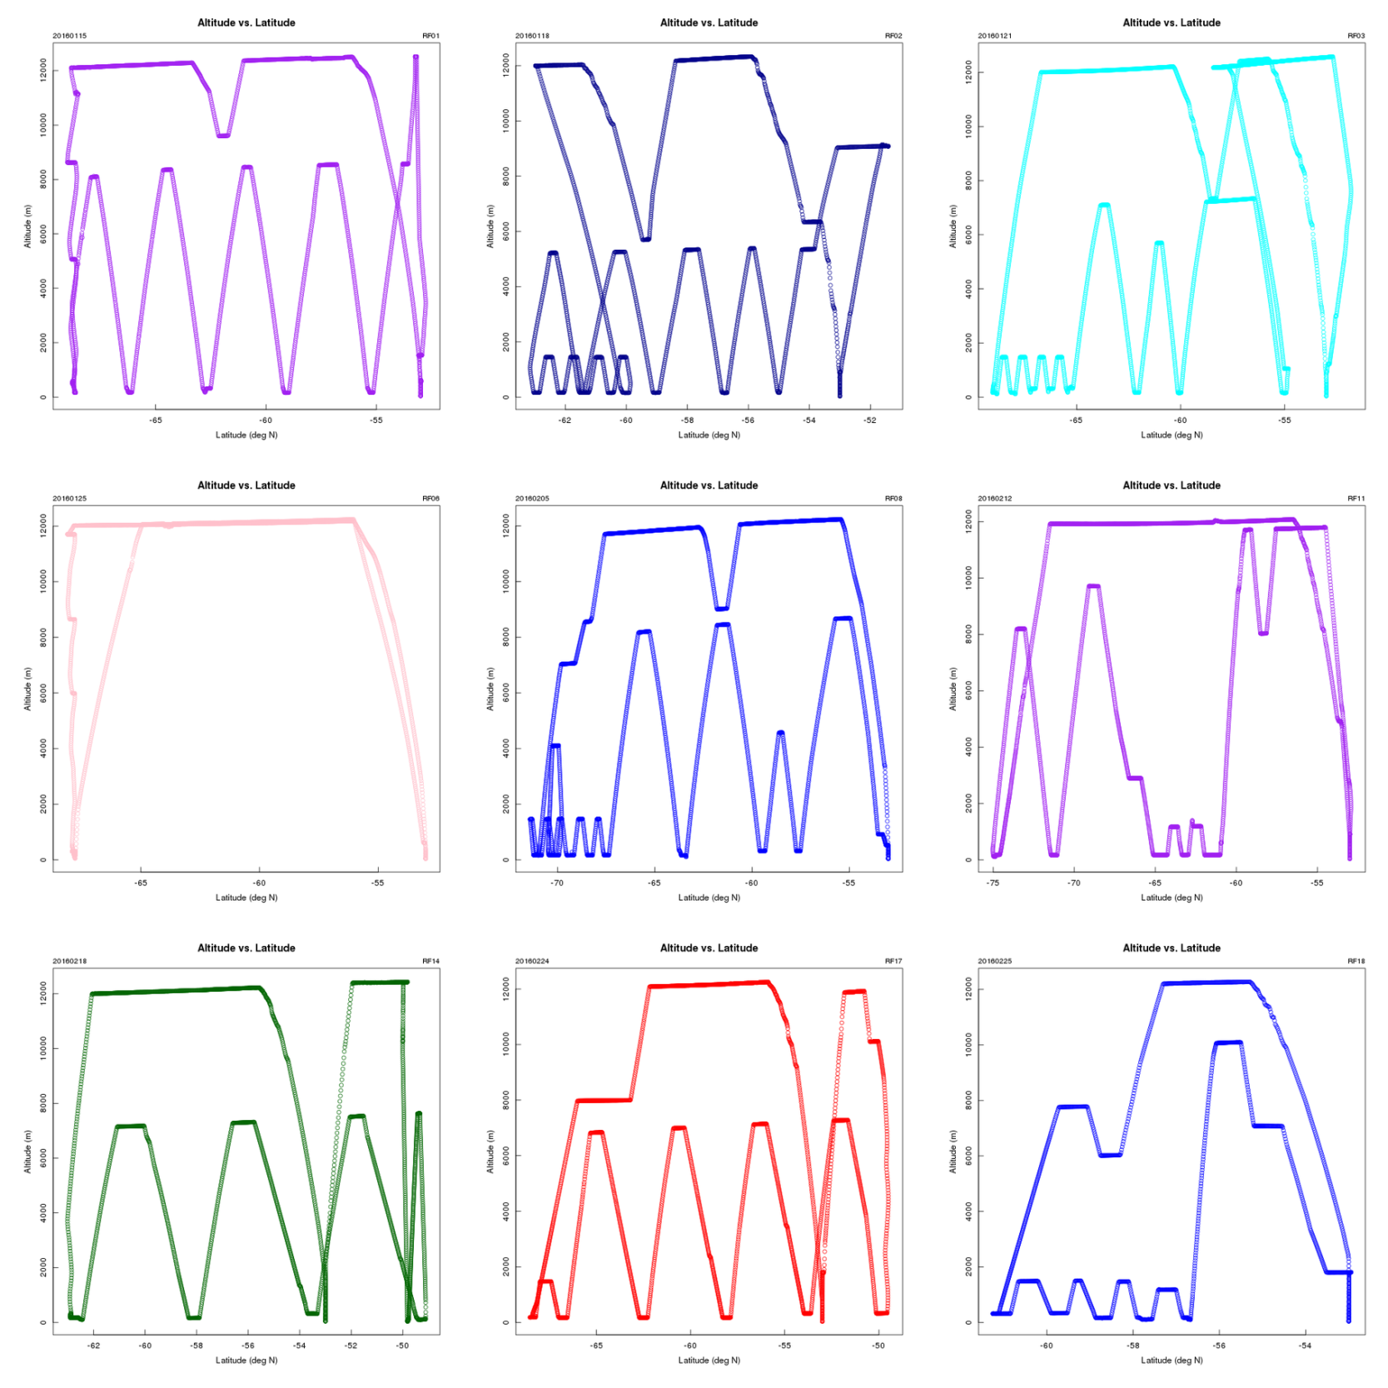
Individual Flights - profiles

Slide 6
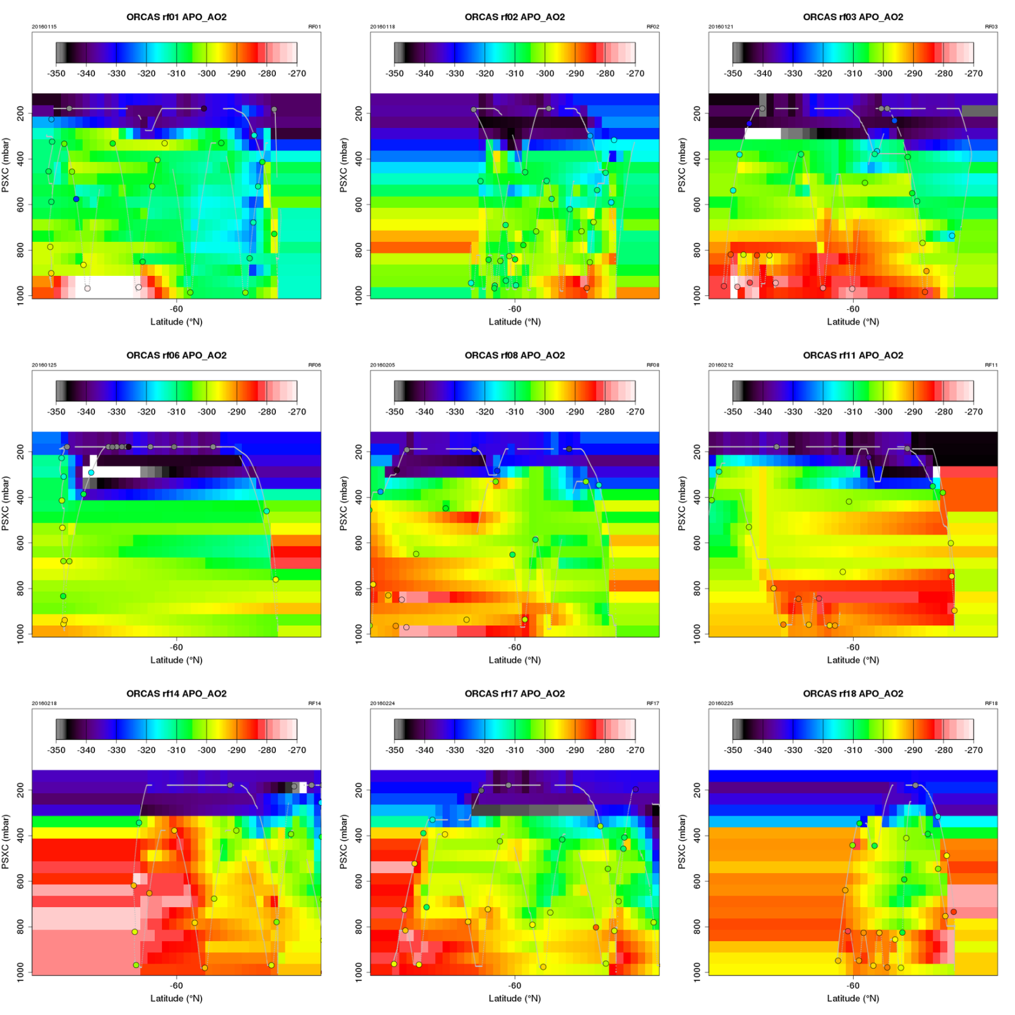
Individual Flights – APO cross-sections

Slide 7
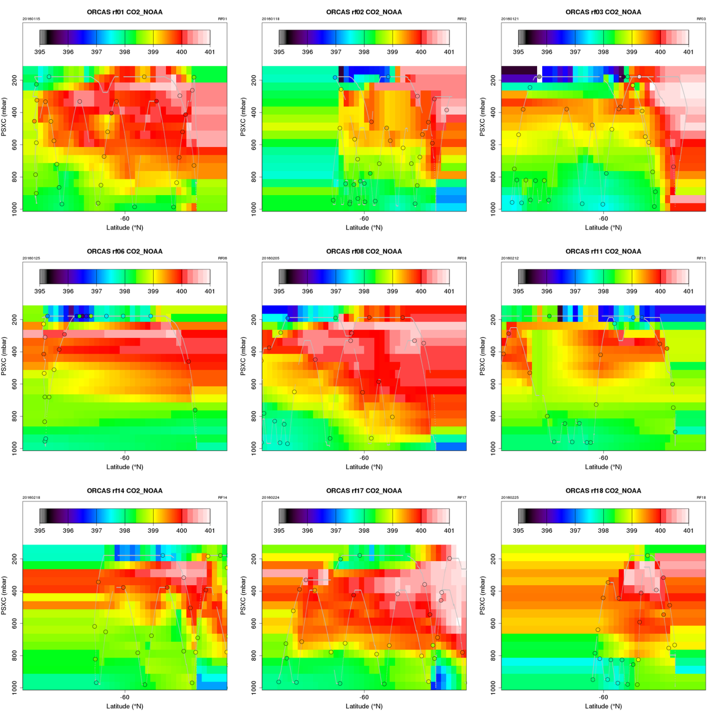
Individual Flights – CO₂ cross sections

Slide 8
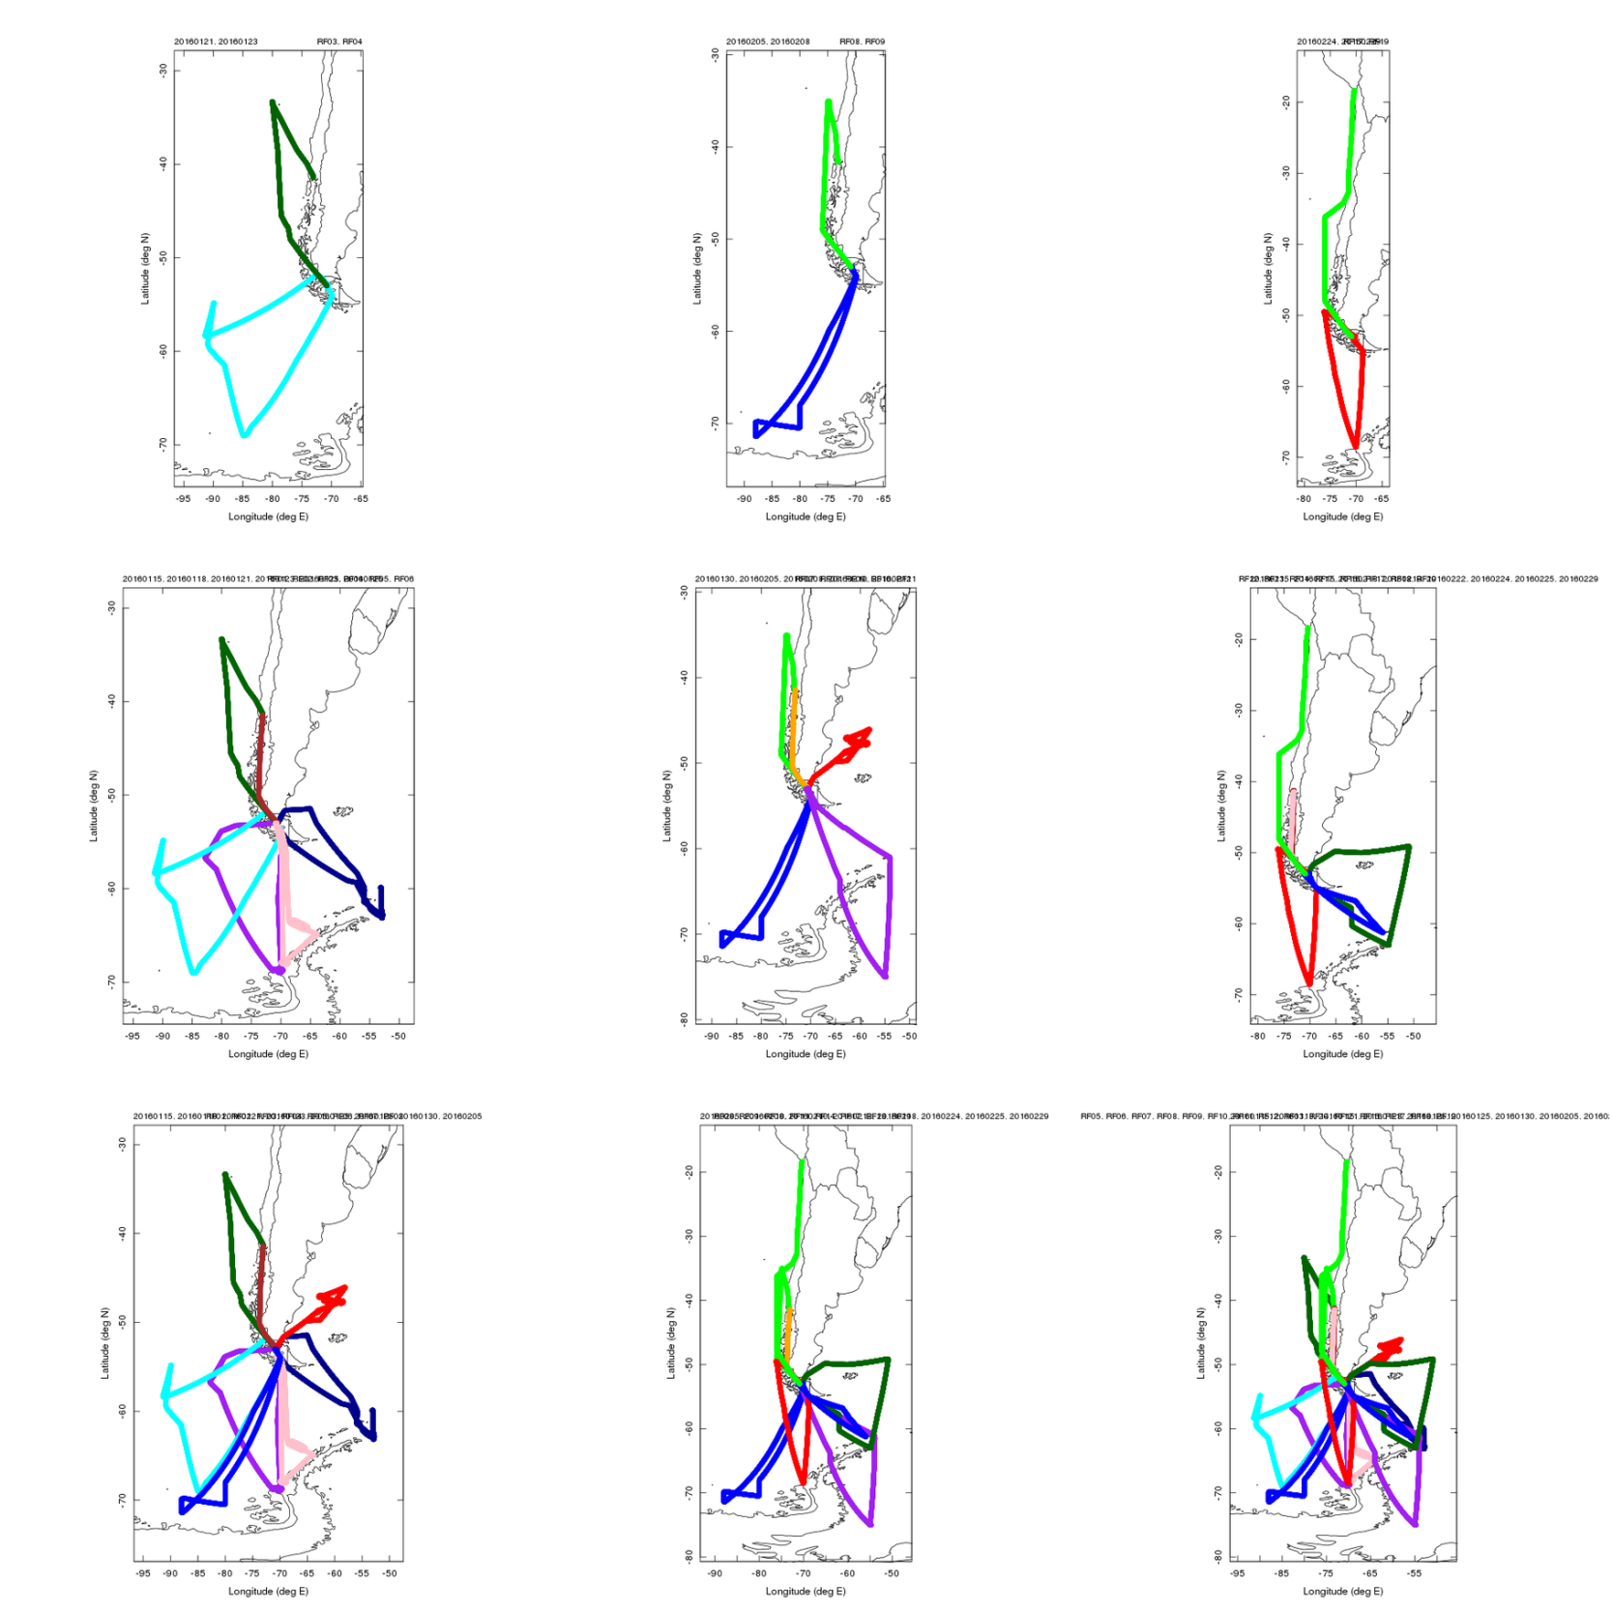
Combined Flights - tracks

Slide 9
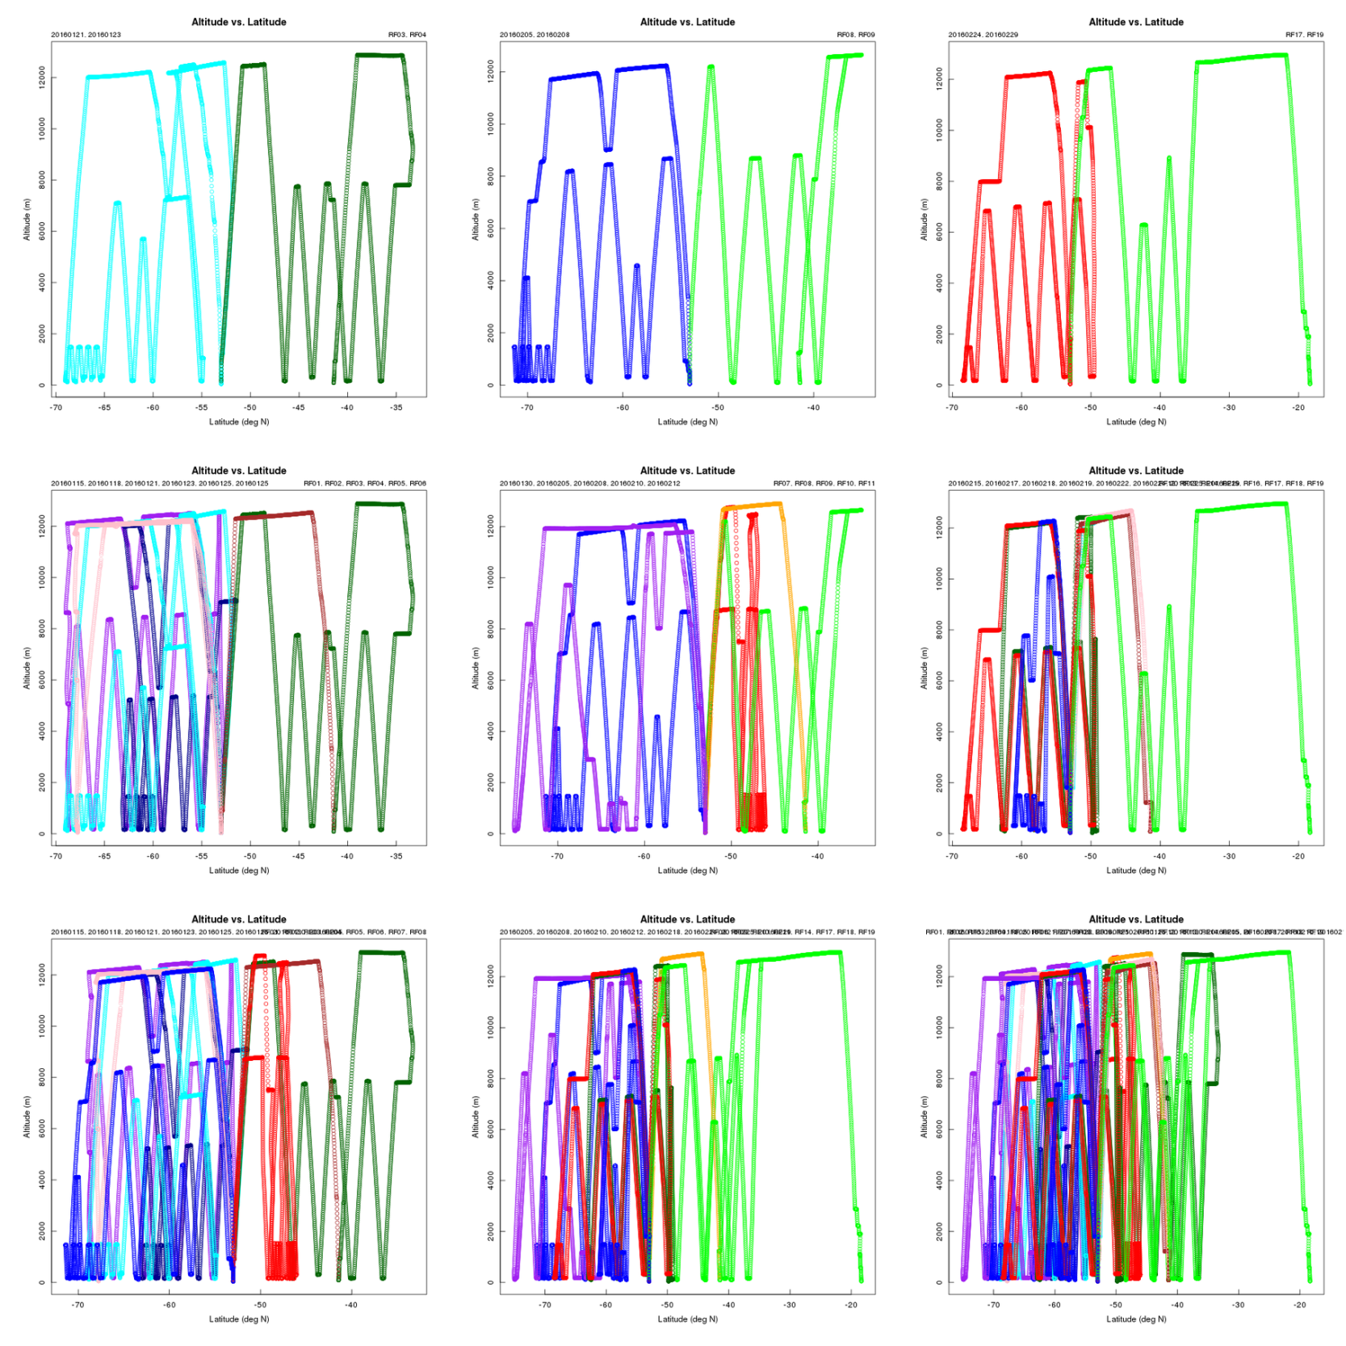
Combined Flights - profiles

Slide 10
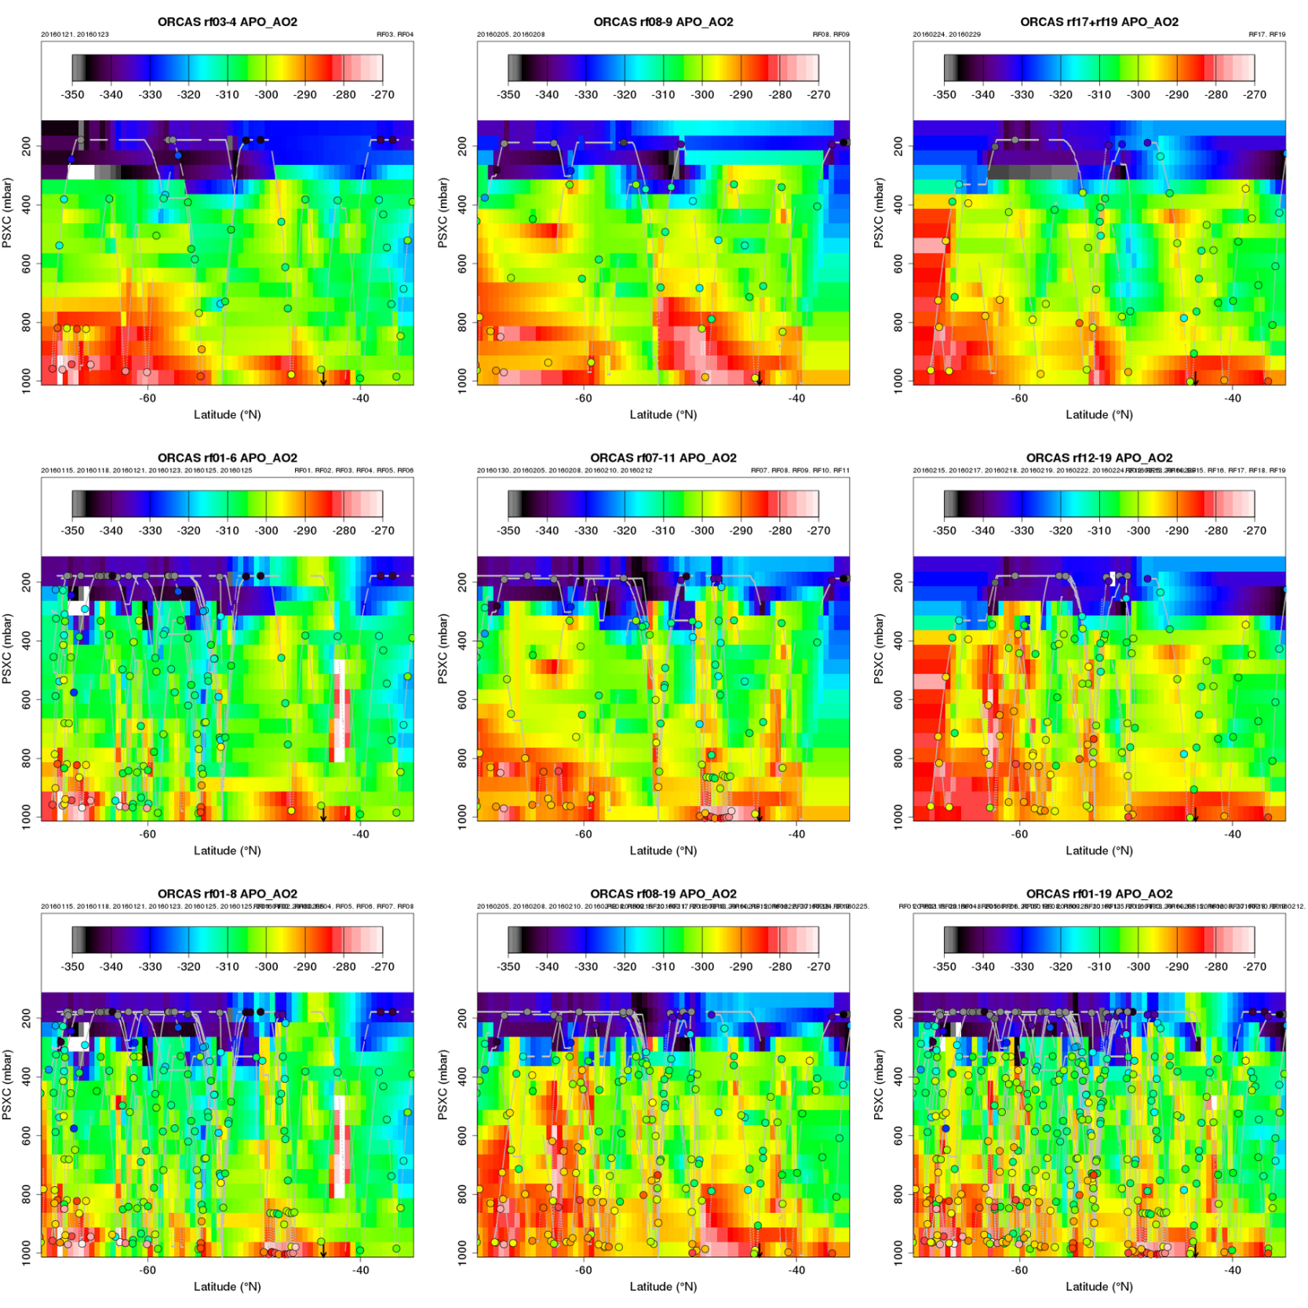
Combined Flights – APO cross sections

Slide 11
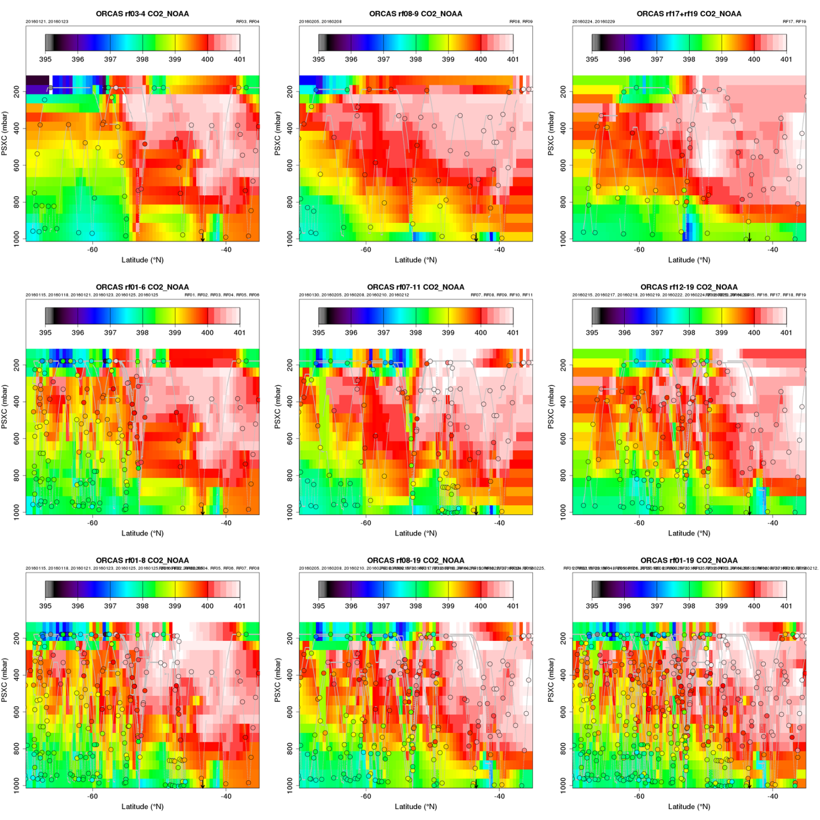
Combined Flights – CO₂ cross sections

Slide 12
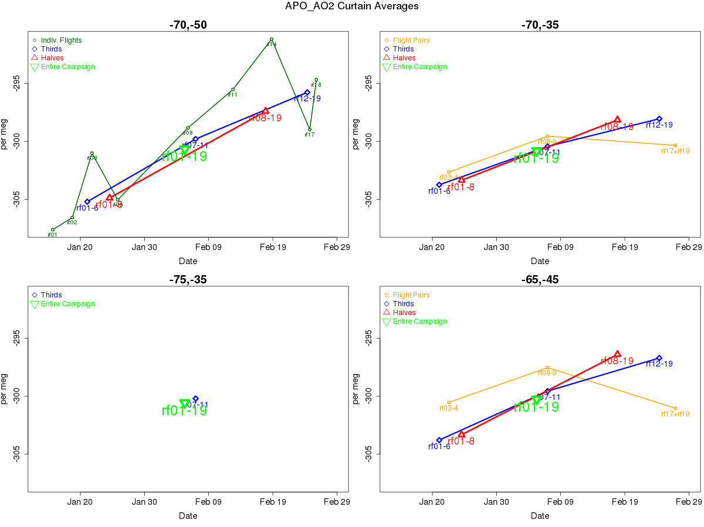

Slide 13
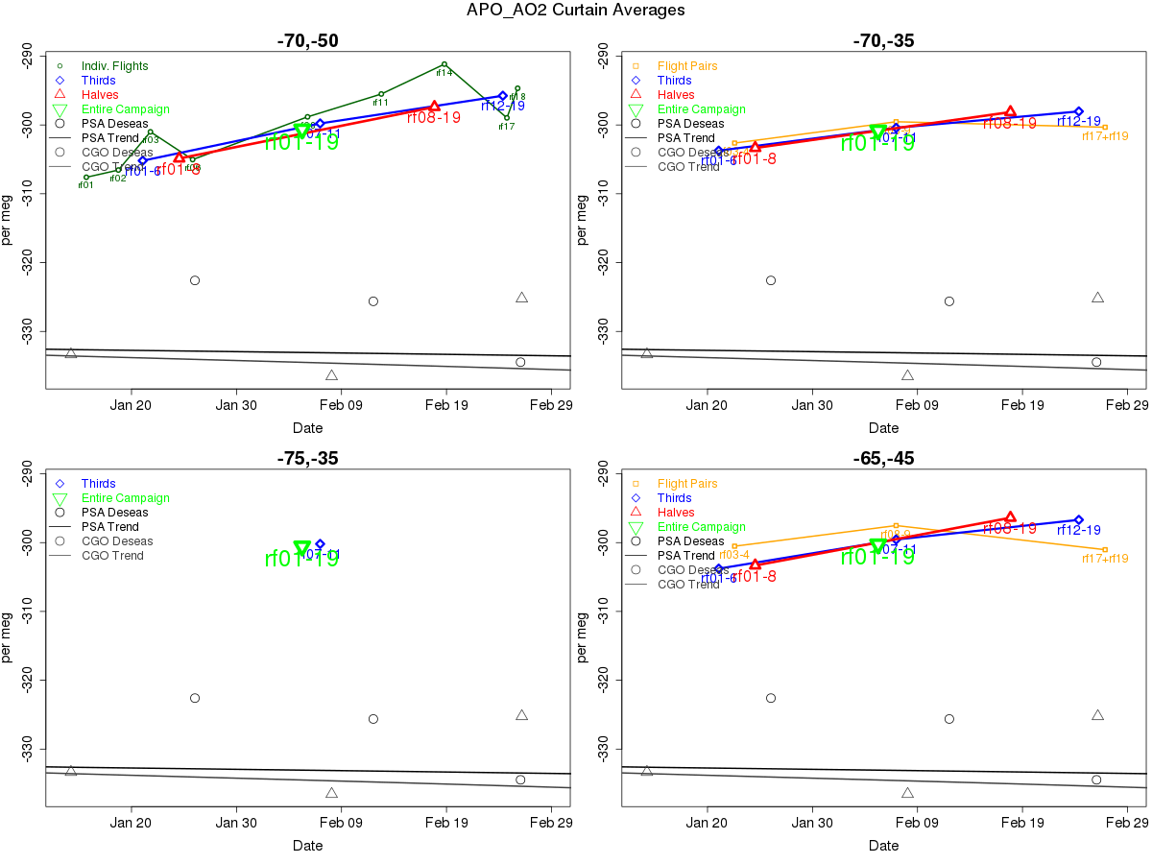

Slide 14
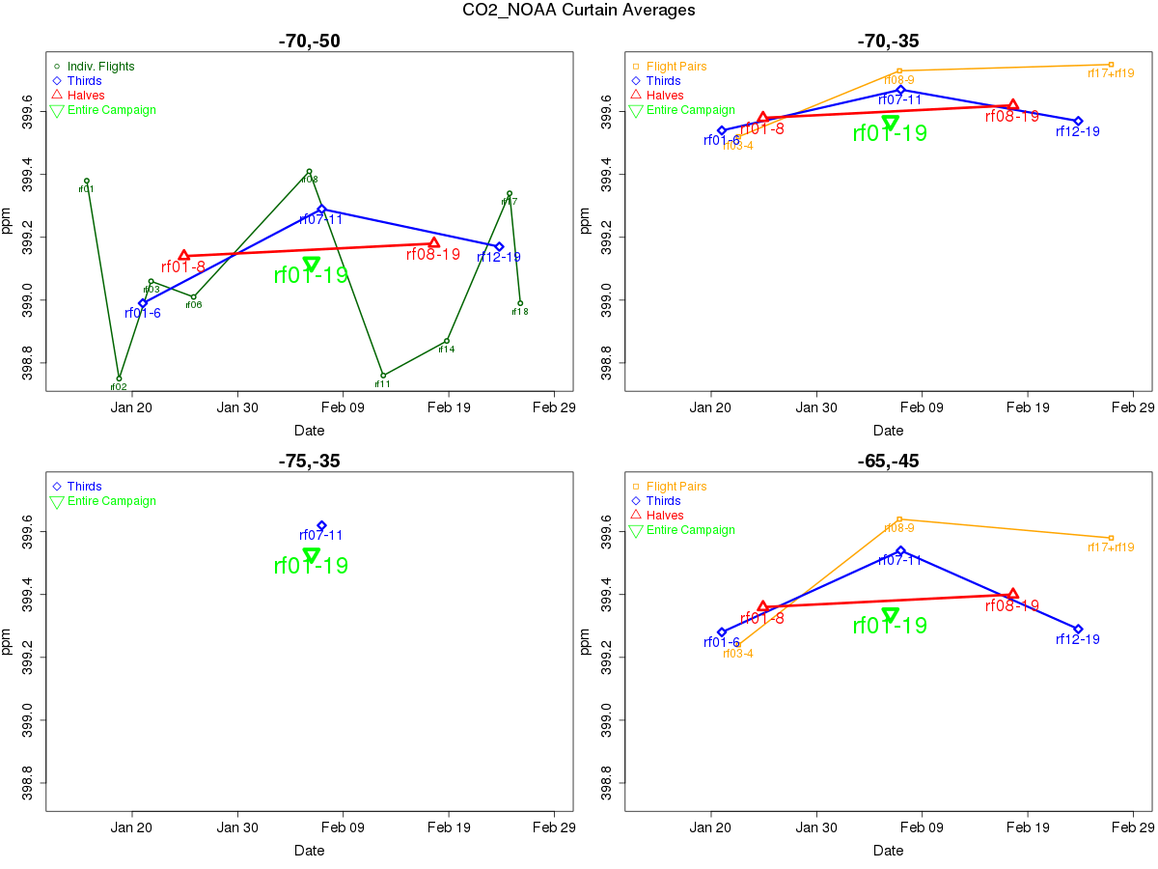

Slide 15
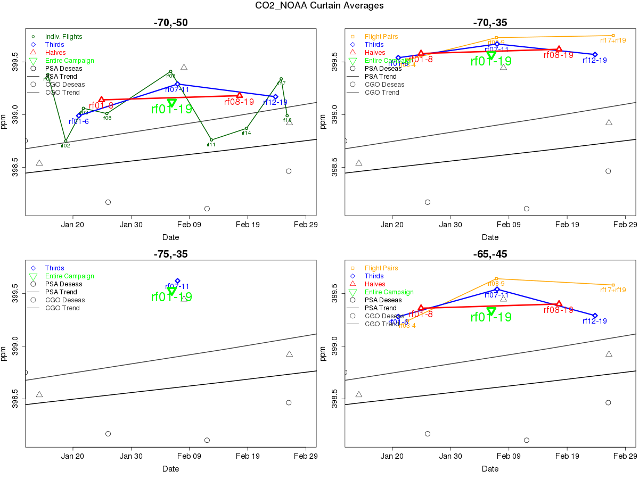

Slide 16
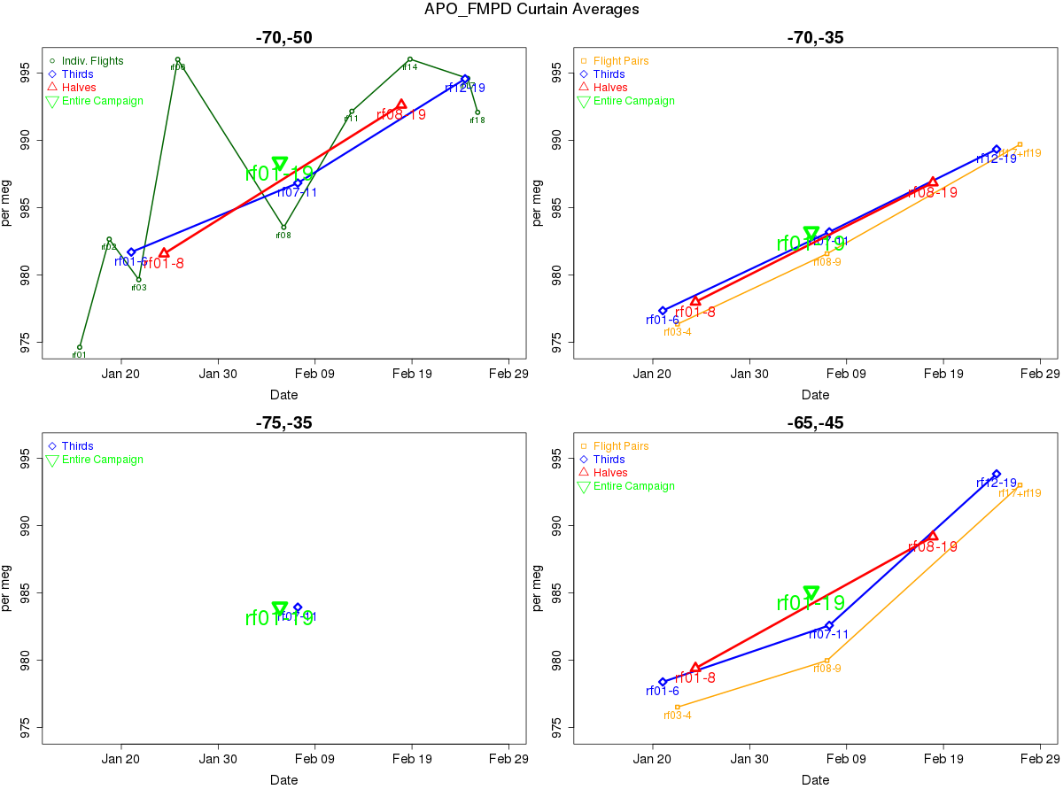

Slide 17
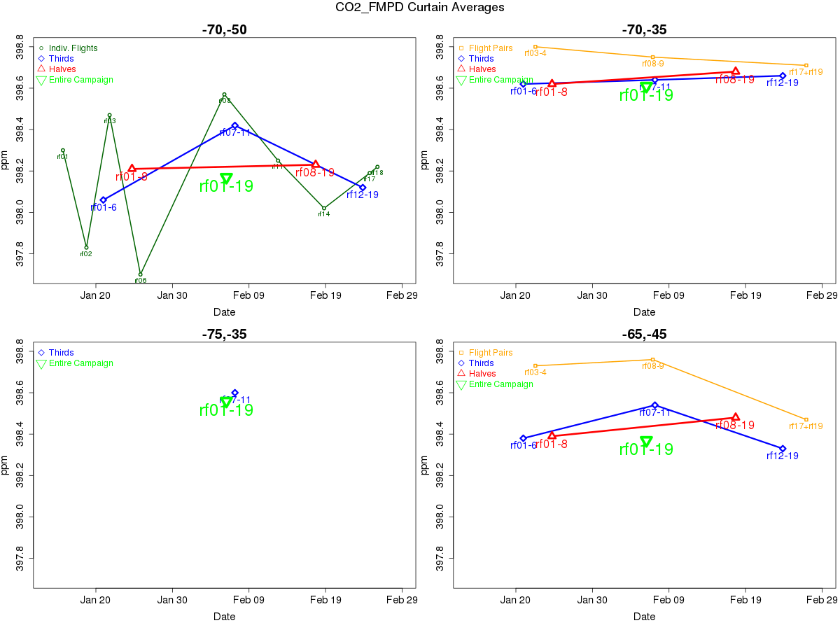

Slide 18
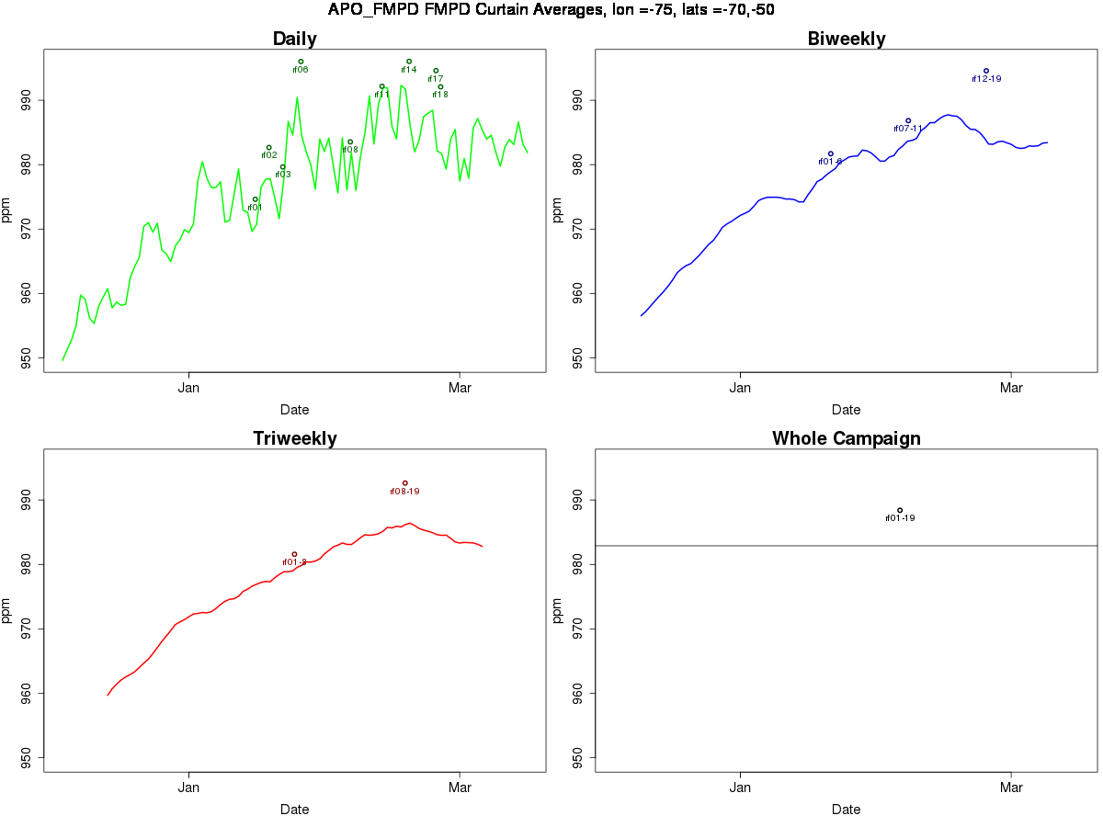

Slide 19
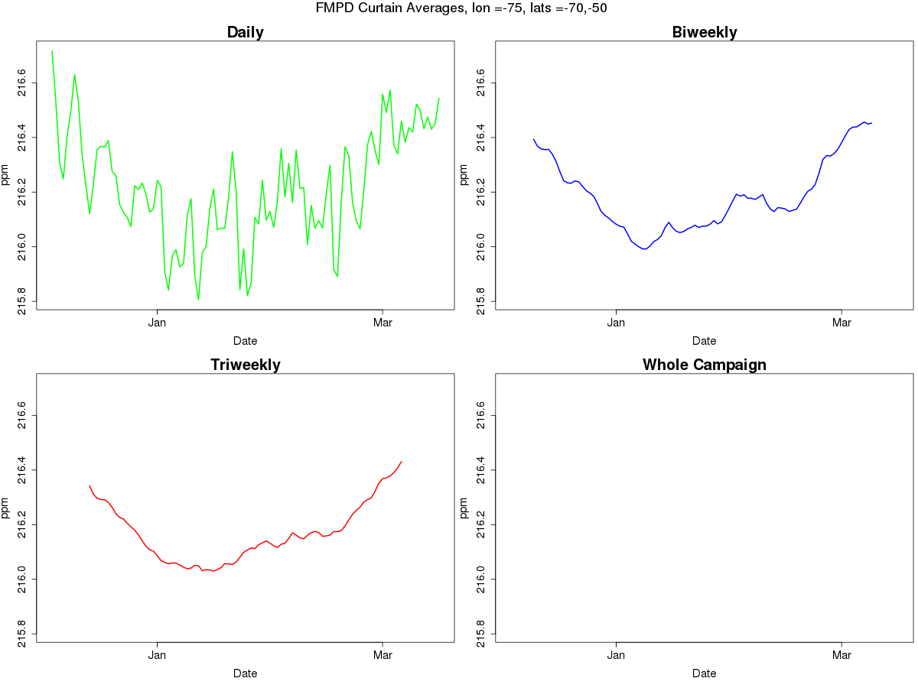

Slide 20
Curtain average preliminary conclusions, plans
O₂ CAs look promising as large-scale constraint
CO₂ has combined (complex) influences
Use actual surface pressure – resolve model offset?
Shorter box for CO₂
Comparison to model zonal means, other lat cutoffs
Decide on lat range
Establish background reference
Using low latitude / high altitude ORCAS data as the reference
Using M-theta reduce synoptic variability?
Stacked boxes?
Use CA trend alone?

Slide 21
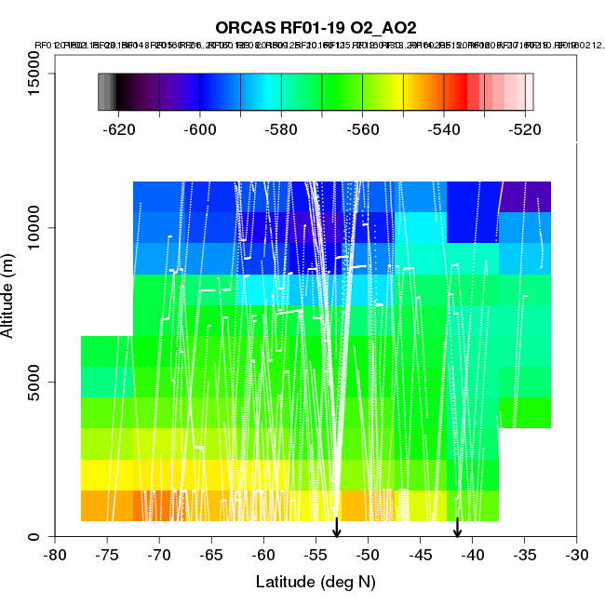
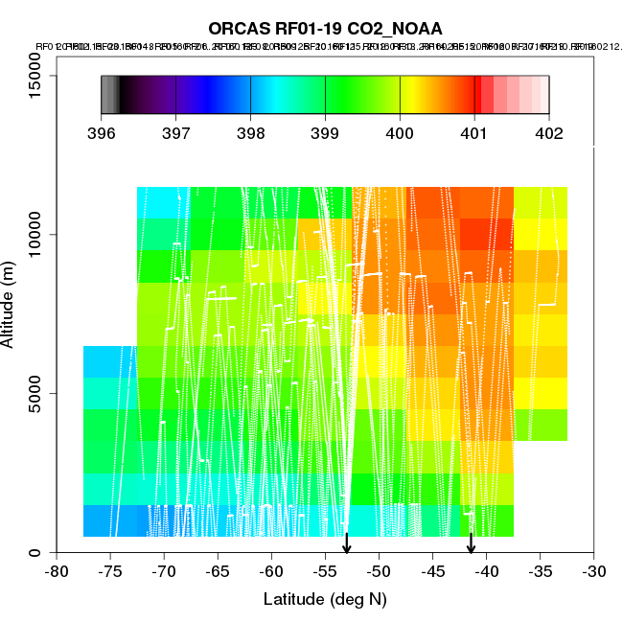
Whole campaign O₂:CO₂ ratio from lat/alt bin averages
O₂
CO₂
per meg
ppm

Slide 22
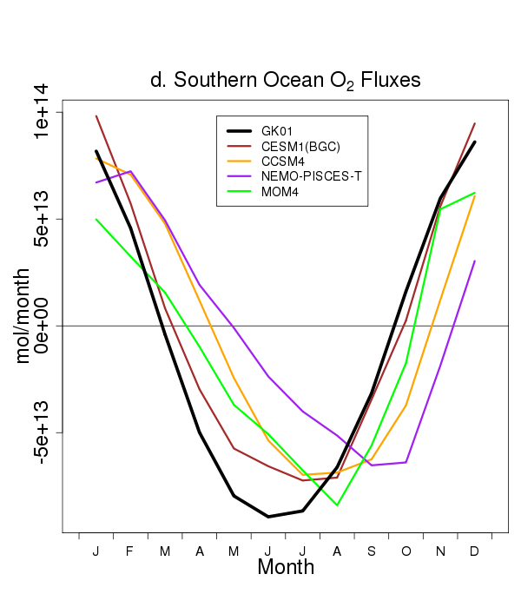
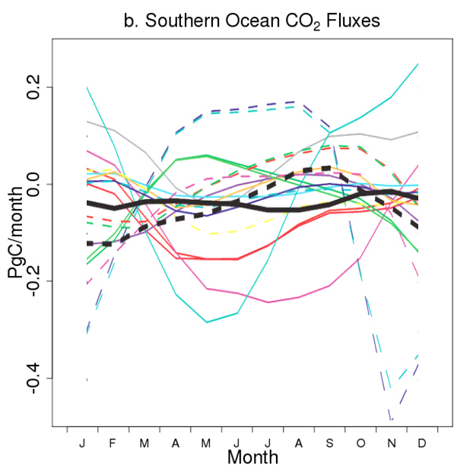
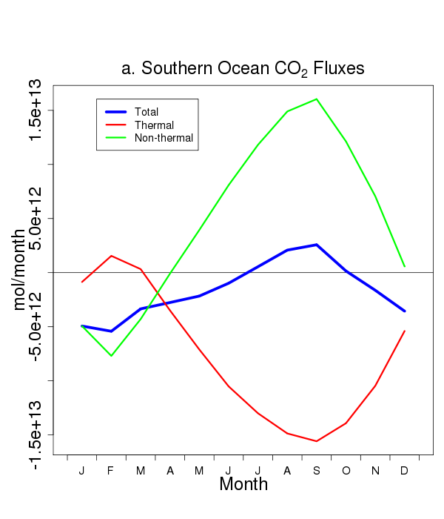
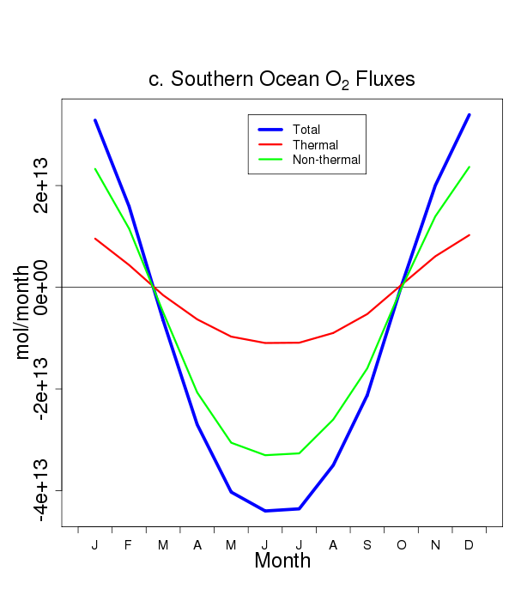
Seasonal CO₂ and O₂ forcings
CO₂
Annual CO₂ flux
~ -0.4 PgC/yr
O₂
Models: Anav et al., J.Clim., 2013
Obs: dash = Takahashi et al. DSR, 2009
M. Long, S. Doney, C. Le Quéré, J. Dunne
black = Garcia and Keeling, JGR 2001
O₂
CO₂
Total (obs)
Thermal (SST, Q)
Non-thermal

Slide 23
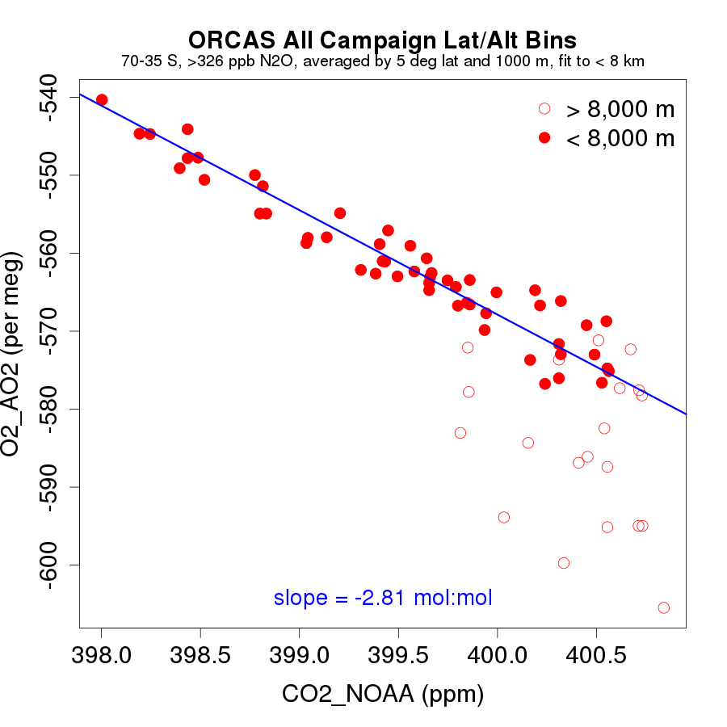
Observed – Total O₂ vs. CO₂

Slide 24
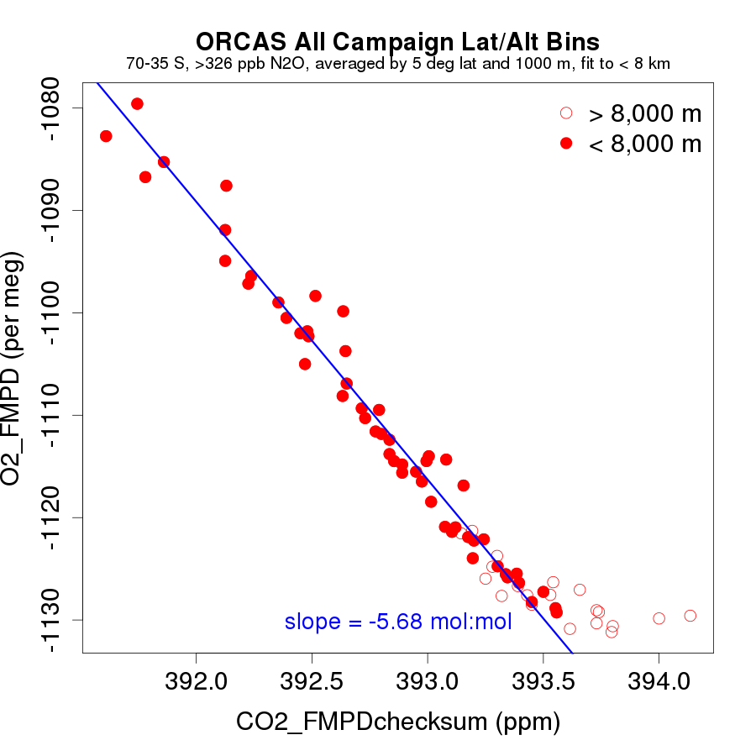
Modeled – Total O₂ vs. CO₂
Figure replaced (and this note added) after talk: CO₂ components do not add to total because on non-linear advection in CAM – resolution currently under investigation – for now, using sum of FF, LND, and OCN components (“FMPDchecksum”) in place of total.

Slide 25
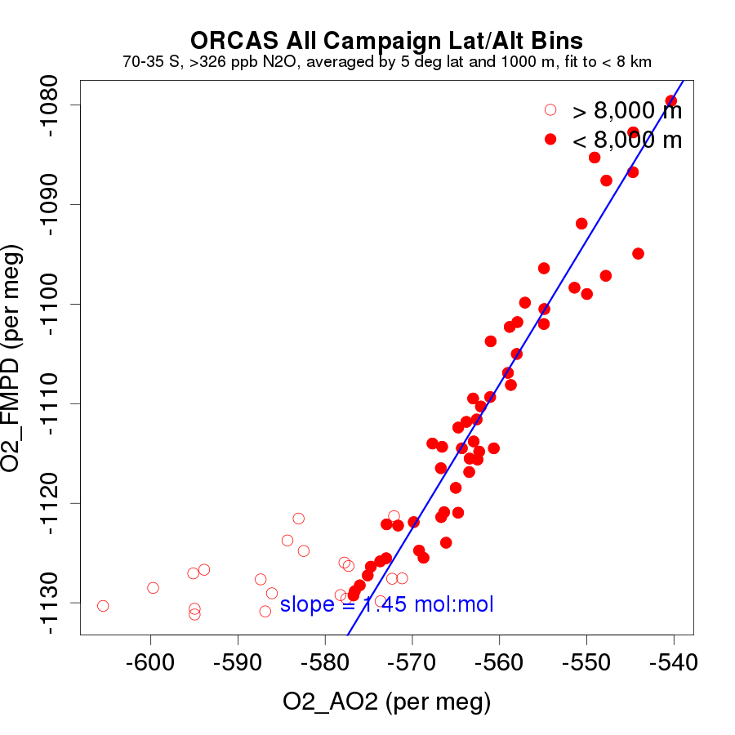
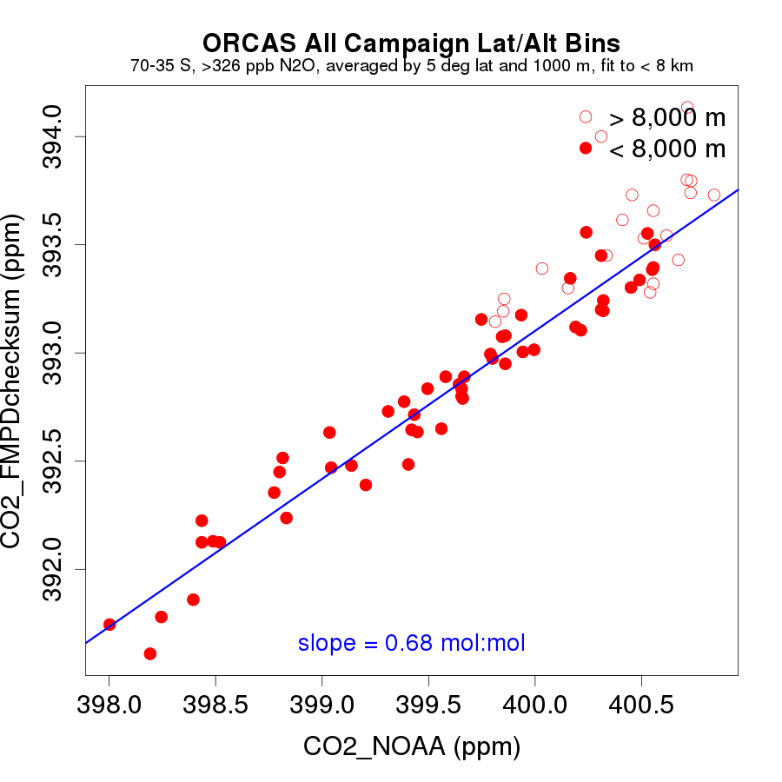
ORCAS whole campaign comparisons to CESM-FMPD
O₂
CO₂
Figure replaced (and this note added) after talk: CO₂ components do not add to total because on non-linear advection in CAM – resolution currently under investigation – for now, using sum of FF, LND, and OCN components (“FMPDchecksum”) in place of total.

Slide 26
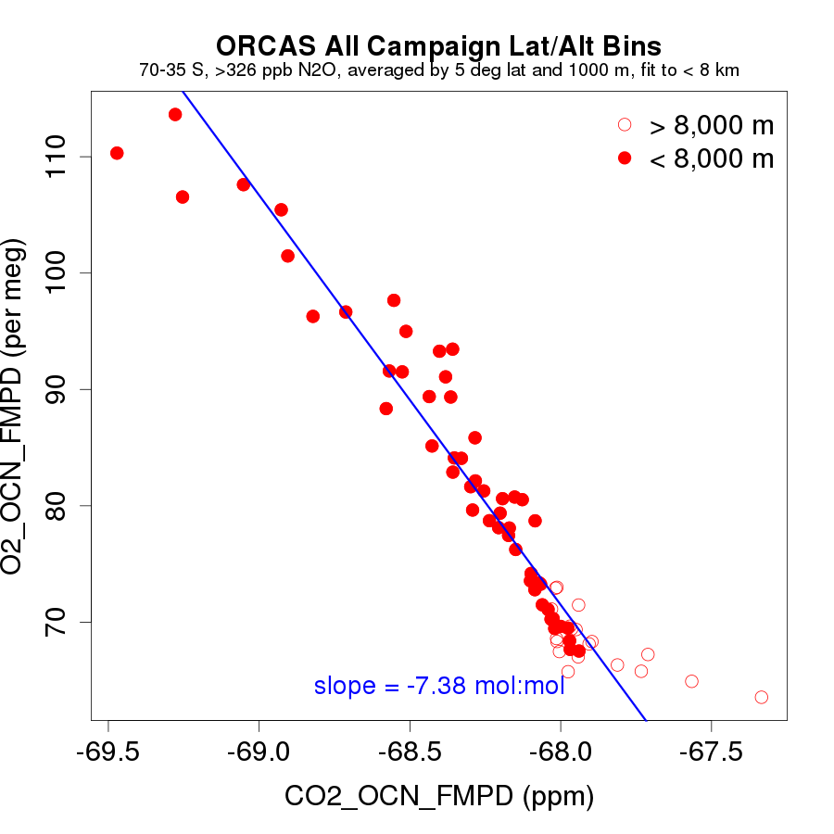
Modeled – Ocean O₂ vs. CO₂

Slide 27
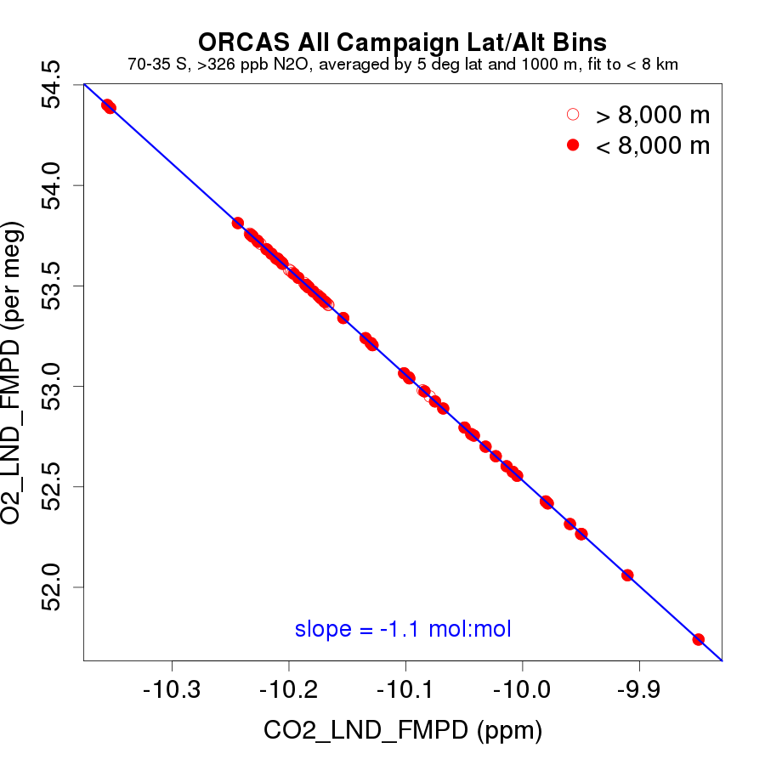
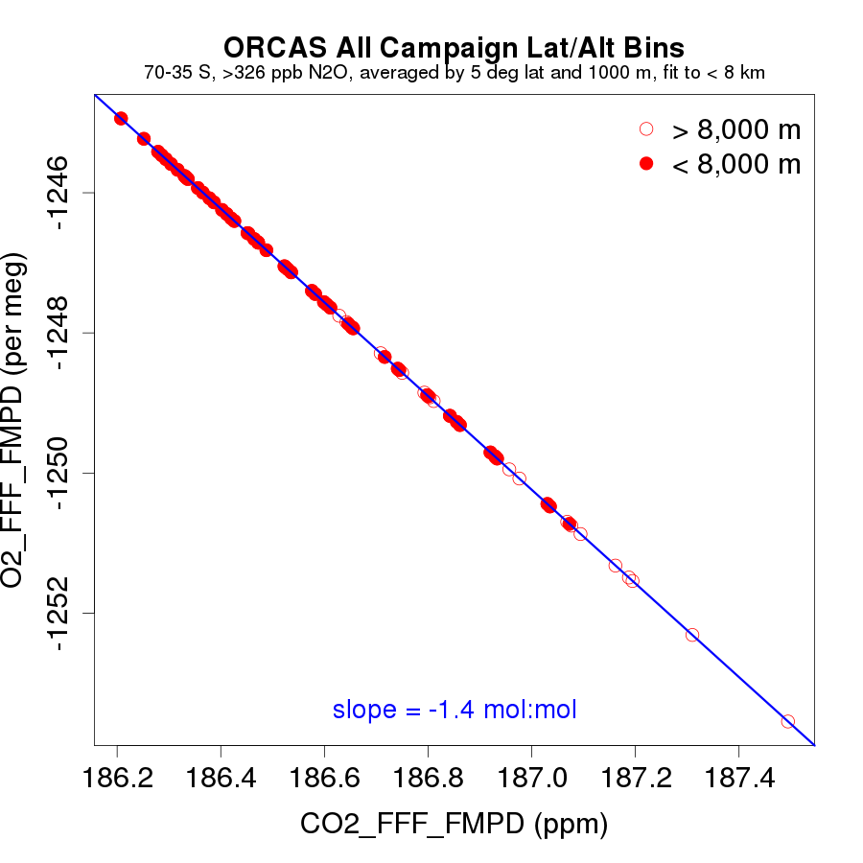
Modeled – Land and Fossil O₂ vs. CO₂
 | Obs Tot | Mod OCN | Mod FF | Mod LND | Mod Tot
O₂ (per meg) | -34.3 | -53.9 | -5.8 | 2.7 | -52.8
CO₂ (ppm) | 2.6 | 1.5 | 0.9 | -0.5 | 1.9
O₂:CO₂ (mol:mol) | -2.8 | -7.4 | -1.4 | -1.1 | -4.4
Table (and this note) added after talk: CO₂ components do not add to total because on non-linear advection in CAM – resolution currently under investigation – for now, using sum of FF, LND, and OCN components (“FMPDchecksum”) in place of total.

Slide 28
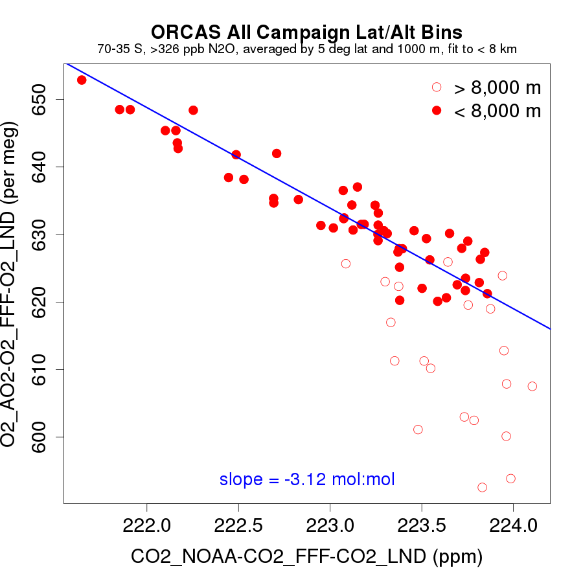
Observed and Modeled – Ocean O₂ vs. CO₂

Slide 29
Observed and Modeled – Ocean
Observed – Total
-0.3 (11%)
Modeled – Total
Modeled – Ocean
see notes on prev slides re:checksum
-1.7 (30%)

Slide 30
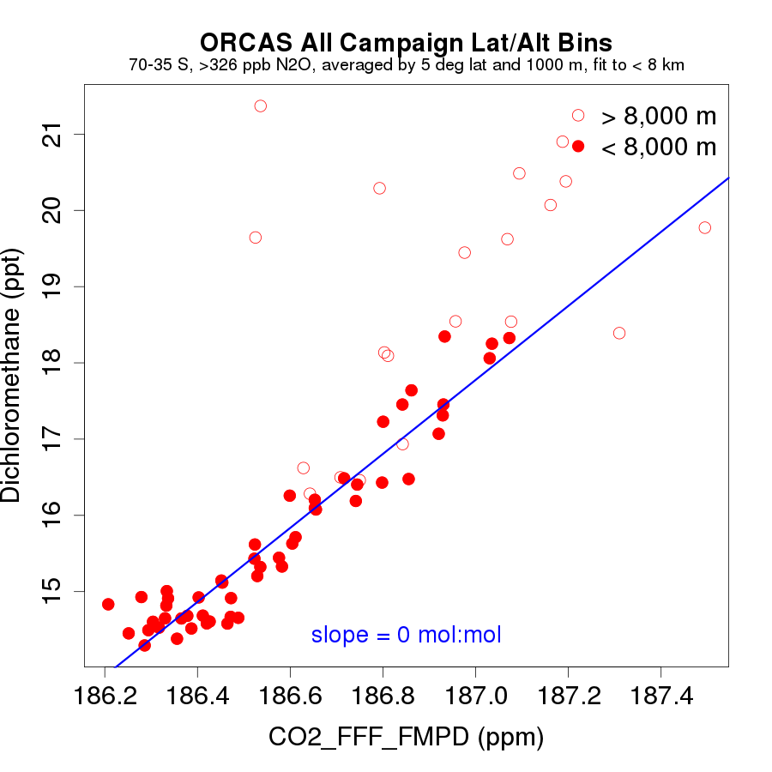

Slide 31
Whole campaign ratio next steps
Establish representativeness
CAM-Chem runs to define CO2_FF vs. Dichloromethane relationship – other tracers?
CT-NRT fossil / land CO₂ estimates

Slide 32
AGU Abstract:
Southern Ocean zonal scale summertime oxygen outgassing and carbon dioxide ingassing
Britton B. Stephens, Matt C. Long, Ralph F. Keeling, Colm Sweeney, Eric A. Kort, Jonathan D. Bent, Eric Morgan, Andrew Watt, Martin Hoecker-Martinez, Bruce C. Daube, Kathryn McKain, Mackenzie Smith, Tim Newberger, and the ORCAS Science Team
Paper Plans / Options:
Combine CA and whole campaign ratio or put whole campaign ratio with BL ratio paper?

Slide 33
