Slide 1
ORCAS Web Site & Data Management
Linda Echo-Hawk, Greg Stossmeister, Scot Loehrer and Linda Cully
NCAR Earth Observing Laboratory (EOL)
Computing, Data, and Software Facility (CDS)
ORCAS Science Meeting
Boulder, CO
7-9 September 2016
EOL ORCAS support sponsored by
Notes:
Lee Clouds over the Mesa Lab

Slide 2
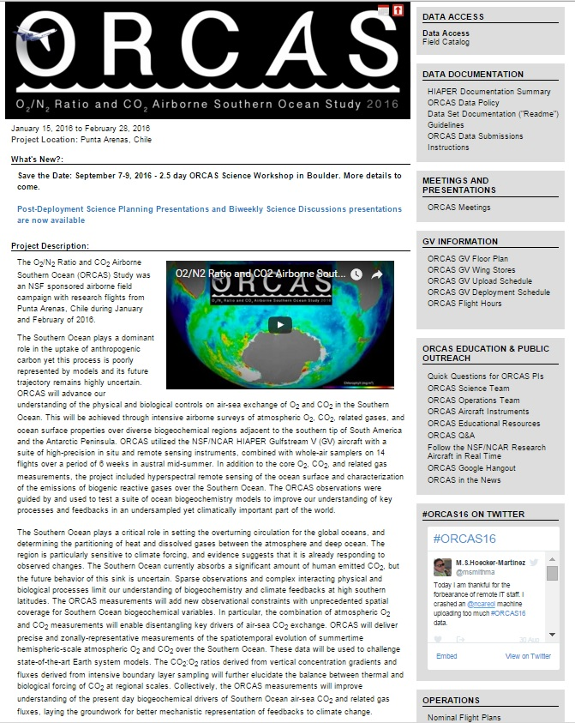
Project Web Site at NCAR/EOL
Project Description
Data Archive
Field Catalog
Publications
Meetings
Education & Outreach
Mailing Lists
Contact Information
https://www.eol.ucar.edu/field_projects/orcas

Slide 3
ORCAS DATA MANAGEMENT MILESTONES
Event | Deadline
End of Field Campaign | 28 February 2016
Preliminary (QAQC) Data Submission | 28 August 2016
Final (Release) Data Submission | 31 December 2016
Data Analysis Period (ORCAS Investigators have exclusive access to the data during this period. Data may be password protected.) | 1 March 2016 to 28 February 2017
Data becomes Public Domain | 1 March 2017

Slide 4
ORCAS DATA POLICY SUMMARY
All investigators agree to submit their processed preliminary (QAQC) data to the ORCAS archive no later than 28 August 2016.
All preliminary (QAQC) data shall be provided to other ORCAS Investigators upon request (restricted as appropriate).
During the initial 1-year data analysis period, data may be provided to a third party (outside ORCAS) only with the permission of the investigator(s) who collected the data.
All data will be considered public domain one year following the end of the ORCAS project (1 March 2017).
Any use of the data will, at a minimum, include acknowledgment or use of DOI. Co-authorship TBD with the investigator(s) who collected the data.

Slide 5
ORCAS Digital Object Identifiers (DOIs)
DOIs are becoming the standard for modern data citation practices (similar to publications).
Provide users with a simple, standard way to reference datasets and provide proper attribution and recognition to authors whose creativity and work created the dataset.
Allow for the unique tracking of metrics for individual datasets.
Allow for linking of related datasets and publications.
NCAR has established a process for creating DOIs (DataCite Registration).
DOIs are considered “perpetual.”

Slide 6
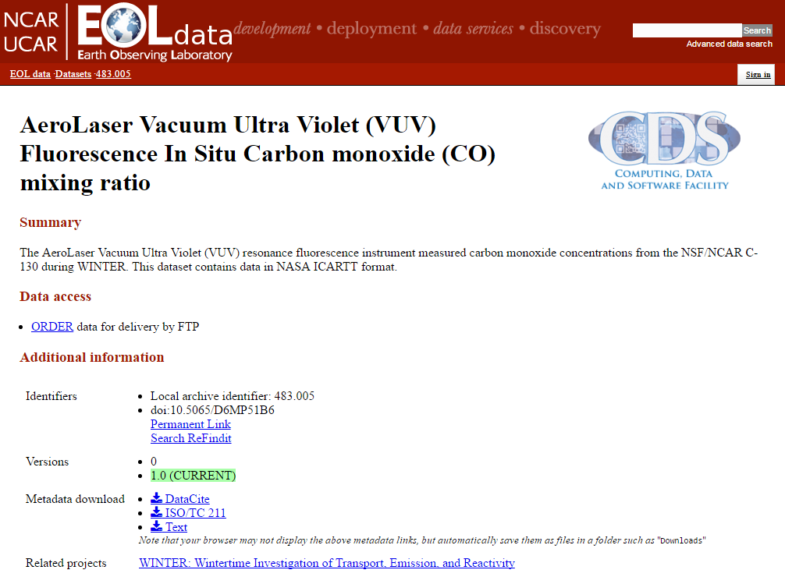
ORCAS DOI and Citation Information
DOI Metadata
Sample Citation

Slide 7
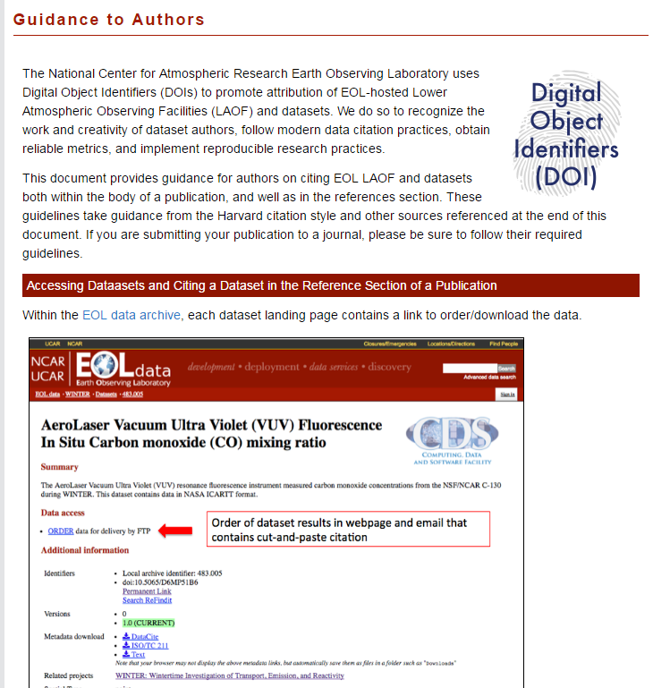
ORCAS Digital Object Identifiers (DOIs)
For Author Guidance:
https://www.eol.ucar.edu/content/DOI-guidance-to-authors

Slide 8
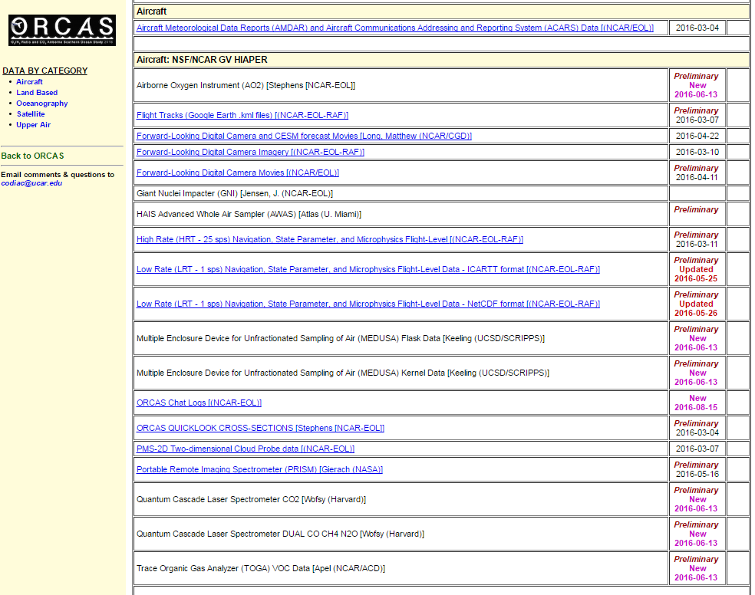
ORCAS Data Archive at NCAR/EOL
Linked on the ORCAS home page
Data organized by categories and sites
Includes operational as well as research data sets
Data sets and documentation linked as they become available
Notification of updates to data sets
Research data sets will be password protected as required by the ORCAS Data Policy

Slide 9
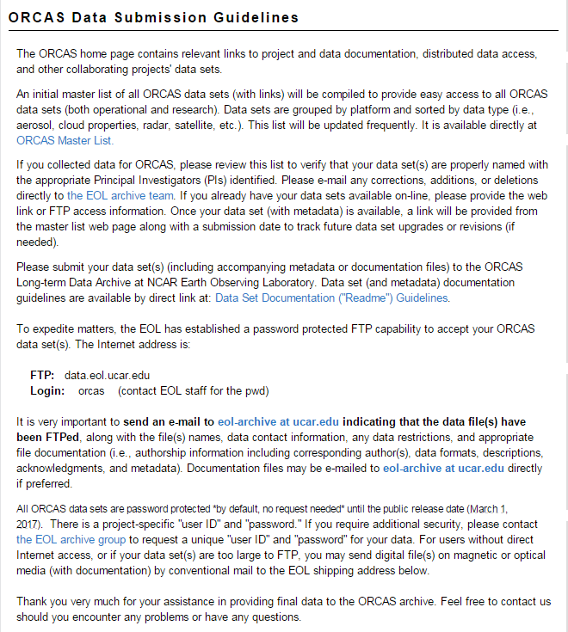
ORCAS Dataset Submission Instructions
Provides the instructions for submitting data to the ORCAS Data Archive after the field phase.
Important to send an email to eol-archive@ucar.edu when submitting data sets.
These instructions are different from those for uploading products to the field catalog.
There is no specified naming convention for data sets submitted to the ORCAS Data Archive.

Slide 10
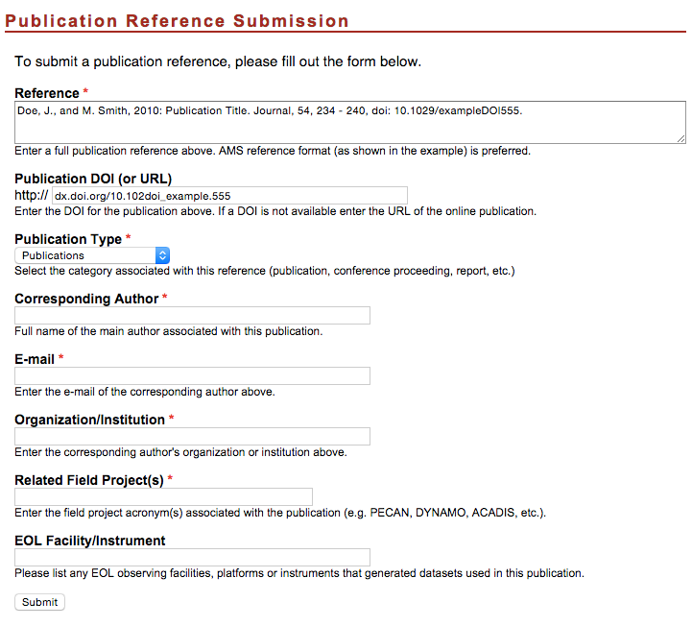
New Publication Submission Form
The first submission causes the Publications Page to be created – something we had to do manually before.
Submit a publication yourself or contact us.

Slide 11
ORCAS Publications Library
Will provide links to all ORCAS publications
Includes refereed papers, conferences, reports, and theses.
Needs the input of investigators.
Can also include papers in submission stage (via password protection) if desired.

Slide 12
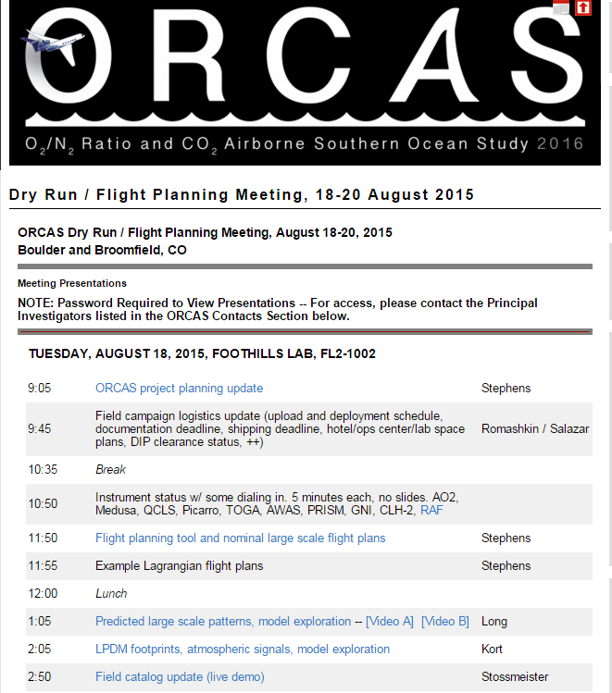
…. Finally, please provide Britt with a final copy of your PPT presentation for this Meeting.
A PDF and/or PPSX copy will be posted on the ORCAS web site (password protected)

Slide 13
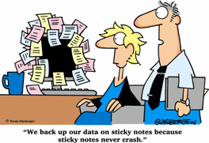
Thank you!
Questions?
https://www.eol.ucar.edu/field_projects/orcas
Linda Echo-Hawk (echohawk@ucar.edu), Greg Stossmeister (gstoss@ucar.edu), Scot Loehrer (loehrer@ucar.edu),
and Linda Cully (cully@ucar.edu)

