Slide 1
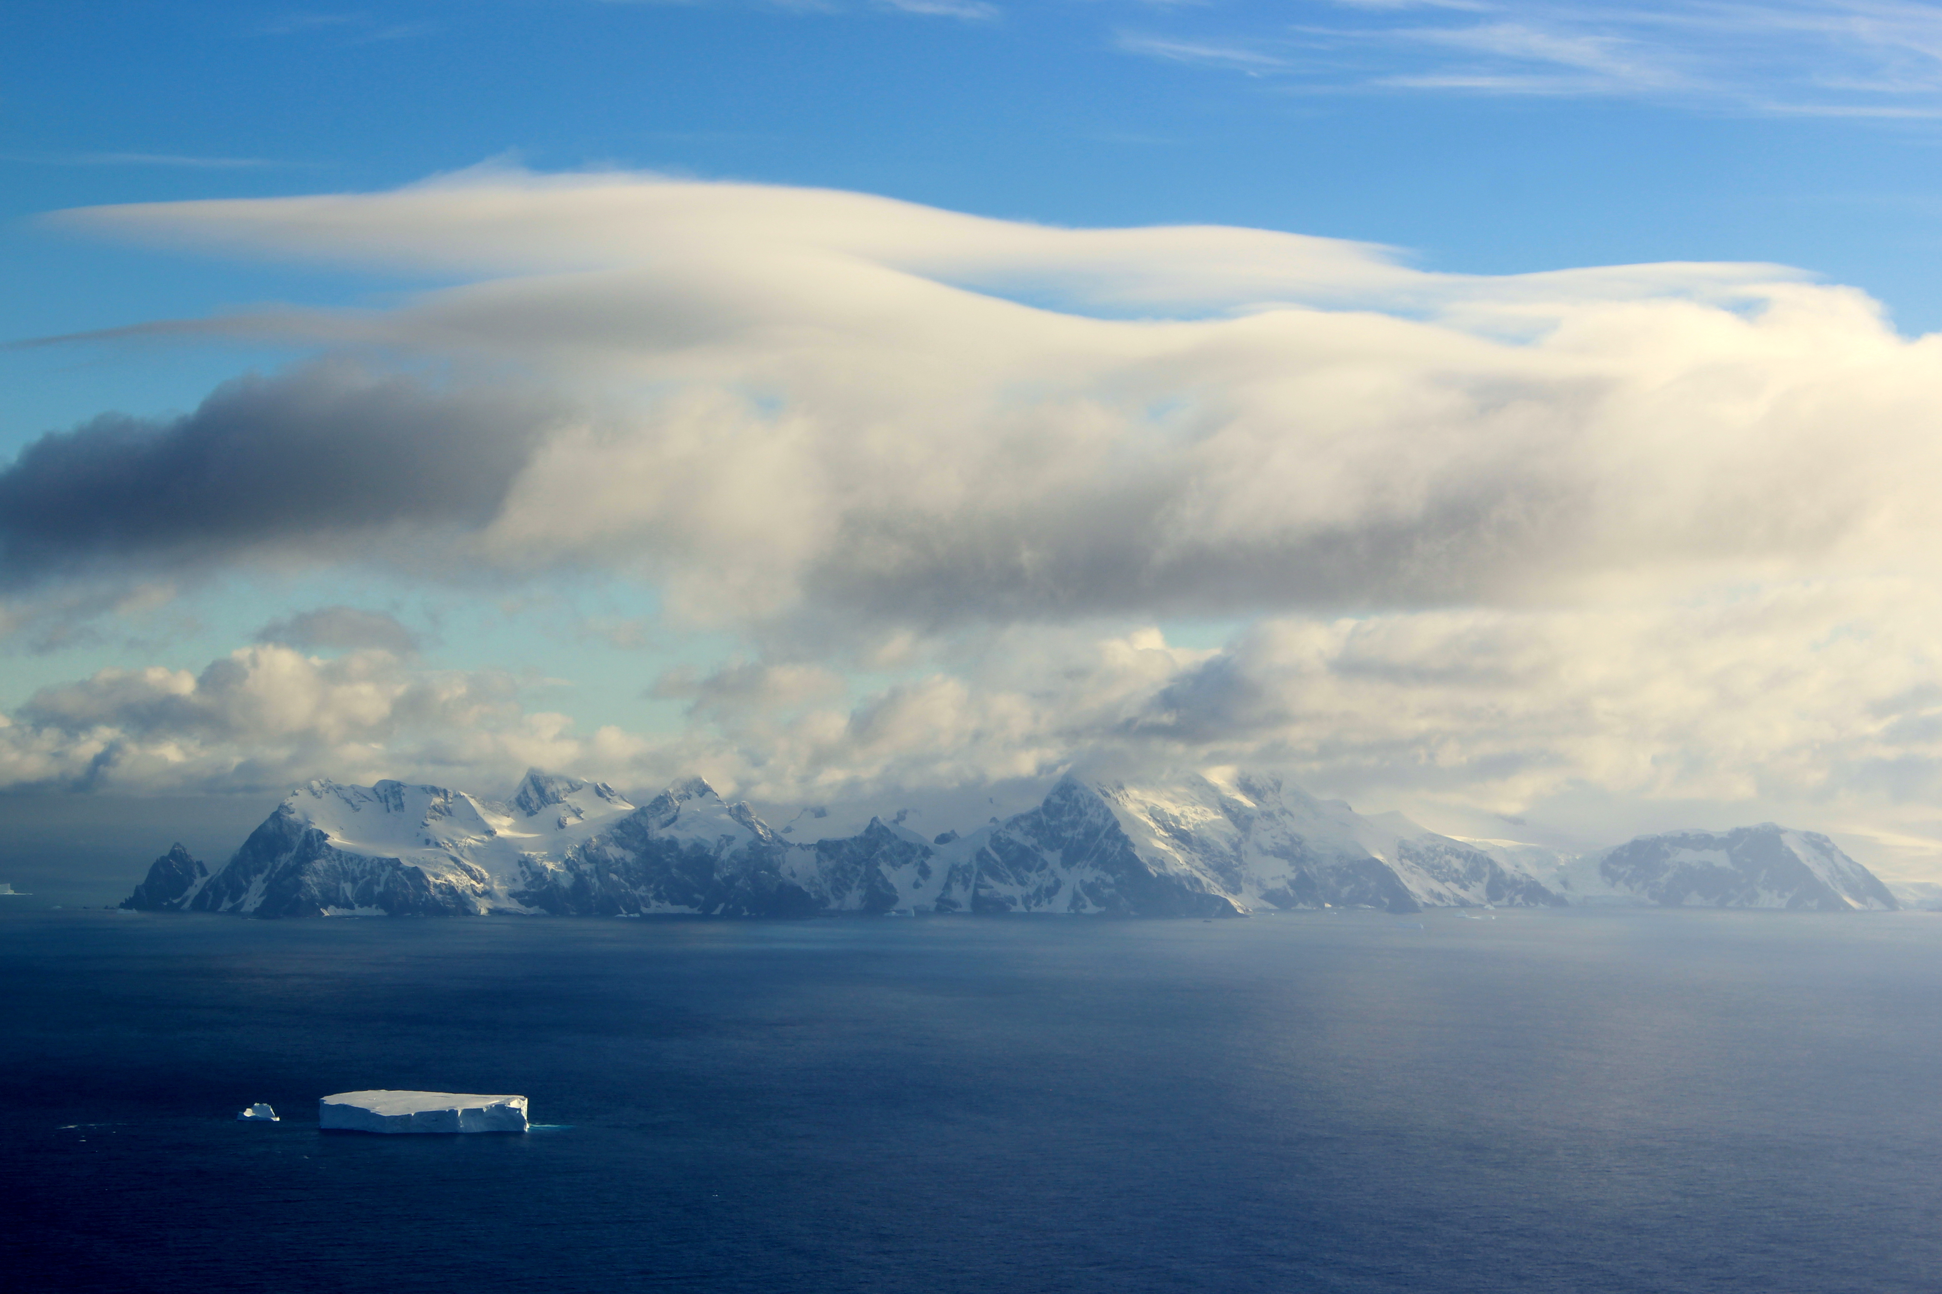
GV Flight Level Data
Cory Wolff
ORCAS Science Meeting
7 September 2016

Slide 2
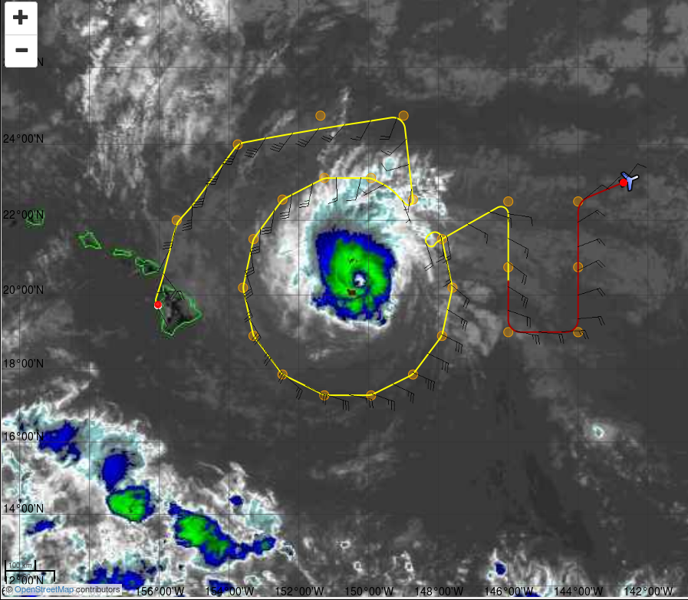
Summary
Release of LR data
Coming soon
Overall, good data quality
Some minor, recurring issues
Topics
Fast response temperature
Dew points
King probe
Missing flights
CN counter
Winds

Slide 3
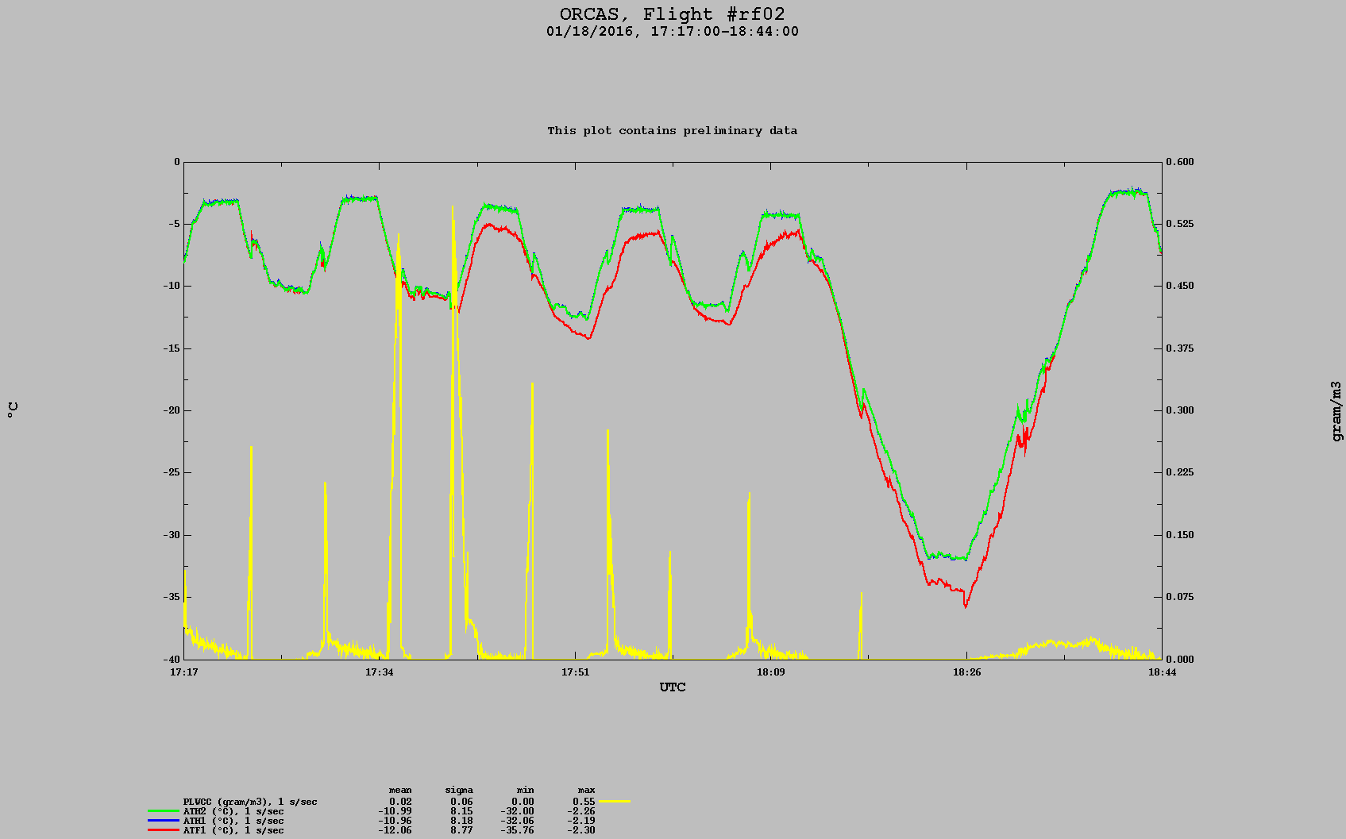
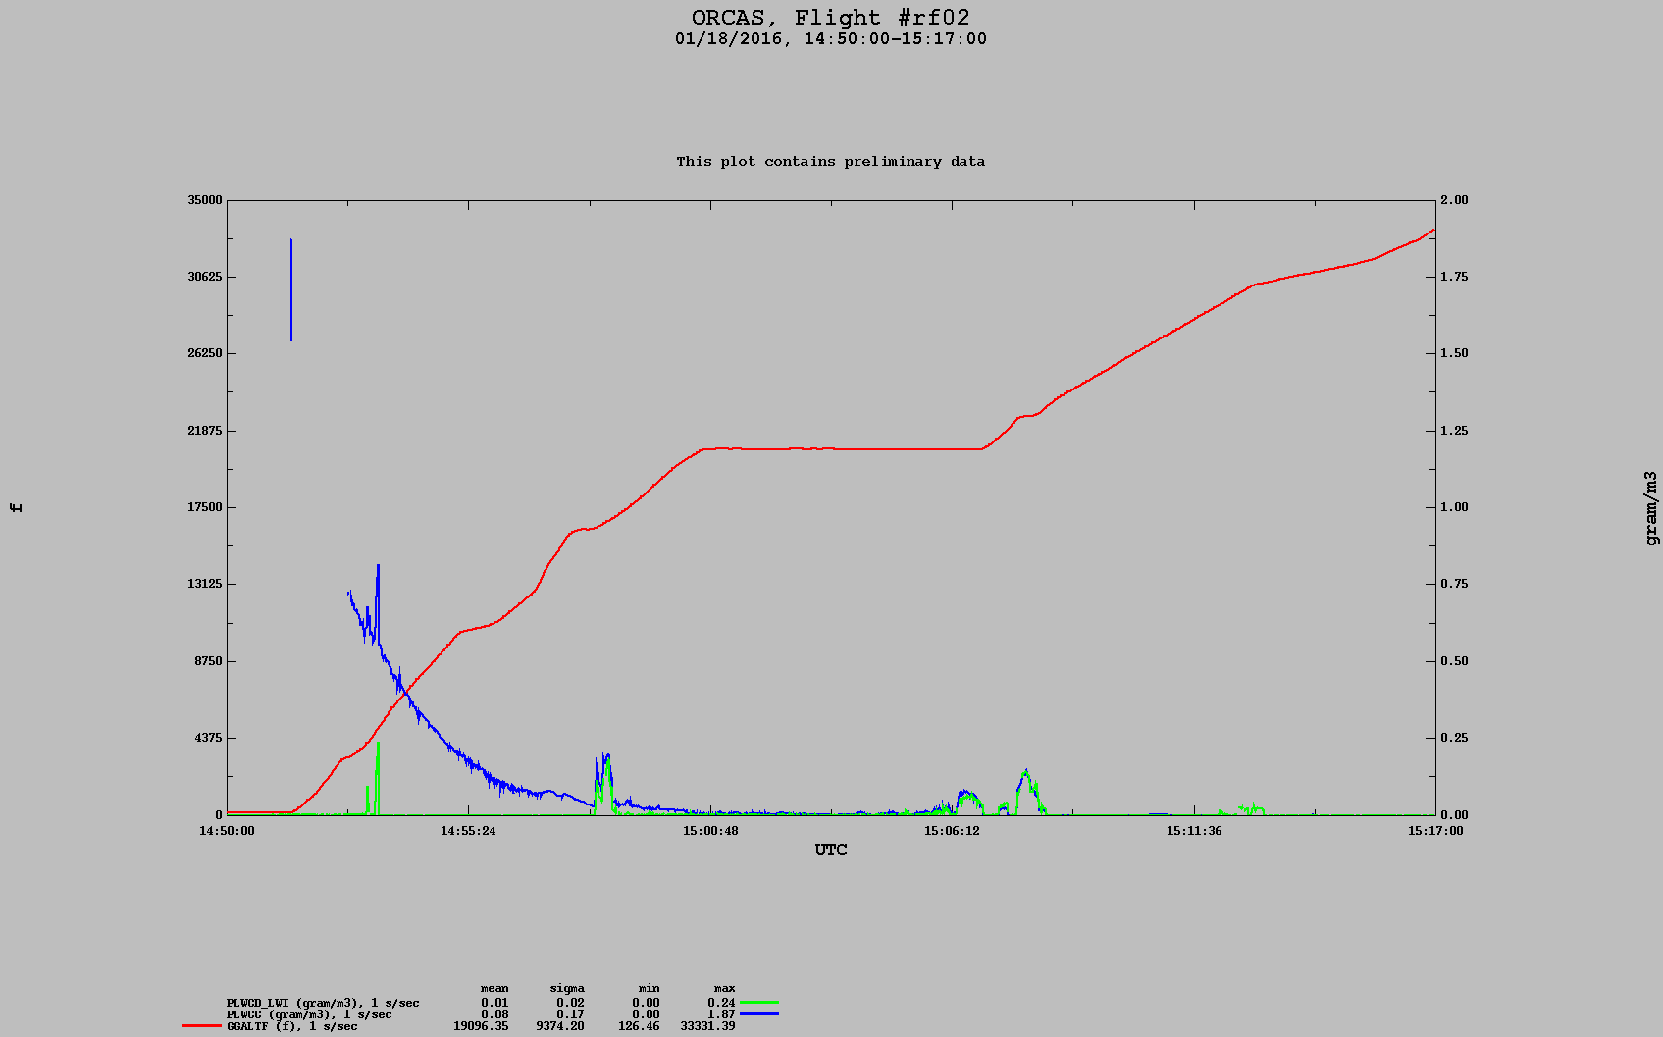
Fast response temperature
Some icing problems
King probe
Showed cloud at start of each flight before correcting
Looking into this, data removed

Slide 4
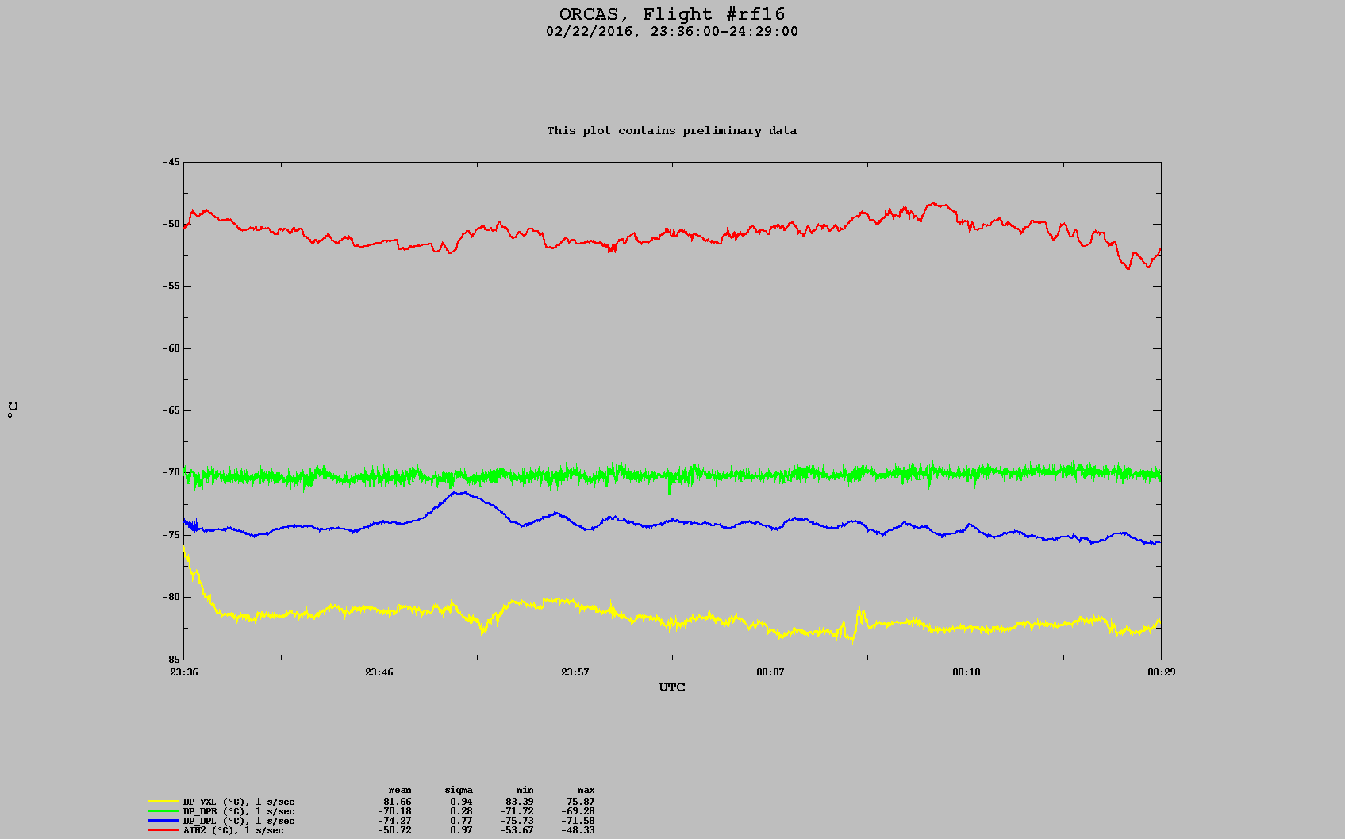
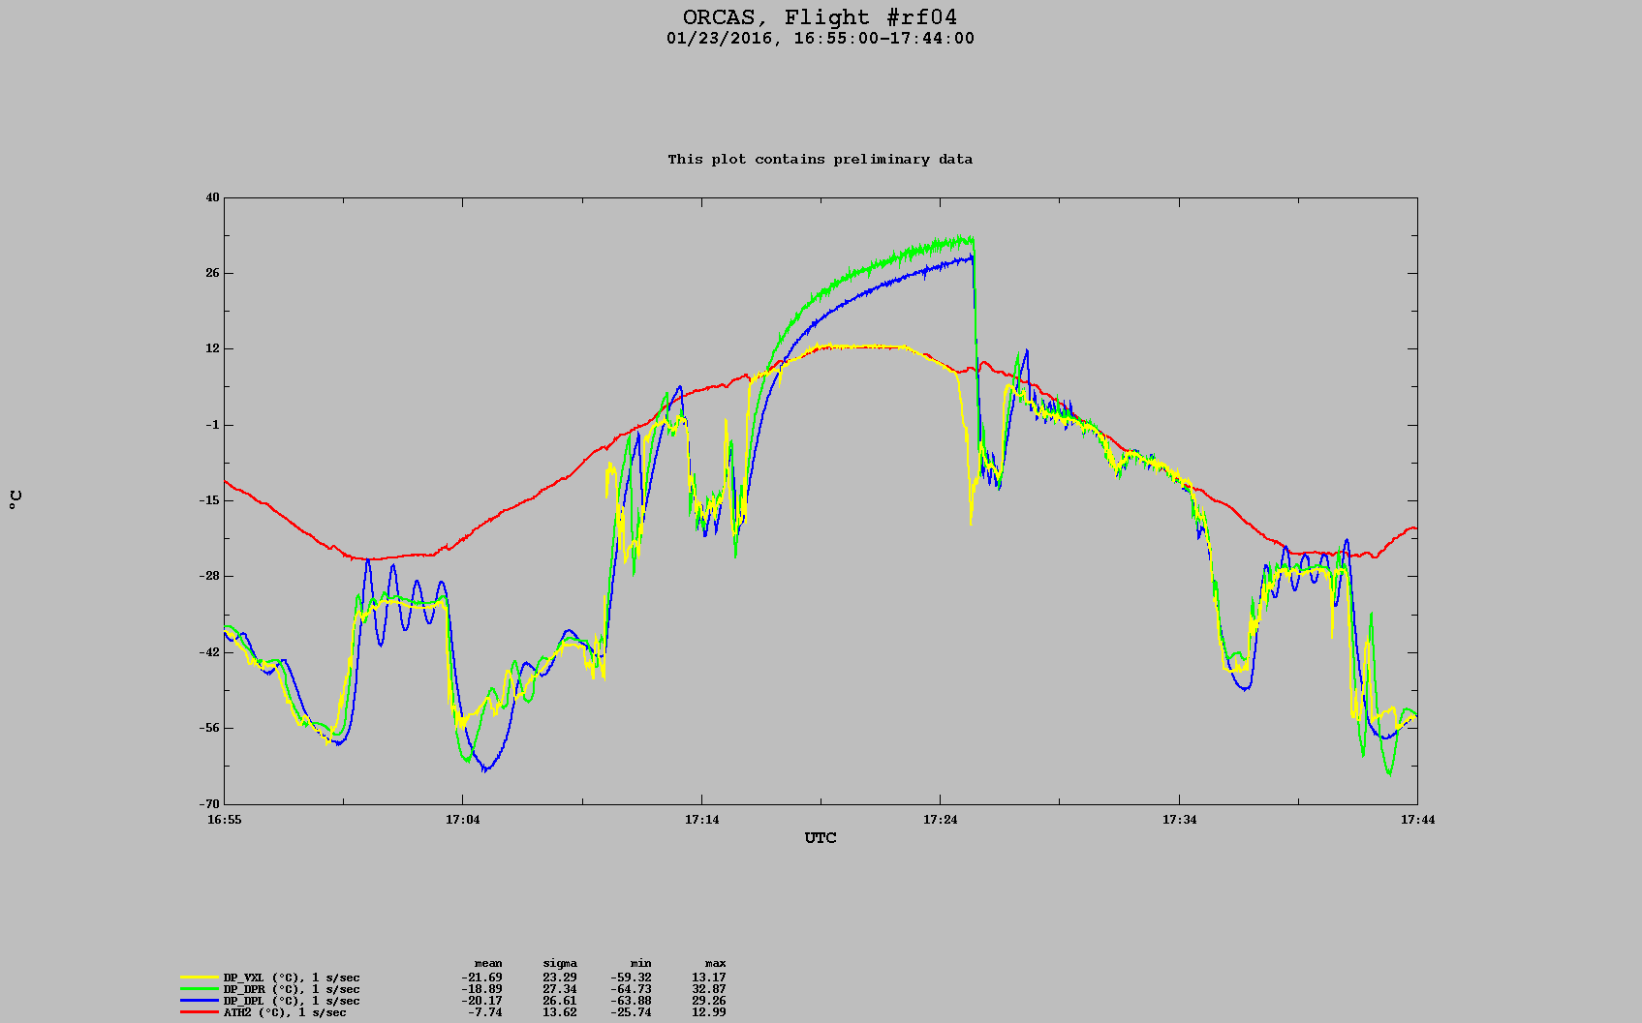
Dew points
Mirror instruments have known issues
Can’t hit low dew points
Oscillations
Flooding on descents
DPL missing until RF04

Slide 5
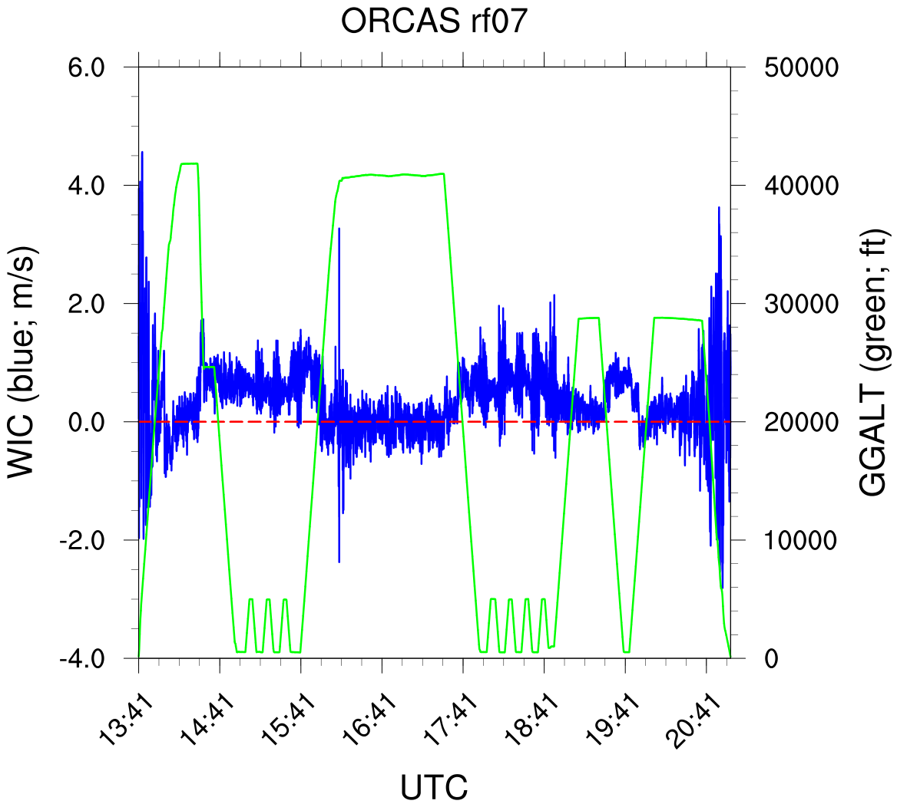
Flights with no data
Timeserver sync issue
All of RF12; half of RF13 (evacuation and return)
Winds
Drift in WIC
Ongoing issue
Apply corrections based on altitude
CN Counter
I/O card failure
Missing RF02 - RF06
Becomes increasingly inefficient above 300 mb (~9 km) and undercounts particles
Effect is size dependent and can’t be corrected for

Slide 6
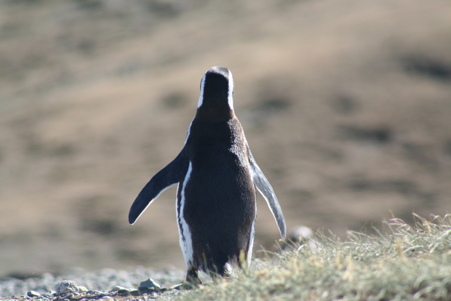
Questions?

