Slide 1
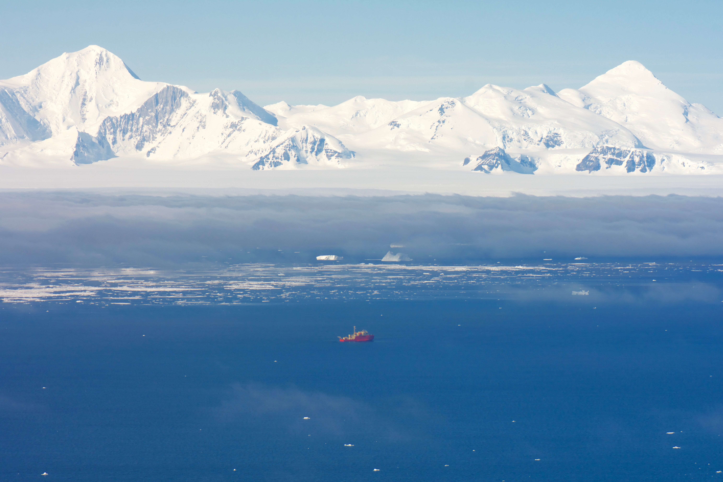



Evidence that Palmer Station Antarctica Seasonal O₂ and CO₂ Cycles Understate Regional Marine Boundary Layer Means
Jonathan Bent
NCAR Earth Observing Laboratory
Contributions from: Britt Stephens, Ralph Keeling, Eric Morgan, Andy Watt
Sara Mikaloff Fletcher, Prabir Patra, and ocean modelers enumerated later

Slide 2
Palmer Station, Antarctica (PSA)
Cape Grim Observatory, Tasmania (CGO)
O₂ and CO₂ Records
Seasonal Cycle O₂ ≈ 10 x CO₂
Seasonal Amp ≈ 1.5ppm

Slide 3
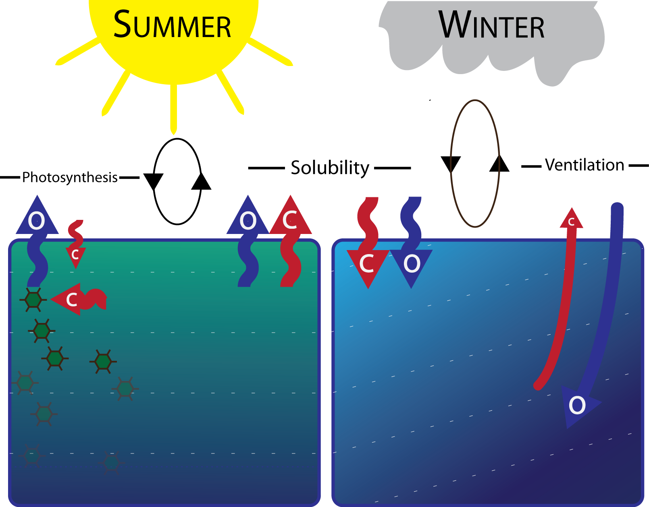
Southern Ocean Air-sea Exchange

Slide 4
Atmospheric Potential Oxygen
APO ≈ O₂ + 1.1*CO₂
Effectively removes land biosphere influence on C cycle, especially useful in open-ocean Southern Hemisphere regions
Reported in “per meg”, equivalent to per mil, but multiplied by 10⁶
1 ppm is ~ 5 per meg

Slide 5
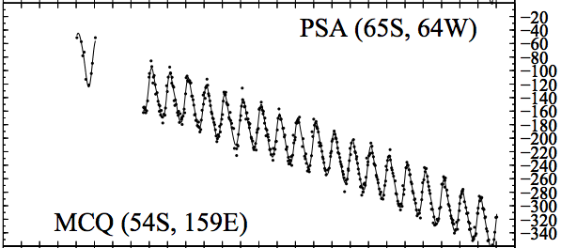
Palmer Station APO Data
1996
HIPPOs
1 2 3 4 5
Gould
ORCAS

Slide 6
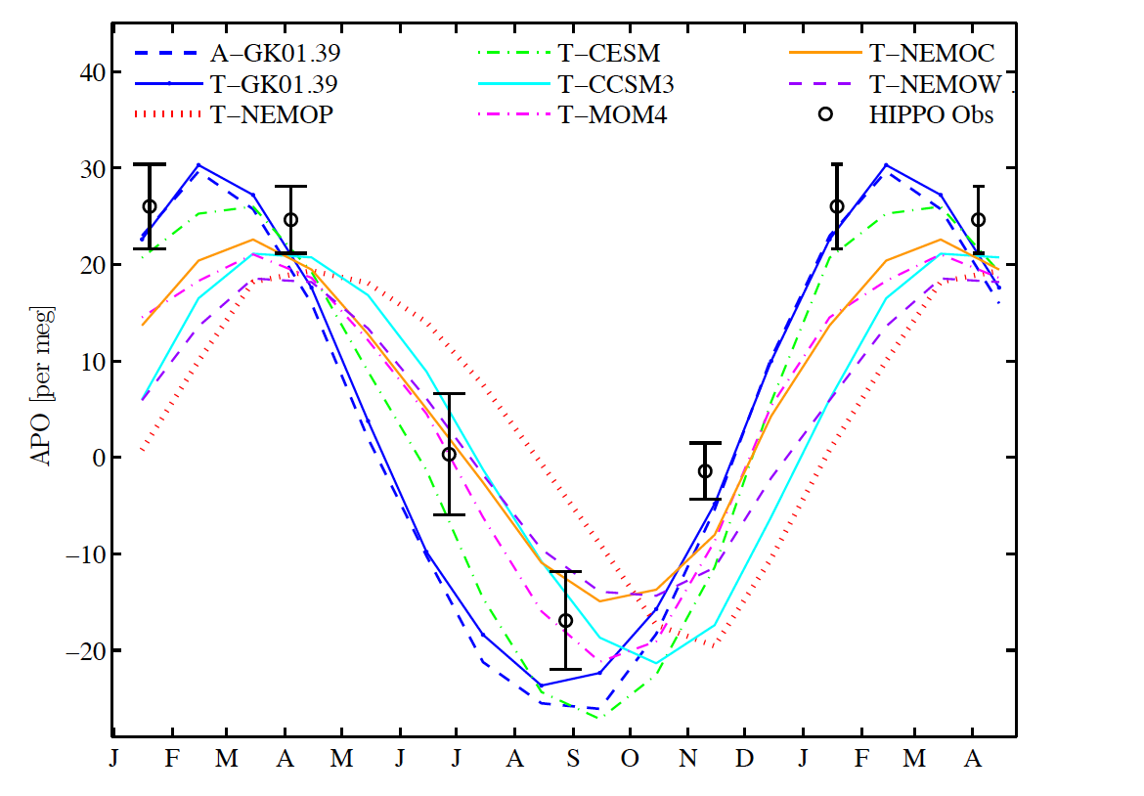
Curtain (Column) Average

Slide 7
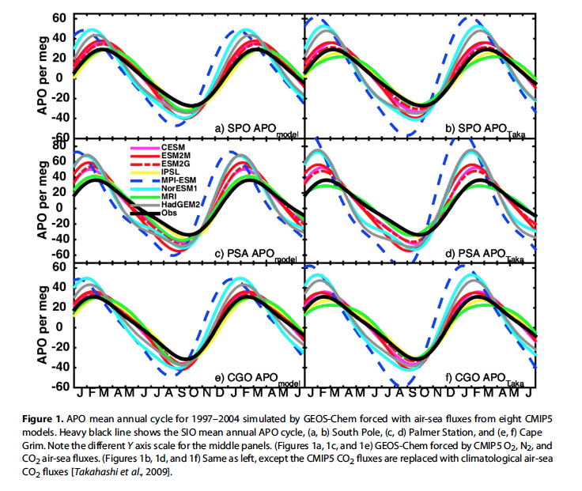
Potential evidence that PSA measurements are not capturing seasonal amplitude
Nevison, 2016 GRL

Slide 8
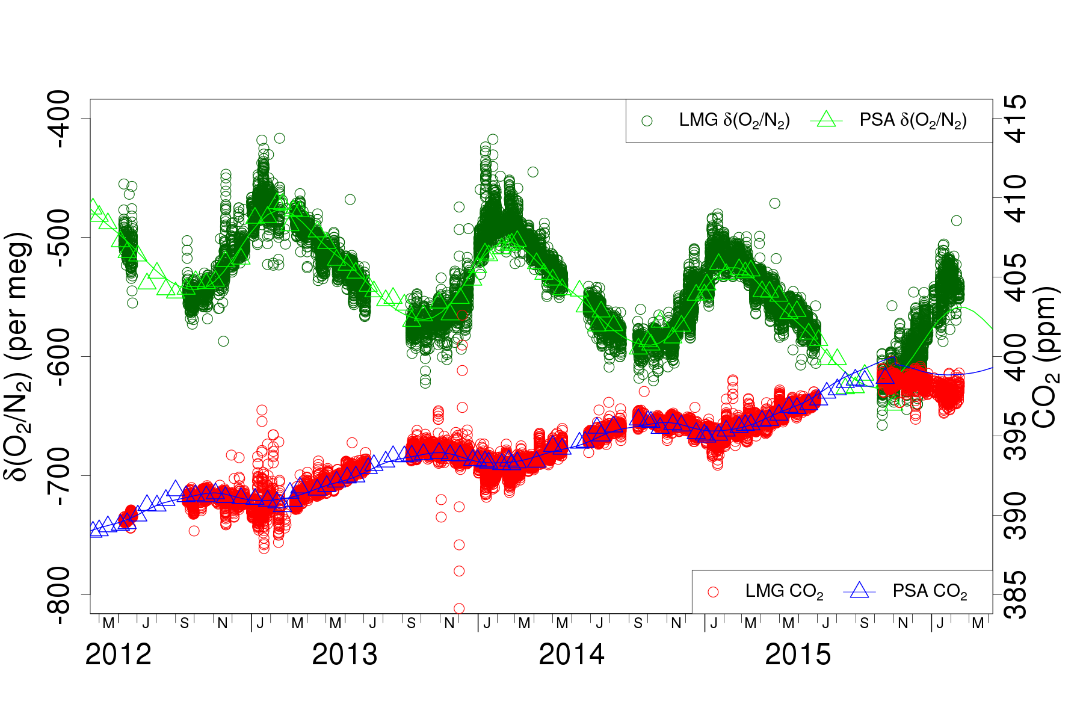
Gould O₂ Data
Peak
Nadir
Figure: B. Stephens
Notes:
----- Meeting Notes (4/24/16 13:02) -----
Get the exact difference at the peak
fit the Gould o2 data with 2 harmonics

Slide 9
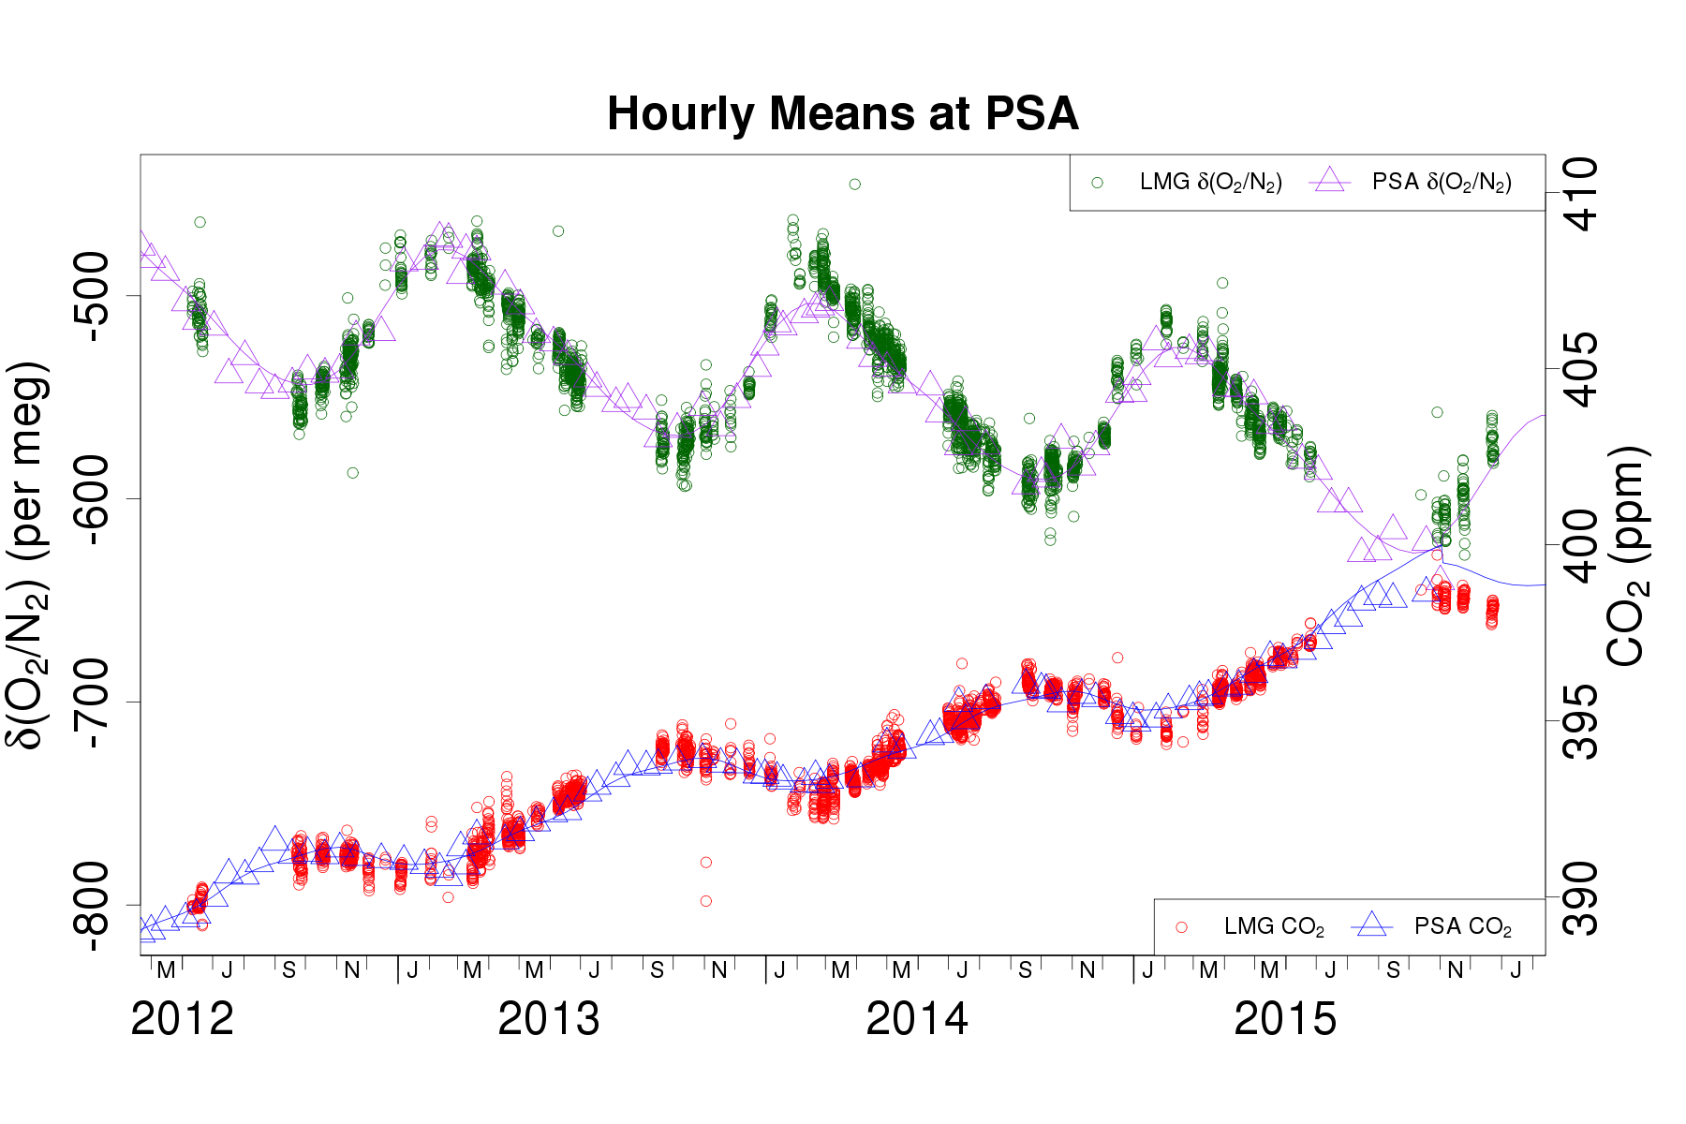
O₂, CO₂ data at Palmer Station only

Slide 10
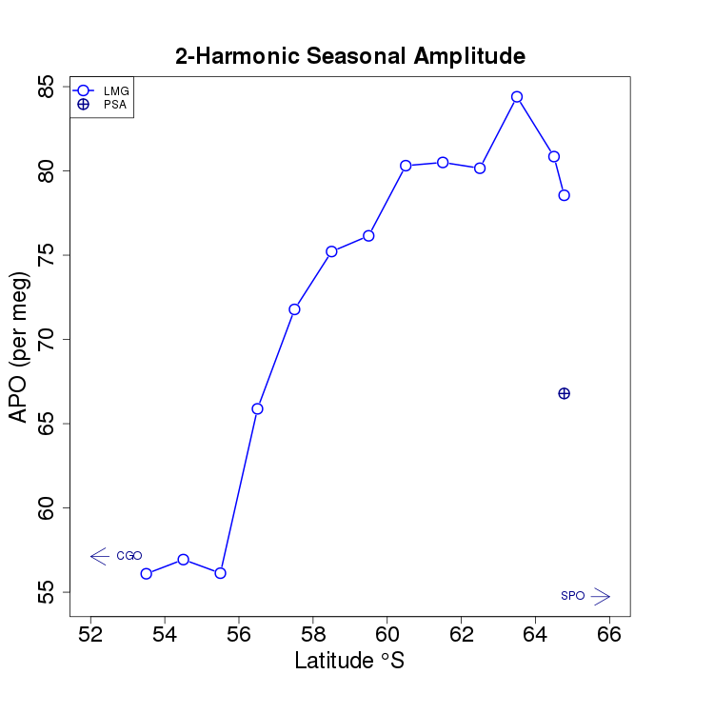
How Palmer Station amplitude compares against other latitudes
Figure: B. Stephens

Slide 11
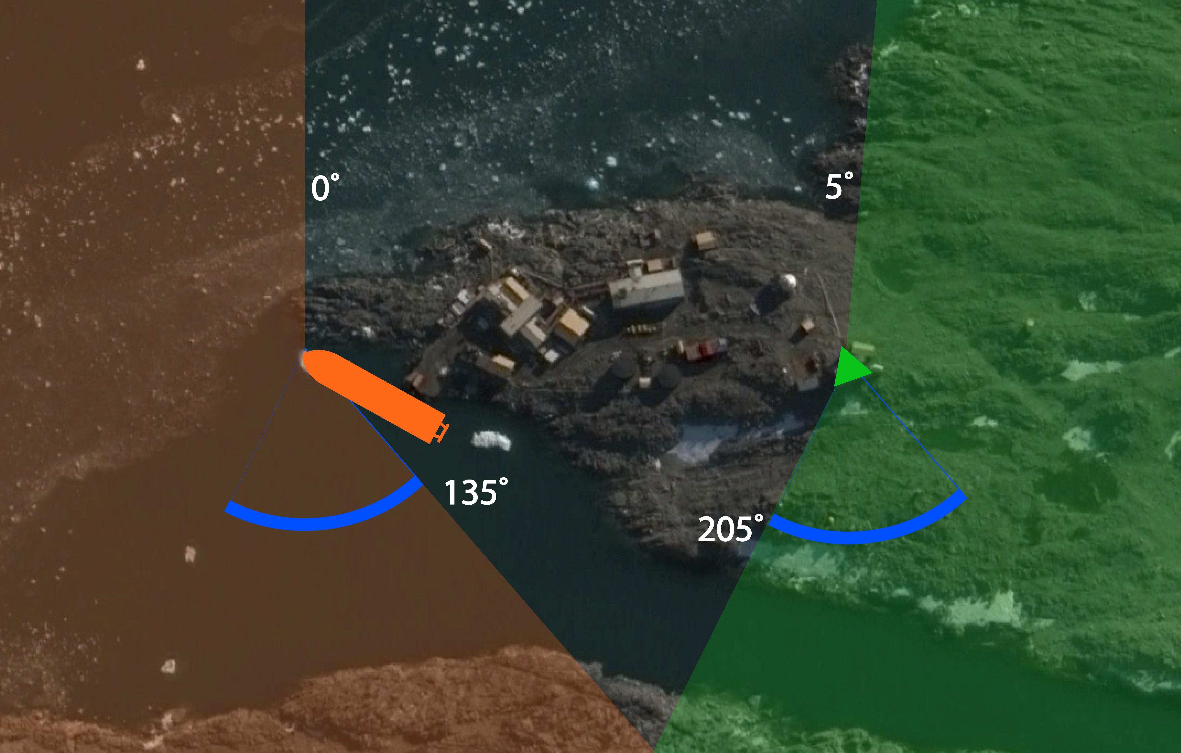
Spheres of wind influence:
RV Gould and Palmer Station

Slide 12
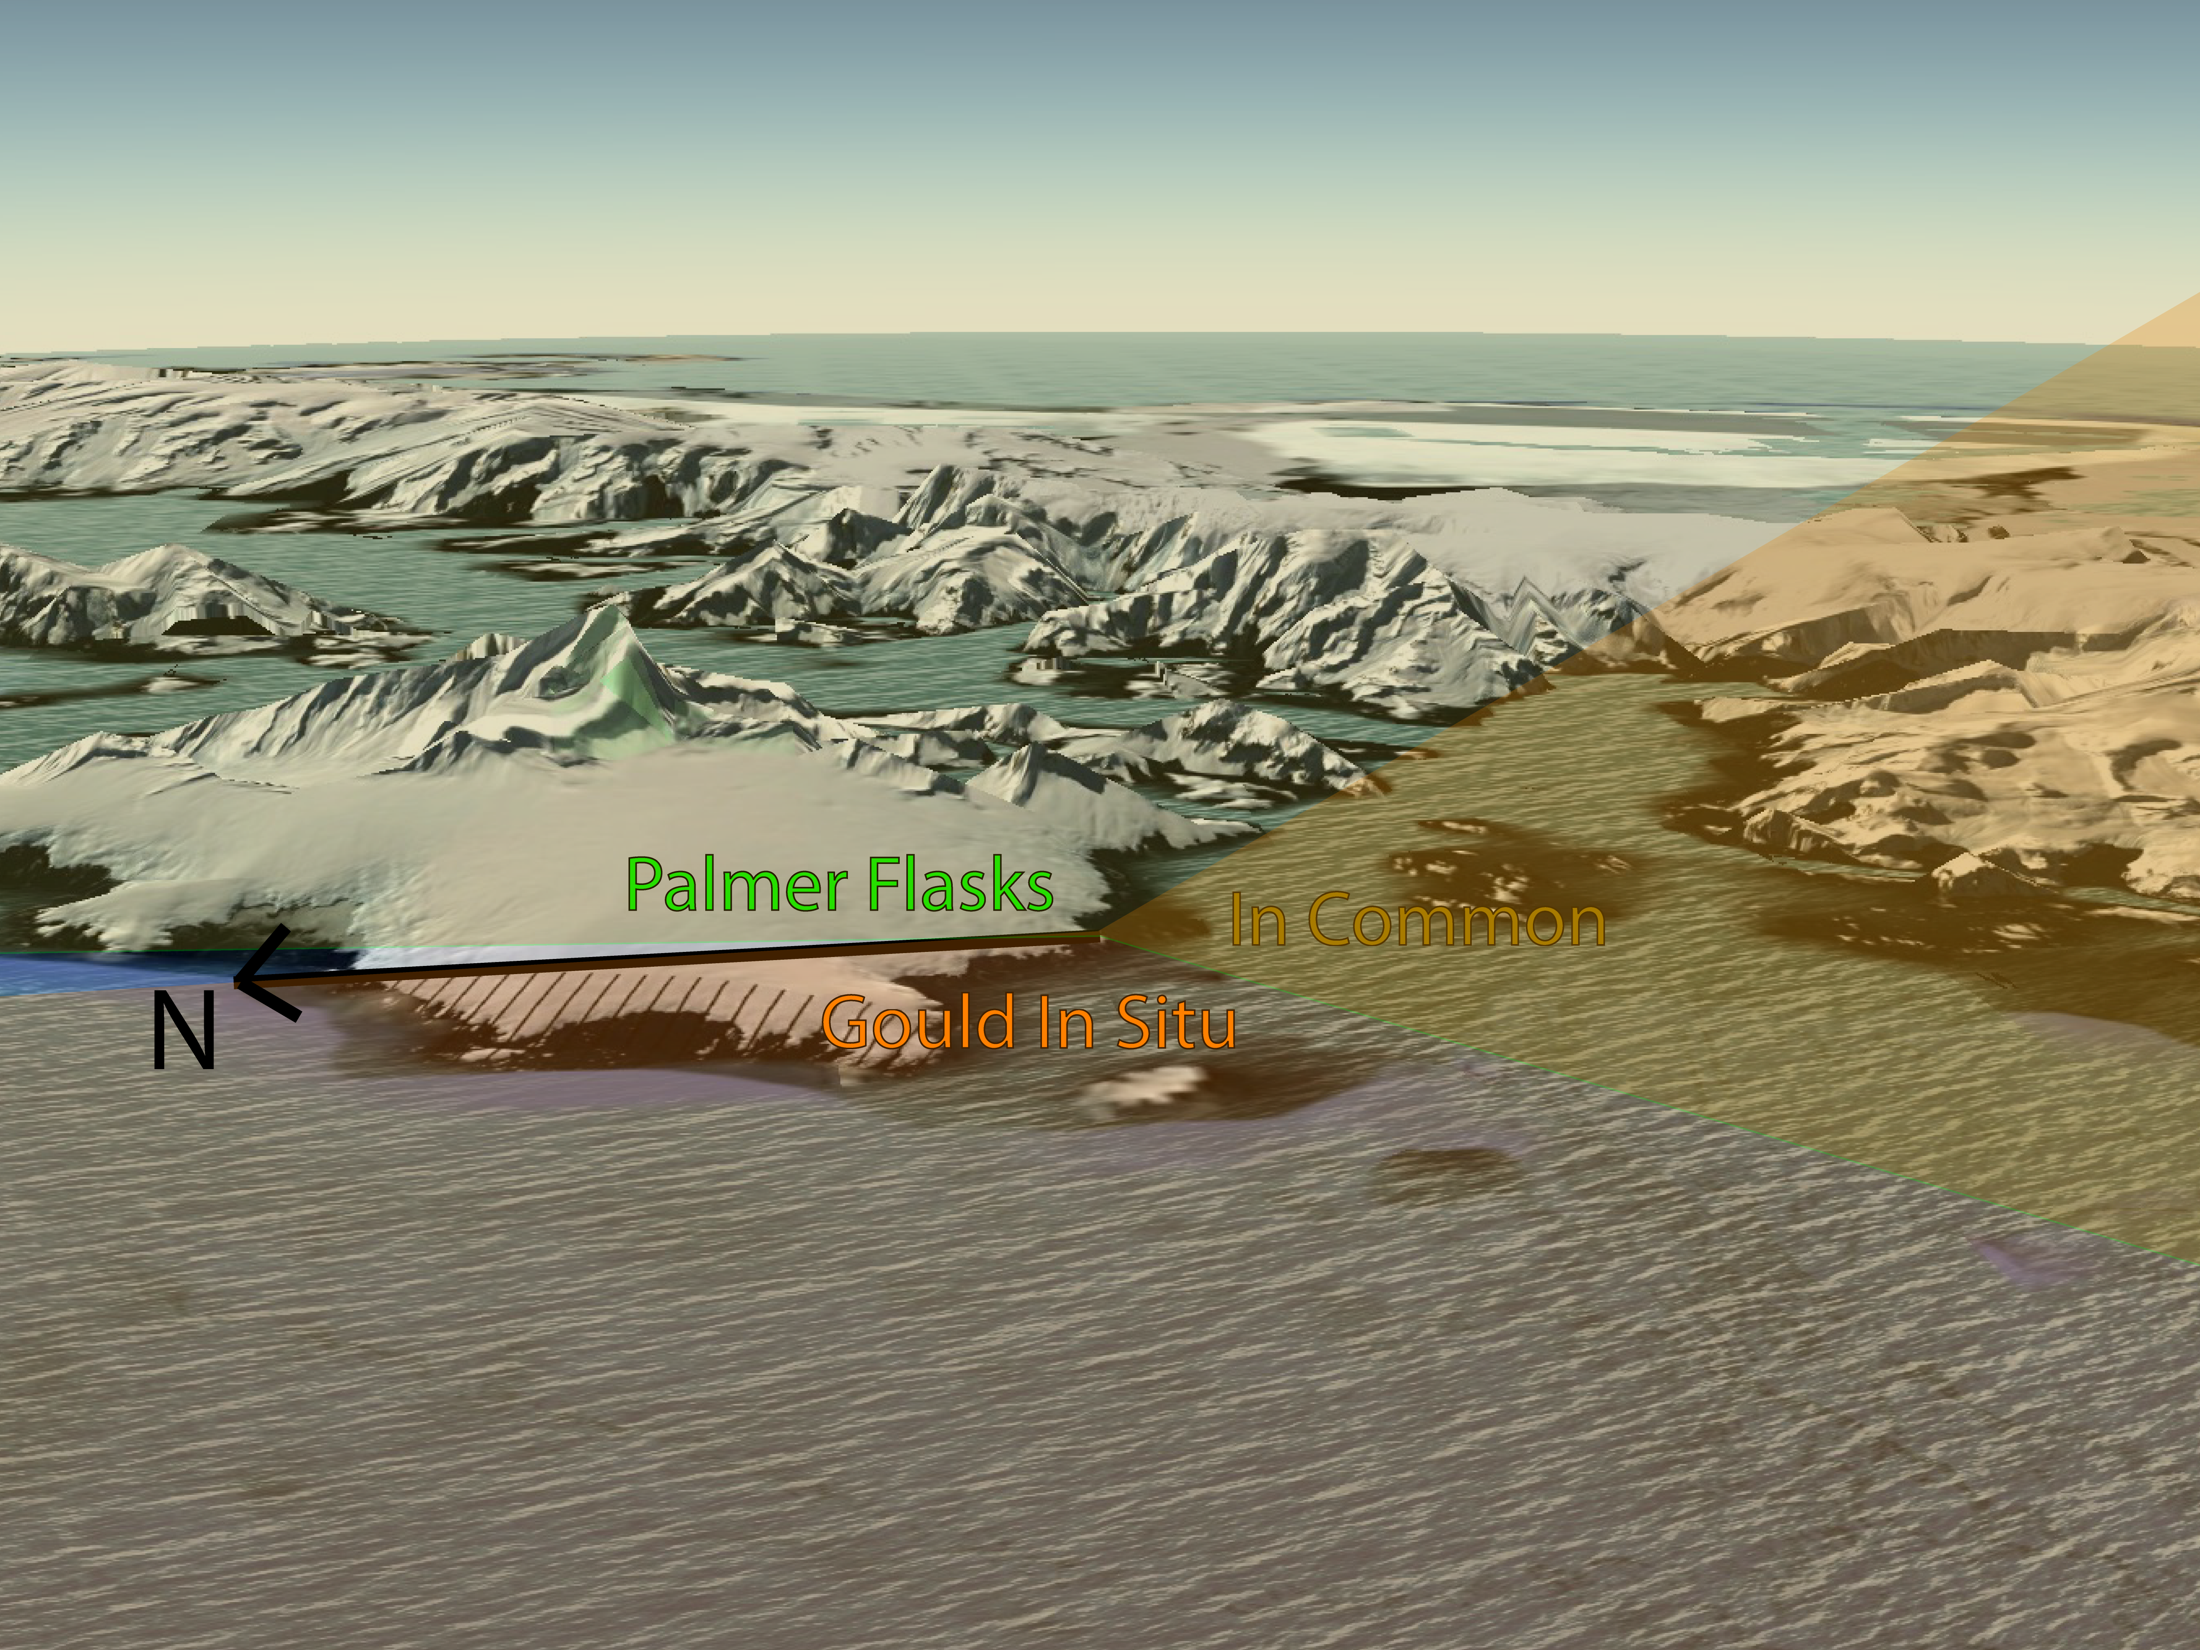
Why does it matter if air is coming from E or W? Topography

Slide 13
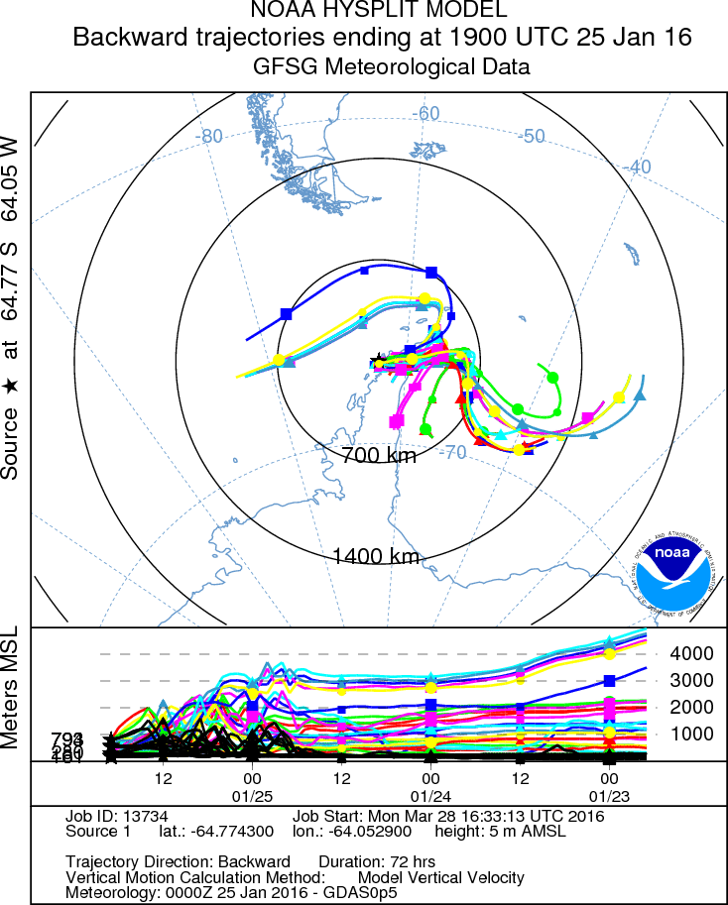
HYSPLIT back trajectories
ORCAS
RF01
ORCAS
RF06

Slide 14
Gould O2 Data
Figure: B. Stephens

Slide 15
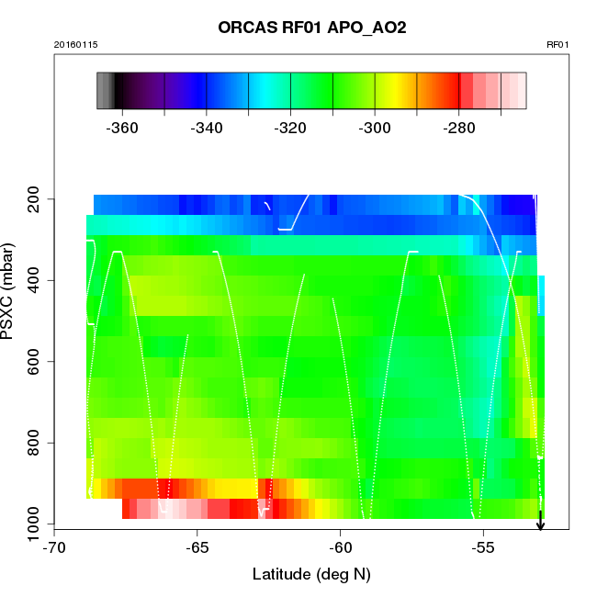
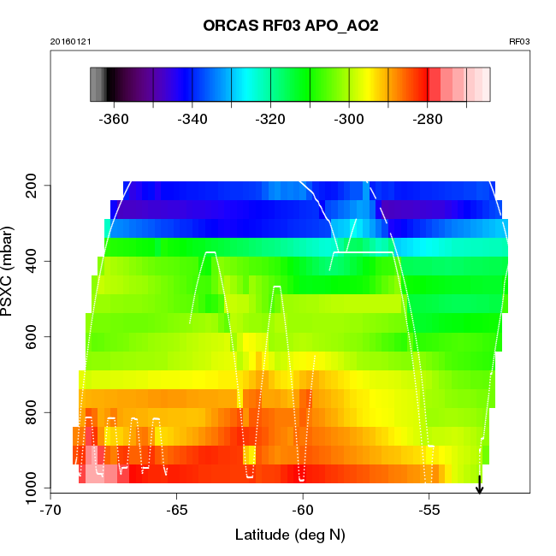
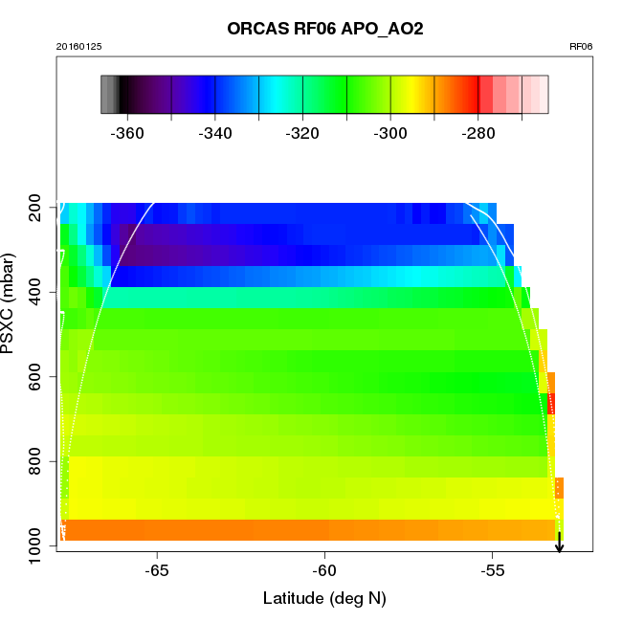
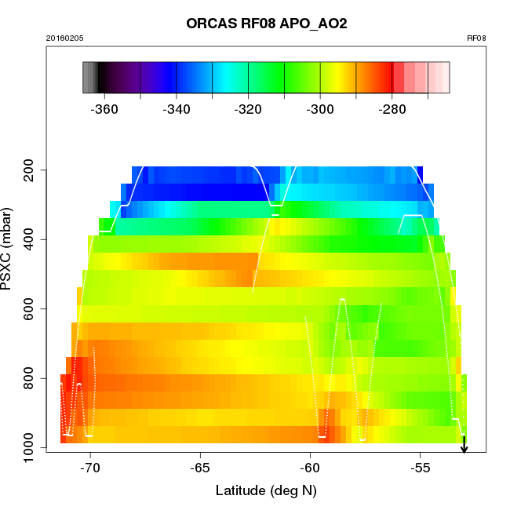
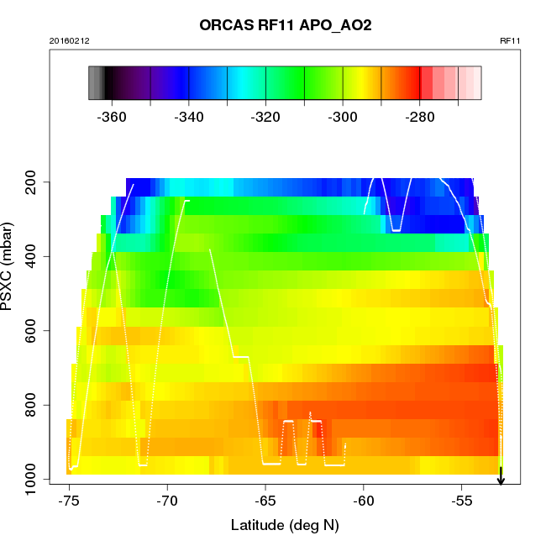
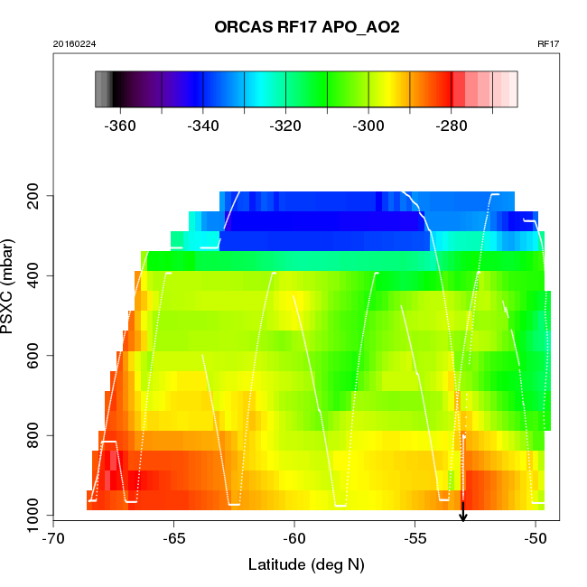
ORCAS RFs that include data at 64S

Slide 16
ORCAS and HIPPO data (detrended)
Asterisks: “b” flask samples near time of ORCAS flights.
Orange: Gould; Green: Palmer Flasks
~12 km
~8 km
~4.5 km
~1 km

Slide 17
Adjusted up/back…
Nevison, 2016 GRL

Slide 18
Conclusions, future steps
Gould APO data has ~20% larger p2p amp then Palmer Station flasks
Differences most pronounced at seasonal peak (austral summer)
Samples are collected in very different wind domains
Back trajectory analysis shows very different source altitudes/regions and that associated topography has a large effect on whether sample air comes from the MBL or deep troposphere
Difference most pronounced in austral summer because vertical gradient is most pronounced at this point in time
ORCAS and HIPPO data preliminarily support the theory that boundary layer height differences and intensity of fluxes influence how far Palmer flasks are from MBL conditions
STILT simulations to determine influence function
Possible influences from E and W domains, including ice cover in Weddell and cold air at surface? Resolvable?
Other suggestions?

Slide 19
Acknowledgements
NSF
Britt Stephens, Ralph Keeling (co-advisors, collaborators)
Eric Morgan, Andy Watt (collaborators)
Sara Mikaloff Fletcher (NIWA) for TM3 runs
Prabir Patra (JAMSTEC) for ACTM runs
Keith Rodgers, Olivier Aumont, Matt Long, Corinne LeQuere, Scott Doney, John Donne for Ocean Model Output

