Slide 1
Ocean “mixed” layer dynamics in the Southern Ocean
Dan Whitt and Matt Long
dw494@cam.ac.uk

Slide 2
Dynamics
Biogeochemistry
Atmospheric dynamics
Atmospheric composition &
chemistry
Atmosphere
Air-sea momentum and buoyancy fluxes
Air-sea flux of geochemical constituents
A multitude of relevant processes.
Interface
Ocean dynamics
Ocean biogeochemistry
Ocean

Slide 3
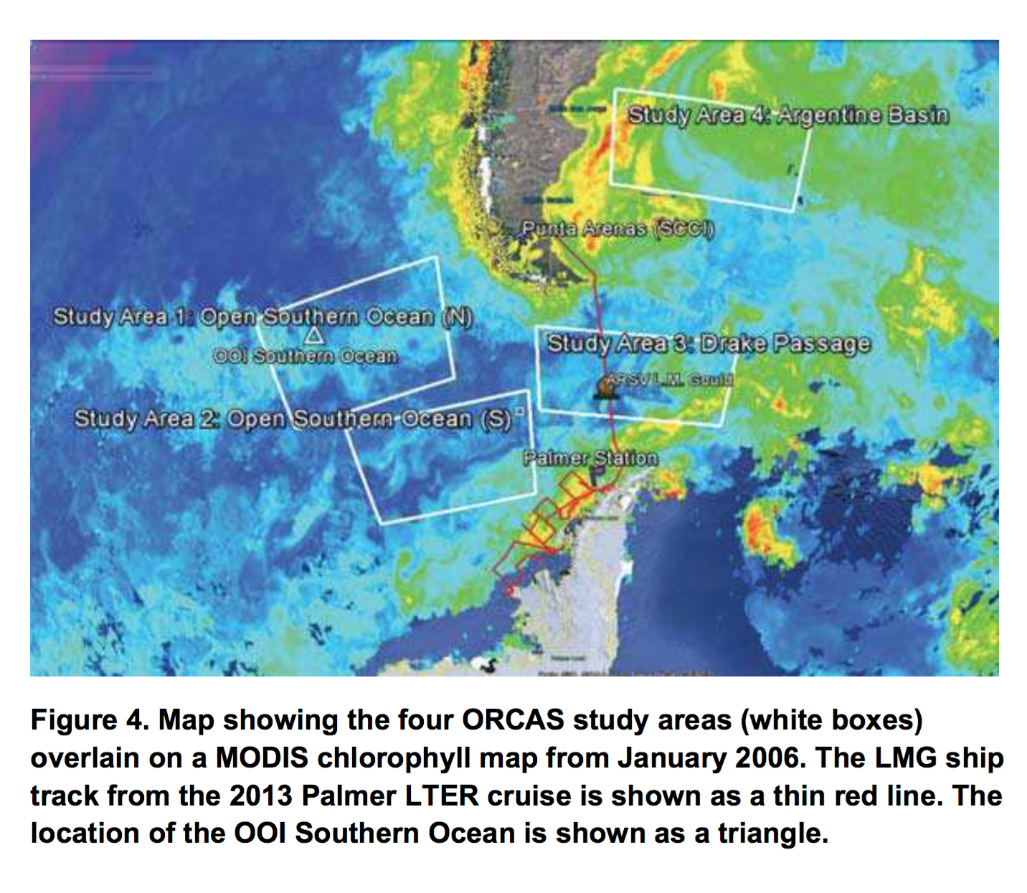
Earth system challenge
Characterize and understand air-sea CO2 and O2 fluxes in the study area and more broadly.
A wide range of space and time scales.

Slide 4
My goals
Characterize O2 and CO2 budgets in ocean mixed layer of 0.1º and 1.0º ocean/biogeochemical simulation (CORE normal year forcing)
Understand the dynamics of the budgets in the models.
Collaborate to help develop understanding of budgets and fluxes in the real world using obs. & models
Air-sea momentum and buoyancy fluxes
Air-sea flux of geochemical constituents
e.g. O2/CO2
Air-Sea Interface
Ocean dynamics
Ocean biogeochemistry
Ocean surface boundary layer

Slide 5
What dynamics are relevant?
Atmospheric physics: momentum and buoyancy fluxes magnitudes, signs, temporal and spatial scales of variability
Ocean ecosystem dynamics: nutrient (Fe/Si/N) and grazing limitations on phytoplankton growth/accumulation/community composition, sinking (and light, but not in summer)
Ocean physics: temperature, currents, vertical circulation, fronts, turbulent mixing and entrainment

Slide 6
Unpacking the ocean surface “mixed” layer
What is an appropriate definition? What is the time scale over which tracers & momentum are homogenized across the layer?

Slide 7
Unpacking the ocean surface “mixed” layer
Math for any arbitrary reactive tracer N, and boundary layer depth H
Easier to interpret with a dynamically relevant H

Slide 8
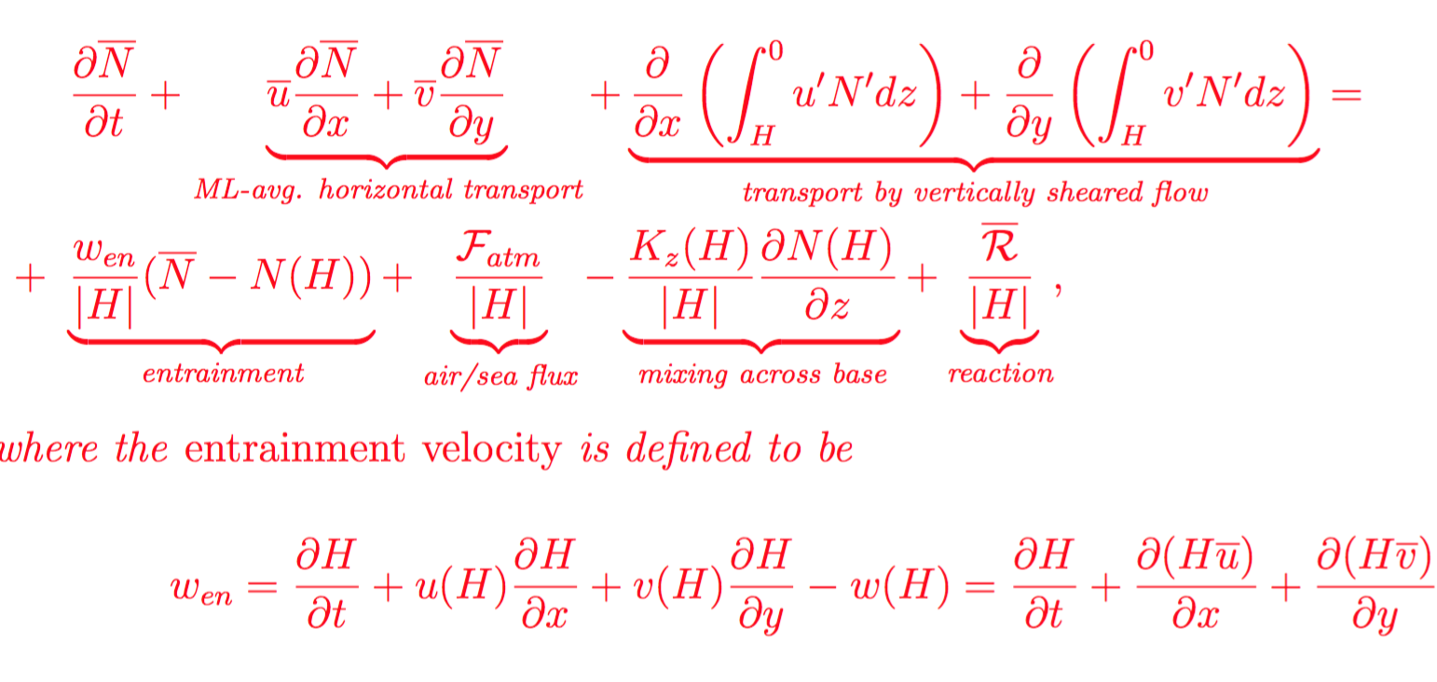
Unpacking the ocean surface “mixed” layer
Depth average over boundary layer
Perturbation from depth avg.
Negative w_{en} <-> water entrained into the boundary layer from below
Positive w_{en} <-> water detrained from the boundary layer to the interior

Slide 9
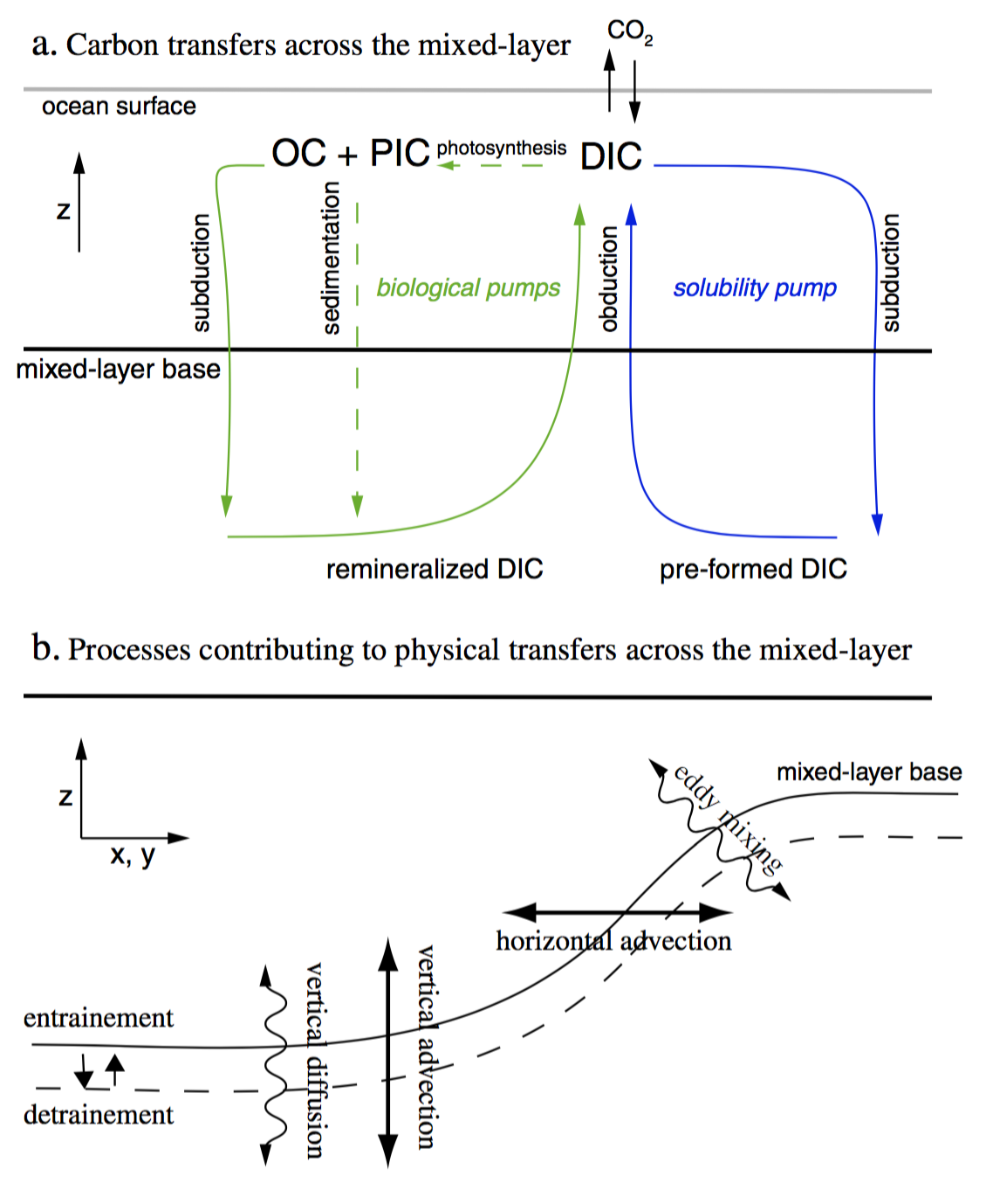
Levy et al. 2013

Slide 10
Unpacking the ocean surface “mixed” layer
Each term will receive an in-depth analysis:
Horizontal transport: Ekman transport (wind?), intrinsic mesoscale variability (topographic features, instabilities?), larger scale geostrophic flows
Entrainment/Mixing at ML base: air-sea physical fluxes, stratification & tracer concentrations in the pycnocline, KE/shear at ML base.
Air-sea flux
Ecosystem reactions: what are phytoplankton growth and loss rates, export, grazing rates, limiting nutrients, etc. Understand different physical/biogeochemical regimes

Slide 11
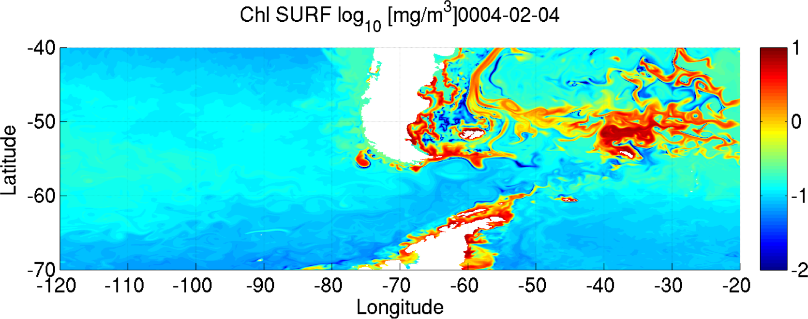
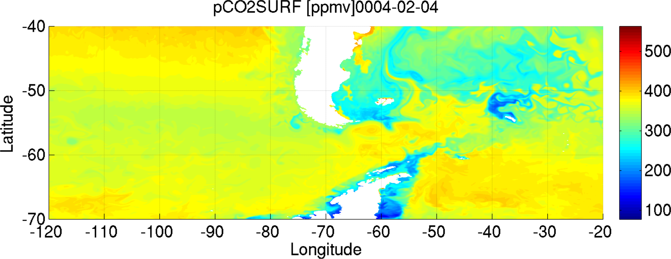
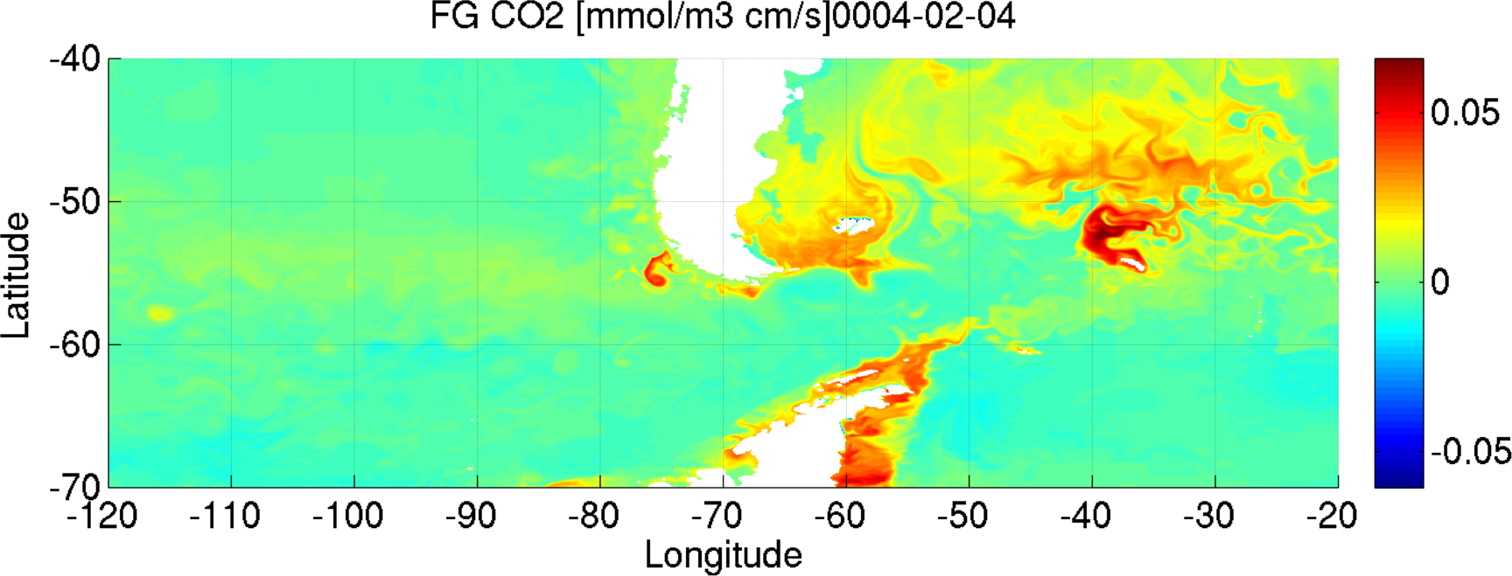
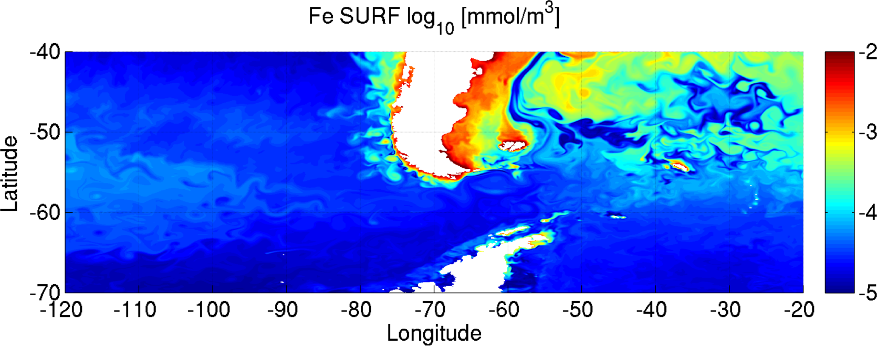
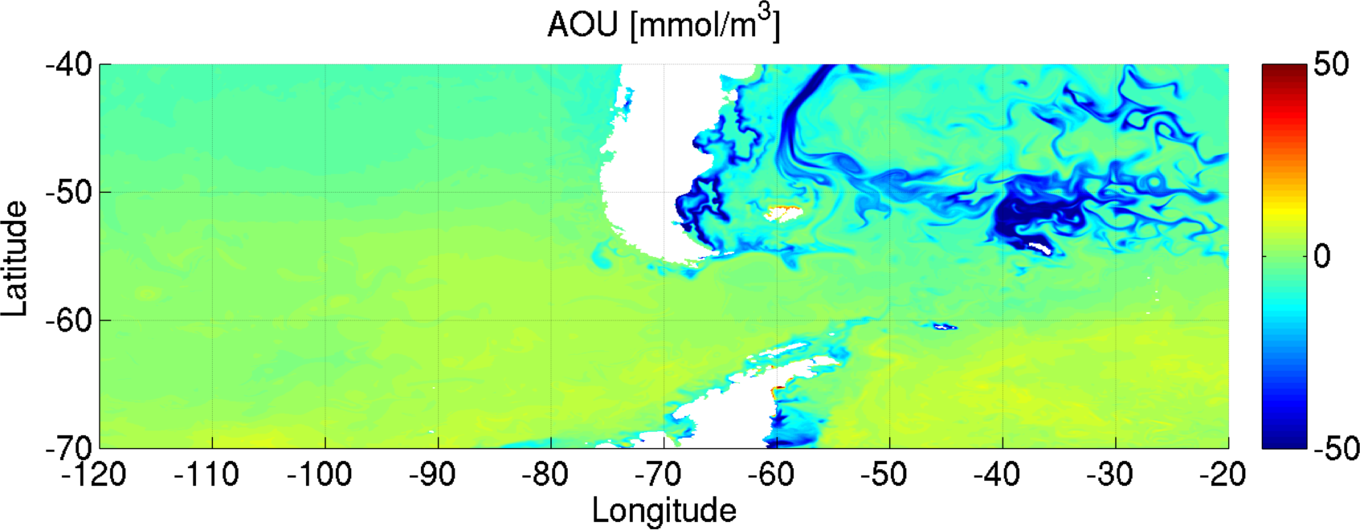
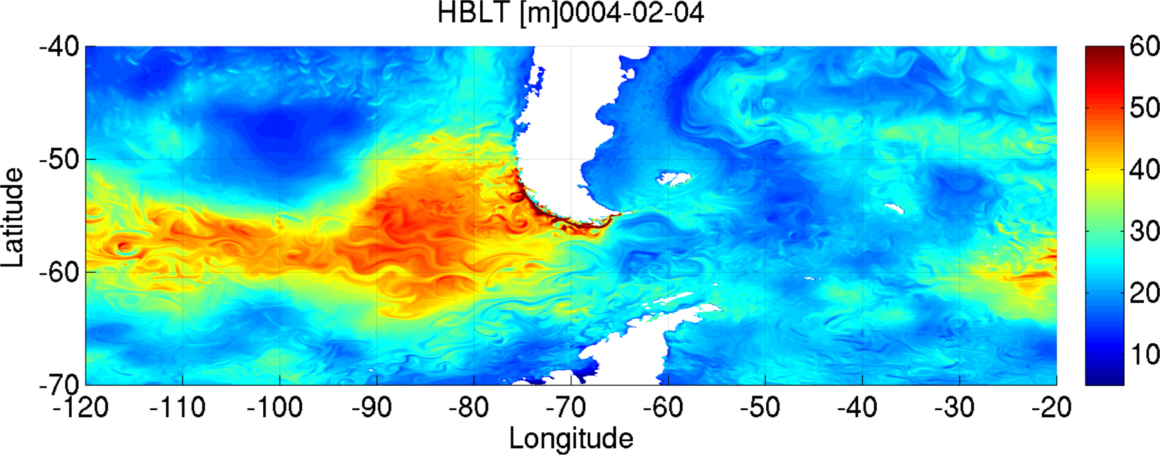

Slide 12
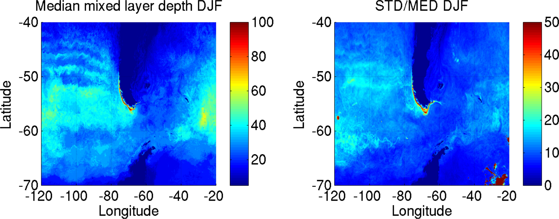

Slide 13
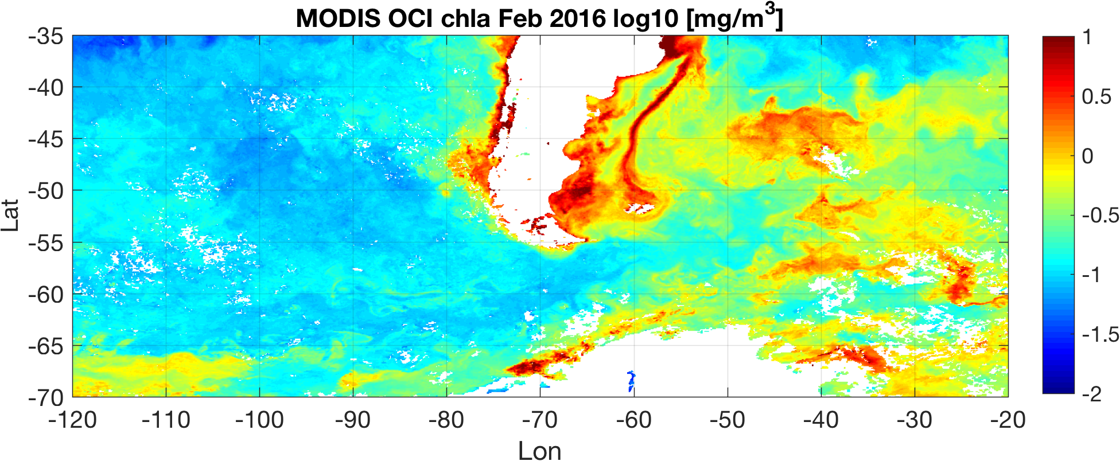

Slide 14
Argo winter (JJA) mixed layer depth climatology
[m]
[%]

