Slide 1
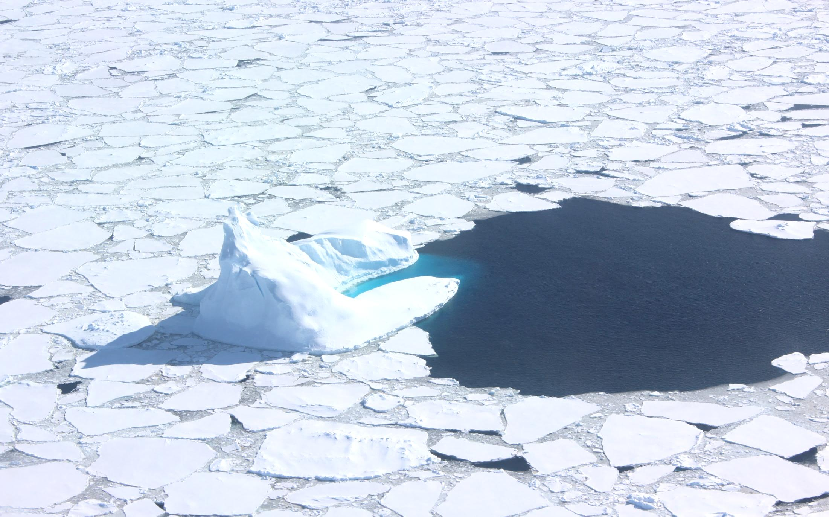
ORCAS WORKSHOP – TOGA Observations
TOGA team: Eric Apel, Rebecca Hornbrook, Alan Hills, Nicola Blake

Slide 2
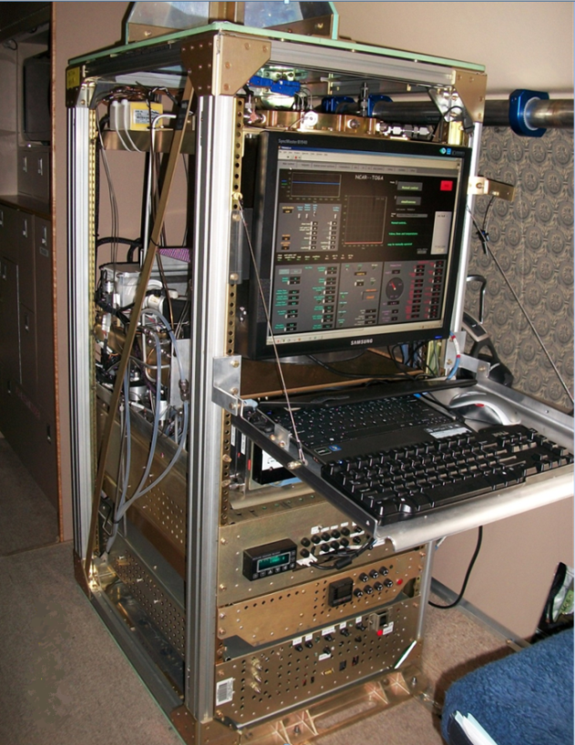
Scientific Motivations
Reactive gases w/ AWAS
TOGA: An airborne high speed GC/MS allows for rapid and sensitive analysis of more than 50 organic molecules - autonomously
Becky Hornbrook, Nicola Blake (UCI), Alan Hills, Eric Apel
Alkanes, Alkenes, Aromatics, Oxygenates, Nitriles, DMS & Halocarbons – 2 minute continuous analysis
NSF/NCAR Gulfstream V
Emissions from productive Southern Ocean can have regional and global (?) impacts.
Distributions and fluxes poorly characterized/or conflicting conclusions
What is the relationship of halocarbon fluxes and distributions to those of CO₂ and O₂?
Installed on the G-V
Notes:
New ‘TOGA’ instrument completed! Received an NSF grant and it took a number of years to develop. Shown here is the beuatiful GV and the inlet for the instrument
flown on series of test flights May

Slide 3
TOGA Measured Compounds - ORCAS
Anthropogenic tracers
NMHCs: 1-butene/isobutene propane isobutane n-butane isopentane n-pentane 2-methylpentane 3-methylpentane n-hexane n-heptane benzene toluene ethylbenzene/p-/m-xylene o-xylene 1,2,3-trimethylbenzene 1,2,4-trimethylbenzene Alkyl Nitrates: methyl nitrate ethyl nitrate isopropyl nitrate butyl nitrates | LOD; pptv 1 10 1 1 1 1 0.5 0.5 0.5 3 1 0.5 0.3 0.2 1 1 LOD; pptv 5 0.5 0.5 1 | OVOCs: formaldehyde (HCHO) acetaldehyde (CH₃CHO) propanal butanal acetone (CH₃COCH₃) MEK (butanone) methanol (CH₃OH) ethanol (C₂H₅OH) 2-propanol acrolein (CH₂CHCHO) MTBE (methyl tert-butyl ether) Biogenic VOCs: isoprene MBO (2-methyl-3-buten-2-ol) MVK methacrolein 3-methylfuran α-pinene β-pinene camphene limonene/3-carene | LOD; pptv 20 5 5 1 20 1 20 10 5 1 0.5 LOD; pptv 0.5 0.5 1 1 1 0.2 0.5 0.5 0.5 | Halogenated VOCs: CFC-11 (CCl₃F) CFC-113 (CCl₂FCClF₂) CH₃Cl (methyl chloride) CH₂Cl₂ (dichloromethane) CHCl₃ (chloroform) CCl₄ (tetrachloromethane) C₂Cl₄ (tetrachloroethene) C₆H₅Cl (chlorobenzene) CH₃Br (methyl bromide) CH₂Br₂ (dibromomethane) CHBr₃ (bromoform) CH₃I (methyl iodide) CH₂I₂ (diiodomethane) C₂H₅I (ethyl iodide) CH₂ICl (chloroiodomethane) CHBrCl₂ (bromodichloromethane) CHBr₂Cl (dibromochloromethane) Others: DMS (dimethyl sulfide) HCN (hydrogen cyanide) Acetonitrile (CH₃CN) | LOD; pptv 5 1 1 1 1 1 0.3 0.1 1 0.03 0.2 0.03 0.05 0.5 0.07 0.05 0.03 LOD; pptv 0.5 10 1
often bdl
often bdl
often bdl
often bdl
often bdl
often bdl
bdl
bdl
bdl
bdl
bdl
bdl
often bdl
often bdl
often bdl
often bdl
Nitrates
(ocean? Anthro?)
Biomass Burning/
Anthropogenic/
Oxidation Products
Biogenics
Ocean emissions
NCAR/ACOM TOGA group
ORCAS – June 14, 2016

Slide 4
Scientific Motivations
Emissions from productive Southern Ocean can have regional and global (?) impacts.
  Reactive halocarbons
    Oxidative processes / ozone depletion (tropospheric and stratospheric)
    Aerosol formation
  NMHCs/OVOCs/nitriles
  Organic Nitrates
  Sulfur species
    DMS and aerosol formation
Distributions and fluxes poorly characterized/or conflicting conclusions
  Investigate links to biogeochemical processes – can these be incorporated into models?
    Pigments
    Species dependence
    Can reactive gas N/S gradients lend insight into inter-hemispheric mixing?

Slide 5
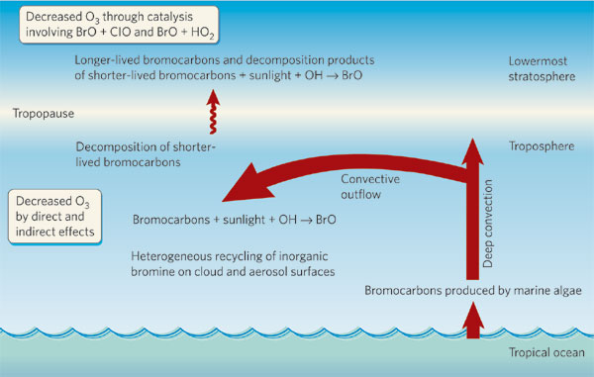
Scientific Motivations
  Reactive halocarbons (LOTS of unknowns about sources)
  - Bromine (and chlorine and iodine) containing reactive gases
  bromoform: τ ≈ 25 days – photolysis/OH
  dibromomethane: τ ≈ 120 days (OH)
Salawich et al., 2006

Slide 6
Bromoform (ocean emission)
ORCAS
Jan/Feb 2016
CONTRAST
Jan/Feb 2014

Slide 7
Bromoform (ocean emission)
ORCAS
Jan/Feb 2016
CONTRAST
Jan/Feb 2014
TORERO – Jan/Feb 2012

Slide 8
TOGA reactive carbon species compared to observed (QCLS) CO
Altitude-binned TOGA data, excluding data sampled over South America*
Low CO = < 43 ppb High CO = > 43 ppb
Means and standard deviations shown, number of data points in each bin shown.
*Includes data sampled over the Argentine Basin, which is influenced by South American outflow.
e.g.:
NCAR/ACOM TOGA group
ORCAS data meeting – Sept 8, 2016

Slide 9
High CO: > 43 ppbv
*Using
CO_QCLS
ORCAS – Altitude-dependent Bromoform,
colored by CO (QCLS)
Low CO: < 43 ppbv
Excluding data sampled over S. America
Weak anti-correlation
with CO in mid-trop

Slide 10
High CO: > 43 ppbv
*Using
CO_QCLS
ORCAS – Altitude-dependent Dibromomethane,
colored by CO (QCLS)
Low CO: < 43 ppbv
Excluding data sampled over S. America
Weak anti-correlation with CO
In the mid-troposphere

Slide 11
Dibromomethane and Bromoform
Ocean Air Fraction (1 = ocean surface, 0 = land surface, 0.8 = 80% ocean surface history.)
NCAR/ACOM TOGA group
ORCAS data meeting – Sept 8, 2016

Slide 12
“IDL T000” = arbitrary (?) model time since air
parcel in lowest model layer over ocean.
Bromoform, binned by IDL T000:
Low < 0.021 < Mid < 0.041 < High
NCAR/ACOM TOGA group
ORCAS data meeting – Sept 8, 2016

Slide 13
High O₂: > -540 per meg
ORCAS – Altitude-dependent Bromoform,
colored by O₂ (AO2)
Mid O₂: -560 to -540 per meg
Low O₂: < -560 per meg
Correlated with O₂

Slide 14
Scientific Motivations
  NMHCs/OVOCs/Nitriles
  NMHC: Example of biogenic/anthropogenic tracer in SH:
  Benzene: τ ≈ 10 days
  OVOCs/HCN/CH3CN: Oceanic emissions and uptake
  Formaldehyde/Acetaldehyde: τ ≈ 0.4 day - oxidizing capacity of troposphere
  Methanol: τ ≈ 10 days, Acetone: τ ≈ 40 days: BB/Anthro/Biogenic
  Nitriles: HCN/CH3CN – very long-lived tracers of BB – months to year – depends on deposition

Slide 15
Benzene (anthro and BB tracer)
ORCAS
Jan/Feb 2016
CONTRAST
Jan/Feb 2014

Slide 16
Benzene (anthro and BB tracer)
ORCAS
Jan/Feb 2016
CONTRAST
Jan/Feb 2014
TORERO – Jan/Feb 2012

Slide 17
High CO: > 43 ppbv
*Using
CO_QCLS
ORCAS – Altitude-dependent Benzene,
colored by CO (QCLS)
Low CO: < 43 ppbv
Excluding data sampled over S. America
correlates with CO (albeit very low levels)

Slide 18
ORCAS – Altitude-dependent Benzene, colored by CO₂ (NOAA)

Slide 19
High O₂: > -540 per meg
ORCAS – Altitude-dependent Benzene,
colored by O₂ (AO2)
Mid O₂: -560 to -540 per meg
Low O₂: < -560 per meg
No correlation with O₂.

Slide 20
Benzene as a pollution tracer
Example of aged pollution layer during RF08
benzene present in layer at 7 km, with butane and toluene bdl – gives information on age of the layer
NCAR/ACOM TOGA group
ORCAS data meeting – Sept 8, 2016

Slide 21
Alkanes (butanes and pentanes) as pollution tracers
RF18 – Elevated butanes and
pentanes in a layer at 6 km:
*colored by flight time
(purple = takeoff
red = landing)
NCAR/ACOM TOGA group
ORCAS data meeting – Sept 8, 2016

Slide 22
Alkanes (butanes and pentanes) as pollution tracers
NCAR/ACOM TOGA group
ORCAS data meeting – Sept 8, 2016

Slide 23
Acetone (CH₃COCH₃) (BB, anthro tracer and oxidation product)
ORCAS
Jan/Feb 2016
CONTRAST
Jan/Feb 2014

Slide 24
Acetone (CH₃COCH₃) (BB, anthro tracer and oxidation product)
ORCAS
Jan/Feb 2016
CONTRAST
Jan/Feb 2014
TORERO – Jan/Feb 2012

Slide 25
Methanol (CH₃OH) (BB, anthropogenic and continental biogenic emissions)
ORCAS
Jan/Feb 2016
CONTRAST
Jan/Feb 2014

Slide 26
Methanol (CH₃OH) (BB, anthropogenic and continental biogenic emissions)
ORCAS
Jan/Feb 2016
CONTRAST
Jan/Feb 2014
TORERO – Jan/Feb 2012

Slide 27
High CO: > 43 ppbv
*Using
CO_QCLS
ORCAS – Altitude-dependent Acetone,
colored by CO (QCLS)
Low CO: < 43 ppbv
Excluding data sampled over S. America
Clear correlation with CO

Slide 28
High O₂: > -540 per meg
ORCAS – Altitude-dependent Acetone,
colored by O₂ (AO2)
Mid O₂: -560 to -540 per meg
Low O₂: < -560 per meg
Anti-correlation with O₂.

Slide 29
CH₃OH and CH₃COCH₃ (moderately long lived OVOCs, combo of anthro, biogenic, and BB)
Clear enhancements of both tracers
with CO in the middle troposphere
NCAR/ACOM TOGA group
ORCAS data meeting – Sept 8, 2016

Slide 30
CH₃OH and CH₃COCH₃ (moderately long lived OVOCs, combo of anthro, biogenic, and BB)
NCAR/ACOM TOGA group
ORCAS data meeting – Sept 8, 2016

Slide 31
Acetonitrile (CH₃CN) (BB tracer)
ORCAS
Jan/Feb 2016
CONTRAST
Jan/Feb 2014

Slide 32
Acetonitrile (CH₃CN) (BB tracer)
ORCAS
Jan/Feb 2016
CONTRAST
Jan/Feb 2014
TORERO – Jan/Feb 2012

Slide 33
High CO: > 43 ppbv
*Using
CO_QCLS
ORCAS – Altitude-dependent Acetonitrile,
colored by CO (QCLS)
Low CO: < 43 ppbv
Excluding data sampled over S. America
Clear correlation with CO

Slide 34
High O₂: > -540 per meg
ORCAS – Altitude-dependent Acetonitrile,
colored by O₂ (AO2)
Mid O₂: -560 to -540 per meg
Low O₂: < -560 per meg
Anti-correlation with O₂

Slide 35
HCN and CH₃CN (BB tracers – lifetimes on order of 1-2 months)
Clear enhancements of both tracers
with CO in the middle troposphere
Indications of loss to the surface
for both HCN and CH₃CN
NCAR/ACOM TOGA group
ORCAS data meeting – Sept 8, 2016

Slide 36
HCN and CH₃CN (BB tracers – lifetimes on order of 1-2 months)
NCAR/ACOM TOGA group
ORCAS data meeting – Sept 8, 2016

Slide 37
HCN and CH₃CN (BB tracers – lifetimes on order of 1-2 months)
Low < 0.021 < Mid < 0.041 < High
NCAR/ACOM TOGA group
ORCAS data meeting – Sept 8, 2016

Slide 38
CH₂Cl₂ (strong NH tracer – emitted in much lower quantities in the SH.)
ORCAS
Jan/Feb 2016
CONTRAST
Jan/Feb 2014
TORERO – Jan/Feb 2012

Slide 39
CH₂Cl₂ (possible NH tracer – emitted in much lower quantities in the SH.)
NCAR/ACOM TOGA group
ORCAS data meeting – Sept 8, 2016

Slide 40
CHCl₃ (possible NH tracer – emitted in much lower quantities in the SH.)
ORCAS
Jan/Feb 2016
CONTRAST
Jan/Feb 2014
TORERO – Jan/Feb 2012

Slide 41
CHCl₃ (possible NH tracer – emitted in much lower quantities in the SH.)
NCAR/ACOM TOGA group
ORCAS data meeting – Sept 8, 2016

Slide 42
CH₂Cl₂ and CHCl₃ (moderately long-lived anthropogenic halocarbons)
No significant
difference observed
with CO in lower and
mid troposphere
NCAR/ACOM TOGA group
ORCAS data meeting – Sept 8, 2016

Slide 43
C₂Cl₄ (another NH tracer – emitted in much lower quantities in the SH.)
ORCAS
Jan/Feb 2016
CONTRAST
Jan/Feb 2014
TORERO – Jan/Feb 2012

Slide 44
C₂Cl₄ (another NH tracer – emitted in much lower quantities in the SH.)
NCAR/ACOM TOGA group
ORCAS data meeting – Sept 8, 2016

Slide 45
TOGA reactive gases summary
VOC species from a number of compound classes were measured during ORCAS
NMHCs
OVOCs
Organohalogens
Nitriles
Organic nitrates
Sulfur species
What are relationships of VOC distributions to those of CO₂ and O₂?
What is effect of southern oceanic uptake on the lifetime and distributions of longer-lived species? (HCN, CH3CN, Acetone, Methanol)
STILT collaboration - hope to derive fluxes for some key ocean emitted species
Importance of southern oceans in global organohalogen distributions?
What is the effect of VOCs (OVOCs) on the oxidizing capacity of the southern ocean MBL?
Can gradients in species such as CH₂Cl₂ and chloroform help inform on inter-hemispheric mixing?
Hope to use data to help improve CAM-chem model organohalogen and DMS representations
Use TOGA tracers to characterize air-masses encountered in ORCAS
NCAR/ACOM TOGA group
ORCAS data meeting – Sept 8, 2016

Slide 46
Other slides to have incase there is a question or two
(could put aldehydes back in here also)

Slide 47
Delete?
ORCAS
Jan/Feb 2016
CONTRAST
Jan/Feb 2014
TORERO – Jan/Feb 2012

Slide 48
DMS during ORCAS, sized by the DMS mixing ratio, and colored by date.
Sized by DMS
Delete?
DMS MRs were elevated during the first half of the ORCAS study.

