Slide 1
Inverse Flux Estimates and Marine Sources of DMS, Isoprene, and Monoterpenes
Elizabeth C. Asher
Collaborators: Eric Apel, Rebecca Hornbrook, AlanHills, Nicola Blake, Britt Stephens…

Slide 2
What are marine emissions and sources of gaseous precursors for natural aerosols?
Notes:
This figure shows…I don’t show fluxes because there exist such large uncertainties…between model and obs (e.g. Matt’s fig. yesterday)
Motivation for this research stems from large uncertainties re radiative impacts of clouds and aerosols
- quantifying biogenic gaseous precursors for natural aerosols and to identify their marine sources
-CESM projections of albedo and precipitation are sensitive to cloud dynamics
-Aer. SO MBL CCN primarily of marine origin, >50% biogenic.
-DMS, isoprene and monoterpenes (e.g. alpha-pinene) likely represent largest sources of biogenic sulfate and SOA

Slide 3
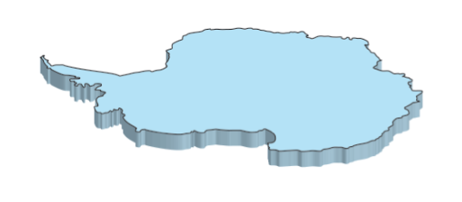
H2SO4
Secondary Organic Aerosols (SOA)
DMS
(CH3)2S
~28 hrs
Monoterpenes
e.g. Alpha-Pinene
~2.6 hrs
Isoprene
C5H8
~1.4 hr
Sea ice
Phytoplankton
OCEAN
Mixed Layer
Notes:
This figure shows…I don’t show fluxes because there exist such large uncertainties…between model and obs (e.g. Matt’s fig. yesterday)
Motivation for this research stems from large uncertainties re radiative impacts of clouds and aerosols
- quantifying biogenic gaseous precursors for natural aerosols and to identify their marine sources
-CESM projections of albedo and precipitation are sensitive to cloud dynamics
-Aer. SO MBL CCN primarily of marine origin, >50% biogenic.
-DMS, isoprene and monoterpenes (e.g. alpha-pinene) likely represent largest sources of biogenic sulfate and SOA

Slide 4
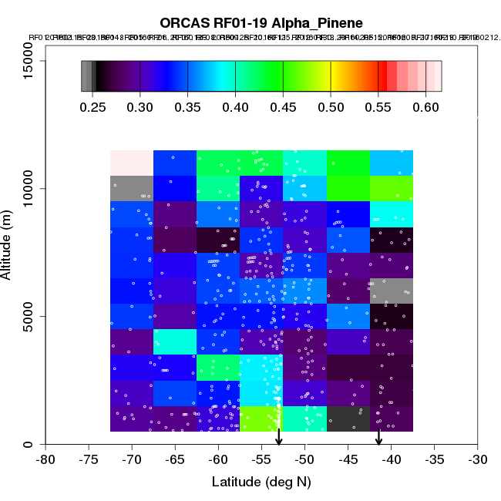
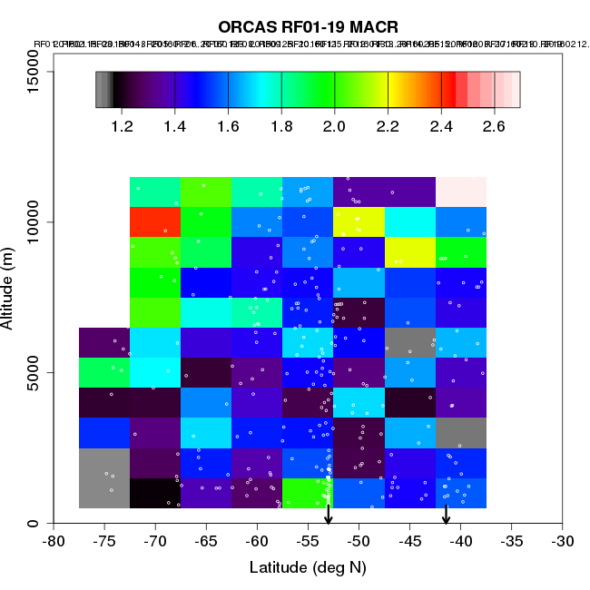
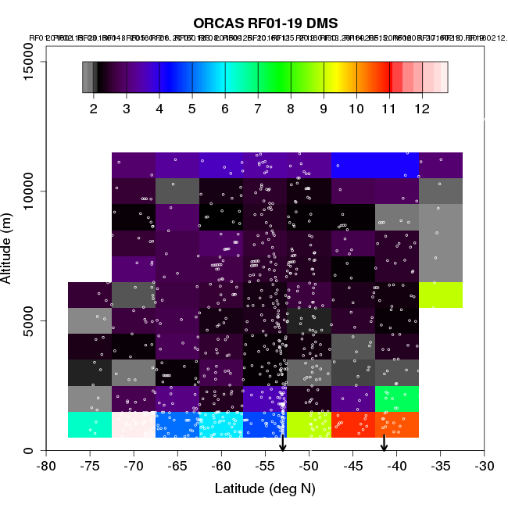
QL Data Summary (RF1-RF19)
Notes:
Isoprene/(MVK + MACR)
Mathacrolein methyl vinul ketone

Slide 5
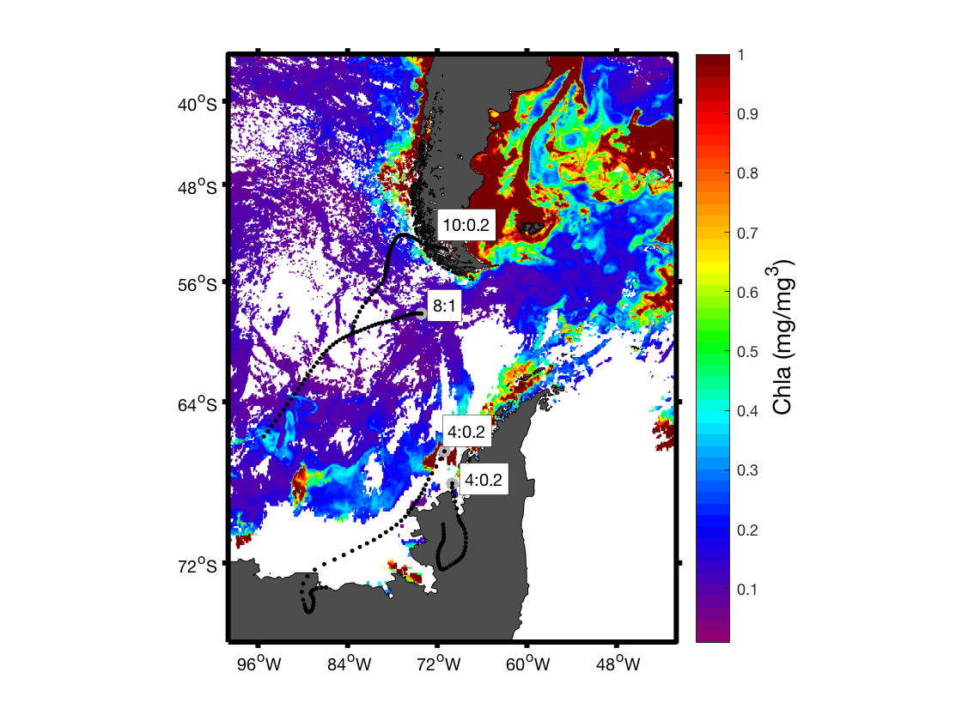
Calculating Sea-Air Fluxes and Identifying Marine Sources
HIPPO Jan 21, 2009
ORCAS Feb 24, 2016
Elliot Atlas, accessed from hippo.ornl.gov
TOGA, Becky Hornbrook
Notes:
Lagrangian Particle Dispersion Modeling (HYSPLITT STILT)

Slide 6
Challenges & Questions:
STILT Meteorology field GDAS0p5 (WRF, AMPS?)
STILT Initial/ background conditions
offline calculation of OH-oxidation (other critical oxidants e.g. BrO?)
Can we use PRISM or PHYSAT data to ID diatoms (isoprene producers) vs. phaeocystis (prolific DMS producers)

