Slide 1




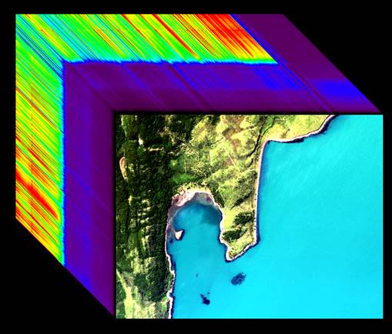
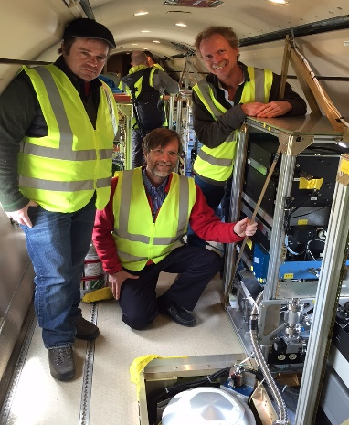
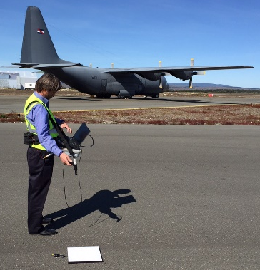

Optical Properties of the Water Column for ORCAS: Airborne (PRISM), Satellite, and Ship Measurements
Heidi Dierssen, Kate Randolph,
& Shungu Garaba
University of Connecticut
Michelle Gierach, David Thompson &
The PRISM Team*
Jet Propulsion Laboratory
*In Alphabetical Order: Ernesto Diaz, Justin Haag, Mark Helmlinger, Marco Hernandez, Byron Van Gorp, Robert Green, Didier Keymeulen, Peter Kobzeff, Linley Kroll, Frank Loya, Huy Luong, Sarah Lundeen, Ian McCubbin, Pantazis Mouroulis, Scott Nolte, Chuck Sarture, John Shaw, Peter Sullivan

Slide 2
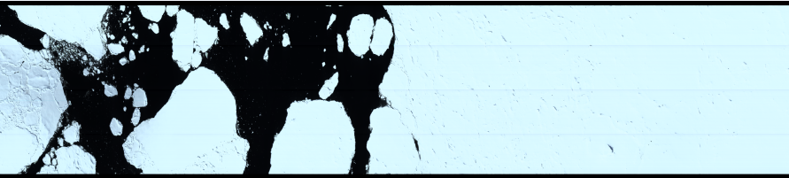
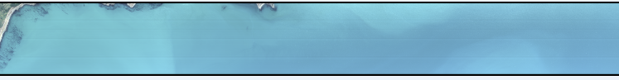
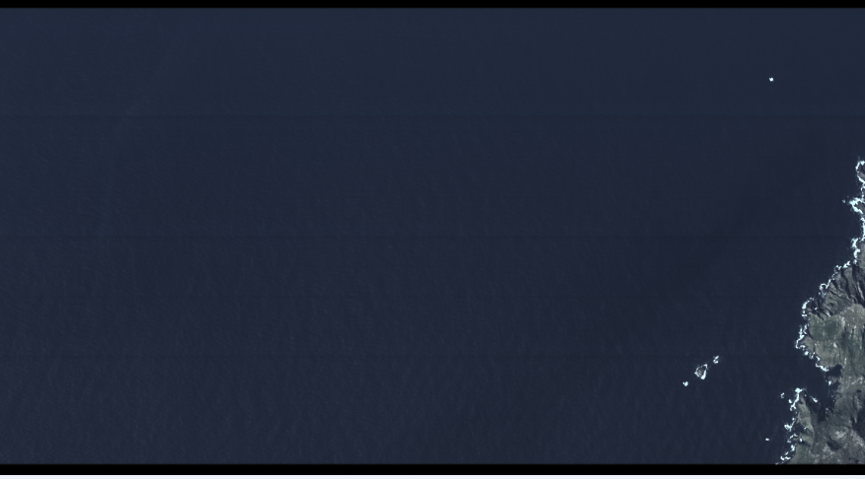
NASA Rapid Response Objectives
PRISM will complement ORCAS observations in the Southern Ocean, providing data products that are critical to:
  Ocean biogeochemistry
  Analog to future hyperspectral satellites (PACE)
  Synergy to ongoing field projects
    -SOCCOM, Palmer LTER, Drake Passage Time Series
Sea Ice
Open Ocean
Coastal Waters
Notes:
SoGasEx, SOCCOM, ICESOCC, Palmer, etc

Slide 3
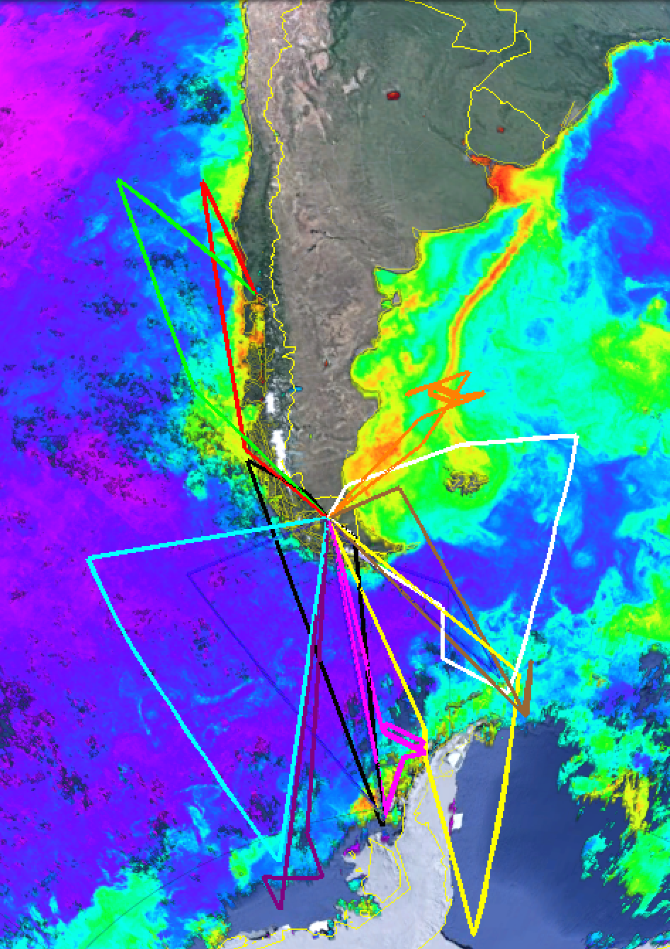
ORCAS Field Campaign
12 research flights in total (98 flight hrs)
  Western Survey:
    15, 21, 23, 25 January
    5, 8, 24 February
  Eastern Survey:
    18 January
    12, 18, 25 February
  Patagonia Shelf
    30 January
Interesting areas from a biological and integrated Earth System perspective (dashed boxes):
1. The Drake Passage
Gradients of particulate inorganic carbon and productivity
2. Patagonian Shelf
  Gradients of productivity
3. Ice edge
  Preliminary CO₂/O₂/trace gas data showed high DMS, N₂O, O₂, productivity and low CO₂

Slide 5
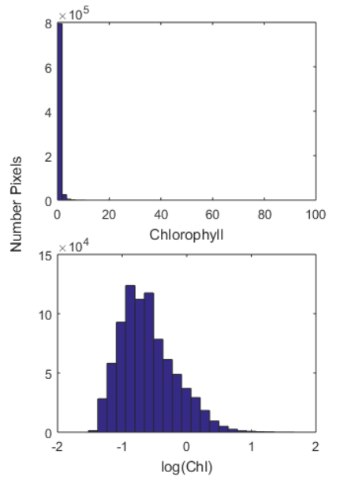
Chlorophyll and Calcite are lognormally distributed
Mean=0.45 mg m⁻³
Geomean=0.25 mg m⁻³

Slide 6
West = Pacific Sector
East = Atlantic Sector

Slide 7

Time Series for the Southern Ocean
-65
-60
-55
-50
-45
-40
Latitude
65
49
33
17
1
Year Day

Slide 8
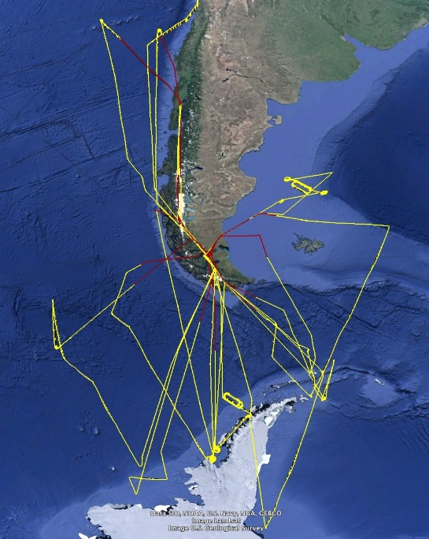
log Chlorophyll
log Calcite
Fig. 8. Overflights conducted with PRISM for ORCAS campaign.
SST

Slide 9
Time Series across Drake Passage
-65
-60
-55
-50
-45
-40
Latitude
65
49
33
17
1
Year Day

Slide 10
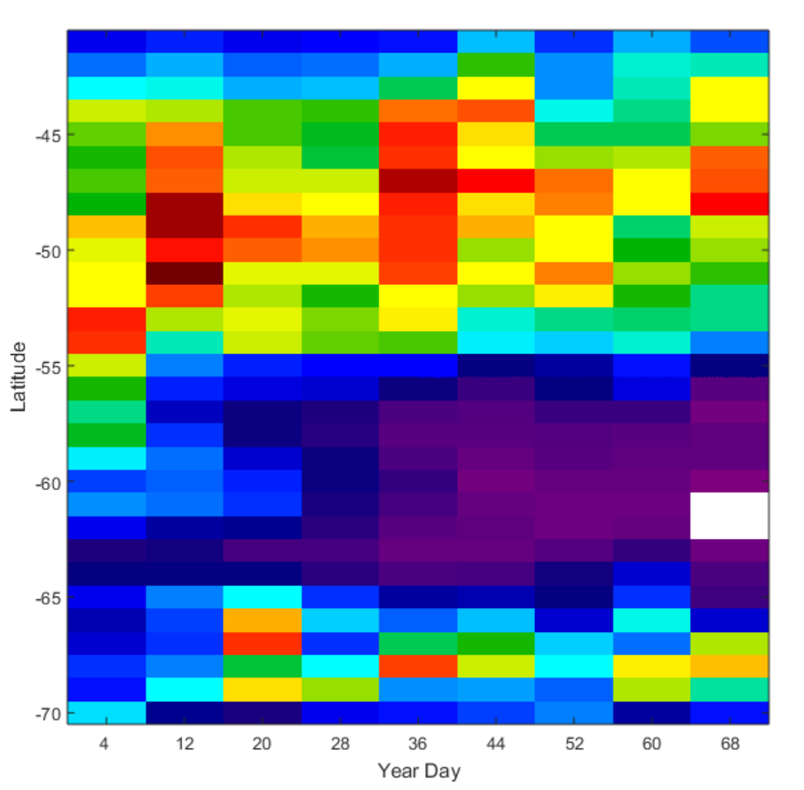
Chlorophyll across Drake Passage 65 to 85W

Slide 11
PRISM Image Analysis Status
PRISM processing is still underway due to:
  Significant data volume - ~5.7TB for raw PRISM data from all lab/field calibration, ferry flights, and research flights
  Code issues - Issues with orthorectification code for ascending/descending flight lines
  Calibration and Atmospheric Correction
Priority is given to flightlines that contain validation sites and that have interesting biological or integrated Earth System perspectives, including:
  February 18, 2016 – Gould Overflight & Drake Passage
  January 30, 2016 – Patagonia Shelf
  January 25, 2016 – Palmer & Gould Overflights
  January 21, February 5, & February 12, 2016 – Ice Edge(s)
  January 15, 2016 – Drake Passage
  All remaining flightlines

Slide 12
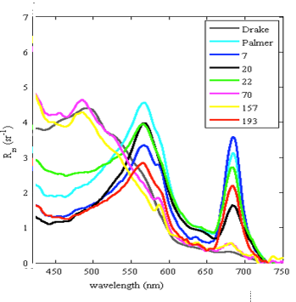
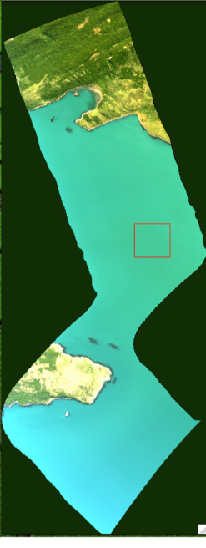
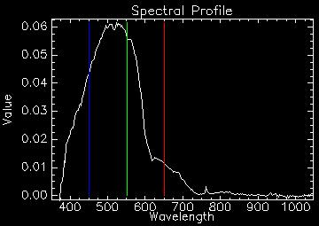
Algorithm Design and Validation
Radiometric Calibration
Open Water Validation
We derived a new calibration solution for PRISM based on hangar experiments in March 2016.
Ocean targets are generally harder to validate directly due to temporal and spatial variability; however, in situ data looks promising.
Comparison with PRISM Rrs ongoing
The flat field used two blue sphere acquisitions at full intensity, and agree to within 0.1%.
Wavelength calibration / solar residual test was reasonable.
Level 2 Product: Reflectance
Level 3: Water Optical Properties (Chla)
Standard multi-beam & spectroscopic retrieval algorithms
PRISM R_{rs} (Visible RGB shown)
Notes:
4 mutli-band retrieval algorithms, ncl. OC4v6, OC3M, MODIS-Aqua and SeaWiFS algorithm versions for the Southern Ocean (Johnson et al., 2013)
Full spectroscopic retrieval of water properties using the deep water model of Lee et al (2004)

Slide 13
Airborne & In Situ Data Products
Data Product | Description
Airborne Data Products Generated by the PRISM Science Data System (SDS)
Level 0 | Reconstructed, unprocessed PRISM digitized numbers (DN) at full resolution with GPS
Level 1 | Calibrated spectral radiance with geolocation information, incl. illumination and observation geometry
Level 2 | Reflectance generated following atmosphere radiative transfer inversion with geolocation, support processing information and flags
Level 3 | Chlorophyll-a with geolocation, uncertainties, and flags
In Situ Data Products Generated by UCONN
Ancillary In Situ Data | Optical ship-based calibration/validation
ORCAS Data Policy
Event | Deadline
Preliminary Data Submission Deadline | 28 August 2016
Final Data Submission Deadline | 31 December 2016
Initial Data Analysis Period (ORCAS Science Team) | 1 March 2016 – 28 February 2017
Data Becomes Public Domain | 1 March 2017
Data products will follow the ORCAS Data Policy.
Notes:
The CORAL data level definitions follow the standard terminology of the NASA Earth Observing System and Data Information System (EOSDIS).

Slide 14
PRISM: Where are we at since last update
Evaluating the atmospheric correction
Spectra appear blue-enhanced compared to our field validation (aerosol and skylight)
This will impact retrievals of Chlorophyll an
GOOD NEWS: Working on improvements with Bo-Cai Gao, NRL and David Thompson, JPL next week
PRISM imagery is available in a binary ENVI format

Slide 15
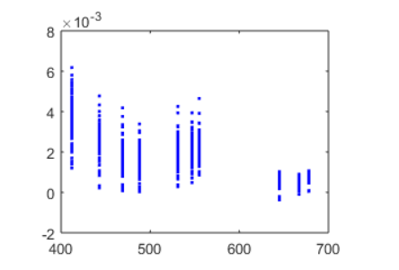
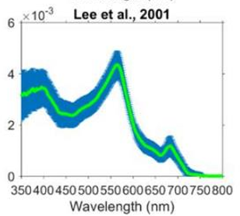
Level 2 - <1 km resolution
MODIS Aqua
Adelaide Island
R/V Gould
Ship Rrs

Slide 16
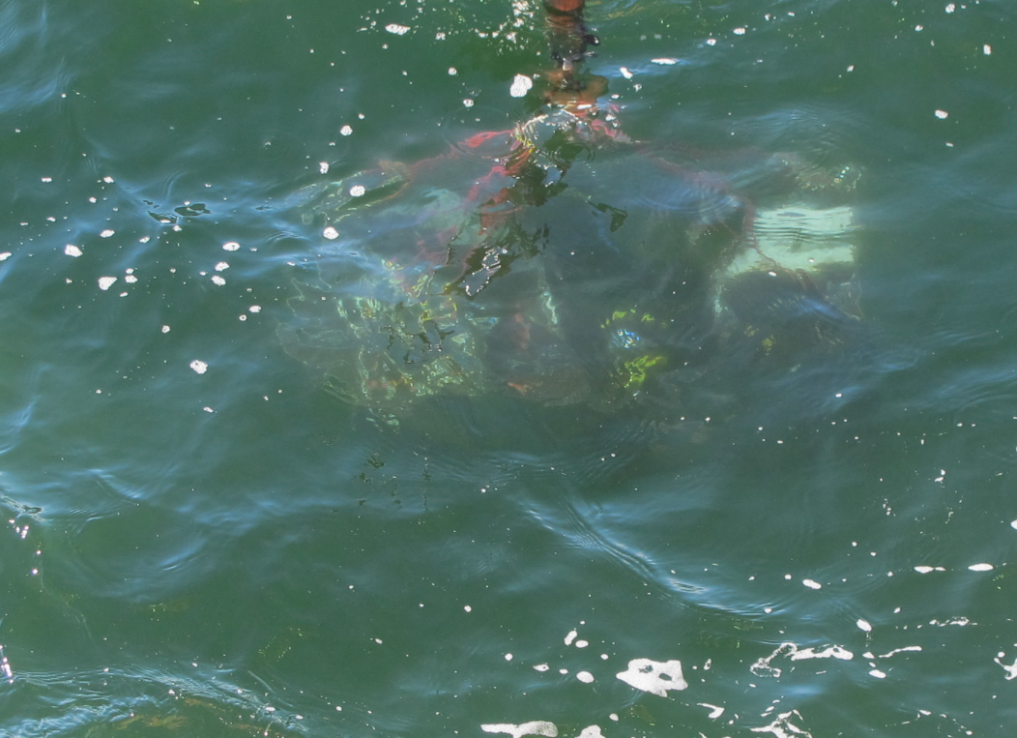
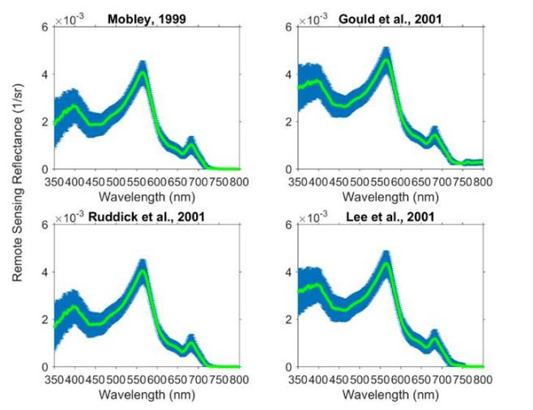
Water was green in color
Chl~ 6 ug/L from
Radiometry

Slide 17
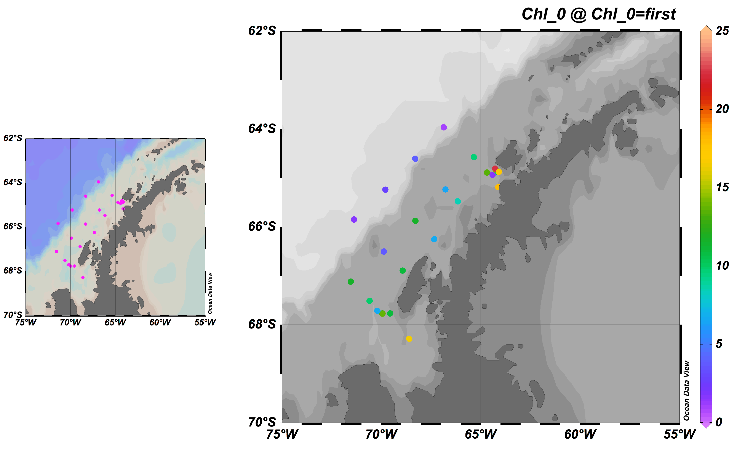
Chlorophyll from ship -- Schofield

Slide 18
PRISM higher blue than measured near the Antarctic Peninsula
Aerosol contamination
Surface reflected skylight
PRISM

Slide 19
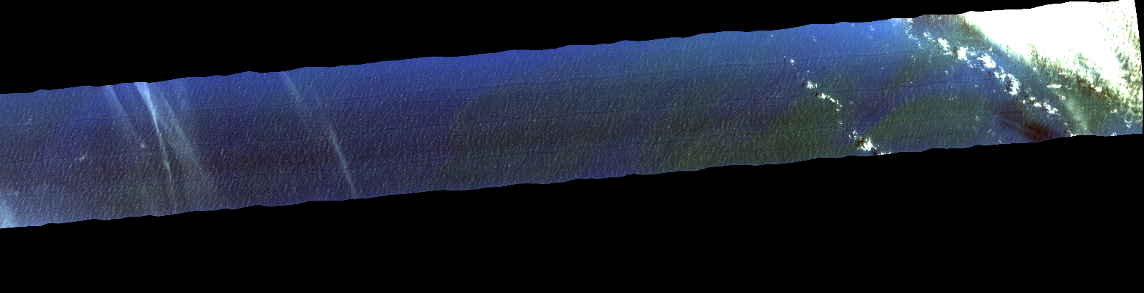
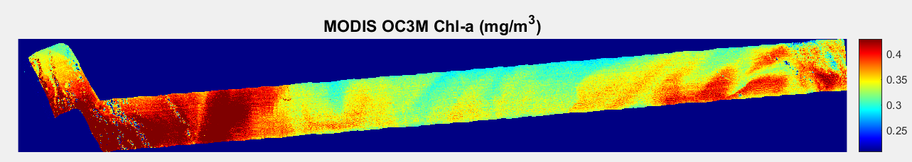
Spatial patterns in Chl can be observed with PRISM
prm20160125t184236_chla_v1k_img

Slide 20
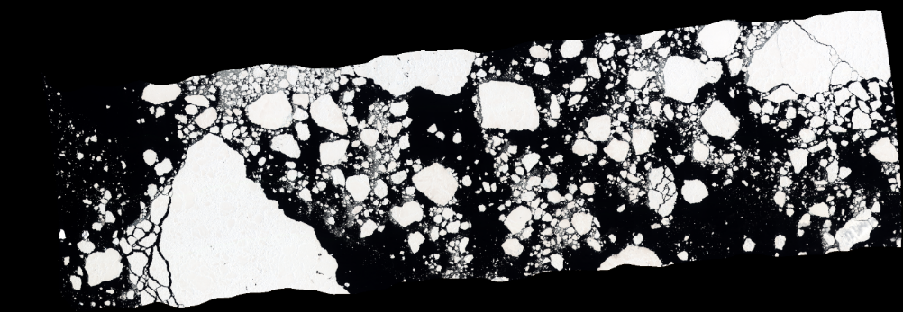
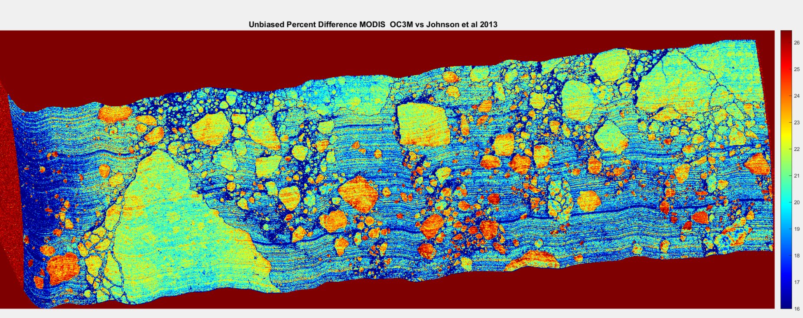
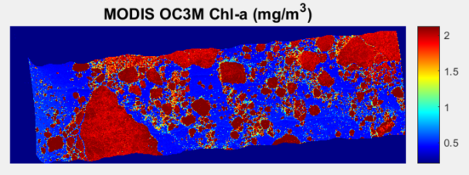
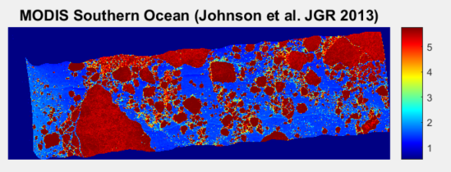
Sea ice masking needs to be applied!
Subtle striping in detector array as well

Slide 21
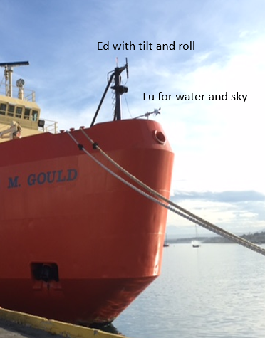
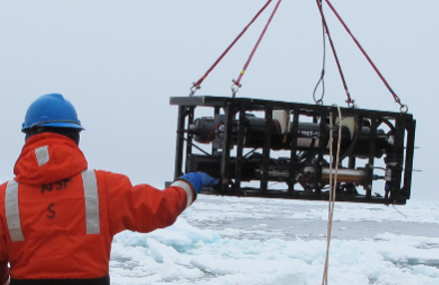
Field effort on Pal LTER cruise
Fig. 5. Pictures of optical sensors deployed during the ORCAS/LTER field campaign. Stations with sea ice will be flagged.

Slide 22
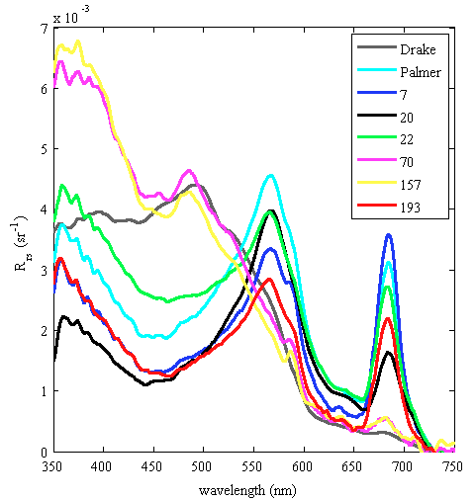
Water-leaving reflectance shows spectral features related to Phytoplankton Type
Multi-Spectral Satellites Hyperspectral

Slide 23
Phytoplankton Taxa will be related to CO2 and O2 flux data
64 deg S
Antarctic Zone
Diatoms type 1
Haptophyte type 8
  Phaeocystis antarctica
Cryptophytes
Mixed flagellates
Polar Front Zone
Diatoms
Haptophytes type 6
  Coccolithophorids
Dinoflagellates Type 2
Subantarctic Zone
Diatom type 2
Dinoflagellates Type 1
Haptophytes type 6
  Coccolithophorids
Subtropical Zone
Haptophytes type 6
  Coccolithophorids
Diatom type 2
Dinoflagellates Type 1
  Peridinin /DMSP
Background
Prasinophytes
Chlorophytes
Cryptophytes
  Except near meltwater
Cyanobacteria
44 deg S

Slide 24
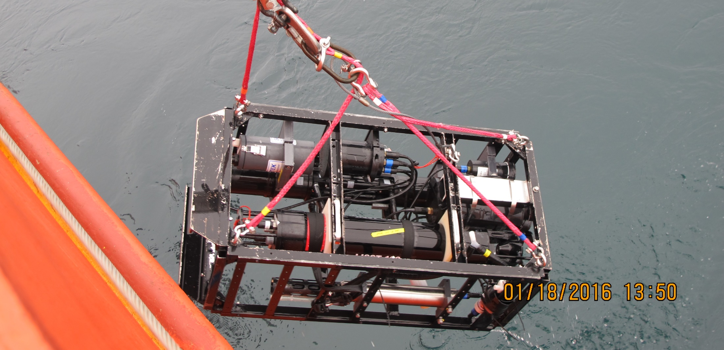
Inherent Optical Properties Collected during LTER
Spectral absorption, attenuation, scattering of particulate and dissolved material
Volume scattering function at 9 angles—an indicator of particle type, including bubbles
Particulate backscattering (single angle, single wavelength)
Chlorophyll and CDOM fluorescence

Slide 25
Status of Field Data
Sea Surface Radiometry
Initial processing
  Correction for skylight sensor shutter problem
Final processing
  Comparison to satellite
  Comparison to Hydrolight radiative transfer model
  Comparison to PRISM
Profiled Inherent Optical Properties
Initial processing underway
Sensor data has been merged with time
Issues with the clean water calibration
Processing to make

Slide 26
Chlorophyll (mg m⁻³)
log(Calcite) (mol m⁻³)

Slide 27
Causes of high backscattering waters
Coccolithophores
  Not near Ant. Coast!
Phaeocystis colonies
Glacial flour from meltwater
Whitecaps and bubbles
Sea ice “bergy bits”
Influence
  Thermal flux
  Accuracy of algorithms

Slide 28
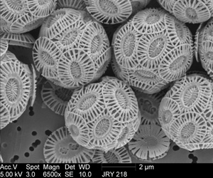
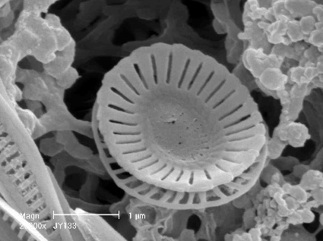
Haptophyte – Emiliania huxleyi
Coccolithophore with a calcite shell
CaCO₃ precipitation produces CO₂ that directly raises pCO_{2surf}
the calcite shells provide efficient ballast to transfer organic carbon from the surface to deep ocean potentially increasing NCP, export production and export efficiency which lowers pCO_{2surf}.
Detached Coccolith

Slide 29
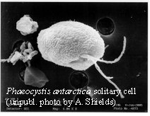
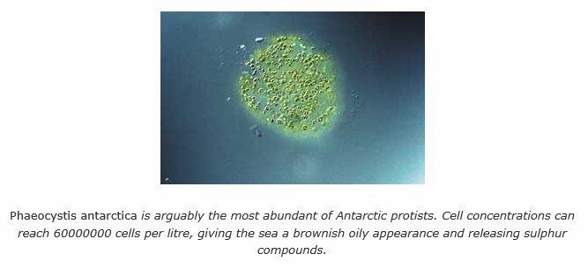

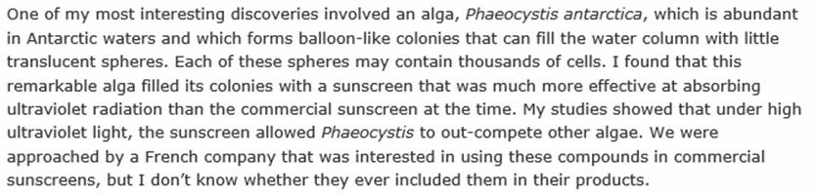
Haptophyte:
Phaeocystis antarctica
Phaeocystis antarctica, a flagellate around 6 µm diameter that forms gelatinous colonies up to 2 cm in diameter, is often the first species to bloom in ice-edge waters.
Quote from Andrew Davidson, Australian Antarctic Division

Slide 30
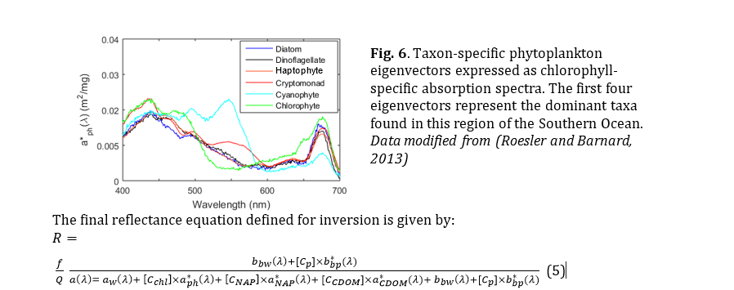
Inversion modeling to estimate phytoplankton taxa

Slide 31
With additional NASA funding
Process and evaluate in situ optical and pigment data for the region in terms of phytoplankton functional groups or taxa
Develop semi-analytical algorithms to estimate dominant phytoplankton taxa from hyperspectral water-leaving reflectance
Evaluate relationships between phytoplankton taxa and carbon fluxes
Apply phytoplankton taxa and pCO_{2surf} algorithms to the PRISM imagery collected as part of the ORCAS campaign

Slide 32
Papers
Algorithm papers
  Chl, PIC, PFT, Chl
Phytoplankton characterization
Assessing Palmer Grid flux across 2 lines
Working with David Munro coupling flux to Phytoplankton
Linking to SOCCOM Bio-argo floats

Slide 33
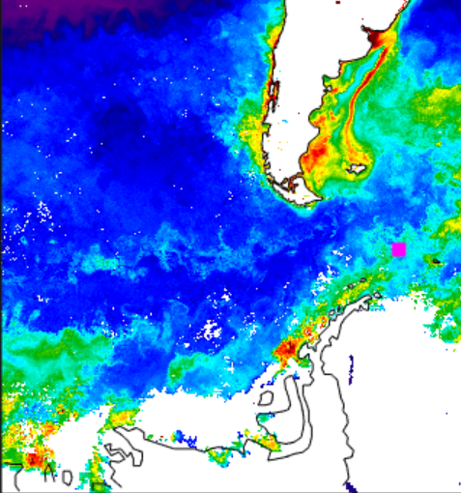
Float 9657
Evidence of surface bloom with O2 production
High surface fluorescence & bbp
Low nitrate
High oxygen, High pH
Low salinity, high SST

Slide 34
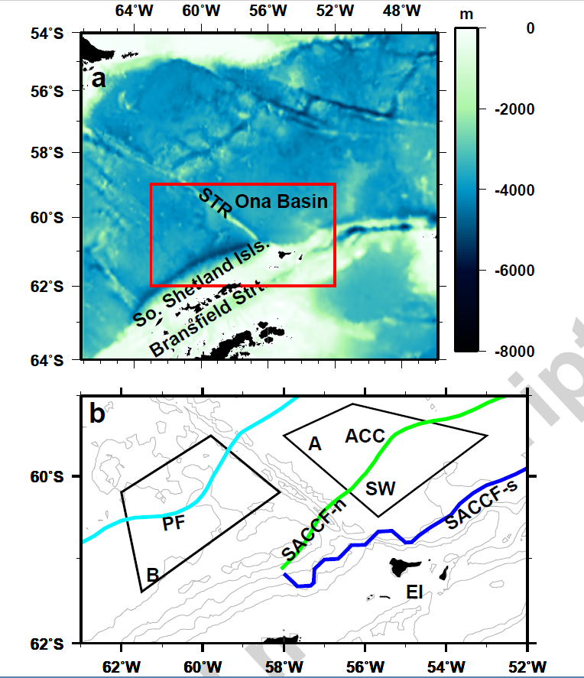
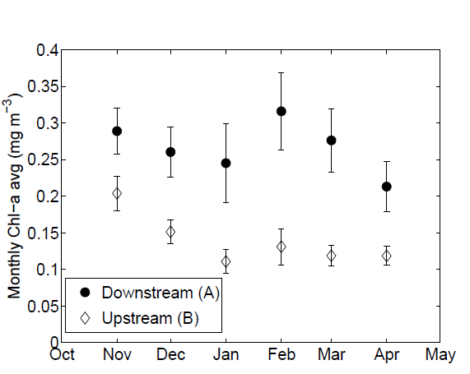
Mitchell et al. 2012

Slide 35
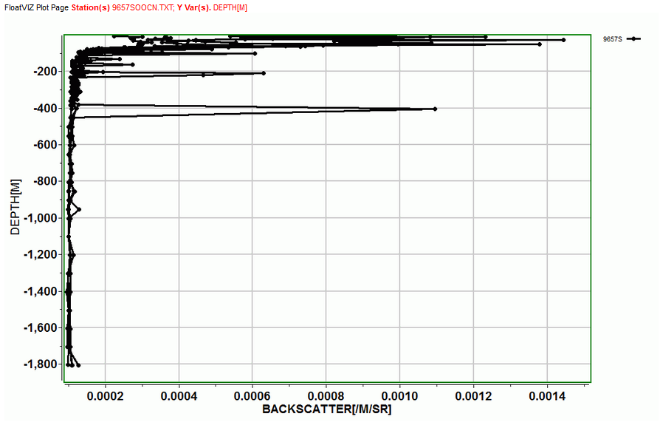
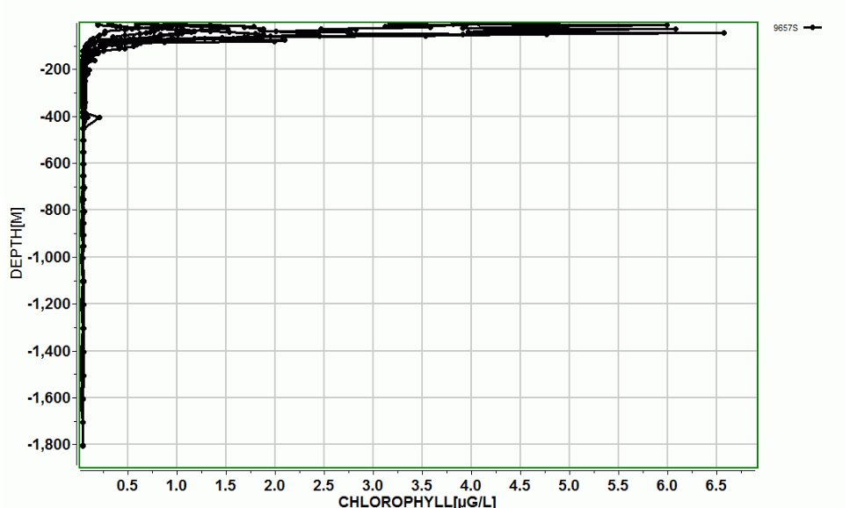

Slide 36
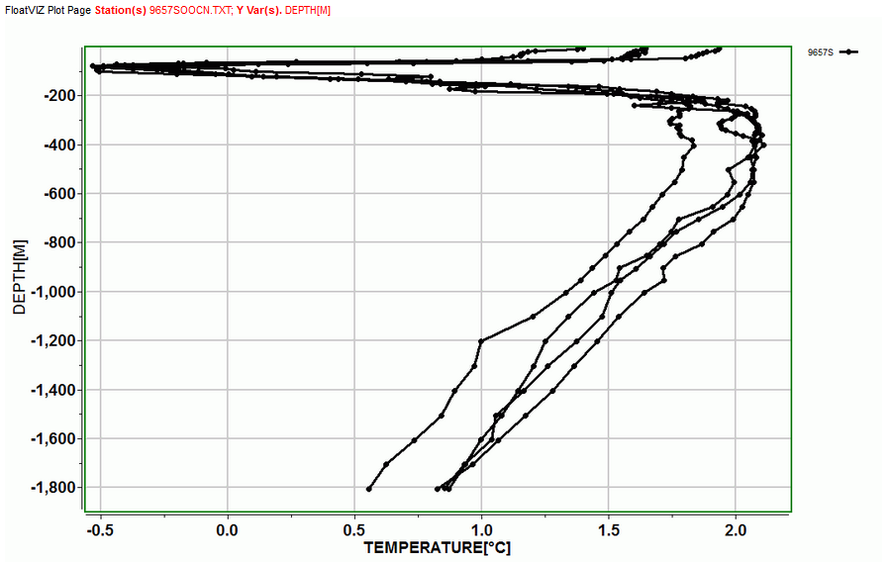
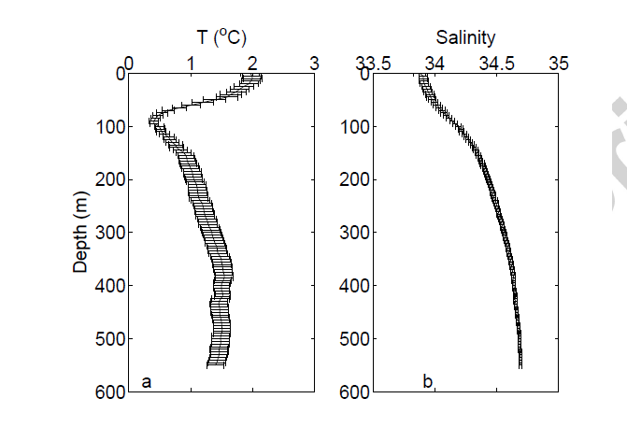
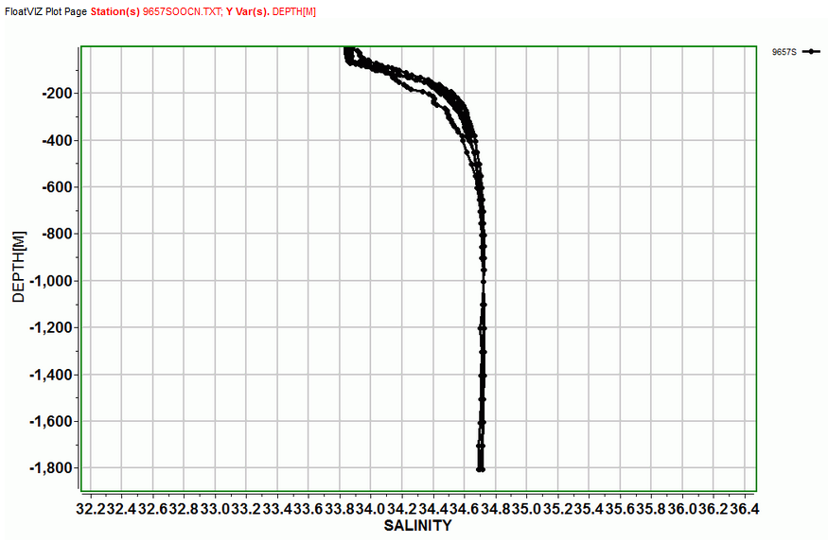

Slide 37
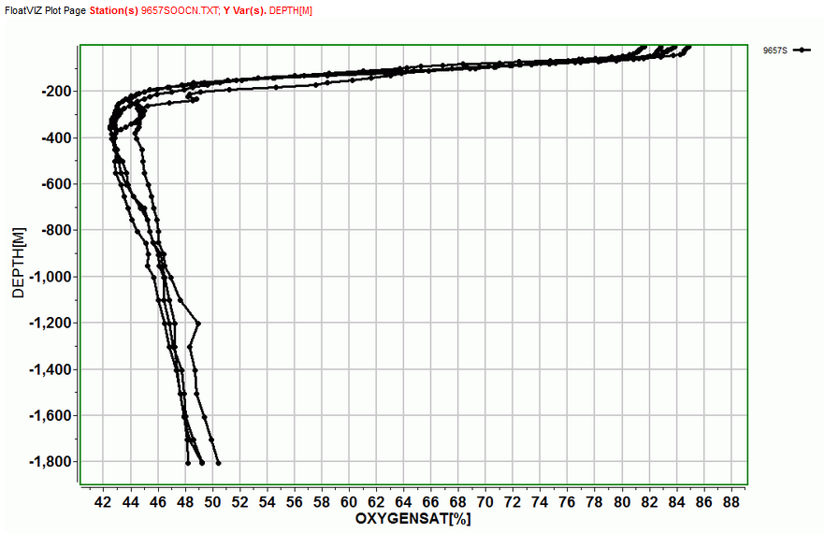
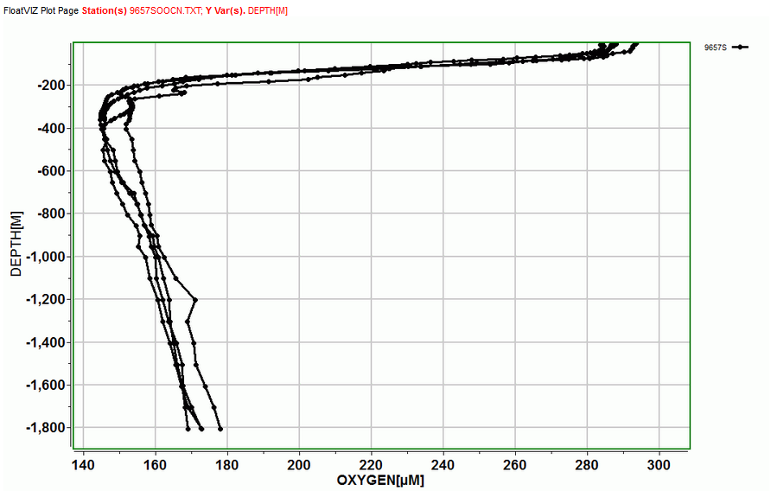

Slide 38
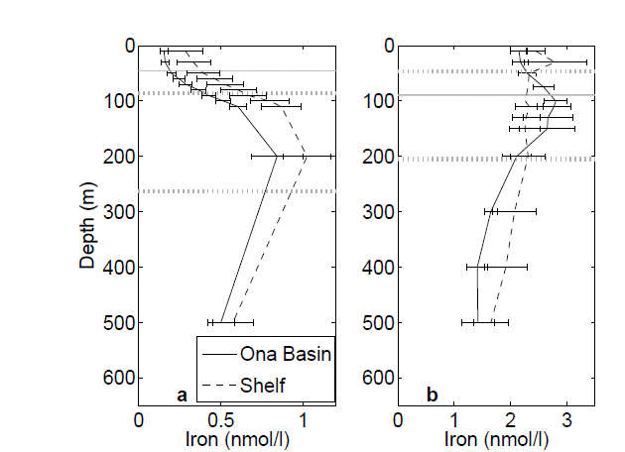
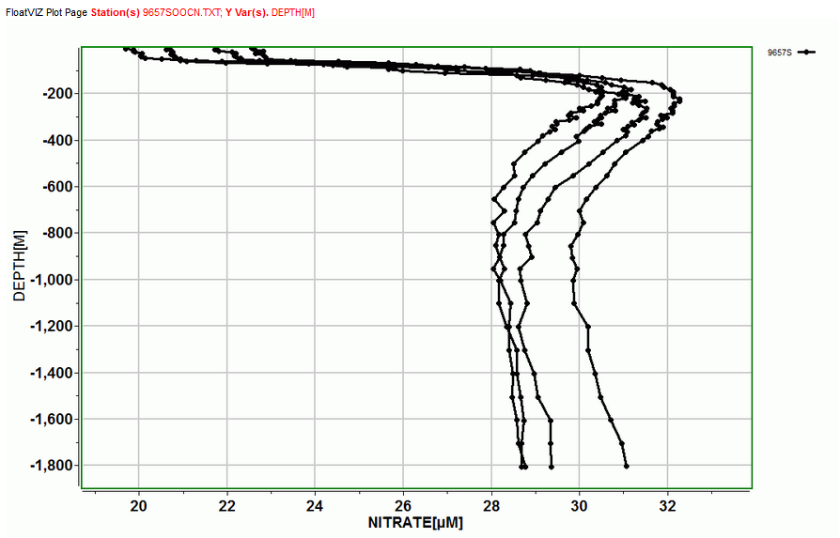
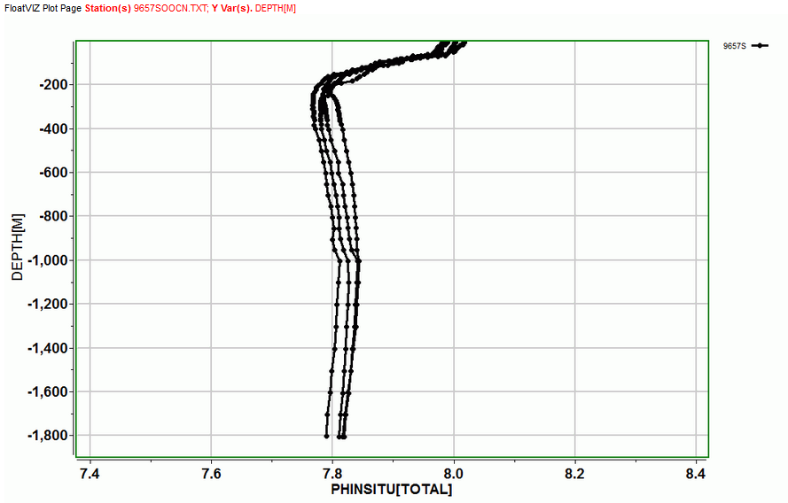

Slide 39
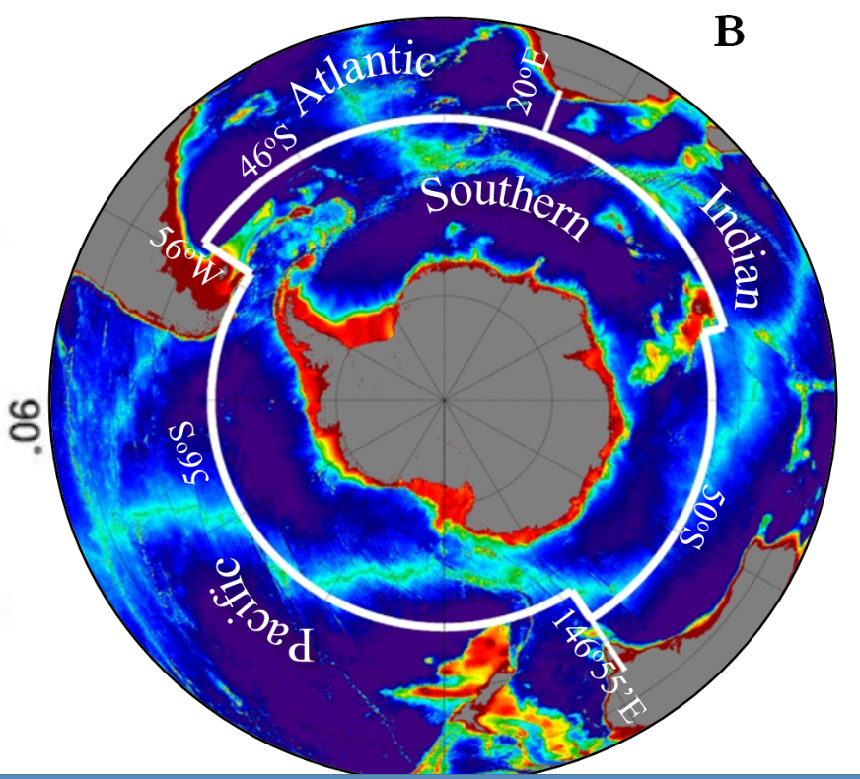

Slide 40
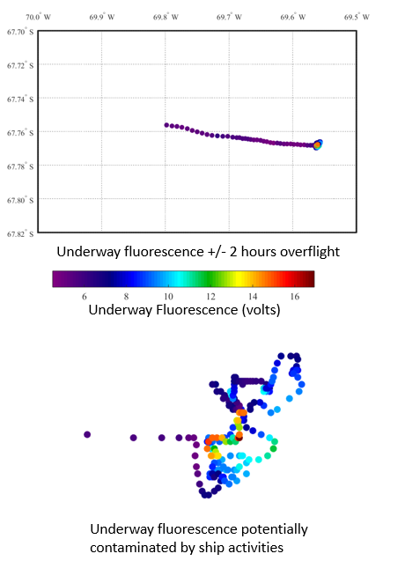
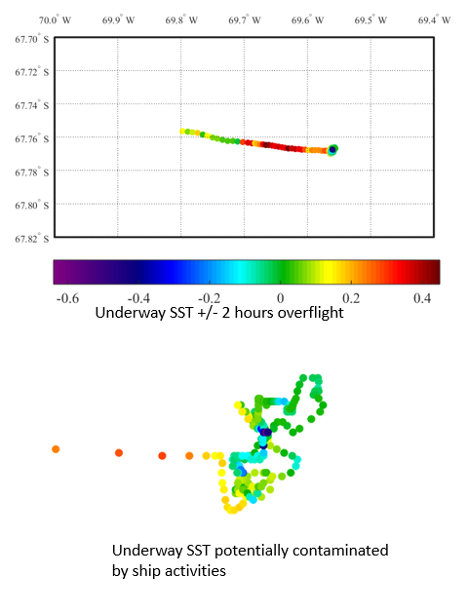

Slide 41


