Slide 1
AWAS trace gas measurements during ORCAS
Sue Schauffler, Valeria Donets, Rich Lueb, Roger Hendershot, Elliot Atlas
Eric Apel, Becky Hornbrook, Alan Hills, Doug Kinnison, Simone Tilmes
Ryan Hossaini, Qing Liang , Steve Montzka
RSMAS/University of Miami
NCAR ACOM
Leeds Univ., NASA GSFC, NOAA

Slide 2
Measurements objectives
Reactive gas emissions/distributions/fluxes
  Halocarbons (bromoform, dibromomethane)
  Sulfur (DMS)
  Organic nitrates (Alkyl nitrates C1 – C4)
  Methyl iodide (….later)
Correlation to remote sensing & biogeochemical processes
  Other trace gas correlations
Transport/air mass diagnostics
  Atmospheric trends and interhemispheric transport
  NMHCs, halogenated solvents
  Vertical profiles/transport time scales
CFCs/HCFCs/solvents in the lower stratosphere

Slide 3
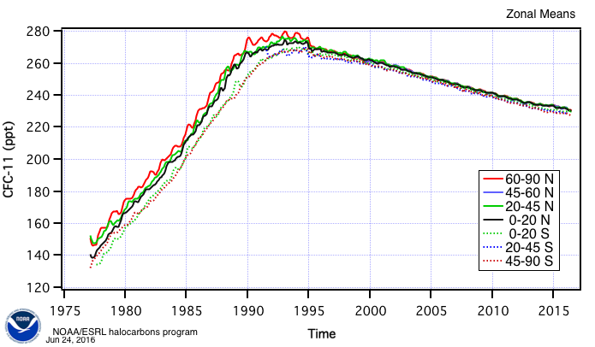
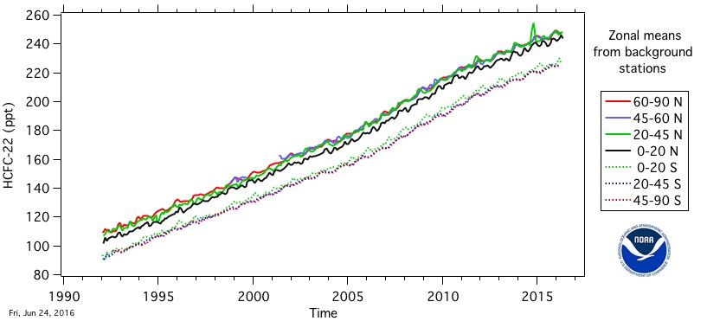
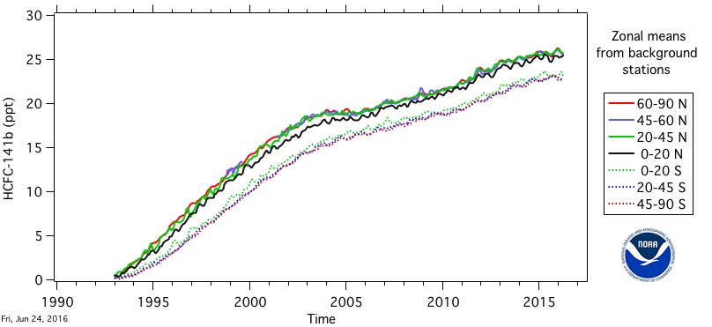
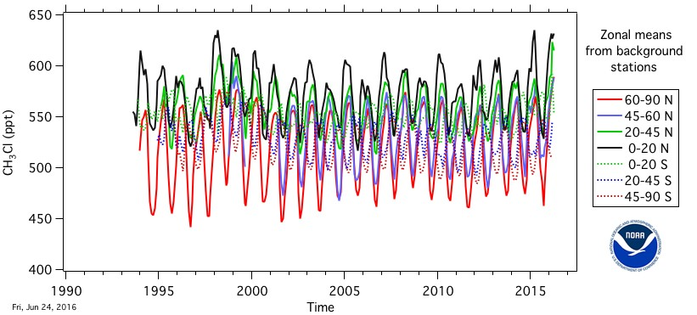
Temporal trends of long-lived halocarbons
CFC 11
HCFC 22
HCFC 141b
CH3Cl

Slide 5
Comparisons to CO2 trend: MLO
Linear trend:
HCFC-22: 5.4 ppt/yr
CO2: 1.9 ppm/yr

Slide 6
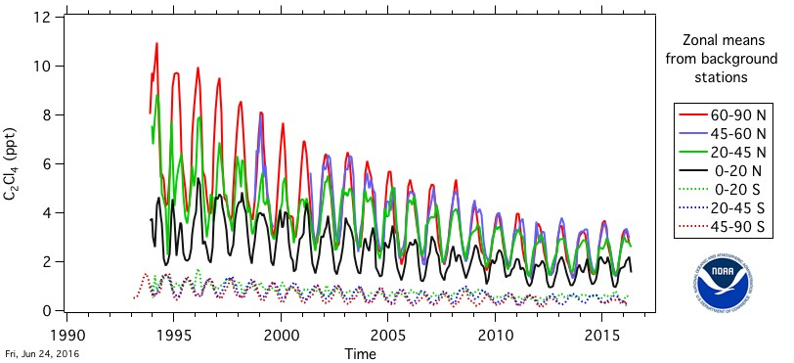
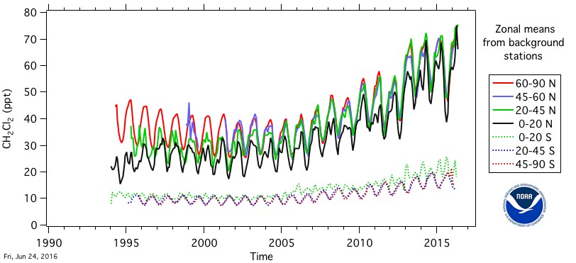
Temporal trends of shorter-lived halocarbons
C2Cl4
Perchlorethylene
CH2Cl2
Dichloromethane
CHCl3
Chloroform
AGAGE data

Slide 7
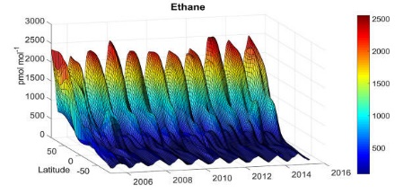
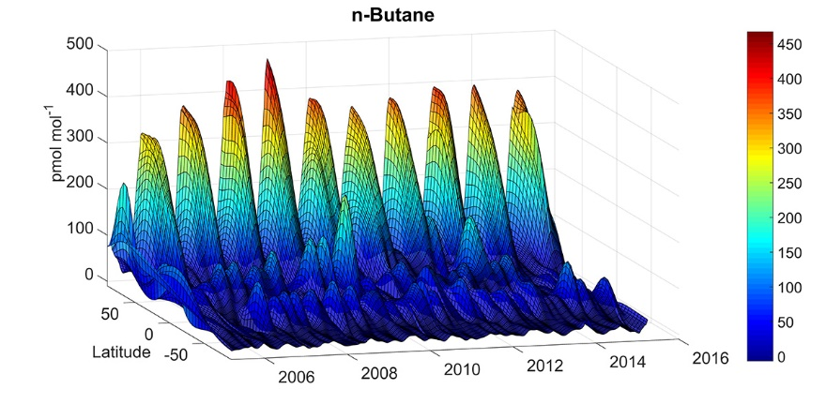
Temporal trends of short-lived hydrocarbons
Data from INSTAAR; D. Helmig et al.

Slide 8
Interhemispheric difference: profiles
DATA from
HIPPO_1
(JAN 2009)
(NOAA+UM)

Slide 9
Altitude profile – Dichloromethane
ORCAS

Slide 10
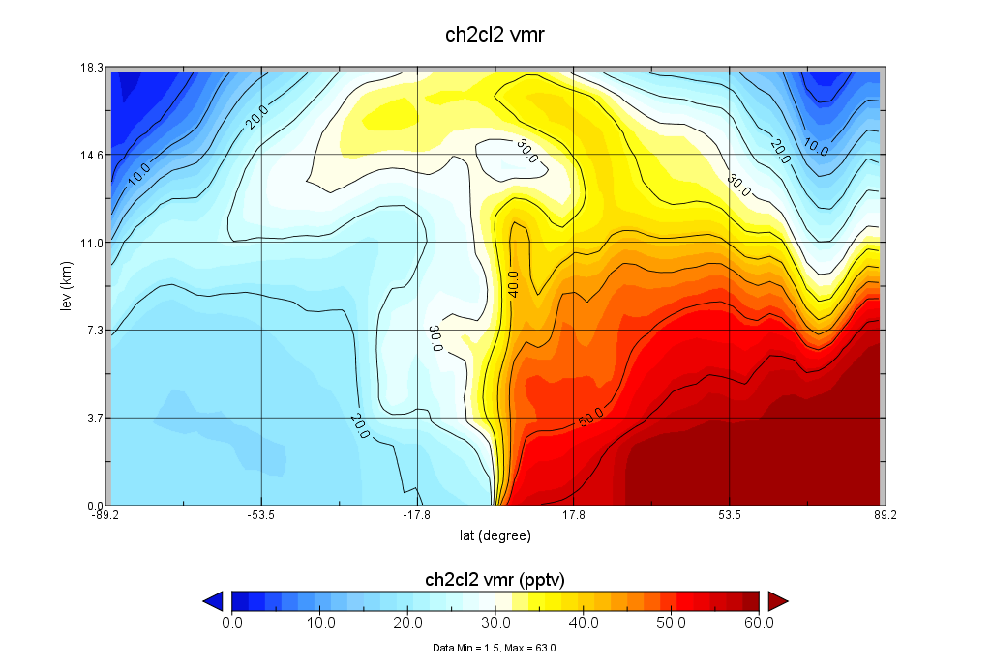
CH₂Cl₂ – TOMCAT (trop) – January mean
Courtesy of R. Hossaini

Slide 11
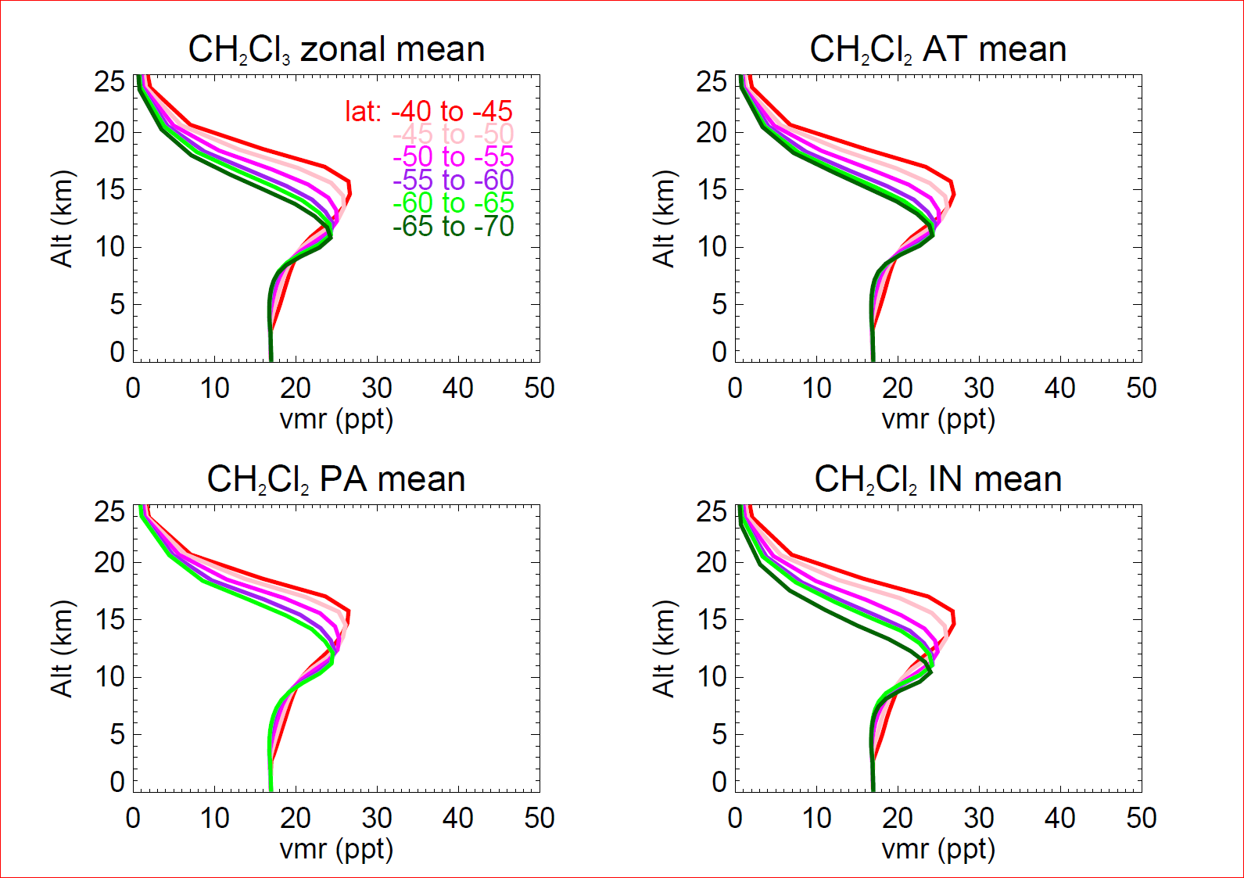
CH₂Cl₂ – TOMCAT (trop) – January mean

Slide 13
Time series – long-lived halocarbons
RF#
-2 -1 1 2 3 4 6 7 8 9 11 14 17 18 19
*
HCFC141b
CFC11
CCl4
* CMDL or AGAGE S. Hemisphere
*

Slide 14
Time series – anthropogenic
-2 -1 1 2 3 4 6 7 8 9 11 14 17 18 19
CH2Cl2
C2Cl4
Ethane

Slide 15
Vertical profiles of selected gases
(stratospheric samples removed)

Slide 17
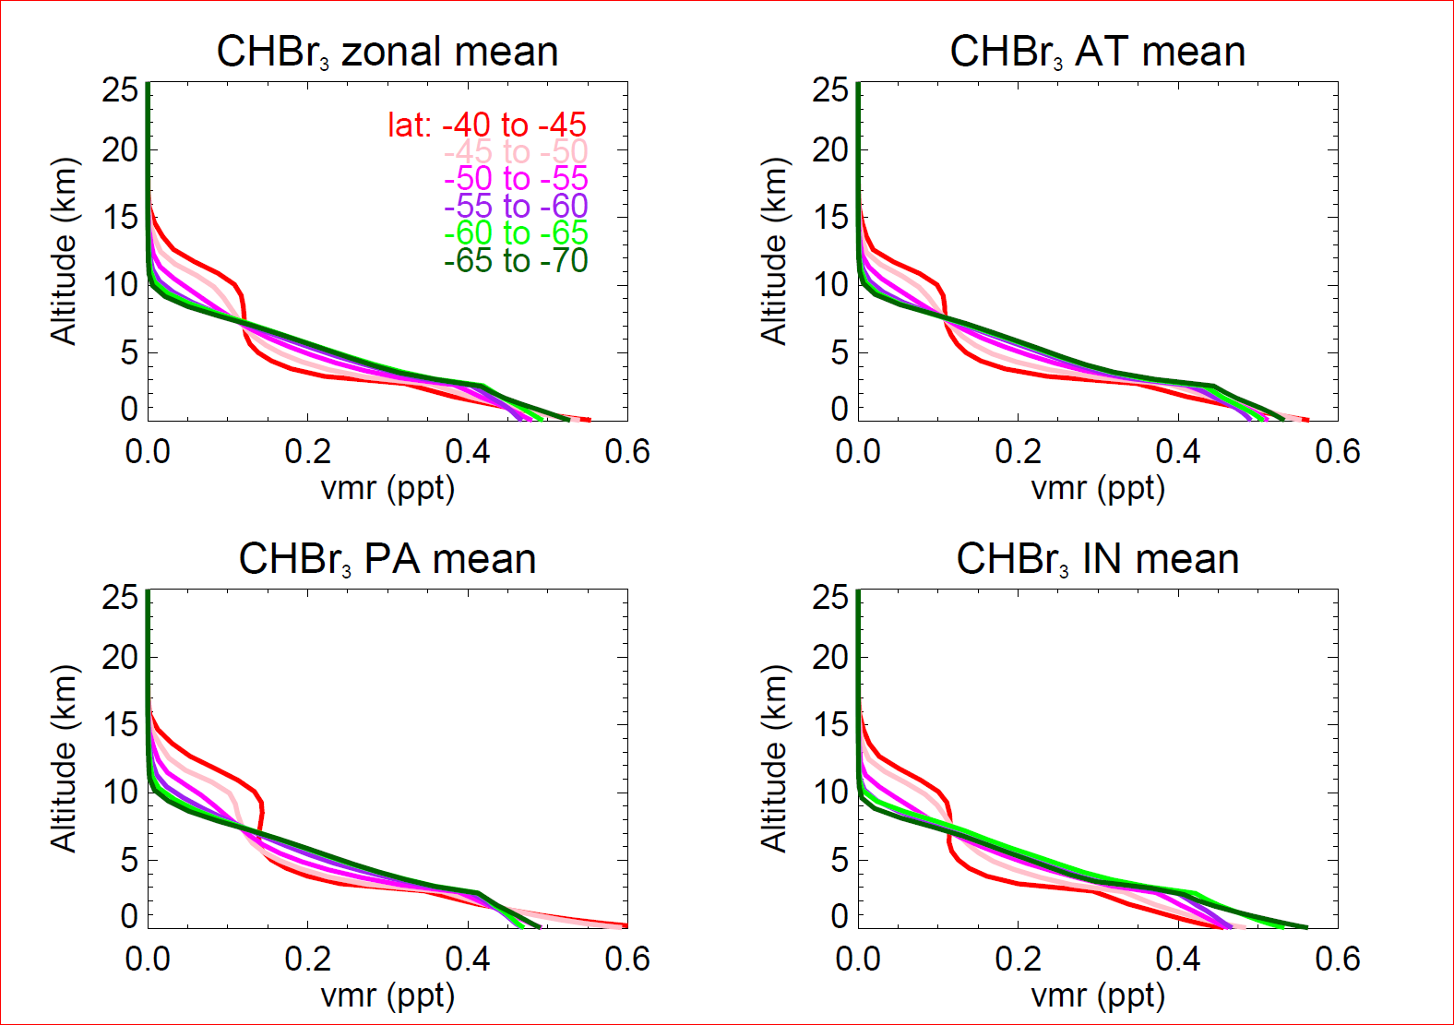
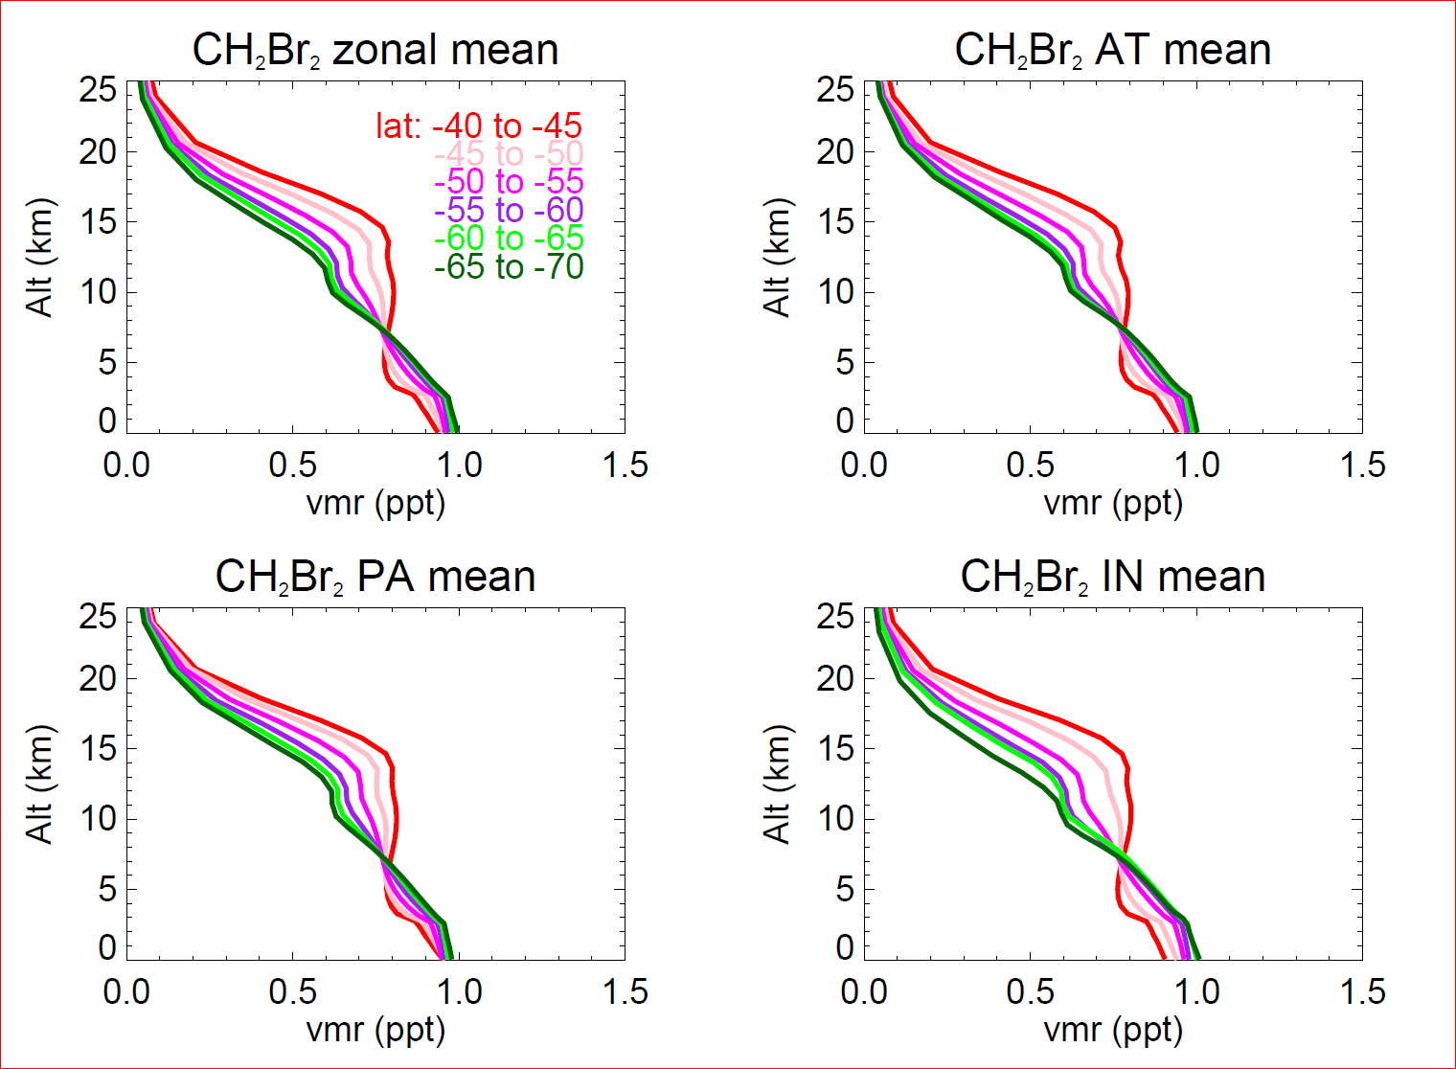
CHBr₃ & CH₂Br₂ – TOMCAT (trop)

Slide 20
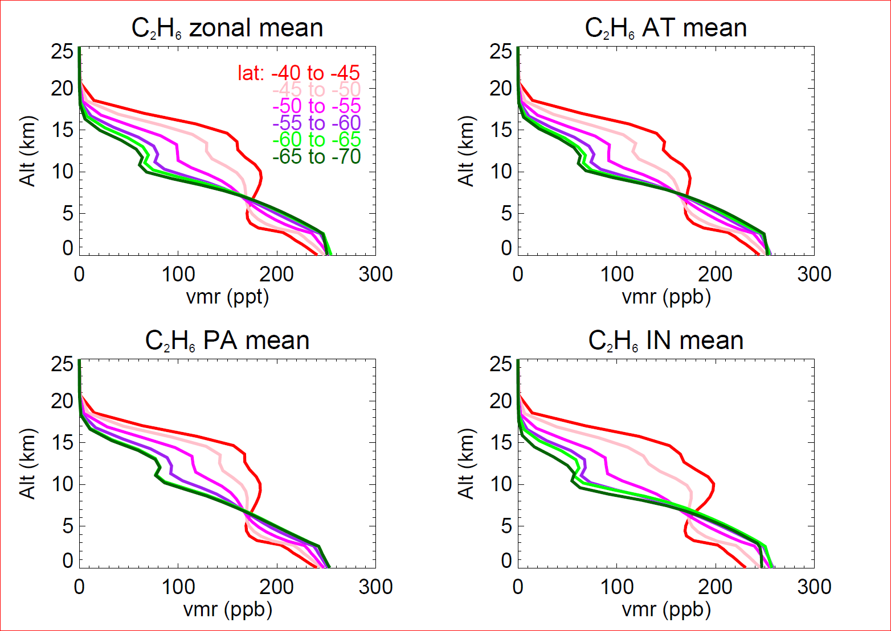
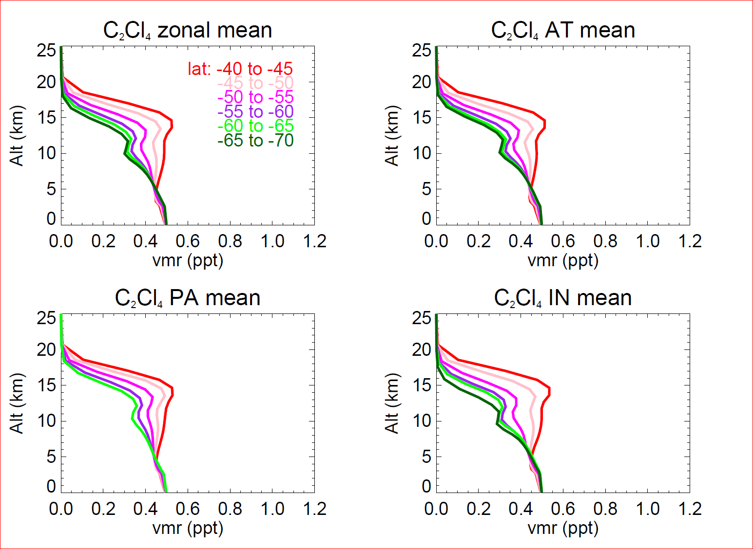
Ethane & C₂Cl₄ – TOMCAT (trop)

Slide 21
Model Ethane vs ORCAS

Slide 22
Model Methyl Chloride vs ORCAS

Slide 24
Ratio to concentrations in BL
 | MID TROP (4.5 Km) | UPPER TROP (11.5 km)
CHBr3 | 0.273 | 0.000
DMS | 0.011 | 0.007
MeONO2 | 0.285 | 0.084
CH2Br2 | 0.704 | 0.575
CH3CCl3 | 0.972 | 0.974
CHCl3 | 0.898 | 0.977
CCl4 | 0.996 | 0.988
CFC11 | 0.996 | 0.991
CFC12 | 1.001 | 0.996
CFC113 | 0.996 | 0.997
CO2_NOAA | 1.004 | 1.006
CH4_NOAA | 1.003 | 1.013
HCFC141b | 1.004 | 1.013
HCFC22 | 1.014 | 1.029
Halon1211 | 1.023 | 1.054
O2_AO2 | 1.043 | 1.098
CH3Cl | 1.042 | 1.108
C2Cl4 | 1.095 | 1.143
CO_NOAA | 1.097 | 1.213
CH2Cl2 | 1.054 | 1.388
C2H4Cl2 | 1.025 | 1.482
Ethane | 1.238 | 1.702
Marine emissions
Long lived halocarbons
(negative trend, small interhem. gradient)
HCFCs
(positive trend, significant IH gradient)
Strong seasonality
Hemispheric asymmetry
Anthropogenic gases
N. Hemis source
Shorter lifetimes

Slide 25
Correlations with CO2
561 ppt
401.0 ppm
225.5 ppt
401.0 ppm
501 ppt
398.1 ppm
221 ppt
398.1 ppm

Slide 26
Time series – marine emissions
-2 -1 1 2 3 4 6 7 8 9 11 14 17 18 19
CHBr3
Methyl
Nitrate
DMS
No data

Slide 27
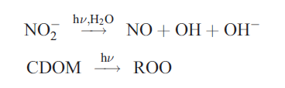
Marine sources of RONO₂
From Dahl et al. (2003),
  In seawater, photolysis of nitrite, organic matter
  Followed by:
  From seawater: Methyl>Ethyl>Propyl, etc.

Slide 28
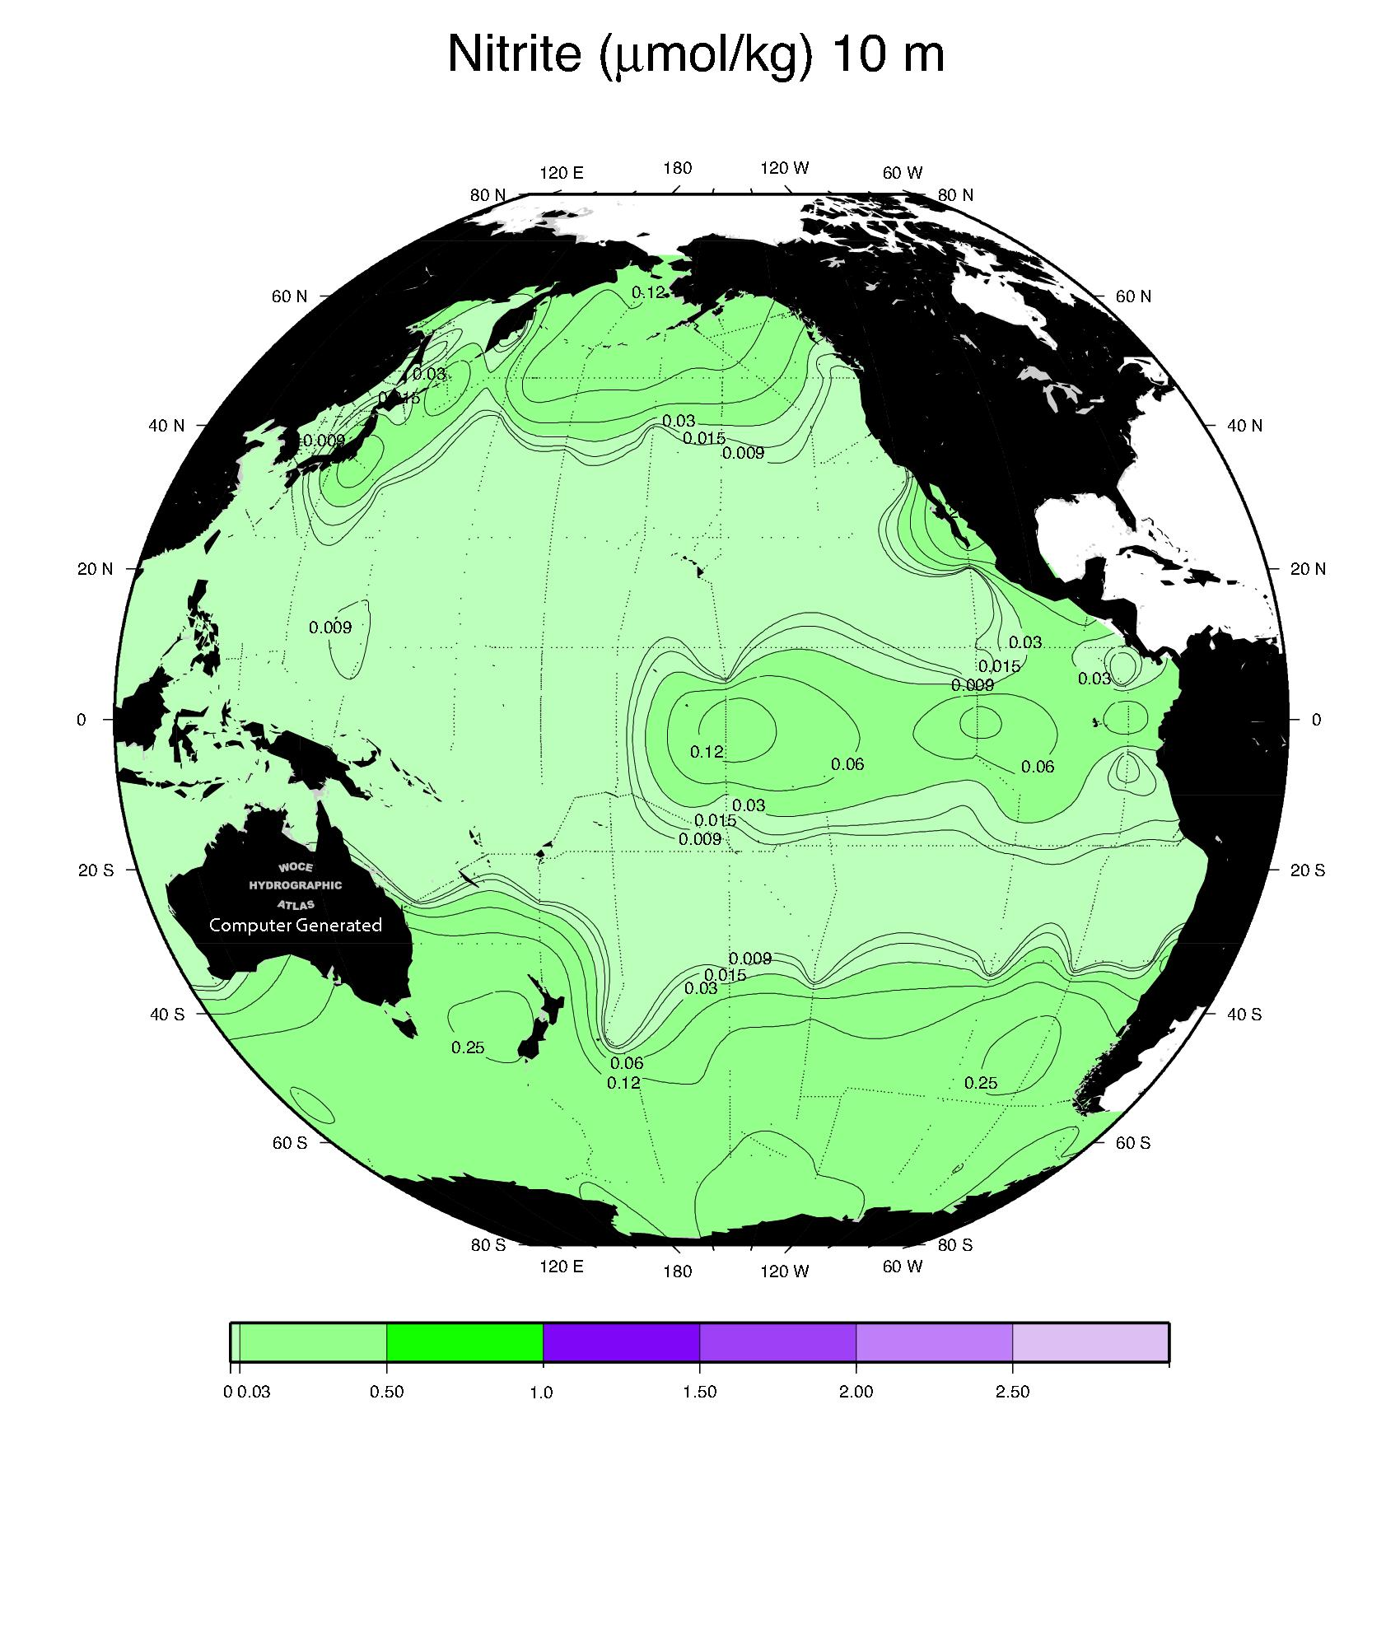
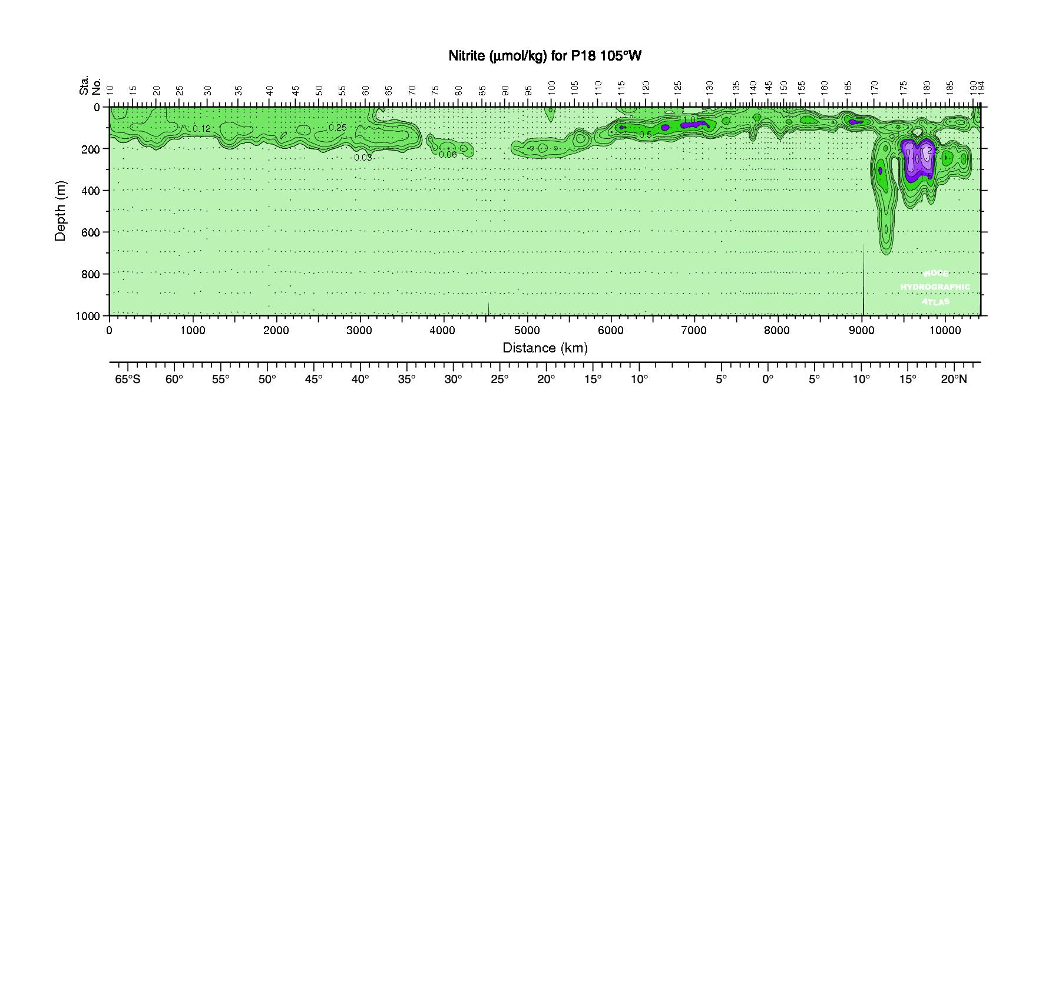
Nitrite in Pacific Ocean waters

Slide 29
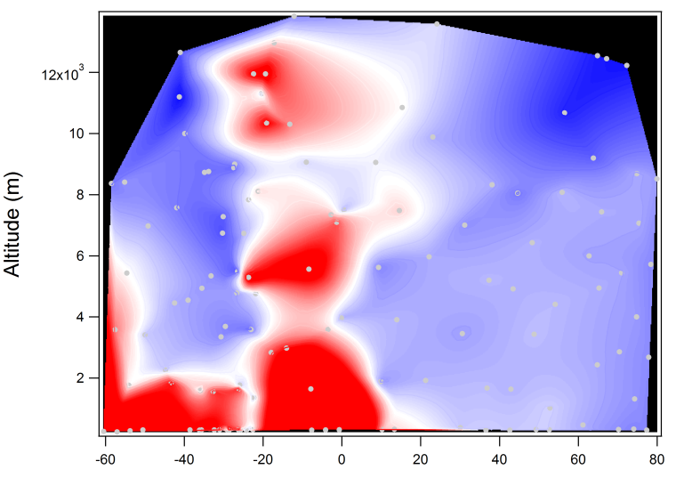
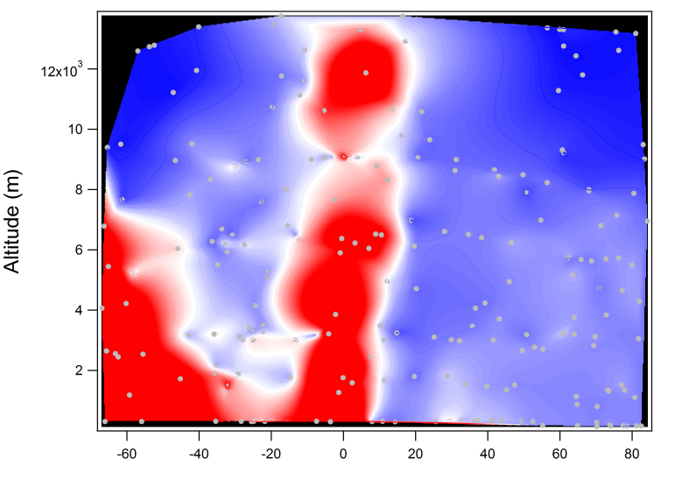
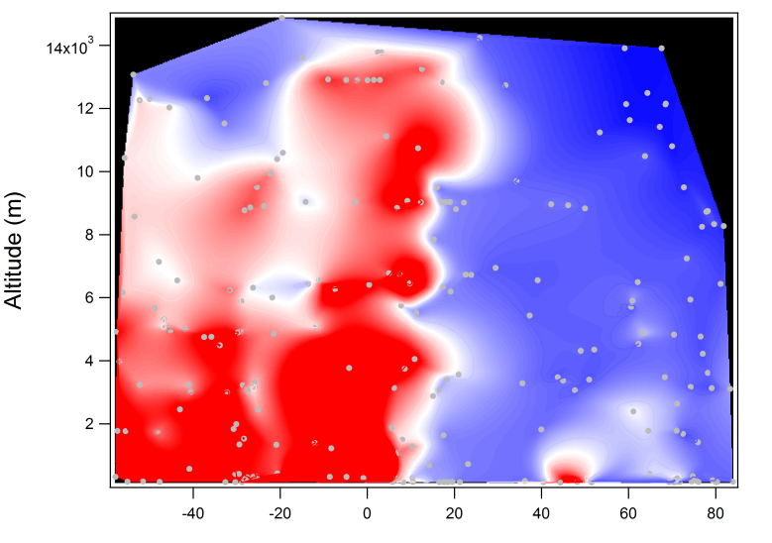
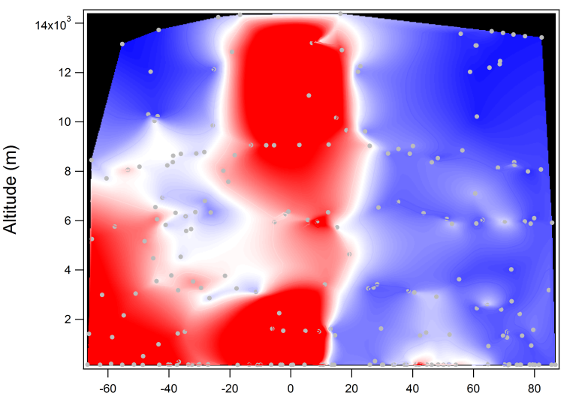
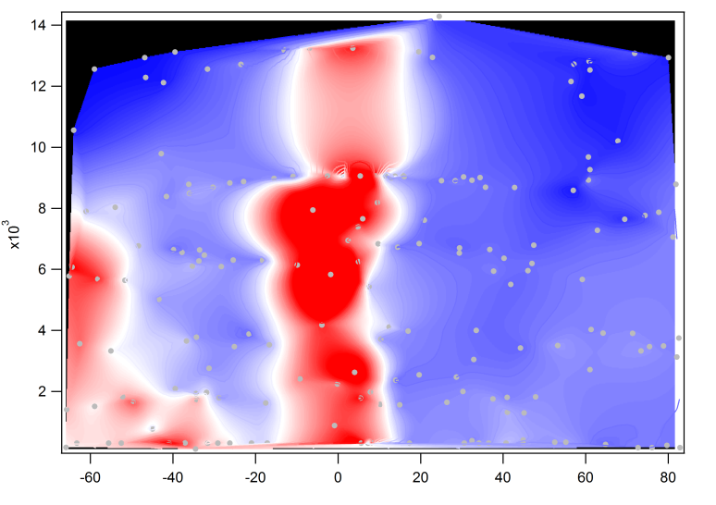
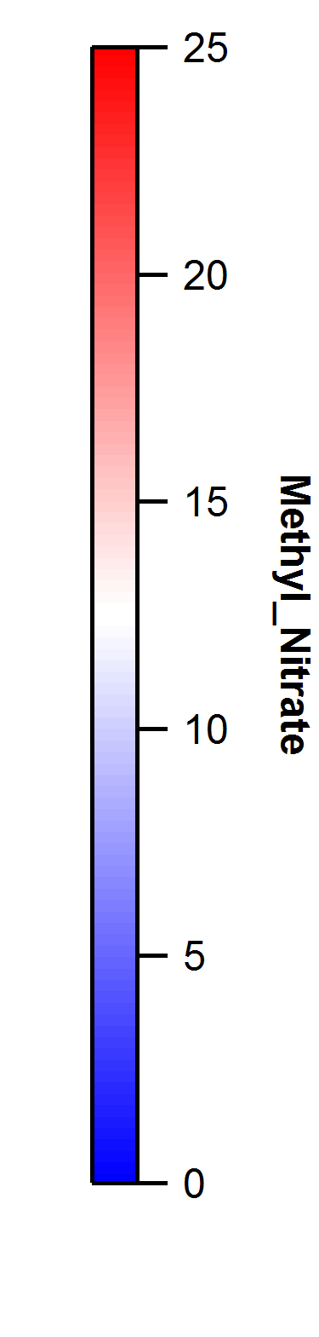
Methyl Nitrate (CH₃ONO₂)
14
12
10
8
6
4
2
0
Data from HIPPO1 - 5
ALTITUDE (km)
>

Slide 30
Methyl and Ethyl Nitrate cruise observations
(no correlation to Chla; near air-sea equilibrium)

Slide 31
Methyl Nitrate
ASTRA cruise; Oct. 2015
ORCAS; Jan/Feb 2016
(small = high alt)

Slide 32
Multi-correlation matrix for selected measurements
(integrated over AWAS fill times)

Slide 33
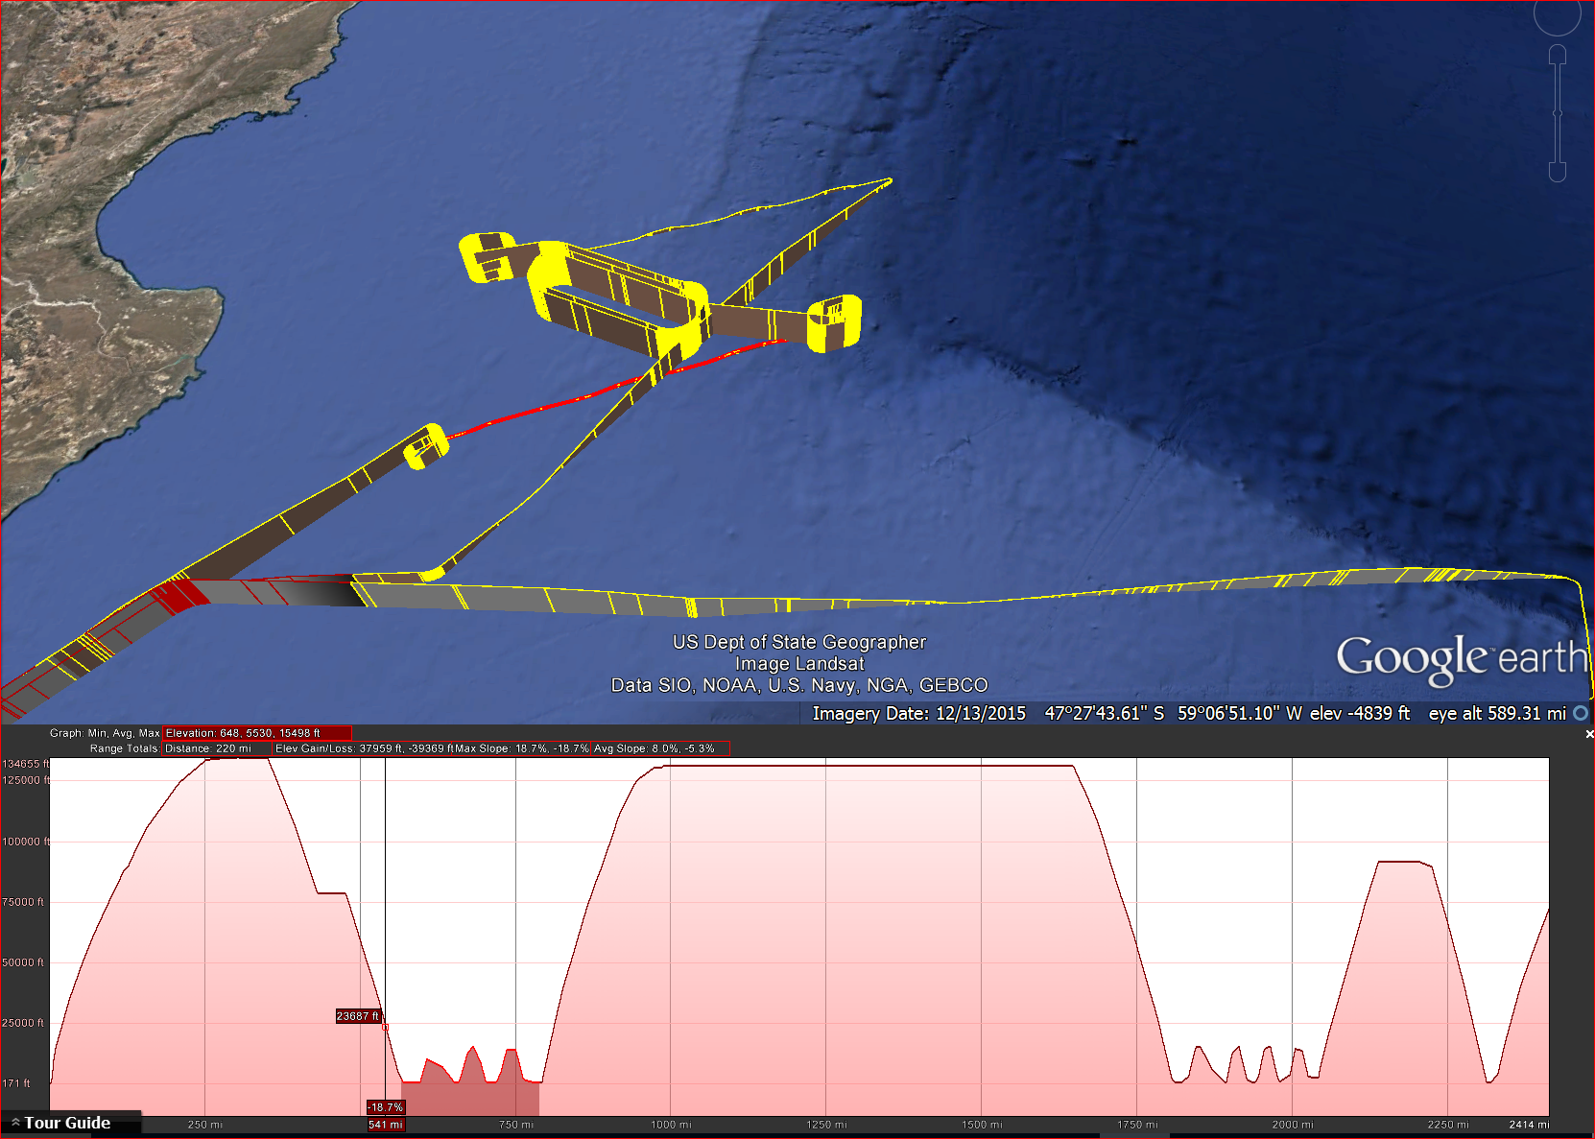
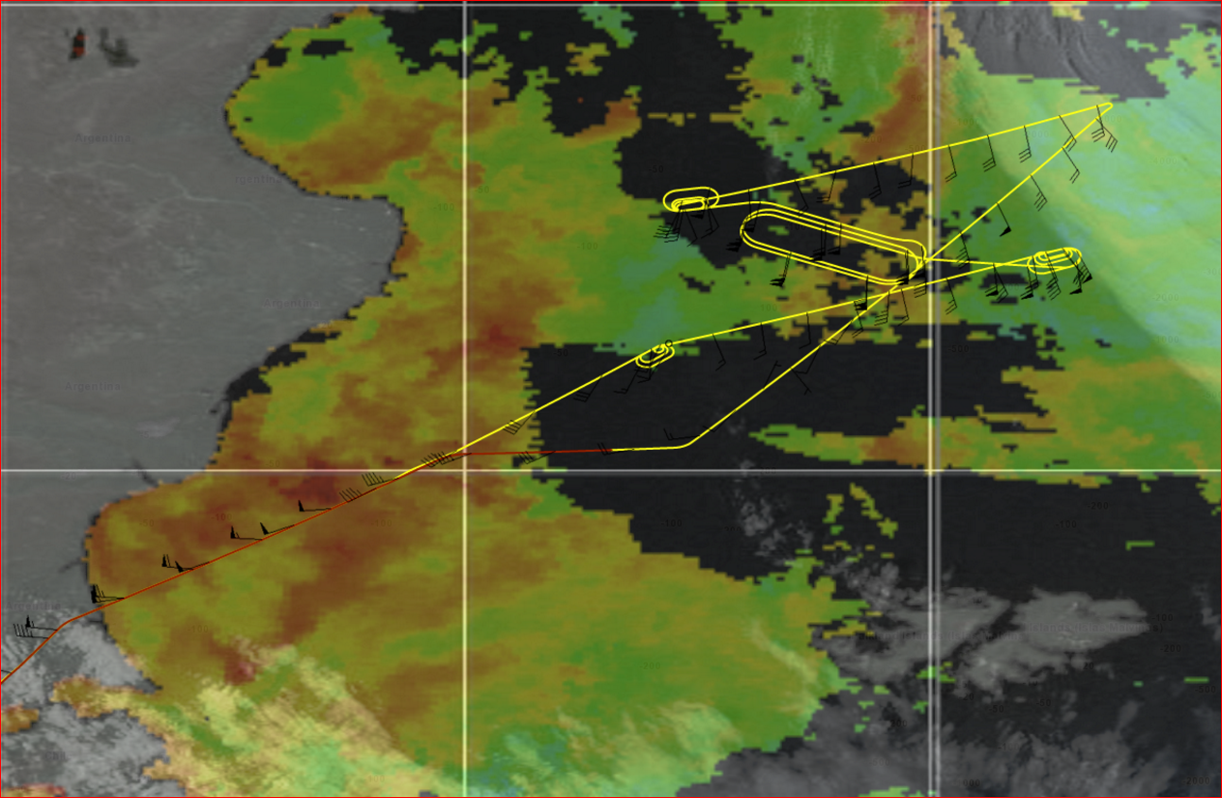
RF07: Patagonian Shelf
Wind

Slide 34
RF07: Patagonian Shelf
CHBr3
Methyl
Nitrate
DMS

Slide 35
Boundary Layer*: CHBr₃ vs CH₂Br₂
RF14
RF7
= flask data (Palmer Station^)
* Selected samples < 1 km
^ courtesy of Steve Montzka, NOAA

Slide 36
Boundary Layer: CHBr₃ vs Methyl Nitrate
RF04
RF09
RF7
RF14

Slide 37
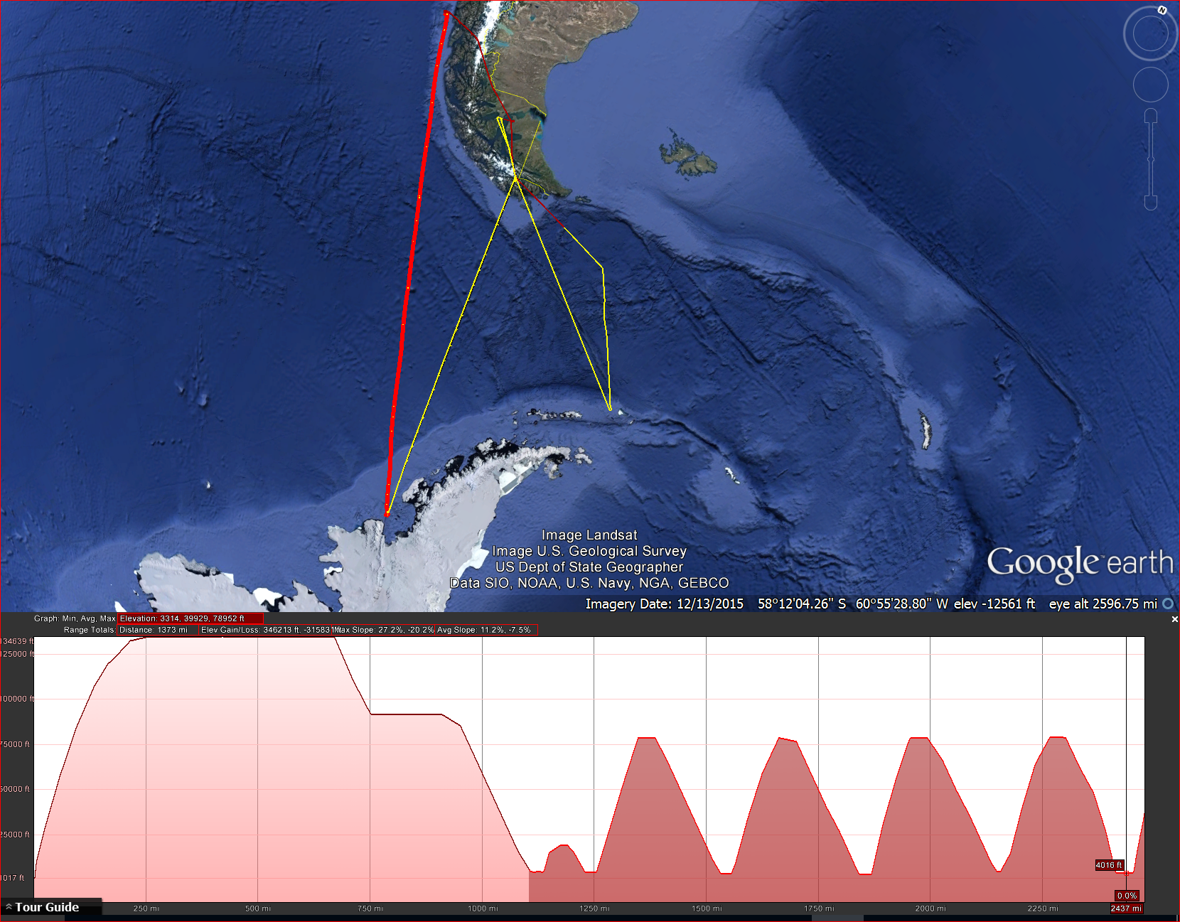
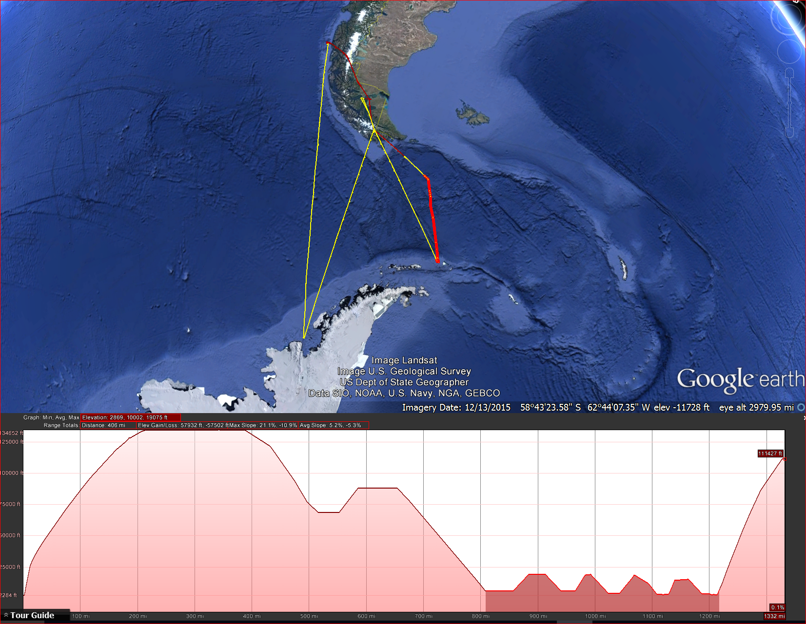
“Lagrangian” flights: RF17 & RF18
RF17
RF18
approximate
wind dir
Flt direction:
S to N
Flt direction:
S to N

Slide 38
“Lagrangian” flights: RF17 & RF18
RF17
RF18
CHBr3
Methyl
Nitrate
DMS

Slide 39
Summary and next steps
Vertical structure/transport
  Clear links to NH transport pathway in upper troposphere
  Develop quantitative relationships
  Examine model features
  Long-range transport (UT) vs. surface emissions
Biogenic/Surface emissions
  Geographic/temporal trends examine in more detail
  Links to remote sensed pigments?
    Regional distributions vs hot spots
  Other biogeochemical factors (nitrite?, O2?)
  STILT model

Slide 41
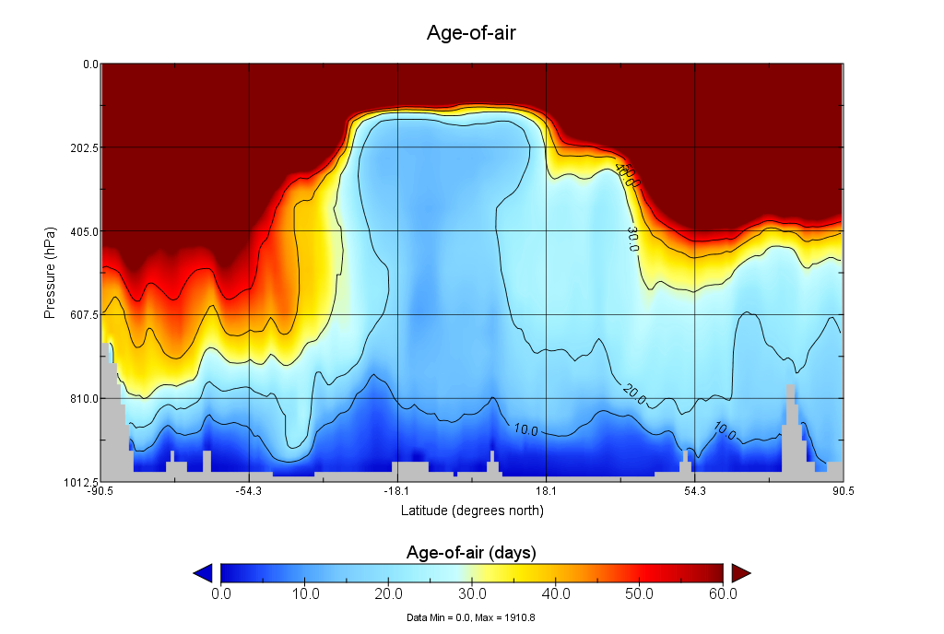
Geos Chem

Slide 42
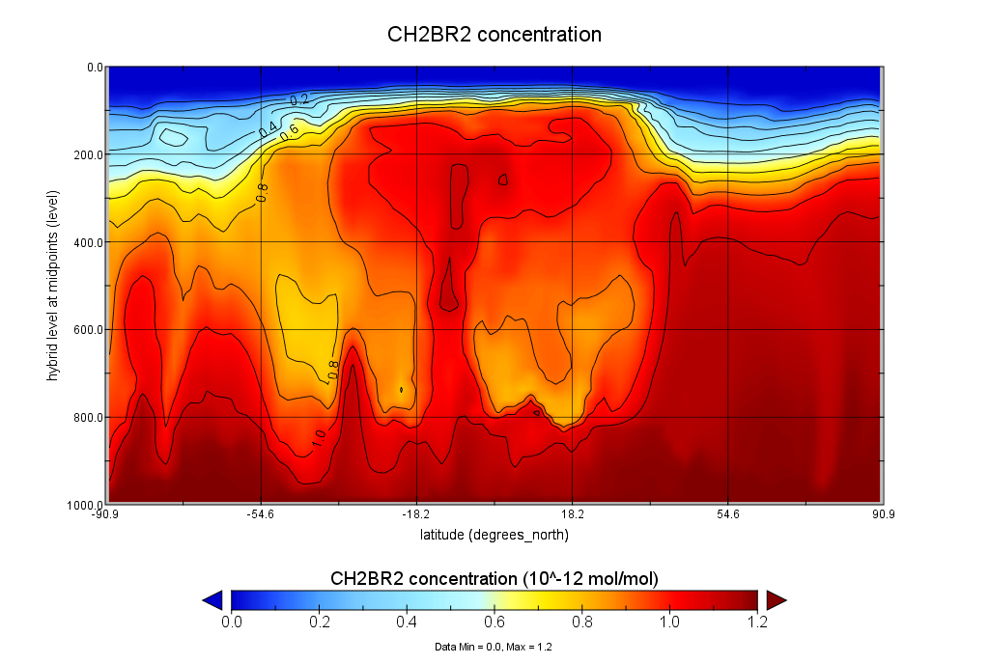
CAM-Chem (1.2 ppt boundary condition)

Slide 43
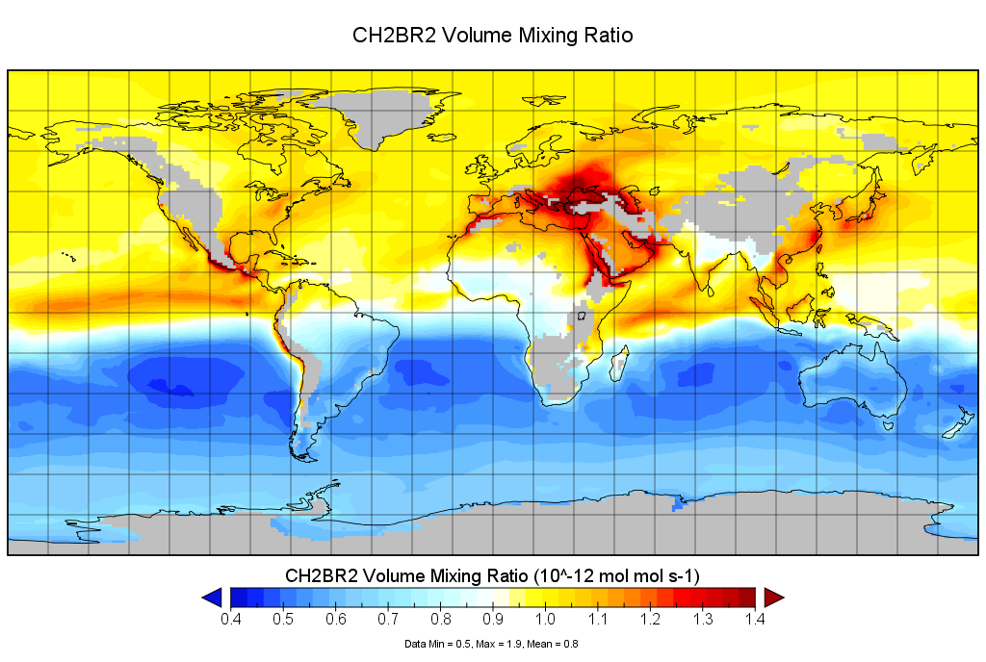
GEOS Chem

Slide 44
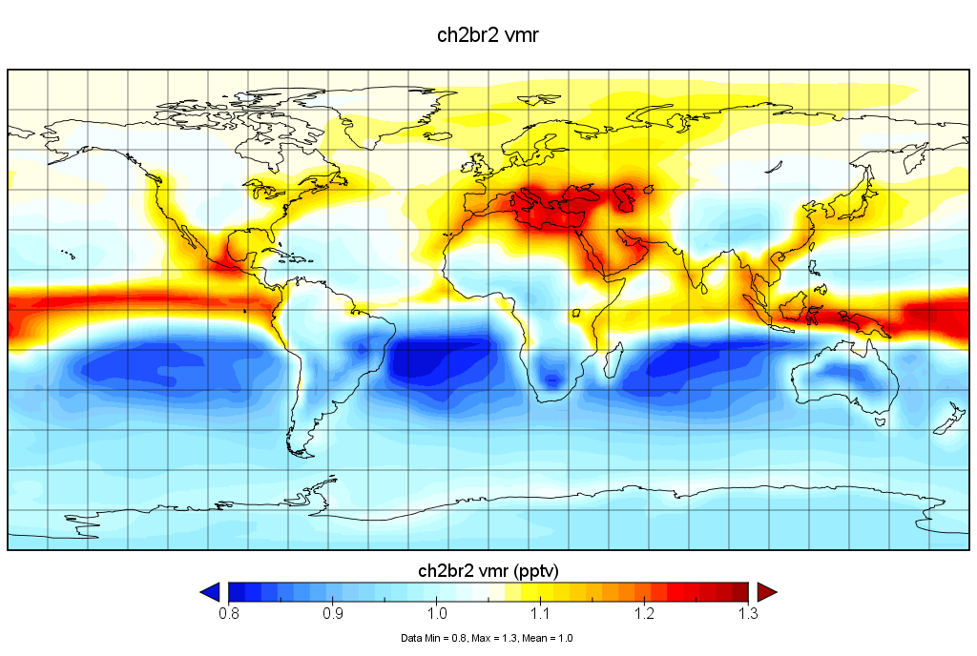
TOMCAT

Slide 45
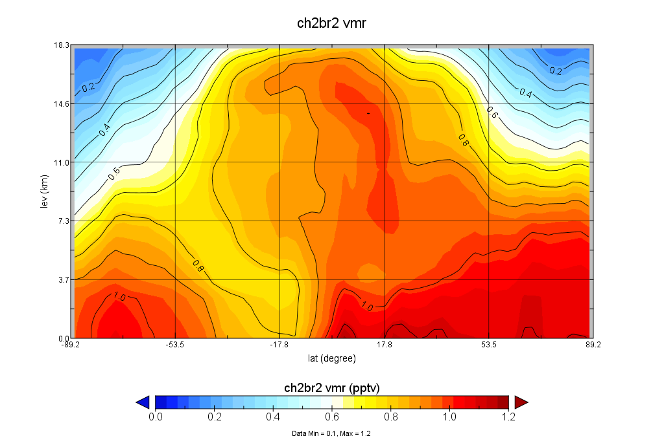
TOMCAT

Slide 46
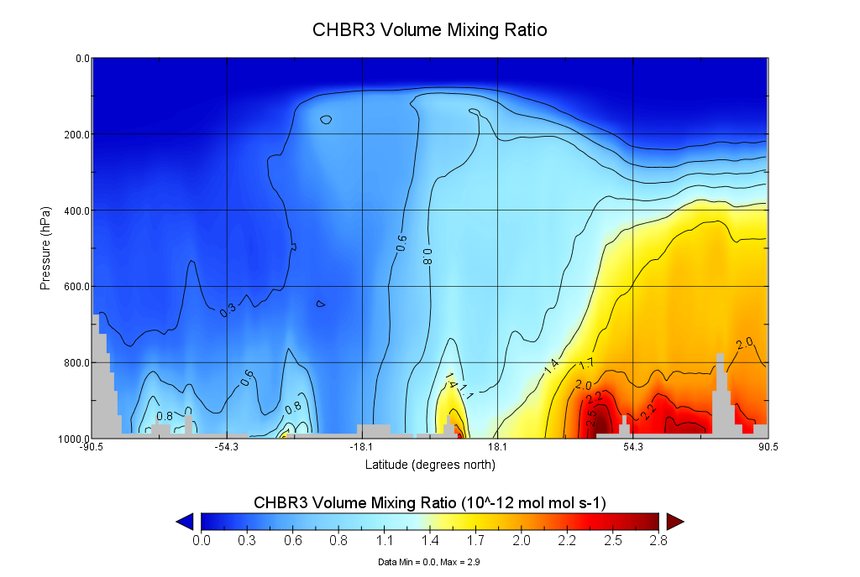
GEOS Chem

Slide 47
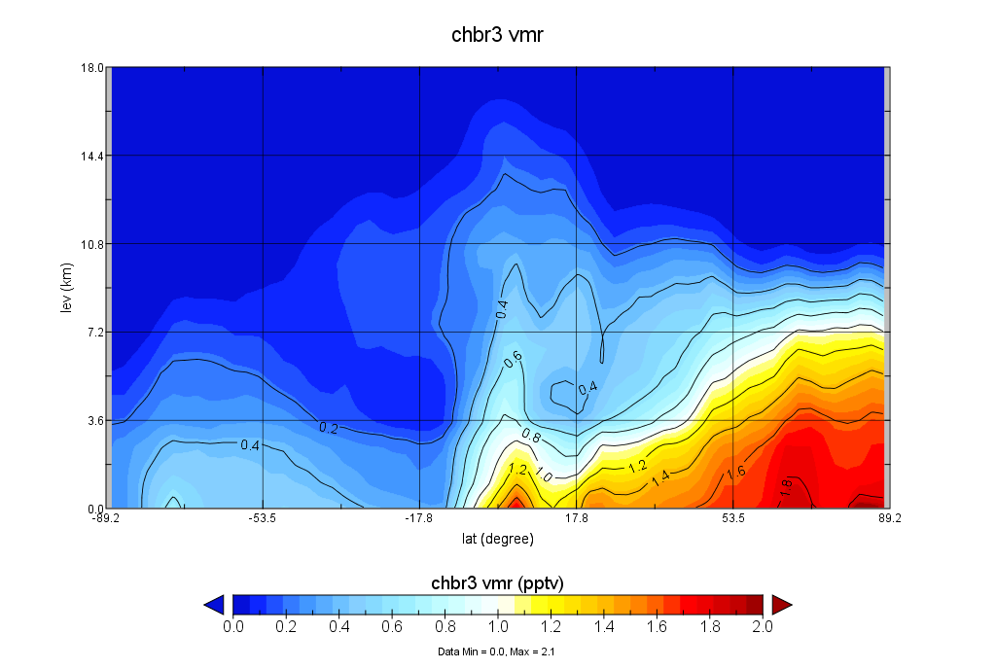
TOMCAT

Slide 48
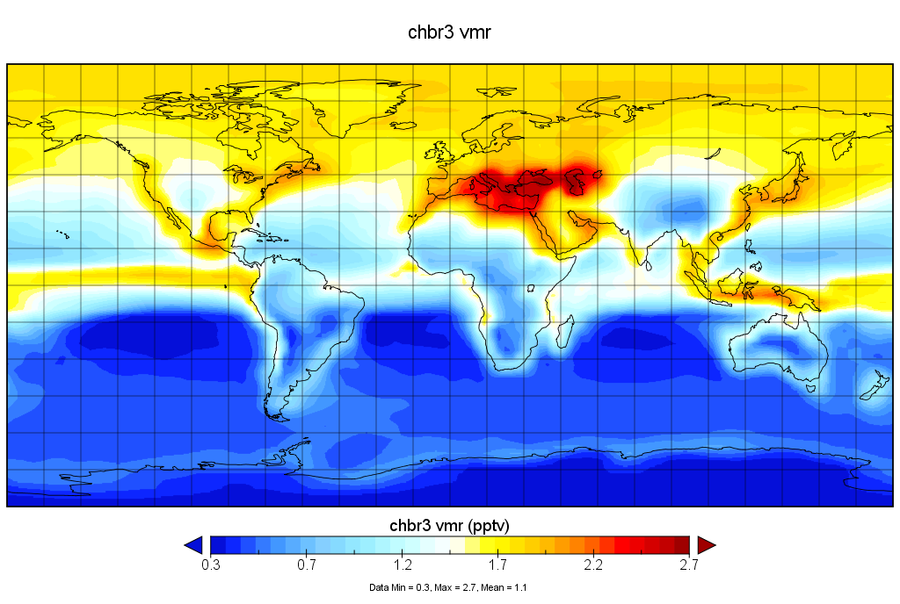
TOMCAT

Slide 49
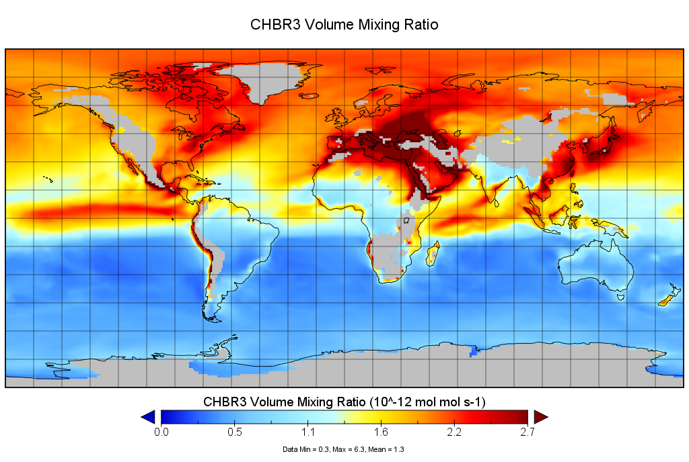
GEOS Chem

Slide 50
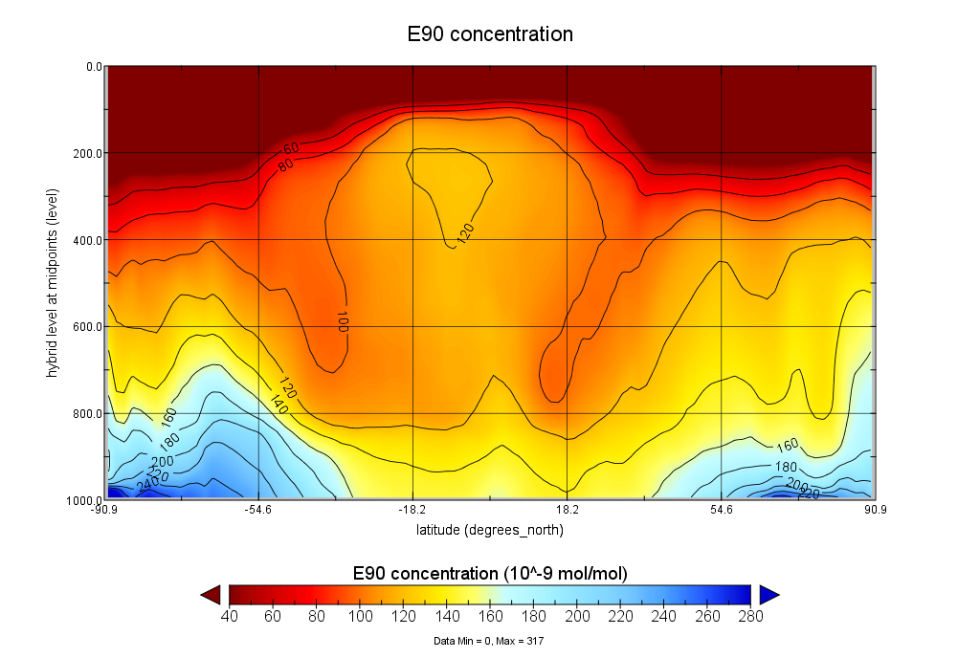
CAM Chem

