Slide 1
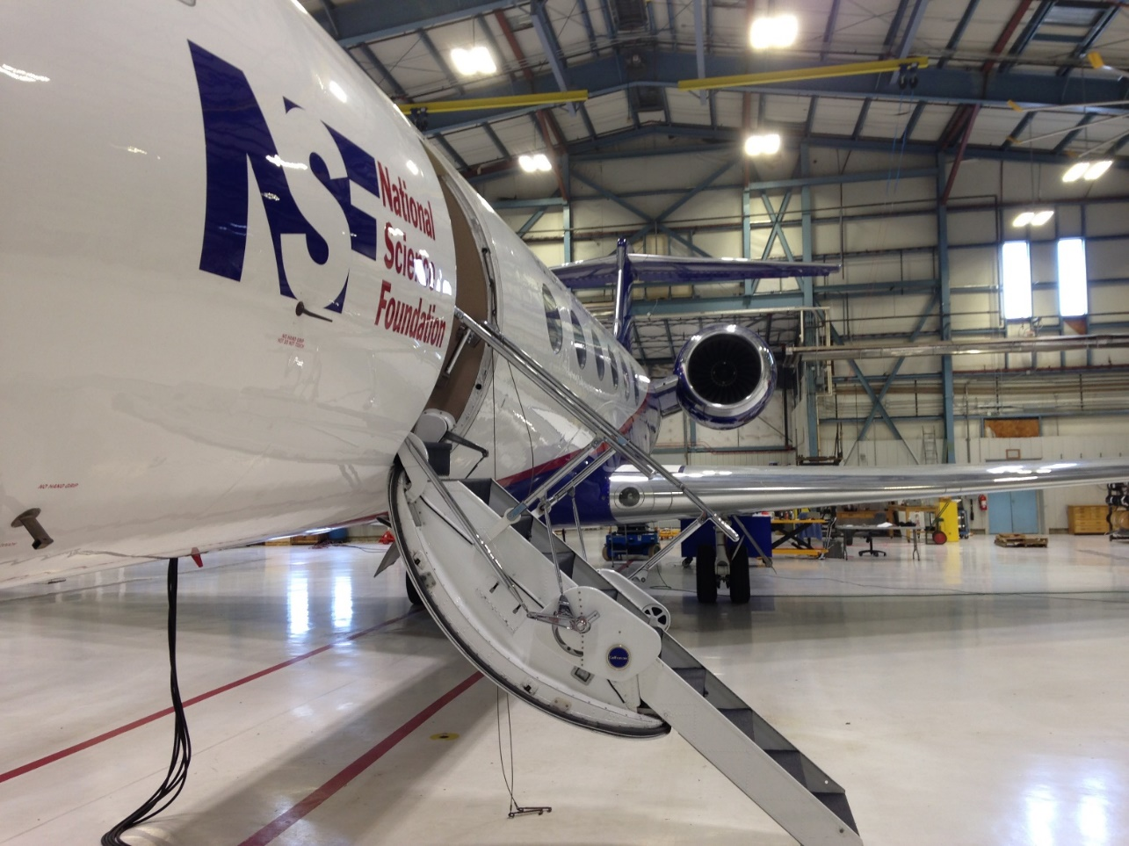


Water vapor measurements from the VCSEL hygrometer and cloud microphysical properties in ORCAS campaign
Minghui Diao, John D’Alessandro
Department of Meteorology and Climate Science
San Jose State University
2016-August-02
Notes:
1

Slide 2
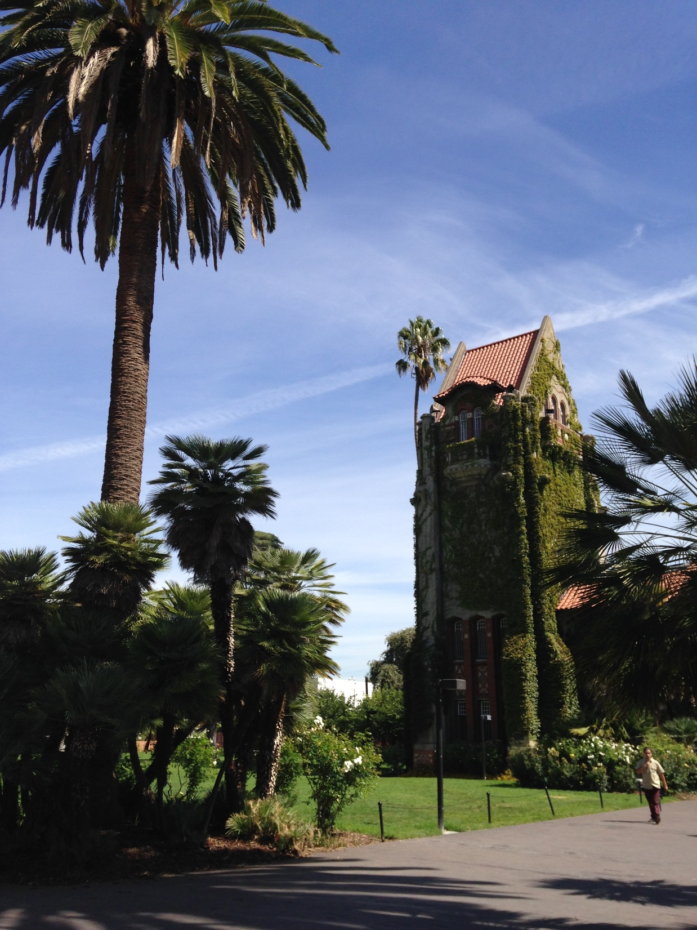
Outline
Motivation
  Importance of understanding relative humidity in cloud formation
QAQC data analysis
  Laboratory calibration in June-August 2016
  Examples of new QAQC VCSEL water vapor data
  Comparisons with NOAA Picarro and the DPXC values
Analysis of relative humidity and cloud microphysics
  Relative humidity distributions in ORCAS
  Comparison of RH distributions with WRF and CAM5
  Summary and future work
Notes:
First, Then the description of… will be given

Slide 3
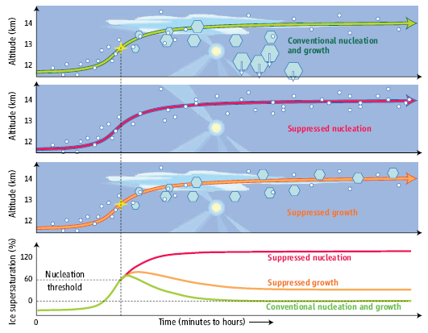
Birthplace of ice crystals – ice supersaturation
Ice Supersaturation (ISS)
Prerequisite condition for ice crystal formation
e: water vapor pressure
e_{s}: saturation vapor pressure wrt ice
ISS = RHi - 1 = e / e_{s} - 1
(Peter et al., Science, 2006)
How often do we see clear-sky ISS,
In-cloud ISS and
non-ISS clouds?
Three important ISS characteristics:
Magnitude
Frequency of occurrence
Spatial extent
Notes:
Last hours to days
Difficult to separate dynamical and aerosol factors
Cirrus cloud (Peter paper 2008 Science) 30% Earth coverage, Mysteries of cirrus cloud formation
Water vapor in the UT/LS (Soden paper)
Time (minutes to hours)

Slide 4
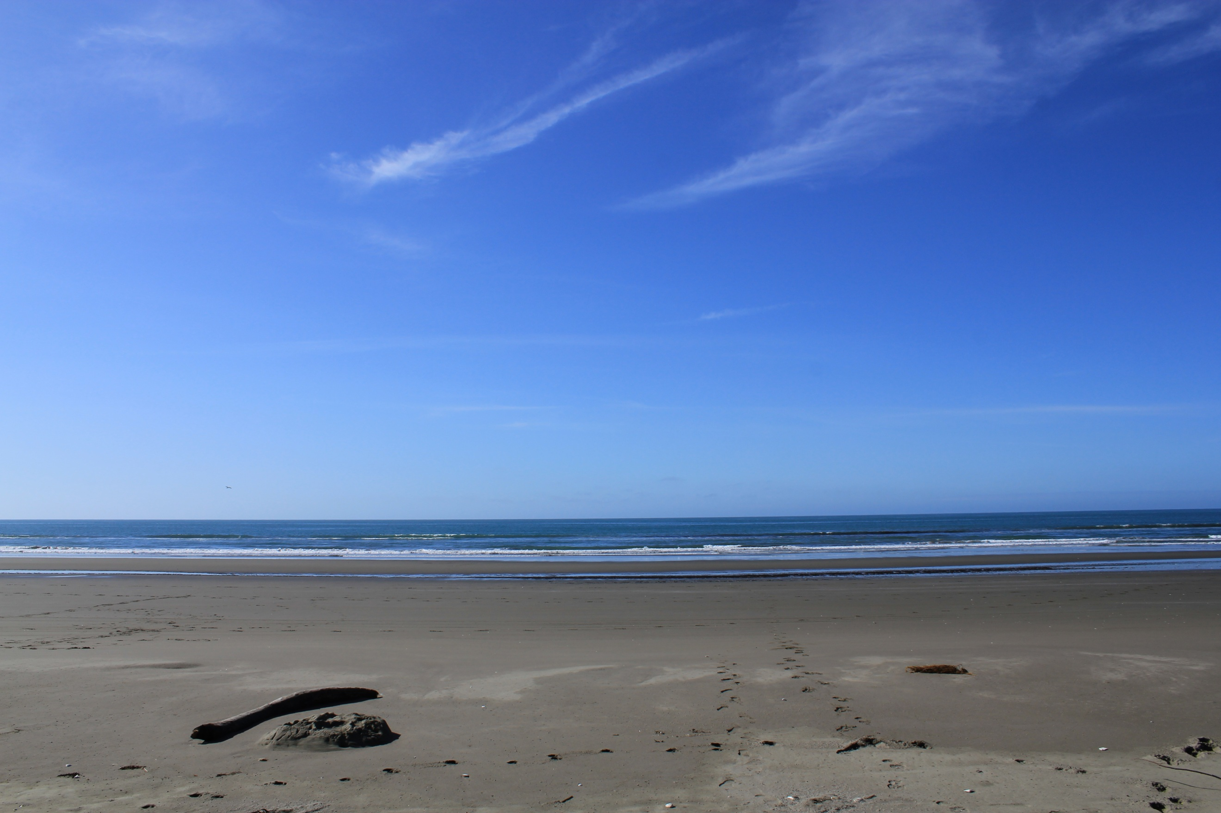
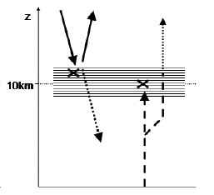
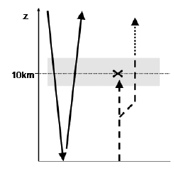
  Representing ice supersaturation in models
SW LW
SW LW
Cirrus clouds
Ice supersaturation
Up to 3 K d⁻¹ difference (Fusina et al. 2007)
  Recent development with ISS allowance in models:
    Cloud models: e.g., Jensen et al. 2010; Bryan and Morrison, 2012
    Climate models: e.g., Tompkins et al. 2007; Salzmann et al. 2010; Gettelman et al. 2012
    - Requires more observations for validating and improving the model simulations/parameterizations
Notes:
Requires more observations for validating and improving the model simulation/parameterization

Slide 5
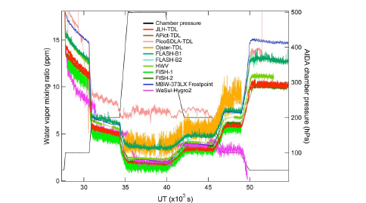
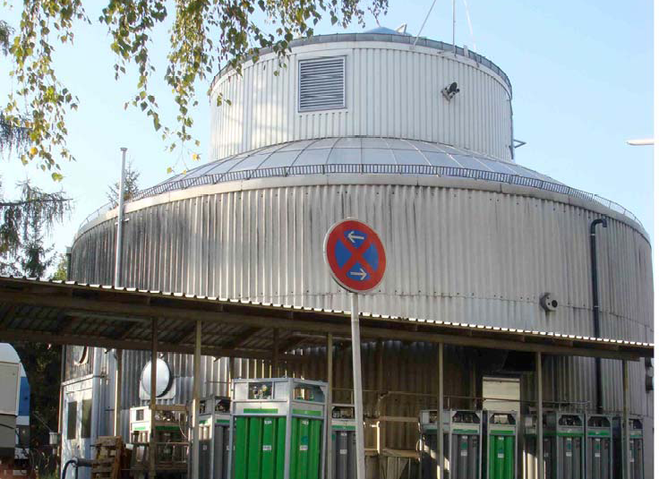
Challenges in water vapor in-situ measurements
Broad dynamic range from 1 to 40,000 ppmv | Hard to measure from the surface to the stratosphere continuously with one instrument
High affinity to surfaces and outgas frm surfaces | Hard to measure < 10 ppmv; Hard to calibrate in laboratory.
AQUAVIT campaign 2007
(Fahey et al., 2009)
AIDA Facility,
Karlsruhe,
Germany
Notes:
Challenges
Broad Dynamic Range
from 1 to 40,000 ppmv
High affinity to surfaces

Slide 6
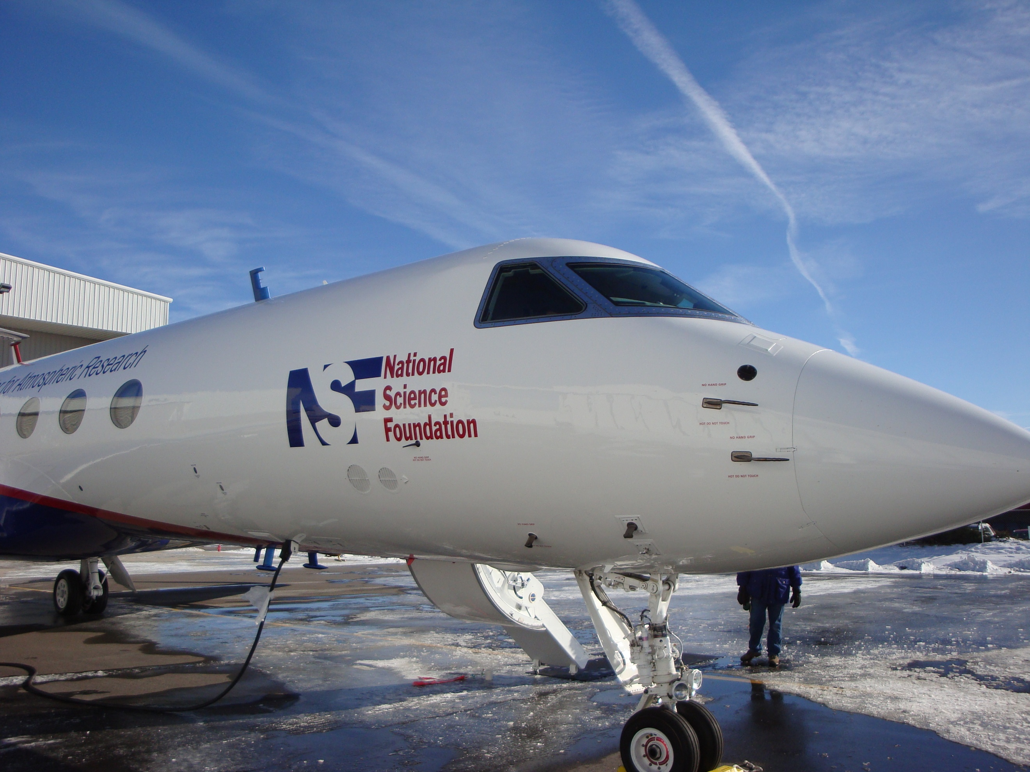
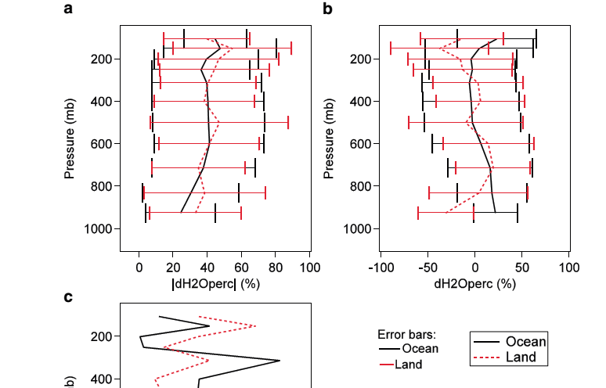
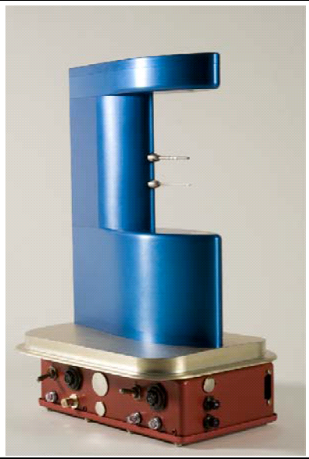
VCSEL hygrometer
Vertical Cavity Surface Emitting Laser (VCSEL) hygrometer
  Near infrared; 25 Hz; Analyses use 1 Hz;
  Accuracy ≤ 6%; Precision ≤ 1% (Zondlo et al. 2010)
Challenges | Solutions of VCSEL hygrometer
Broad dynamic range from 1 to 40,000 ppmv | 1854.03 nm (strong absorption) 1853.37 nm (weak absorption)
High affinity to surfaces | Open Path
With the most recent QC/QA temperature accuracy (±0.3 K), the RHi accuracy is ~7%-8% at -40ºC to -77ºC, respectively.
VCSEL
hygrometer
Validation of NASA AIRS water vapor and temperature
(Diao et al. 2013)
~40% H₂O difference, ~1–2 K T difference in the UT/LS

Slide 7
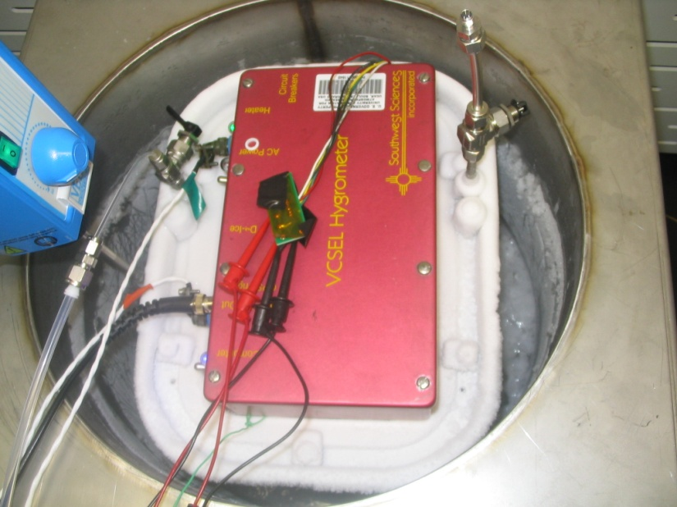
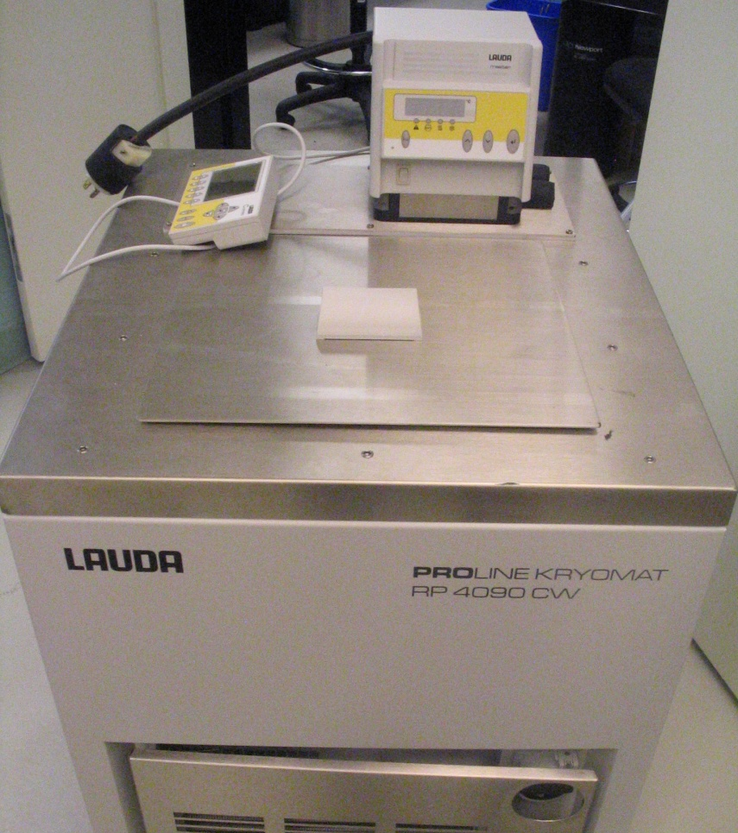
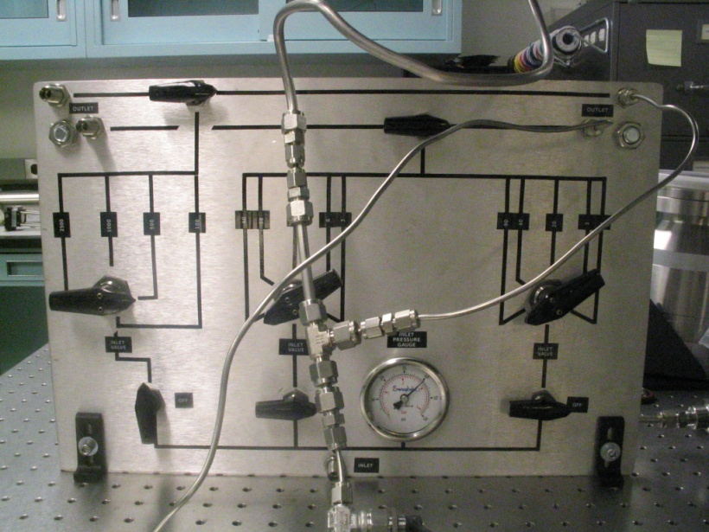
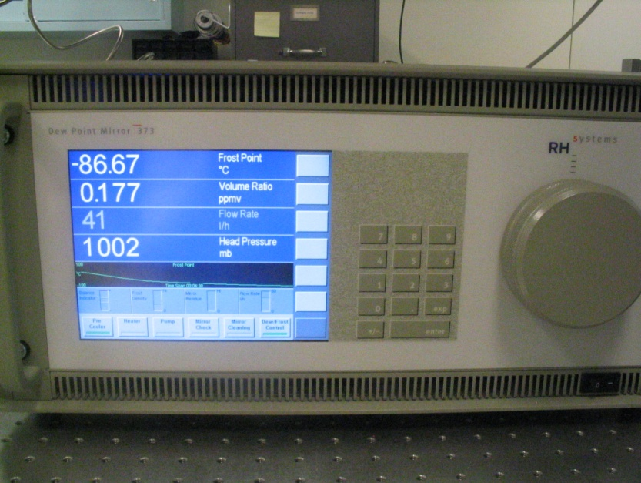
Previous laboratory calibrations for VCSEL water vapor measurements
Princeton calibration systems
Organic slush bath system
LAUDA temperature controller
Critical orifice dilution flow
RHS chilled mirror instrument
NCAR RAF and FL environmental chambers
1
2
  Various conditions:
  Pressure (100–1013 hPa)
  Temperature (-90–30°C)
  H₂O (0.5–4×10⁵ ppmv)
3
4
Notes:
Organic slush bath system (-80 to -10 C)
Critical orifice dilution flow system (3 to 3000 ppmv)
LAUDA temperature controller (-90 to 30 C)
RHS chilled mirror relative humidity instrument (-100 to 40 C)
VCSEL sealed up for calibration

Slide 8
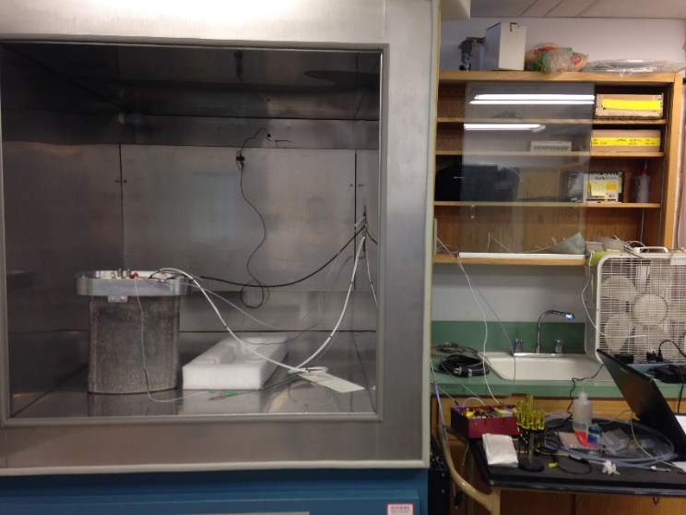
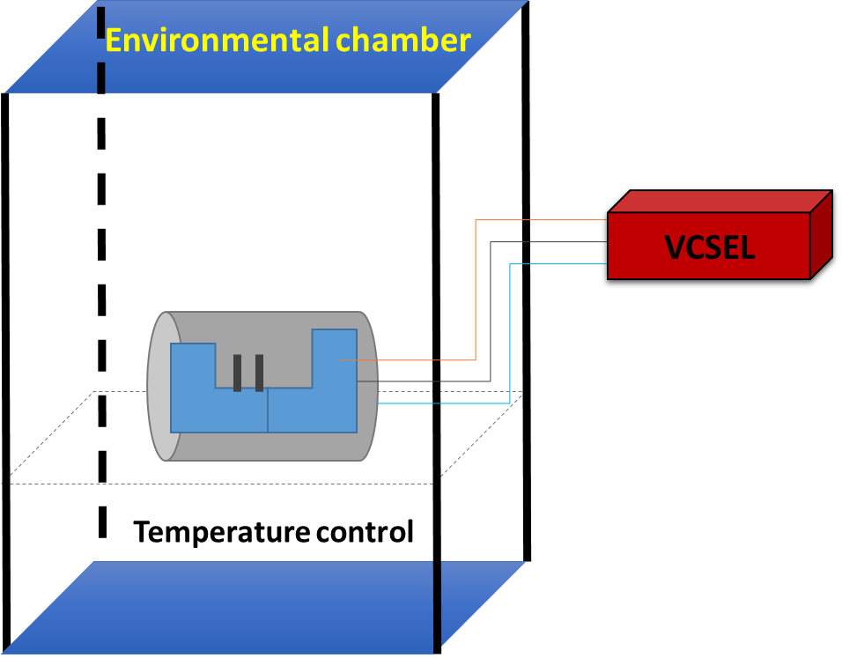
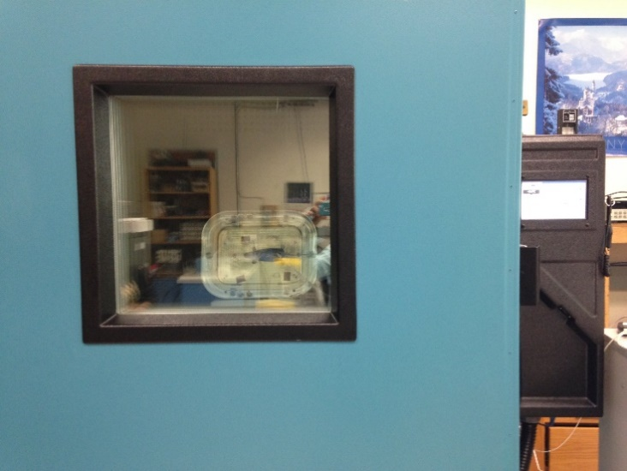
2016 NCAR EOL Laboratory calibrations
1
RAF chamber
2
Laboratory support from Stuart Beaton, Teresa Campos and Steve Semmer
Two environmental chambers (RAF and FL): calibrations from 0°C to -70°C
New QC/QA VCSEL water vapor data to be applied into the QAQC data for the ORCAS and previous GV campaigns (e.g., CONTRAST, etc.)
FL chamber
Notes:
Help from Stuart Beaton, Teresa Campos and Steve Semmer

Slide 9
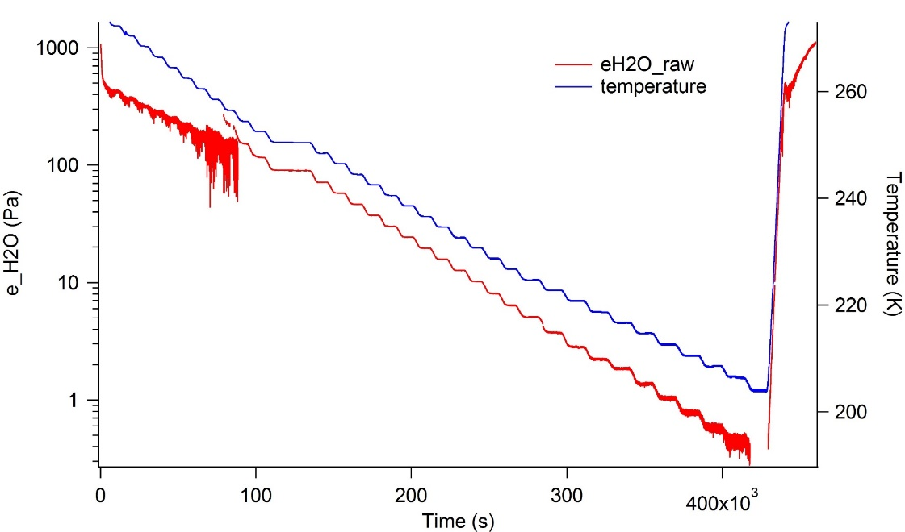
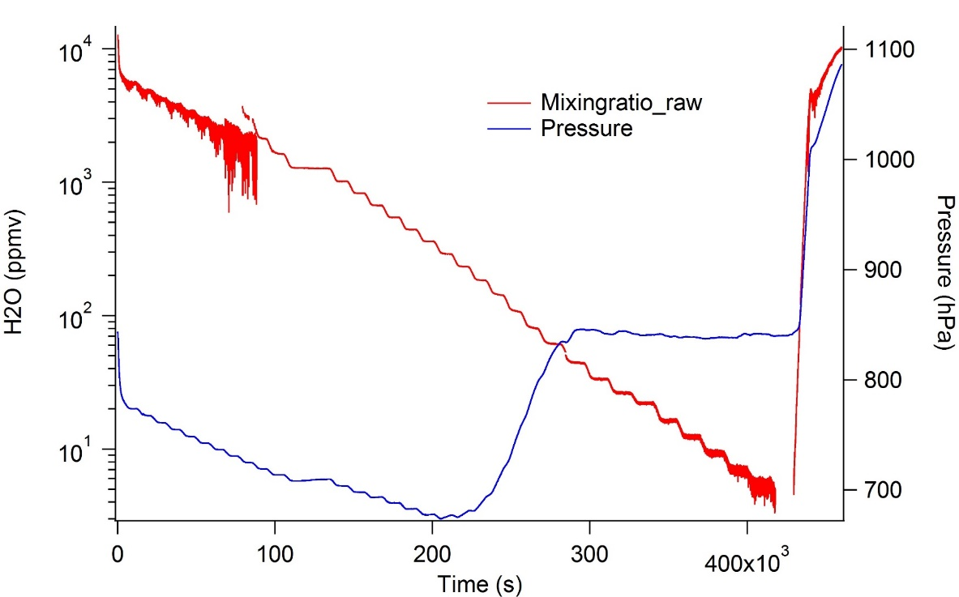
Temperature chamber calibration example
FL environmental chamber:
summer 2016
Calibration range conducted:
0 to -66°C (5500 to 5 ppmv)
New VCSEL QAQC data:
Weak and direct modes follow the original calibration (small chamber calibration in 2014 at Princeton)
Strong mode: use the silicon oil bath calibration but further applies the new environmental chamber calibration
Blue: temperature
Red: H2O mixingratio (raw)
Notes:
Red: mixingratio (raw)

Slide 10
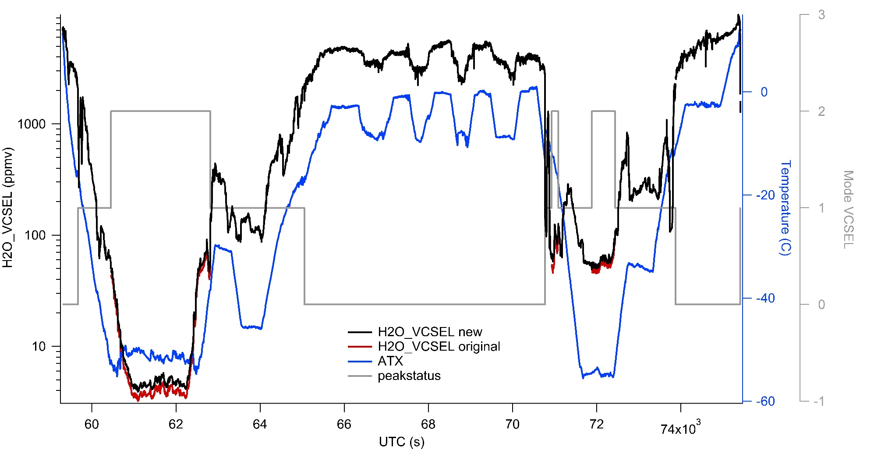
Example of new H2O_VCSEL QAQC data
(ORCAS RF18)
The new H2O VCSEL data are different from the quicklook data at the lower H2O mixing ratio (strong mode)
Notes:
Differences in the new H2O VCSEL data happen at the lower H2O mixing ratio (strong mode)

Slide 11
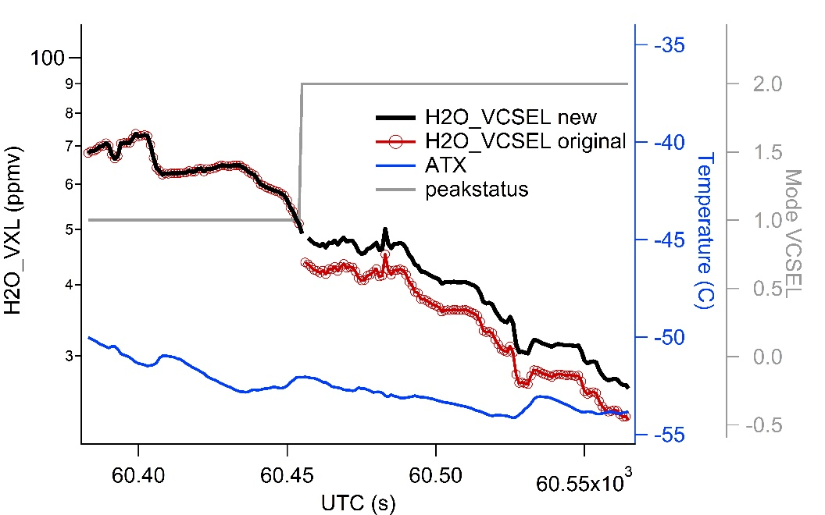
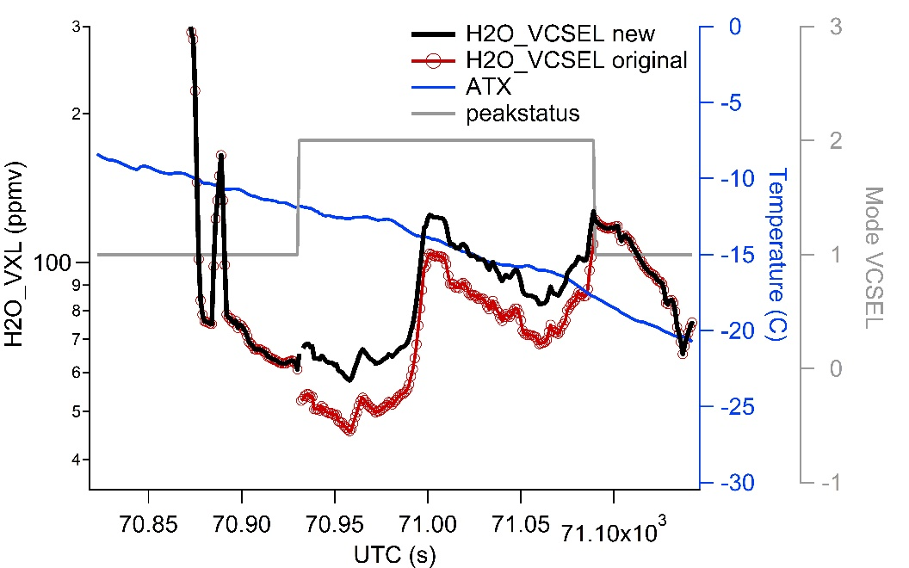
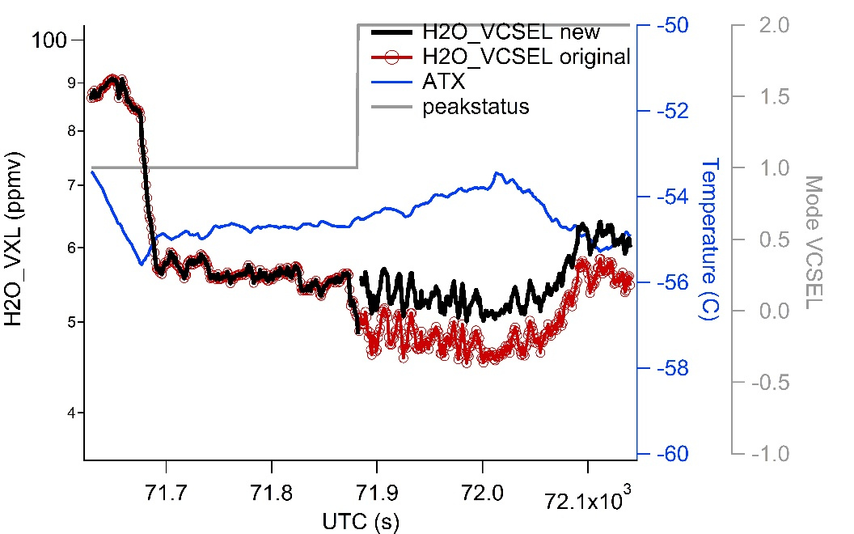
Improved transition between VCSEL two modes
Black: new VCSEL data
Red: quicklook VCSEL data
Improved transitions between Direct and Strong modes
Notes:
Black: new VCSEL data
Red: original VCSEL data

Slide 12
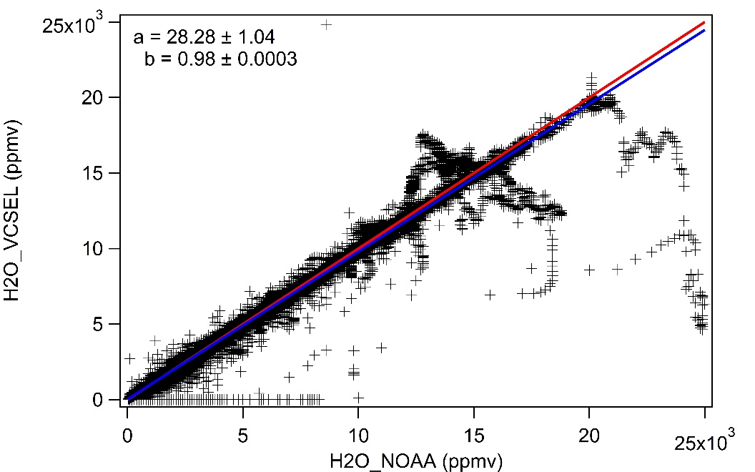
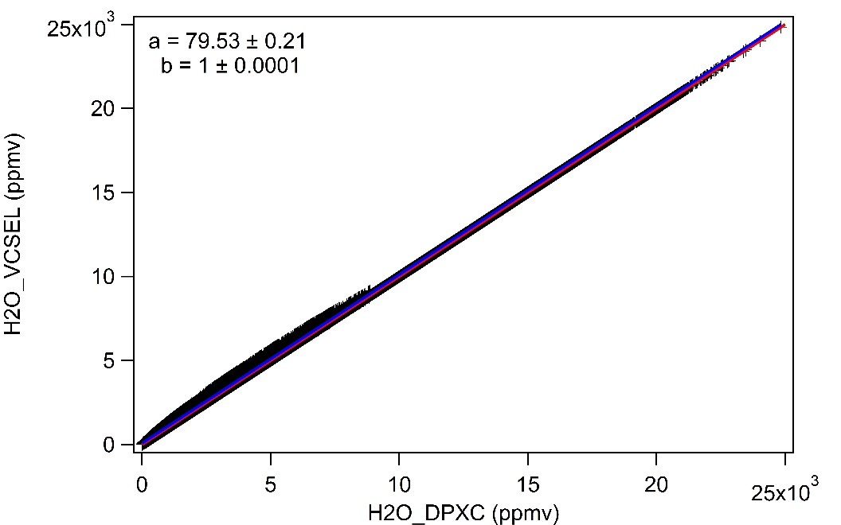
H2O mixing ratio comparisons:
H2O_VCSEL, H2O_NOAA and DPXC
b = 0.98 ± 0.0003
b = 1 ± 1e-4
Linear fit
H2O_VCSEL = a + b * H2O_NOAA
Linear fit
H2O_VCSEL = a + b * H2O_DPXC
Notes:
Linear fit
H2O_VCSEL = a + b * H2O_NOAA

Slide 13
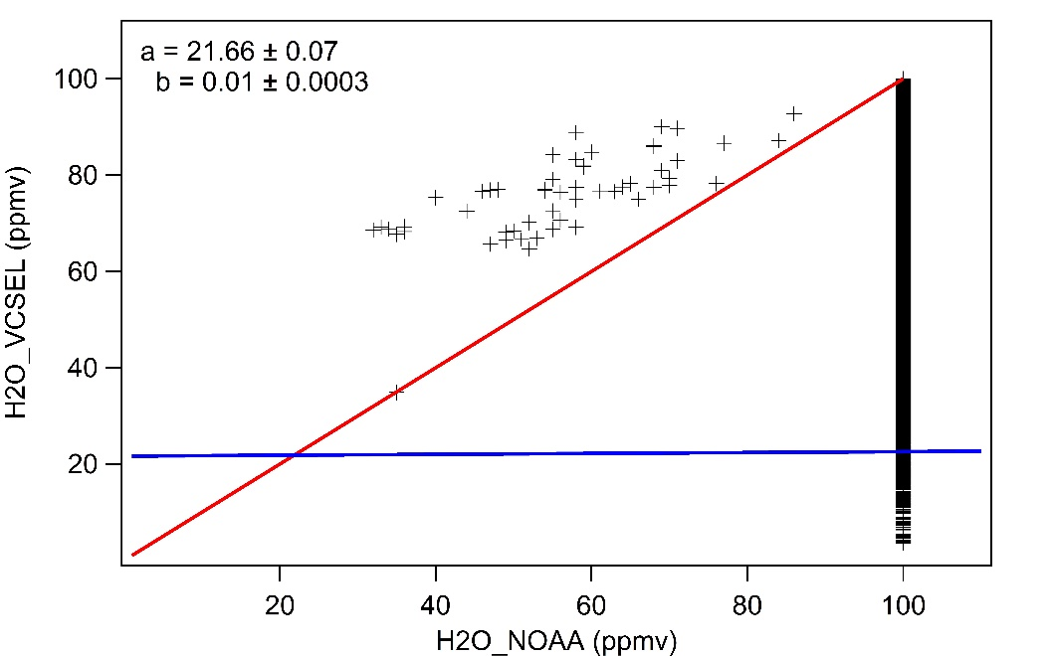
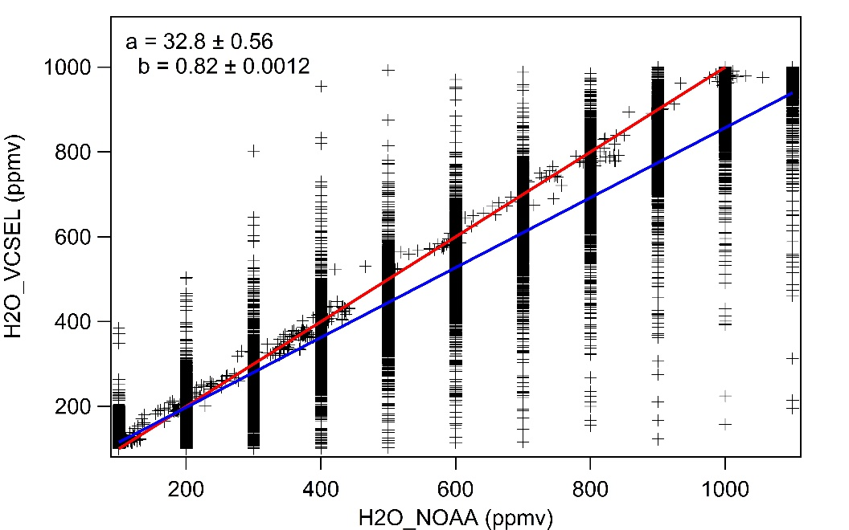
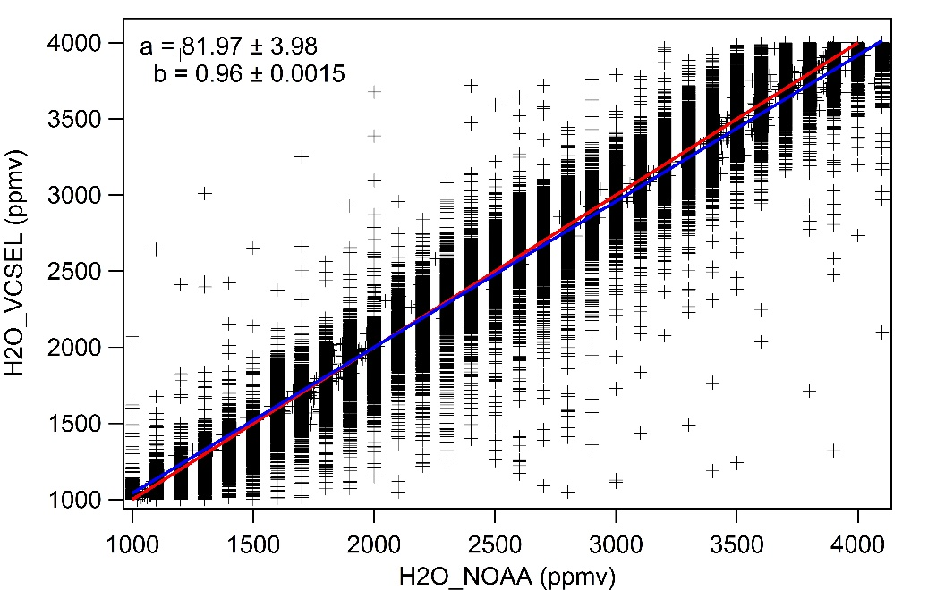
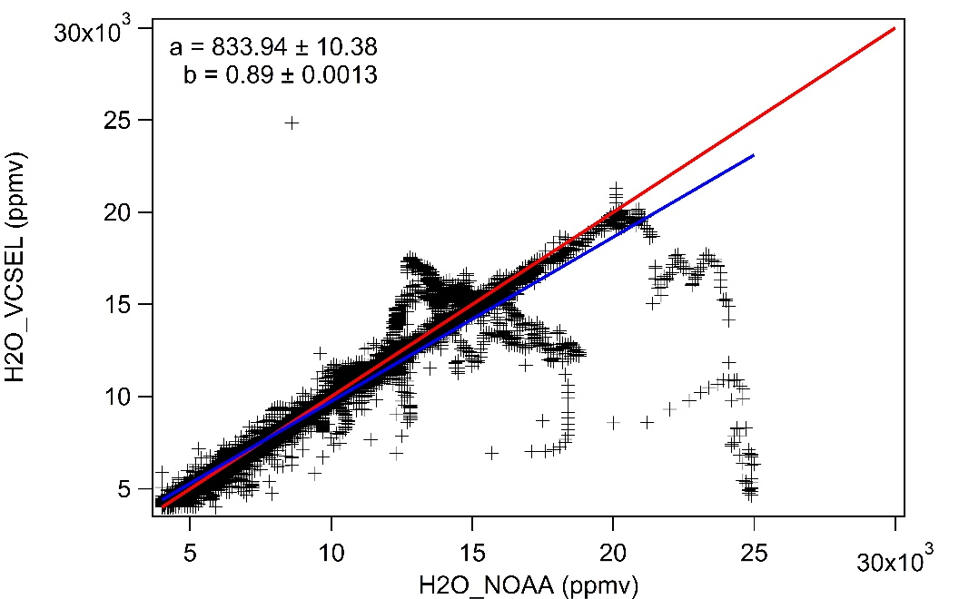
H2O_VCSEL and H2O_NOAA
b = 0.01 ± 0.0003
b = 0.82 ± 0.001
H2O_NOAA minimum
limited to ~100 ppmv
b = 0.96 ± 0.002
b = 0.89 ± 0.001
Generally good agreement at
1000 – 25000 ppmv
Notes:
b = 0.82
H2O_NOAA minimum limited to 100 ppmv

Slide 14
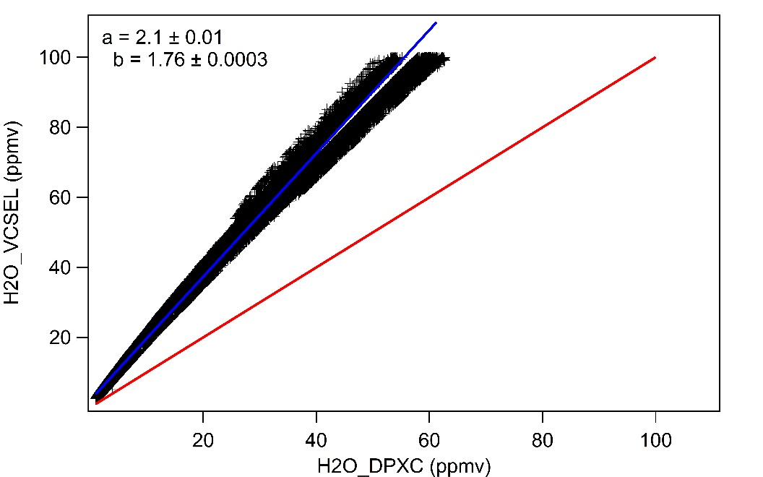
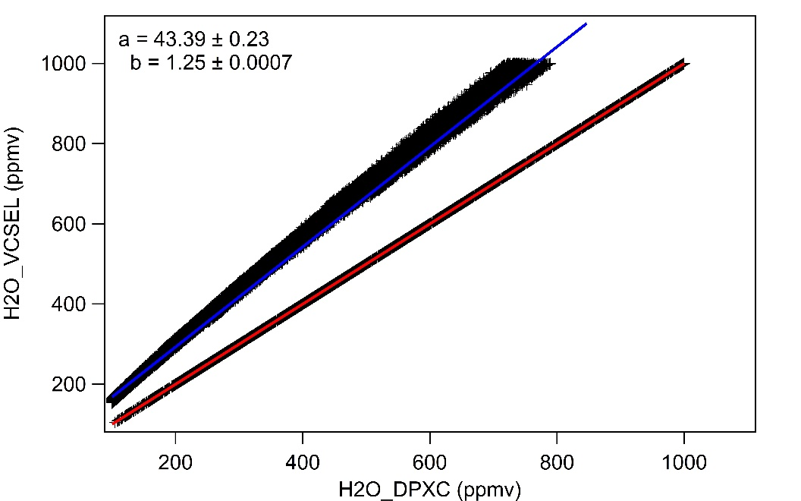
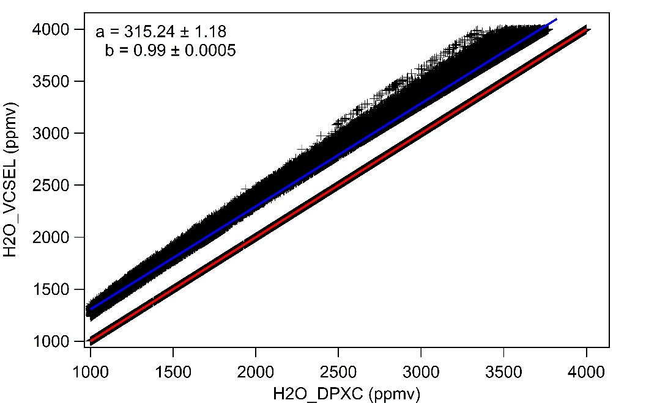
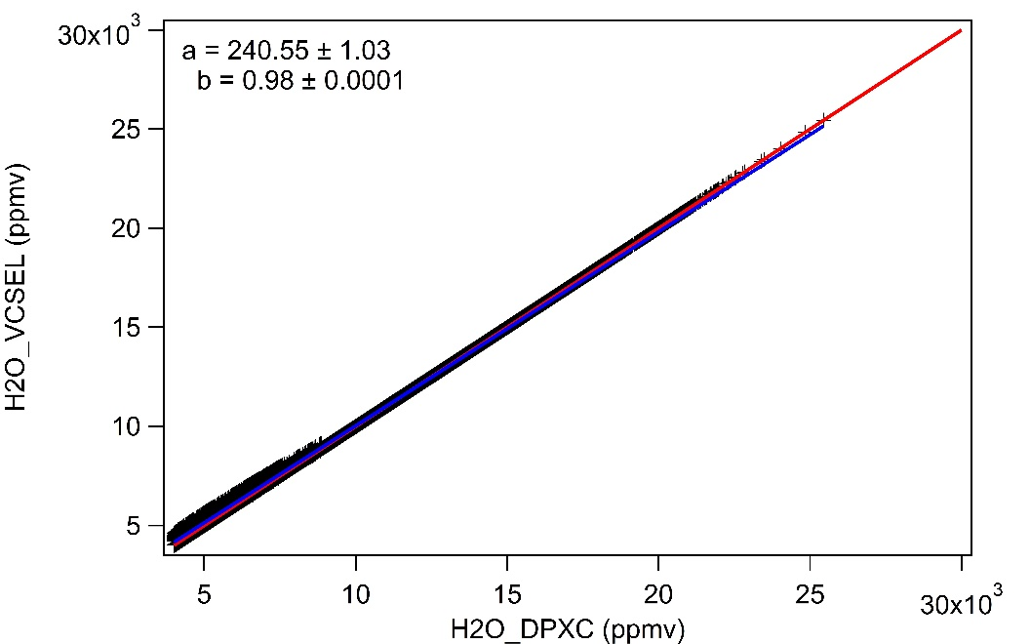
H2O_VCSEL and H2O_DPXC (raw data of VCSEL)
b = 1.76 ± 0.0003
b = 1.25 ± 0.0007
b = 0.99 ± 0.005
b = 0.98 ± 0.0001
Similar at >1000 ppmv
Notes:
1000 - 25000

Slide 15
RH distribution: Quicklook VCSEL data

Slide 16
RH distributions: QAQC VCSEL data
Very low altitude (~500 m), how is the temperature measurement at these low altitudes?
Notes:
Warm T, both H2O VCSEL and DPXC shows high SS at T > 0 (T may be off)
Very low altitude, about 500 m, slow TASX about 100-130 m/s
Quicklook data

Slide 17
Normalized RH distributions: quicklook VCSEL data

Slide 18
Normalized RH distributions: QAQC VCSEL data

Slide 19
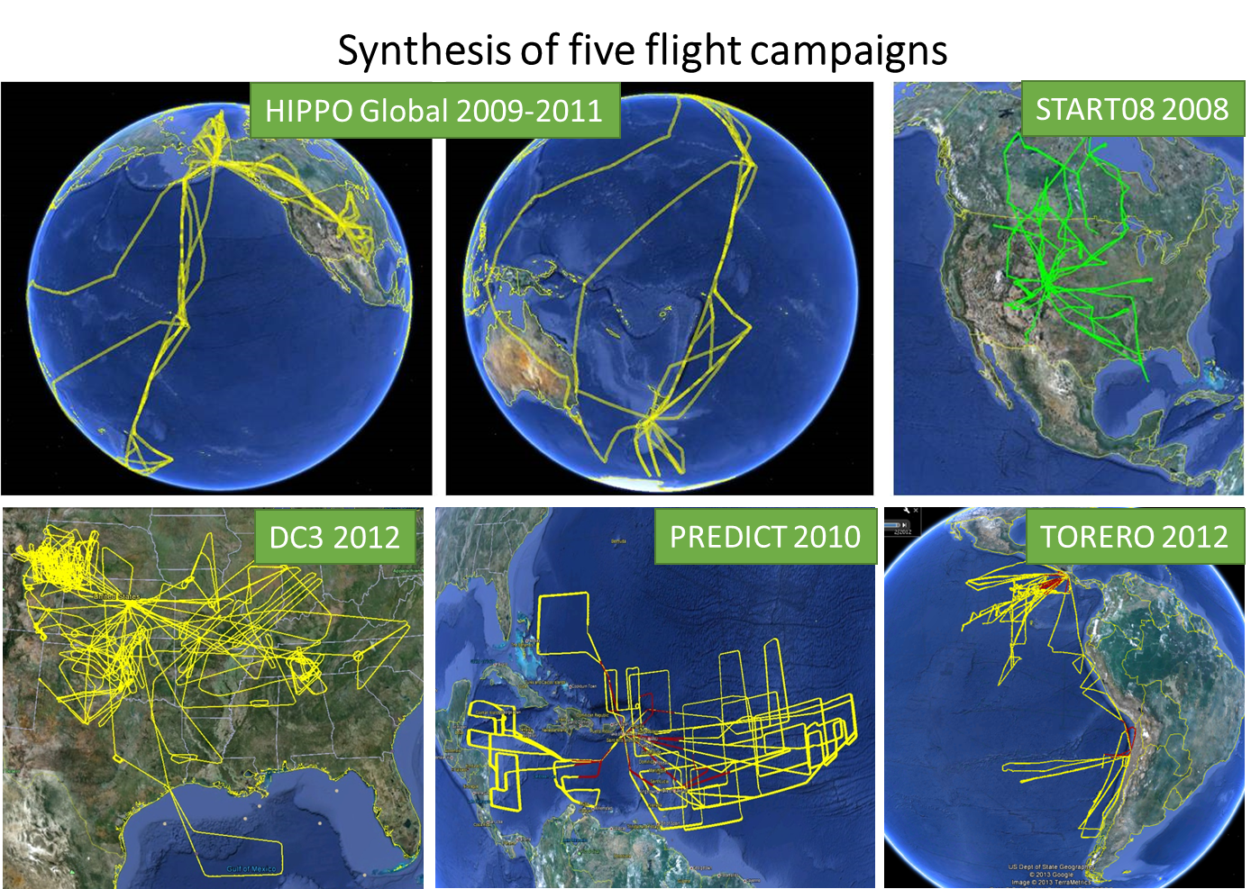
Radiative impacts of ice supersaturation
Dataset and Method
Five flight campaigns with in-situ measurements of ISS and ice crystals
The ERA-Interim data: atmospheric variables (temperature, specific humidity, etc.)
RRTMG model (Iacono et al., 2008) for calculating the radiative fluxes and heating rates.
Gettelman and Kinnison (2007) used WACCM model to quantify radiative impacts of ISS;
Still lack of analysis based on in-situ observation
Collaborative work with Yi Huang and Xiaoxiao Tan at McGill University.
Notes:
Previous studies used satellite data or climate model simulations to quantify radiative impacts of ISS, but not using the in-situ observations.
ozone mixing ratio, surface pressure, surface temperature and albedo

Slide 20
Misrepresent ice supersaturation as ice crystals
Artificially added ice
observed ISS
cirrus clouds
ISS radiative
impact type 1)
Impact type 2)
clear-sky ISS
cirrus clouds with more ice
In-cloud ISS
Calculation from RRTMG model and atmospheric conditions from ERA-interim
A total of 2988 and 890 clear-sky and in-cloud ISS samples, respectively
    Misrepresenting clear-sky ISS as artificial cirrus at maximum (average)
          TOA net radiation: 54 (4.24) W/m²
          Surface net radiation -7.7 (-3.65) W/m²
          Heating rates: 22 (2.23) K/d
    Misrepresenting in-cloud ISS leads to similar radiative effects.
Notes:
Mistaking in-cloud ISS leads to similar average effects of 2.60 W/m² at TOA, -3.16 W/m² at surface and 1.80 K/d on heating rates, smaller than those of clear-sky ISS.

Slide 21
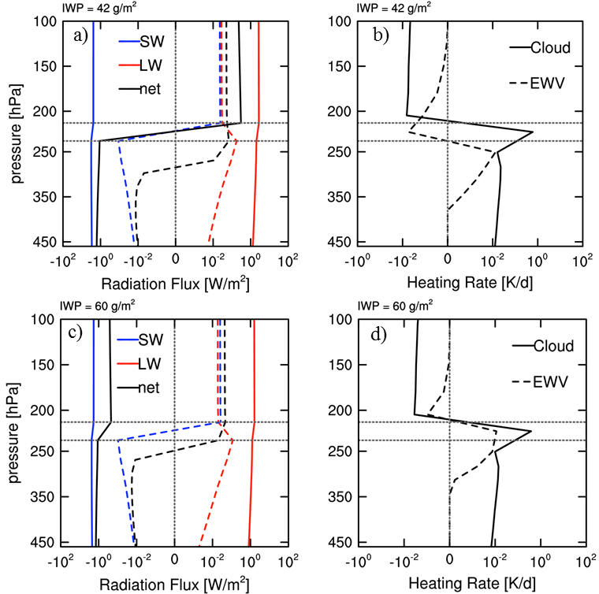
Sensitivity of ISS radiative impacts to pre-existing IWP
IWP = 42 g/m²
Different net radiative effects of ISS due to different pre-existing ice water path (IWP)
Dashed line: Radiative effects of removing ISS;
Solid line: Replacing ISS with cirrus clouds.
IWP = 60 g/m²
Notes:
*Note the differences in the radiative effects of ISS shown by two black lines in (a) and (c).
Horizontal dotted lines: vertical boundaries of the ISS layer.
IWC = 42 g/m3

Slide 22
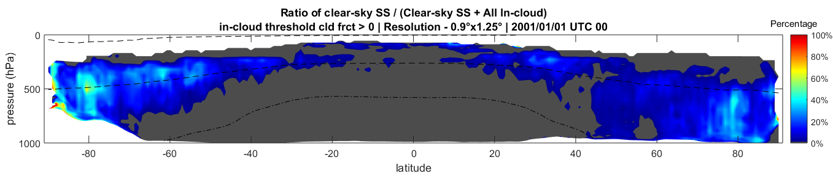
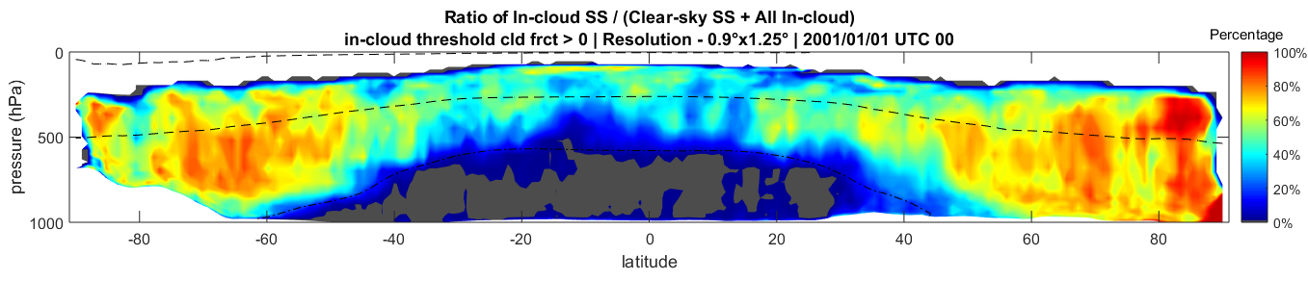
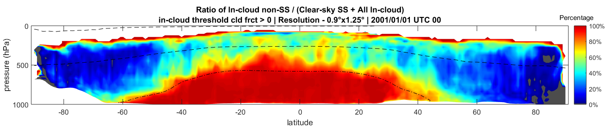
Latitudinal distributions of supersaturation (SS) frequency in CAM5
Pressure
Percentage of
clear-sky SS
Latitude
Pressure
In-cloud SS
Latitude
Non-SS clouds
Pressure
Latitude
CAM5 can capture three conditions: clear-sky ISS, in-cloud ISS and non-ISS clouds.
More merged outputs are needed to evaluate the seasonal variabilities
Dot-dashed line: T = 0°C; Dashed line: T = -40°C
One time output on Jan 1 2000 UTC 00
Horizontal resolution 0.9° × 1.25°
Notes:
Dot-dashed line: T = 0C
Dashed line: T = -40C
Latitude

Slide 23
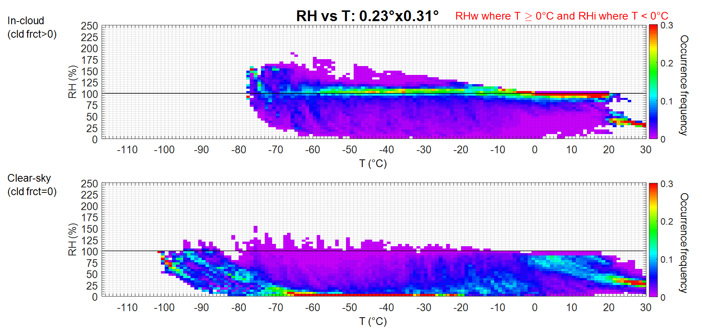
RH – T distributions (ORCAS and CAM5)
ORCAS: 2DC and CDP probes
0.3
0.2
0.1
0
Obs: In-cloud
RHi (%)
frequency
Obs: Clear-sky
No ice/liquid in 1 Hz measurements
0.3
0.2
0.1
0
RHw for T > 0 °C
RHi for T ≤ 0 °C
Distribution range of RHi is similar between CAM5 (30-75°S, 92-50°W) and ORCAS, but mixing lines of H₂O is shifted to lower T in CAM5.
RHi (%)
frequency
0.3
0.2
0.1
0
CAM5: In-cloud
CAM5 0.23° × 0.31°
RHi (%)
frequency
0.3
0.2
0.1
0
CAM5: Clear-sky
CAM5 Cloud fraction = 0
RHi (%)
frequency
Temperature (°C)
Notes:
Temperature (C)
RHi (%)
Occurrence frequency
No ice/liquid particles

Slide 24
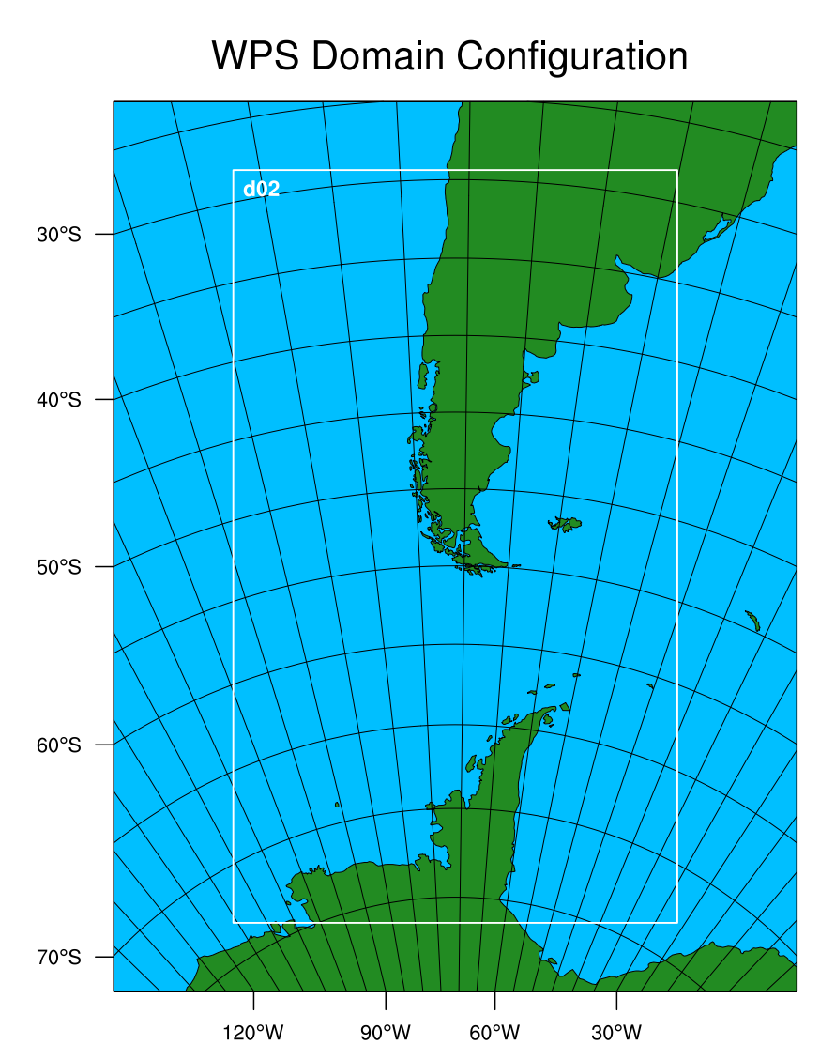
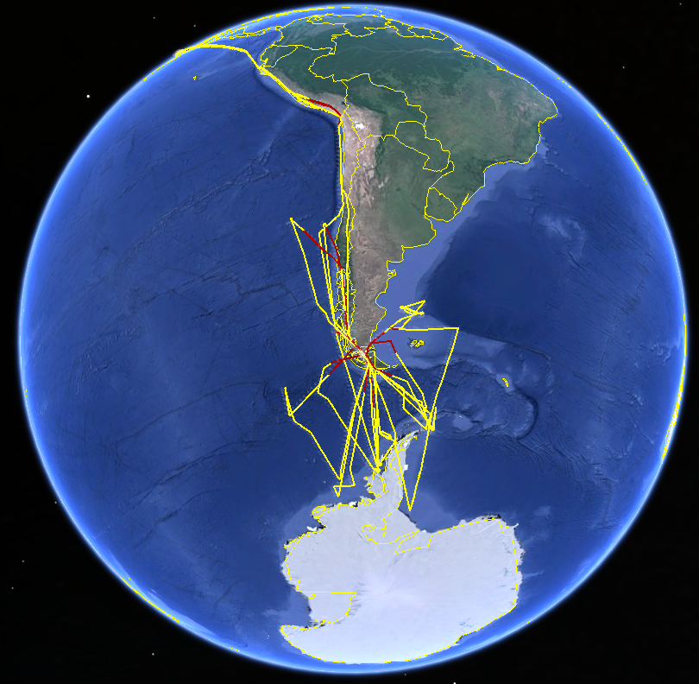
WRF simulations for ORCAS domain
WRF simulations: February 24 UTC 00 – February 26 UTC 00 2016
12 km parent domain with 2.4 km nested domain
Notes:
WRF run: February 24 – February 26 2016

Slide 25
RH – T distributions (ORCAS and WRF)
ORCAS: 2DC and CDP probes
0.3
0.2
0.1
0
Obs: In-cloud
RHi (%)
frequency
Obs: Clear-sky
No ice/liquid in 1 Hz measurements
0.3
0.2
0.1
0
RHi (%)
frequency
Morrison double moment microphysics scheme
WRF: In-cloud
WRF: Clear-sky
Notes:
Morrison double moment microphysics scheme

Slide 26
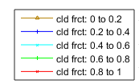
Correlations between cloud microphysical properties and ice supersaturation frequency
log₁₀(IWC) (log₁₀(g m-3))
log₁₀(LWC) (log₁₀(g m-3))
log₁₀( IWC / LWC )
ORCAS
Frequency of ISS
Frequency of ISS
Frequency of ISS
CAM5 0.23°×0.31°
Correlations between ISS and microphysical properties (IWC, LWC) are different between ORCAS and CAM5
log₁₀(IWC) (log₁₀(g m-3))
log₁₀(LWC) (log₁₀(g m-3))
log₁₀( IWC / LWC )
CAM5
Frequency of ISS
Frequency of ISS
Frequency of ISS
Notes:
ORCAS
log₁₀(IWC) (log₁₀(g m-3))
Frequency of ISS
0.23

Slide 27
Frequency of ice supersaturation and cloud microphysical properties
WRF time output: 2016/02/25
UTC 00
Notes:
ISS frequency

Slide 28
Total number of samples of ice and liquid phase in ORCAS, WRF and CAM5
ORCAS
WRF
CAM%
Notes:
WRF

Slide 29
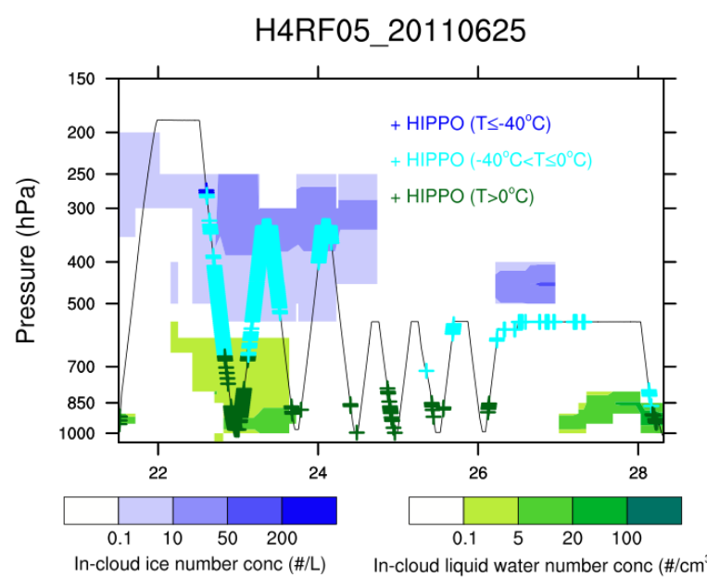
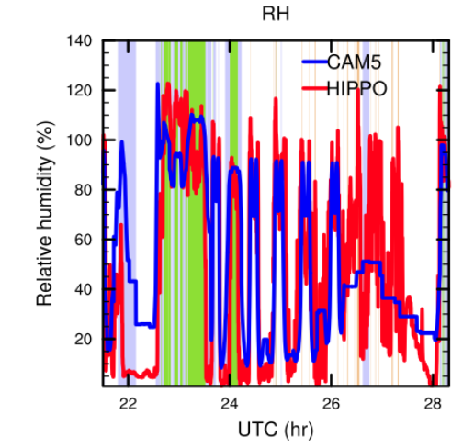
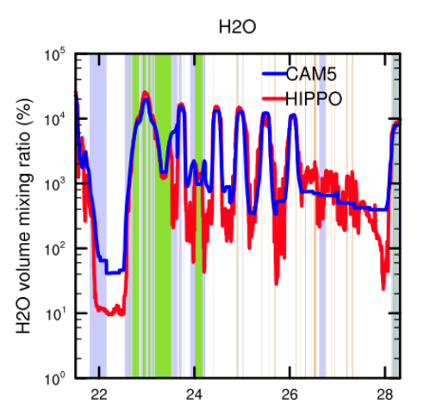
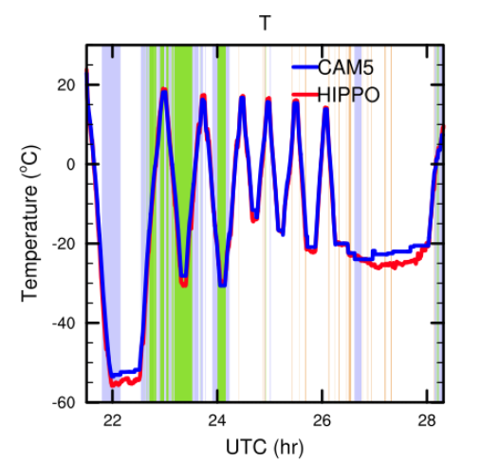
Ongoing work: Comparisons with CAM5 along flight track
Offline Meteorology nudged by GEOS5 analysis data. Collaborative work with Xiaohong Liu and Chenglai Wu (U. Wyoming), and Andrew Gettelman
HIPPO#4 RF05 case study:
Missing clouds due to lack of water vapor spatial variability
Notes:
Offline Meteorology nudged by GEOS5 analysis data.
Collaboration with Drs. Xiaohong Liu and Chenglai Wu from U. Wyoming.

Slide 30
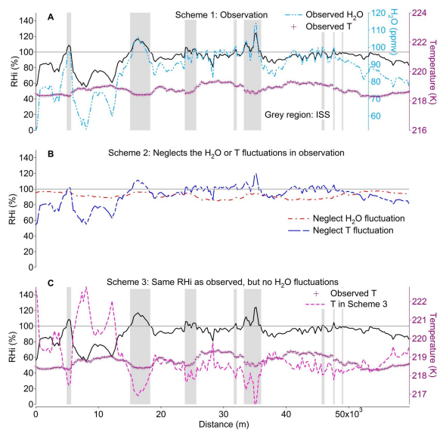
Importance of water vapor spatial heterogeneities
(1) Observation
(Diao et al. 2014, ACP)
(2) Neglect H₂O or T variability
No ISS would occur if only allow T variability
(3) Use T to compensate for neglected H₂O variability
Up to ~2 K colder for where ISS occurs
Notes:
Comparisons of three schemes
Diao et al. (2014 ACP)

Slide 31
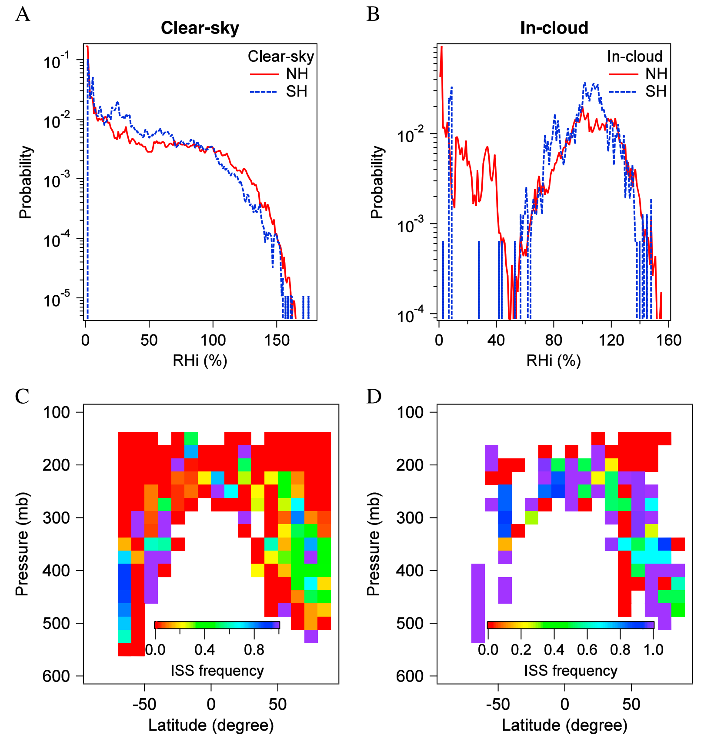
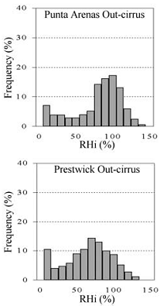
Remaining questions on hemispheric comparisons after previous analysis on the HIPPO data
Ovarlez et al., 2000
1 Hz
SH
SH higher
frequency
of ISS
NH
Previously, Diao et al. (2014) used HIPPO Global campaign to compare ISS frequency distributions in the NH and SH.
ORCAS provides more a unique dataset to examine ice crystal formation over the Southern Ocean.
Notes:
Previously, Diao et al. (2014) used HIPPO Global campaign to compare clear-sky ISS frequency distributions in the NH and SH.
Slide from Britton Stephens (PI of ORCAS campaign)
A total of 18 research flights from January 15 – February 29 2016.

Slide 32




Influences of aerosol and CO concentrations on number-weighted mean diameter and cloud ratio
Analysis based on the HIPPO Global campaign shows smaller Dc at higher CO;
Higher in-cloud occurrence frequency at higher aerosol concentrations
Ongoing work in collaboration with Prof. Ulrich Schumann from German DLR
Number-weighted
mean diameter (Dc)
Frequency of in-cloud
observations
Notes:
Number-weighted mean diameter
HIPPO Global campaign

Slide 33

Results and ongoing work
1. New QAQC VCSEL data
Main changes are at lower H2O mixing ratio ranges, which increases by ~5%-10%
New QAQC VCSEL data provide better transition between strong and direct modes
2. Intercomparisons with H2O_NOAA
Generally good agreement at 1000 – 25000 ppmv
3. Intercomparison with DPXC
Similar at > 5000 ppmv;
DPXC are lower at < 1000 ppmv, and systematically lower by 300 ppmv at 1000 – 5000 ppmv
4. Relative humidity distributions and cloud microphysical properties
a) Similar ranges of RH distributions between ORCAS and CAM5 inside ORCAS domain
b) Correlations between cloud microphysical properties and ISS frequency
WRF simulations show more comparable ISS frequency distributions in relation to IWC, LWC and IWC/LWC ratios than CAM5
Future work:
Testing new sub-grid scale RHi parameterizations and correlations between ice microphysical properties and aerosol in CAM5
Further laboratory calibrations using the Foothills environmental chamber at higher laser intensity of VCSEL
Notes:
Thank you!
Questions?
A071:
Microphysical and macroscopic properties of ice clouds and mixed-phase clouds: linking in-situ, remote sensing observations and multi-scale models
WRF-chem

Slide 34

Summer 2016 at NCAR Research Aviation Facility
John D’Alessandro
Kathryn Steinmann
Thank you for your attention!
Questions?
Notes:
Kathryn Steinmann

Slide 37


H2O difference (%)
VCSEL and NOAA

Slide 38


H2O difference (%)
VCSEL and DPXC

Slide 39


H2O_VXL and H2O_NOAA

Slide 40


Comparison with H2O_NOAA
H2O_NOAA in merge file
Raw data of H2O_NOAA
(from Nimbus)
a = -0.20
b = 1.05
a = 0.24
b = 0.92
Notes:
Raw data of H2O_NOAA (from Nimbus)
H2O_NOAA in merge file
a = -0.20
B = 1.05

Slide 41

Near pole-to-pole, in-situ measurements of water vapor
HIPPO Deployment #1 Water vapor distribution
Flight Track of GV
Water Vapor Mixing Ratio (log(ppmv))
Notes:
Surface to the upper troposphere and lower stratosphere
Minghui Diao, San Jose State University
Southern Pacific Convergence Zone
(SPCZ)
Inter-Tropical Convergence Zone
(ITCZ)

Slide 42

Sensitivities of ISS radiative impacts to pre-existing ice crystals
Two transition thresholds due to changes in IWP:
7 g/m²: reaching the maximum radiative effects
53 g/m² : radiative effects changing from positive to negative
Notes:
Two transition thresholds are found when replacing ISS EWV with artificial ice crystals with pre-existing IWP of 7 g/m² (maximum RE) and 53 g/m² (change to negative RE). The change in the sign of TOA RE (e.g., Figure 2 a and c black solid lines) occurs because the reflected SW radiation becomes larger than the absorption of LW radiation at higher IWP values.

Slide 43

ISSR formation mechanism
T
q
more H₂O
Colder T
ISSRs
dRHi = RHi_{inside} – RHi_{outside}
dRHi =d(e*1/e_{s}) = (1/e_{s}) de + e d(1/e_{s})
Part 1.
Part 2.
H2O
contribution
T
contribution
Observation
H₂O spatial heterogeneities contribute to
92% of dRHi_{max}
Notes:
More ISSRs with colder T and higher H₂O mixing ratio (Spichtinger et al., 2003)
H2O contribution
Part 1: de is changes in water vapor partial pressure
Part 2 : d(1/e_{s}) is changes in saturation vapor pressure
e_{s} calculated based on Murphy and Koop 2005
Observation
More ISSRs with colder T and higher H2O mixing ratio
Part 1. water vapor
Part 2. temperature
dRHi

Slide 44








ISSR formation mechanism: water vapor and temperature spatial heterogeneities
0.92
1.04
0.89
0.65
0.81
0.95
0.77
0.95
A
B
E
250 m
RH130%
F
250 m
RHinf
1 Hz Obs
250 m
1.17
0.74
1.17
0.64
0.79
0.54
1.05
0.65
C
D
G
250 m
Dep*0.1
H
250 m
IN*0.5
1 km
4 km
Blue: contributions to ISS formation from H₂O heterogeneities
Green: ratio of ISS cloud coverage/non-ISS cloud coverage
Notes:
ISS cloud/non-ISS cloud ratio

Slide 45








Spatial characteristics of ISSR: correlation between RHi_{max} and ISSR length
12.68
2.25
10.57
17.28
A
B
E
F
250 m
RH130%
250 m
RHinf
1 Hz Obs
250 m
2.14
1.50
1.98
3.00
C
D
G
H
1 km
4 km
250 m
Dep*0.1
250 m
IN*0.5
Blue: slope of linear fit
RHi_{max} = a + b * log₁₀ (Length_{ISSR})

Slide 46

NSF DC3 campaign and WRF simulations
In-situ observations
The NSF Deep Convective Clouds and Chemistry (DC3) campaign (May-June 2012):
22 flights onboard the NSF Gulfstream-V aircraft
WRF v3.7 simulations
1. Realistic simulations (May 19th, 2012 and different days)
2. Horizontal resolutions (2.4 km and 800 m show similar results)
3. Four double-moment microphysics scheme
1) Morrison et al. (2005; 2009)
2) Morrison-modified: higher Cooper parameterization threshold at RHi=125%
3) Thompson et al. (2008)
4) Thompson and Eidhammer (2014): includes heterogeneous freezing
Notes:
DC3 campaign and WRF
Above liquid saturation (DeMott et al., 2010)
Below liquid saturation (Philips et al., 2008)
simulations

Slide 47
Obs
In-cloud
Clear-sky
Frequency and magnitude of RHi
All analysis restricted to T≤ -40°C
1. Activating Cooper curve at a higher RHi threshold allows more ISS at higher magnitudes;
2. Thompson-aerosol aware scheme provides the most similar PDF of RHi as observed.
MORR
MORR-mod
THOM08
THOM14
Notes:
Morrison

Slide 48
Probability of ISS at various vertical velocity and IWC
DC3
Morrison
Two factors:
IWC
Vertical velocity
Morrison
-125%
1. At IWC > 0.1 g/m³, simulations show ISS frequency significantly higher in higher w than lower w
Thompson
Thompson
-aerosol

