Slide 1
N₂O, flux variability, and other incoherent thoughts
Overall campaign optimized fluxes of CO2 & O2
Targeted Lagrangian studies for CO2 & O2
Nitrous Oxide
Importance of ‘high’ flux events

Slide 2
What is planned/not planned for STILT analyses: Current thoughts for Martin’s paper writing
Paper 1 (writing soon)
  Focus on 2 specific Lagrangian flights. Some discussion of flight planning/approach (demonstration of method). Focus on quantification of O2 and CO2 flux. Comparison with CESM and climatology fluxes and discussion of implications. (optional geostatistical analyses)
Paper 2 (longer time scale)
  “Whole” campaign O2 & CO2 flux. Similar in concept to lagrangian, but uses all flights. Has more complications with initial conditions. Lot of details that are tbd.

Slide 3
Simple ‘optimized’ flux
Slope = Flux correction multiplier
Assumes prior emissions flux spatial distribution correct
Observation
Model

Slide 4
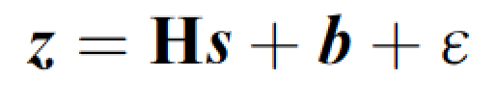
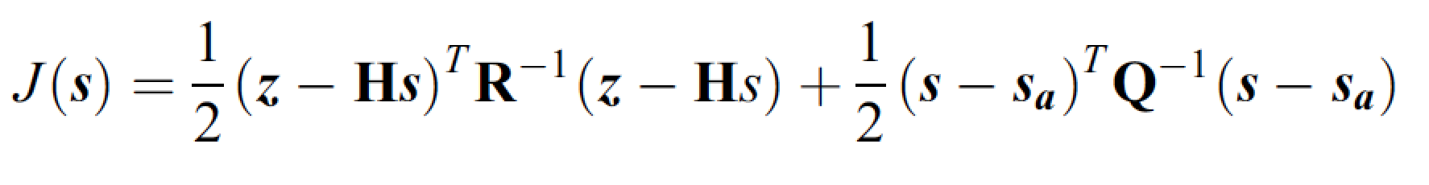
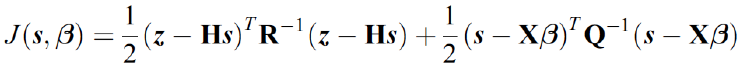
For the mathematically inclined
Bayesian cost function
Geostatistical cost function

Slide 5
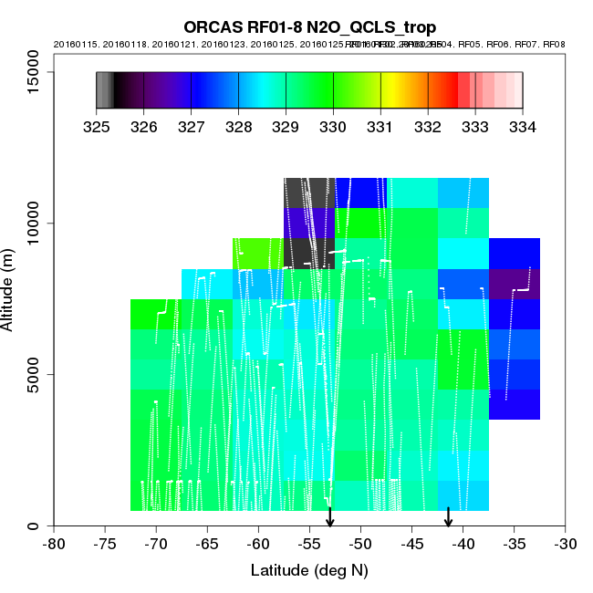
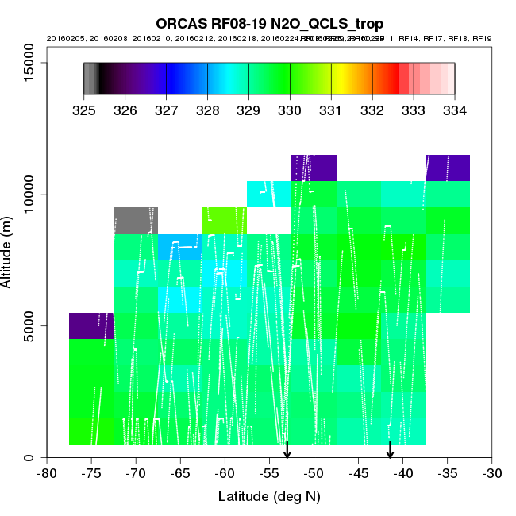
N2O story?
block averaging. Is there a robust yellow bloom in the lower left? Is that growing over the campaign?

Slide 6
N₂O Boundary Layer, Free Troposphere latitudinal and vertical gradients
N₂O (ppb)
N₂O (ppb)
PBL-FT gradient (ppb)
PBL-FT gradient (ppb)
Latitude
Latitude

Slide 7
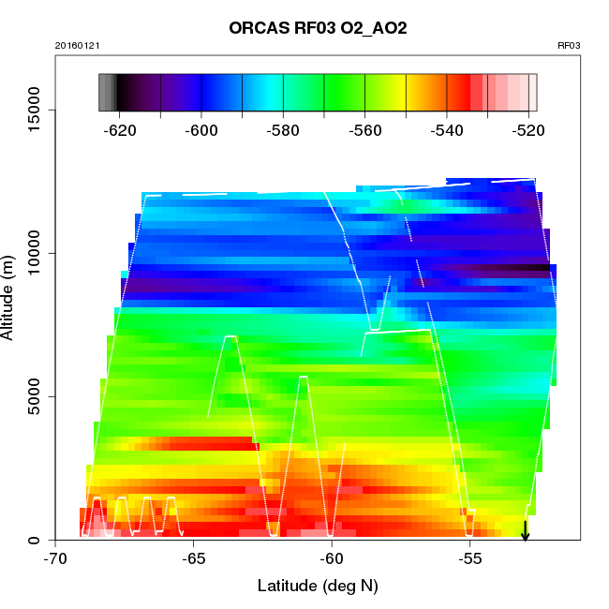
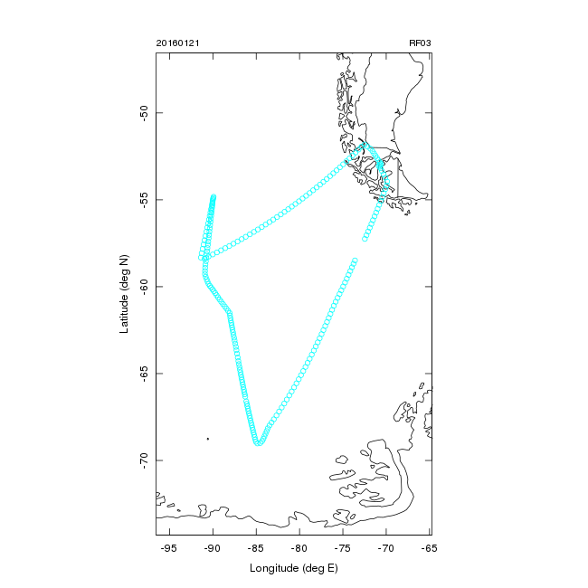
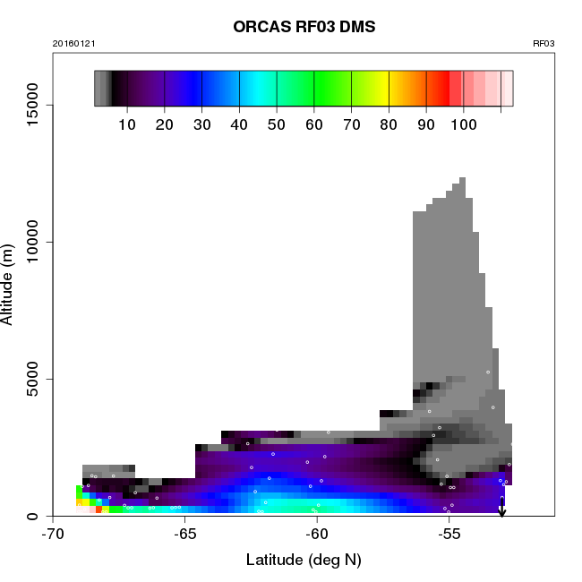

Slide 8
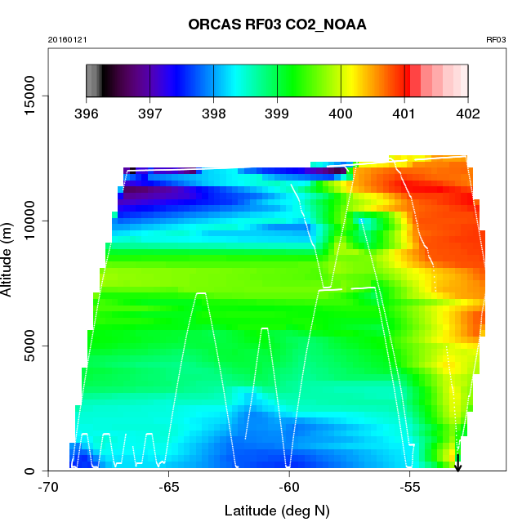
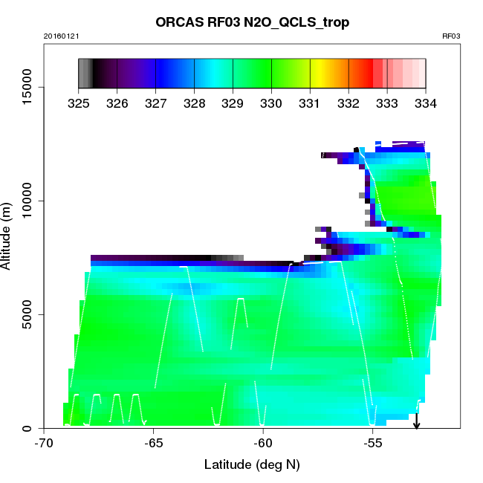
Specific N2O example: RF03
South of 61S
North of 61S
CO2
N2O
N2O
CO2
Notes:
Interesting N2O, CO2, O2 signal on RF03: definitely different behavior in different regimes– region most south above broken sea-ice seems to be distinct -- will want to sample this again. Will want to sample this and ice on east

Slide 9
South of 61S
South of 61S
North of 61S
North of 61S
CO2
O2

Slide 10
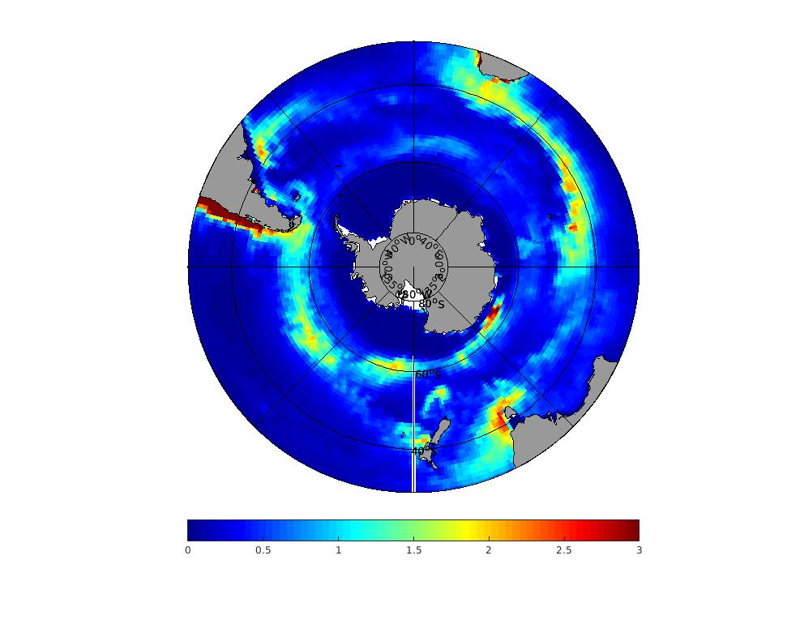
ECCO2-Darwin N2O fluxes for comparison

Slide 11
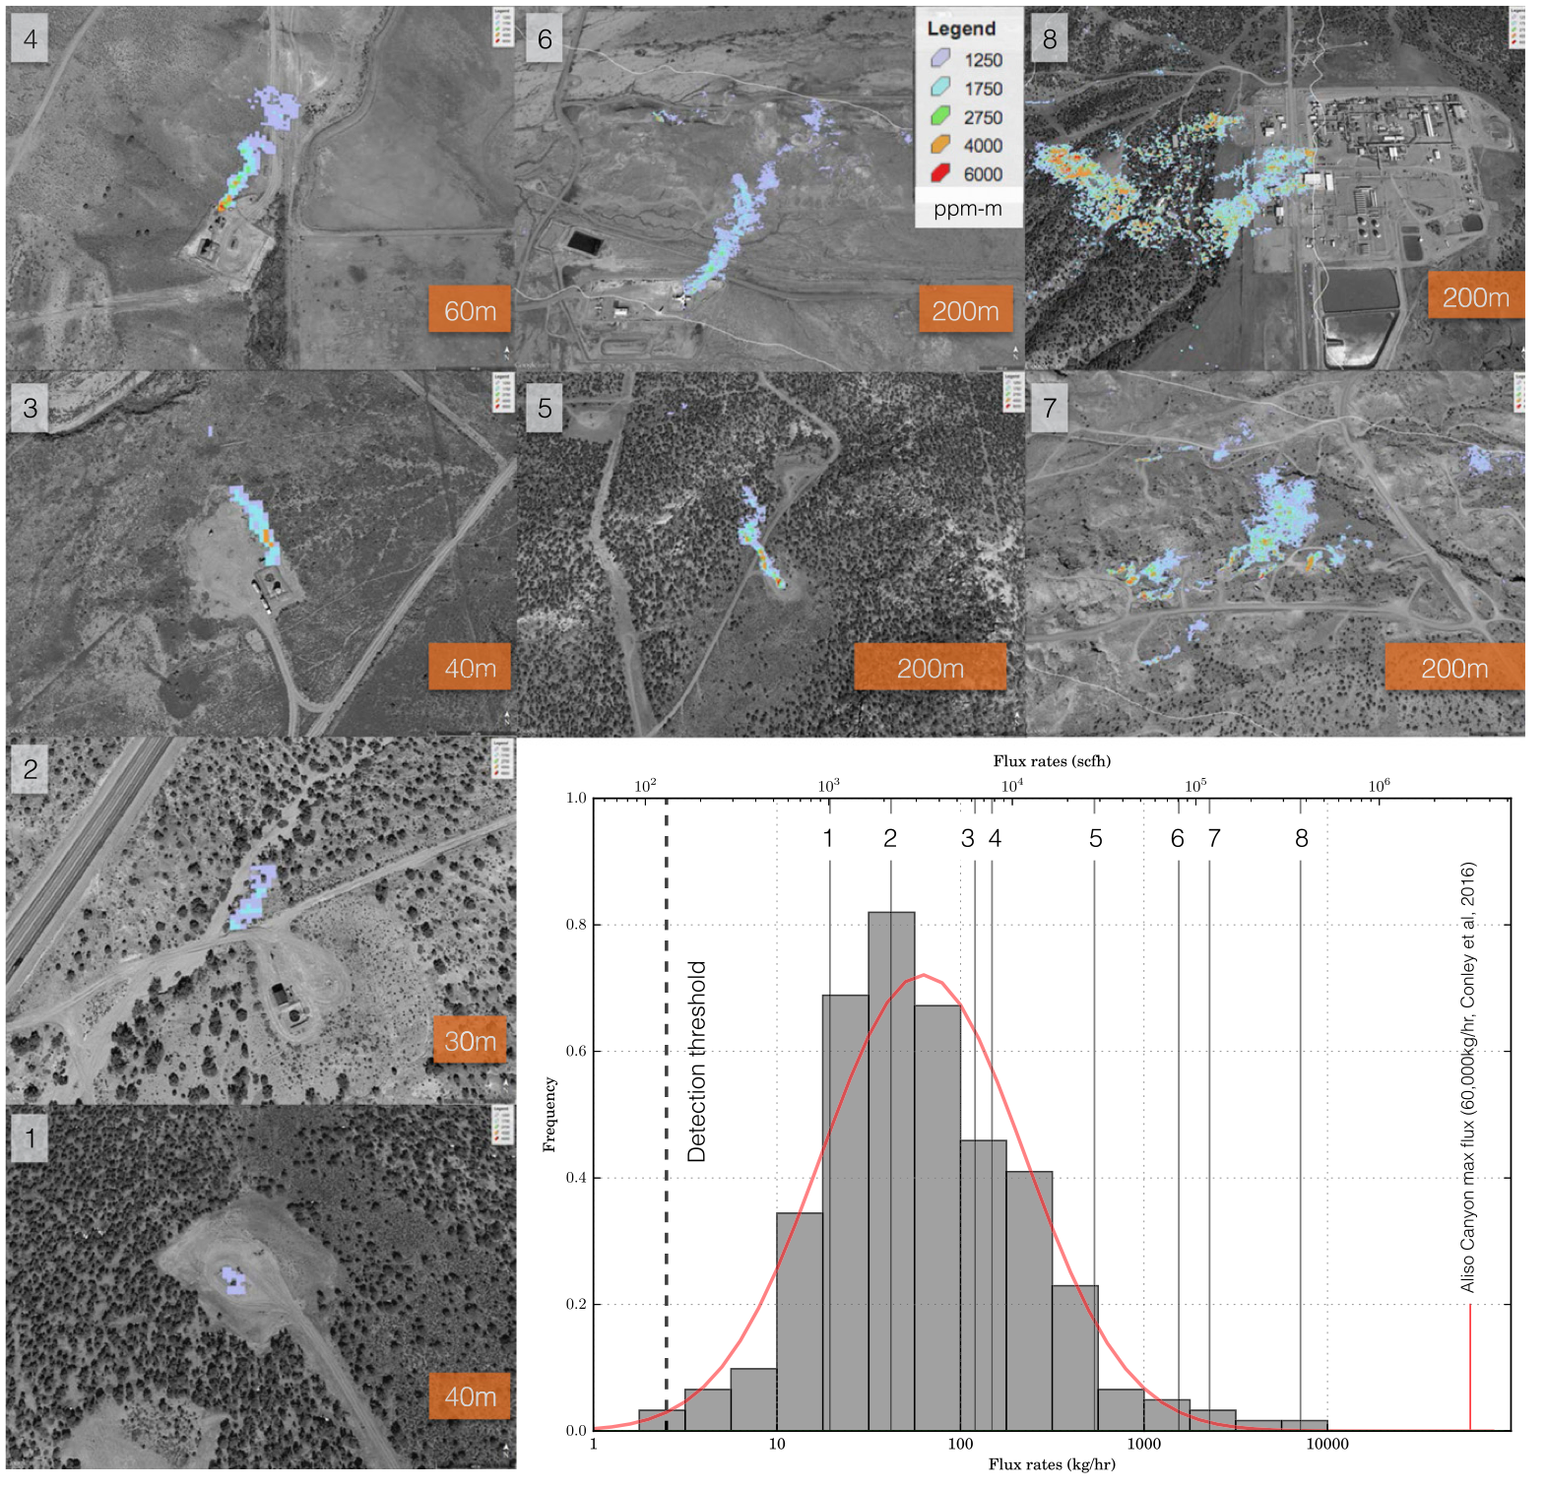
High Flux Events: Where my though process is coming from

Slide 12
High-flux event, existence & importance?
Climatologies have smooth flux distributions

Slide 13
Models exhibit ‘intense’ flux events
Prior Flux Fields: CESM daily model

Slide 14
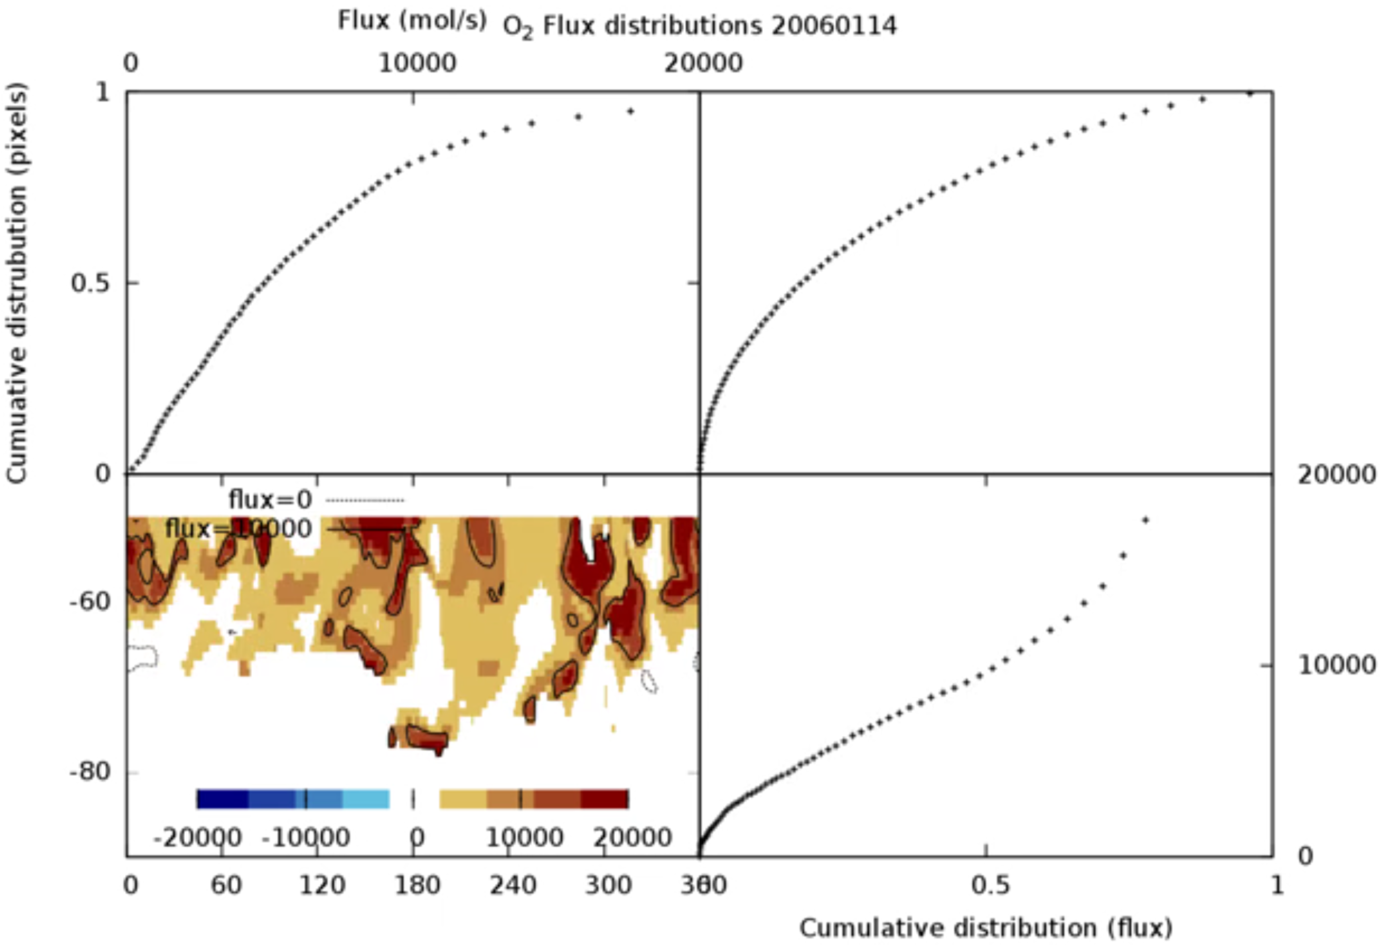
Distribution of flux statistics: importance of high-exchange events
https://www.youtube.com/watch?v=a2rQOQ0RqXw&feature=youtu.be
Notes:
Flux distributions: roughly 50% of the flux comes from top 20% of the highest flux pixels (importance of high-flux events). Are we seeing this? Will we have sampling to confirm deny?

Slide 15
Can we look at distributions of boundary layer variability in the observations contrasted with model and climatology predictions to ‘confirm/deny’ presence of high flux events impacting observations in reality.
Different/related questions: does climatology get net seasonal/annual correct? And what are most important processes controlling exchange (high flux/ or diffusive controls?)

