Slide 1
Overview of SAR Wind Processing
&
Projection-Based Wind Direction Retrieval
C. Wackerman, M. Caruso, R. Foster, H. Graber, J. Horstmann, R. Romeiser
ITOP Meeting, 17-20 May 2011, Santa Fe NM

Slide 2

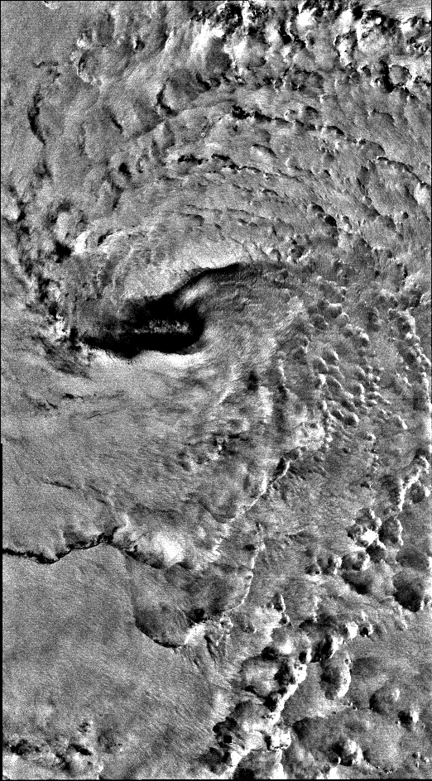

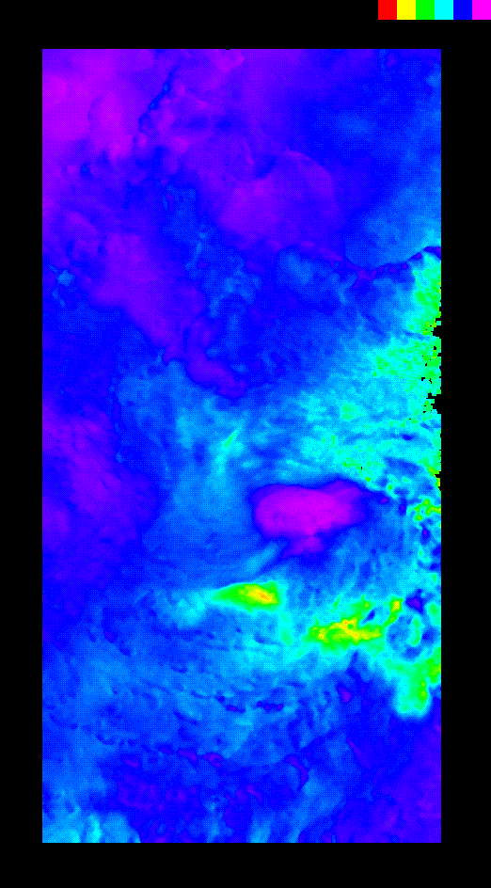
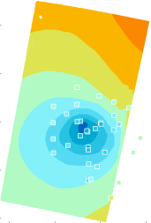
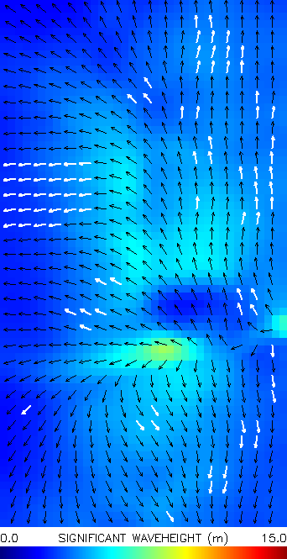
SAR Typhoon Processing System (SARTyPS)
Real-time SAR environmental product generation system being built at CSTARS to support field deployment
CSTARS SAR BackBone Processing System
Environmental Products
SAR Data
Eye location, size
Winds & Pressure Fields
Waves
CSTARS
Back
Bone
SAR Ancillary Files
Land
Mask
Wind Vectors ASCII File
Wave MeasuresASCII File
Previous Tracks
Eye Product
Eye Location,
Properties
UW-APL
Pressure Analysis
GD Eye Finder
NURC Eye Finder
Internet Access
GD Winds
Wind Product
Best Wind Directions
RCS-GMF
Wind Speed
NURC
WiSAR
GD Waves
Wave Product
Wave Spectral Map
CSTARS
Waves
Wind &Wave Products
SRI
SWAN/SAR
Assimilation
Best-Fit
Wave Spectra
& Winds

Slide 3
Summary of Wind Estimation / Science issues
C-band SAR wind estimation for winds < 20 m/s is well validated (RMSEs ~ 2 m/s wind speed , 20 degs wind direction)
  uses an empirical relationship derived from a large number of aircraft flights, but with little high wind data
  ITOP SAR program is expanding this to typhoon winds and X-band SAR
  images
Wind direction estimates appears to work well in Typhoons (RMSE = 21 degs)
  developed a “best” combination of two approaches (J. Horstmann)
  appears to be an inflow rotation between SAR ocean features and wind
  direction
ME: 0 degs
RMSE: 21 degs
Results from 17 historical storms (11 Pacific, 6 Atlantic)

Slide 4
Summary of Wind Estimation / Science issues (cont.)
For wind speeds from < 40 m/s the results appear reasonable
(RMSE = 3 m/s – 4 m/s)
  There are some issues with the look angle dependence of the transfer function at some incidence angles and high wind speeds
    C. Wackerman is working on a modified transfer function
    J. Horstmann will discuss approaches to flag these regions
ME: -0.8 m/s
RMSE: 5.9 m/s
ME = 0.1 m/s
RMSE = 3.3 m/s
ME = 0.0 m/s
RMSE = 2.8 m/s
w/o Katrina 28
Results from 3 Atlantic storms (Katrina 27th, Helene 20th, Lilli)

Slide 5
Summary of Wind Estimation / Science issues (cont.)
For wind speeds > 40 m/s, the current empirical transfer function needs to be modified (only two cases so far, Katrina on 28th, Megi on 17th) and we need to consider carefully how to compare SAR winds to dropsonde/SFMR
  SAR transfer function is tuned to 10m, temporal averaged winds, dropsondes are instantaneous winds
  existing SAR transfer function has little to no points in this region
  The peak winds are still reasonably tracked

Slide 6
Summary of Wind Estimation / Science issues (cont.)
On-going work to address these issues
  development of a modified transfer function (C. Wackerman/
  J. Horstmann)
  automated flagging for regions with high uncertainty in wind speeds
  (J. Horstmann)
  Assimilating SAR winds into H-WINDS (J. Horstman)
    interpolates into flagged regions as well as smoothing winds
  Assimilating SAR winds into a boundary layer model (R. Foster)
    interpolates into flagged regions as well as smoothing winds
Need to determine which product is of most use to the community
Expanding process to include X-band SAR images

Slide 7
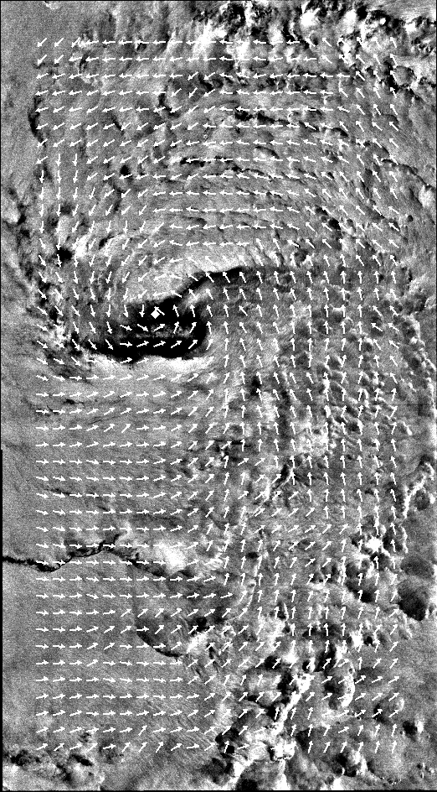

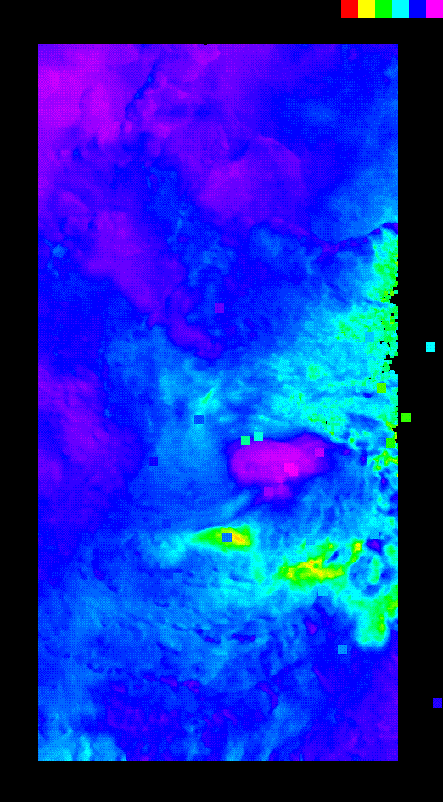
Malakas 9/22/2010
+/- 2 hrs
Flattened SAR Image with estimated wind directions
Dropsonde Wind Speeds
SAR Wind Speeds with Dropsonde Wind Speeds

Slide 8
Malakas 9/22/2010
ME = 0.0 m/s
RMSE = 2.8 m/s
SAR Winds speeds Versus Dropsonde Wind Speeds with +/- 2 pixel jitter

Slide 9
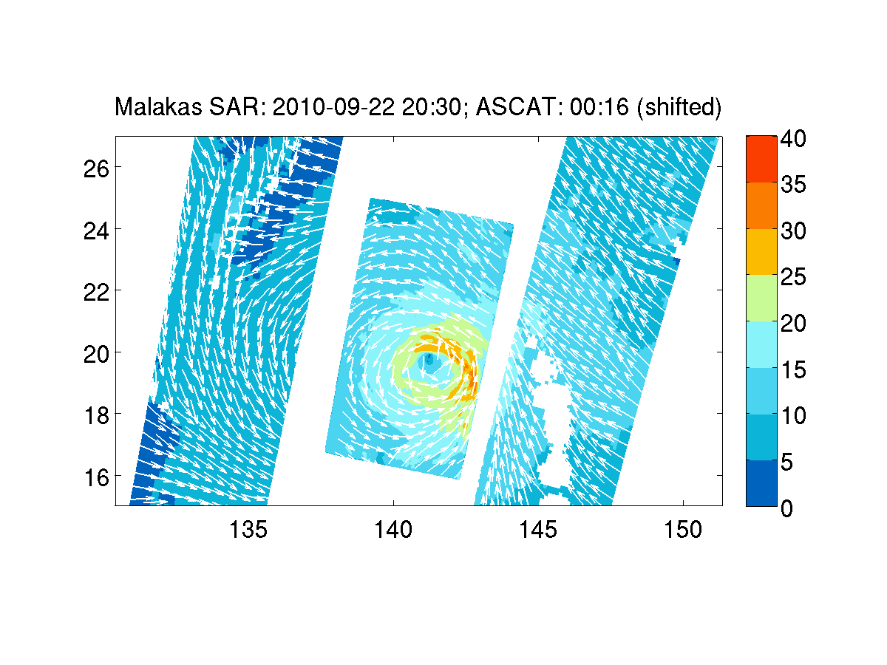
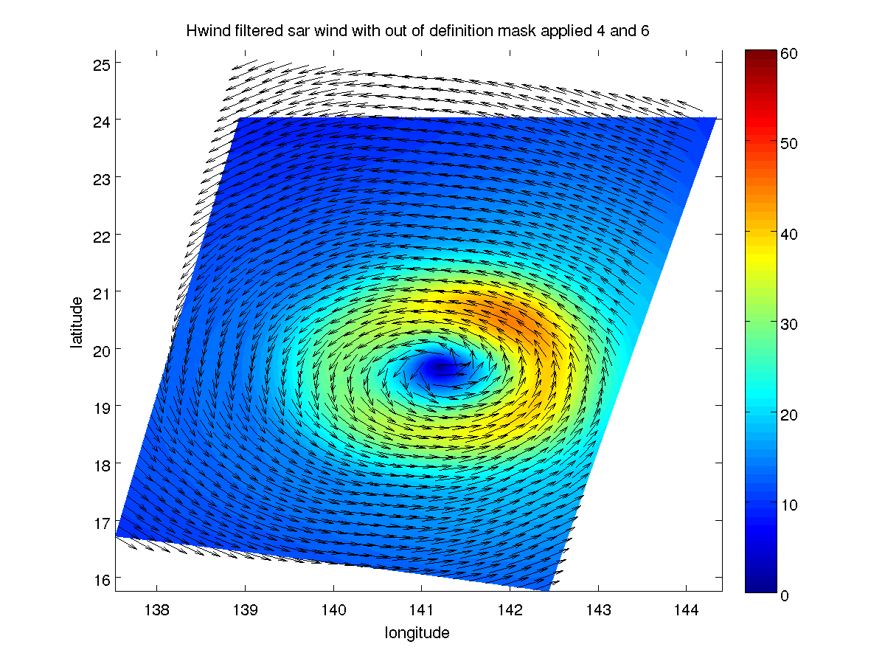
Malakas 9/22/2010
Raw SAR Winds
Assimilated into Foster’s BLM
H-Winds with SAR input

Slide 10
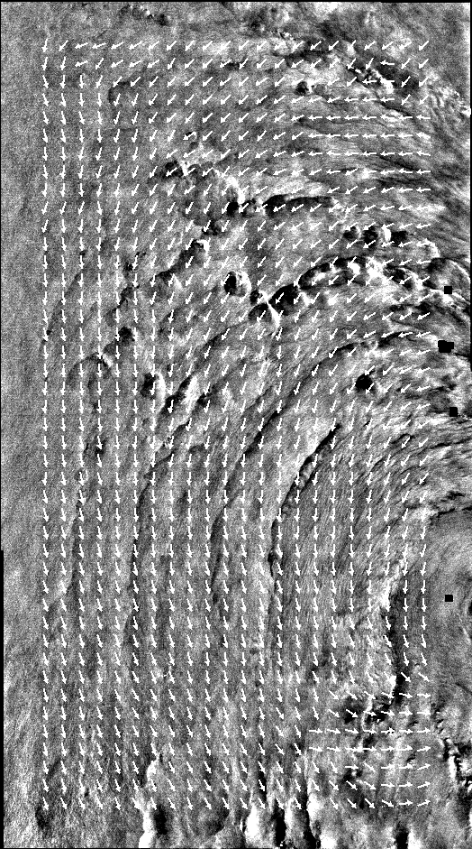
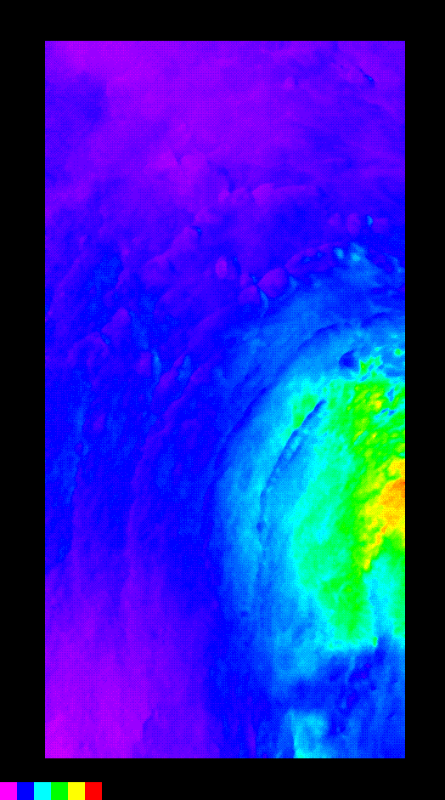
Malakas 9/24/2010
Flattened SAR Image with estimated wind directions
SAR Wind Speeds

Slide 11
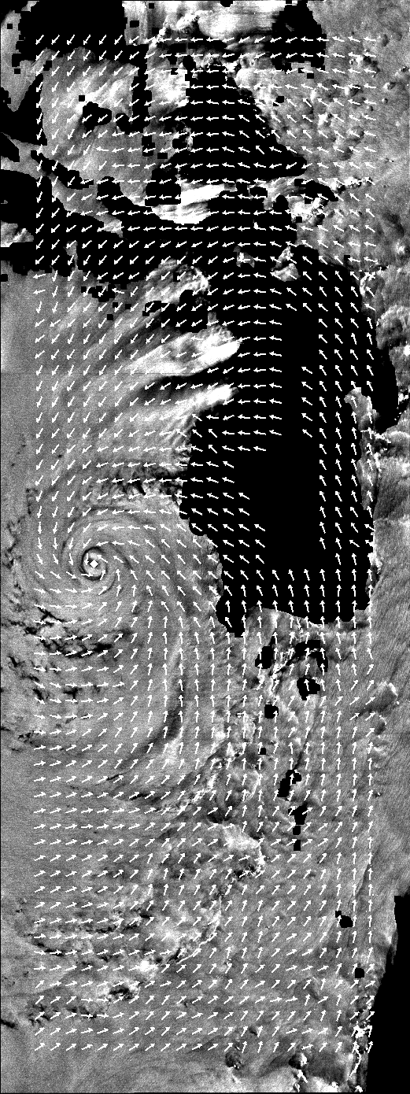

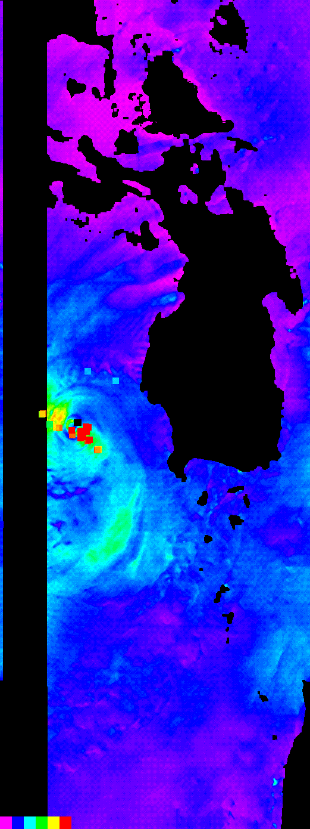
Megi 10/17/2010
-10 to -6 hours
Flattened SAR Image with Estimated Wind Directions
SAR Wind Speeds with Dropsonde Wind Speeds
Dropsonde Wind Speeds

Slide 12
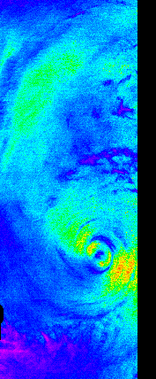
Megi 10/17/2010
Squares are 25km x 25 km
SAR Wind Speeds
SAR Wind Speeds with Dropsonde Wind Speeds

Slide 13
Blue squares use SFMR winds for the historic Pacific/Atlantic storms without Katrina on the 28th
Blue squares use SFMR winds for all the historic Pacific/Atlantic storms (with Katrina on the 28th)

Slide 14
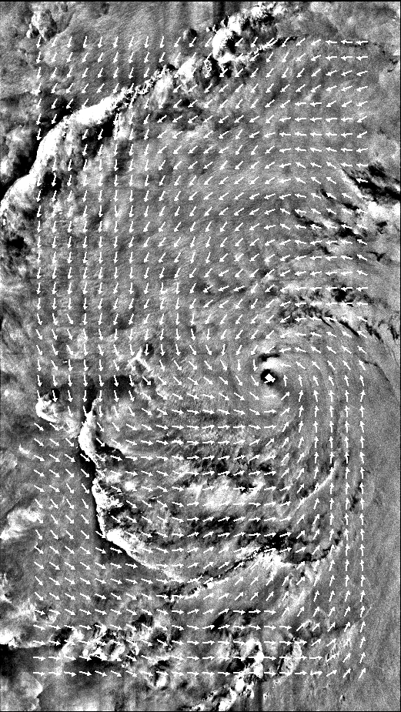

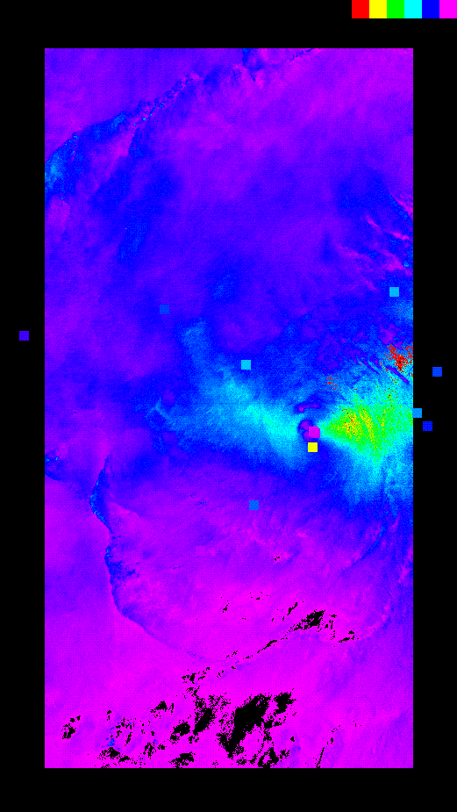
Megi 10/15/2010
+4 hours
-20 hours
Flattened SAR Image with Estimated Wind Directions
Dropsonde Wind Speeds
SAR Wind Speeds with Dropsonde Wind Speeds

Slide 15
Ongoing ITOP Analysis
Incorporate SFMR winds in the ground truth
Expand into X-band images to gain additional comparisons
Determine if modifications to the empirical transfer function can be
made for:
  high wind regions
  look angle dependence for low incidence angles/high winds
Getting SAR Winds Into The Archive
Data to be submitted:
  ascii files with lat., long. wind speed (m/s), wind direction (degsT)
  graphic (tif, bmp, ?) of colored wind speeds with wind directions
  unformatted 2D binary files of lat., long. wind speed., wind direction
When: The SAR team still needs to finalize the product, so preliminary
data in June-July, final products in Aug-Sept
Where: EOL
Contact Person: C. Wackerman

Slide 16
Back-up

Slide 17
Validation Using Historical SAR Database
11 Pacific Typhoons
  QSCAT wind speed/directions corrected for storm motion
  Best Track results
6 Atlantic Hurricanes
  SFMR wind speed corrected for storm motion for subset
  QSCAT wind speed/direction corrected for storm motion
  Best Track results

Slide 18
SAR Wind Vectors Validated Against QSCAT/SFMR/Best Track
ME: 0 degs
RMSE: 21 degs
ME: -0.8 m/s
RMSE: 5.9 m/s
w/o Katrina 28

Slide 19
Alantic/Pacific Storms vs. SFMR and Best Track Max Winds

Slide 20
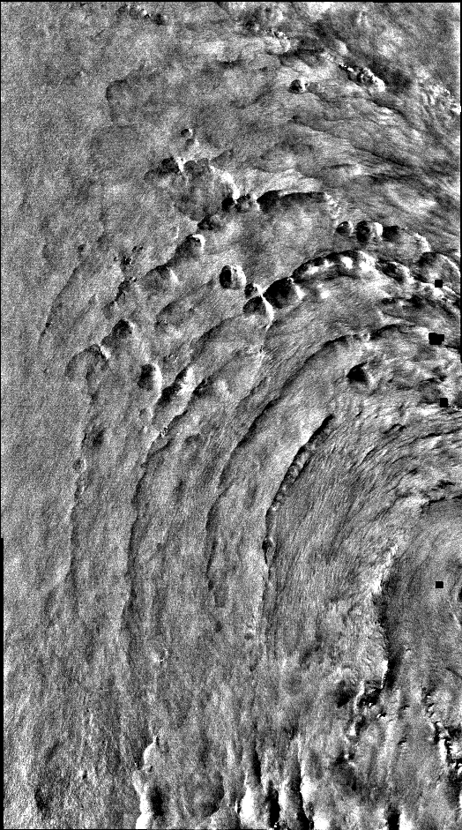
Malakas 9/22/10
Malakas 9/24/10

Slide 21
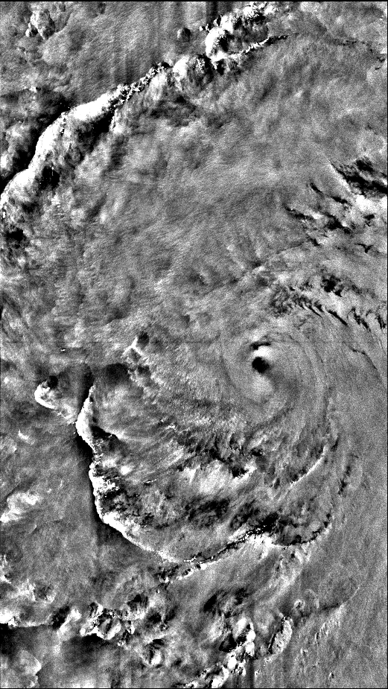
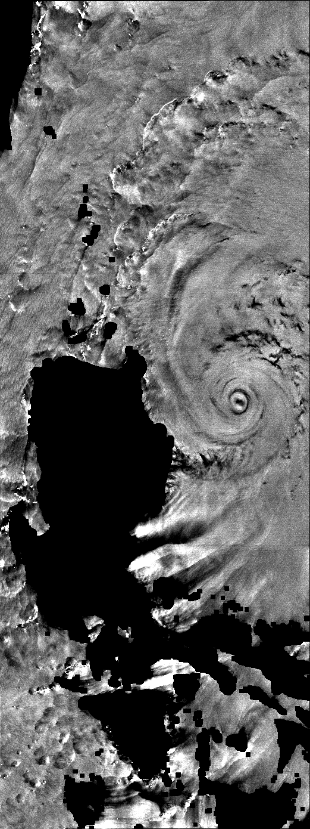
Megi 15 Oct 2010
Megi 17 Oct 2010

