Slide 1
Biogeochemical changes in the Wake of T. Megi
by
Craig McNeil and Eric D’Asaro (APL/UW)
Collaborations: Mark Altabet and Laura Bistrow (U. Mass., Dartmouth) and Nathaniel Ostrom (Michigan State U.): mass-spectrometer analysis of N₂/O₂/Ar gases and isotopic fractionation. Simone Alin (PMEL) for DIC/TAlk analysis.
Acknowledgements: Ren-Chieh Lien and Tom Sanford (APL) for sharing EM-APEX data, Mike Ohmart (APL) and Revelle crew for all efforts during the recovery cruise, Chin-Chang Hung (Nat. Taiwan Ocean U.) for providing me with HazMat chemicals which saved the day!, and ONR for allowing me to participate in ITOP cruise.
GasFlux work is NSF funding

Slide 2
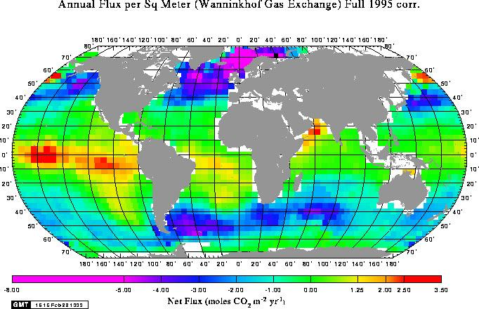
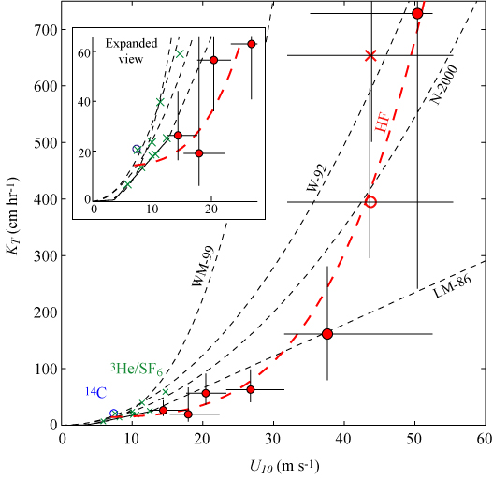
Big Science Questions
How important are TC’s in global carbon budget?
2) How to parameterize air-sea gas flux at hurricane force winds in terms of wind speed and wave breaking rates?
<F> = < K_{T} S_{H} ΔpCO₂>
K_{T}
H. Frances
U₁₀
McNeil & D’Asaro (2007)

Slide 3
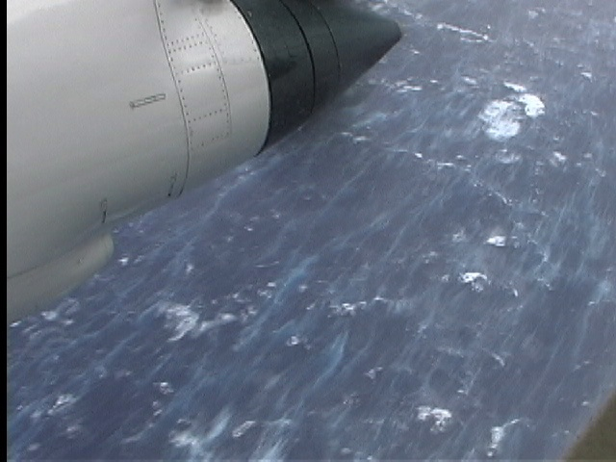
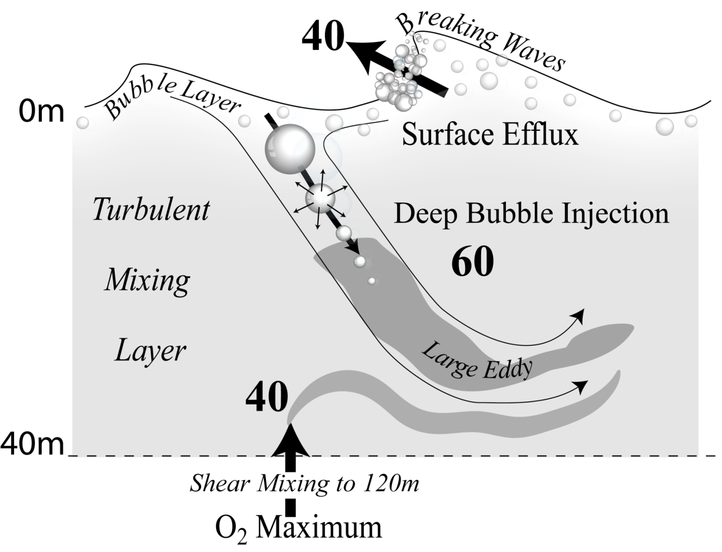
Gas flux processes at hurricane force winds
Surface breaking
strips gas out
of the ocean
Converging currents
pump gas into
the ocean and super-
saturate it
D’Asaro & McNeil (2007)
Eric Uhlhorn (NOAA) during Hurricane Fabian

Slide 4
Typhoon Megi Shipboard Measurements
TSG (Fl?...)
O₂/N₂/CO₂

Slide 5
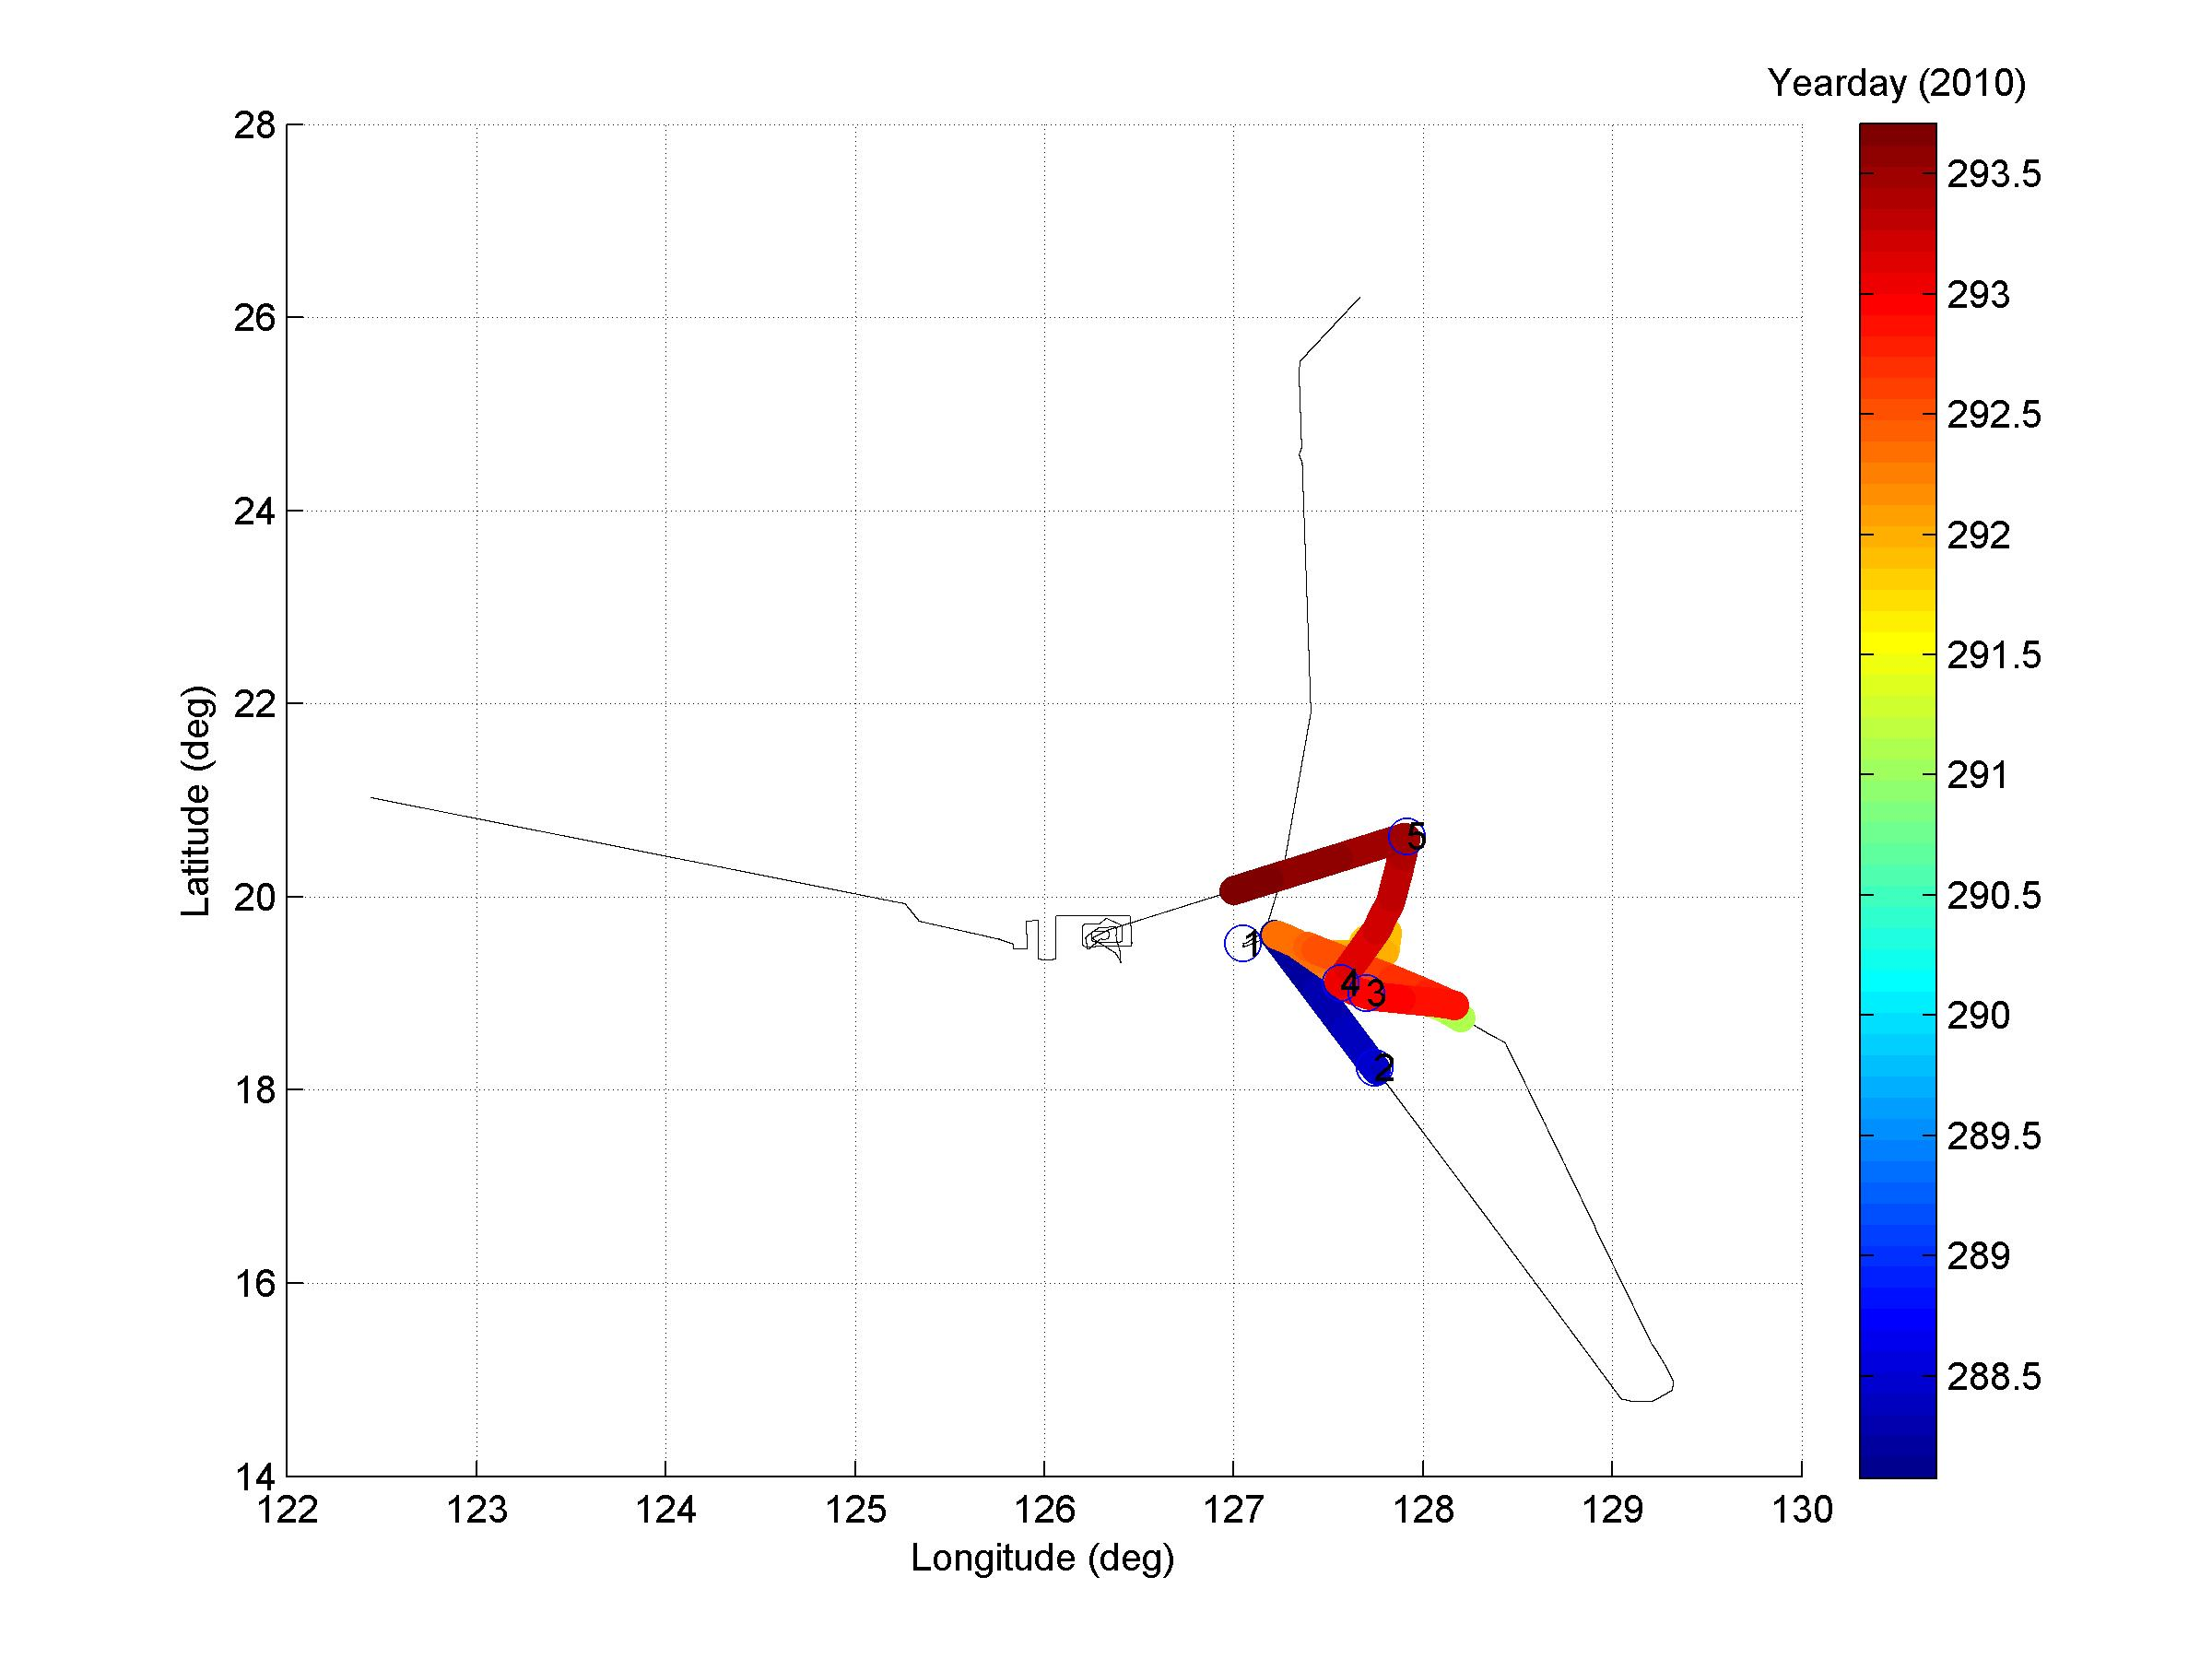

Ship track and timeline
Start
Okinawa, Japan
End
Kaohsiung, Taiwan
Wait!

Slide 6
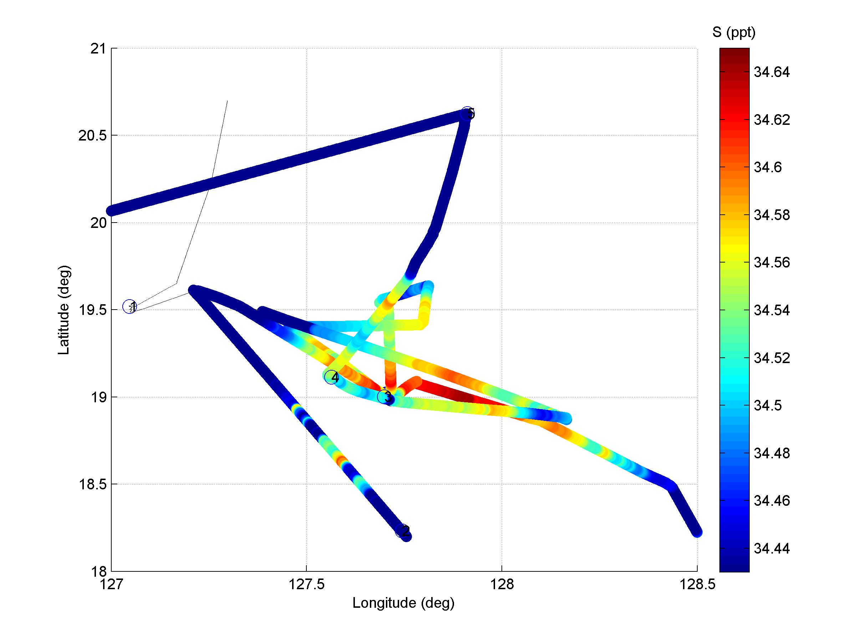
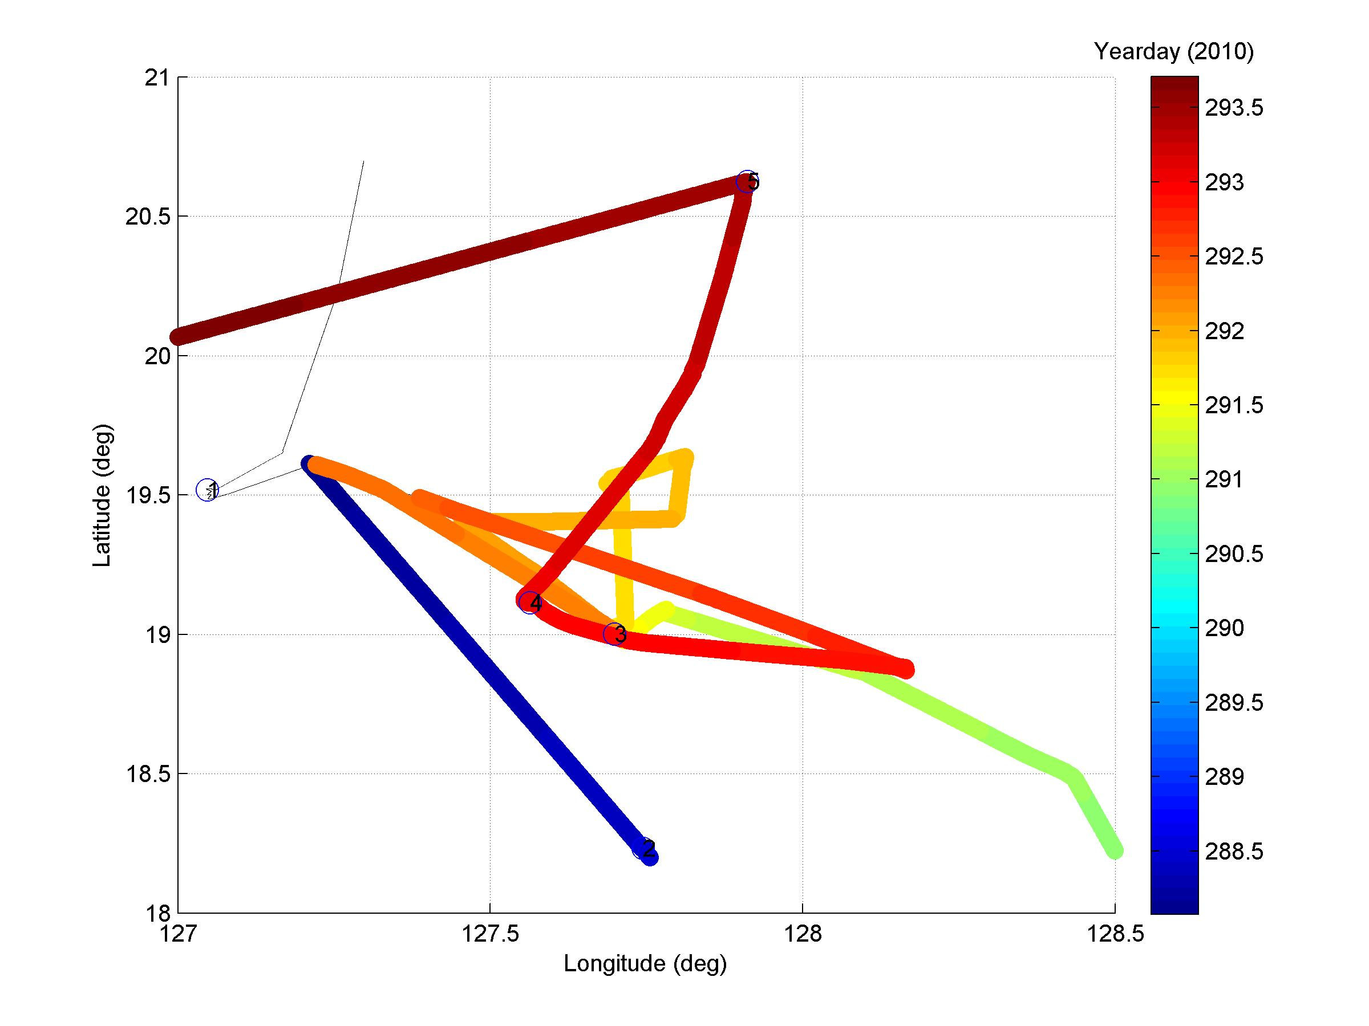
Zoom of wake region
bad
before
after

Slide 7
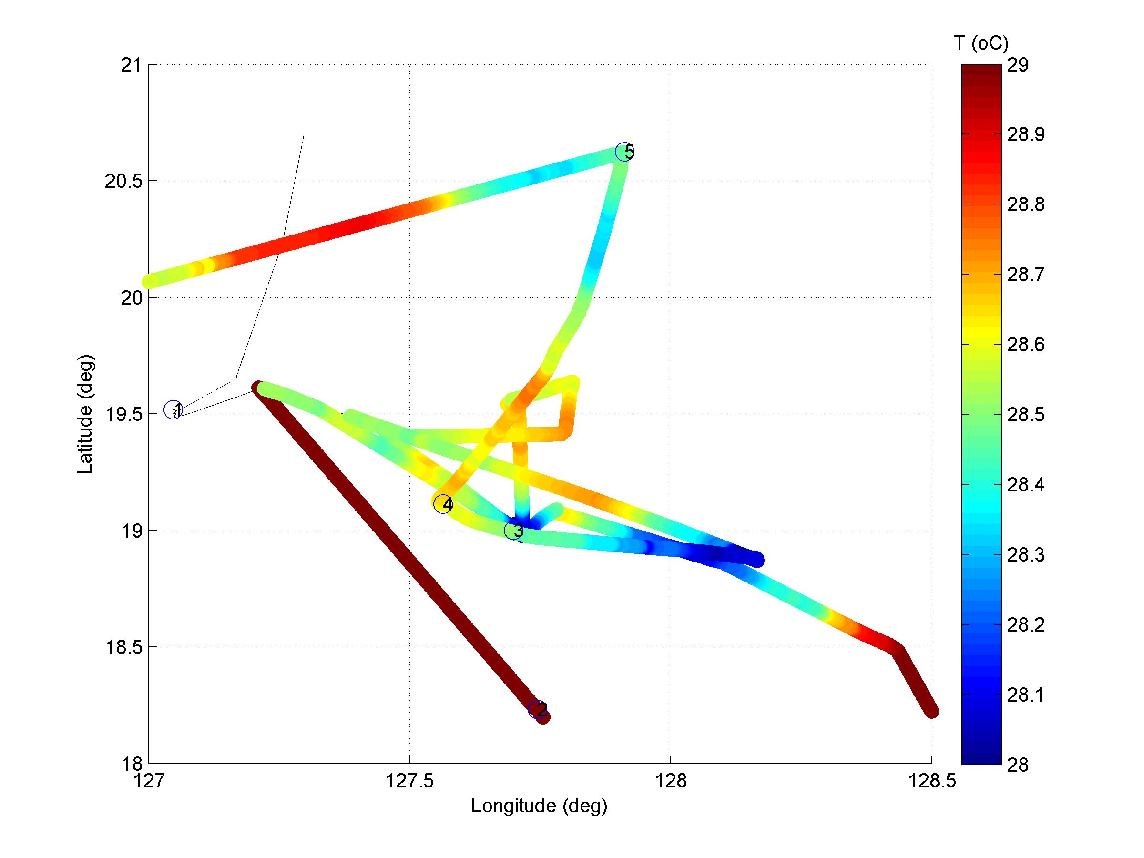
Temperature zoom
Still large regional variability
after storm
cold
wake!
Cold Wake
Region

Slide 8
Salinity zoom
CTD
cast #
salty wake
but large
variability
Cold Wake
Region

Slide 9
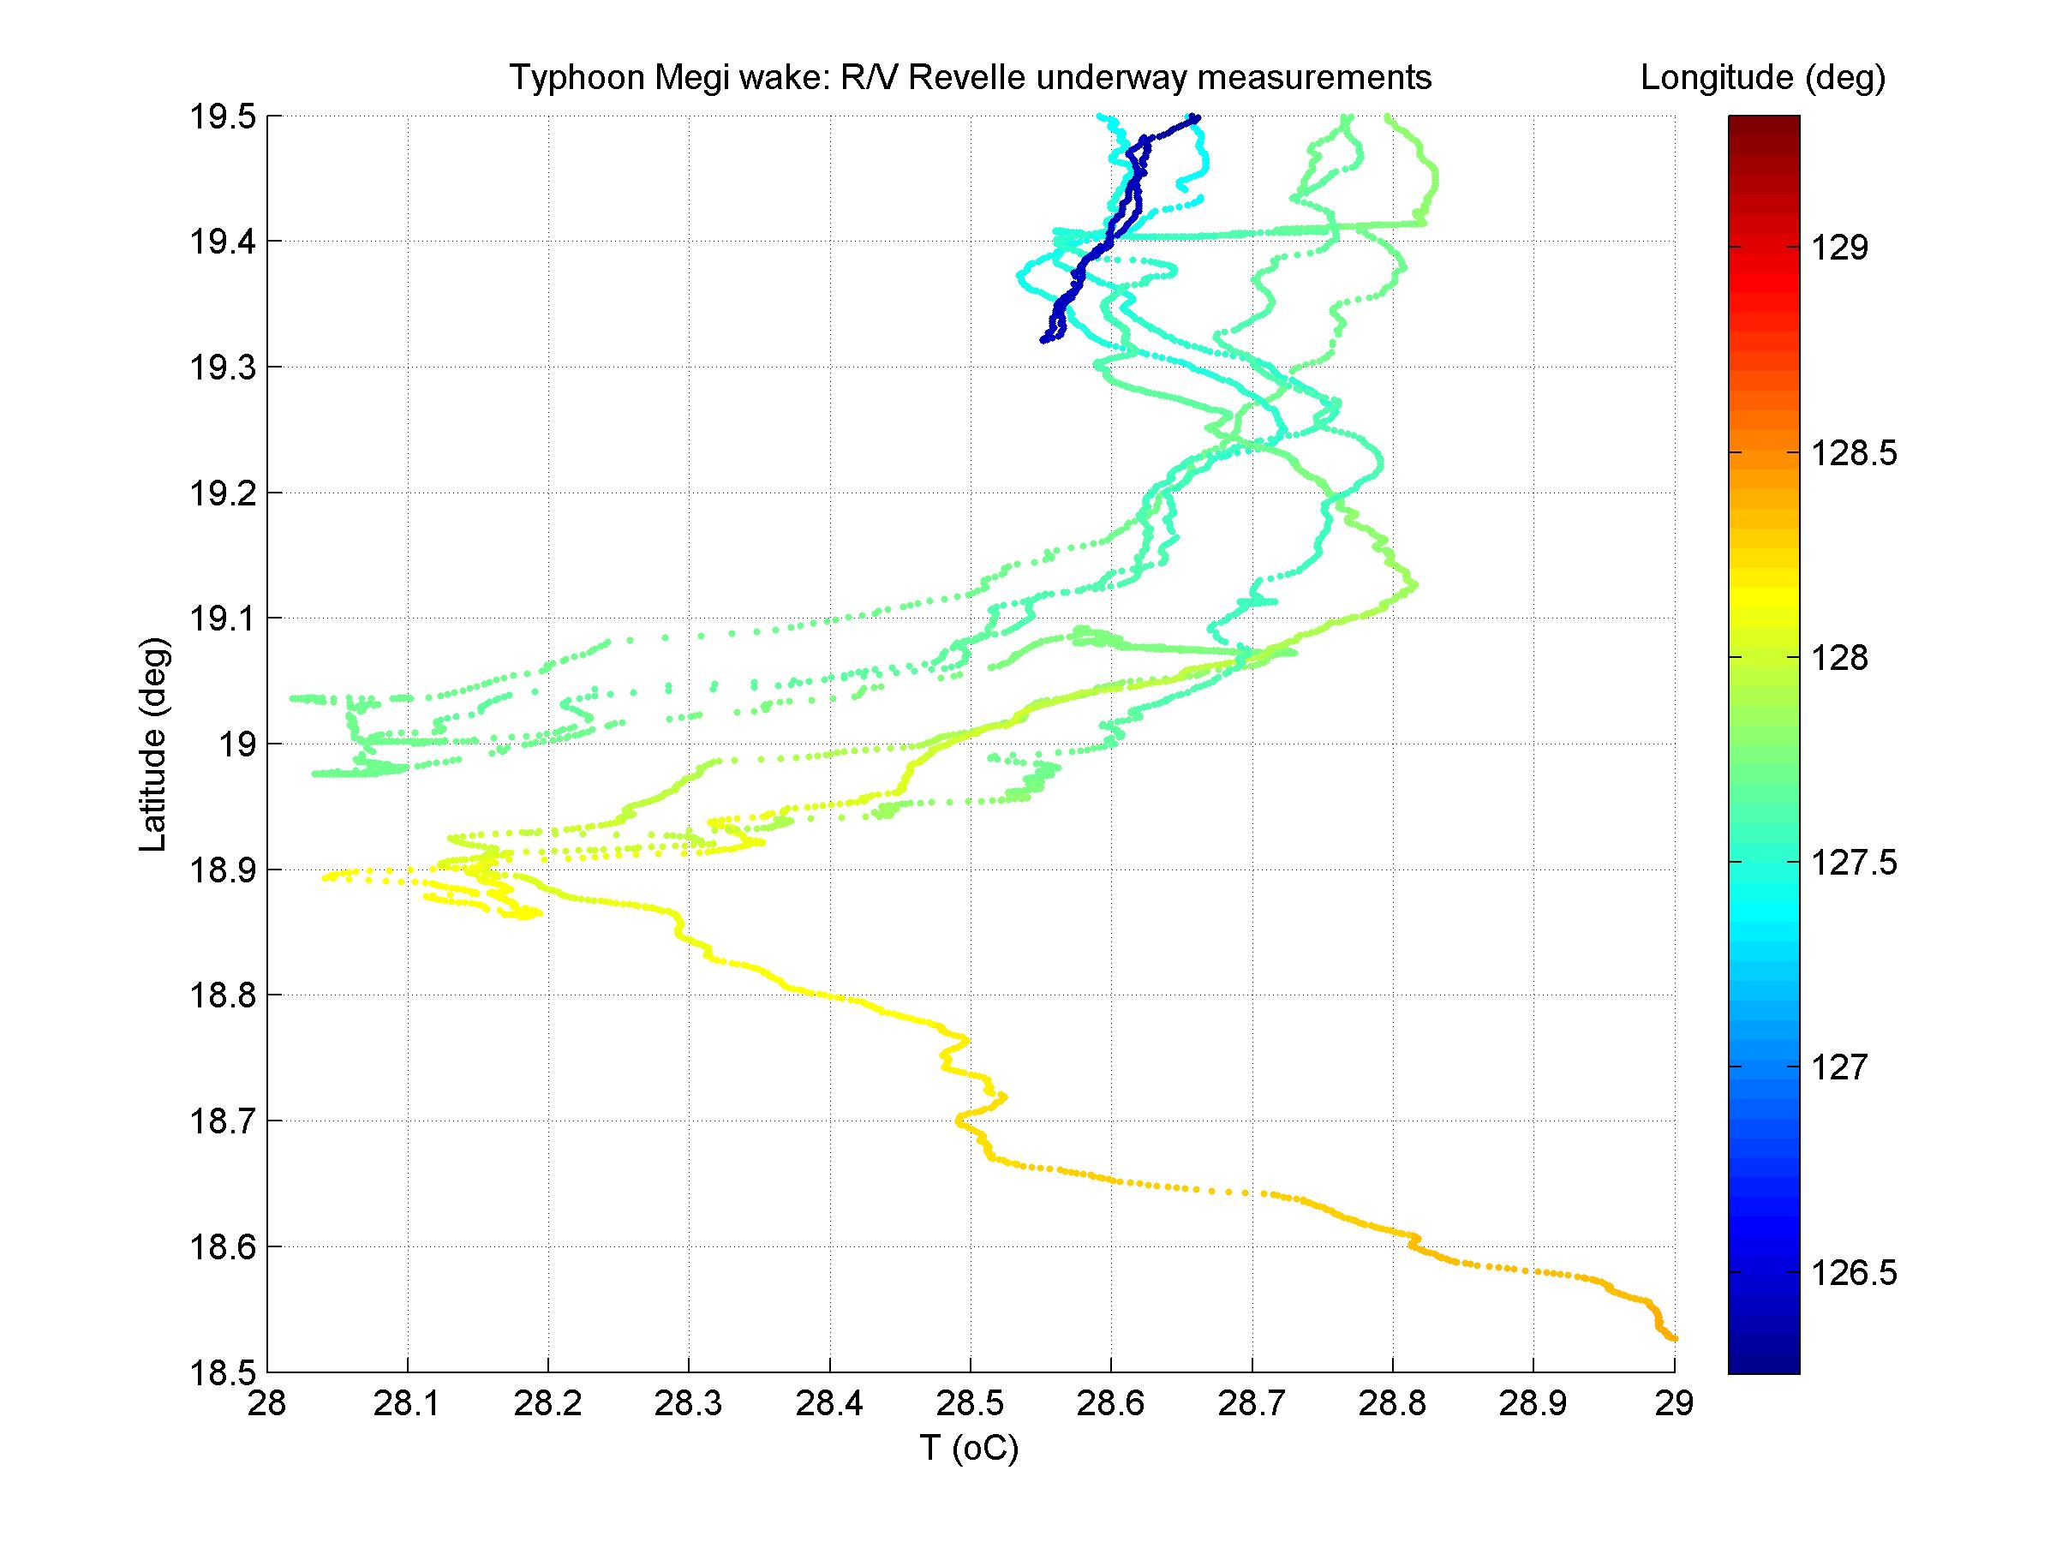
Width of cold wake
~ 60 km
ΔT = -0.75 ºC

Slide 10
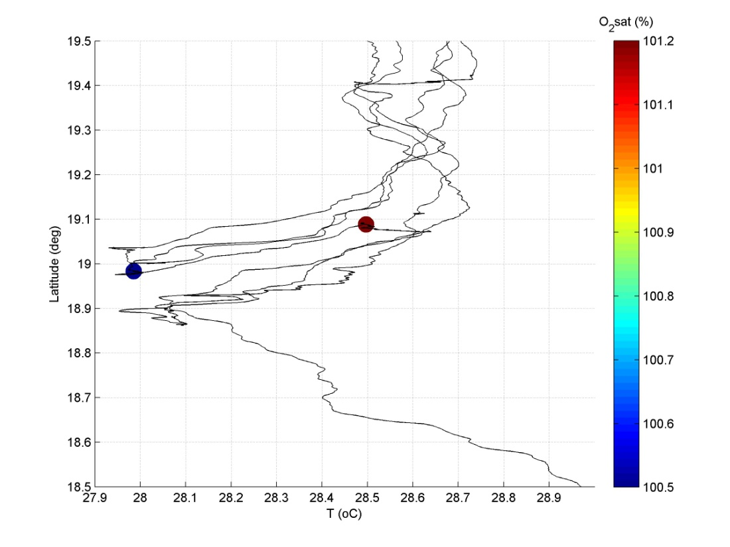
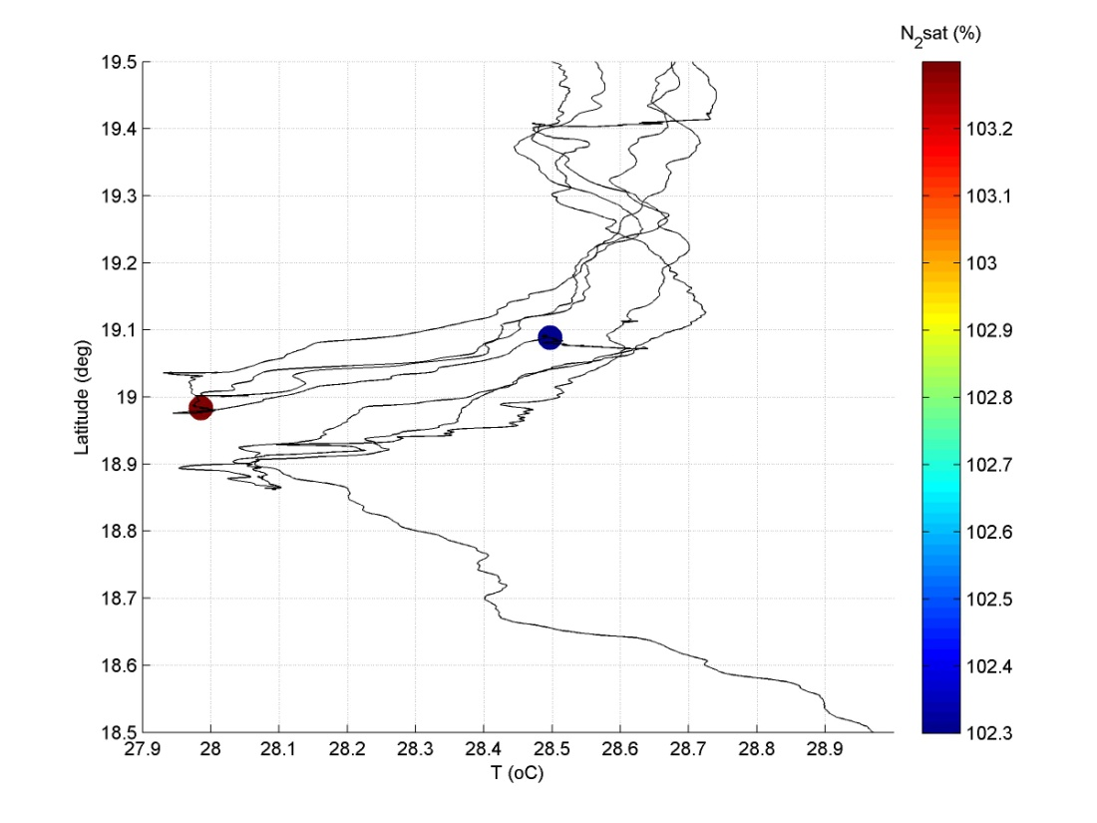
Preliminary….
low
high
high
low
O₂
N₂
in wake O₂ : 100.5%, but variable.
out wake O₂ : 101.2%
Biology important:
sets O₂ profile being mixed
wake net heterotrophic?
in wake N₂ : 103.3%
out wake N₂ : 102.3%
Think of N₂ as a proxy for ‘abiotic O₂’
N₂ increases due to bubble injection.

Slide 11
CTD CAST DATA:
O₂ (+ Chl?, yet to look)
Dissolved inorganic carbon system (PMEL analysis)
N₂ + Ar + stable isotopes (U. Mass Dartmouth and MSU)

Slide 12
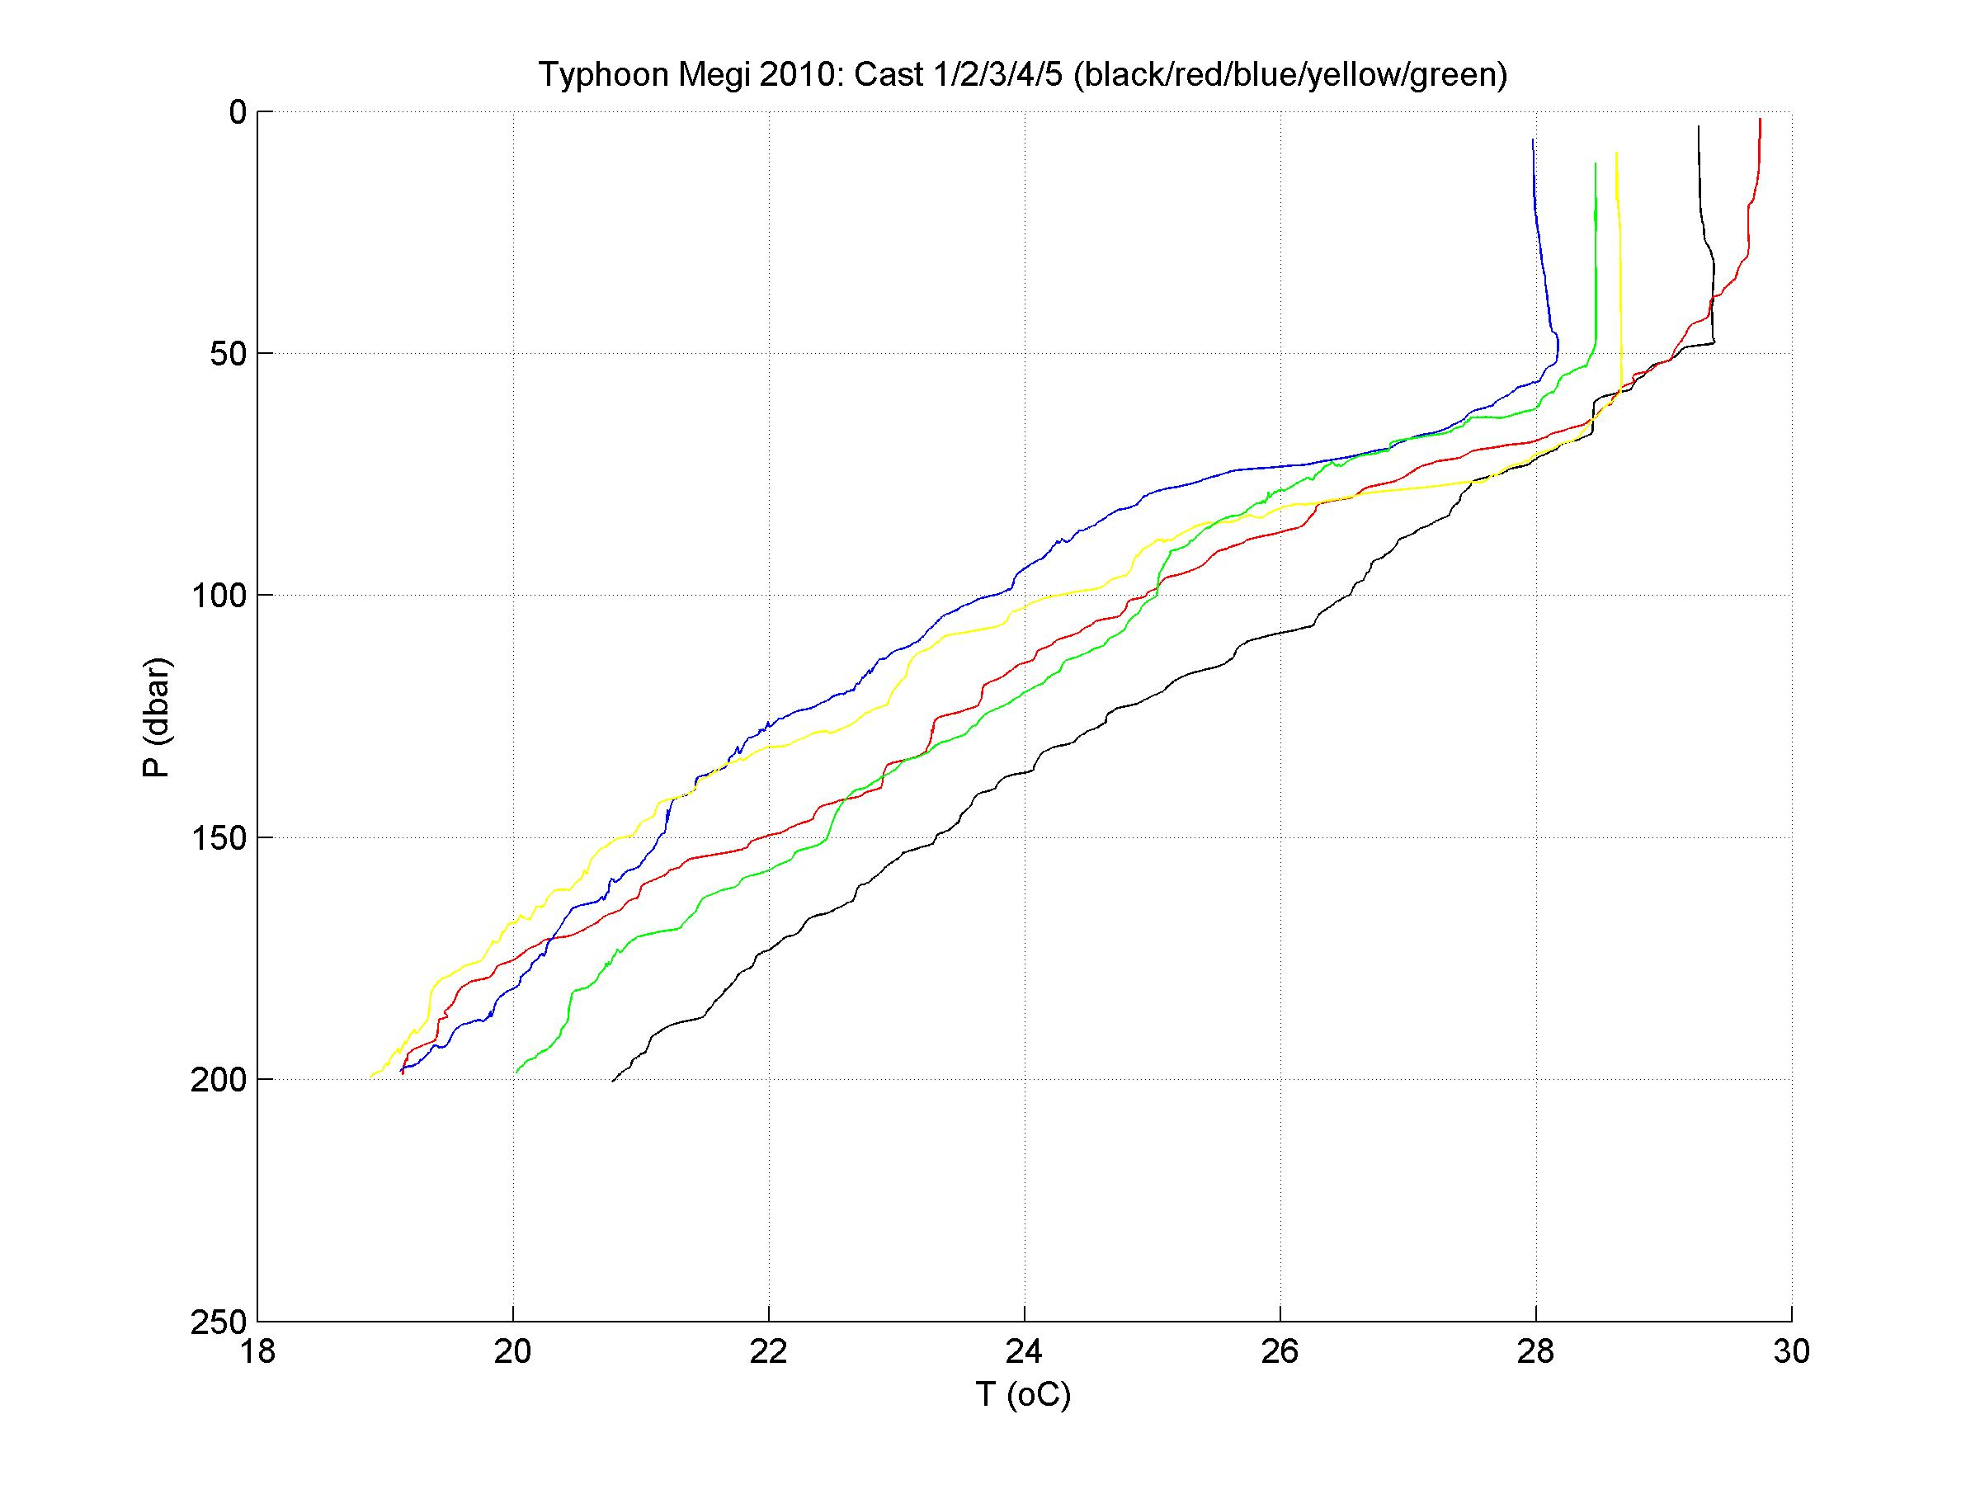
before
after
3
5
4
1
2
Note large variability
in thermocline water properties
Temperature decrease

Slide 13
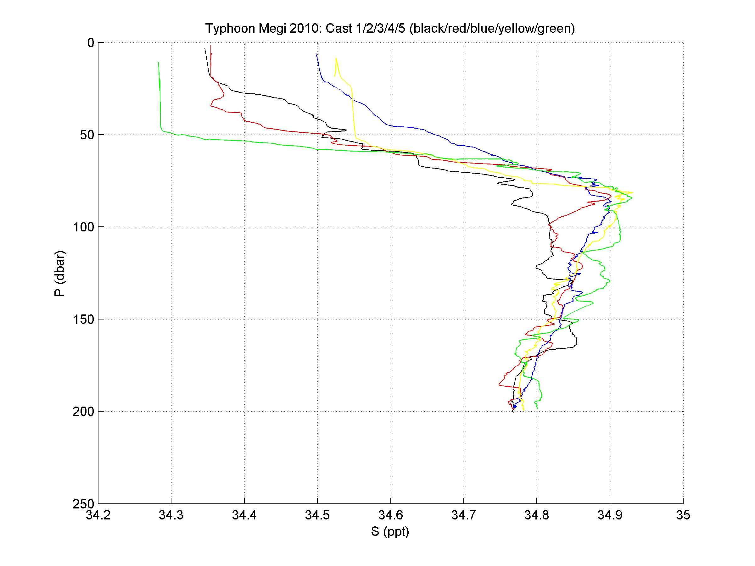
before
after
after
mostly
salinity increase

Slide 14
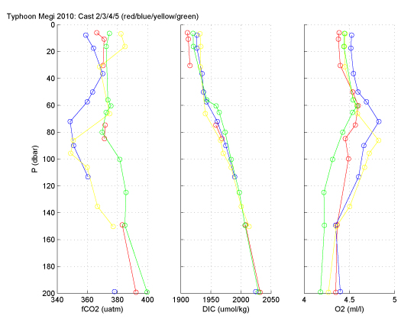
± fCO₂
+ DIC
+ O₂
fCO₂ min
O₂ max
Depends on mixing and
depth of fCO₂ min
Increase due to mixing up CO₂ rich deeper waters
Increase in O₂
concentration
392.5 ppm Mauna Loa during 2010

Slide 15
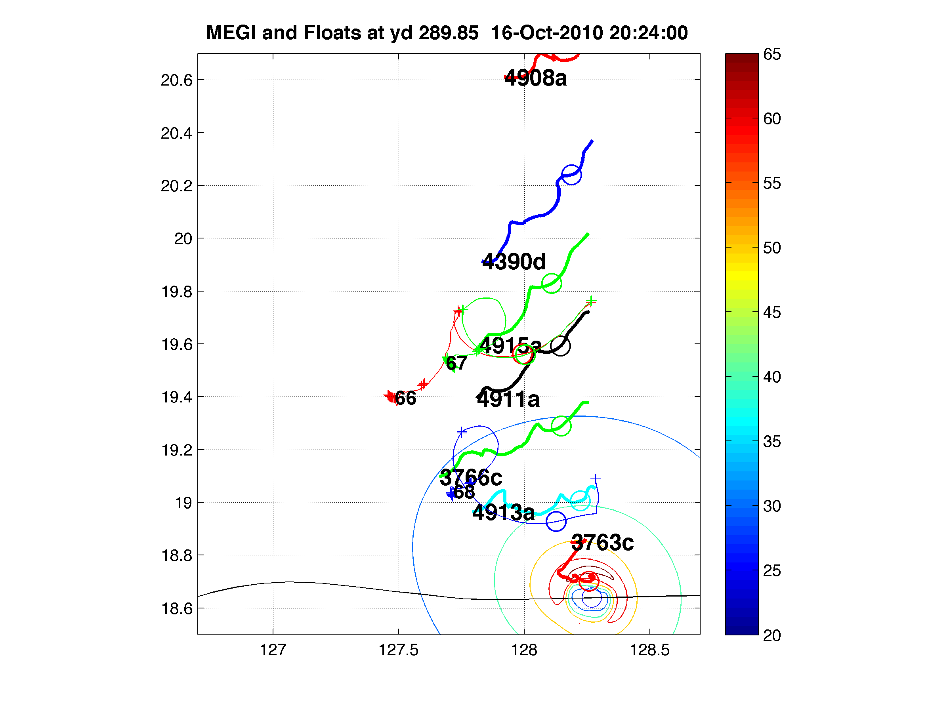
FLOAT DATA
Sanford floats
3 D’Asaro
floats

Slide 16
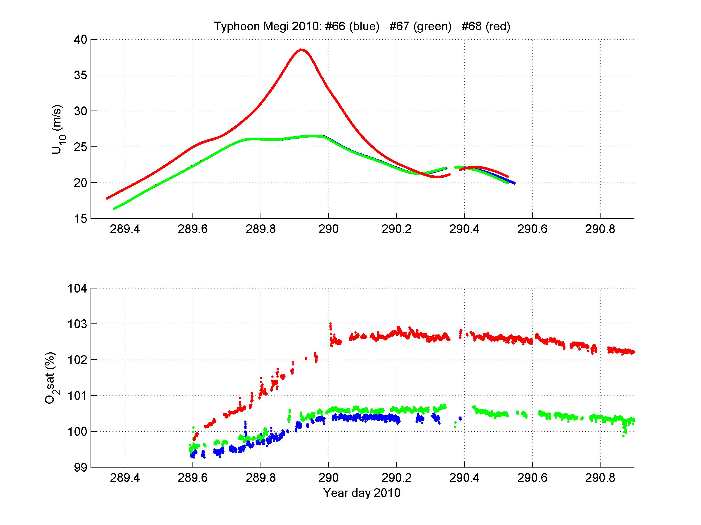
Slow degassing and respiration?
Dissolving
bubbles and
mixing into
subsurface
O₂ max

Slide 17
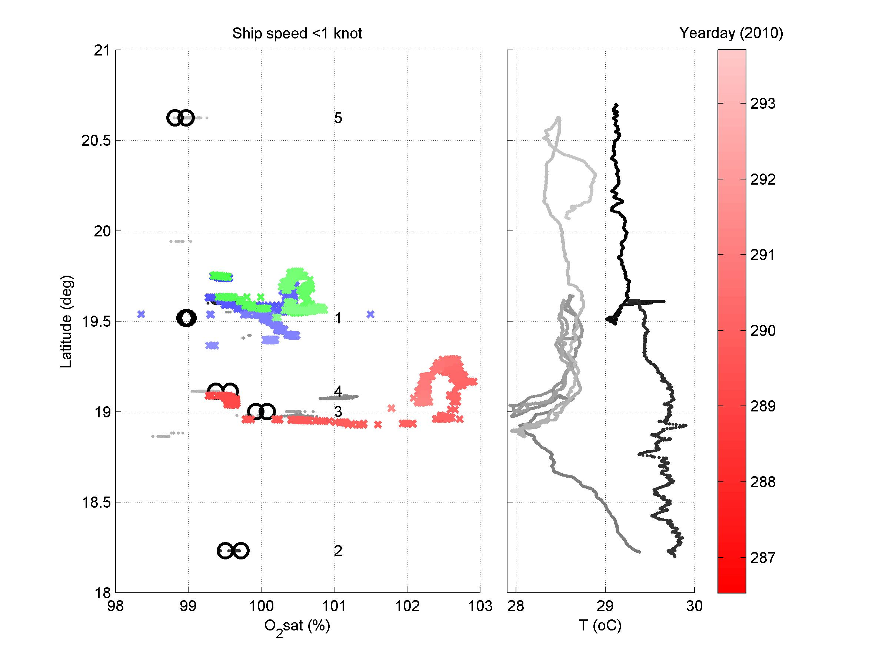
Compare ship and float dissolved oxygen
CTD
cast #
after
before
max during
storm
before
multiple
cuts into
cold wake
after
Absolute levels TDB

Slide 18
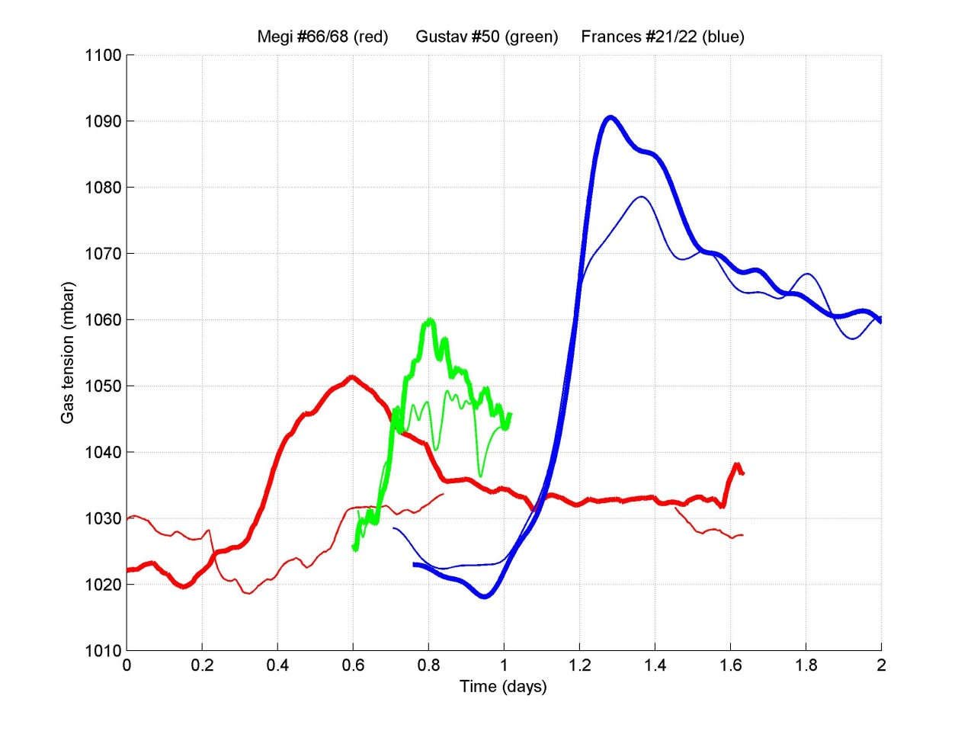
Total dissolved air pressure of mixed layer
Hurricane
Frances (2004)
Hurricane
Gustav (2008)
Typhoon
Megi
(2010)

Slide 19
SUMMARY
Typhoon Megi completes our 3rd gas flux data set
More complete data in Megi since have inorganic carbon data
Megi has complex water masses and mixing: confounds simple interpretation, need to interpret before/after changes AFTER accounting for mixing
Familiar story:
- mixed layer O₂/N₂ gas levels are raised in wake by dissolution of bubbles that are dragged deep by turbulent currents.
Plan to use DIC data to constrain carbon flux during Typhoon Megi by budgeting.

