Slide 1
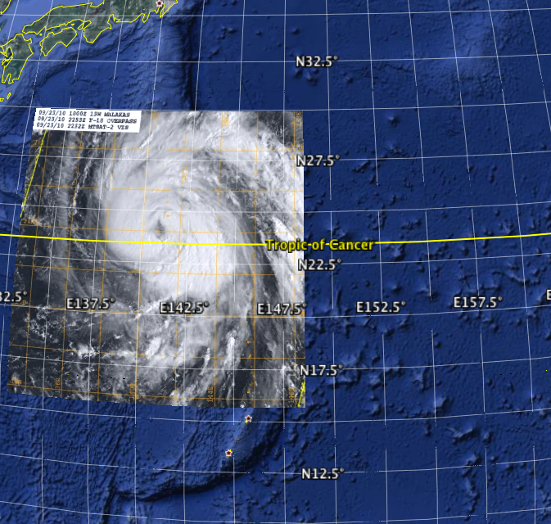
Atmosphere and Ocean Characteristics during TY Malakas
TY Malakas (1200 UTC 19 September – 0000 UTC 25 September
ITOP-22
Formed rapidly
4 RECON Flights
1 Drifting Buoy Deployment
Flight
1 Wake Flight
4
2412
3
2312
2
2212
1
2112
2012
1912
Guam
Patrick A. Harr
Dept. of Meteorology
Naval Postgraduate School
Acknowledgment: Office of Naval Research

Slide 2
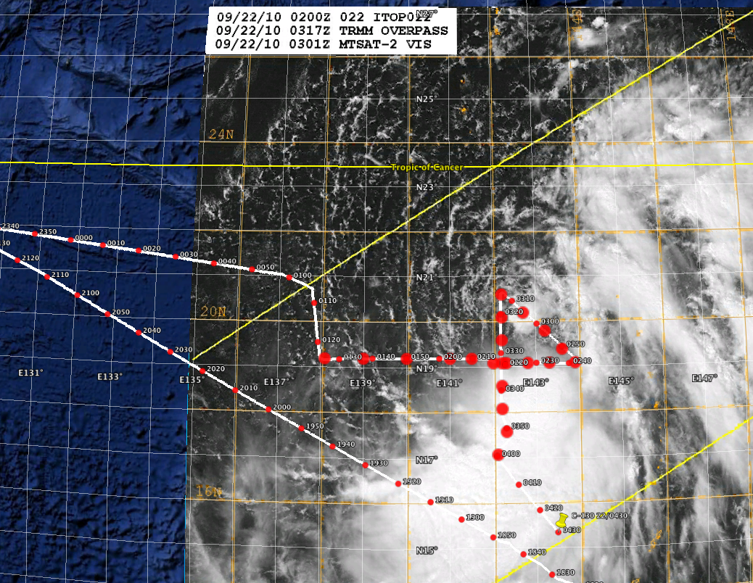
Flight 1:
Originally a wake flight
over the region east of Taiwan
after TY Fanapi had made
landfall
JTWC:
Tropical depression @ 30 kts
Flight 1:
Asymmetric structure with
10-15 kt vertical wind shear from
the north-northwest due to the
anticyclone hat built behind TY Fanapi

Slide 3
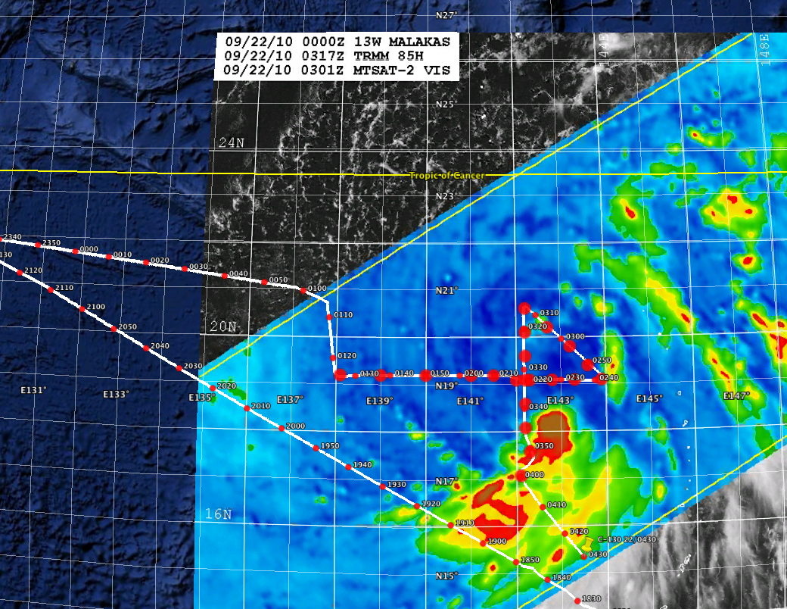
Flight 1:
Originally a wake flight
over the region east of Taiwan
after TY Fanapi had made
landfall
JTWC:
Tropical depression @ 30 kts
Flight 1:
Asymmetric structure with
10-15 kt vertical wind shear from
the north-northwest due to the
anticyclone that built behind TY Fanapi

Slide 4
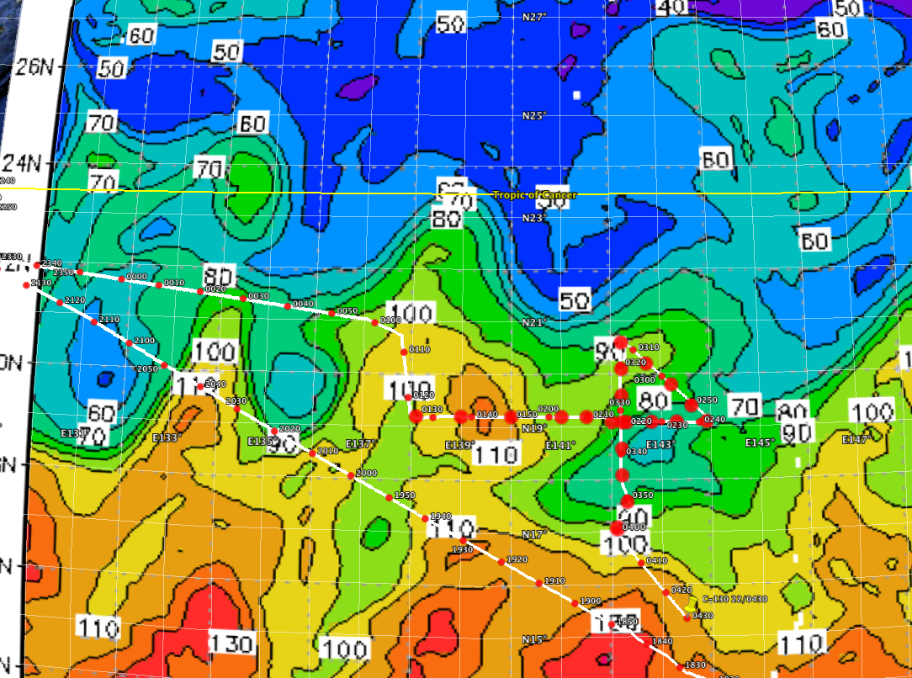
NRL EASNFS: OHC (kJ cm⁻²) 0000 UTC 22 September
From itop.org
Flight 1:
Originally a wake flight
over the region east of Taiwan
after TY Fanapi had made
landfall
JTWC:
Tropical depression @ 30 kts
Flight 1:
Asymmetric structure with
10-15 kt vertical wind shear from
the north-northwest due to the
anticyclone that built behind TY Fanapi

Slide 5
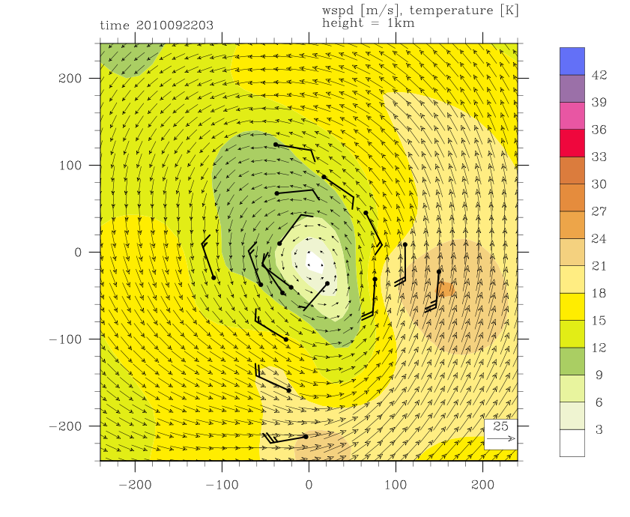
Spline Analysis at Mesoscale Utilizing Radar and Aircraft Instrumentation (SAMURAI)
Developed by Michael Bell
21.5ºN
10 km horizontal grid
0.5 km vertical grid spacing
ECMWF Analysis
at 1/8 deg. Horizontal
grid
19.5ºN
19.5ºN
140.5ºE
142.5ºE
144.5ºE

Slide 6
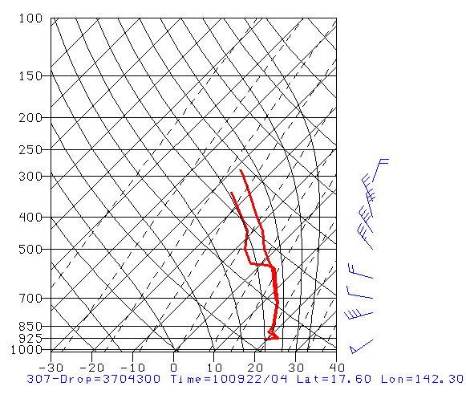
Spline Analysis at Mesoscale Utilizing Radar and Aircraft Instrumentation (SAMURAI)
Developed by Michael Bell
21.5ºN
10 km horizontal grid
0.5 km vertical grid spacing
ECMWF Analysis
at 1/8 deg. Horizontal
grid
19.5ºN
17.5ºN
19.5ºN
140.5ºE
142.5ºE
144.5ºE

Slide 7
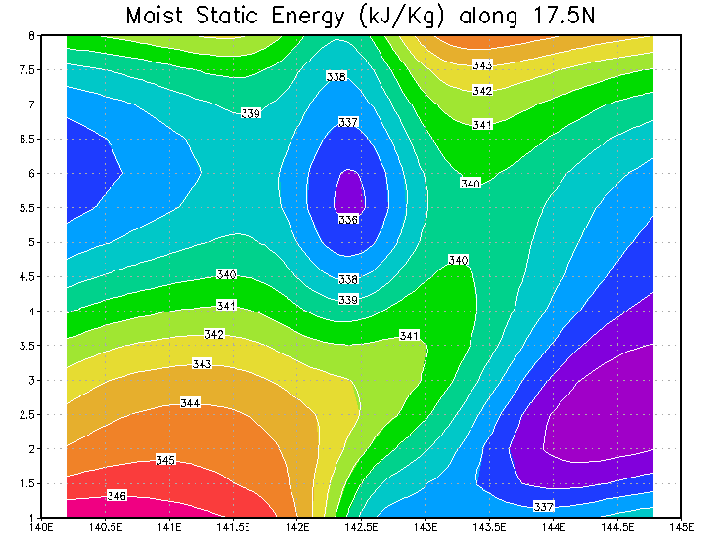
Horizontal Grid Center

Slide 8
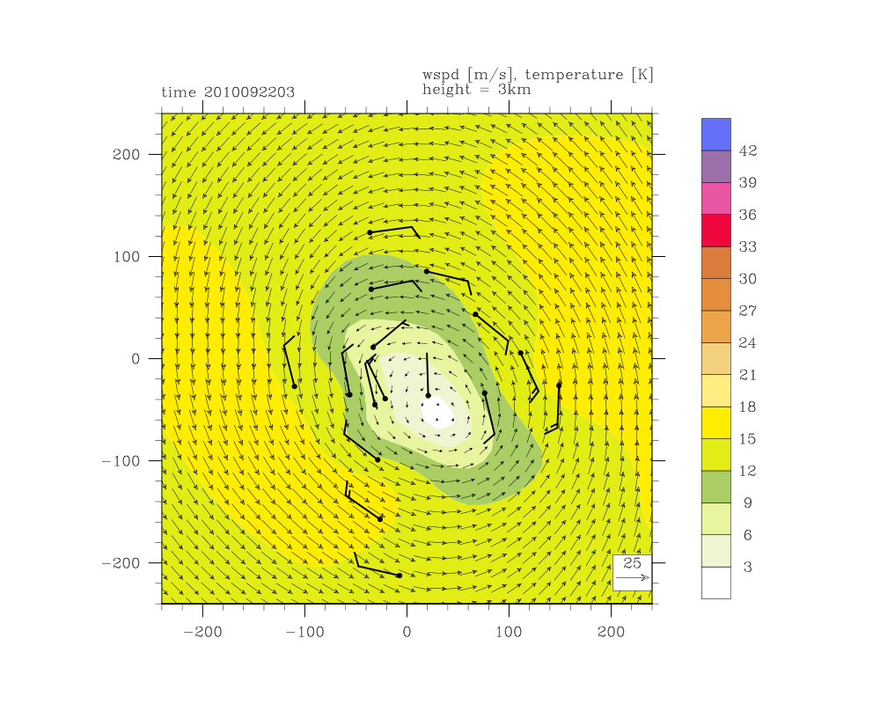
SAMURAI Horizontal Wind Analysis: 3 km
21.5ºN
19.5ºN
19.5ºN
140.5ºE
142.5ºE
144.5ºE

Slide 9
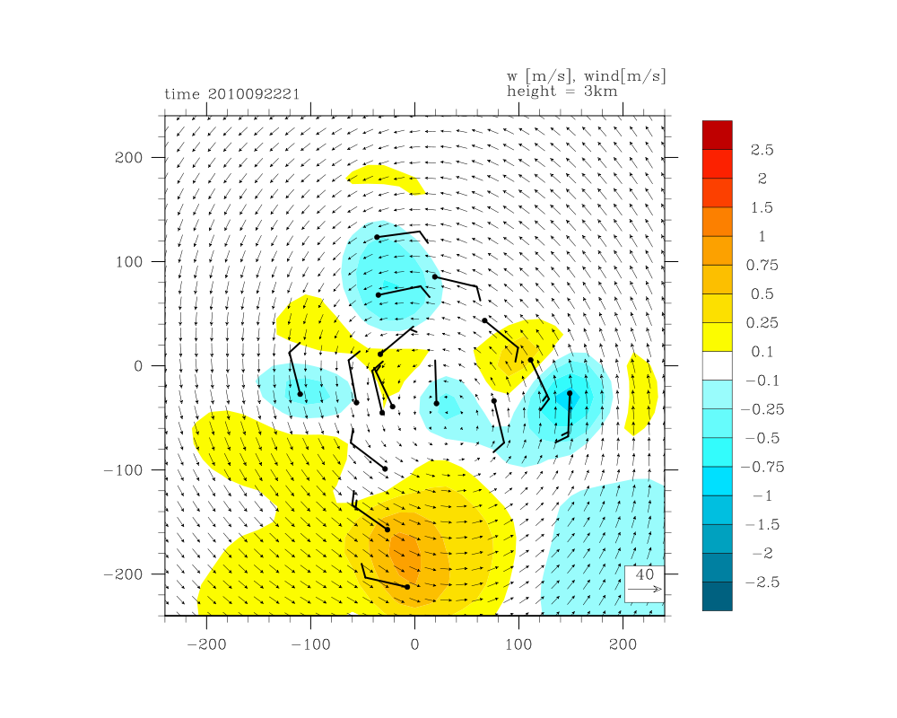
SAMURAI Horizontal and Vertical Wind Analyses: 3 km
21.5ºN
19.5ºN
19.5ºN
140.5ºE
142.5ºE
144.5ºE

Slide 10
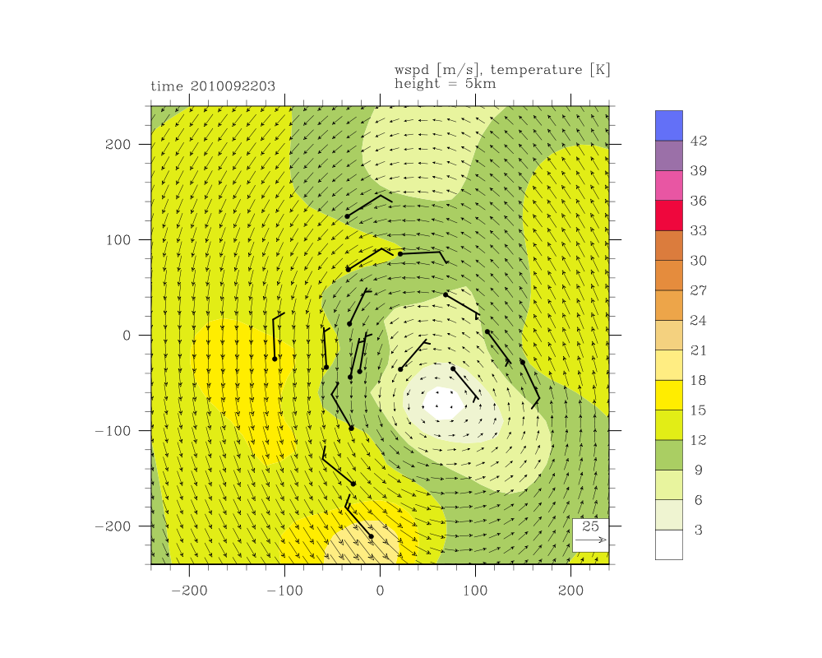
SAMURAI Horizontal Wind Analysis: 5 km
21.5ºN
19.5ºN
19.5ºN
140.5ºE
142.5ºE
144.5ºE

Slide 11
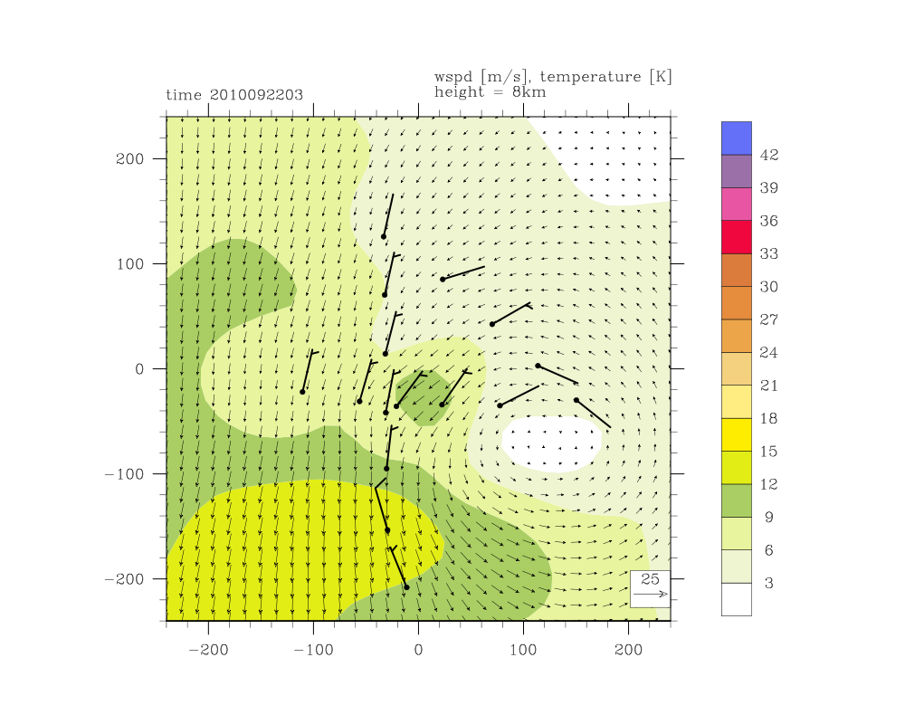
SAMURAI Horizontal Wind Analysis: 8 km
21.5ºN
19.5ºN
19.5ºN
140.5ºE
142.5ºE
144.5ºE

Slide 12
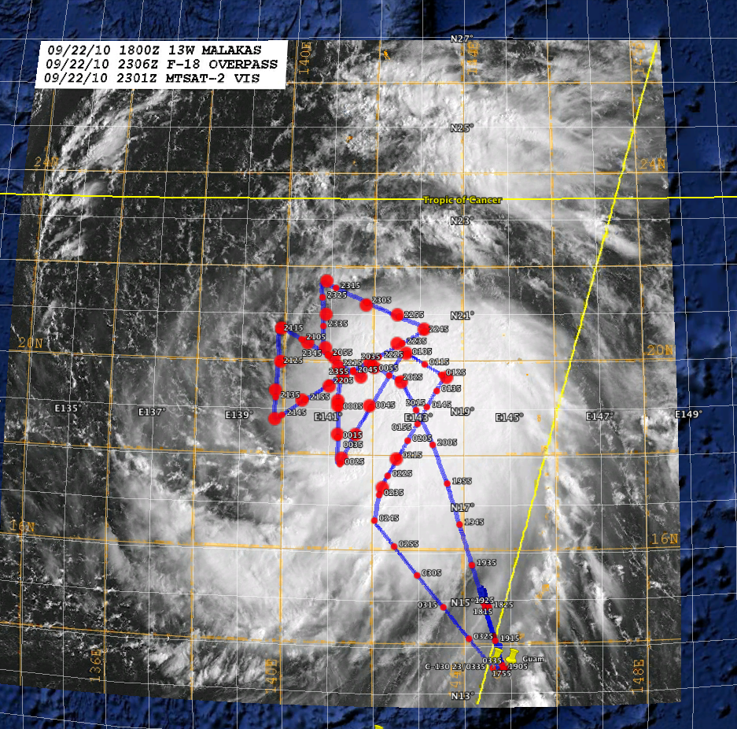
JTWC:
Typhoon @ 65 kt
Flight 2:
Continued asymmetric structure with
Decreased vertical wind shear (7 kt) from
the north-northwest due to the
anticyclone hat built behind TY Fanapi

Slide 13
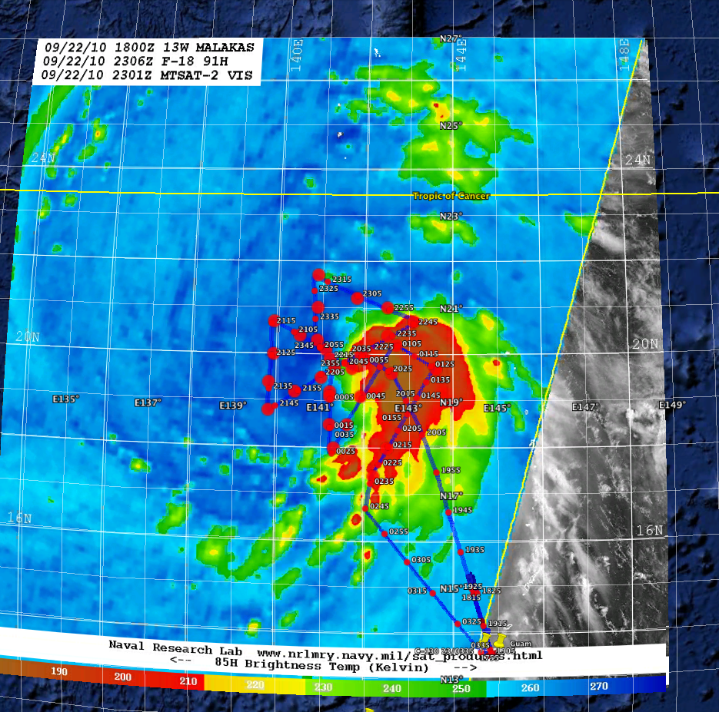
JTWC:
Typhoon @ 65 kt
Flight 2:
Continued asymmetric structure with
Decreased vertical wind shear (7 kt) from
the north-northwest due to the
anticyclone hat built behind TY Fanapi

Slide 14
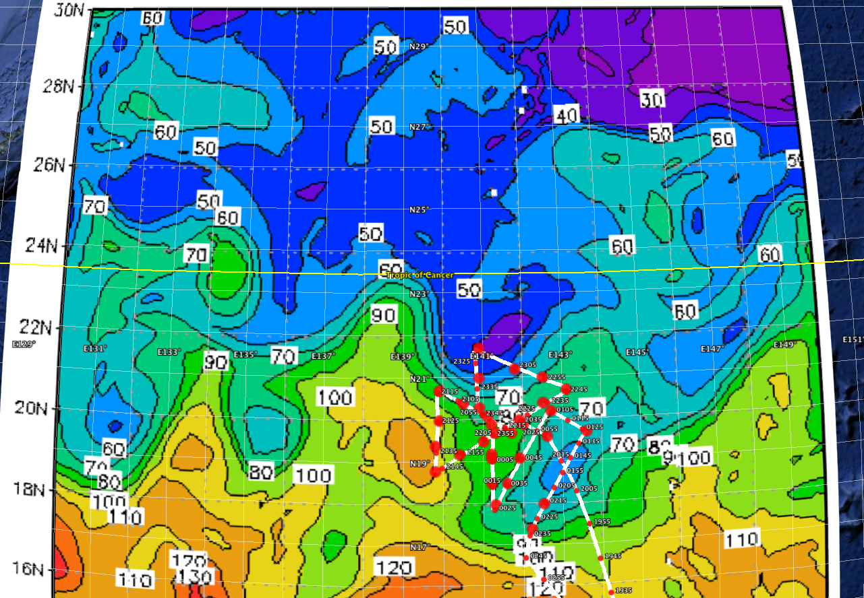
NRL EASNFS: OHC (kJ cm⁻²) 0000 UTC 23 September
From itop.org
Flight 2:
Continued asymmetric structure with
Decreased vertical wind shear (7 kt) from
the north-northwest due to the
anticyclone hat built behind TY Fanapi
JTWC:
Typhoon @ 65 kt

Slide 15
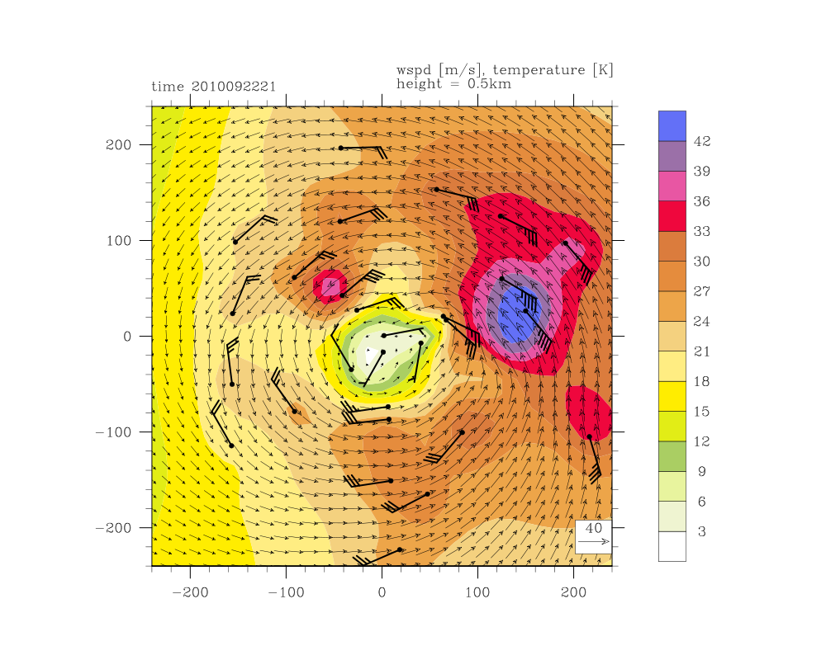
SAMURAI Horizontal Wind Analysis: 0.5 km
21.5ºN
19.5ºN
19.5ºN
140.5ºE
142.5ºE
144.5ºE

Slide 16
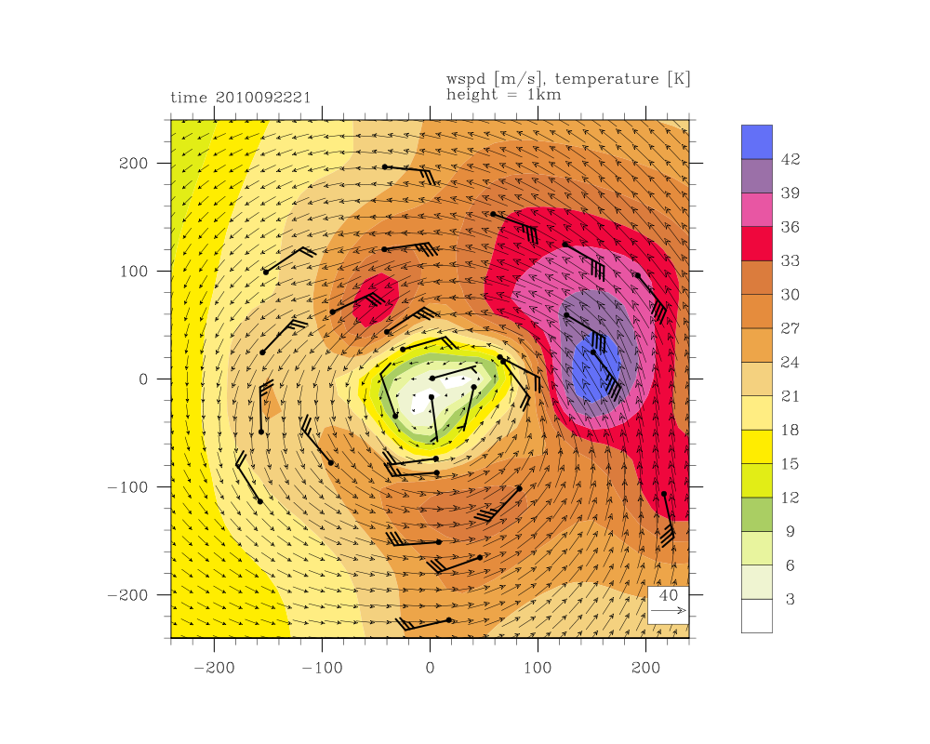
SAMURAI Horizontal Wind Analysis: 1 km
21.5ºN
19.5ºN
19.5ºN
140.5ºE
142.5ºE
144.5ºE

Slide 17
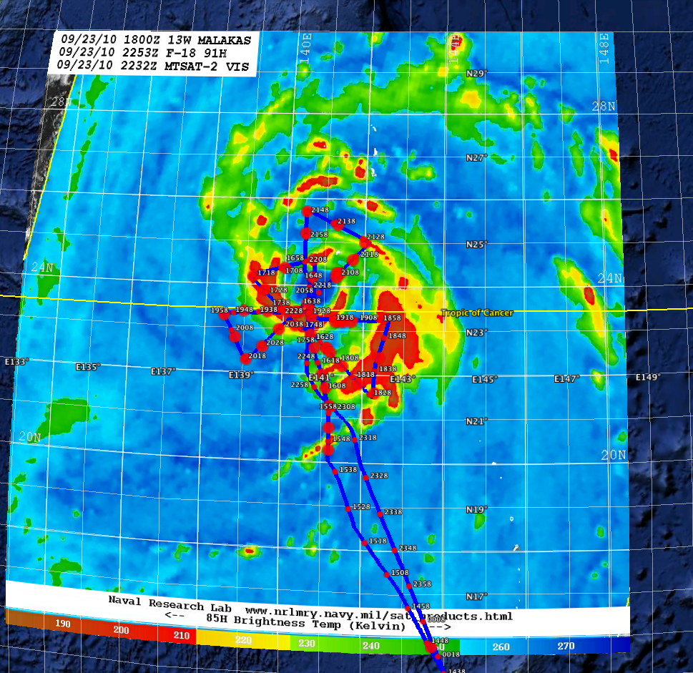
JTWC:
Typhoon @ 90 kt
Flight 3:
Intensification and transition to a more
symmetric structure.
shear decreased to 5 kts from
the north and average OHC decreased to
40 kJ cm⁻²

Slide 18
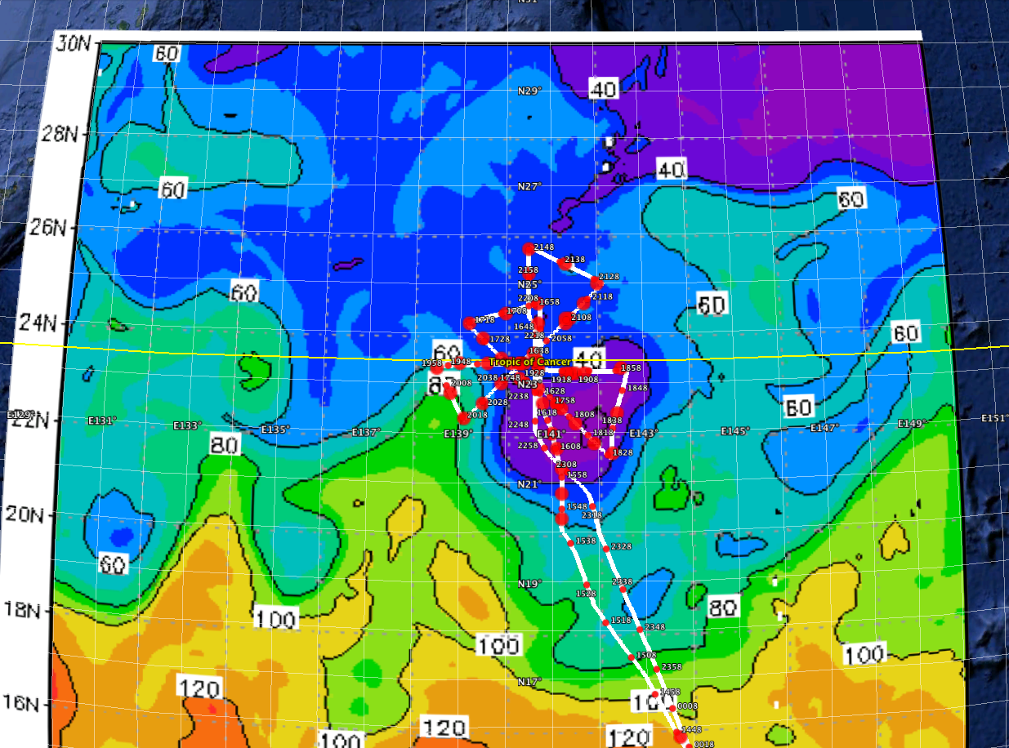
NRL EASNFS: OHC (kJ cm⁻²) 0000 UTC 24 September
From itop.org
JTWC:
Typhoon @ 90 kt
Flight 3:
Intensification and transition to a more
symmetric structure.
shear decreased to 5 kts from
the north and average OHC decreased to
40 kJ cm⁻²

Slide 19
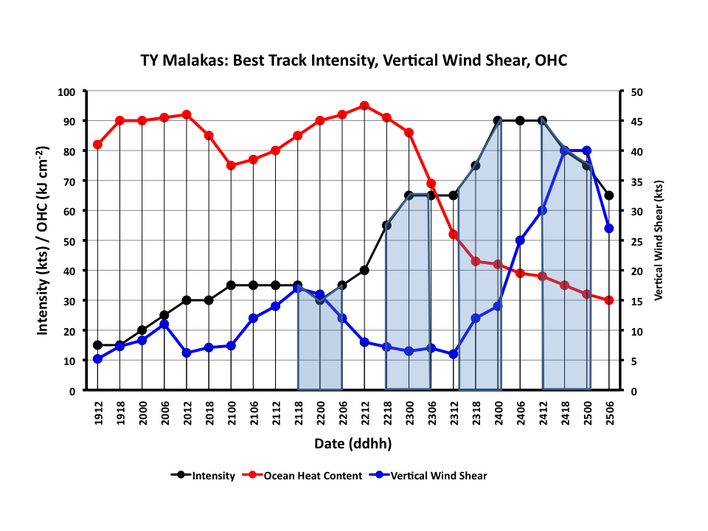
Vertical wind shear from ECMWF Analysis, OHC from NRL EASNFS:2 deg. radius average
3
4
2
1

Slide 20
Vertical wind shear from ECMWF Analysis, OHC from NRL EASNFS:2 deg. radius average
Continuing Analysis
Incorporate analysis of AXBT data:
Quality control
Comparison with NRL EASNFS analyses
Variation relative to storm structure
Relative roles of the atmospheric and oceanic environments
Standardized Analysis System
Both environments have well-defined features that vary throughout the life cycle and path of TY Malakas
Transition from a weak, asymmetric TS to a more symmetric TY
Intensification relative to the approach of the midlatitude upper-level trough
3
4
2
1

