Slide 1
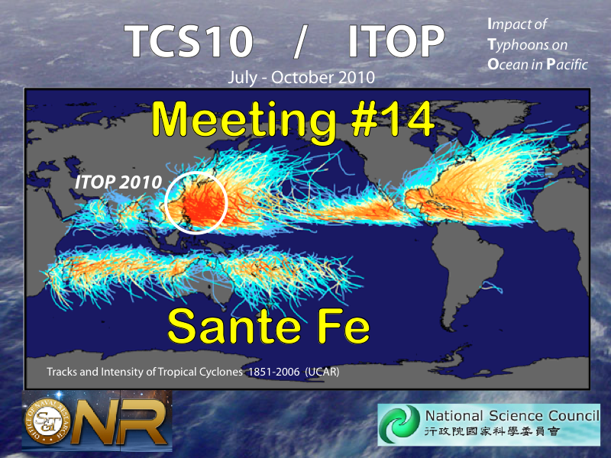

Slide 2
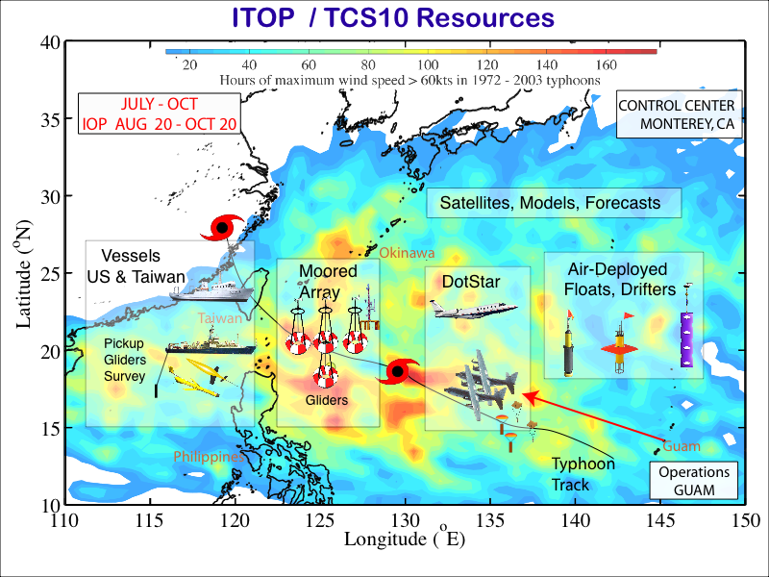

Slide 3
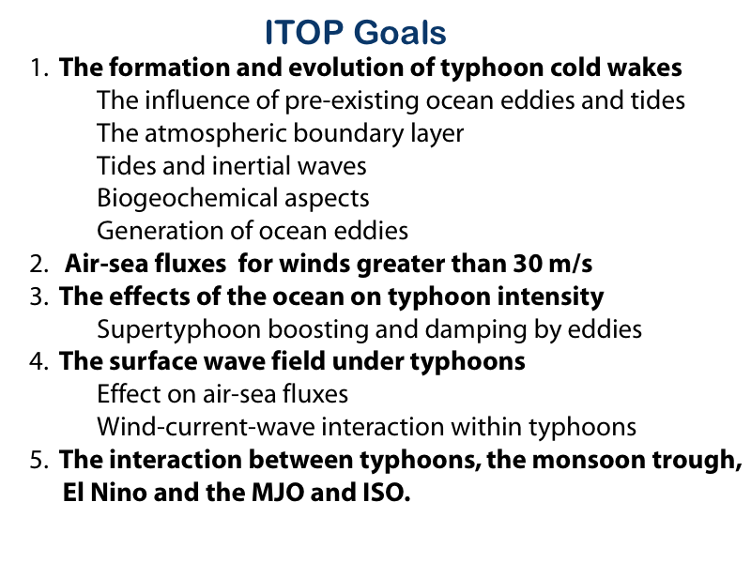

Slide 4
What analysis products do you need from others?
Surface wind maps for each storm?
Heat flux maps?
Internal tide analysis?
…..
Making this list is a major goal of this meeting

