Slide 1
Anvil Lightning and Aircraft
Briefing to DC3 Participants
by Stephanie Weiss
9 April 2012

Slide 2
Types of lightning-aircraft interaction (Rakov and Uman 2003, pp. 347-348)
Corona discharge
Aircraft-intercepted lightning
Aircraft-initiated lightning

Slide 3
Anvil Lightning Study Weiss et al. (MWR – in press 2012)
Extension of work by Kuhlman et al. (GRL - 2009)
Anvil lightning: Lightning > 30km from the 30dBZ contour in the storm core
Anvil lightning in six supercell thunderstorms
Storm ID | Analysis Time (UTC) | No. of anvil flashes | Anvil flash rate (min⁻¹) | Average anvil flash size (km²)
24 May 2004 N | 2210-2330 | 27 | 0.37 | 1435
24-25 May 2004 S | 2220-0020 | 94 | 0.81 | 1154
26 May 2004 | 2230-2340 | 11 | 0.16 | 2320
29 May 2004 N | 2250-2320 | 6 | 0.50 | 1779
29-30 May 2004 S | 2250-0010 | 322 | 2.68 | 401
4-5 June 2005 | 2250-0020 | 16 | 0.21 | 2340

Slide 4
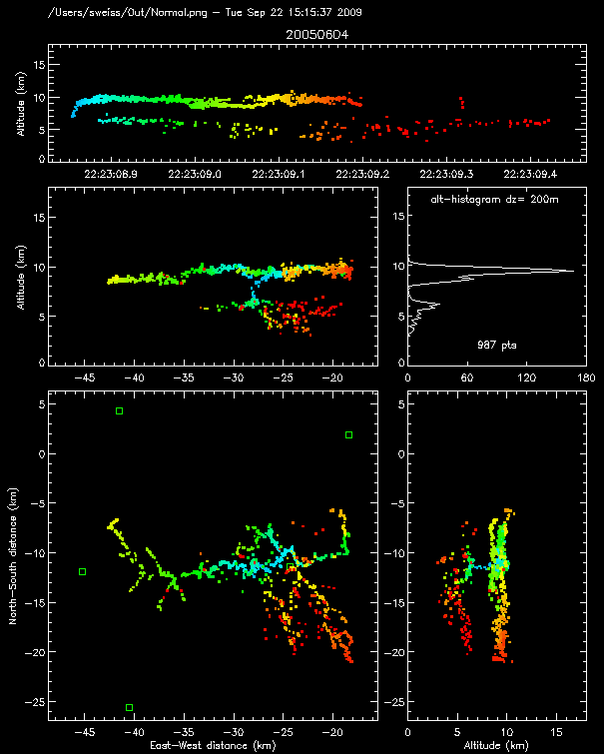
a
Visualization of Lightning Mapping Array (LMA) Data
Colors represent time sequence of VHF sources (a,b,d,e)
Time-height plot (a)
Plan view (d)
Projection views (b,e)
Histogram (c)
b
c
d
e

Slide 5
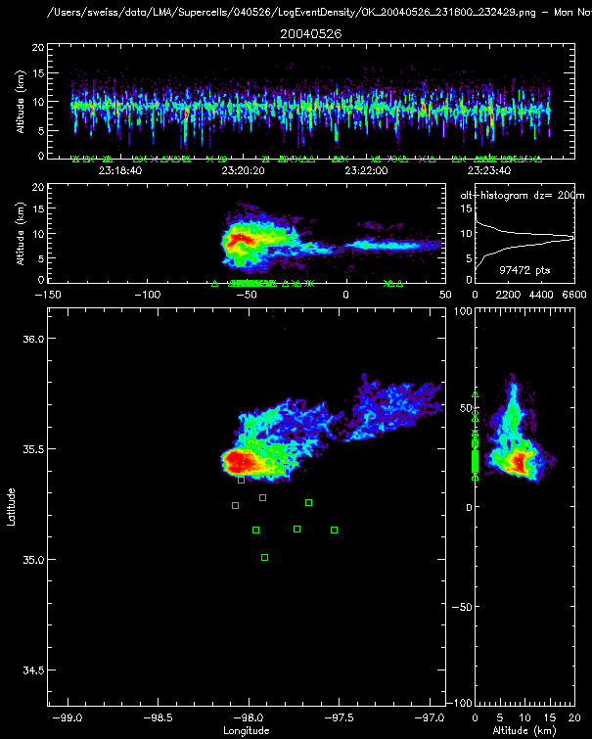
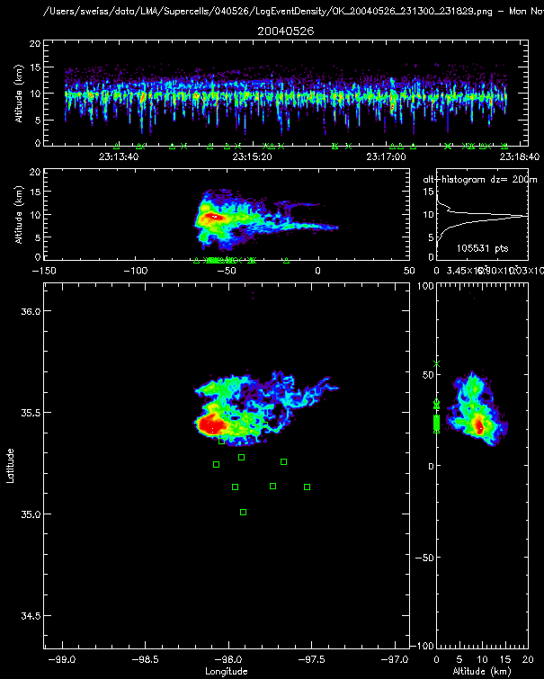
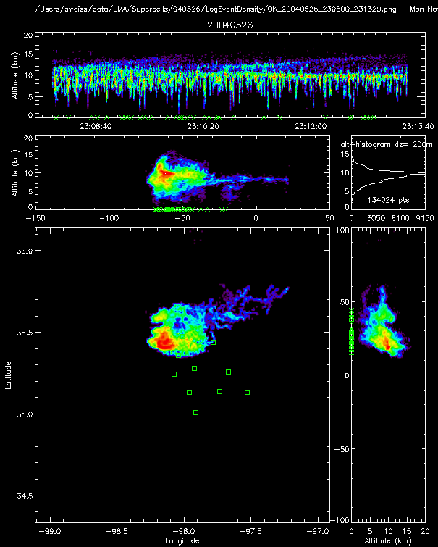
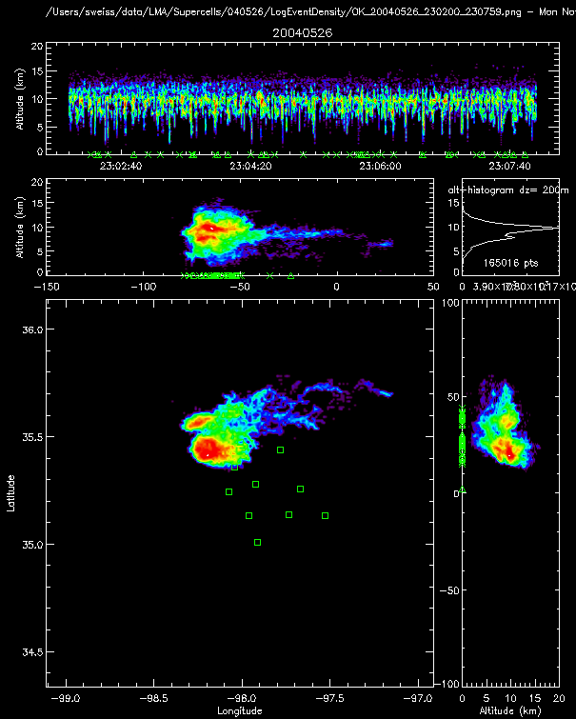
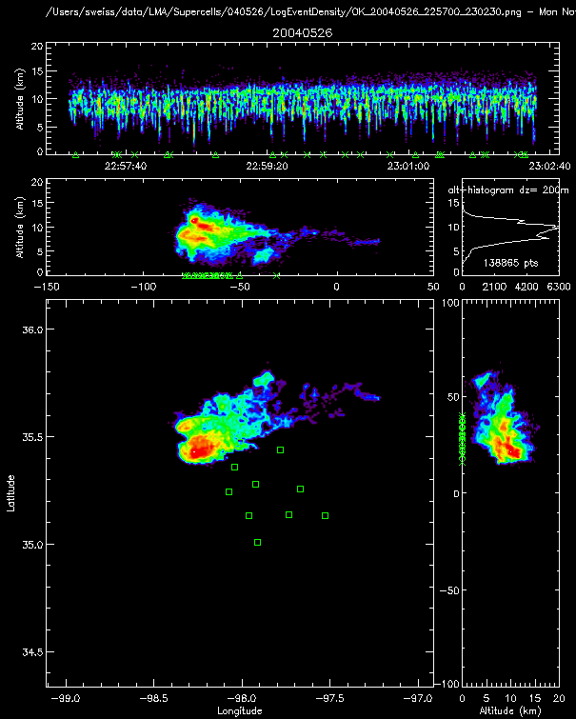
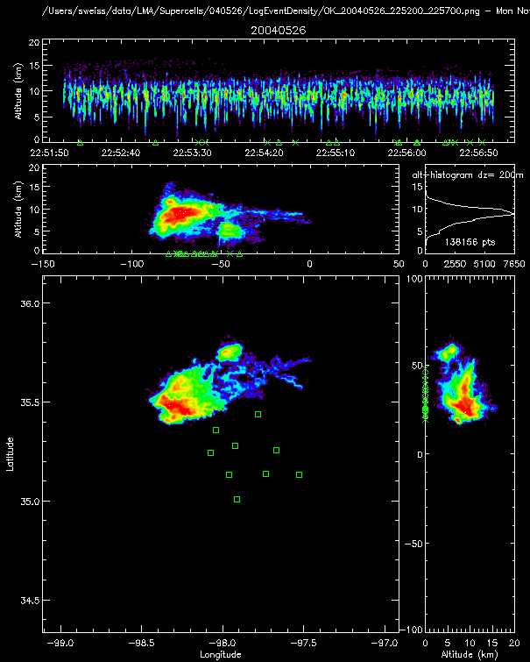
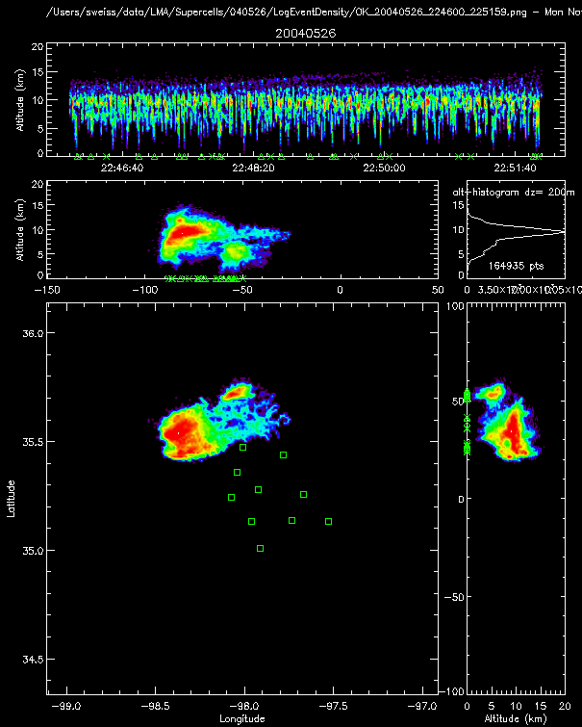
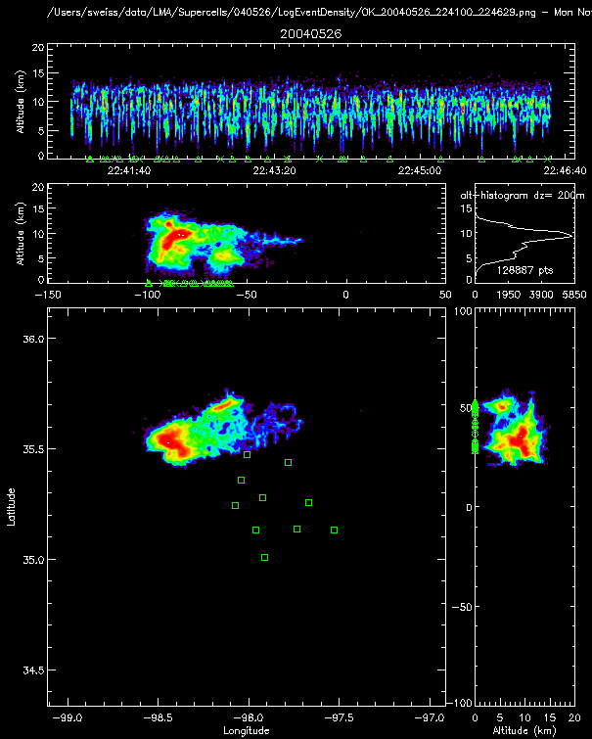
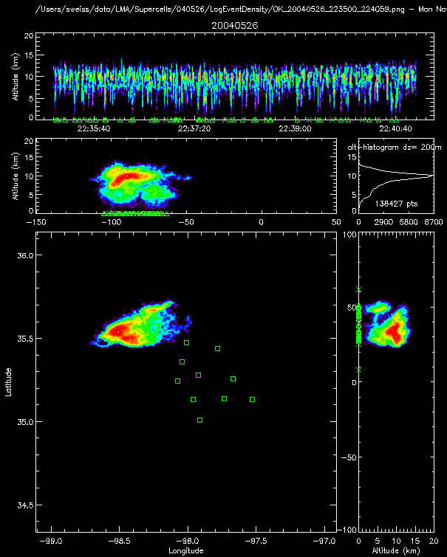
26 May 2004
Isolated supercell
2235:00 – 2324:30 UTC

Slide 6
Table of Anvil Flashes
Storm ID | Analysis Time (UTC) | No. of anvil flashes | Anvil flash rate (min⁻¹) | Average anvil flash size (km²)
24 May 2004 N | 2210-2330 | 27 | 0.37 | 1435
24-25 May 2004 S | 2220-0020 | 94 | 0.81 | 1154
26 May 2004 | 2230-2340 | 11 | 0.16 | 2320
29 May 2004 N | 2250-2320 | 6 | 0.50 | 1779
29-30 May 2004 S | 2250-0010 | 322 | 2.68 | 401
4-5 June 2005 | 2250-0020 | 16 | 0.21 | 2340

Slide 7
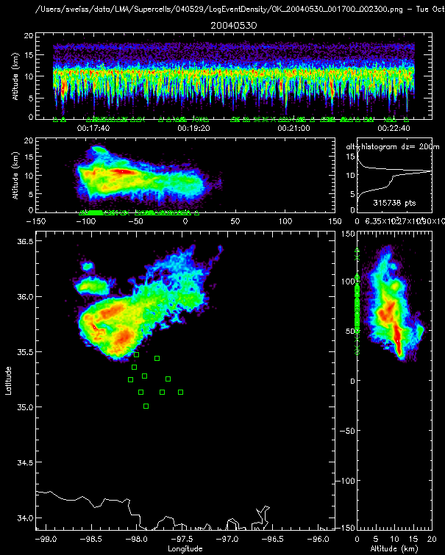
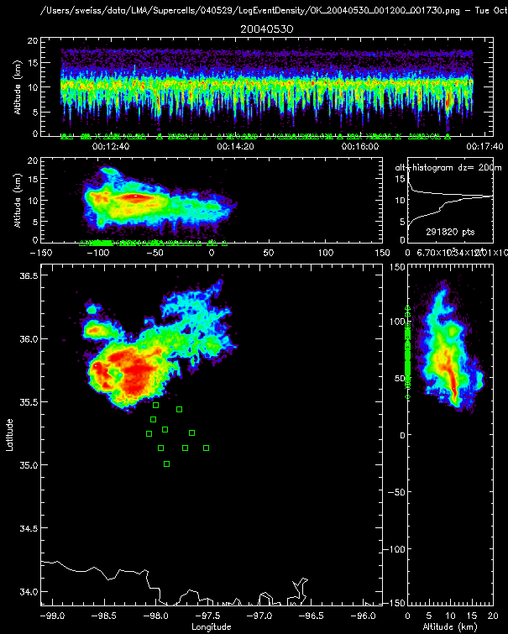
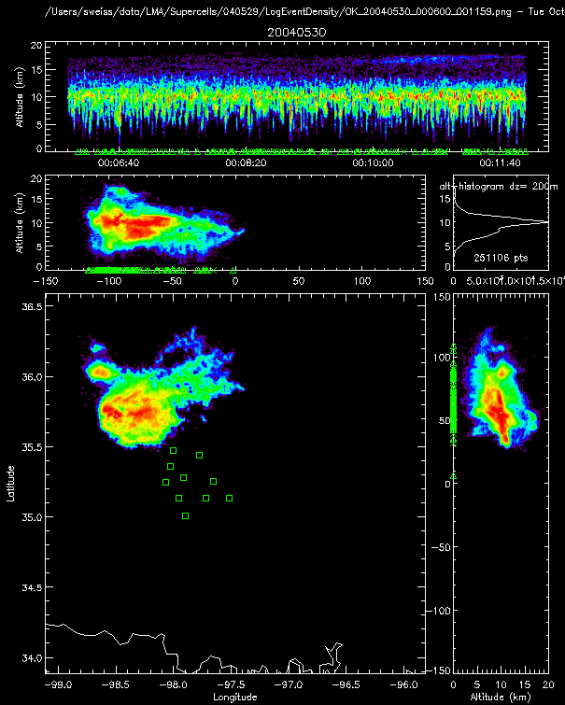
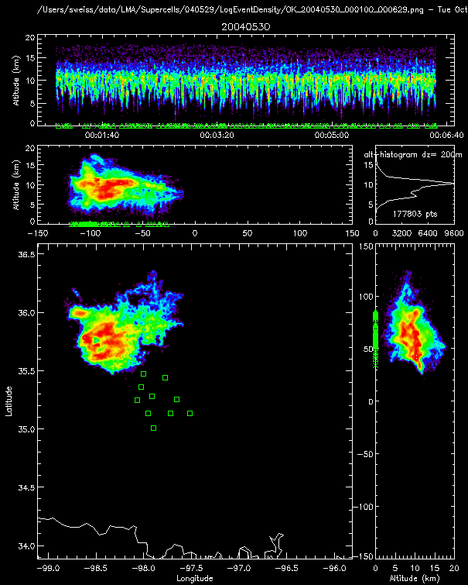
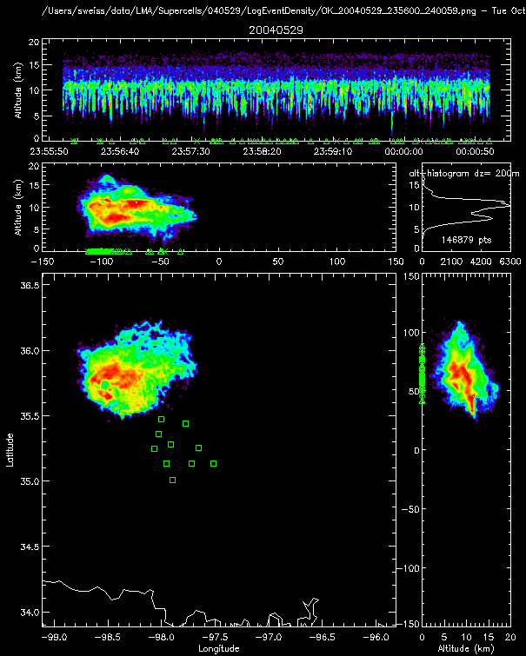
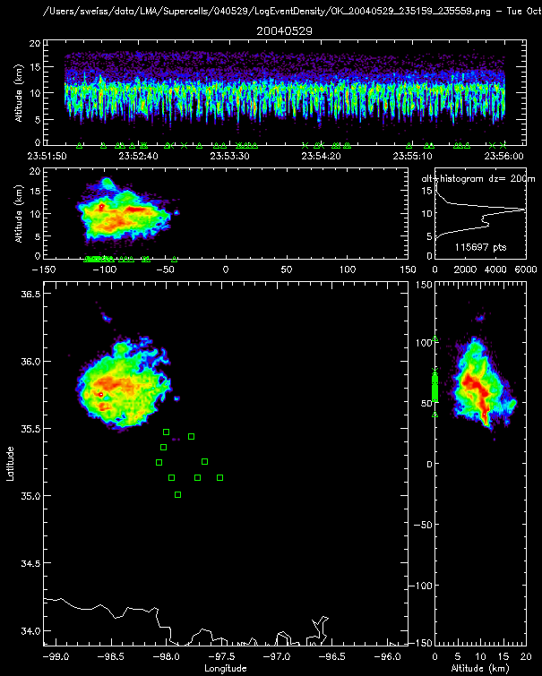
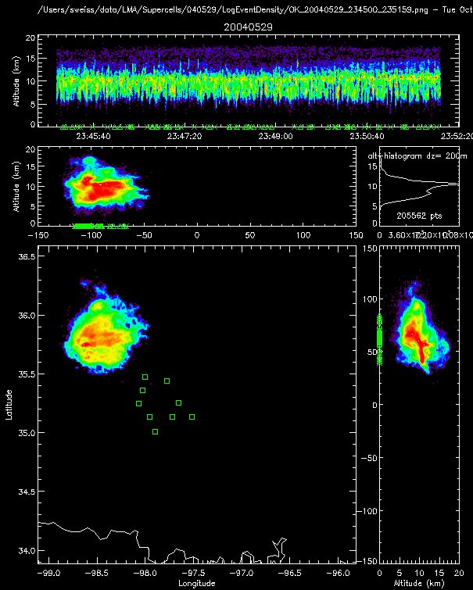
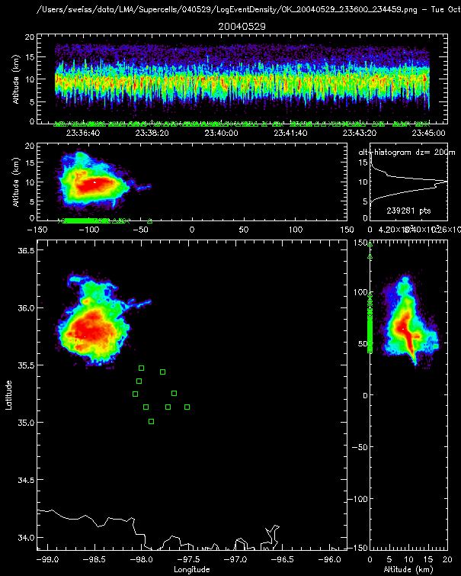
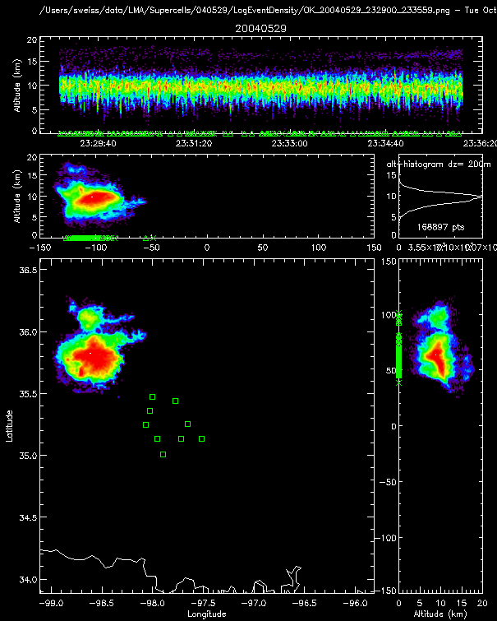
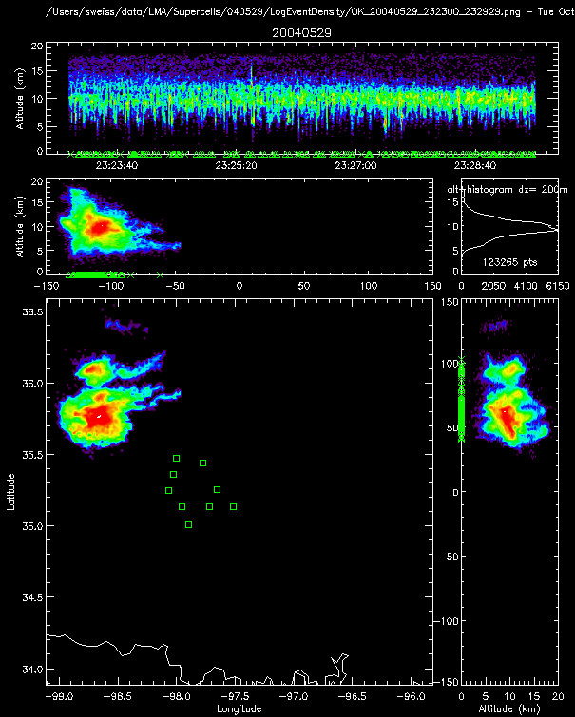
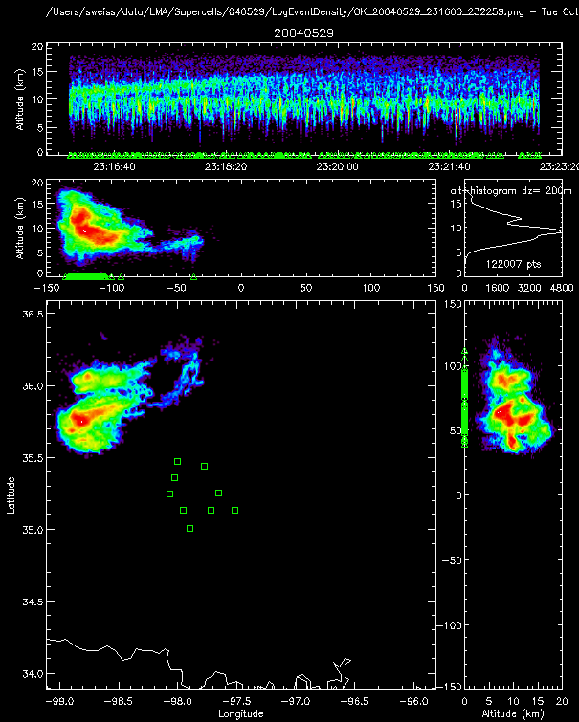
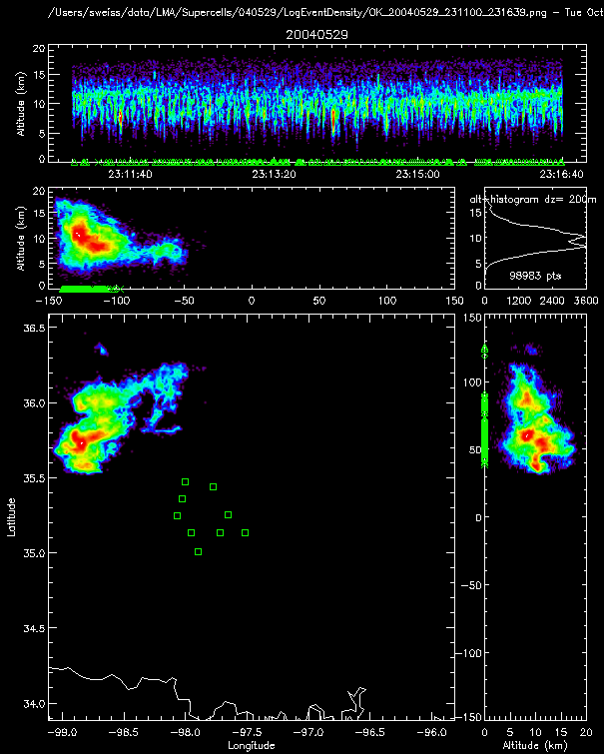
29-30 May 2004
Two supercells – one dying and one intensifying
2311 – 0017 UTC

Slide 8
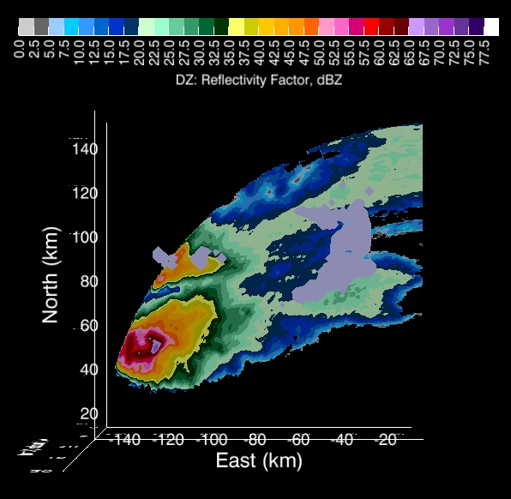
Flash Initiation in Anvil: Anvil Interaction
2321:45 UTC 29 May 2004 CAPPI at 7km
Notes:
Anvil-Initiated where anvils interact: 2321:45

Slide 9
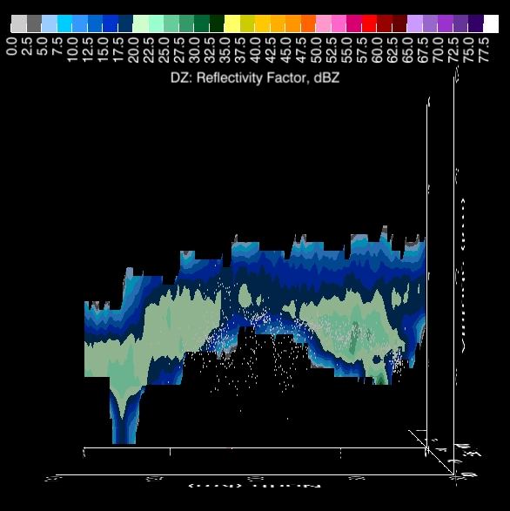
Flash Initiation in Anvil: Anvil Interaction
2321:45 UTC 29 May 2004
Anvil of
Northern Storm
Anvil of
Southern Storm
Notes:
Show that CG and initiation location in flash from previous slide is in between the two anvils, with no development underneath the anvil.

Slide 10
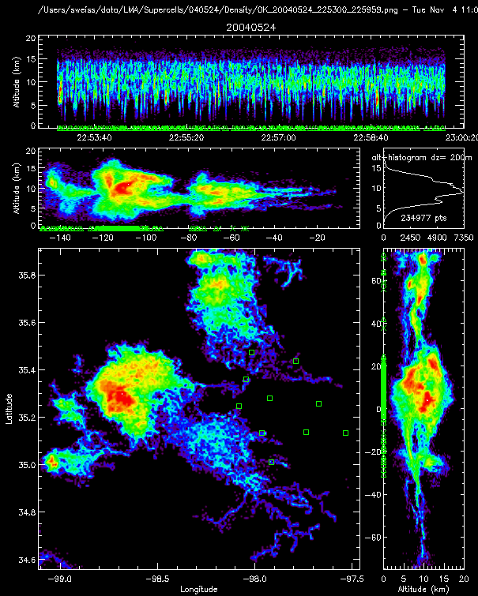
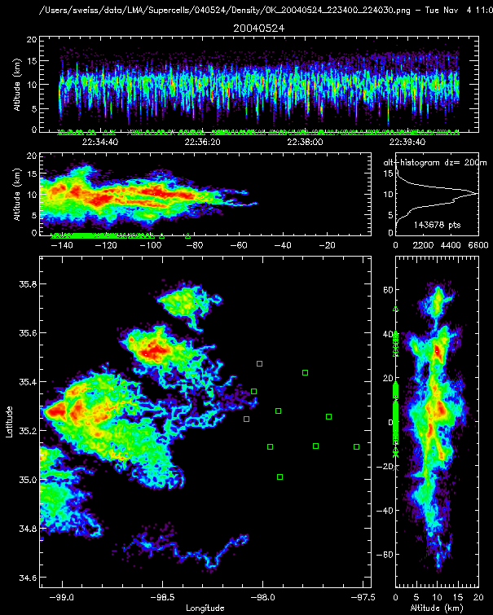
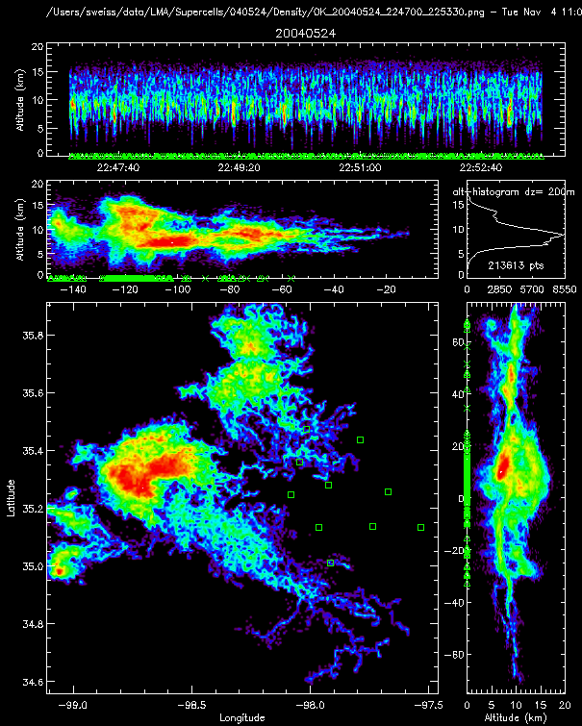
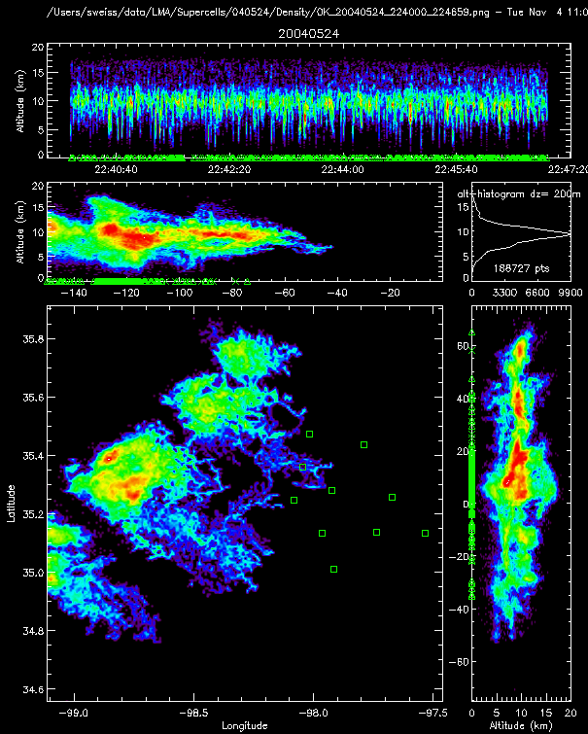
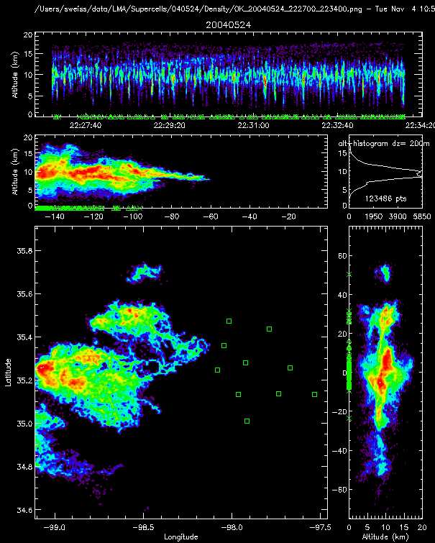
24 May 2004
Line of supercells
2227 – 2300 UTC

Slide 11
24 May 2004
Secondary reflectivity maxima
Lightning being initiated in these cells

Slide 12
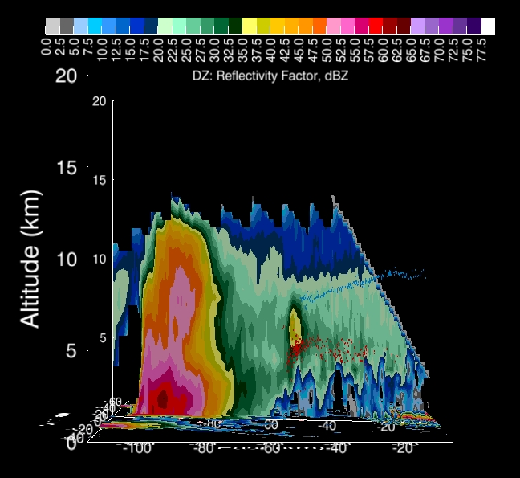
Flash Initiation in Anvil: Reflectivity Maximum
2328:43 UTC 24 May 2004

Slide 13
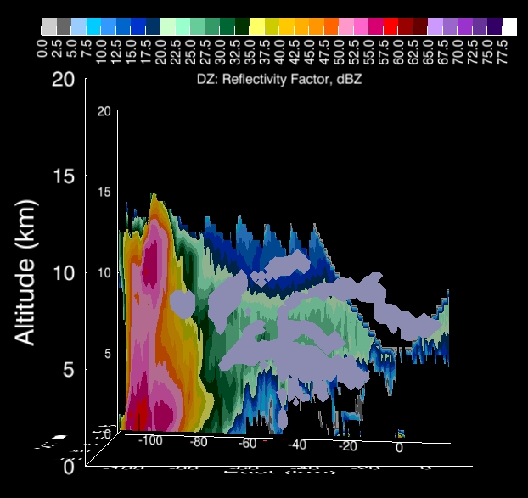
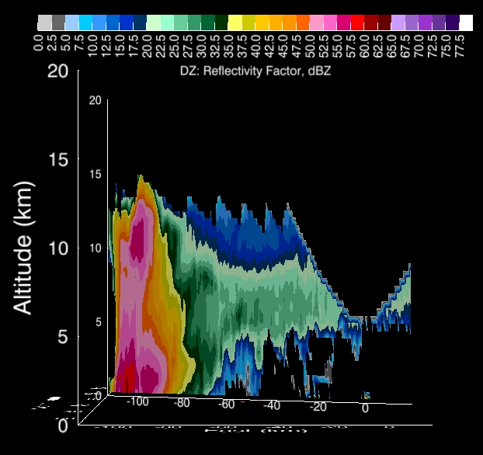
Ground Flashes beneath Anvil: Rain or Virga
2324:30 UTC 24 May 2004
Notes:
+CG: 8.7kA

Slide 14
Screening Layer Charge
Difference in conductivity between clear and cloudy air
Discontinuity in current across the cloud surfaces
Charge on the surface of the cloud boundary
Cloud boundary vs Radar echo boundary?

Slide 16
Aircraft in LMA Data: Aircraft-Initiated Example 2259-2305 UTC on 24 May 2004
Aircraft-Initiated,
Bidirectional Discharges
Single-point,
Corona Discharges
Notes:
850 km/hr, 525 mi/hr

Slide 17
Aircraft in LMA Data: Aircraft-Initiated Example 2259-2305 UTC on 24 May 2004

Slide 18
KVNX Base Reflectivity from 2301:36 UTC on 24 May 2004
Lightning: 2305-2310 UTC

Slide 19
KVNX Base Reflectivity from 2301:36 UTC on 24 May 2004
Lightning: 2305-2310 UTC
15 km
10 km
5 km

Slide 20
KVNX CAPPI at 10 km from 2301:36 UTC on 24 May 2004
Lightning: 2305-2310 UTC

Slide 21
Discussion Jumpstart
Watch for:
Anvils from more than one storm interacting
Secondary cells of reflectivity forming in the anvil
Virga and/or rain beneath the anvil
Will a general rule of keeping the aircraft >30km downstream of recent lightning activity work?

Slide 22
26 May 2004
Isolated supercell
2235:00 – 2324:30 UTC

Slide 23
29-30 May 2004
Two supercells – one dying and one intensifying
2311 – 0017 UTC

Slide 24
24 May 2004
Line of supercells
2227 – 2300 UTC

